Slide 1

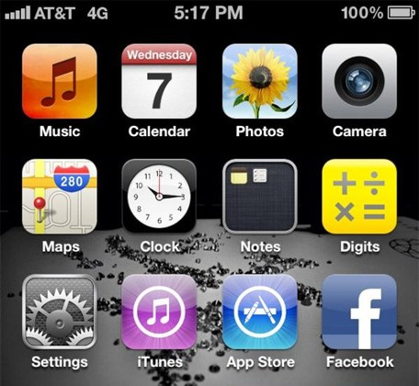
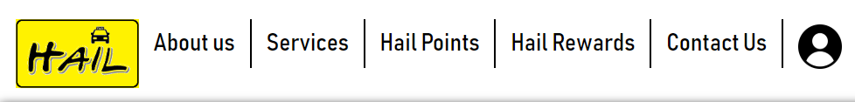
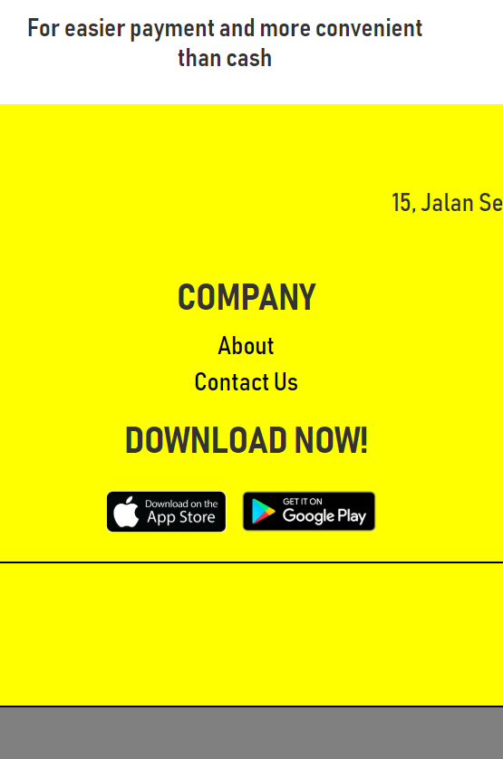
Step 1 : Download HailFood app.
Visit our website where we will have the link for you to download our app
According to our record from over 10.000 people, It only took 10 seconds to go to App Store or Google Play and download it.

Slide 2
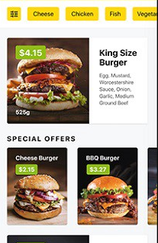
Step 3 : Choose Your Favourite Meal
We’ll help narrow your choices down to your preference.
Special offers will be available to make your life a little bit better.
Sauces, Straws, Tissues will be provided and can be as much as you want!
Search :
Burger

Slide 3

Step 2 : Register a New Account
Register a account for we will remember your information such as your address, phone number, and etc. so that we do not have to keep contacting and asking you the same questions of your information over and over again.
Welcome to
Food
Login
Sign Up

Slide 4
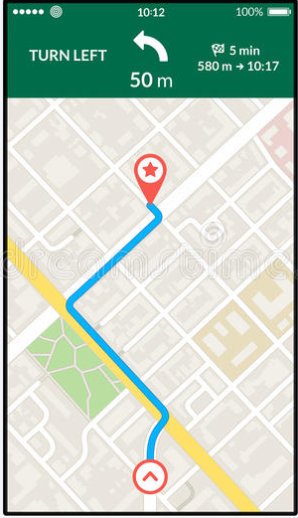
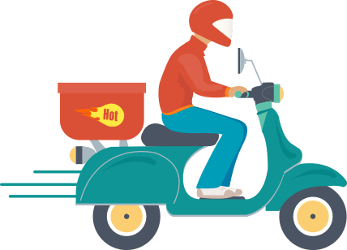
Step 4 : Sit Back, Relax And Wait For Our Call When The Food Has Arrived!
Share your ride or carpool with your love ones for it is convenient and extra safe.
Last but not least, enjoy your day as you are no longer have to find car park or refill your car fuel at gas station whenever it’s empty.
Food is on the way!
RM26.70
Food
Food delivery guy is arriving in 10 minutes

Slide 5
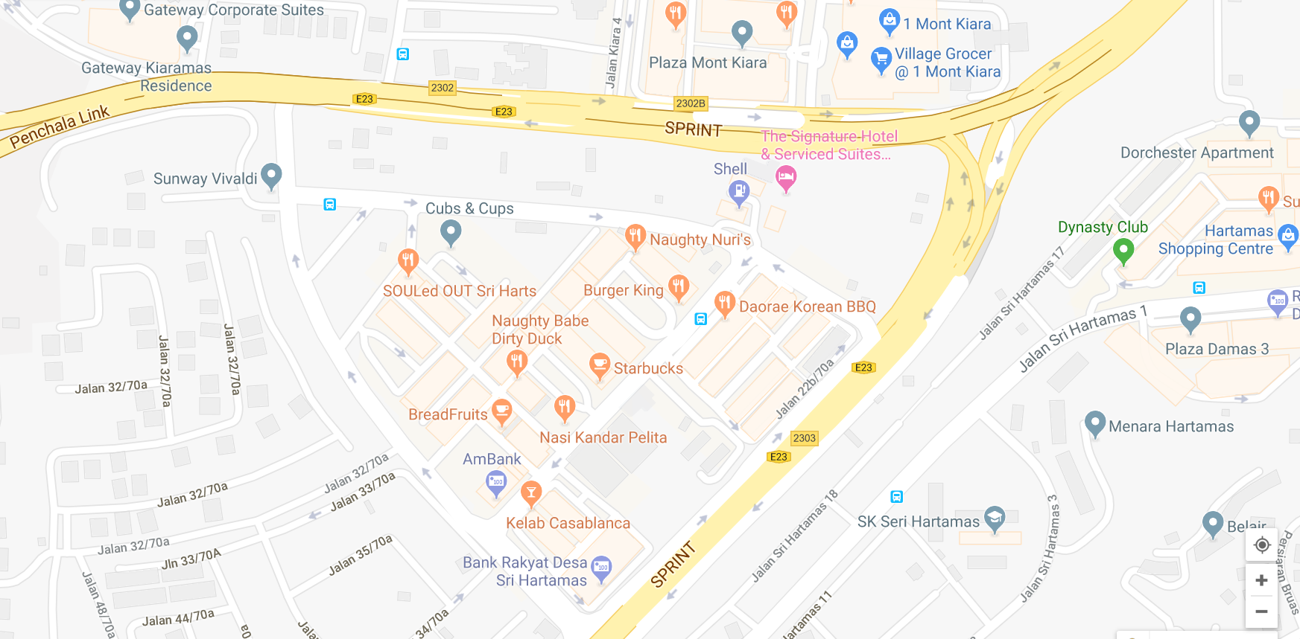

Hail Malaysia HQ Office

