Slide 1
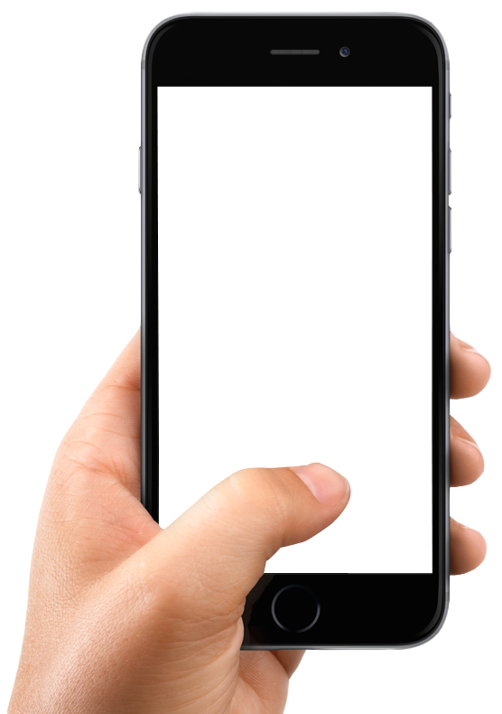
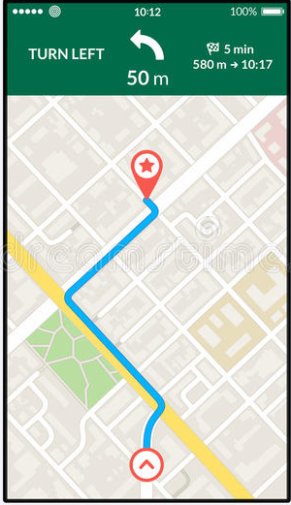
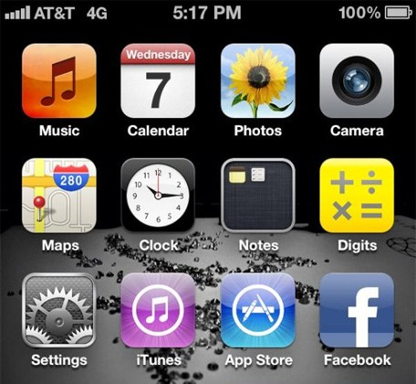

Step 1 : One button is all it takes!
Select your drop off location and get your estimated fare.
Once you ready to book, just press one button called ‘Book Now’ at the bottom of your phone screen.
It’s that easy!
Help University
RM15..50
Book Now!

Slide 2

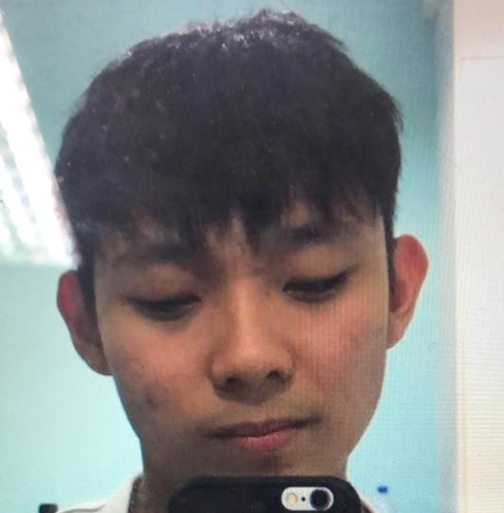
Step 2 : Track Your Driver
We’ll find you the nearest driver from your location and you can able to track down the location of your driver in real time.
You can able to know the duration of the time for your driver to arrive at your pick up location.
Driver is on the way
SAA 12345
Kam Yik Wah
012-1123231234
yikwah@haha.com
20 Kilometres Away

Slide 3
Step 3 : You Have Arrived To Your Destination Safely!
Share your ride or carpool with your love ones for it is convenient and extra safe.
Last but not least, enjoy your day as you are no longer have to find car park or refill your car fuel at gas station whenever it’s empty.
Help University
RM15..50
You Have Arrived Your Destination!

Slide 4


