Slide 1
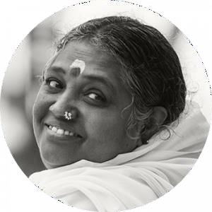


22AIE401 Reinforcement Learning
Uncertainty-Aware Active Vision
for UAV-Based Infrastructure
Inspection Using Deep
Reinforcement Learning
N. Leekhith Sri Krishna (BL.EN.U4AIE23060)
Individual component:
Agent B: Active View Refiner (PPO) + Integration
Team – 08 | Faculty: [Name] | AY 2026–27
Dept. of Computer Science and Engineering
Amrita School of Computing, Bengaluru
Notes:
My component: Agent B, which gets the best possible view of one uncertain crack, and the integration of all three agents.

Slide 2
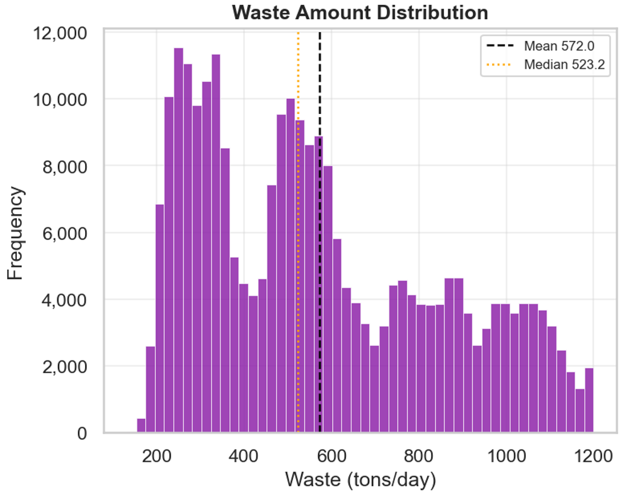
My Component: Problem and Role
Problem Agent B solves
Altitude alone reaches at most view quality q3; the sharpest view q4 needs close, well-aligned positioning
Agent B moves the UAV/camera around ONE uncertain cell to obtain the best view in as few steps as possible
Called by the supervisor's Refine option
Agent C (A2C)
supervisor
Agent A (DQN)
where to fly
Agent B (PPO)
how to view
My contributions
Agent B: continuous-control MDP, PPO training and evaluation
Integration: all three trained agents in one mission + ablation study
Team deliverables: report, team poster and slide assembly
Shared environment + detector
bridge · UAV · uncertainty · battery
Why RL: the right sequence of small camera moves depends on the current geometry; the payoff (best view) comes only after several moves.

Slide 3
MDP Formulation of Agent B
Element | Definition
State (6) | Distance d ∈ [0,1], view angle θ ∈ [−1,1], lateral offset ℓ ∈ [−1,1], target uncertainty, battery, time left
Actions (3, continuous) | Δd, Δθ, Δℓ ∈ [−1, 1], scaled × 0.2 per step (gradual approach)
Dynamics | View quality s = 1 − 0.6d − 0.4|θ| − 0.3|ℓ|; q = round(4s); the cell keeps its best view; battery −0.008 per step
Reward | Δu − 0.01·‖a‖ + 0.5·(γ·s′ − s); +5 at best view (q = 4); −2 on timeout
Episode end | Best view reached (success) or 30 steps
Reward design
Δu: rewards actual uncertainty reduction on the target
−0.01‖a‖: smooth, efficient motion
0.5(γs′ − s): potential-based shaping (Ng et al., 1999): denser signal without changing the optimal policy
+5 / −2: clear success and timeout signals
Notes:
Example state from the demo: [0.83, −0.28, 0.13, 0.31, 1.00, 1.00].

Slide 4
Algorithm: Proximal Policy Optimization (PPO)
Why PPO
Continuous 3-D actions: DQN cannot be used
Clipped update keeps each policy change small and stable
Gaussian policy gives natural exploration
Hyper-parameter | Value
Network (MLP) | 64 – 64
Learning rate | 3 × 10⁻⁴
Discount γ | 0.99
Clip range ε | 0.2
GAE λ | 0.95
Rollout | 256 steps × 4 envs
Epochs / batch | 10 / 64
Training | 100k steps
Clipped objective (as implemented in SB3)
ρₜ = π_θ(aₜ|sₜ) / π_old(aₜ|sₜ)
L = E[min(ρₜÂₜ, clip(ρₜ,1−ε,1+ε)Âₜ)]
Exploration: learned Gaussian std σ + entropy bonus; mean action at evaluation. Advantages Âₜ from GAE.

Slide 5
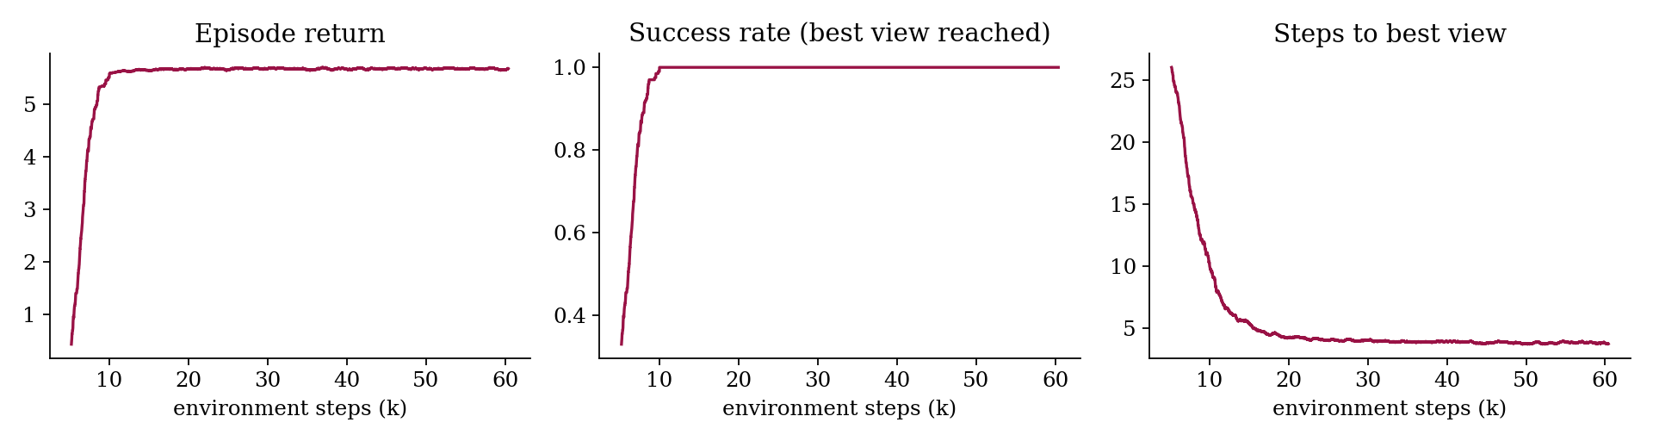
Demo and Results
Policy (50 episodes) | Success | Steps | Return
PPO (Agent B) | 1.00 | 3.7 | 5.67
Fixed orbit | 0.00 | 30.0 | −2.28
Random | 0.02 | 29.8 | −2.04
Scripted approach (upper bound) | 1.00 | 3.6 | 5.67
Live demo: one episode
t0 s=0.35 a=[−1.00, 0.92,−0.13] r=+0.08
t1 s=0.55 a=[−1.00, 0.45,−0.11] r=+0.25
t2 s=0.71 a=[−1.00, 0.12,−0.12] r=+0.05
t3 s=0.84 a=[−1.00,−0.01,−0.10] r=+5.17
→ best view (q=4) reached in 4 steps
Policy N(μ, σ): moves closer, straightens the angle, reduces offset.
The scripted policy uses privileged knowledge of the ideal geometry; PPO learns to match it from reward alone.
Learning curves
Success reaches 100% and steps to best view drop to ≈ 4 within ~10k environment steps.
Numbers from our verification run; replace with your final run.

Slide 6
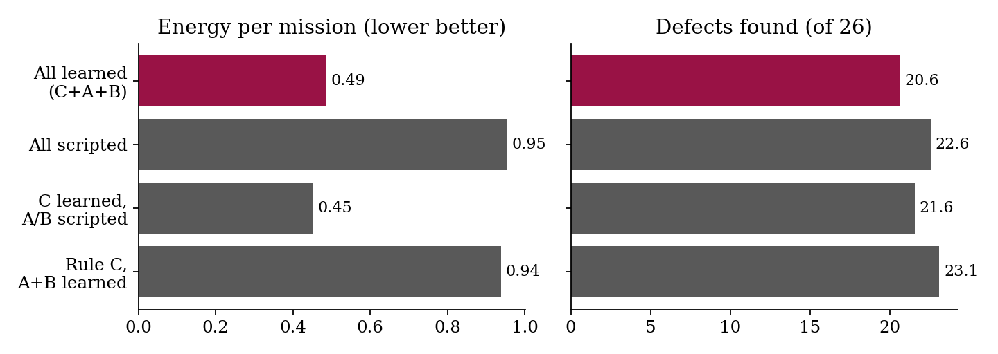
Integration and Conclusion
Integration (ablation)
All learned: ~half the energy (0.49 vs 0.95), slightly fewer defects
Learned A + B under a rule supervisor: most defects
Agent C trained with scripted sub-agents → distribution shift
CO | Evidence from my component
CO1 | View refinement is interactive and sequential; payoff only after several moves; compared with fixed orbit / random
CO2 | Continuous-action MDP with potential-based shaping; PPO justified by continuous actions and stable updates
CO3 | Working PPO agent, live demo, learning curves; all three agents integrated in one mission
Next: entropy / clip-range sensitivity (CO5), retrain Agent C with learned sub-agents. Numbers from our verification run; replace with your final run.

