Slide 1



22AIE401 Reinforcement Learning
Uncertainty-Aware Active Vision
for UAV-Based Infrastructure
Inspection Using Deep
Reinforcement Learning
Mukhesh ([Register No.])
Individual component:
Agent C: Mission Supervisor (A2C) + Real-Image Detector
Team – 08 | Faculty: [Name] | AY 2026–27
Dept. of Computer Science and Engineering
Amrita School of Computing, Bengaluru
Notes:
My component: the real-image crack detector that produces uncertainty, and Agent C, which decides when to explore, refine or return.

Slide 2
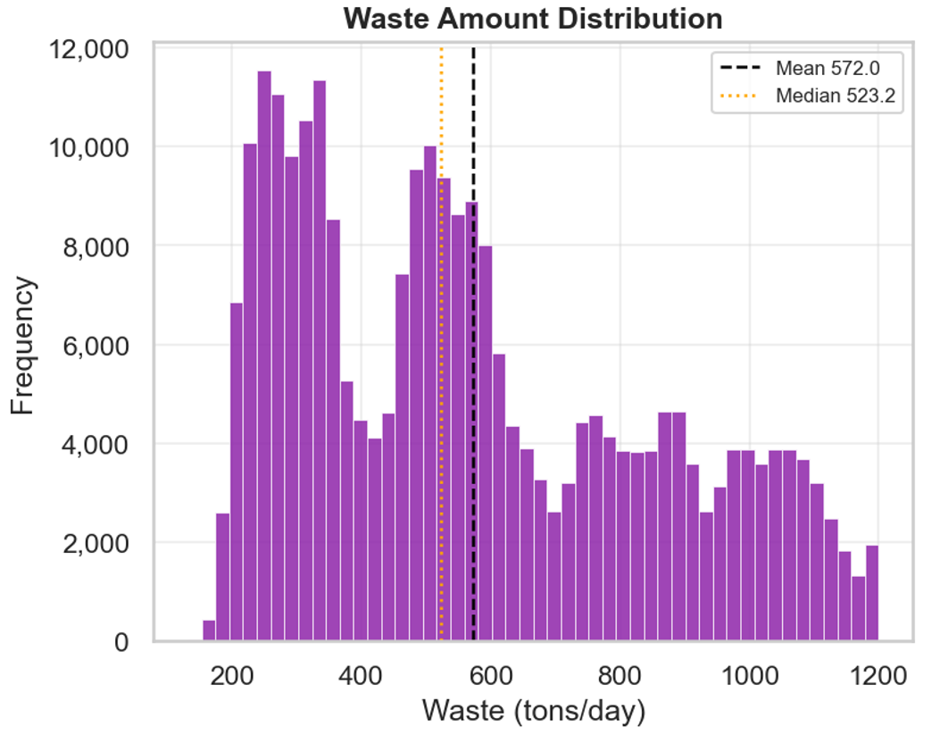
My Component: Problem and Role
Problems I solve
Detector: turn real crack images into per-cell uncertainty the agents can act on
Agent C: decide at each moment whether to explore new areas, refine an uncertain crack, or return home before the battery runs out
Agent C (A2C)
supervisor
Agent A (DQN)
where to fly
Agent B (PPO)
how to view
My contributions
DeepCrack → U-Net with MC-dropout → uncertainty cache used by the environment
Agent C: option-level (semi-MDP) formulation, A2C training and evaluation
Comparison with a rule-based supervisor
Shared environment + detector
bridge · UAV · uncertainty · battery
Why RL: explore / refine / return is a long-horizon trade-off between defects found and battery; its value is known only at mission end.

Slide 3
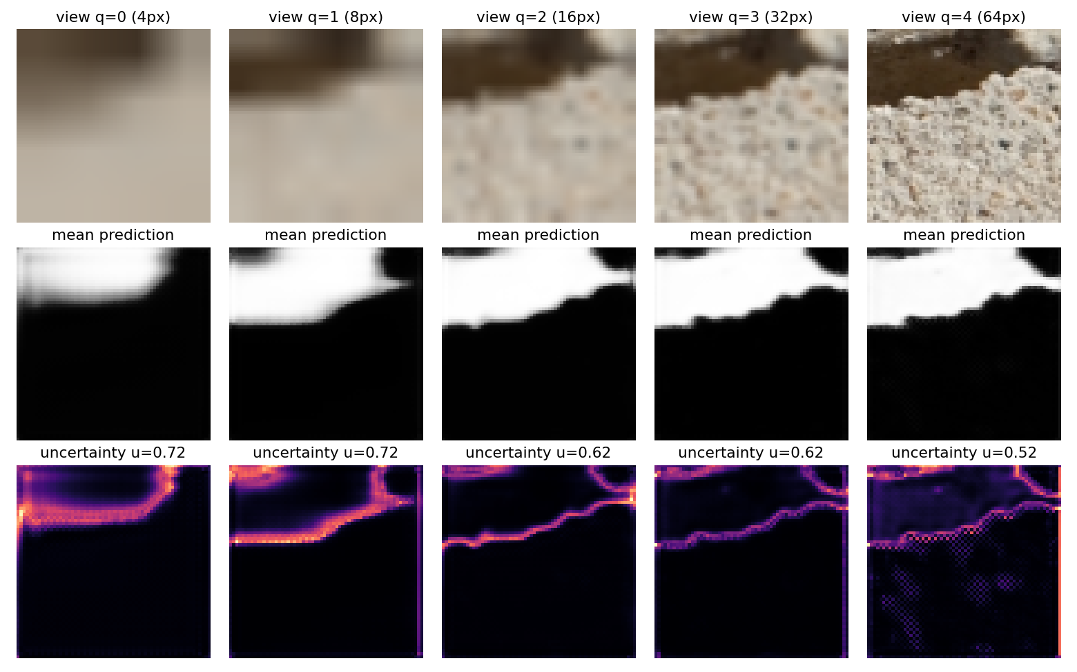
Real-Image Detector: DeepCrack + MC-Dropout U-Net
Pipeline
DeepCrack: 300 train / 237 test crack images with masks
U-Net trained on TRAIN only; 64×64 patches from TEST only (no leakage)
Each patch viewed at 5 qualities (4 → 64 px)
10 MC-dropout passes → uncertainty = predictive entropy of the mean
View | u defect | u clean | IoU defect
q0 (4 px) | 0.59 | 0.41 | 0.23
q2 (16 px) | 0.47 | 0.21 | 0.66
q4 (64 px) | 0.42 | 0.14 | 0.72
Better view → lower uncertainty and higher IoU. Std alone failed (blurred views look falsely confident); predictive entropy works. Numbers from our verification run; replace with your final run.

Slide 4
MDP Formulation of Agent C (Semi-MDP)
Element | Definition
State (6) | Battery, coverage, mean uncertainty, fraction of defects found, distance to base, time used; all in [0, 1]
Actions (3 options) | Explore: Agent A for 5 steps · Refine: Agent B (≤ 10 steps) on the most uncertain cell in view · Return home
Dynamics | Each option runs several low-level steps, updating coverage, uncertainty and battery (temporal abstraction)
Reward | +2 per newly confirmed defect − 0.5 × energy used; −10 if the battery empties
Episode end | Return home (success = safe return), battery empty, or 40 decisions
Why options?
One supervisor decision spans many low-level moves (Sutton, Precup & Singh, 1999)
Small, abstract state: easy to learn and to explain
The same options can call scripted stubs during training or the trained Agents A and B at integration
Notes:
Example state from the demo: [0.97, 0.12, 0.93, 0.15, 0.18, 0.02].

Slide 5
Algorithm: Advantage Actor-Critic (A2C)
Why A2C
Only 3 discrete options and a 6-value state
Actor-critic: the critic V(s) reduces variance of policy gradients
Cheap, on-policy, 4 parallel environments
Hyper-parameter | Value
Network (MLP) | 64 – 64
Learning rate | 7 × 10⁻⁴
Discount γ | 0.99
n-steps × envs | 8 × 4
Entropy coef β | 0.01
Value coef | 0.5
Grad-norm clip | 0.5
Training | 100k decisions
Update (as implemented in SB3)
A = r + γ·V(s′) − V(s)
∇J = E[∇log π(a|s)·A] + β·∇H(π)
Exploration: softmax policy + entropy bonus β = 0.01. Demo: at the start π(Explore) ≈ 1.0 → reward +5.99 (4 defects confirmed).

Slide 6
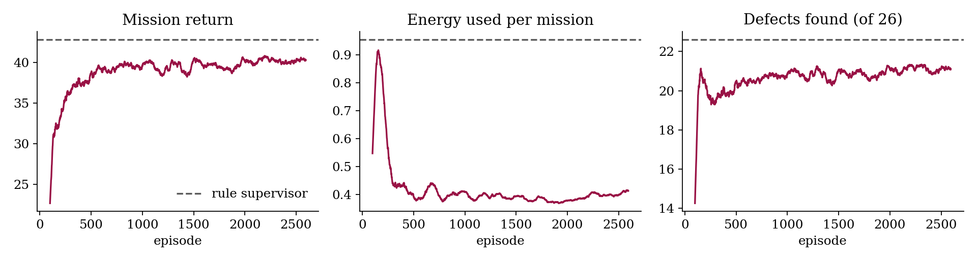
Results, Analysis and Conclusion
Policy (20 missions) | Return | Decisions | Defects | Energy
A2C (Agent C) | 41.1 | 16.8 | 21.6 | 0.45
Rule supervisor | 42.8 | 33.8 | 22.6 | 0.95
Random | 4.1 | 3.0 | 3.0 | 0.07
Analysis
Same safe-return rate as the rule, at about half the energy and half the decisions
Learned policy almost never chooses Refine: refining rarely confirms new defects under this reward → reward-design insight
Next: entropy sensitivity (CO5), retrain with learned Agent A
Curves: mission return, energy and defects vs episode (dashed = rule supervisor). Numbers from our verification run; replace with your final run.
CO | Evidence from my component
CO1 / CO2 | Long-horizon explore/refine/return trade-off as a semi-MDP; A2C justified by small discrete option space
CO3 | Working A2C supervisor + real-image detector feeding the environment; demo and learning curves

