Slide 1
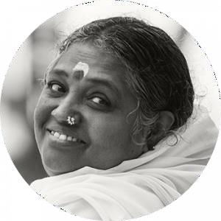


22AIE401 Reinforcement Learning
Uncertainty-Aware Active Vision
for UAV-Based Infrastructure
Inspection Using Deep
Reinforcement Learning
K. S. G. Yeseswini (BL.EN.U4AIE23013)
N. Leekhith Sri Krishna (BL.EN.U4AIE23060)
Mukhesh V (BL.EN.U4AIE23036)
Team – 08 | Faculty: Dr. Amudha J. | AY 2026–27
Dept. of Computer Science and Engineering
Amrita School of Computing, Bengaluru
Notes:
Introduce the team and the project: a UAV that decides where to look next using its own detection uncertainty.

Slide 2
Problem Statement
UAV inspection systems detect and segment cracks well, but they do not decide where to look next. They fly a fixed raster path and process every region equally, so inspections are slow, battery-hungry and cannot return for a better view of an uncertain region.
Question: how can a UAV use its own detection uncertainty to choose the next viewpoint, so it inspects the whole structure in less time and with less energy than passive scanning?
Objective
Full coverage of the bridge surface
Low residual detection uncertainty
Fewer steps and less battery than a raster scan
Environment
Bridge surface: 8 × 16 grid, 20% hidden defects
UAV with 3 altitudes and a camera footprint
Crack detector reporting per-cell uncertainty
Limited battery
Decisions to be made
Where to fly next and at which altitude
How to position the camera on an uncertain crack
When to explore, refine or return home
Notes:
The gap: perception is good, but flight planning ignores it. Our agents close that loop.

Slide 3
Why Reinforcement Learning?
1
Interaction
Each flight move changes what the camera sees and therefore the next state.
Why RL fits
The goal is a policy that maximises the expected cumulative return: coverage and uncertainty reduction minus time and energy.
The UAV sees only its camera footprint, so inspection is a POMDP, solved as an MDP over an observation-based state.
Supervised learning can only predict; RL learns to act.
2
Sequential decisions
A mission is 80–200 dependent moves; early choices constrain later ones.
3
Actions
Move, climb/descend, adjust camera pose, or choose to refine / return.
4
Delayed reward
Whether a path was good is known only when the inspection completes.
5
No labels
There is no dataset of 'correct' flight paths to imitate, only outcomes to optimise.
Notes:
Stress sequential decisions and delayed reward: these are what make it an RL problem rather than a vision problem.

Slide 4
RL vs Other Approaches
Aspect | Supervised / non-interactive ML | Fixed rule (raster scan) | Reinforcement Learning (ours)
Learning signal | Labels / targets | None (hand-designed) | Reward and return
Interaction | No action–environment loop | Open-loop path | Agent acts and observes consequences
Output | Prediction (crack mask) | Pre-computed waypoints | Action selection (next viewpoint)
Temporal structure | Independent samples | Fixed order | Sequential, delayed consequences
Objective | Minimise prediction loss | Cover everything uniformly | Maximise expected cumulative return
Uses uncertainty? | Produces it, but doesn't act on it | No | Yes: it is part of the state
Our design uses both: a supervised U-Net (DeepCrack) provides the uncertainty, and RL agents decide how to act on it.
Notes:
The detector is supervised learning; the flight policy is RL. The raster scan is our rule-based baseline.

Slide 5
Agent–Environment Model
Element | In our project
Agents | A: navigation (DQN) · B: view refinement (PPO) · C: mission supervisor (A2C)
Environment | Shared Gymnasium simulator: bridge grid, UAV pose, camera, detector, battery
Observation | Coverage map, uncertainty map, pose, battery (hidden: true defect map)
Actions | A: 6 discrete moves · B: 3 continuous pose changes · C: 3 options
Rewards | Uncertainty reduced, defects confirmed, success bonus; step / energy penalties
Episode end | Inspection complete, return home, battery empty or step limit
RL Agent
policy π(a | s)
state s(t+1)
reward r(t)
action a(t)
Environment
bridge · UAV · detector
Loop repeats every step until the episode ends.
Notes:
Same loop for all three agents; they differ in state, action and reward, and in time scale (C acts over options).

Slide 6
System Architecture
Camera view
footprint by altitude
Crack detector
U-Net + MC-dropout
State builder
coverage · uncertainty · pose · battery
Agent C: Supervisor (A2C)
explore / refine / return
Explore
Refine
Agent A (DQN)
where to fly next
Agent B (PPO)
how to view
next state + reward → learning
Reward
uncertainty ↓ · defects ✓ · energy / time costs
Environment update
move UAV / camera · update maps · battery
Flow: observation → state → RL agent → action → environment → reward, repeated each step. Each agent can be trained alone against scripted stand-ins for the others.
Notes:
Walk the loop left to right. Mention the four environment modes: navigate, refine, supervise, full.

Slide 7
State Space
Agent | State variables | Representation / range | Example
A – Navigation | 7×7 local visited + 7×7 local uncertainty, 2×4 block coverage + block uncertainty, row, column, altitude, battery | 118 values in [0, 1]; egocentric window, cells outside bridge = visited, u = 0 | Start: coverage 0.07, mean u 0.97, altitude high, battery 1.00
B – Refinement | Distance, view angle, lateral offset, target uncertainty, battery, time left | 6 values; d ∈ [0,1], angle and offset ∈ [−1,1], others ∈ [0,1] | [0.83, −0.28, 0.13, 0.31, 1.00, 1.00]
C – Supervisor | Battery, coverage, mean uncertainty, fraction of defects found, distance to base, time used | 6 values in [0, 1] | [0.97, 0.12, 0.93, 0.15, 0.18, 0.02]
Why egocentric for Agent A? Our first design used a global one-hot position (386 inputs) and reached 0% success. Features relative to the drone let the network reuse the same spatial rule everywhere.
Observation vs state: the true defect map is hidden, so the state is built from what has been observed (POMDP).
Notes:
Examples are real values printed by our demo cells.

Slide 8
Action Space
Agent A – Discrete(6)
N / S / E / W: move one cell
Climb: higher altitude, wider 5×5 view, coarser
Descend: lower altitude, 1×1 sharp view
Altitude → footprint → view quality: high 5×5 (q1), mid 3×3 (q2), low 1×1 (q3)
Agent B – Continuous, 3-D
Δ distance to the target cell
Δ viewing angle
Δ lateral offset
Each ∈ [−1, 1], scaled × 0.2 per step, so the drone must approach gradually
Best view q4 is reachable only through refinement
Agent C – Options (semi-MDP)
Explore: run Agent A for 5 steps
Refine: run Agent B (≤ 10 steps) on the most uncertain cell in view
Return home: fly back, mission ends
One decision spans many low-level steps (temporal abstraction)
Notes:
Three action types in one project: discrete, continuous, and options. This is why we chose three different algorithms.

Slide 9
Reward Function
Agent A (navigation)
Agent B (refinement)
Agent C (supervisor)
r = 0.2·ΔU − 0.01
− 0.05·[revisit]
− 1·[out of bounds]
success: +10 + 20·battery
r = Δu − 0.01·‖a‖
+ 0.5·(γ·s′ − s)
best view: +5
timeout: −2
r = +2·(new defects)
− 0.5·energy
battery empty: −10
+ ΔU: total uncertainty removed (unseen cell = 1)
− step cost: be fast
− revisit: don't hover
+ battery-scaled bonus: finish cheaply
+ Δu: uncertainty reduced on target
− ‖a‖: smooth, efficient motion
Shaping on view quality s is potential-based: speeds learning, same optimal policy
+ defects confirmed: mission value
− energy: every option costs battery
− crash penalty: always return safely
Notes:
Our first reward (separate coverage and uncertainty terms) was hacked: the agent collected reward without finishing. Rewarding total uncertainty reduction plus a battery-scaled success bonus fixed it.

Slide 10
Algorithm Selection
Agent | Algorithm | Why it fits | Exploration
A – Navigation | DQN | Discrete 6 actions; off-policy replay reuses experience (sample-efficient); target network stabilises learning | ε-greedy, 1.0 → 0.05
B – Refinement | PPO | Continuous 3-D actions (DQN cannot handle them); clipped updates are stable; Gaussian policy | Learned σ + entropy bonus
C – Supervisor | A2C | Only 3 options and a small state; cheap on-policy actor-critic; parallel environments | Softmax policy + entropy bonus
Considered and rejected
Tabular Q-learning: state space far too large (118 continuous features). Single PPO for everything: mixes discrete, continuous and long-horizon decisions in one policy, and gives the team one component instead of three.
Notes:
Each algorithm is chosen by action type. Stable-Baselines3 implementations are used.

Slide 11
Core Equations Used in the Implementation
DQN (Agent A)
y = r + γ · maxₐ′ Q_θ⁻(s′, a′)
L(θ) = ( y − Q_θ(s, a) )²
θ⁻ = target network, updated every 1000 steps. Transitions sampled from a 100k replay buffer.
PPO (Agent B)
ρₜ = π_θ(aₜ|sₜ) / π_old(aₜ|sₜ)
L = E[min(ρₜÂₜ, clip(ρₜ,1−ε,1+ε)Âₜ)]
ε = 0.2 clip range; advantages Âₜ from GAE (λ = 0.95); rollouts of 256 steps × 4 envs.
A2C (Agent C)
A = r + γ·V(s′) − V(s)
∇J = E[ ∇log π(a|s) · A ] + β·∇H(π)
β = entropy coefficient (0.01) keeps option choices exploratory.
Notes:
These are exactly the objectives optimised by the SB3 implementations with our hyperparameters.

Slide 12
Implementation
Software modules
Hyper-parameter | A: DQN | B: PPO | C: A2C
Learning rate | 5e-4 | 3e-4 | 7e-4
Discount γ | 0.995 | 0.99 | 0.99
Network (MLP) | 256-256 | 64-64 | 64-64
Batch / rollout | 128 / – | 64 / 256×4 | – / 8×4
Buffer / target | 100k / 1000 | – | –
Exploration | ε 1.0→0.05 | clip 0.2 | entropy 0.01
Training | 200k steps | 100k steps | 100k decisions
env/inspection_env.py
shared env: 4 modes, analytic + real-image detector
env/baselines.py
raster, orbit, rule, random + evaluate()
build_detector_cache.py
DeepCrack → U-Net → MC-dropout cache
train_agent_a / b / c.py
DQN / PPO / A2C training + evaluation
run_full_mode.py
all 3 agents together + ablation
Stack: Python · Gymnasium · Stable-Baselines3 · Google Colab. Data flow: env.reset() → policy(obs) → env.step(action) → (obs, reward, done, info) → SB3 update; models and logs saved to Google Drive.
Notes:
Everything is on GitHub; large files (models, cache) live in Google Drive.

Slide 13
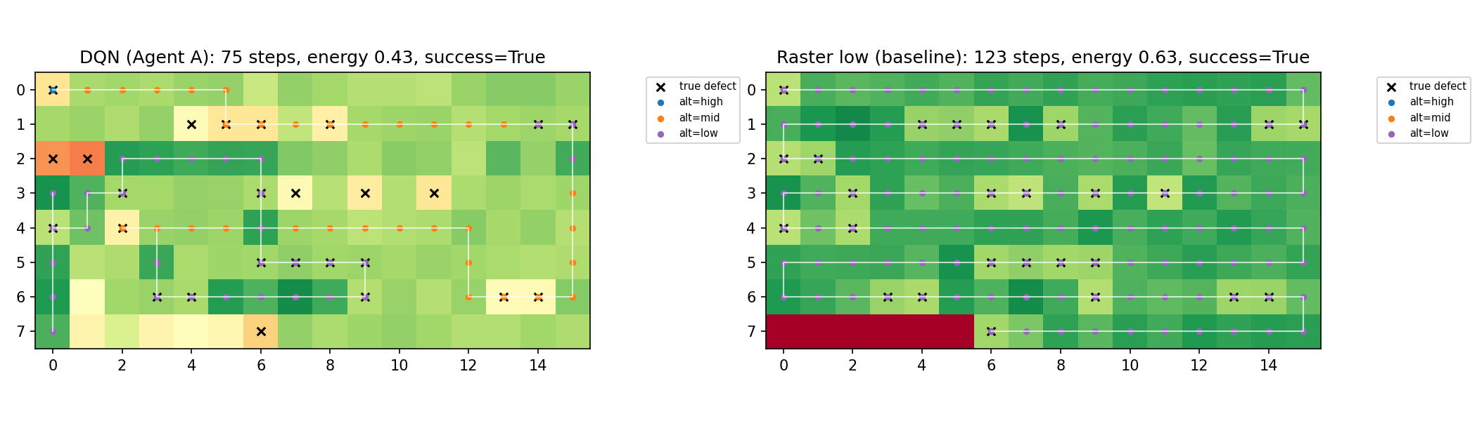
Demo: One State → Action → Reward → Next-State Cycle
Agent A (trained DQN), fixed bridge seed: one decision step
State sₜ
U54.........
544.........
775.........
alt high bat 1.00
coverage 0.07
Q-values → action
E 17.00
S 16.87
Desc 16.96
Climb 15.93
argmax → East
Reward rₜ = +0.300
new cells seen (ΔU)
minus step cost
next step: Descend
→ reward +0.219
Next state sₜ₊₁
7U44........
5444........
7755........
alt high bat 0.99
coverage 0.09
Full episode on one bridge
DQN (left) sweeps mostly at mid altitude and descends only where needed; the raster (right) flies low over every cell.
U = drone, . = unseen, digit = uncertainty × 10; × = true defect. Path figure from our verification run.
Notes:
Run notebook Step 11 live: it prints state, Q-values, chosen action, reward and next state. Replace numbers with your live run if they differ.

Slide 14
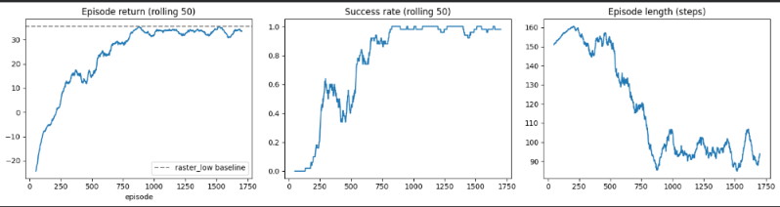
Results: Agent A (DQN) vs Raster Baselines
Metric (20 seeded bridges) | Raster mid | Raster low | DQN
Success rate | 0.00 | 1.00 | 1.00
Steps (time) | 199.0 | 123.0 | 87.5
Energy used | 1.000 | 0.625 | 0.463
Coverage | 1.000 | 0.953 | 0.998
Defects found (/26) | 20.9 | 23.5 | 22.0
mIoU | 0.500 | 0.626 | 0.539
Return | 6.20 | 35.43 | 35.81
100%
−29%
−26%
success
steps vs dense raster
energy vs dense raster
Analytic detector · 200k steps · 10.2 min on Colab CPU. Same success as the dense raster with far less time and energy; lower mIoU is the trade-off (see Analysis).
Learning curves
Episode return, success rate and episode length vs training episode (rolling mean of 50). Return reaches the dense-raster line (dashed) and success reaches 1.0.
Notes:
Numbers from our own Colab run (notebook Steps 5 and 8).

Slide 15
Analysis
Agent A learning behaviour
0–60k steps: mostly exploration (ε 1.0 → 0.05); return rises from −25 to about +15
60k–140k: the big jump happens after exploration ends; success → 100% by ~episode 750, episode length 160 → ~90
140k–200k: training return plateaus ≈ 34 → convergence
Evaluation reward oscillates (36.2 → 14.0 → 30.4): DQN's moving-target instability; best checkpoint kept
Trade-off: agent inspects just enough to meet the uncertainty target → lower mIoU than dense raster
Team components: preliminary verification runs
Component | Result
B: PPO refiner (60k) | 100% success in 3.7 steps; orbit 0%, random 2%
C: A2C supervisor (40k) | Return 41.1 vs 42.8 (rule) at half the energy (0.45 vs 0.95)
All 3 learned | Energy 0.49 vs 0.95 (scripted); defects 20.6 vs 22.6
Real-image detector | IoU on defects 0.23 → 0.72 as view improves
A on real images | 15–20% success so far; weaker, noisier signal
Final numbers for B, C and integration come from each owner's full runs.
Notes:
Be honest about the preliminary numbers; the Agent A numbers are final.

Slide 16
Limitations and Future Work
Current limitations
2D grid abstraction: no wind, collisions or 3D geometry
Vanilla DQN: late-training evaluation instability
Agent C trained with scripted sub-agents → distribution shift when learned agents are plugged in
Real-image uncertainty gives a weaker, noisier reward; learning needs many more samples
Single training seed per result
Realistic improvements
Part II: convergence, regret and sample-efficiency analysis (CO4)
ε / entropy / clip-range sensitivity studies (CO5)
Retrain Agent C with the learned Agent A inside Explore
Multiple seeds with confidence intervals
Double / Dueling DQN; curriculum from analytic to real detector
3D simulator (AirSim) for sim-to-real transfer
Notes:
Each limitation maps to a concrete next step.

Slide 17
Conclusion
We built a shared Gymnasium environment, formulated UAV inspection as three cooperating RL agents (DQN navigation, PPO view refinement, A2C mission supervision) and a real-image uncertainty detector. Agent A matches dense raster scanning's 100% success with 29% fewer steps and 26% less energy.
Course outcome | Evidence in this project | Slides
CO1 – RL vs AI / non-interactive ML | Sequential, interactive, delayed-reward problem; comparison with supervised ML and fixed raster scanning | 2–5
CO2 – Formulate as RL, choose algorithm | MDP for each agent (state, action, reward, dynamics); DQN / PPO / A2C justified by action type | 6–11
CO3 – Implement RL algorithms | Working SB3 implementation, live state → action → reward demo, learning curves, results vs baselines | 12–15
AI tools (Claude) were used for planning and code assistance; acknowledged in the report.
Notes:
Close by mapping evidence to CO1–CO3. Part II will add CO4–CO5 analysis.

Slide 18
Thank you !!
Questions?
Team 08 · Uncertainty-Aware Active Vision for UAV-Based Infrastructure Inspection

