Slide 1
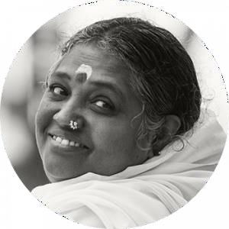


22AIE401 Reinforcement Learning
Uncertainty-Aware Active Vision
for UAV-Based Infrastructure
Inspection Using Deep
Reinforcement Learning
K. S. G. Yeseswini (BL.EN.U4AIE23013)
Individual component:
Shared Environment + Agent A: Viewpoint Planner (DQN)
Team – 08 | Faculty: [Name] | AY 2026–27
Dept. of Computer Science and Engineering
Amrita School of Computing, Bengaluru
Notes:
My component: the shared Gymnasium environment used by the whole team, and Agent A, the navigation agent.

Slide 2
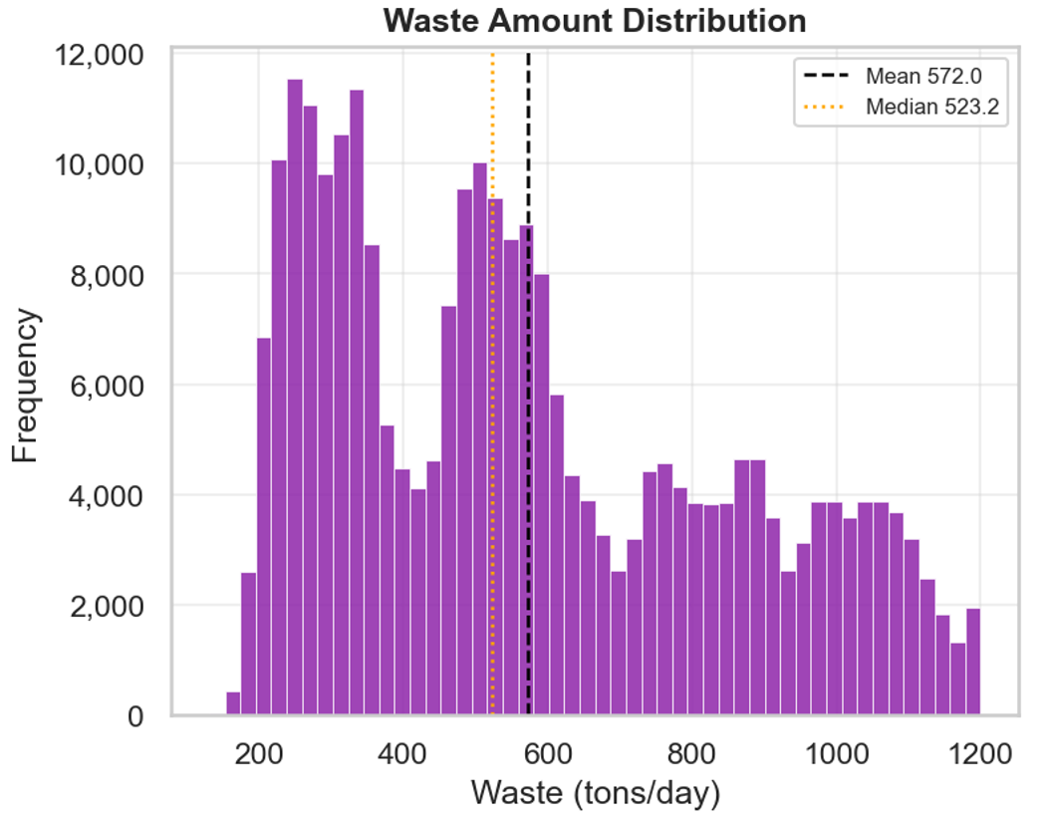
My Component: Problem and Role
Problem Agent A solves
A raster scan flies a fixed path and treats every region equally: slow and battery-hungry
Agent A decides where to fly next and at which altitude, using the detector's uncertainty map
Goal: inspect the whole bridge with low uncertainty in fewer steps and with less energy
Agent C (A2C)
supervisor
Agent A (DQN)
where to fly
Agent B (PPO)
how to view
My contributions
Shared Gymnasium environment for the team: 8×16 bridge grid, 3 altitudes, camera footprint, detector, battery
4 modes (navigate / refine / supervise / full) so each agent trains independently
Baselines (raster mid / low, random) evaluated on identical seeded bridges
Agent A: MDP design, DQN training, evaluation and analysis
Shared environment + detector
bridge · UAV · uncertainty · battery
Why RL: every move changes what the camera sees next, success is known only at the end, and there is no labelled 'correct path' to imitate.
Notes:
Highlighted boxes are my work.

Slide 3
MDP Formulation of Agent A
Element | Definition
State (118) | Egocentric 7×7 window of visited flags + 7×7 uncertainty, 2×4 block coverage + uncertainty, row, column, altitude, battery; all in [0, 1]
Actions (6) | North, South, East, West, Climb, Descend
Dynamics | Move / altitude change → camera footprint 5×5 / 3×3 / 1×1 → each cell keeps its best view → uncertainty map updated; battery −0.005 per move, −0.01 per altitude change
Reward | 0.2·ΔU − 0.01 − 0.05·[revisit] − 1·[out of bounds]; success: +10 + 20·battery_left
Episode end | Success (coverage ≥ 95% and mean uncertainty ≤ 0.32), battery empty, or 200 steps
Design decisions from experiments
Global one-hot position (386 inputs) → 0% success. Egocentric state fixed it
Separate coverage + uncertainty rewards → reward hacking. Total uncertainty reduction + battery-scaled bonus aligned the goal
γ = 0.99 discounted the late success bonus too much → γ = 0.995
Notes:
ΔU is total uncertainty removed; an unseen cell counts as uncertainty 1. The problem is a POMDP (defects hidden), solved as an MDP over this observation.

Slide 4
Algorithm: Deep Q-Network (DQN)
Why DQN
Discrete action space (6 moves)
Off-policy replay buffer reuses experience: sample-efficient
Target network stabilises the moving regression target
Hyper-parameter | Value
Network (MLP) | 256 – 256
Learning rate | 5 × 10⁻⁴
Discount γ | 0.995
Replay buffer | 100,000
Batch size | 128
Target update | every 1,000 steps
Train frequency | every 4 steps
Training | 200k steps (10.2 min, Colab CPU)
Core update (as implemented in SB3)
y = r + γ · maxₐ′ Q_θ⁻(s′, a′)
L(θ) = ( y − Q_θ(s, a) )²
Exploration: ε-greedy, ε decays 1.0 → 0.05 over the first 30% of training; greedy (argmax Q) at evaluation.
Notes:
Stable-Baselines3 DQN = replay + target network (no Double/Dueling).

Slide 5
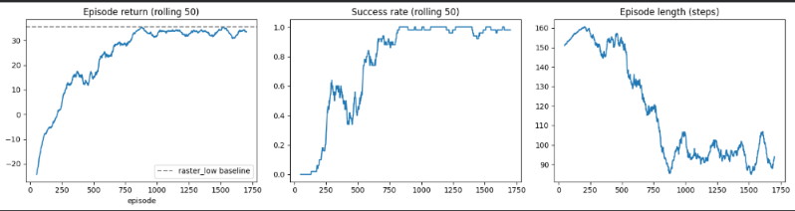
Demo and Results
Metric (20 seeded bridges) | Raster mid | Raster low | DQN
Success rate | 0.00 | 1.00 | 1.00
Steps (time) | 199.0 | 123.0 | 87.5
Energy used | 1.000 | 0.625 | 0.463
Coverage | 1.000 | 0.953 | 0.998
Defects found (/26) | 20.9 | 23.5 | 22.0
mIoU | 0.500 | 0.626 | 0.539
Return | 6.20 | 35.43 | 35.81
100%
−29%
−26%
success
steps vs dense raster
energy vs dense raster
Live demo (notebook Step 11)
State map → Q-values for all 6 actions → argmax action → reward → next map. Example: East (+0.30, new cells), then Descend (+0.22, uncertainty drops).
Learning curves
Return reaches the dense-raster line (dashed), success reaches 1.0 and episodes get shorter (160 → ~90 steps).
Notes:
All numbers here are from my own Colab run.

Slide 6
Analysis and Conclusion
Analysis
0–60k steps: exploration (ε 1.0 → 0.05); return −25 → +15
60k–140k: main improvement after ε floor; success → 100%
140k+: plateau ≈ 34 → convergence; eval oscillates (DQN instability) → best checkpoint kept
Trade-off: inspects just enough → lower mIoU than dense raster
Limitations and next steps
2D grid abstraction; single seed
Real-image uncertainty: weaker signal, 15–20% success so far
Next: ε-sensitivity, regret and sample-efficiency analysis (Part II)
Future: Double / Dueling DQN, 3D simulator
CO | Evidence from my component
CO1 | Navigation is sequential, interactive and delayed-reward; compared with a fixed raster scan
CO2 | Full MDP (state, 6 actions, reward, dynamics); DQN justified by discrete actions and sample efficiency
CO3 | Working DQN in the shared environment, live demo, learning curves, beats dense raster in time and energy
Notes:
Close with the CO mapping.

