Slide 1
ABS(-15)
CEIL(15.7)
COS(3.14159)
FLOOR(15.7)
LOG(10,100)
MOD(11,4)
POWER(3,2)
ROUND(15.7)
SIGN(-15)
TRUNC(15.7)
CHR(67)
CONCAT('HAPPY ', 'Birthday')
LOWER('Birthday')
LPAD('Page 1', 15, '*.')
LTRIM('Page 1', 'ae')
REPLACE('JACK', 'J', 'BL')
RPAD('Page 1', 15, '*.')
RTRIM('Page 1', 'ae')
SUBSTR('ABCDEFG', 3, 4)
TRIM(LEADING 0 FROM '00AA00')
UPPER('Birthday')
ASCII('A')
INSTR('CORPORATE FLOOR','OR', 3, 2)
LENGTH('Birthday')
ADD_MONTHS('14/05/21', 1)
LAST_DAY(SYSDATE)
NEXT_DAY(SYSDATE, ‘화’)
ROUND(SYSDATE)
SYSDATE
TO_CHAR(SYSDATE)
TO_CHAR(123)
TO_DATE('12 05 2014', 'DD MM YYYY')
TO_NUMBER('12.3')
DECODE(1,1,'aa','bb')
NULLIF(123, 345)
NVL(NULL, 123)

Slide 2
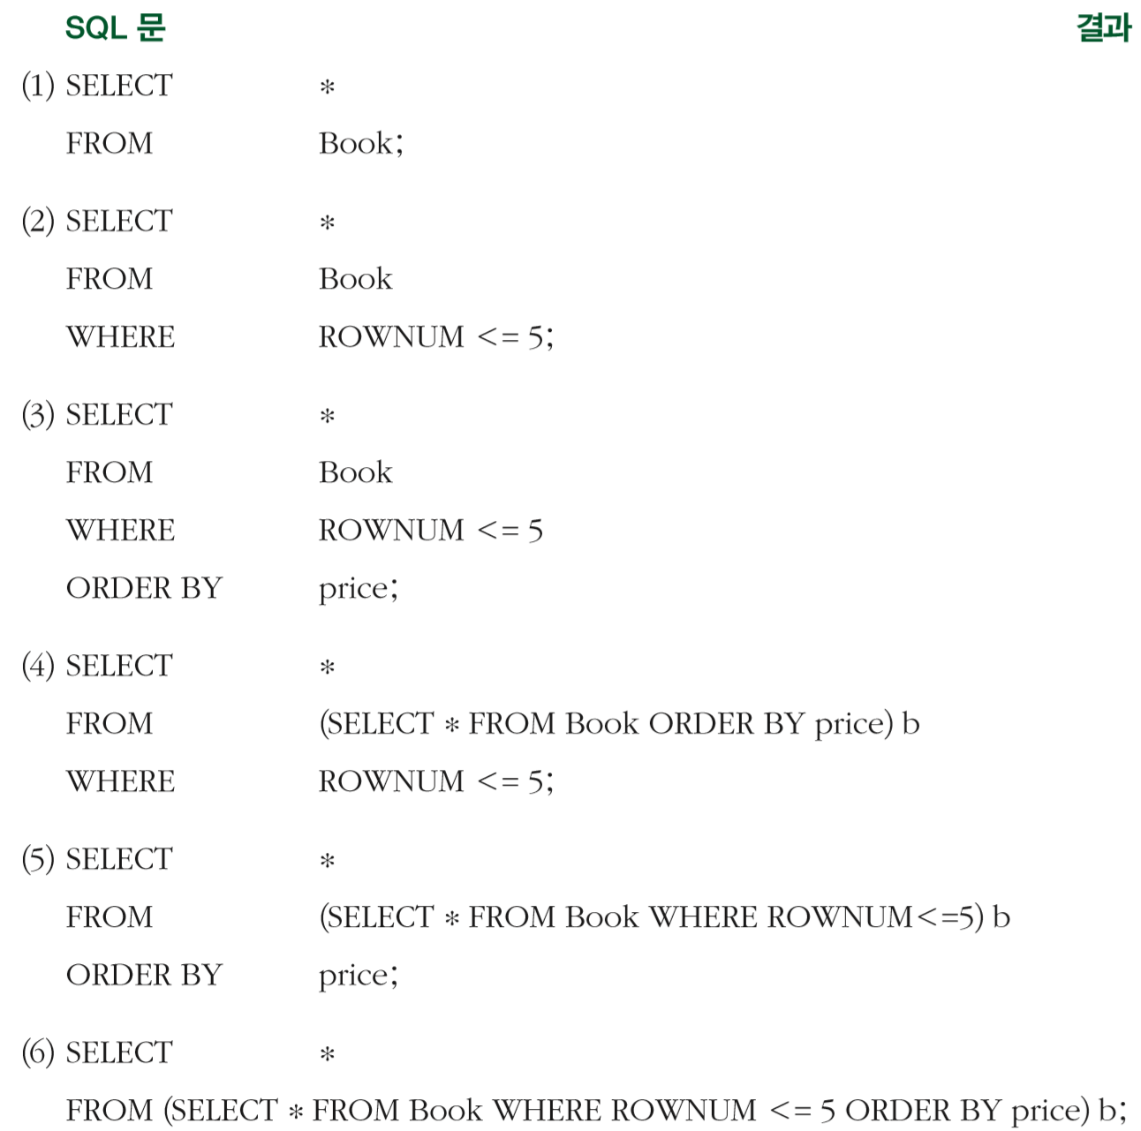

Slide 3
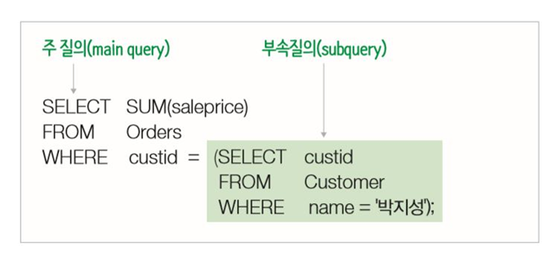
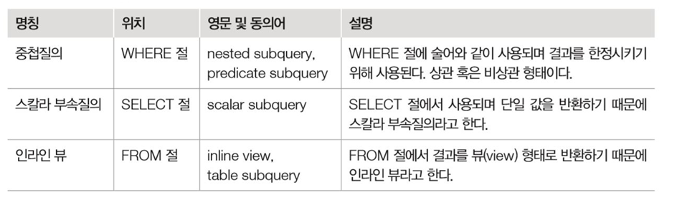

Slide 4
