Slide 1
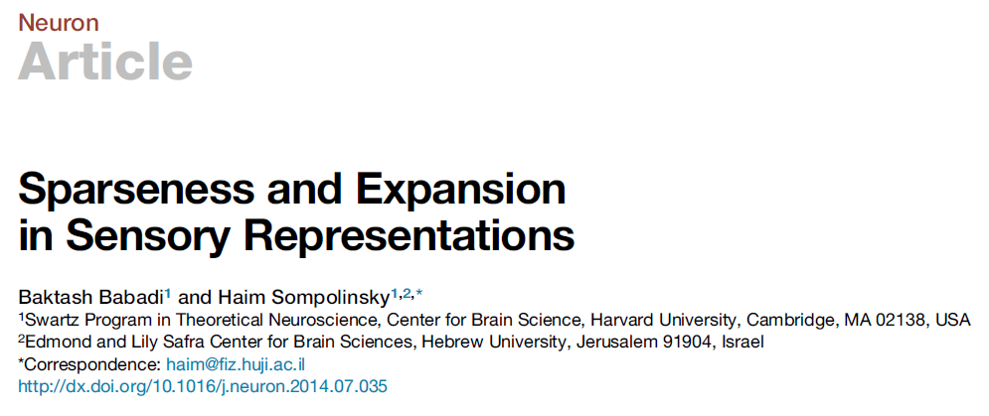
Presented by Xueyan Niu (Julie)
Dec. 5, 2019

Slide 2
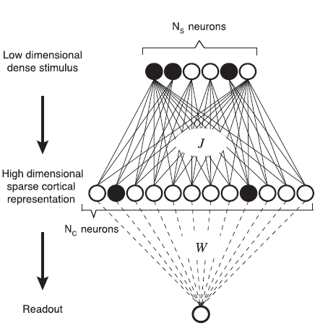
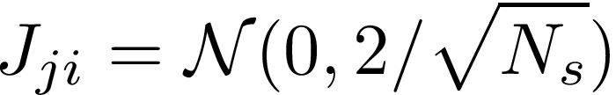
A feedforward model
stimulus layer
Basic assumptions:
Neurons only have two states: 0/1
Expansion: Nc >> Ns
Sparseness: in the cortical layer
Objective: evaluate the effect of expansion and sparseness on the performance of the network
2 choices for J:
Random
By Hebbian learning
cortical layer
readout layer
Notes:
They make sure the variance of this neuron is not related to the value of Ns.

Slide 3
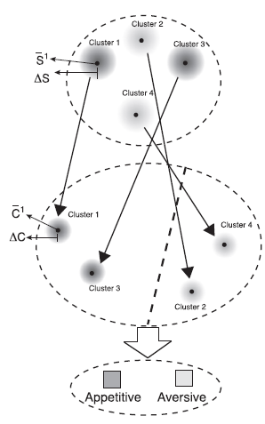



The first 2 criteria
Simulation details:
Stimuli form P clusters
Stimulus cluster center chosen randomly
Generate noisy stimuli with cluster size
If samples are chosen completely randomly -> cluster size = 1
Sparsity constraint : set threshold T in the cortical layer so that there are fPNc neurons that fire
= on average, each cortical neuron has f probability to fire
Criterion 1: size of cortical clusters
(Distance between patterns to their center) / (distance between centers)
Criterion 2: overlap of two clusters
Notes:
They introduce noise to the stimulus domain and investigate the impact of the noise in cortical domain and readout layer.

Slide 4
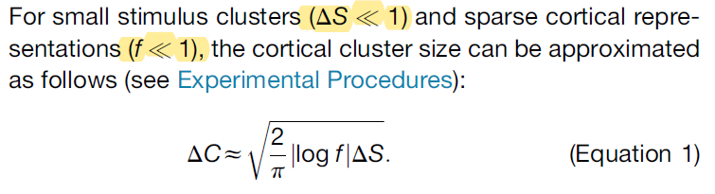
Cluster size
Analytical evaluations:
Reasonable assumptions!
Coefficient of J does not matter
Delta C increases as f decreases

Slide 5
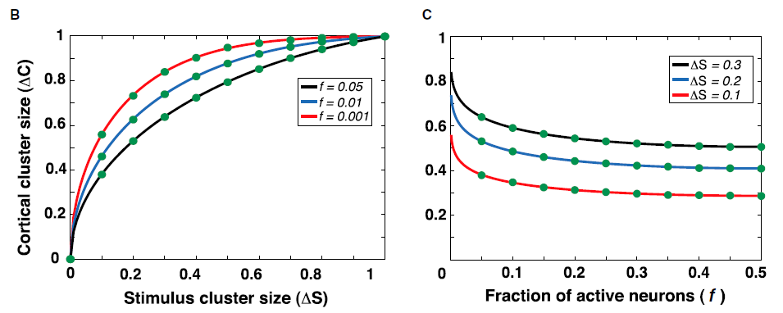

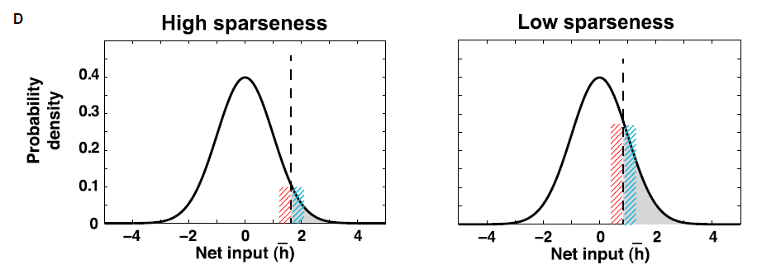
Cluster size
An intuitive explanation:
Delta C = (Distance between patterns to their center) / (distance between centers)
= (number of neurons that flip sign due to stimulus noise and random J) / (2 * number of neurons that fire)
Expanded noise:
Sparser (less f) -> larger cortical cluster not desirable!!
Pdf of the input in cortical layer
Notes:
Counting how many neurons flip sign due to the noise in the stimulus layer

Slide 6
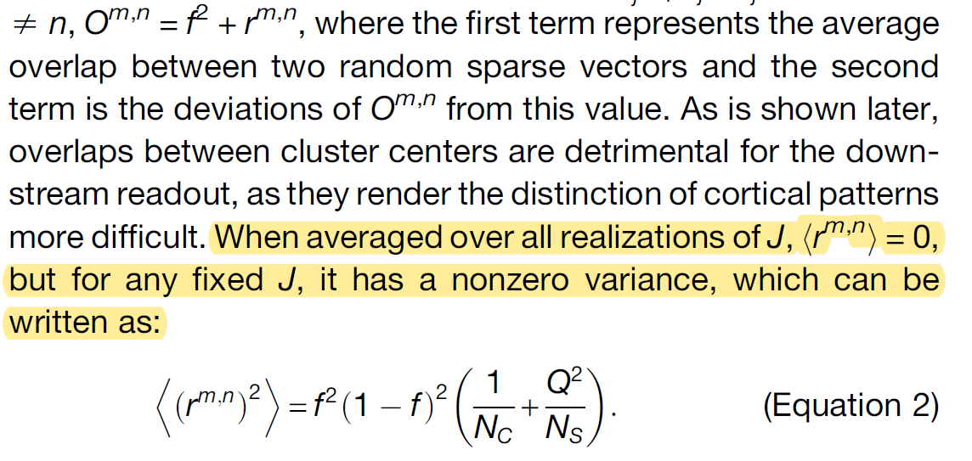
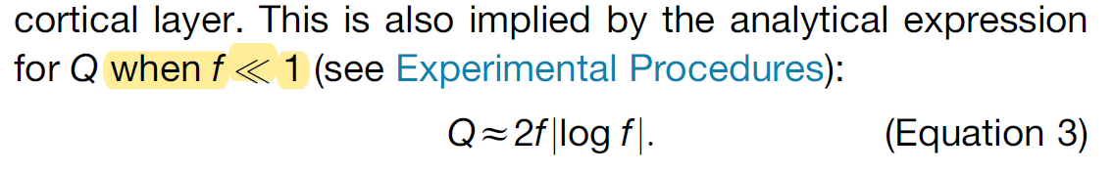
Overlaps between clusters
Analytical evaluations:
The first term is the intrinsic variance; the second term depends on the choice of J

Slide 7
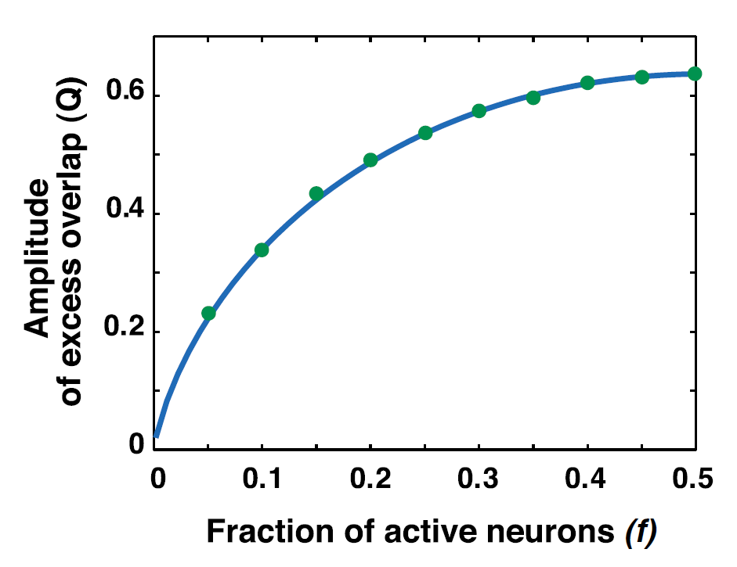
Overlaps between clusters
Simulations:
Sparser (less f) -> smaller cluster overlap desirable!!

Slide 8
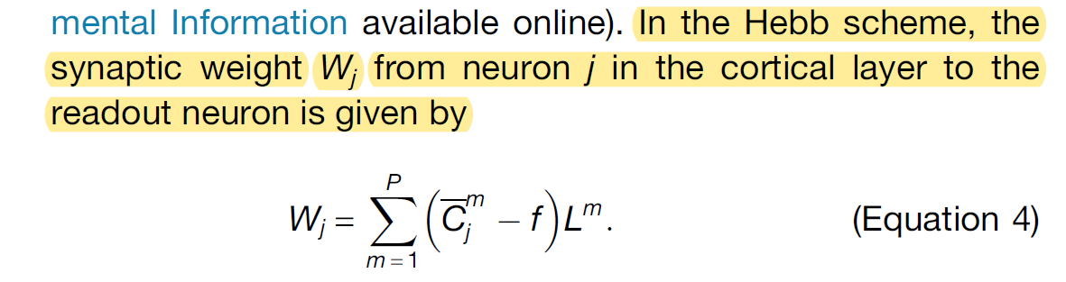
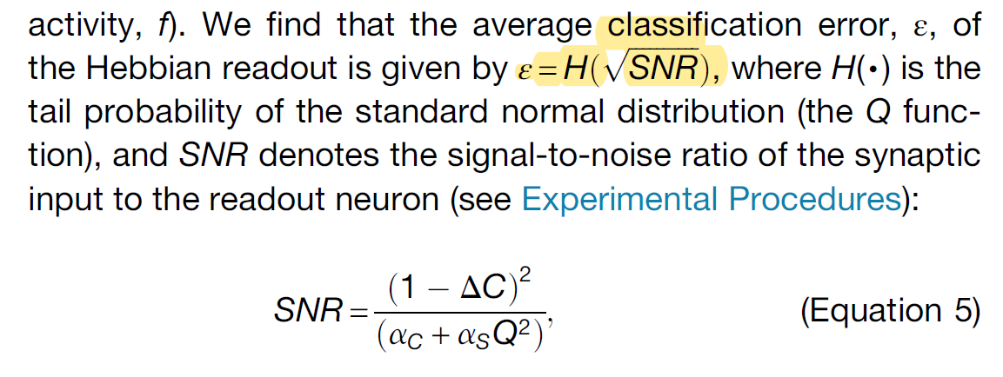
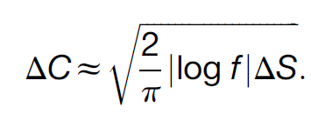


Classification by a readout neuron
Each stimulus cluster center m has a label Lm, 1 or -1, ½ probability
W is trained by supervised Hebbian rule
Analytical evaluations:
decreasing function
decrease with f
Increase with f
Notes:
They train W to learn to reproduce this label

Slide 9
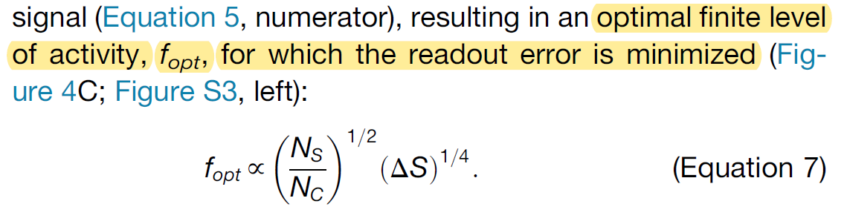
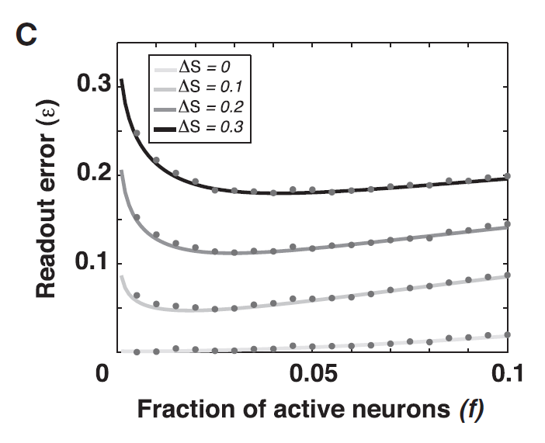
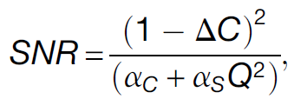
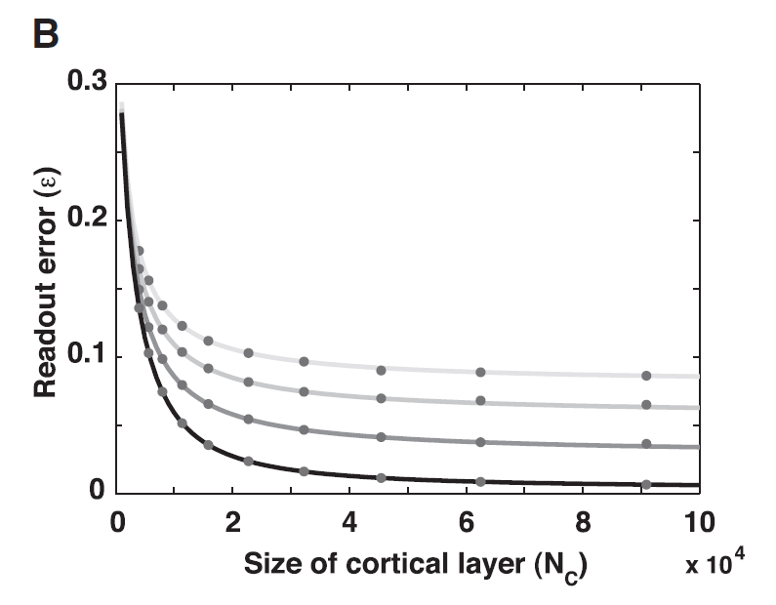

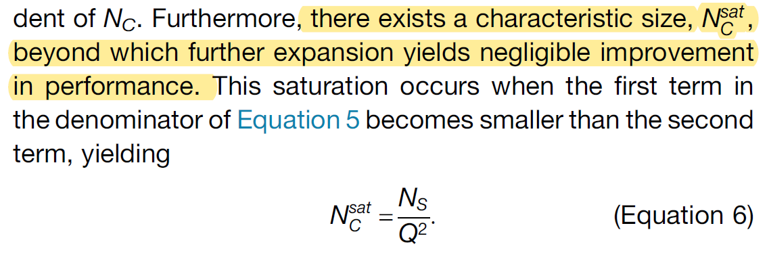
Classification by a readout neuron
Analytical evaluations:
Simulations:
We can also look at the effect of expansion (Nc)
The performance initially improves when Nc increases, but then

Slide 10
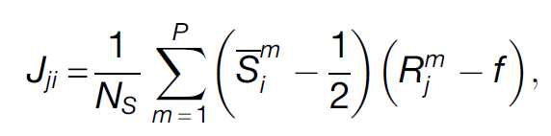
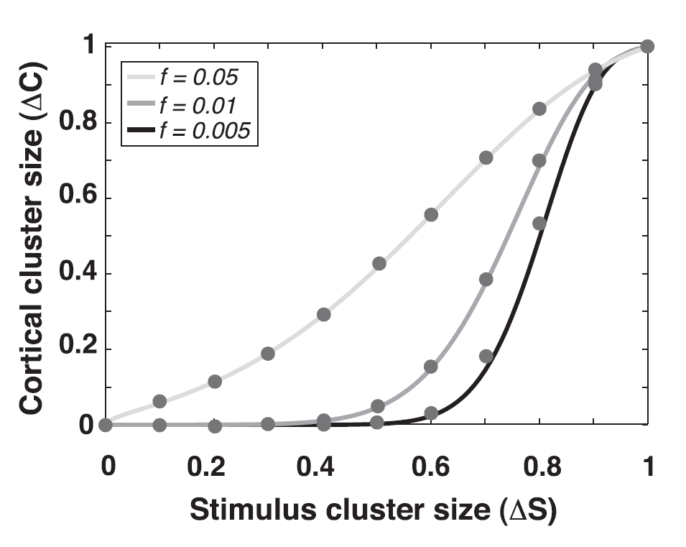
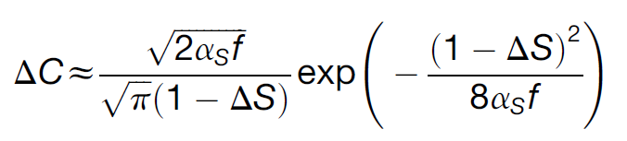

J by Hebbian learning
For each stimulus cluster center Sm, choose a random cortical pattern Rm
When f << 1, taking expectation, we have
Sparser, smaller f, smaller cluster size desirable!!
Notes:
And make them a pair

Slide 11

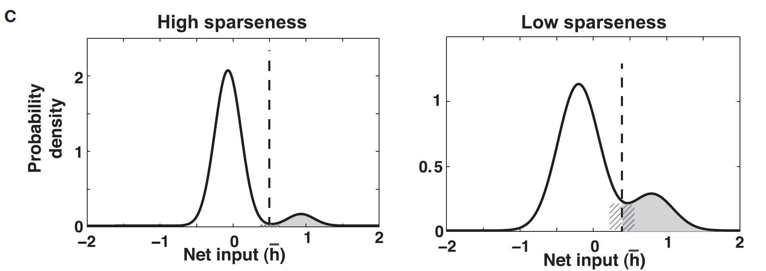
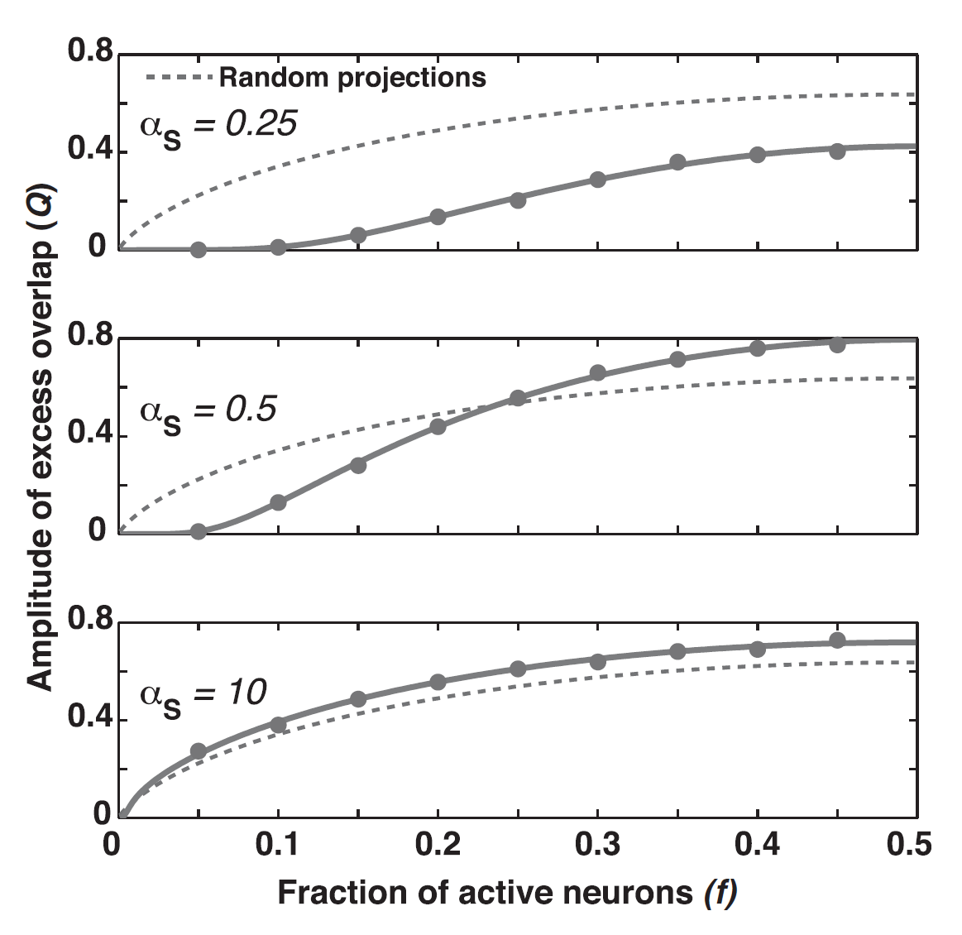
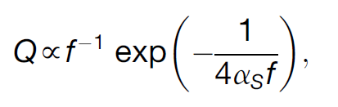
J by Hebbian learning
The overlap between the two Gaussians become larger than their widths; then the structured connections reduce to random connections
When f << 1, taking expectation, we have

Slide 12

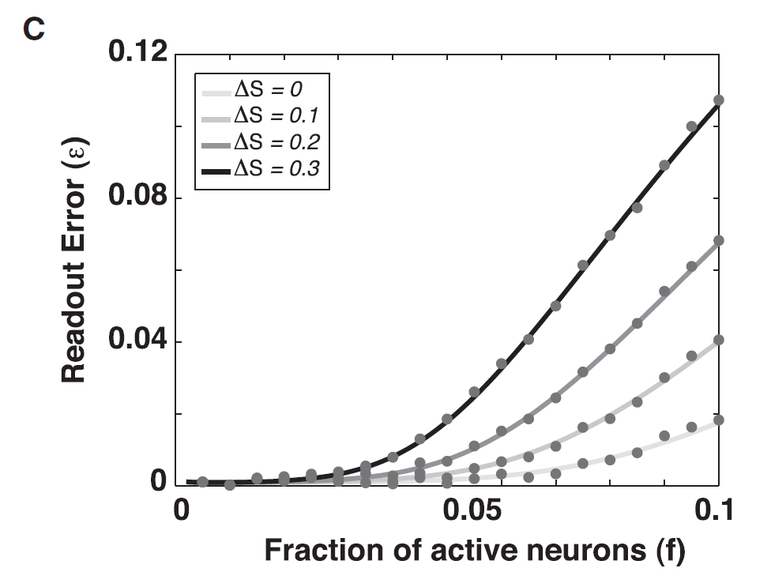
J by Hebbian learning
Since W does not change, SNR is given by the same formula:
decrease with f
increase with f
With a different expression for Q, we have:
For sparse representations, expansion is highly effective at improving SNR
The performance of readout improves as the cortical representation becomes sparser

Slide 13
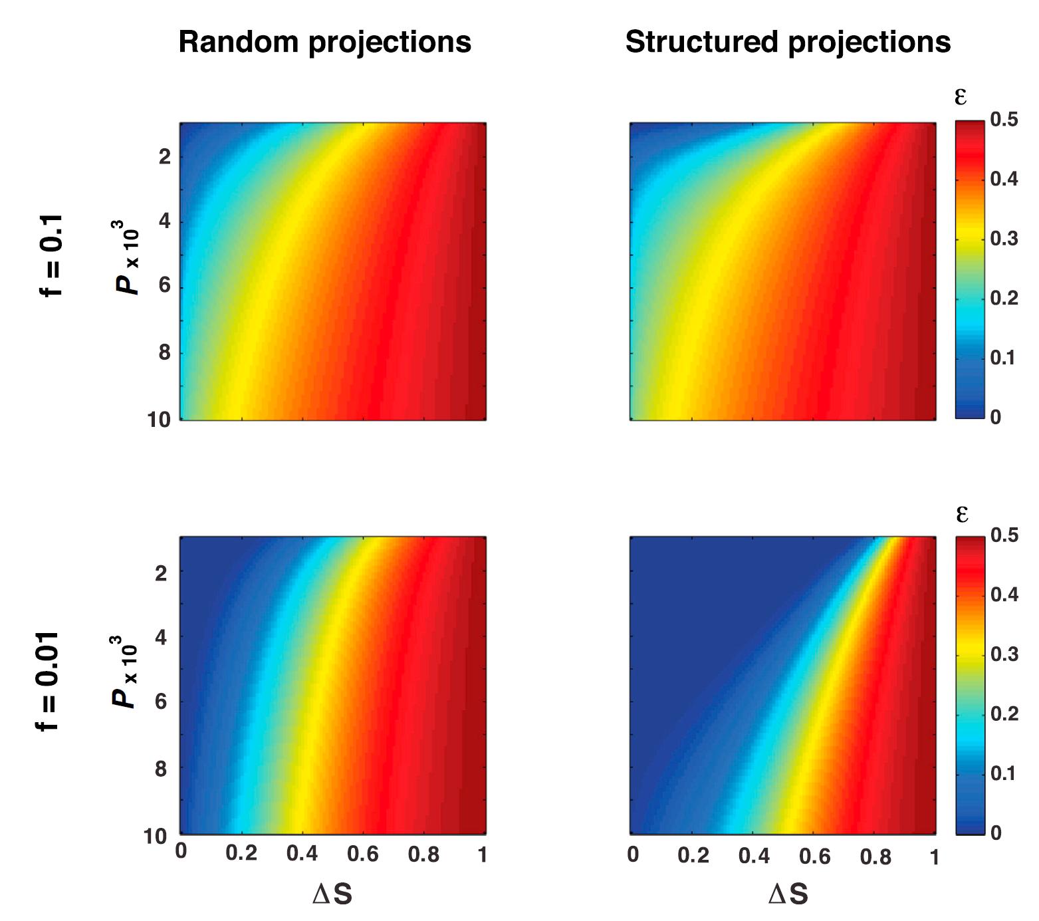
Discussion
Classification
Different level of sparsity in different neural systems?
The biological mechanism of the allocation process
In structured projections
Notes:
Maybe they have different strategies in setting the connections for optimal performance
This mechanism is quite reasonable in their opinion

