Slide 1
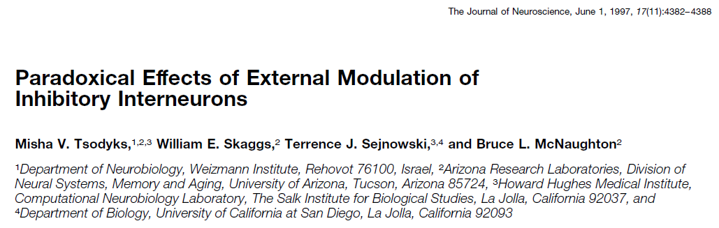
Presented by Xueyan Niu (Julie)
Feb 15, 2020

Slide 2
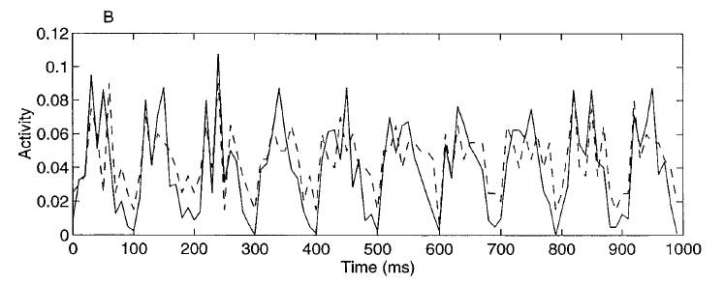
Motivations
When modeling the hippocampal theta rhythm (which is considered to be an external input to the inhibitory neurons) in an E-I system, people noticed that E-I neurons oscillated in synchrony -> a paradoxical effect
Proportion of neurons that fired in 10 ms
Solid: E
Dashed: I
Notes:
Instead of in synchrony, the E-I activities should be in the opposite direction.
In this paper, the authors modeled the E-I system in a formal way and gave a parameter regime that can reproduce this effect.

Slide 3
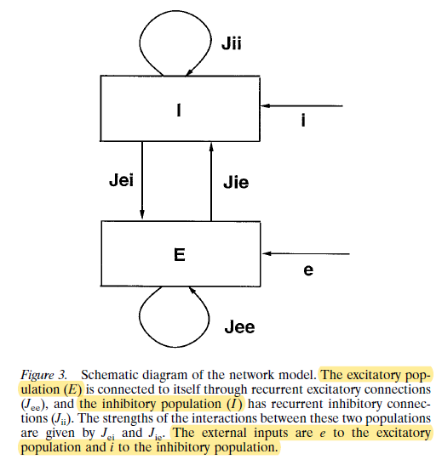
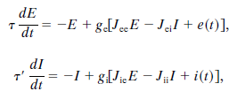

The model
Linear response functions make the system tractable
Notes:
Population firing rate
In the following analysis, E and I are scalars, not vectors. Of course here, they did not model each neuron explicitly, but only modeled the population activity to make the system tractable.
Also in the following analysis, g is taken to be in this range (this linear form) all the time.

Slide 4
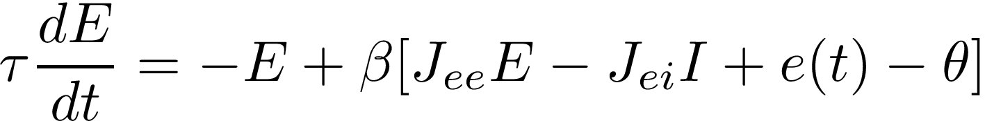
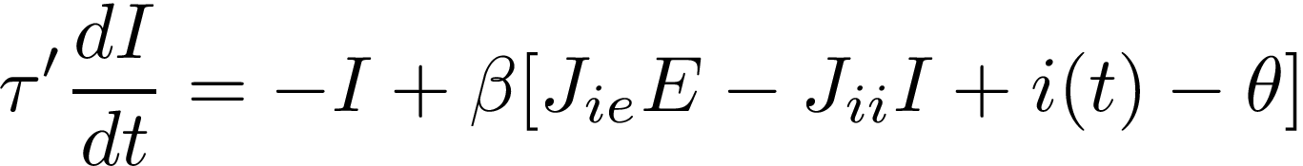
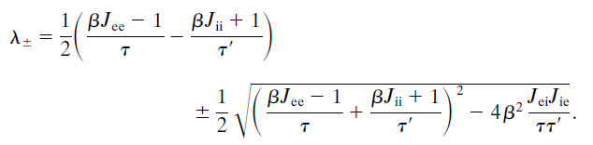


Steady-state solutions - stability
To have stable solutions, the matrix of the coefficients must have eigenvalues with a negative real part
Inhibitory-inhibitory connections are critical for stability
The necessary condition:
The sufficient condition:
needs to be large
Notes:
Otherwise E and I would keep increasing in the direction of the eigenvector with a positive eigenvalue.

Slide 5
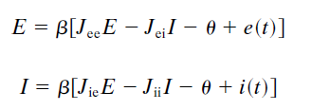
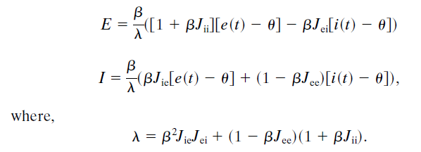

Steady-state solutions – the solution
Solving the system of linear equations…
When , (paradoxical effect) increasing the input to inhibitory neurons will reduce their response
When , the E neurons will blow up without the inhibition from I neurons
\lambda < 0 will yield unstable solutions (does not meet the stability conditions in the last slide)
Notes:
Here we focus on the effect of external input to the steady-state solution.
So don’t worry about that, lambda will be positive all the time.

Slide 6
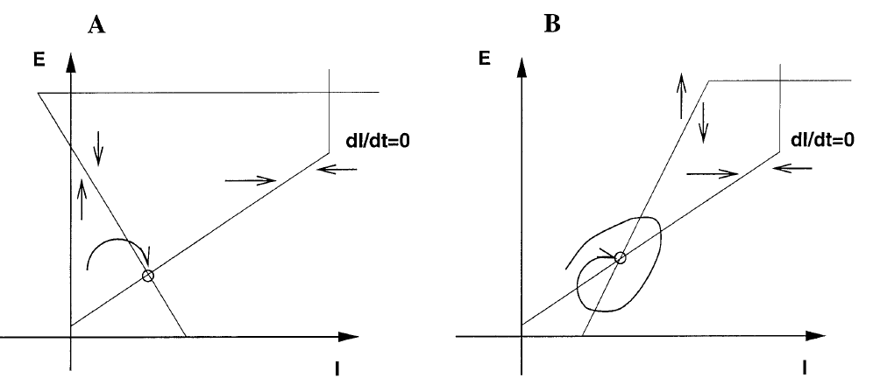
Intuitive understanding 1
Intersection -> steady-state solution
Extra i(t) -> moving the dI/dt curve down
For A, E decreases, I increases
For B, both E and I decrease
Notes:
That is a mathematical way to look at those equations.

Slide 7
Intuitive understanding 2
Excitatory recurrent connections are like the amplifiers (if they are strong enough)
i(t) increases -> I increases -> E decreases -> the excitatory connections amplify the decrease -> I decreases
J_ee is strong -> I receives strong excitatory input -> I needs inhibition to balance the dynamics
Finally, experimental findings (in rat hippocampus): the strength of excitatory recurrent connections is negatively correlated to the phase difference between excitatory and inhibitory neurons
Notes:
If you want to give a large value to Jee, there is a constraint on Jii to consider about.
And lastly, whether this paradoxical effect really happens in the brain, or it’s just a model.

Slide 8
For the familiarity effect
inhibitory
I
E
C
If E and C are fully-connected, it is like increasing Jee, which will never produce the results we want
The increased activity of C can be the additional external input to I, which can lead to the paradoxical effect

Slide 9
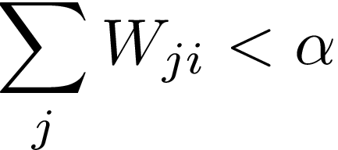
For the familiarity effect
Basically, we want C neurons to not connect to E neurons, and there are some (possibly) reasonable ways to do that:
By restricting the number of connected neighbors one neuron can have
By restricting the total pre-synaptic connection one neuron can have
I
E
C
C increases -> I increases -> E decreases -> I decreases -> C+E decreases (familiarity suppression)

Slide 10

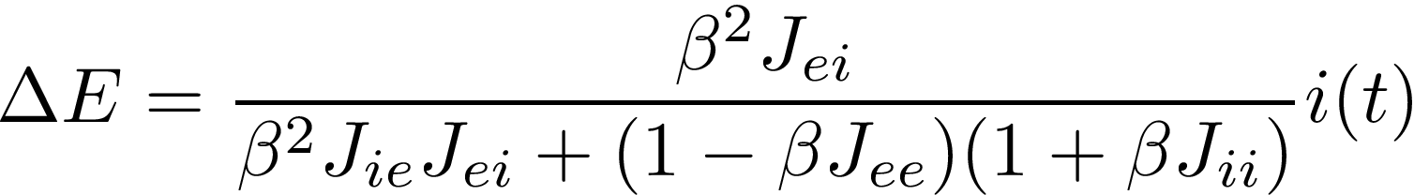
For the familiarity effect
C = The amount of external input to inhibitory neurons / the amount of increased activity due to the Hebbian circuits
\delta E = The amount of decreased activity for excitatory neurons outside the circuit
Larger than 1/Jic
Notes:
A lot of parameters can meet this condition.

Slide 11
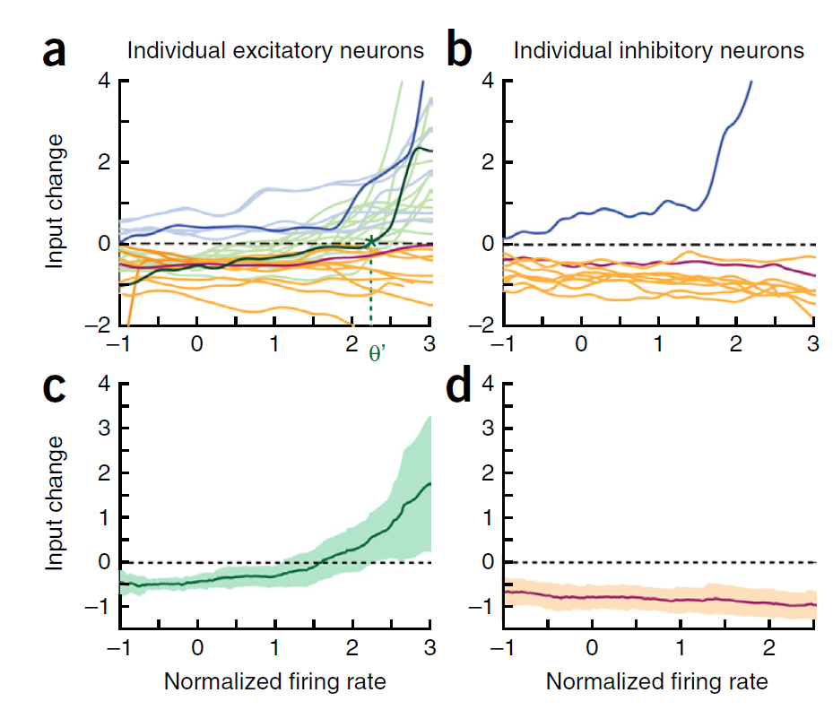
Other possibilities?
“I” as a combination of SOM and PV neurons, maybe VIP neuron can be the special inhibitory neuron?
Different types of inhibitory neurons?
X: normalized post-synaptic firing rate
Y: change in activity after training / familiarizing
VIP
PV
SOM
E
Notes:
These 3 types of neurons can account for 80%~90% of inhibitory neurons.
Image recognition can be more robust against noise with the Hebbian circuits.

