Slide 1
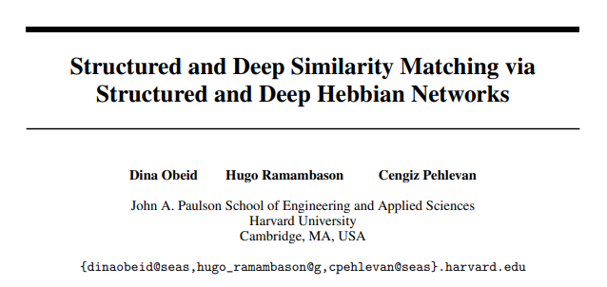
Presented by Xueyan Niu (Julie)
Feb 1, 2020
Notes:
How to design a neural network that achieves similarity matching only by Hebbian and anti-Hebbian rules -> local synaptic rules
Counter-example: gradient descent via chain rule
How to break an objective function into two parts: a dynamical equation for individual neurons, local update rules for the connections (weights)
Inversely, concise and well-established objective function
I will start with the first direction, and let’s understand this paper first.

Slide 2
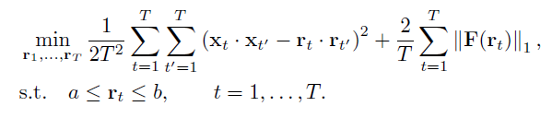
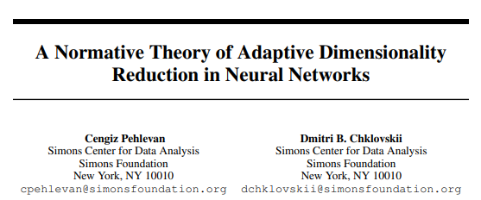
1. Objective function: similarity matching
?
N
……
-> conducting PCA in the input space on the samples
-> finding N PCs for the T samples
K
……
Notes:
The objective is to minimize the dot products of different samples between the input space and the output space.
Intuition behind similarity matching: conducting PCA in the input space; (instead of) PC for variables, PC for samples. So for the T-by-N output matrix, it’s like finding N uncorrelated types of samples.

Slide 3
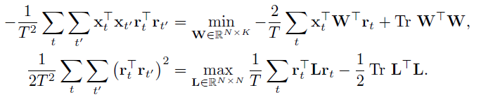
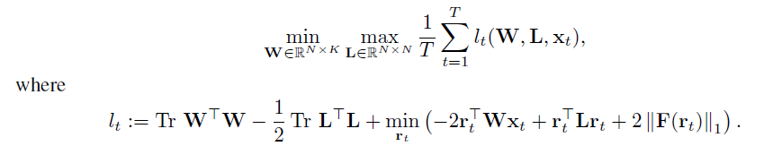
2. Hypothesizing “connections”
x is fixed
= f(W)
= g(L)
min/max change locations
Notes:
In this function, there are no terms for connections, we just directly optimize over r.
What they do is that they put this min over r in the most inner place.
The advantage is that now they can separate the optimization over r with the optimization over connections.

Slide 4
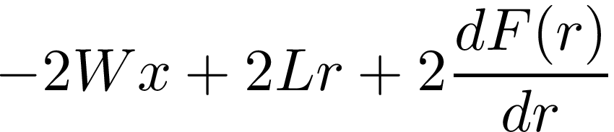
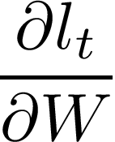
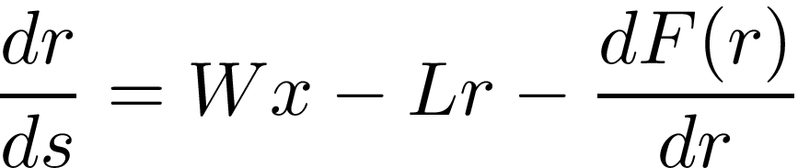
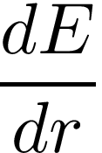


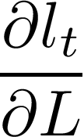


3. Breaking the equation into 2 parts
= E(r)
Let:
The direction for the energy function to decrease (- ) = the direction for r to change with time ( )
Compute :
Compute :
Inhibition within the same layer
feedforward
Tips: 1) f and F have certain relations
2) dr/ds can be computed by chain rule
Notes:
In this way, with time, r is going in the direction for the energy function to decrease.

Slide 5
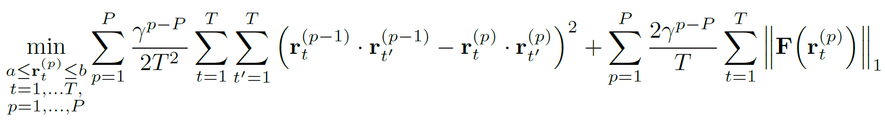
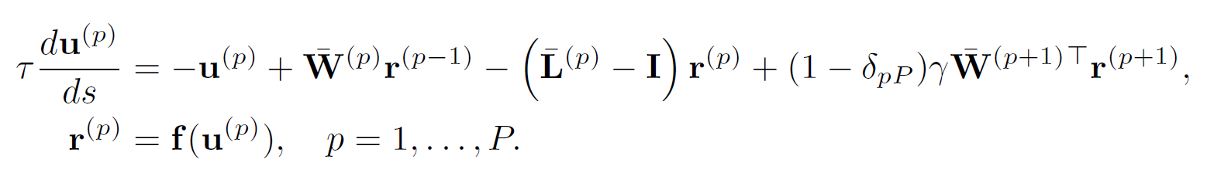
4. Deep similarity matching
-> There would be feedback connections
Consider layer m: the terms that are involved include both cases when p=m and when p=m+1
The cross term gives feedback connections, the same form as feedforward connections
Notes:
It’s straightforward that similarity matching is not restricted to two layers. We can have a deep network that does this similarity matching layer by layer.
Gamma is a constant that gives different costs to different layers.

Slide 6
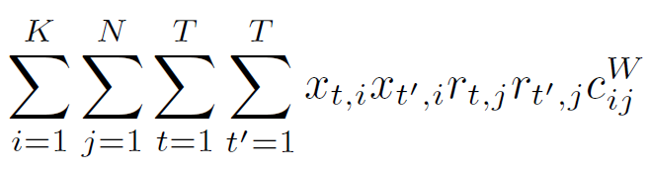
5. Structured similarity matching
Write explicitly about every neuron…
We can involve constants that set the structure
j
x
i
Having those constants would not affect the local learning
Drop out
Control the size of receptive field (more biologically plausible)
Notes:
Another improvement is to have some structures of the connections.
The network structure can be more flexible by introducing structure constants

Slide 7
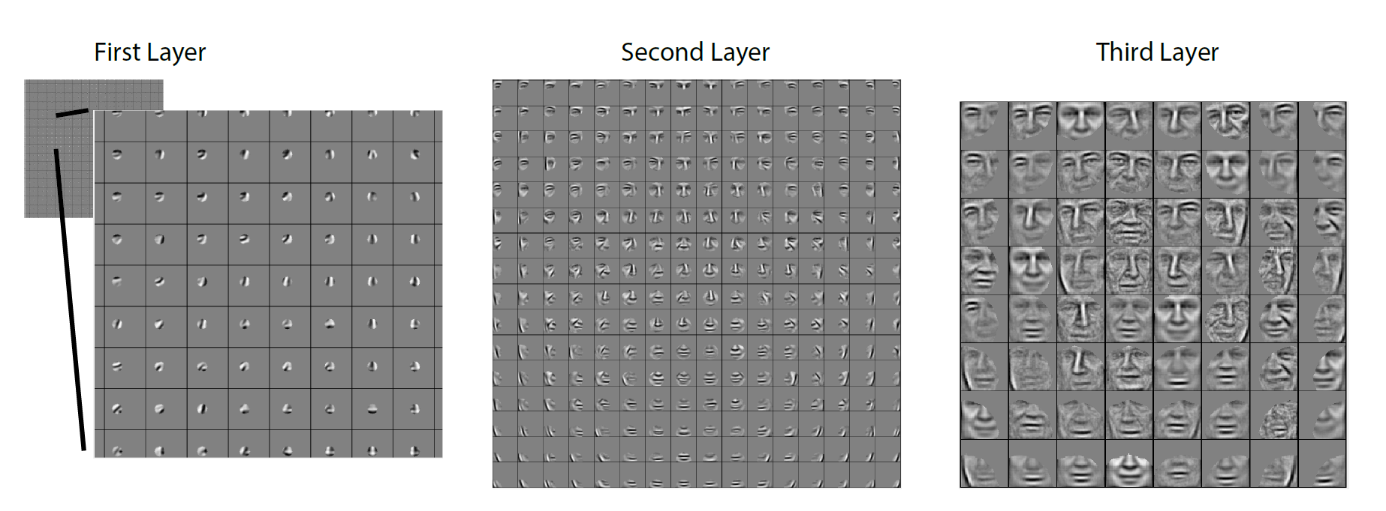
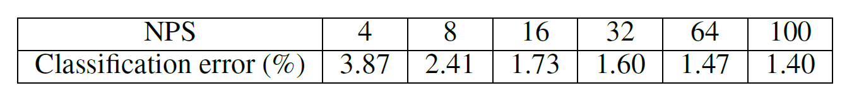
6. Simulations
The features learned from a face dataset, with 3 layers, small feedback (or unnecessary)
2. Single layer + LinearSVC on the MNIST data set -> comparable results with other biologically plausible networks
Notes:
Since they only took the output layer to do classification, it shows the output layer keeps the features of the input layer.

Slide 8
7. Future directions
Constraint: speed
Applications: 1) neuromorphic chips; 2) video analysis?
Think inversely:
Dynamical equations → objective functions
Let:
The direction for the energy function to decrease (- ) = the direction for r to change with time ( )
Notes:
Cooperation with Intel
That is what Prof. Lee wants me to do, because we sort of have an idea of what the dynamical equations should be to reproduce visual familiarity effect. But before that, we need to find justifications for the dynamical equations we design, and that would be the second part of this presentation.

Slide 9
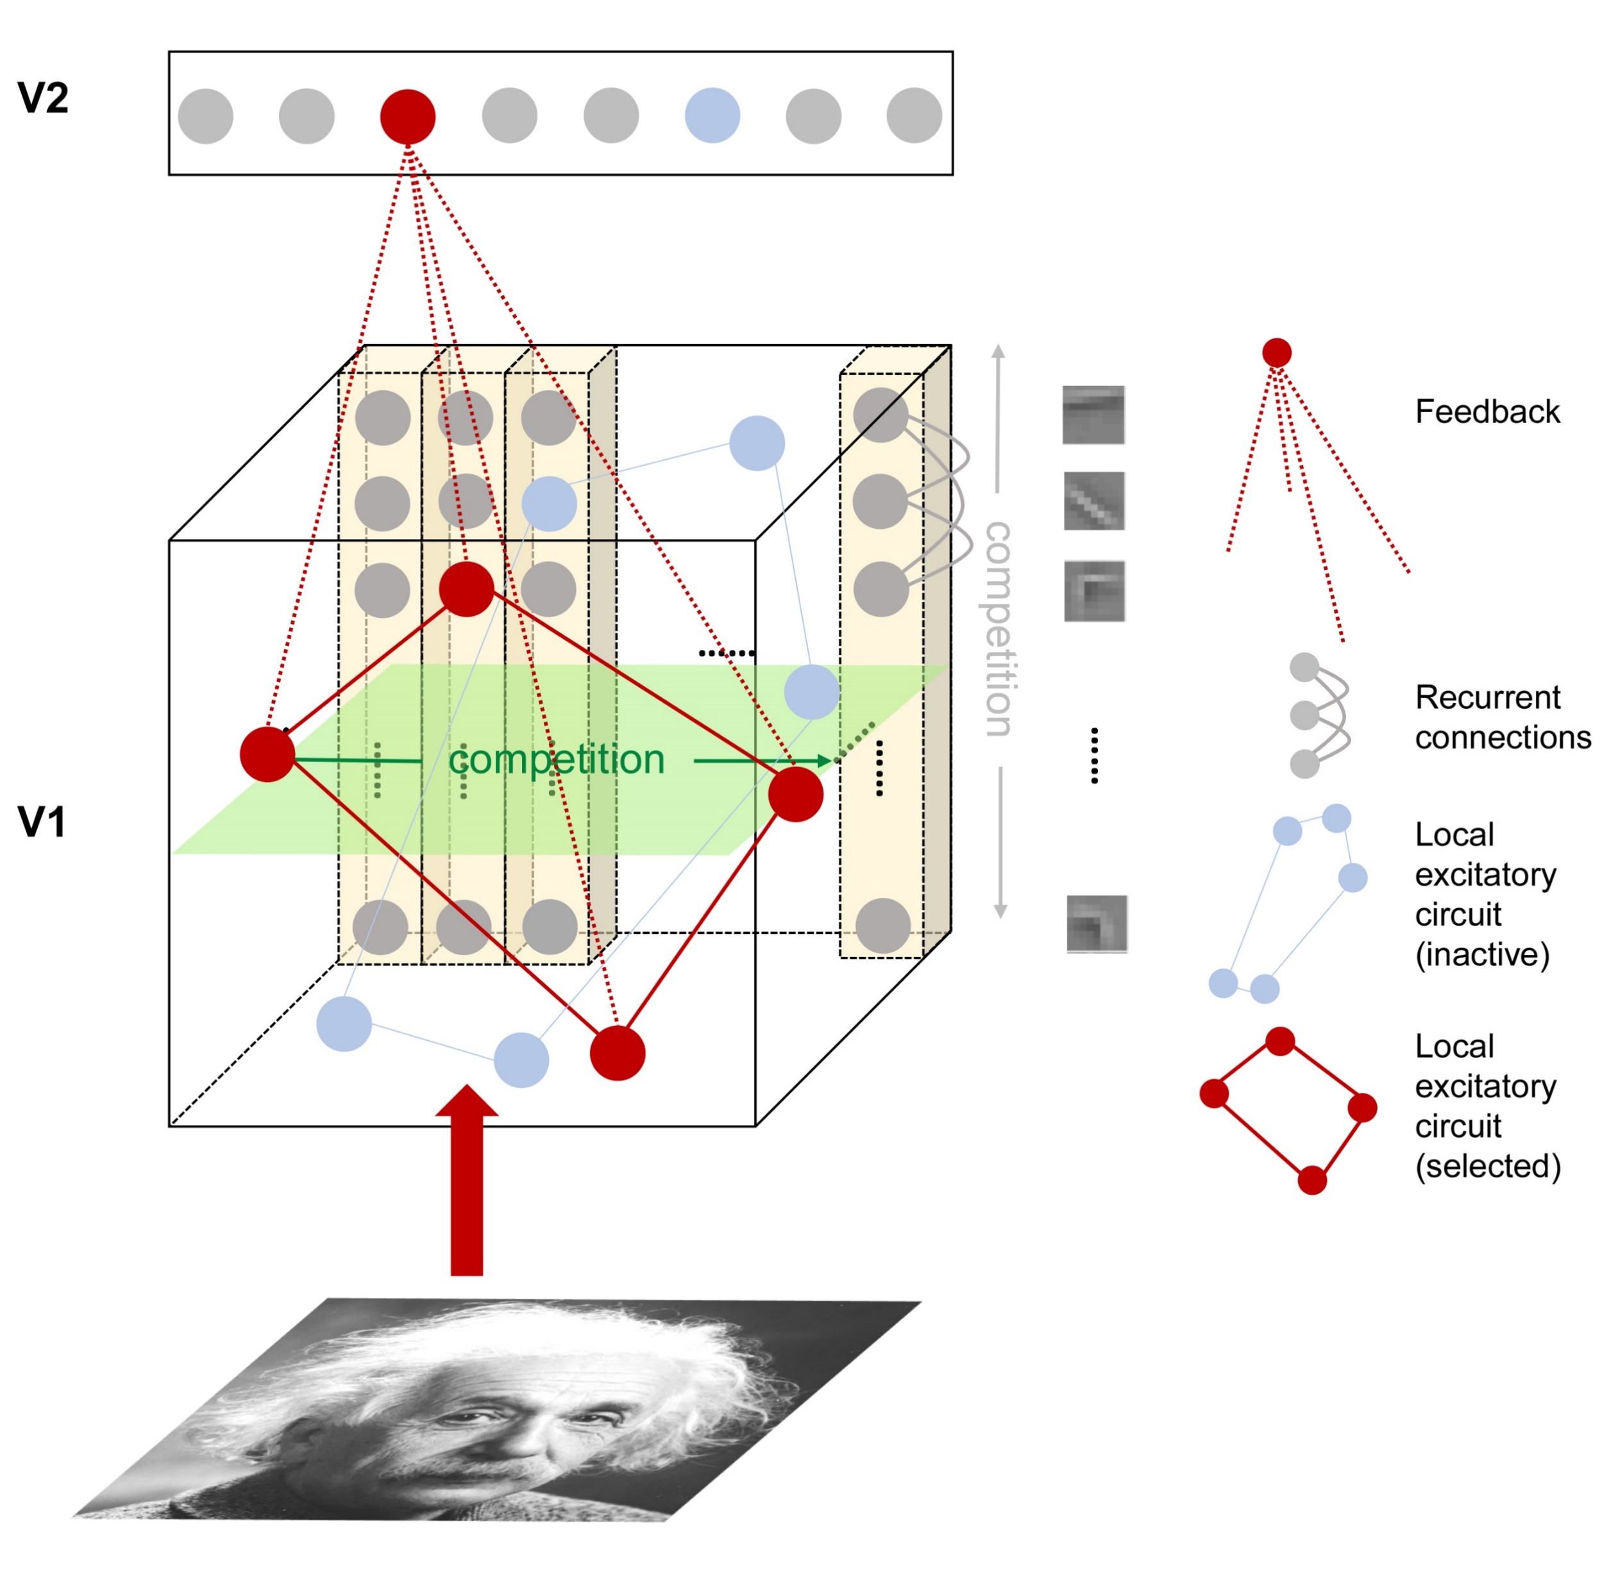
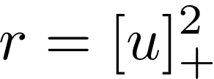
Our equations right now
u: input / current / field
r: output / firing rate
W^{rc}: excitatory recurrent connections within one hypercolumn
W^{rp}: excitatory connections across hypercolumns, learned by the Hebbian rule
A few points that need justification:
Excitation acts on the input, while inhibition acts on the output
Additive inhibition instead of divisive / shunting inhibition
The amount of inhibition is given by the total activity of related neurons
Notes:
By justification I mean to find other papers that have similar expressions.

Slide 10
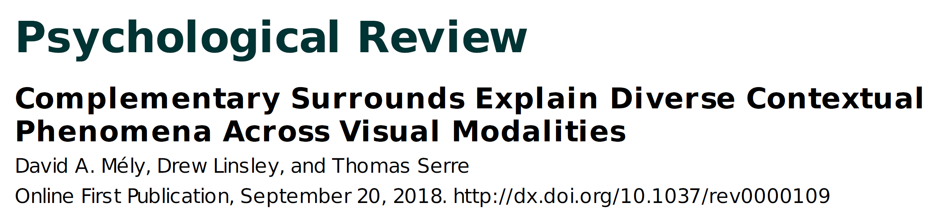
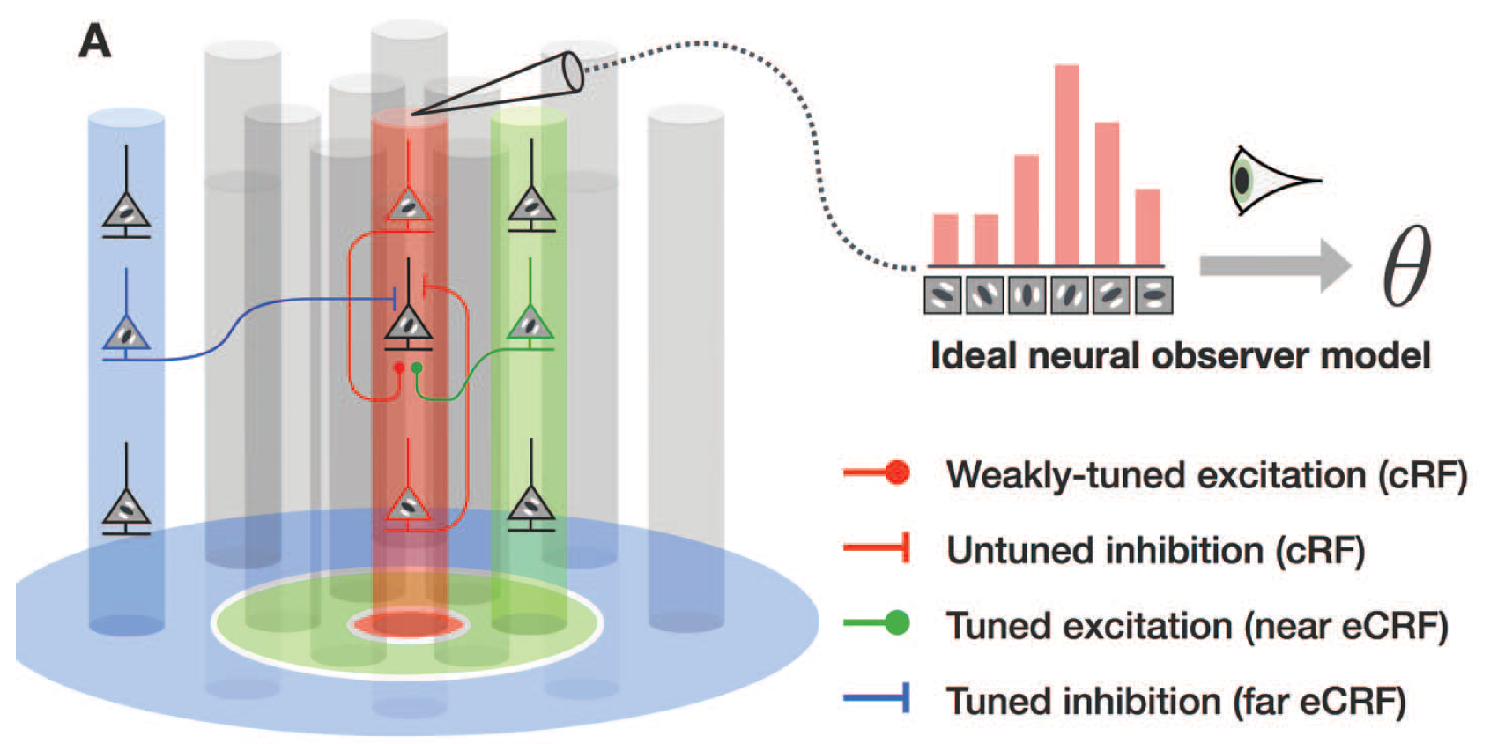
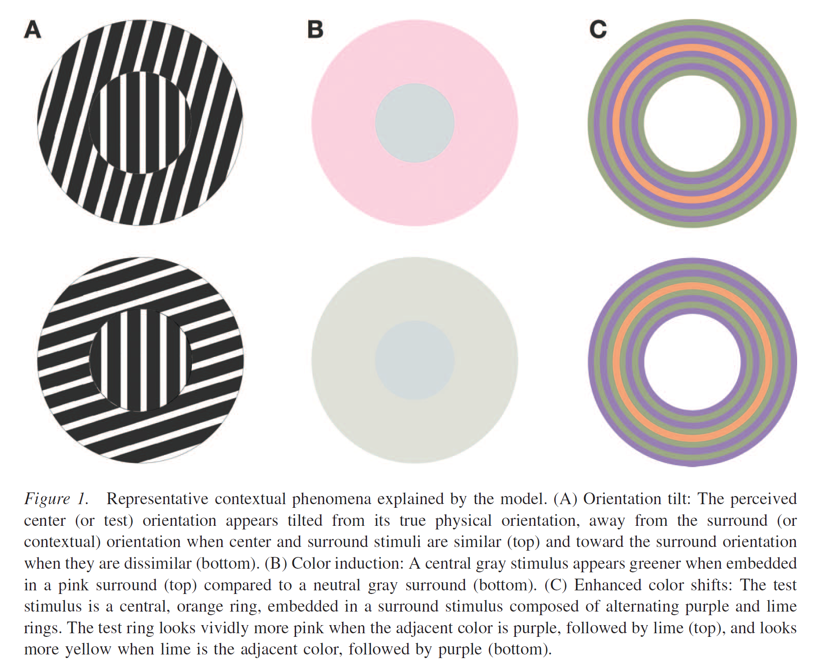
Justification 1: input/output
Notes:
Excitation acts on input, inhibition acts on output

Slide 11
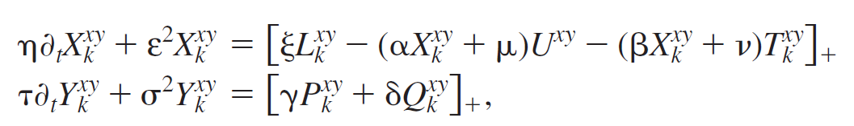
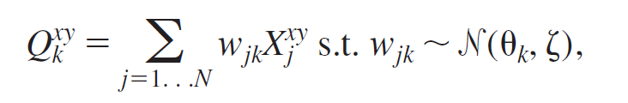
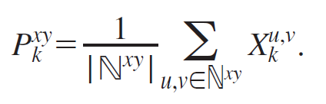
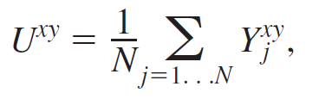
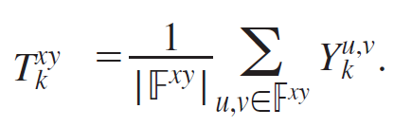
Justification 1: input/output
Their equations:
Problem: 2 dynamics for input and output

Slide 12
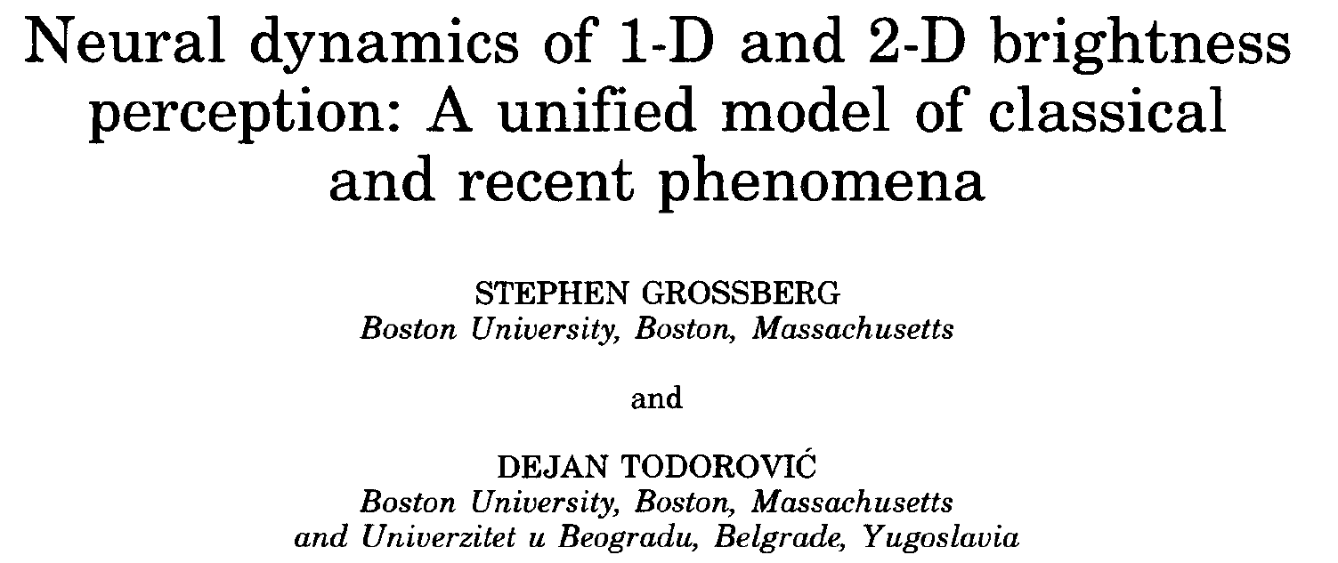
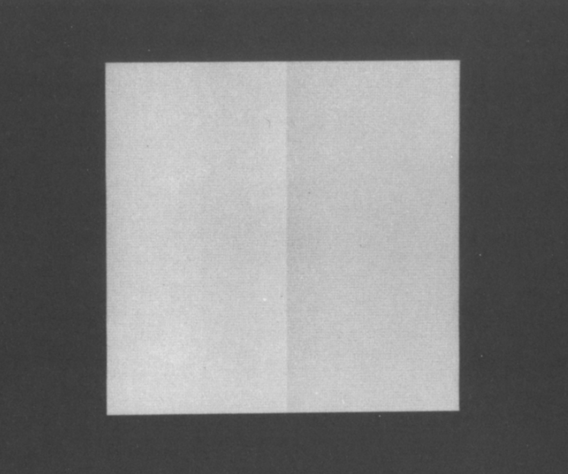
Justification 1: input/output
A system that models brightness perception (“filling-in” process)

Slide 13
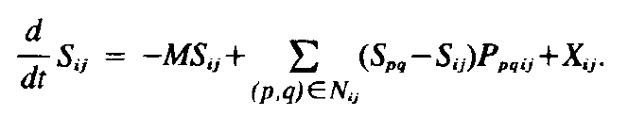
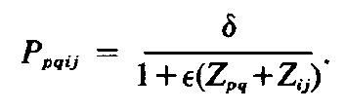

Justification 1: input/output
The system has 6 layers: stimulus grid → LGN cells → simple cells →complex cells → BC (boundary contour) system → FC (feature contour) system
Layer 6
(FC)
Feedforward input
S (left) ~ X (right), Z (left) ~ Y (right)
The right one borrows the idea that Z (left) / T (right) can act as a form of inhibition in the equation
The right one does not have excitatory terms, so it does not give “rules” in terms of where the excitatory terms should be put
→ Our equation does not violate this model
Layer 5
(BC)
Layer 4 responses
(complex cells)
The response of the BC system inhibits the diffusion across hypercolumns → make sense for the “filling in” process

Slide 14
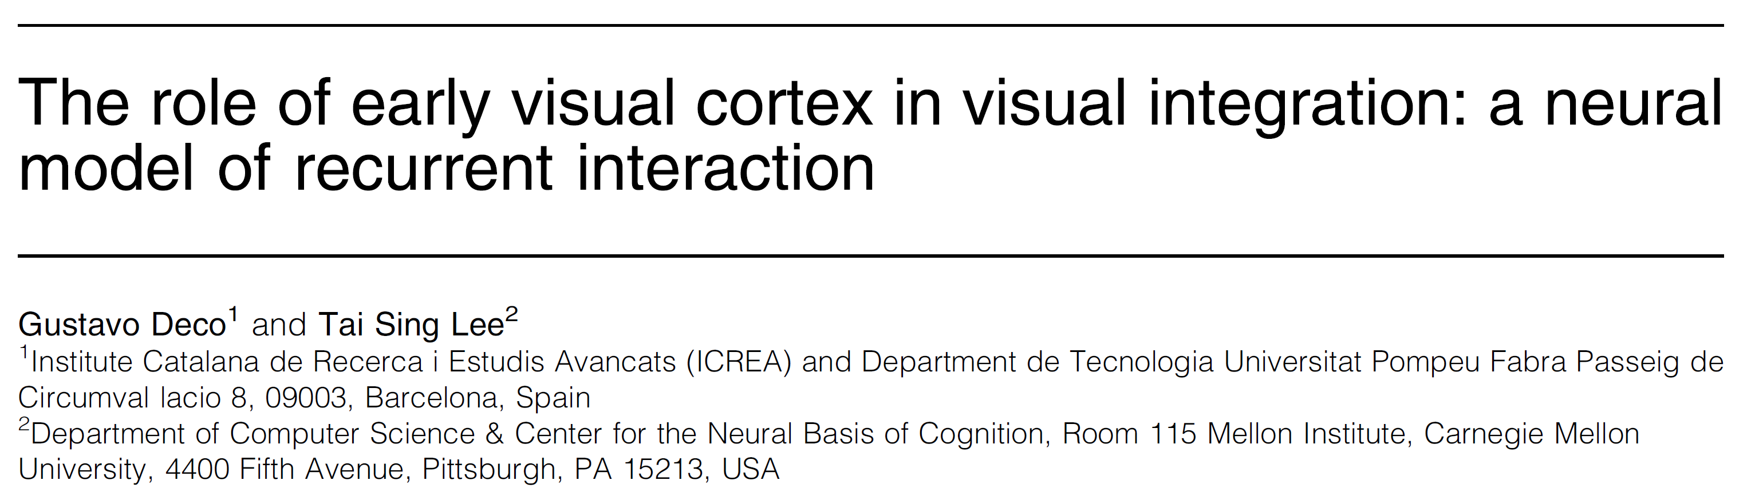
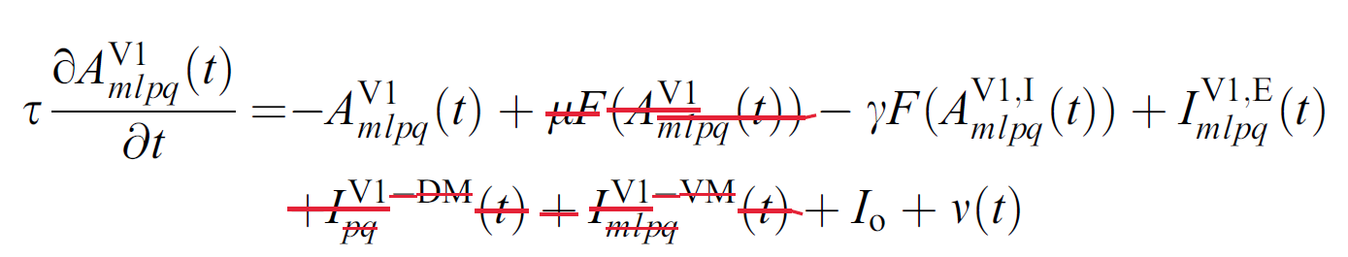
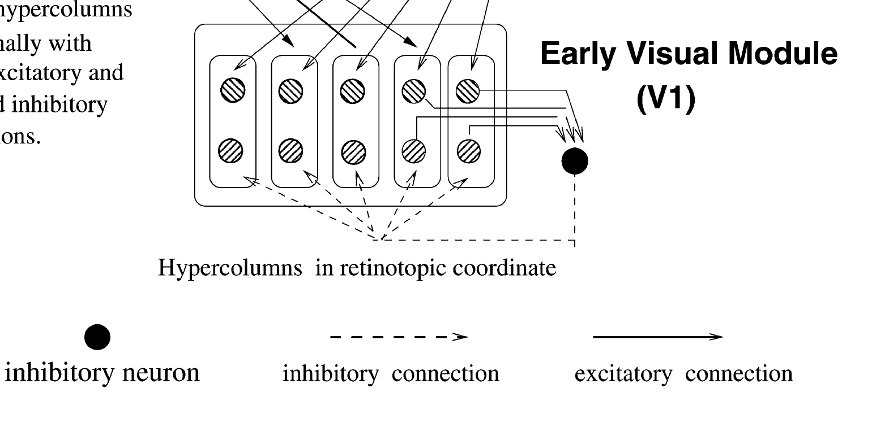
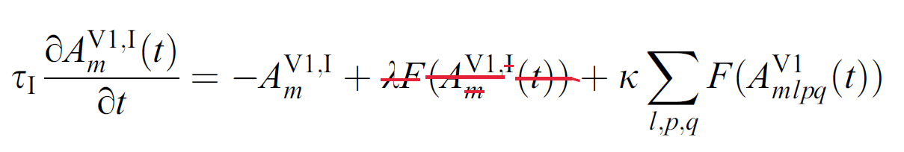
Justification 2&3: additive inhibition
This work models the dynamics of an assembly of neurons having the same location and orientation
“While inhibitory connections are more local and fine tuned for implementing precise computations in real V1 and V2 neuronal circuits, we found that one inhibitory neuron per scale is sufficient to mediate the basic competition between neurons in the same scale to produce the effect that we are seeking.”

