Slide 1
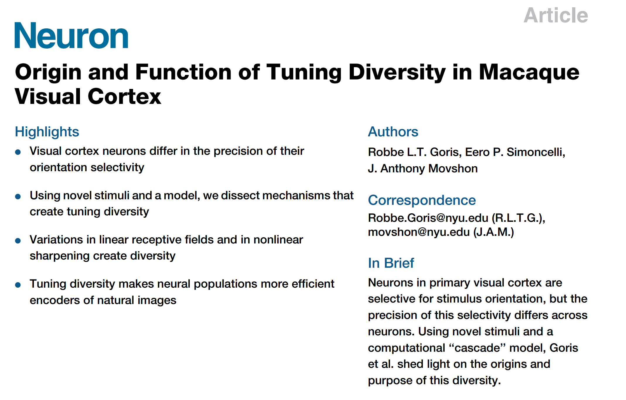
Presented by Xueyan Niu (Julie)
May 9, 2020

Slide 2
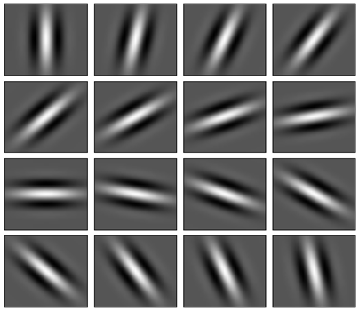
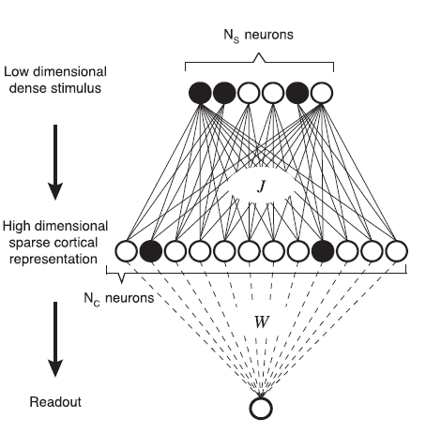
My project
One theme of my project: to show Gabor neurons in V1/V2 can develop complex feature selectivity by forming horizontal and feedback connections (circuits)
When designing the V1 architecture, we want many neurons to represent the same orientations, in the same hypercolumn (overcompleteness) because…
1) to allow for greater flexibility in forming circuits (we don’t want one neuron to participate in too many circuits, hallucination)
2) sparseness and expansion can improve classification (paper by Sompolinsky)
3) even Gabor neurons have their tuning diversity (this paper)

Slide 3
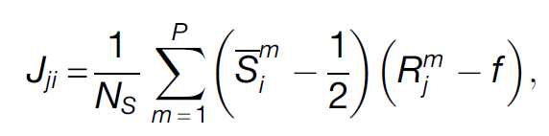
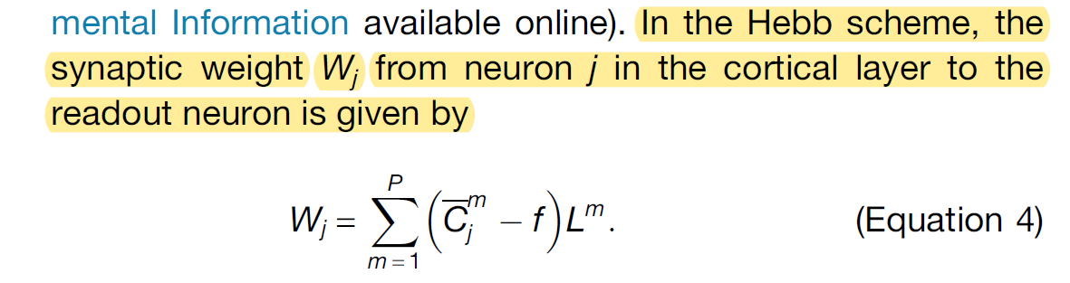
My project
2) sparseness and expansion can improve classification (paper by Sompolinsky)
For each stimulus cluster center Sm, choose a random cortical pattern Rm
Unsupervised Hebbian
Supervised Hebbian

Slide 4
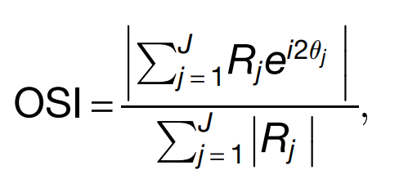
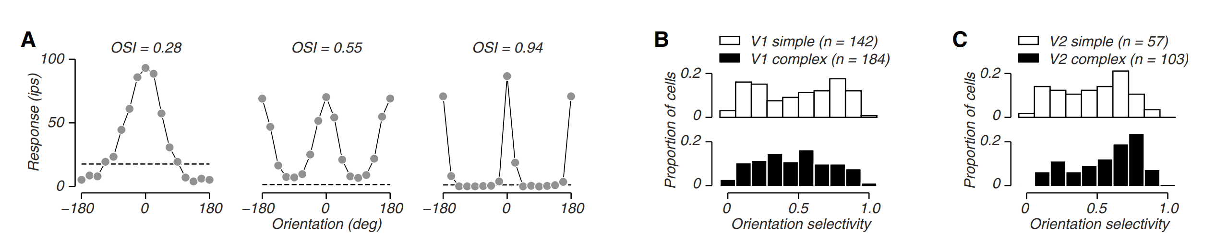
Diversity of orientation selectivity (a single orientation)
Experiment: macaque, V1 / V2, sine wave drifting gratings
Some neurons respond exclusively to a narrow range of stimulus orientations, but others are less selective
Orientation selectivity index (OSI) for each neuron
Less selective
More selective

Slide 5
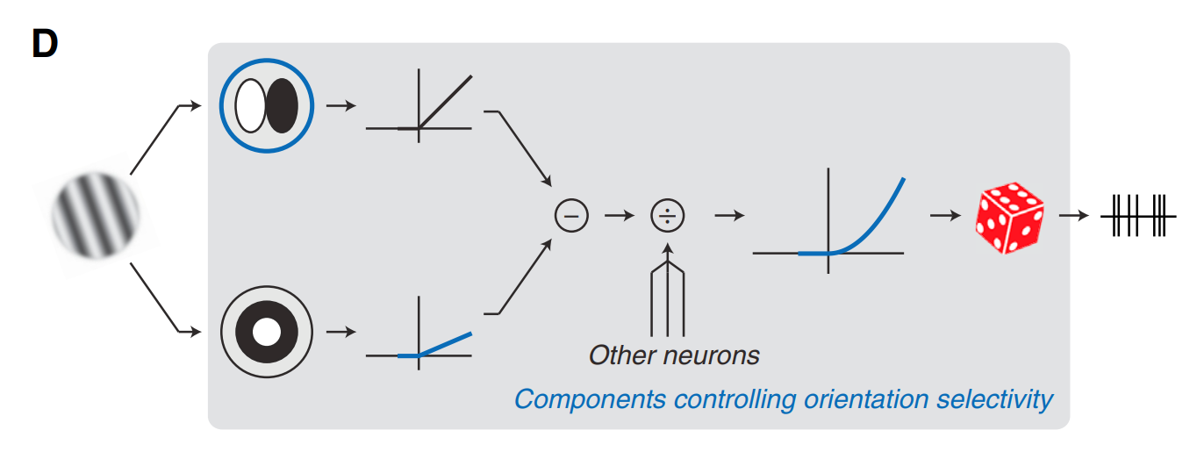
Origin of such diversity
An LN-LN cascade model
3 components (in blue), 3 parameters (in green)
Power law nonlinearity, depending on the exponent
Linear
NL
Linear
NL
Derivatives of Gaussian, depending on aspect ratio and derivative order, combined as filter OSI
Divisive normalization
Filter: orientation selective
Activation function
rectification
Filter: untuned
Facilitation or suppression depending on the sign of baseline value

Slide 6
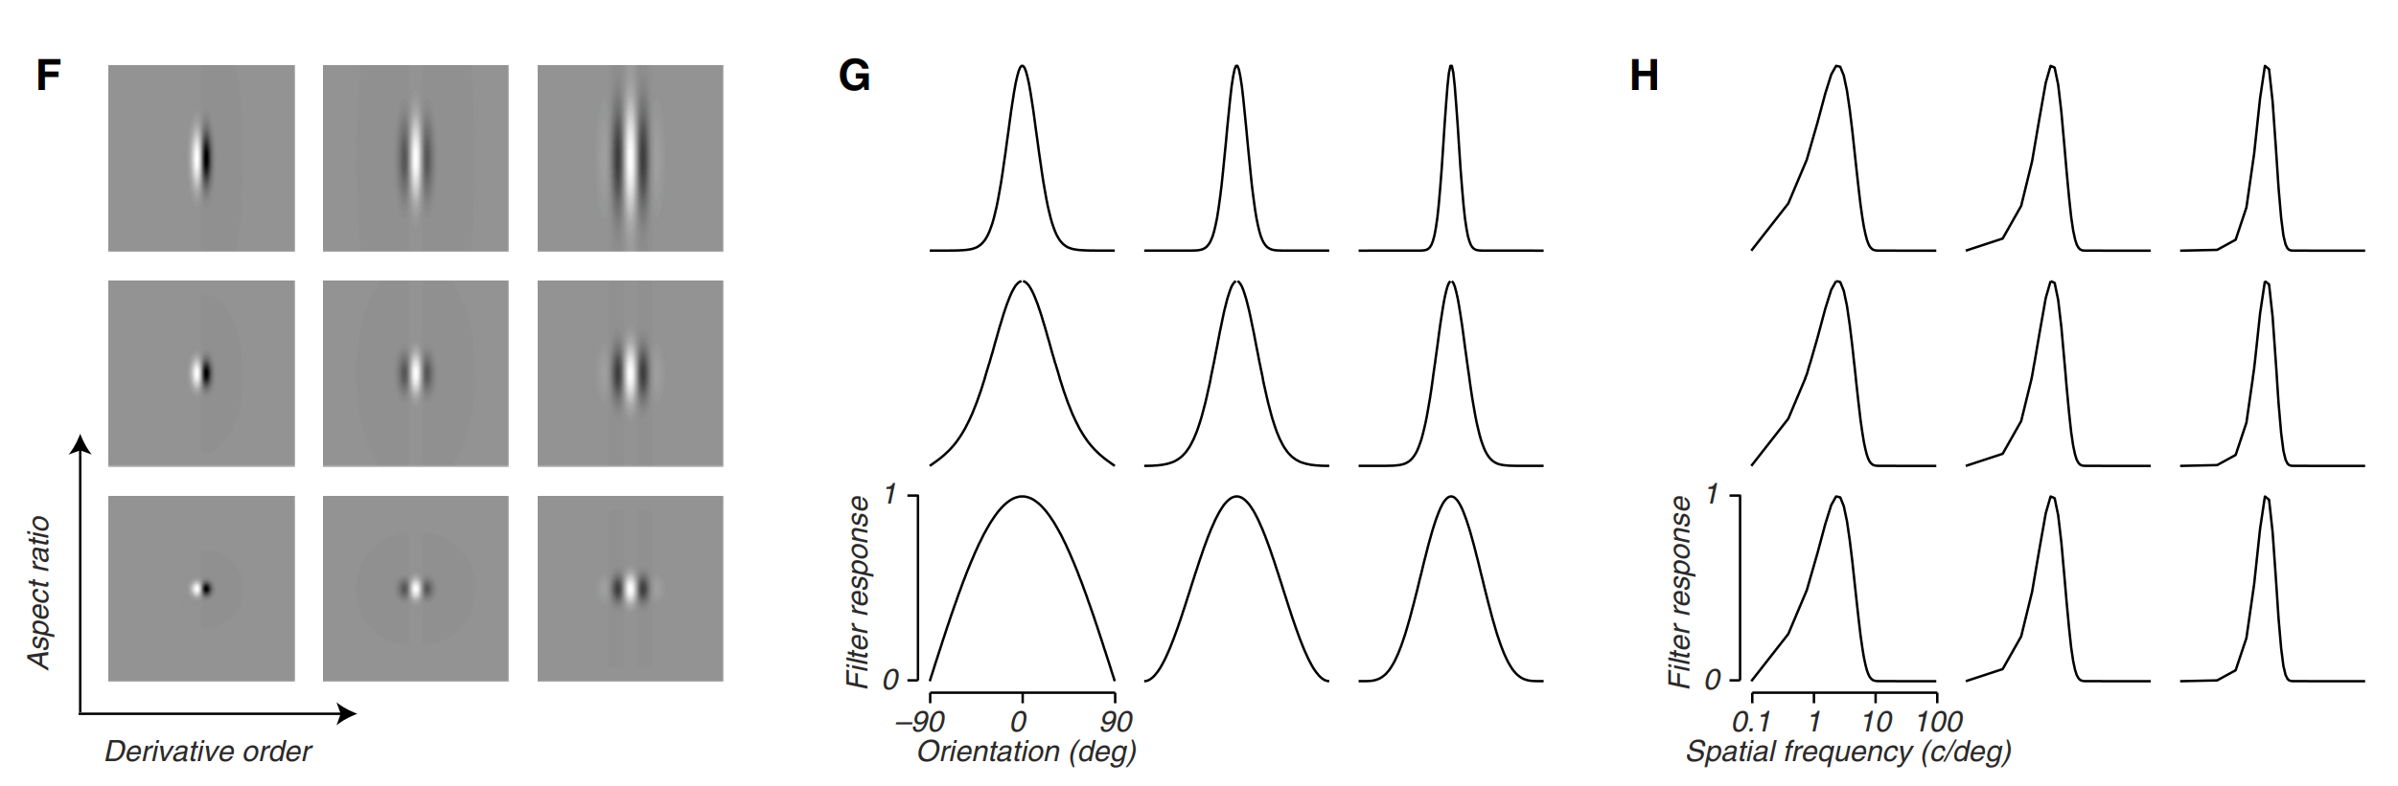
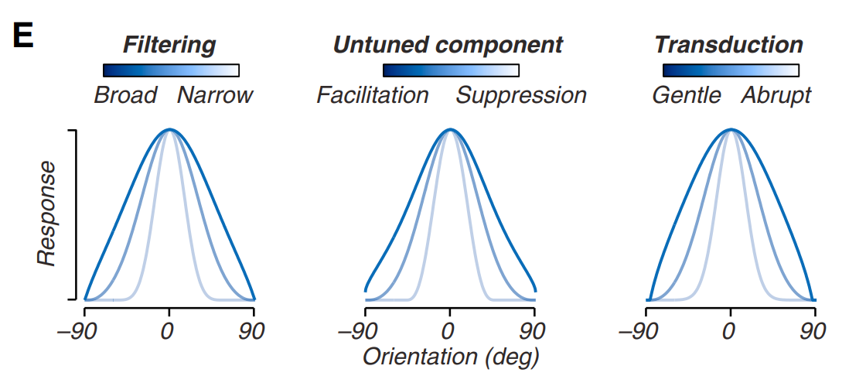
Origin of such diversity
Derivatives of Gaussian:
Orientation tunings as the 3 components change:

Slide 7
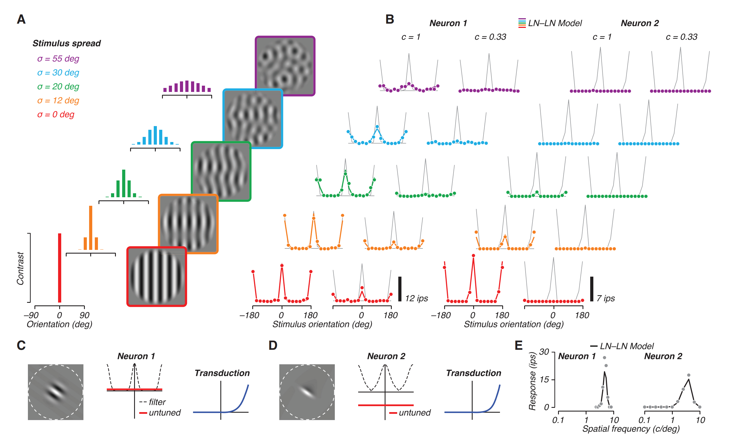
Diversity of orientation selectivity (orientation mixtures)
Orientation mixtures: superimposition of stimuli that vary in orientation and contrast
A good way to separate the linear and nonlinear components, since the linear filter obeys superposition
Fitting the 3 parameters
for each neuron

Slide 8
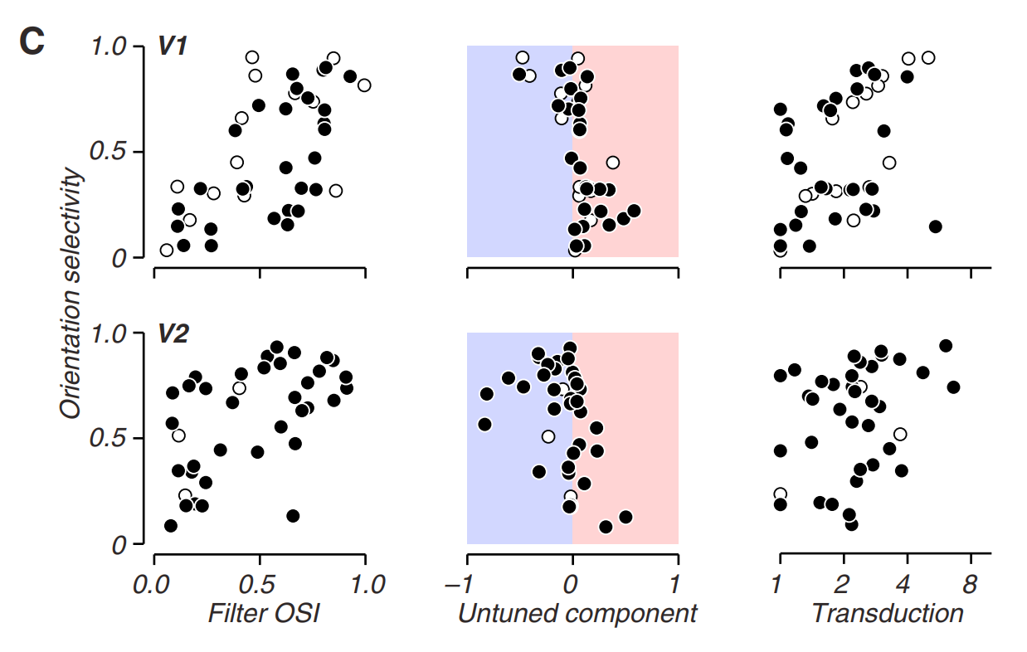
Contributions of each component
The model performs well:
1) correlation between model components and observed OSI:
2) explanatory power of each component:
Only one parameter is allowed to vary, the other two are chosen
to be the median value of all neurons
corr.coef. | Filter OSI | baseline | exponent
V1 | 0.59 | -0.55 | 0.46
V2 | 0.52 | -0.45 | 0.32
Open circles indicate simple cells, filled circles complex cells

Slide 9
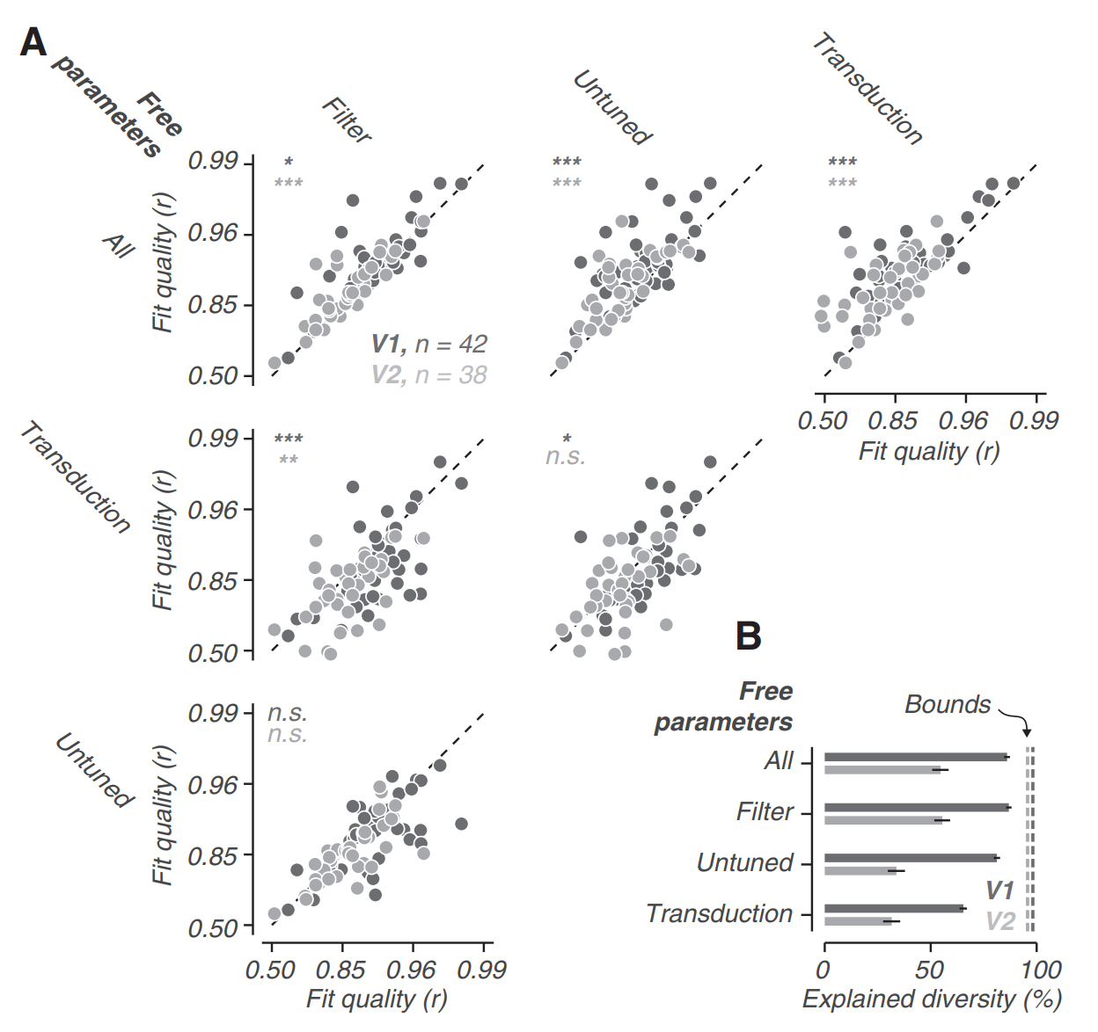
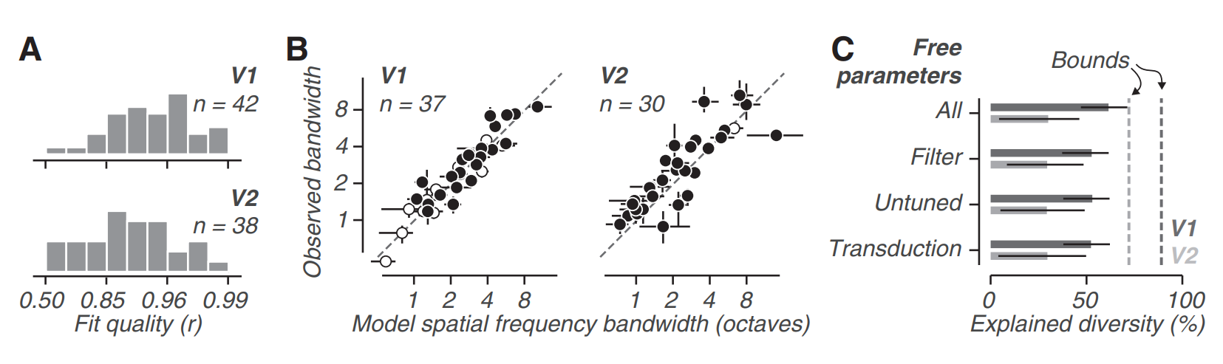
Contributions of each component
Fit quality = the correlation of model predicted and measured responses for a held-out set of stimuli
2) explanatory power of each component:
Variability in the filtering stage is the main source of
tuning diversity
3) side note: use this model to predict spatial
frequency selectivity:
3 parameters roughly play the same role

Slide 10
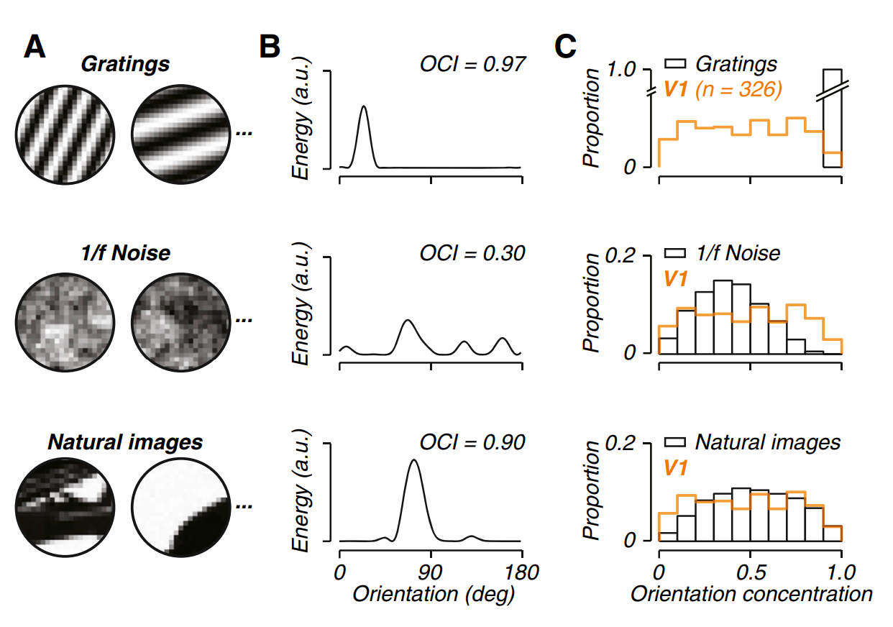
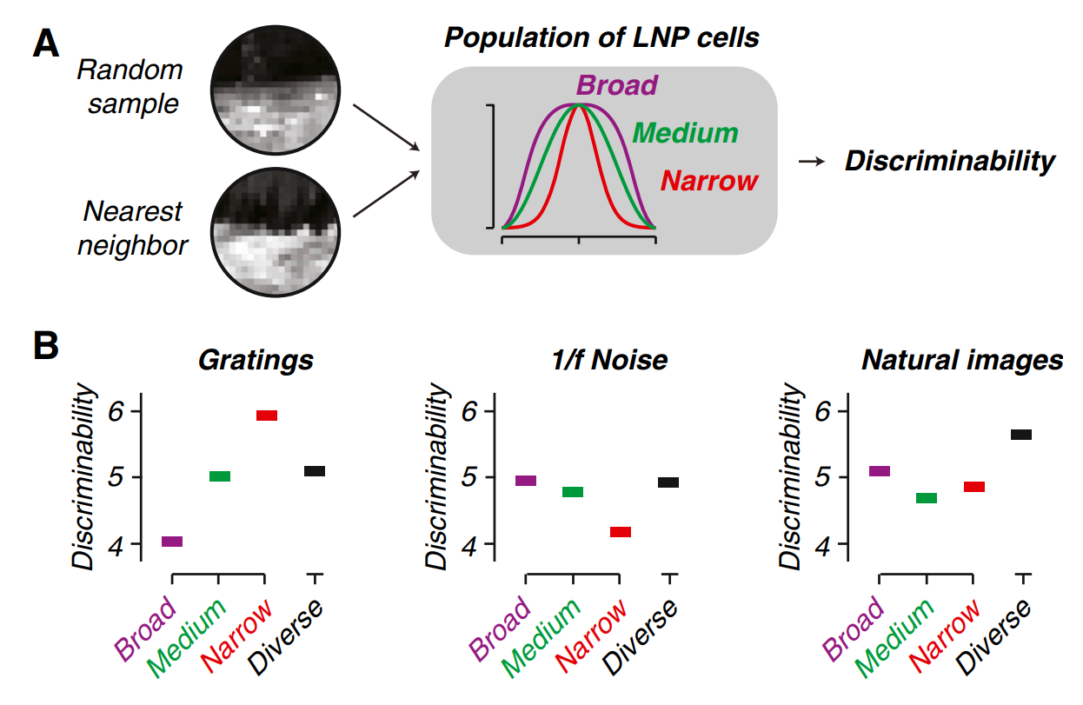
Function of such diversity
Simulating 4 populations with the same number of neurons, total spike rate, distribution of preferred orientation, response nonlinearity etc., 3 homogeneous, consisting of 45 broad, medium or narrowly tuned filters, 1 diverse, consisting of 15 each
Applying to a discrimination task:
From natural image statistics: define orientation concentration index (OCI) = OSI

Slide 11
Back to my project
Previously, I said I wanted overcompleteness in my hypercolumns…
This paper provides a great way to parametrize and design those Gabor neurons
What’s more?

