Slide 1

LFADS: Latent Factor Analysis via Dynamical Systems
David Sussillo, Rafal Jozefowicz, Larry F. Abbot, Chethan Pandarinath
Presented by Hal Rockwell

Slide 2
Two paradigms for neural computation
Feedforward: purely input-driven
Sequential: autonomous dynamical system with initial state, running according to “computational dynamics” to produce outputs
Two sides of a spectrum

Slide 3
LFADS: mostly sequential, but flexible
Can model non-autonomous dynamical system (with external inputs)
Allows highly nonlinear dynamics (unlike more analytically tractable techniques like Gaussian processes)
Models deterministic low-dimensional dynamics, but probabilistic spike generation and (potentially) probabilistic inputs

Slide 4
LFADS as VAE
Two parts: encoder and decoder/generator
Encoder: spike train x -> distribution over latent code z
Decoder: latent code z -> distribution over spike trains x

Slide 5

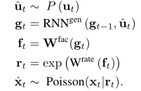
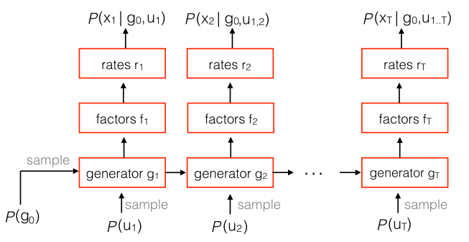
LFADS decoder/generator
(here, z is the combination of g₀ and u_{t} for all t from 1 to T)
f chosen to be low-dimensional -- these are the ‘latent factors’
dynamics of RNN^{gen} determine the dynamics of the system
can add observed inputs to the RNN input (e.g. stimuli) if you want

Slide 6



LFADS encoder
Get distribution of RNN^{gen} initial state, inferred inputs u_{t} from spike trains, possibly also observed inputs (e.g. stimuli)
RNN^{gen} initial state:
(diagonal Gaussian)

Slide 7



LFADS encoder: inferred inputs
Also diagonal gaussian, but takes previous latent factor into account
Idea is that to infer perturbations to the system, you need to directly represent the dynamics of the system

Slide 8
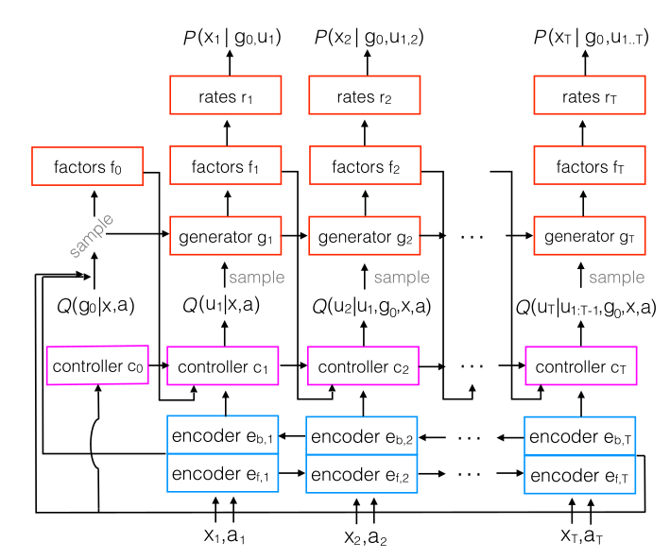
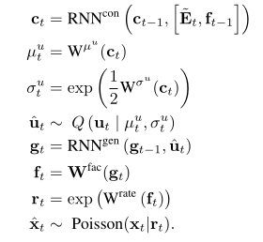
LFADS: all together
(initial state sampled from encoders)

Slide 9

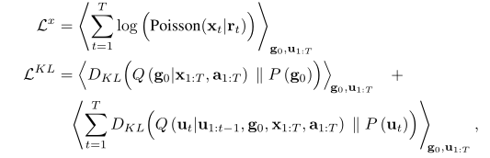
LFADS: training
Fairly standard; maximize lower bound on log-likelihood of data
Plus regularization of initial state and inferred inputs distributions

Slide 10
LFADS: summary
4 RNNs in total
Little feedforward processing
However, general framework is very flexible; no need to copy their particular choices

Slide 11
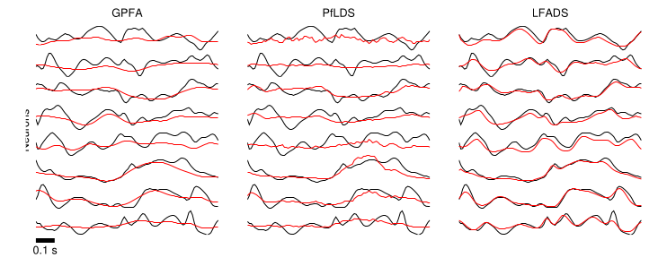
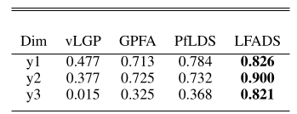
LFADS: results
In their paper, only test on synthetic neural data (spike trains from classic Lorenz attractor and more complex nonlinear RNN)

Slide 12
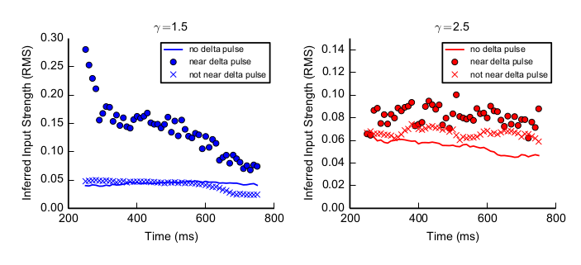
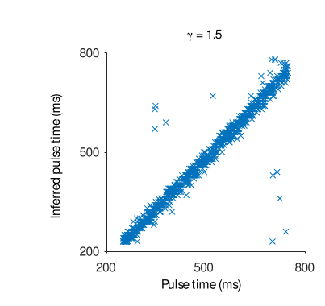
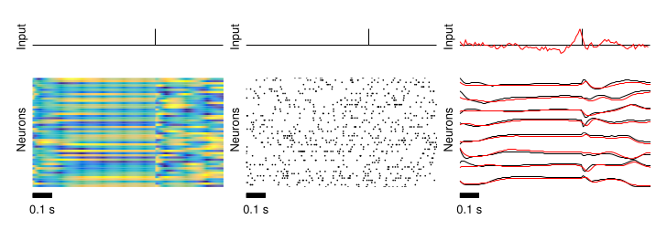
LFADS: inferred input results

Slide 13
LFADS: real neural data
From “Inferring single-trial neural population dynamics using sequential auto-encoders”
All motor cortex (human and macaque)
Pretty good

Slide 14
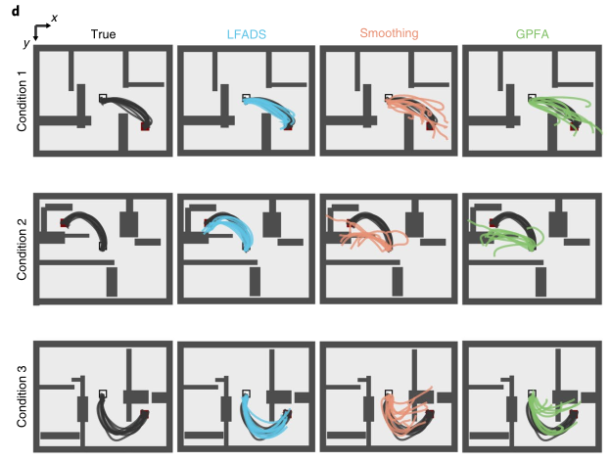
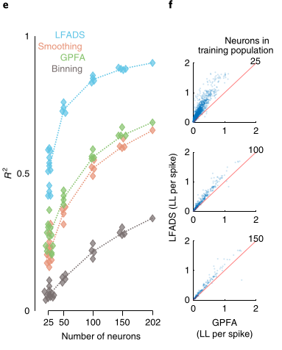
LFADS: real neural data

Slide 15
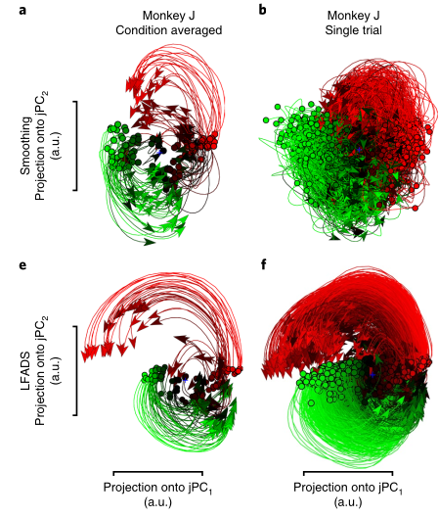
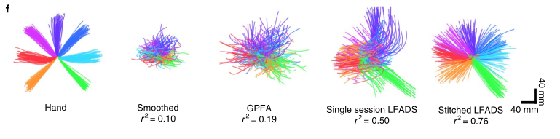
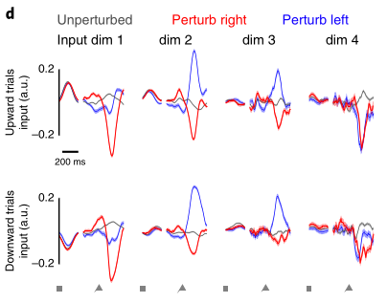
LFADS: real neural data

Slide 16
Conclusions/Implications for us
Probabilistic nature of LFADS allows modeling of single-trial dynamics (improvement over normal RNN)
Can be easily modified to include information about stimuli
How do you interpret the latent factors? What kind of dynamics do you expect/predict in visual cortex?

