Slide 1
Tensor Analysis Reveals Distinct Population Structure that Parallels the Different Computational Roles of Areas M1 and V1
Jeffrey S. Seeley, Matthew T. Kaufman, Stephen I. Ryu, Krishna V. Shenoy, John P. Cunningham, Mark M. Churchland
Presented by Hal Rockwell

Slide 2
What does neural activity reflect?
Classic/modern view of sensory systems: direct encoding of stimuli
Classic view of motor systems: direct encoding of motion-related variables (e.g. velocity, reach direction, etc.)
Modern view of motor systems: single, evolving dynamical system that produces motor output (so motor variables not necessarily simply encoded)

Slide 3
How to determine the primary driver of responses?
To some extent, all neural activity is partially driven by external input (‘encoding’ it in some way), partially by internal dynamics
But usually one view is more fruitful
The paper’s answer: tensor analysis

Slide 4
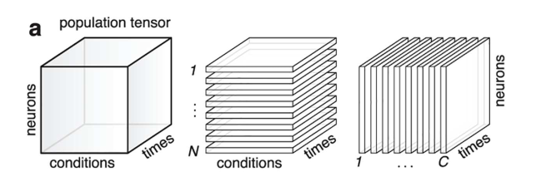


Tensor analysis: two different perspectives
(x is population response)
Top: neural activity inherits its dynamics from the stimulus (“condition-driven”)
Bottom: neural activity has its own dynamics (“neuron-driven”)

Slide 5
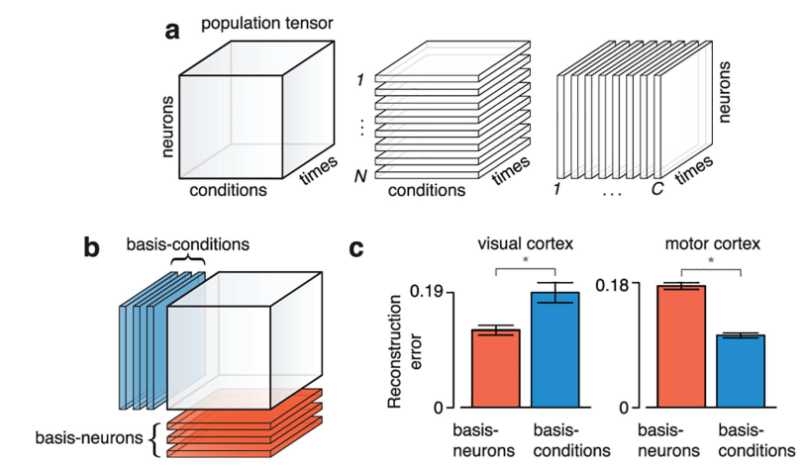
Tensor analysis: basic example
(PCA-like)
(importance of condition-driven activity versus neuron-driven activity)

Slide 6
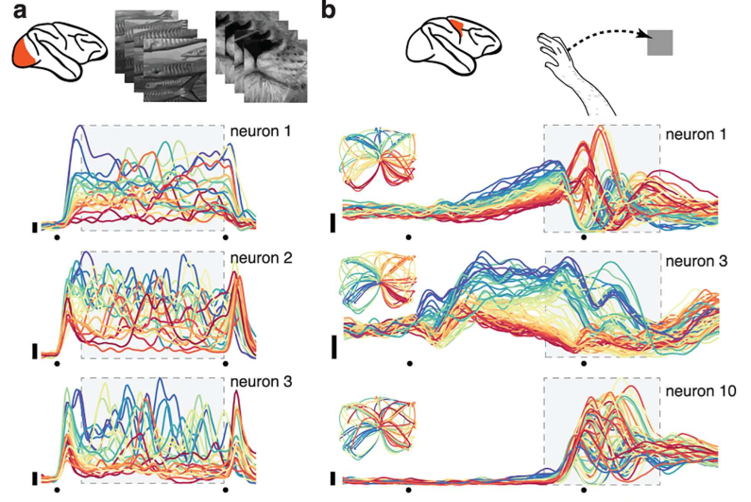
Note on “conditions”
Stimuli for sensory systems
Reach trajectory for motor systems
(in this case, V1 + M1)

Slide 7
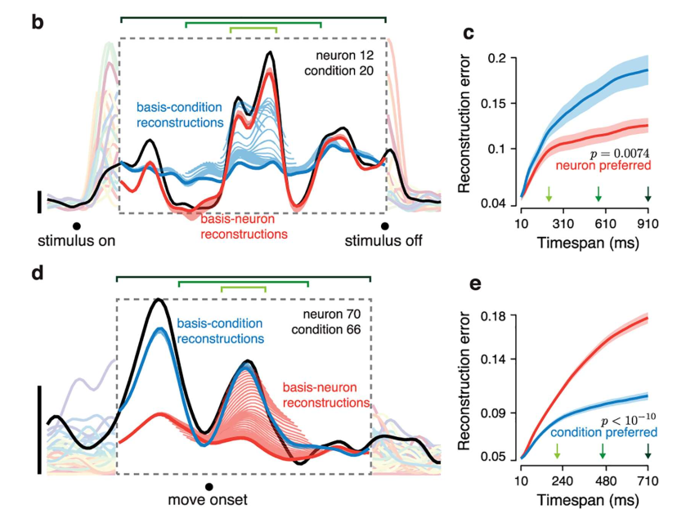
More detail on the tensor analysis
Determine preferred mode by stability of reconstruction error over time
(e.g. if error is relatively constant over timescales, that basis is preferred, so the activity is “driven” by the other basis)

Slide 8
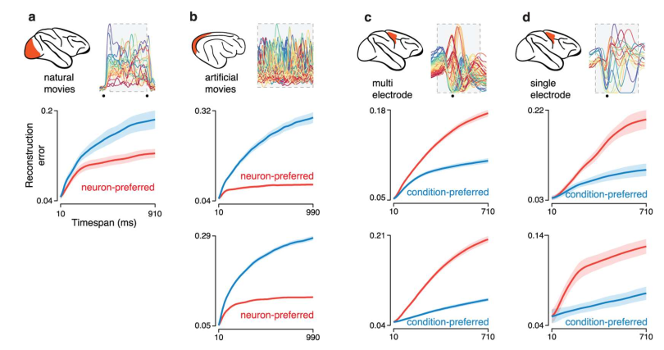
Consistency across datasets

Slide 9
Extra details/checks
Neuron count is always matched to condition count
Bases are found by standard PCA (as far as I can tell; using SVD, etc.)
Mode preference is robust to differing number of conditions (between datasets, and also downselecting a single dataset)
Preferred mode can be mathematically derived for idealized, linear models (when completely stimulus-driven, neuron-preferred, when driven by a shared linear dynamical system across all conditions, condition-preferred)
Mode preference is robust to different levels of smoothing of spiking data

Slide 10
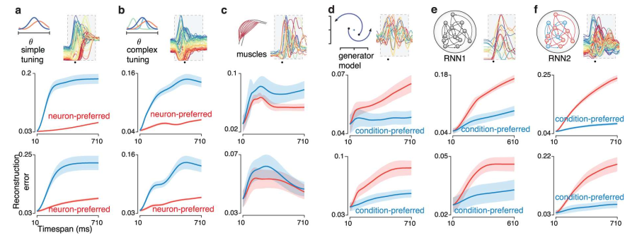
Testing on various models (mostly of M1)

Slide 11
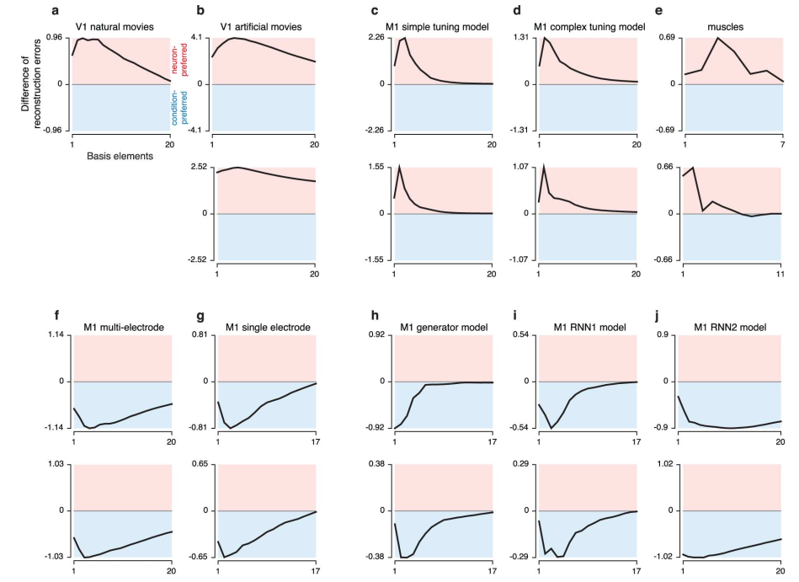
Models+data (consistency across basis count)

Slide 12
Applicability to other datasets
Need rich dynamics: PSTHs vary across neurons and conditions
Might be a problem for our static images
Also need good estimates of those dynamics, meaning many trials (they use at minimum about 10 per condition)
Needs low-rank activity: more neurons/conditions than variables being represented (or dimensionality of the dynamical system)
Can be tested by seeing if the results change with number of neurons/conditions considered

