Slide 1
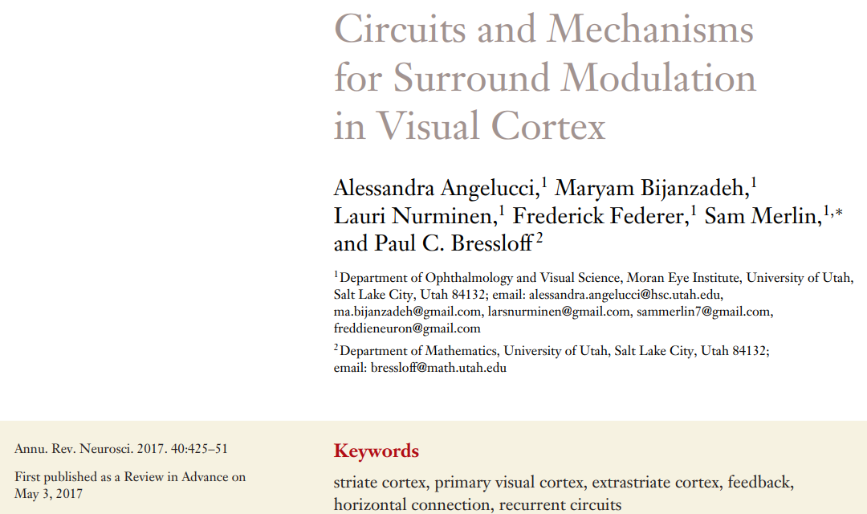
Presented by Xueyan Niu (Julie)
Oct 24, 2019
All figures except the one on pg. 2 are from this paper

Slide 2
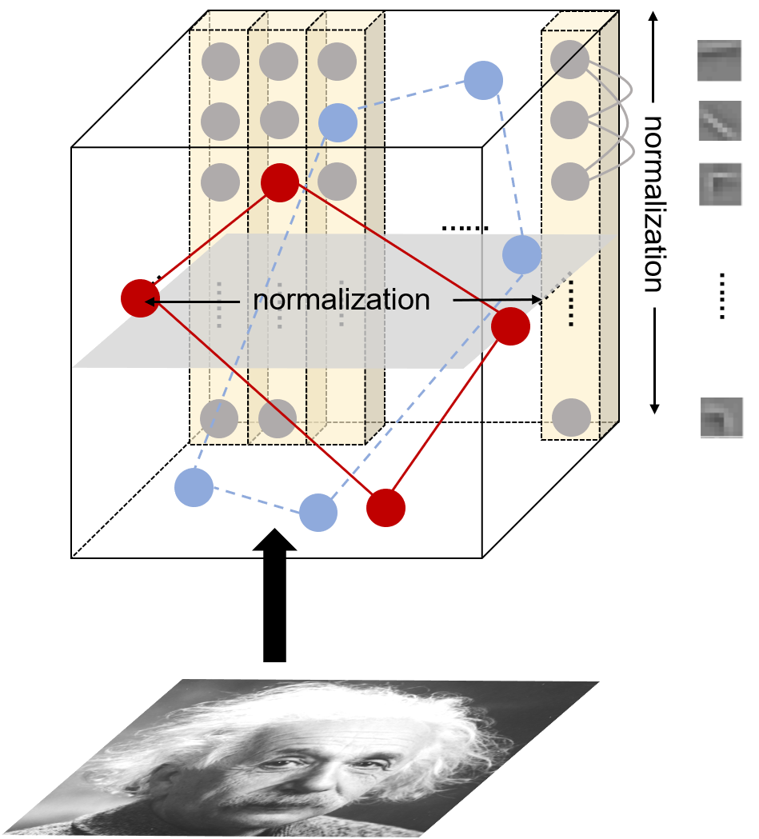
Surround modulation includes both excitation and inhibition
Normalization is just one way of implementing surround suppression, one can also use inhibitory connections
This paper talks about the experimental findings + proposed circuit of surround modulation in V1

Slide 3
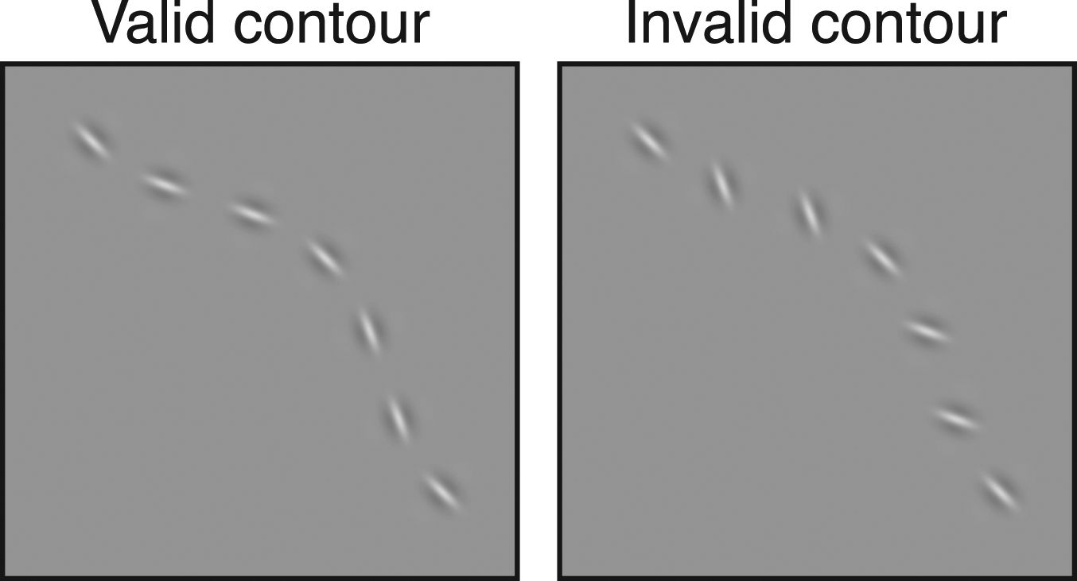
Function of surround modulation
Suppression – enhance neuronal responses to discontinuities in stimuli
Suppression – reduce redundancy and increase sparseness
Facilitation – perceptual contour integration
Notes:
Surround modulation is widely found in visual areas, so they must carry important functions.

Slide 4
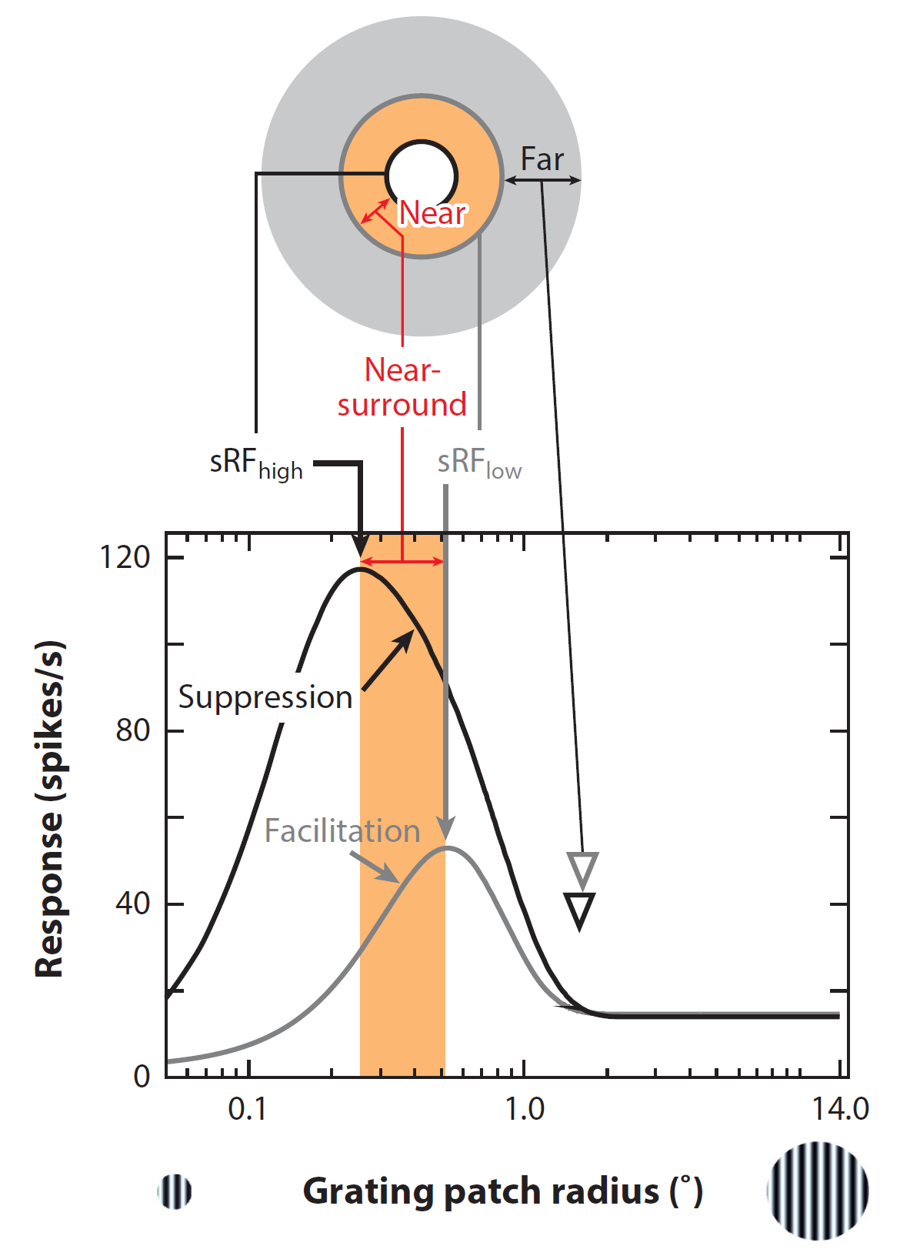
Experimental findings
(less important ones)
Modulation strength decreases with distance from RF increases
Properties of SM differ across cortical layers
(more important ones)
Strongest suppression <- stimuli in the RF and surround have the same orientation
(but this orientation does not have to be the neuron’s preferred orientation)
Stimuli of high contrast will have smaller no-suppression RF
SM develops dynamically in time
Notes:
Here are some experimental findings or basic truth about SM.
The white circle is RF. The black curve is the neuron’s response when given high-contrast stimuli. The x-axis is the patch radius shown to the neuron. We can see that when the radius is roughly here, increasing the radius will cause suppression.

Slide 5
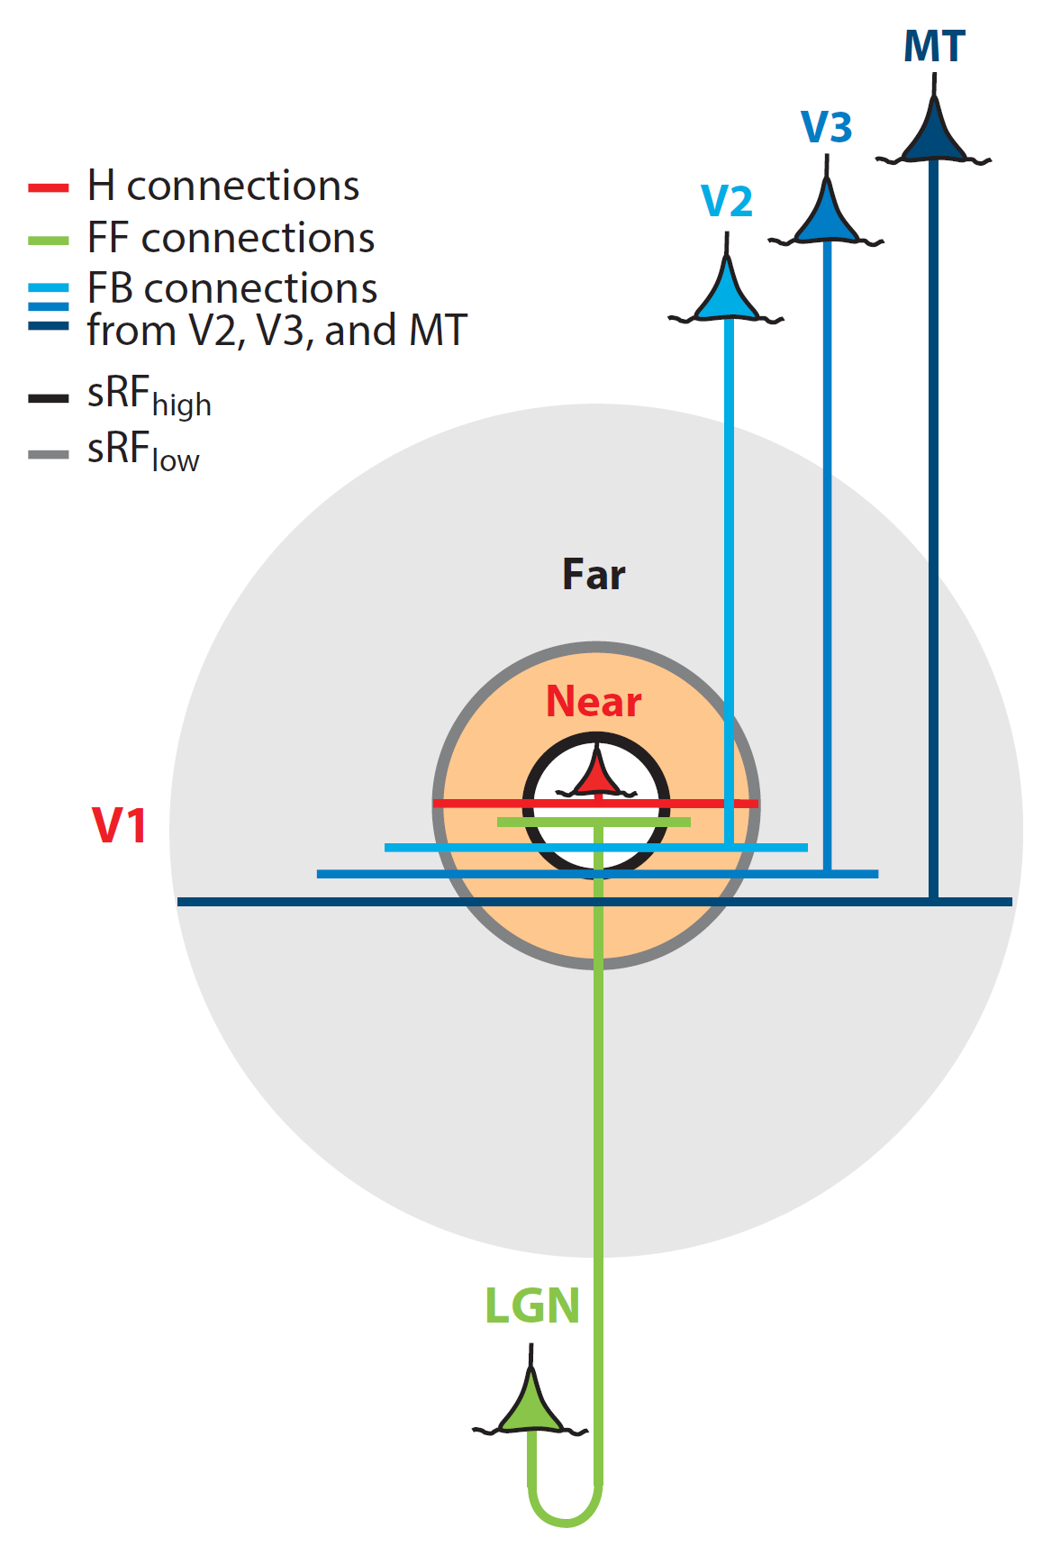
2 modulations, 3 sources
2 modulations: near-SM and far-SM
3 sources of modulation: feedforward (LGN cells exhibit SM), horizontal, feedback
Hypothesis: all 3 sources contribute to near-SM, only feedback contributes to far-SM

Slide 6
Evidence
Near-SM is more strongly suppressive and more orientation-tuned
Feedforward SM is spatially restricted, weakly suppressive, poorly tuned for orientation (not of interest）
Horizontal connections target both excitatory and inhibitory neurons, link neurons of similar orientation preference along an axis in space that is colinear with the orientation preference (contour facilitation)
Horizontal connection has low conduction velocity, cannot explain the fast onset of far-SM
Onset of far-SM: 10-30 ms; speed of horizontal conduction: 0.1-0.3 m/s (0.1-0.3 mm/ms)

Slide 7
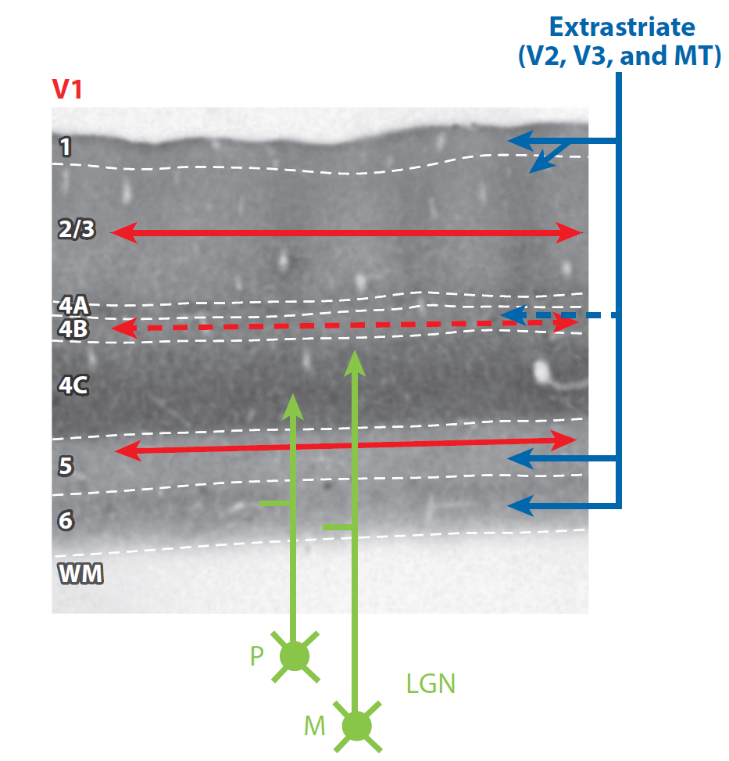
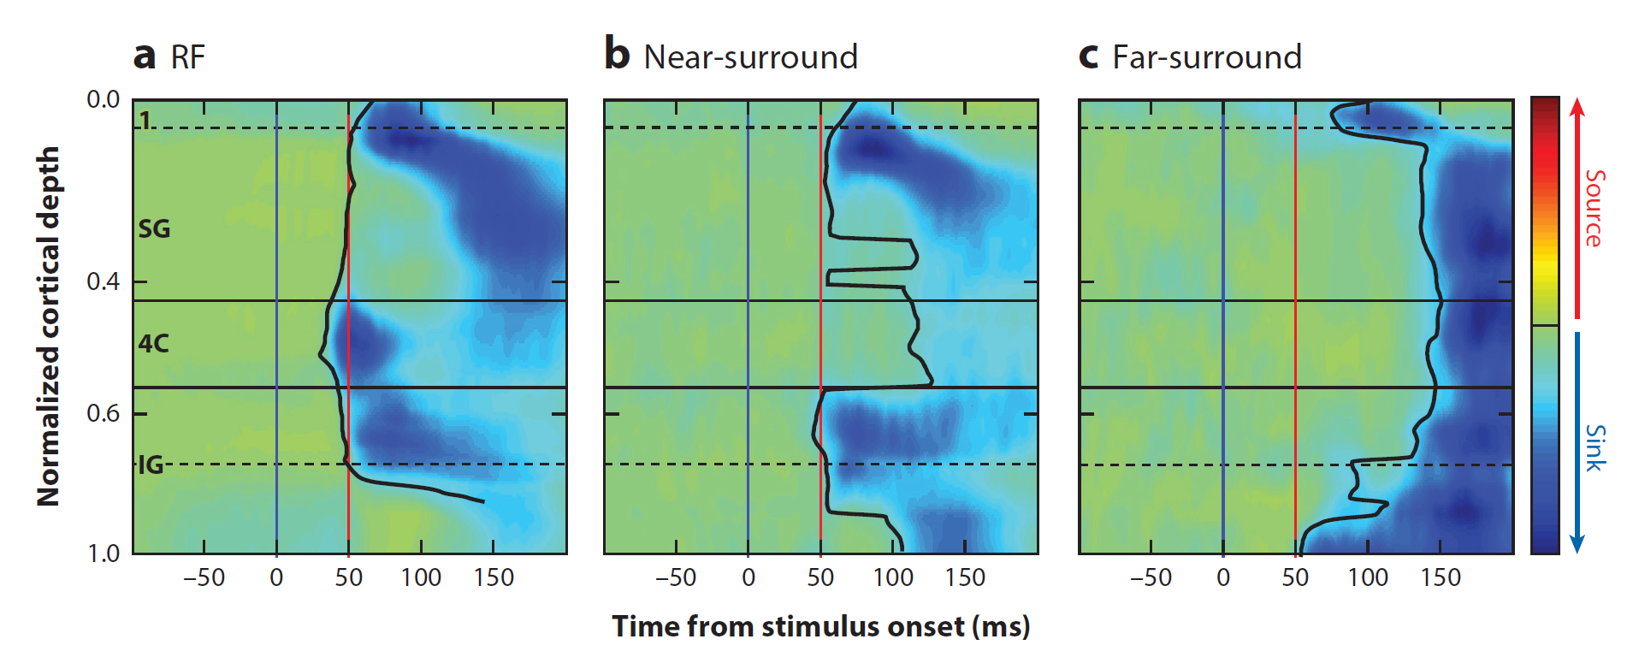
Evidence
Stimulate the surround RF without stimulating the center of RF, so as to separate the surround effect
Measure LFP and apply CSD
SG: supragranular layer, or layer 1, 2, 3
IG: infragranular layer, or layer 5, 6
Blue means suppression
a: suppression starts in layer 4C
b: suppression starts simultaneously in SG and IG
c: suppression starts in layer 1 and 6, which are the primary targets of feedback connections
Dashed line means weaker connections
Notes:
V1 has 6 layers, different layers have different sources of information.
By examining the behavior of different layers, we can separate the roles played by the 3 sources of modulation.
So basically the blue part indicates suppression. What is important is in which layer the suppression starts.

Slide 8
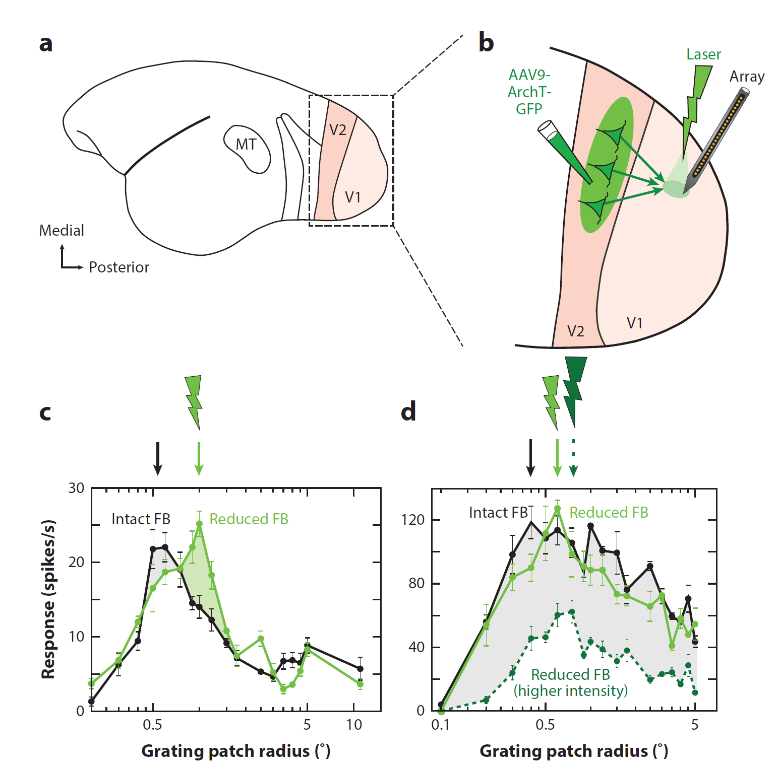
The role of feedback
Spatial precision
Feedback connections target both excitatory and inhibitory neurons; V2, V3, MT provide progressively larger feedback RF to V1; 10 times faster conduction than horizontal; less orientation-selective in general
An optogenetics study: feedback has both inhibition and excitation
Notes:
So the fact about feedback connection is that…
To further examine the role of feedback, here is another experiment.
We can see that when they paralyze some of the feedback, it enlarge the RF that will not cause suppression.

Slide 9
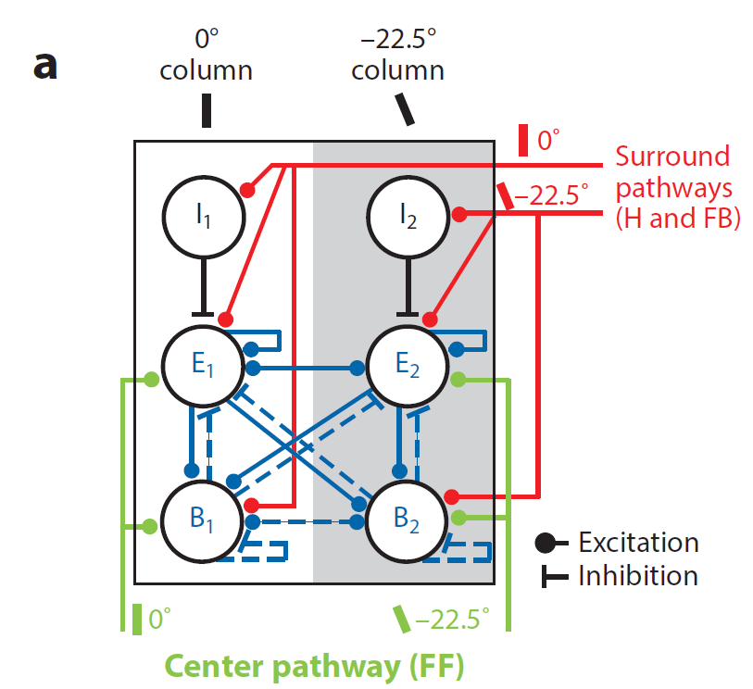
Circuits for SM
2 kinds of inhibitory neurons
Role of modulation within hypercolumn: balance the strong recurrent excitation
Can explain why the suppression is strongest when center and surround are of the same orientation, even if that orientation is not the neuron’s preferred orientation
Notes:
Based on all the experimental findings, the authors propose a circuit for SM.
When the stimulus is of certain orientation, at least one of these columns will prefer that orientation. Since the columns talk to each other, the suppression propagate through all the columns. That can explain the effect of near-SM.

Slide 10
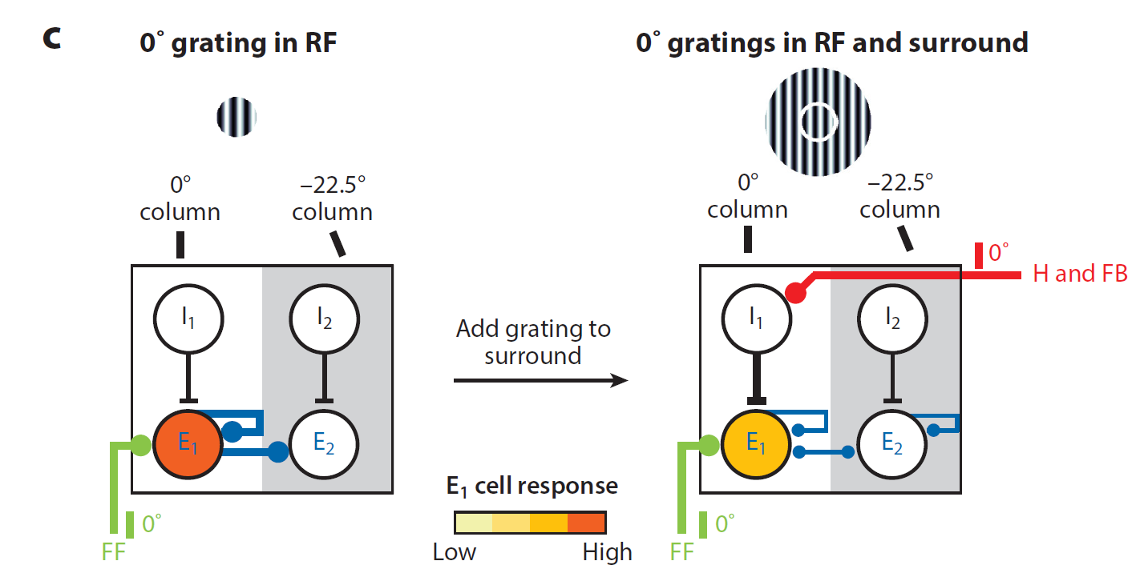
Modulation from far surround
Notes:
It suppresses the response of E1, by increasing the response of I1.

Slide 11
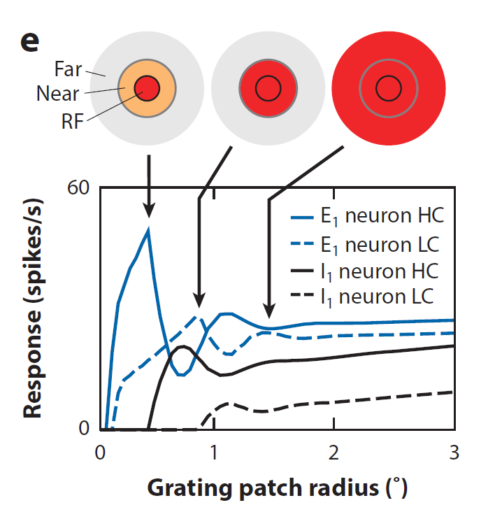
Modulation from surround
Asymmetry of I neuron response: for weak visual inputs, I neurons are silent; for strong visual inputs, I neurons are active (higher threshold for I neurons to fire)
Notes:
There is also asymmetry in I neuron’s response.

Slide 12
Biological plausibility
I neuron is like SOM neuron; B neuron is like PV neuron (still in debate)
Other reasons for I neuron to have the threshold-like behavior:
1) SOM neuron has larger RF size, hence require more stimulus to fire
2) SOM neuron has slower membrane time constant than PV neuron
Related to the project:
Feedback also needs modulation
Delays in modulation
Low-contrast and high-contrast I neurons (caps of different sizes)

