Slide 1

Layer-specificity in the effects of attention
and working memory on activity in primary visual cortex
Jiaxin Wang, Fall 2019

Slide 2
Introduction
Selective attention and working memory in primary visual cortex
Curve-tracing stimuli to examine neuronal activity in the different layers of V1.
The result reveals top-down inputs, an increase in firing rates in the superficial and deep layers, and weaker in input layer 4.
The results provide new insights in the top-down modulation in V1 in the presence and absence of visual stimuli using laminar recoding.

Slide 3
Overlook
Experiment:
Curve-tracing task: 8 stimuli
Remain (Attention) vs briefly presented (working memory)
High-density depth probe between electrodes (24 probes)
Record: multiunit activity (MUA), local field potential (LFPs)
Area: V1, superficial, L4, deep layer
Data analysis:
method: current-source density(CSD), ROC analysis between target and distractor curve
Eye movement: video tracker at 250Hz

Slide 4
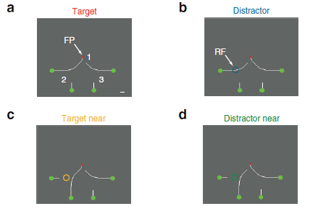
Curve-tracing stimuli

Slide 5
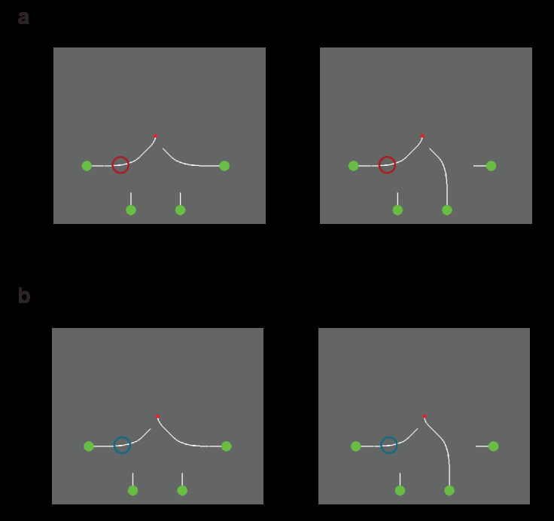
Curve-tracing stimuli

Slide 6
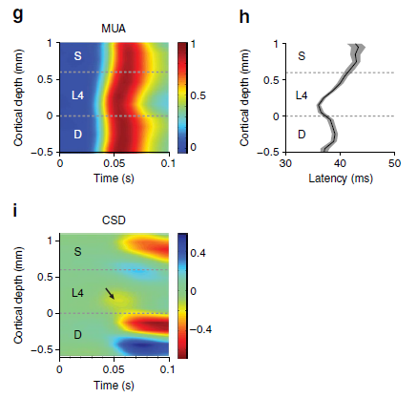
MUA & CSD of attention task

Slide 7
Aim of experiment
Whether trace briefly presented curves. If so, do V1exhibit activity depends on previous contour element?
Compare V1 memory signal to attentional response modulation when curves remain visible.
Measure the influence of visual mask on V1 as it interferes with iconic memory but not working memory
Compare different V1 layers which might contribute differently to attention and working memory.

Slide 8
Conclusion
Monkey can trace briefly presented curve and cause persistent spiking activity in V1 implies a form of working memory
V1 trace is briefly abolished by mask and reinstated implying it provides with working memory, not iconic memory.
Spiking activity modulation by attention and working memory is strongest in the superficial and deep layers of V1 and weaker in layer 4.
CSD indicates two cognitive functions increase the magnitude of synaptic input into the superficial layers and layer 5, thus providing top-down signature from higher cortical areas.

Slide 9
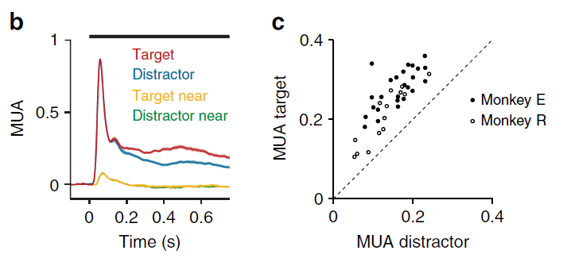
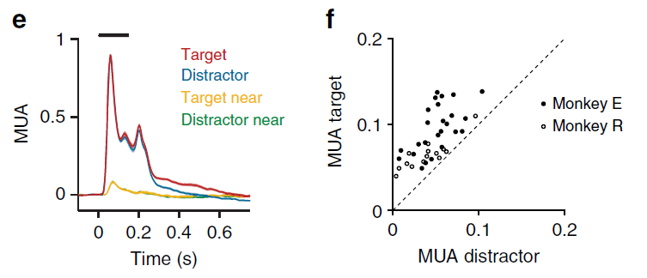
Both experiments

Slide 10
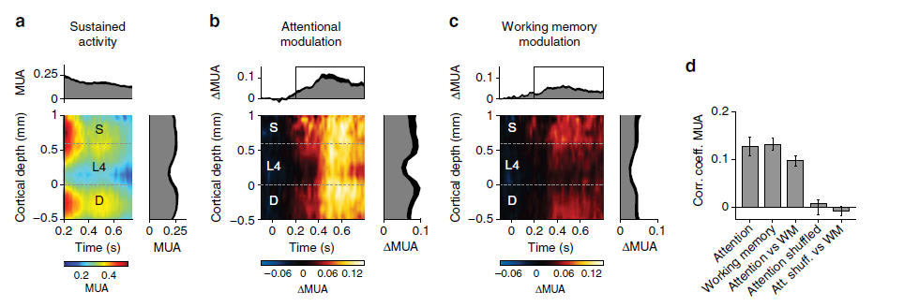
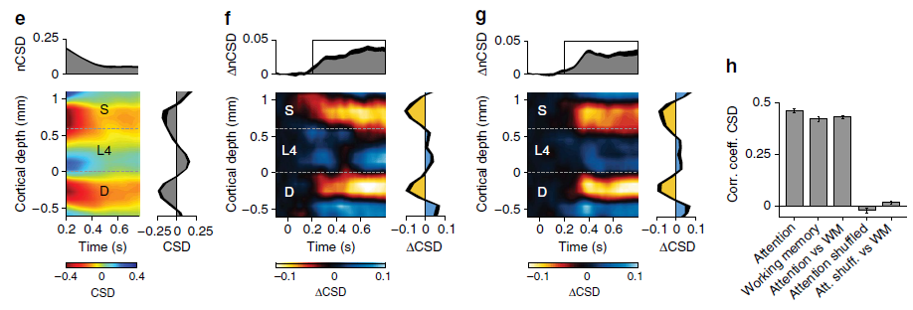
Presence&Absence of the stimuli

Slide 11
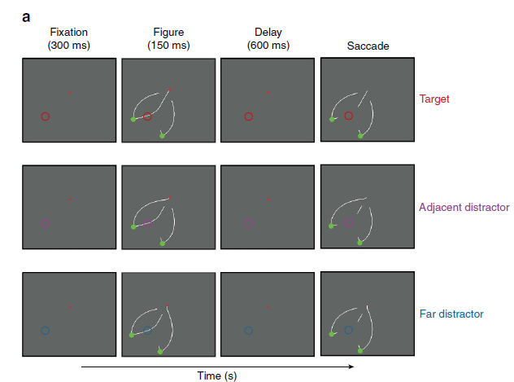
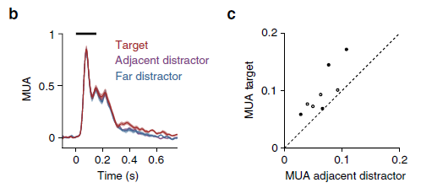
Control task
Dissociating the memory trace from saccade plan

Slide 12
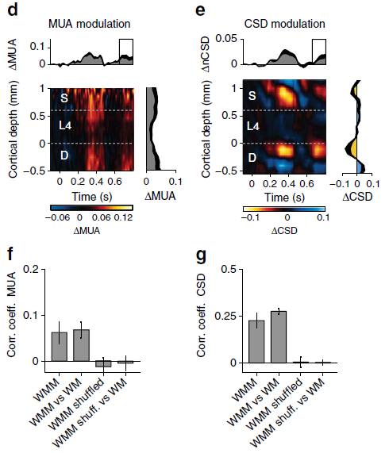
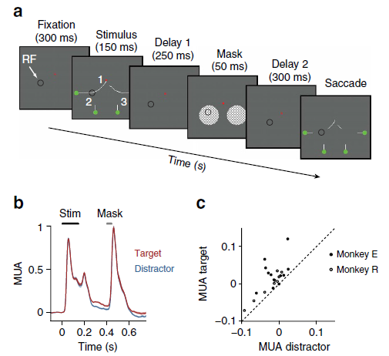
Masking

Slide 13
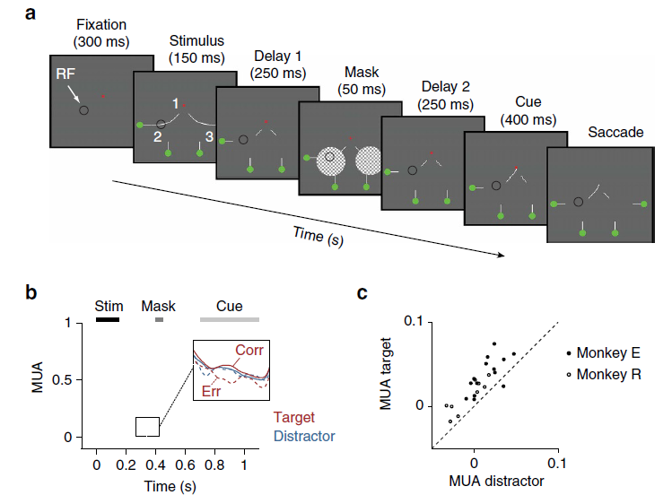
Limited capacity

Slide 14
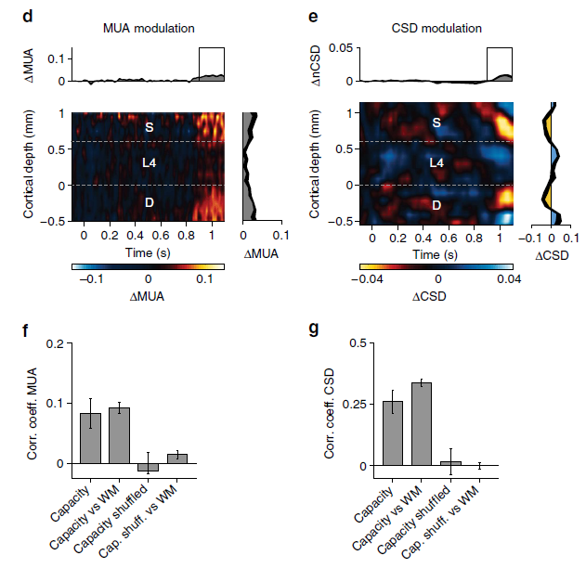
Limited capacity

Slide 15
MUA & CSD
MUA: The electrophysiologically recorded multiunit activity (MUA) is thought to represent the average spiking of small neuronal populations close to the vicinity of the placed microelectrode. It is obtained by band-pass filtering the recorded signal in a frequency range of 400 to a few thousand Hz.
Where φ is the voltage, x is the point at which the CSD is calculated, h is the spacing of electrodes for the computation and σ is the conductivity of cortical tissue. The CSD is negative if currents flow towards the electrode (sink) and positive if currents flow away from the contact points (source).

Slide 16
Discussion
Neuronal correlates of spatial attention and working memory, short-term memory
CSD the sinks in S layer and L5, feedback on firing rates
Mask result implies the V1 response to working memory
Provide new insights in the top-down modulation in V1 in the presence and absence of visual stimuli using laminar recoding.

Slide 17
Thank you!

