Slide 1
Controversial stimuli: pitting neural networks against each other as models of human recognition
Tal Golan, Prashant C. Raju, and Nikolaus Kriegeskorte
(preprint from 11/22/19)
Presented by Hal Rockwell

Slide 2
Testing generalization of CNNs
Test sets aren’t enough; want to look at out-of-distribution generalization
Normal perturbation (noise, etc.) compared against human responses are good
But best for comparing models against each other would be to probe their differences directly

Slide 3
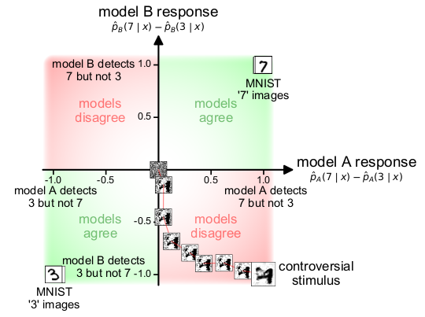

Controversial stimuli
Optimize images directly for different classifications from two models
Show these generated images to humans, see which model they side with

Slide 4
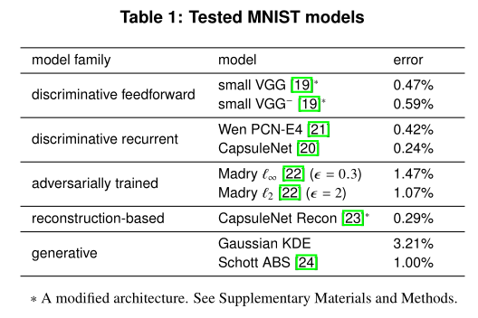
Models examined
MNIST models, ostensibly because there are many qualitatively different ways to solve it (versus Imagenet where there is less diversity in good models)

Slide 5
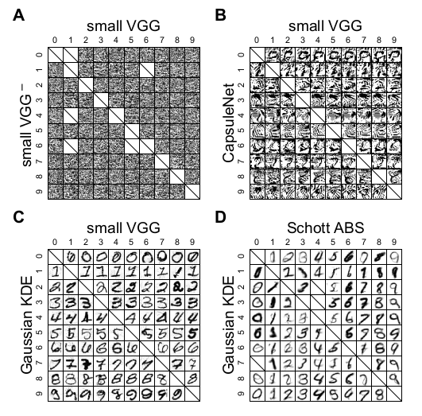
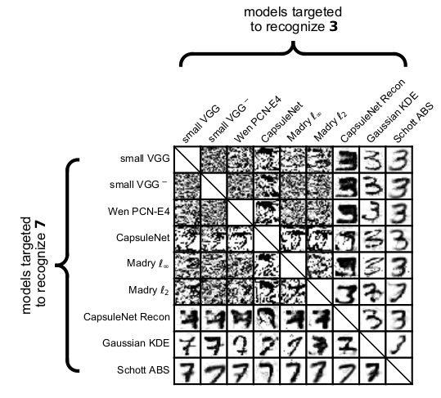
Intuitive comparisons

Slide 6
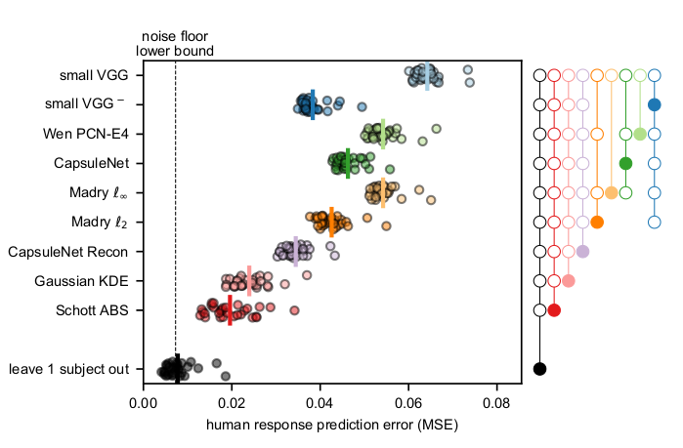
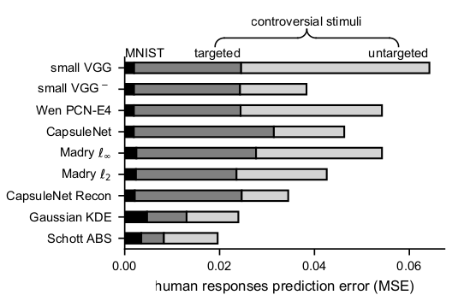
Quantitative comparisons

Slide 7
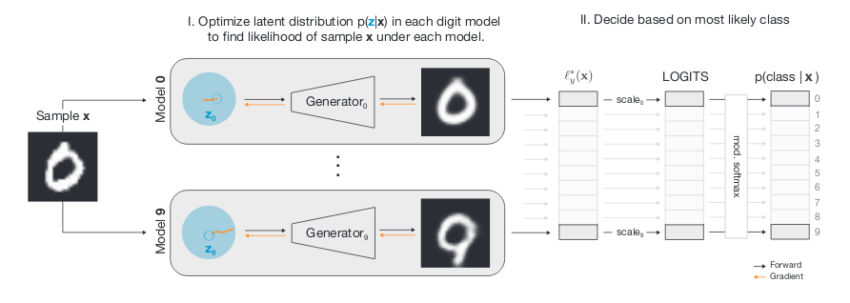
ABS model overview
Not scalable to many classes :(

Slide 8
Conclusions
Generating controversial stimuli is an interesting technique, though with some limitations
Generative models best capture human judgement, but discriminative ones are better for in-distribution images
How to combine them?

