Slide 1
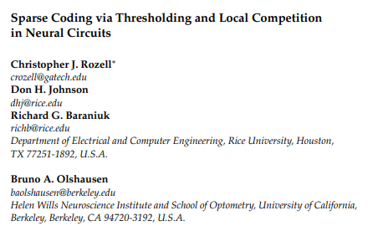
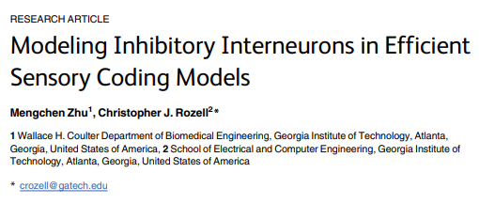
Presented by Xueyan Niu (Julie)
Nov 7, 2019

Slide 2
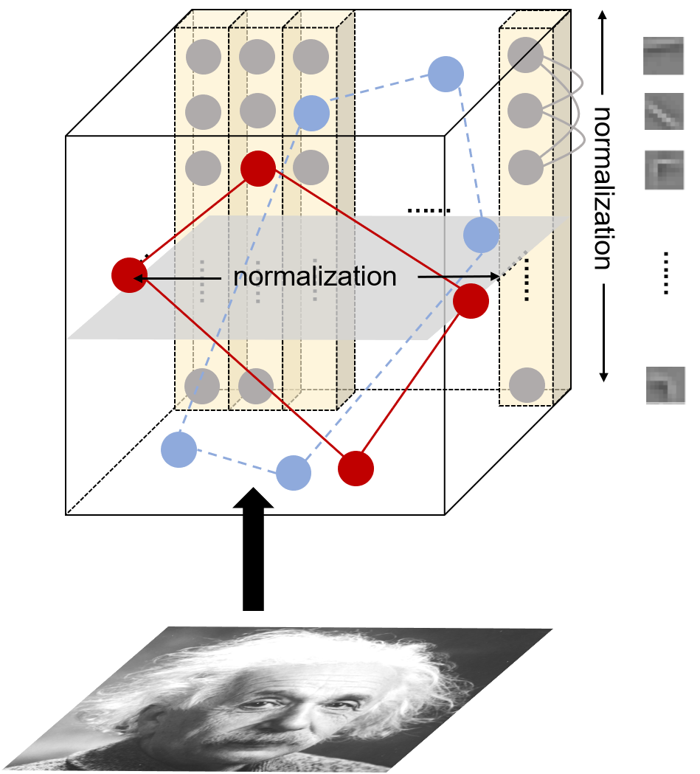
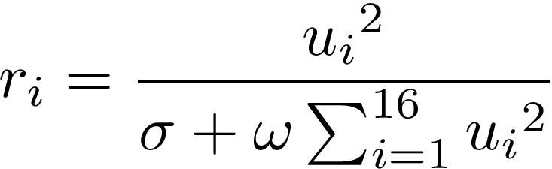
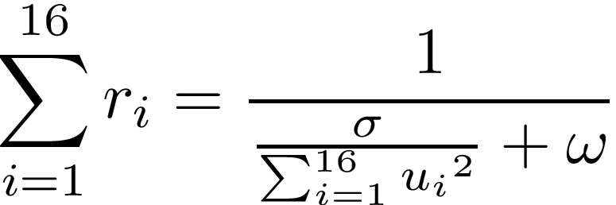
The familiarity project so far
The familiarity effect we want to achieve:
Lower average response (overall suppression)
Several salient neurons (specialists)
Normalization will not achieve 1) because average response increases as input increases, and familiar images invoke larger input due to reciprocal connections.
-> Consider inhibition

Slide 3
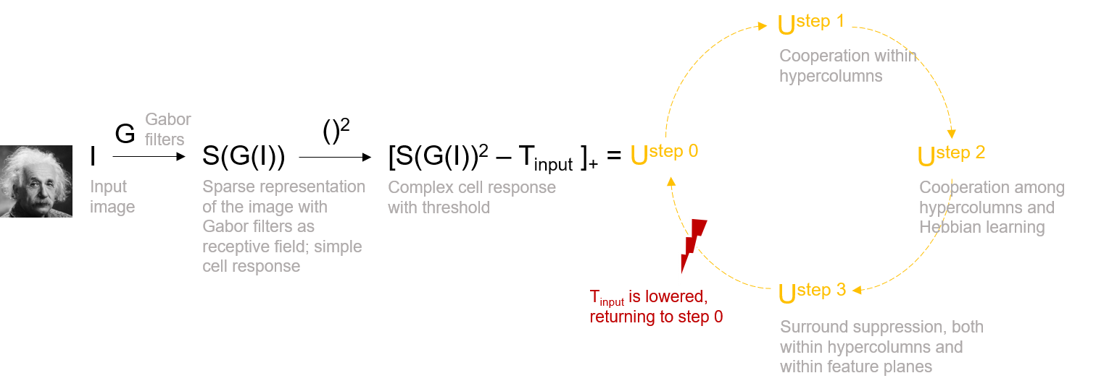
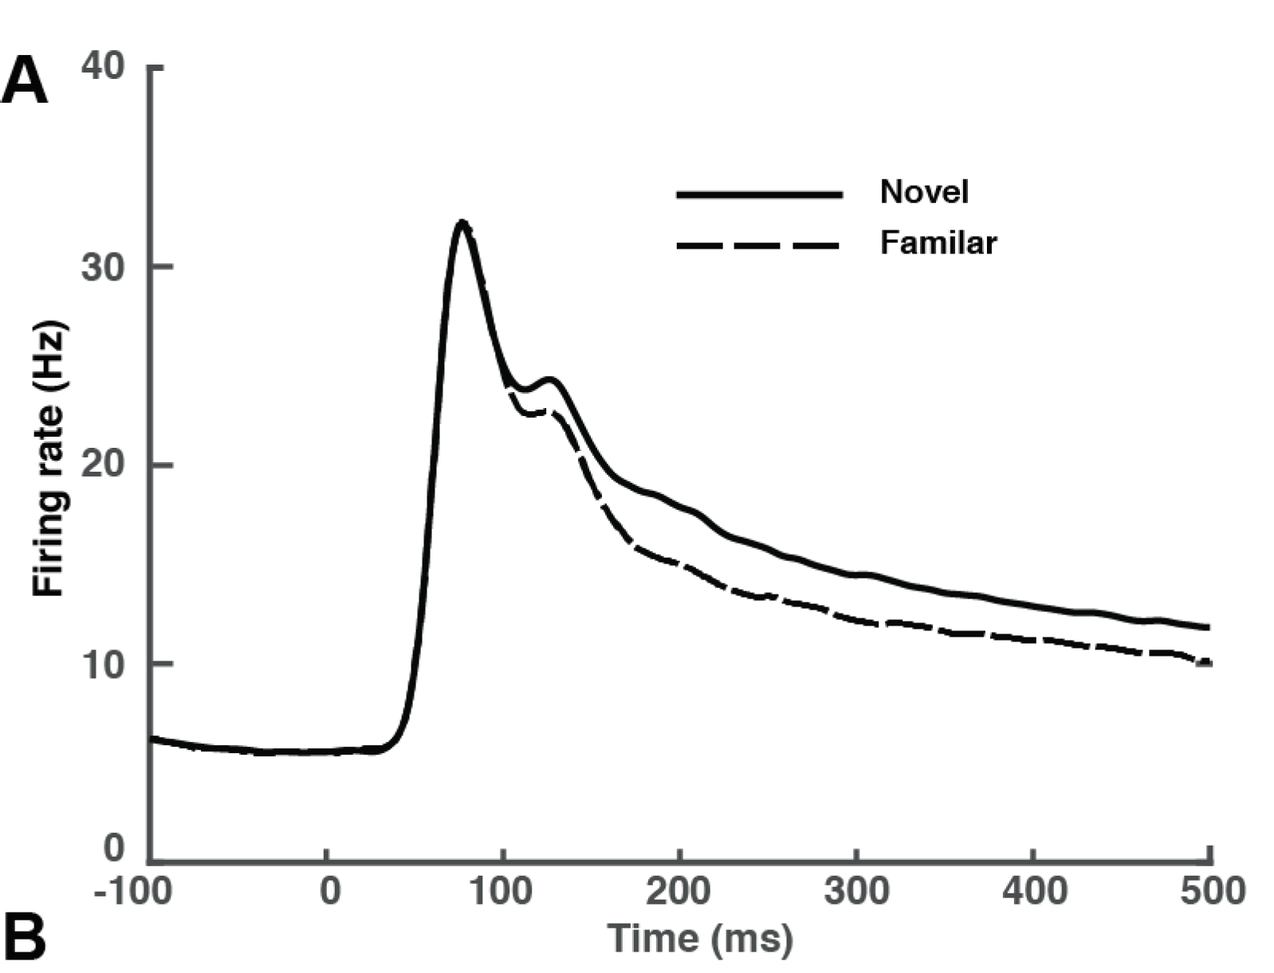
The familiarity project so far
From last time: different delays in surround modulation
Salient neurons to form circuit first
Can explain the second bump
Notes:
Before that, I want to talk about this flowchart designed by Prof. Lee.
After that, we introduce this threshold, and only neurons pass this threshold can enter into this cycle.

Slide 4



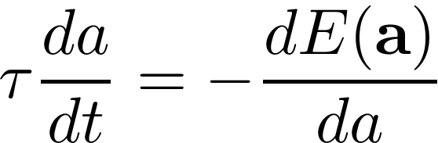
BPDN (Classical sparse coding) basis pursuit denoising ——in search for the inhibition term
Assuming a generative model where the sensory cue (image) is composed of a linear combination of basic features (gabor filters)
M neurons,
s – image, phi_m – receptive fields of the m-th neuron, a_m – response of the m-th neuron
Using dynamical systems to implement gradient descent
Drawback: 1) small coefficients are not identically zero -> introducing threshold
2) requiring persistent (two-way) signaling between all units with overlapping receptive fields
-> new competition terms
Notes:
In search for the inhibition term, we would consider some sparse coding scheme.
We know that to solve this problem, we can do gradient descent, because it is a convex problem.

Slide 5




Sparse coding via local competition ——in search for the inhibition term
Design of the dynamics:
Feedforward input of neuron m:
(normal dot product / convolution)
Thresholding: internal state and firing rate
Inhibition from neuron m to neuron n: proportional to , where
Between two neurons that fire: mutual inhibition
(More importantly,) from one firing neuron to one silent neuron: prevent it from firing
More inhibition – less neuron to pass the second threshold – sparsify the response
Neurons have higher firing rate for familiar stimuli due to reciprocal input

Slide 6




Sparse coding via local competition ——in search for the inhibition term
Equation for the dynamics:
Writing the equation to be the negative gradient of an energy function,
, where
to separate the role of thresholding function
Notes:
Now we can see how different thresholding functions can affect the dynamics.

Slide 7
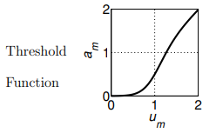



Sparse coding via local competition ——in search for the inhibition term
Ideal thresholding function:
Hard thresholding function:
The hard-thresholding local competitive algorithm reduces to sparse coding with l₀ penalty
Soft thresholding function:
The soft-thresholding local competitive algorithm reduces to BPDN with l₁ penalty
Either way, the cost can be given by
Notes:
Both of the terms are when gamma goes to infinity.

Slide 8

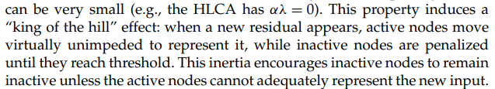
Sparse coding via local competition ——in search for the inhibition term
——advantages
Solving the two drawbacks of BPDN
Comparable sparsity and representation error (SLCA vs BPDN, HLCA vs MP matching pursuit)
Can achieve temporal smoothness when dealing with time-varying stimuli (movie)
by nature!!
inertia property:
Notes:
Because the internal state vary continuously.

Slide 9
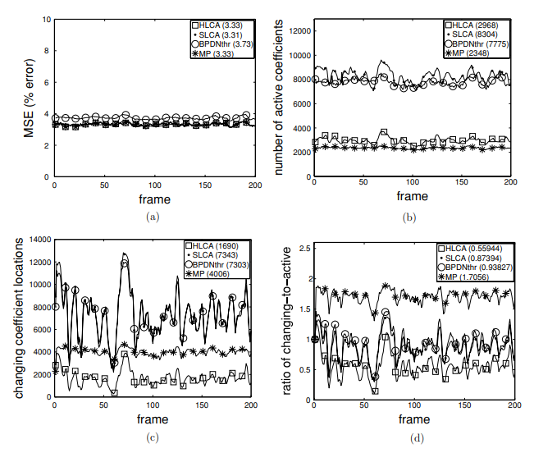
Sparse coding via local competition ——in search for the inhibition term
——advantages
Smoothness in transition

Slide 10
Modeling inhibitory interneurons ——biological mechanism
The coding models do not respect biological facts:
Inhibition must be implemented by inhibitory interneurons (Dale’s law)
Those interneurons have a diversity of tuning properties
Those interneurons have characteristic E/I cell ratios
Approach: use the dynamical equations to infer the structure of interneurons

Slide 11

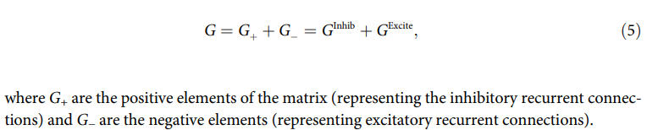
Modeling inhibitory interneurons ——biological mechanism
Reference equation
G reflects connectivity
G is semi-positive definite
Achieving Dale’s law:
Notes:
Everything is contrary in terms of signs.

Slide 12
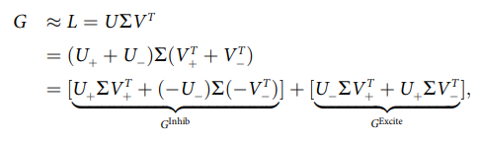
Modeling inhibitory interneurons ——biological mechanism
If we decompose the matrix in this way…
Inhibitory interneurons
V^T
U
Both fully-connected
Excitatory neurons
Since G is semi-positive definite, we can always have
Notes:
G only has non-negative eigenvalues, so sigma will not flip the sign.

Slide 13

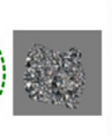
Modeling inhibitory interneurons ——biological mechanism
G is likely to be low-rank because:
1)
2) The images themselves are highly structured, rank (Phi) < N
Hence the number of interneurons can be smaller than excitatory neurons (excitatory neurons are assumed to be over-complete in the first place), which can account for the E/I ratio.
However, the RF of interneurons have a dot-shaped structure,
inconsistent with observations, where some of their RF are
complex, some are orientation-tuned.

Slide 14
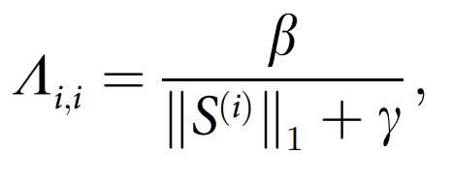
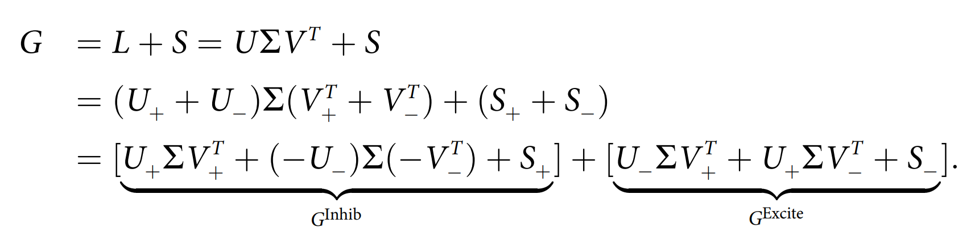
Modeling inhibitory interneurons ——biological mechanism
Robust PCA:
Decompose G into a low-rank matrix L and a column-sparse matrix S by solving the following convex optimization problem iteratively:
Sum of |eigenvalues|
Inhibitory interneurons
One-to-one connection
Excitatory neurons
Notes:
Lambda is a diagonal matrix updated by this rule.

