Slide 1
Artificial neural networks with biological characteristics
Hal Rockwell

Slide 2
Artificial “““neural networks”””
CNNs trained to classify natural images are the best predictive models of human visual representations we have
They match human performance in some regards, but not others, and are structurally similar enough for direct comparisons
So, they can serve as tools for understanding the functional purpose of neuroscience’s details

Slide 3
Biological detail
There’s a lot of it, mostly ignored by CNN models
Three such features:
Center-surround receptive fields in retinal ganglion cells
Separation of inhibition and excitation into cell types with different connectivity
Extensive, highly structured lateral connections between neurons in an area
What functions do these serve?

Slide 4
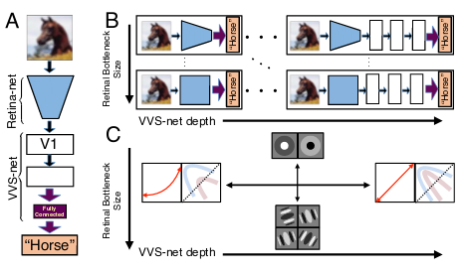
1: Retinal receptive fields
“A unified theory of early visual representations from retina to cortex through anatomically constrained deep CNNs” -- Lindsey et al.
CNN model, split into “retina-net” (first two layers) and “VVS-net” (ventral visual system, later layers), trained on CIFAR10
Vary the number of neurons in the retina-net, and depth of the VVS-net, see how the “retinal” representations change

Slide 5
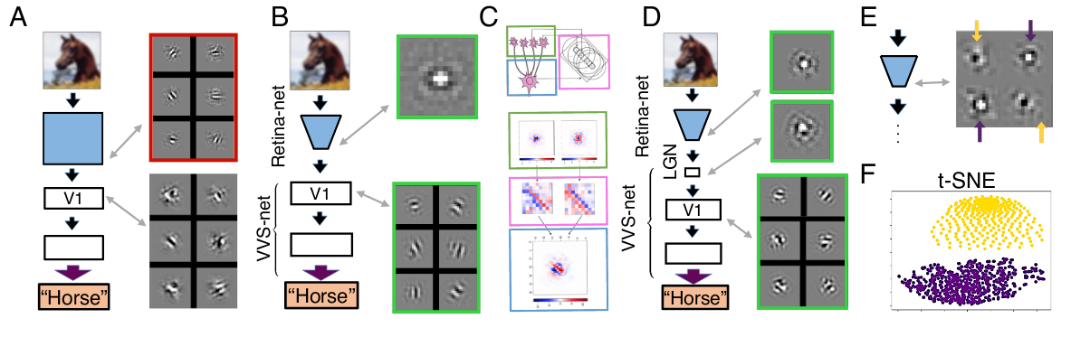
1: Retinal receptive fields: center-surround
Limiting number of neurons in retina-net output leads to a variety of well-known biological features

Slide 6
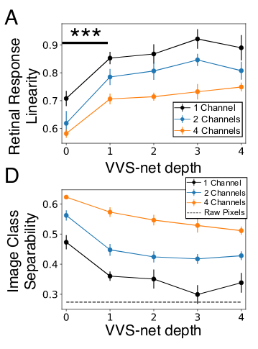
1: Retinal receptive fields: nonlinearity
Is the role of the retina to extract behaviorally relevant features? Or to faithfully transmit information to the rest of the visual system?
Might depend on the species

Slide 7
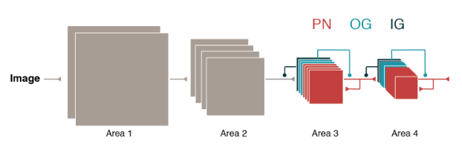
2: Excitatory and inhibitory cells
“Understanding the functional and structural differences across excitatory and inhibitory neurons” -- Minni et al.
Separate a convolutional LSTM layer into input-gate, output-gate, principal neuron populations (IG, OG, PN), train on CIFAR10
Excitatory cells
Outnumber inhibitory cells by at least 4x
Are more selective in their responses to stimuli than neighboring inhibitory cells
Project to other (sub)cortical areas, unlike inhibitory cells
Are more sparsely connected to nearby neurons than inhibitory cells

Slide 8
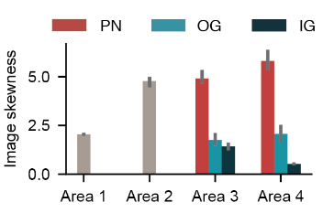
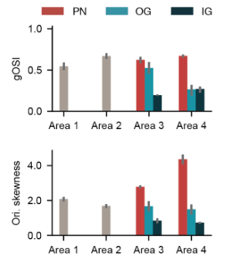
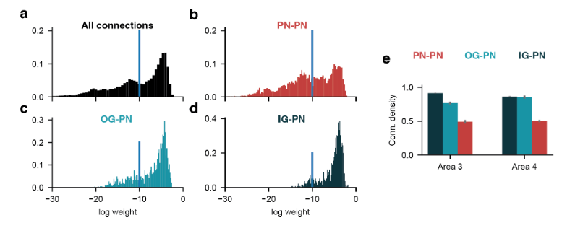
2: Excitatory and inhibitory cells
Mimicking the structure of real cortex (PNs are excitatory, IG+OG inhibitory)

Slide 9
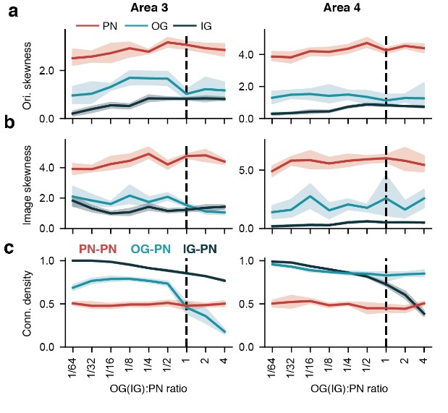
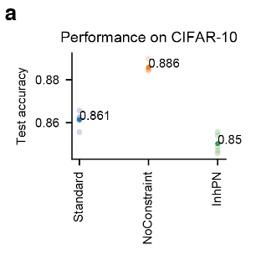
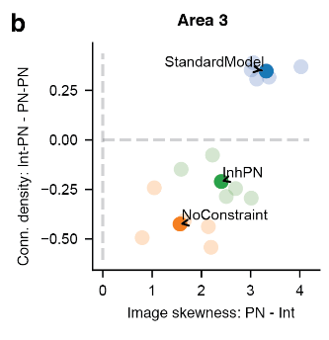
2: Excitatory and inhibitory cells
Varying the structure to understand the function

Slide 10
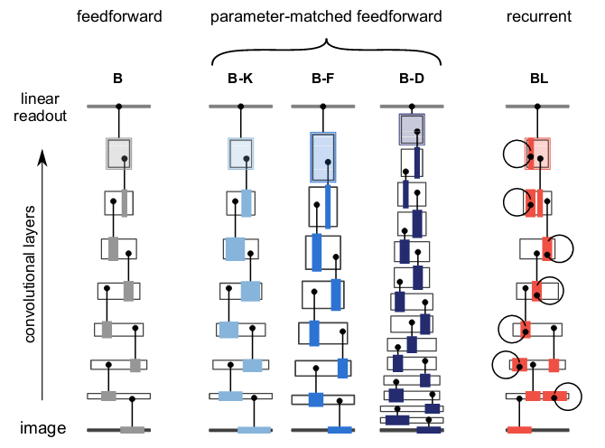
3: Lateral connections
“Recurrent networks can recycle neural resources to flexibly trade speed for accuracy in visual recognition” -- Lindsey et al.
Introduce lateral connections (convolutions from one layer to itself at the next time step)
Train on Imagenet (!)

Slide 11
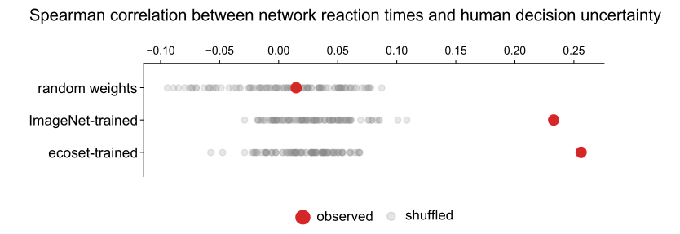
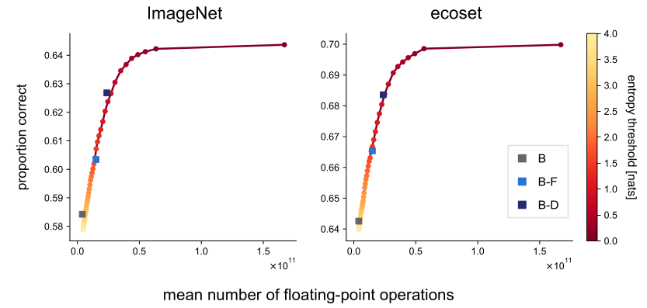
3: Lateral connections: recurrent processing
People take longer to recognize/categorize “difficult” images
Enforcing recurrent processing until an entropy threshold over the outputs is reached results in similar behavior

Slide 12
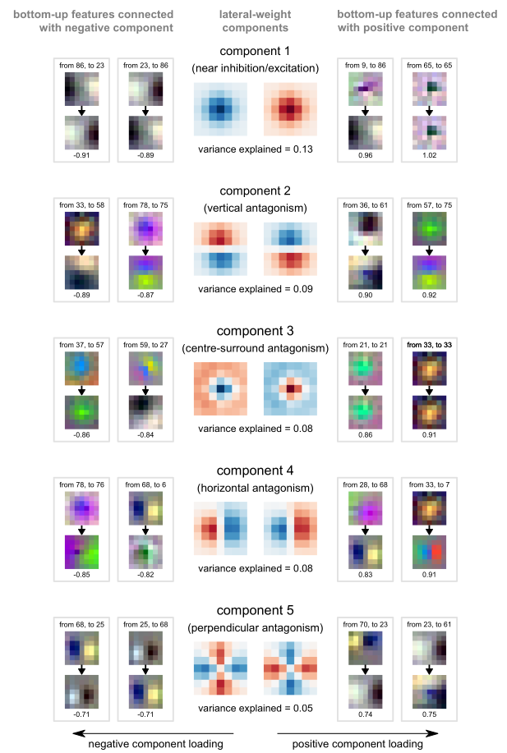
3: Lateral connections: structure
Visualize the first few PCs of lateral connections in the first layer

Slide 13
Conclusions
Relating structure and function is hard but important, and CNN models are a useful tool for this purpose
The kind of understanding they yield is (often) directly applicable to improving them as tools for computer vision

