Slide 1
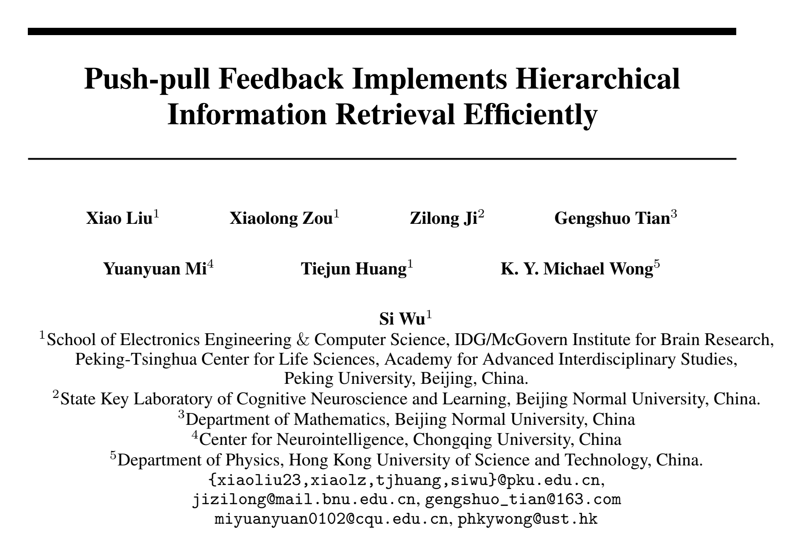

Slide 2




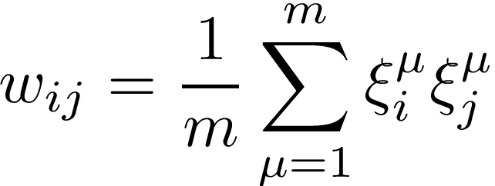
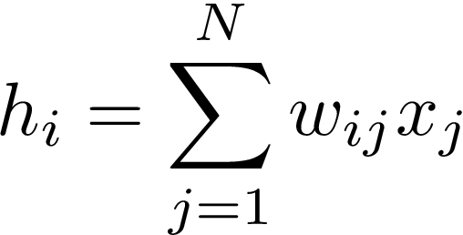

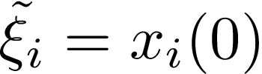

0. Hopfield network
States
Symmetric recurrent connections:
1
2
……
N
Used to model associative memory
Memory pattern :a pattern of the states of the N neurons
that we hope the network can remember
—— by learning the weights among neurons
Hebbian learning:
Input:
Retrieve the desired memory pattern : 1) give the network corrupted (initial states)
2) in each run, until convergence

Slide 3
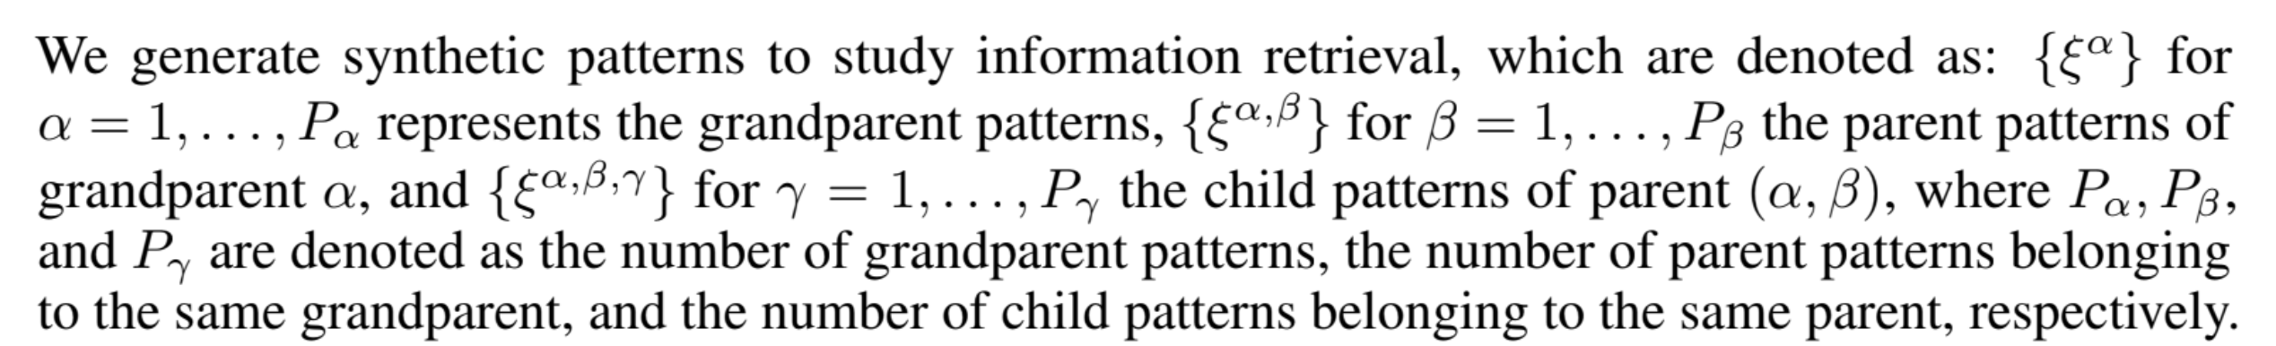
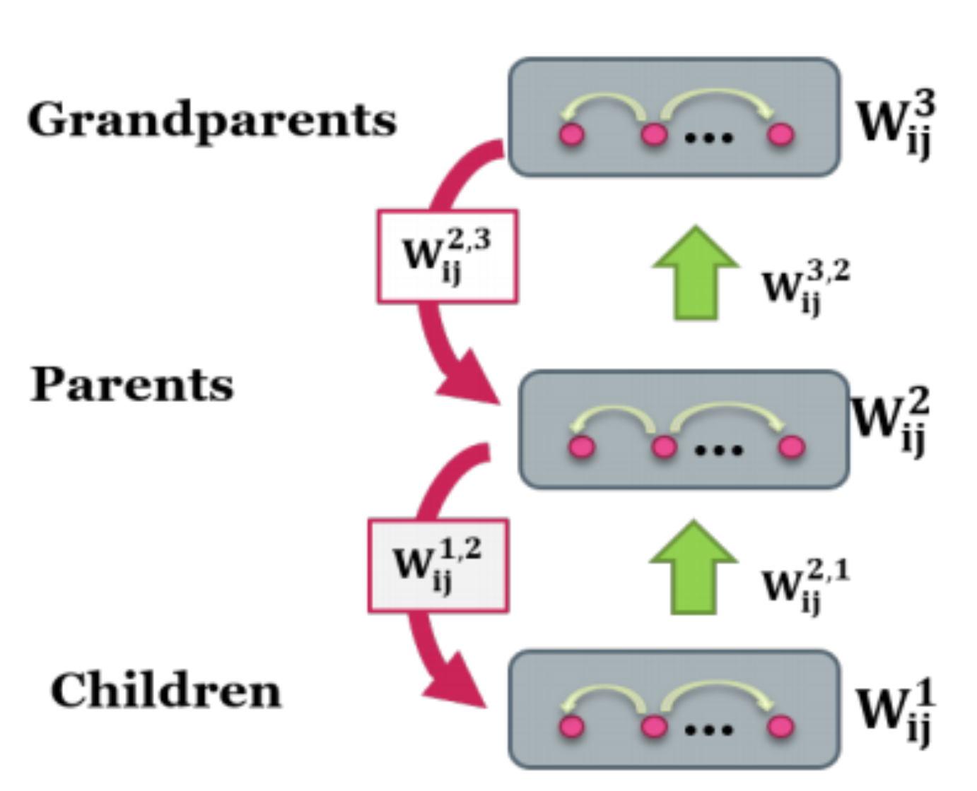
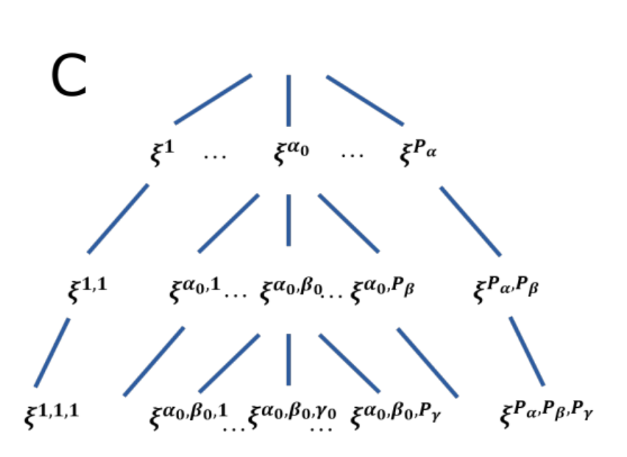
1. Constructing memory patterns
Notes:
We can look at the tree graph. Do not confuse this graph with the neuron graph. Each xi here really means the states of N neurons, for example (1,1,1,1,1)

Slide 4
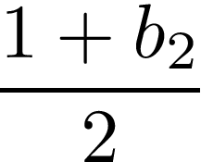

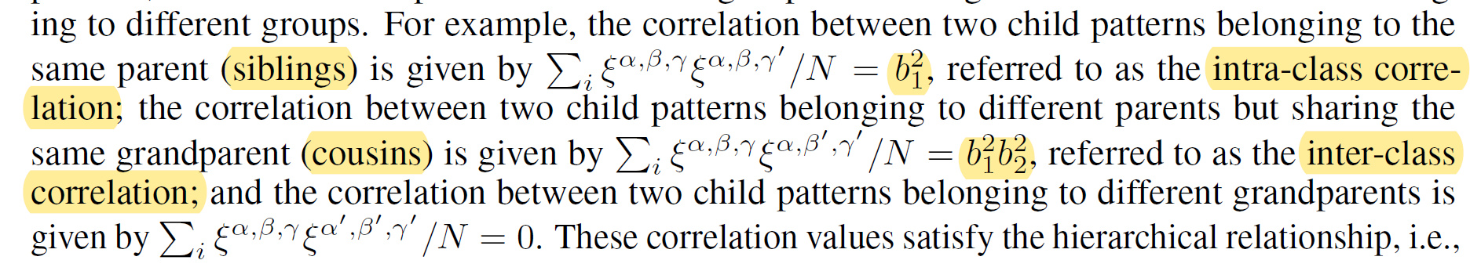
1. Constructing memory patterns
Represent hierarchical information
Each element (neuron) of a grandparent pattern has equal probabilities to be -1 or 1
Each element of a parent pattern has >0.5 probability to have the same value as
the corresponding element of the grandparent pattern
Each element of a child pattern has >0.5 probability to have the same value as
the corresponding element of the parent pattern
Notes:
1) We want the memory pattern in different layers to represent hierarchical information, so there has to be some relation between the memory patterns in different layers.

Slide 5
1. Constructing memory patterns
a database of 200 patterns, each pattern has 3 layers
Represent hierarchical information
Each element of a grandparent pattern has equal probabilities to be -1 or 1
Each element of a parent pattern has >0.5 probability to have the same value as
the corresponding element of the grandparent pattern
Each element of a child pattern has >0.5 probability to have the same value as
the corresponding element of the parent pattern
Notes:
In this way, we can generate a database of patterns that we hope the network can remember.

Slide 6
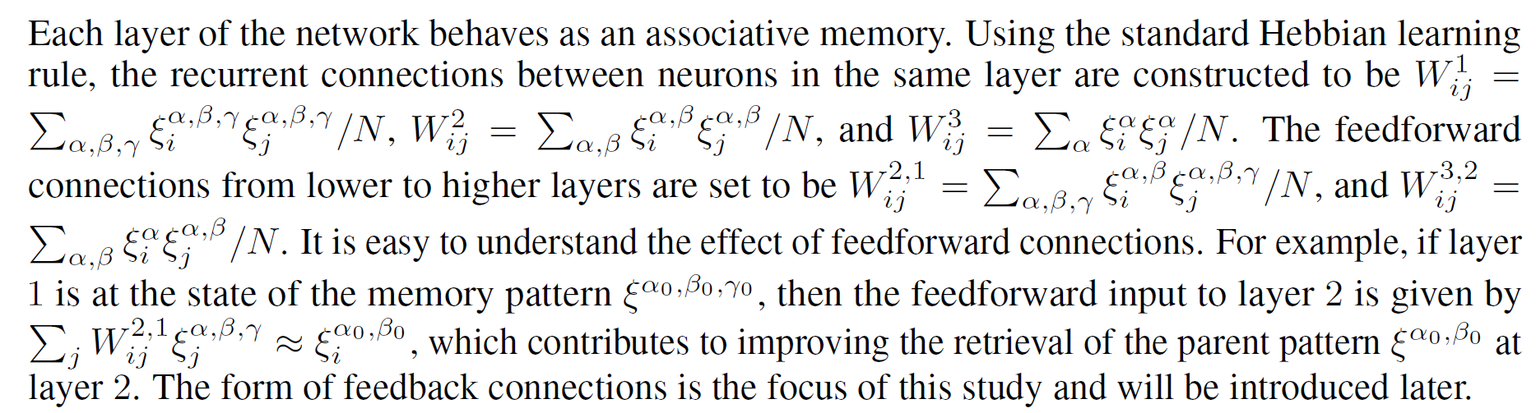
2. Forming connections among neurons
Recurrent and feedforward weights follow Hebbian rule:
Neuron i in
Notes:
The network remember patterns by learning the weights. W_ij1 is the state of neuron I times the state of neuron j, summer over all memory patterns, divided by some number.

Slide 7
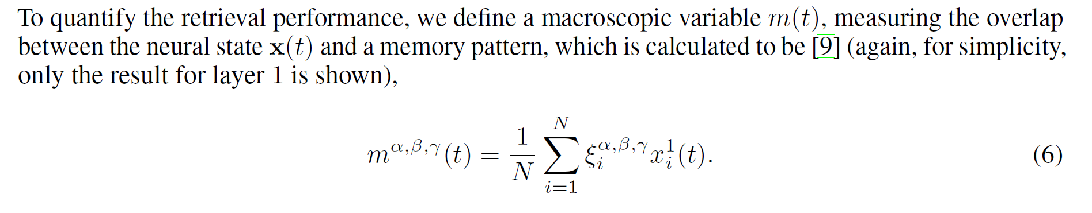
2. Forming connections among neurons
Testing information retrieval without feedback
Retrieval accuracy:
Notes:
Now we want to test information retrieval without feedback. So this part is talking about the inspiration of push-pull feedback.

Slide 8
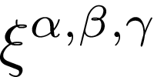
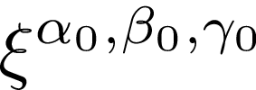
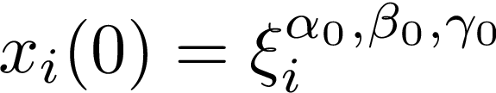
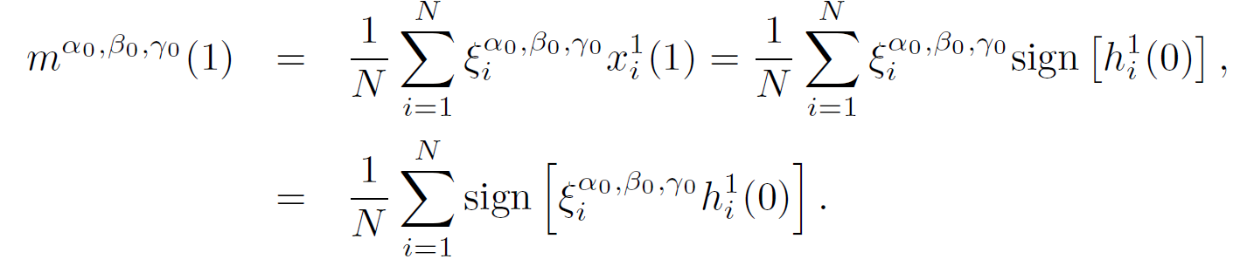
2. Forming connections among neurons
Train the weight using many memory patterns
Want to retrieve one of them
Assume perfect initial state
Consider the retrieval accuracy after the first iteration
Notes:
That is just an assumption that leads us to see what happens next.
The noise comes from intra-class correlation and inter-class correlation.
That is how the authors came up a way to improve the network.

Slide 9
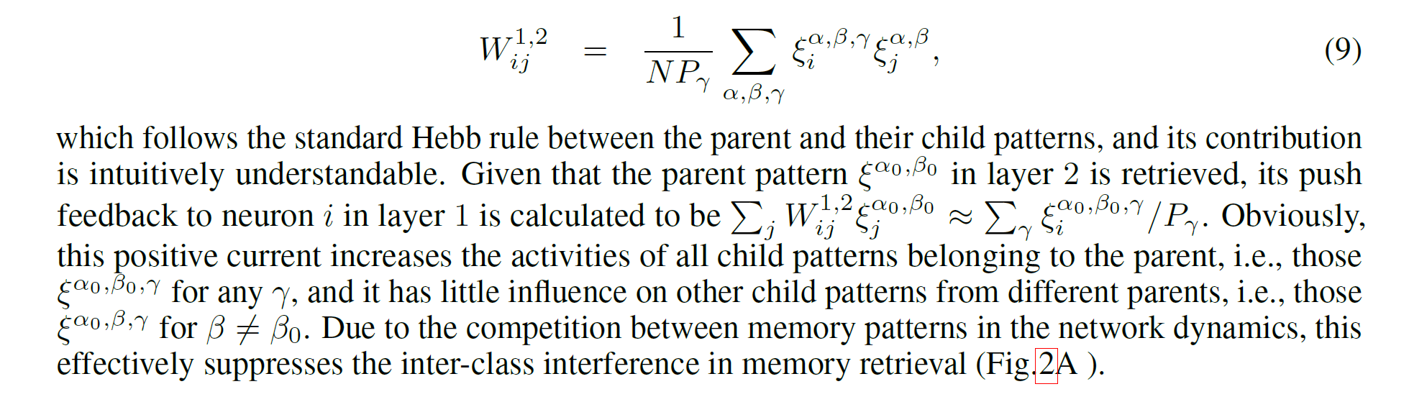
2. Forming connections among neurons
——the push feedback
Notes:
They can assume that because information of a higher level is easier to retrieve. For example, in image classification, its easier to judge whether the image is a dog or cat than the subtypes of dogs or cats. Anyway, we can just assume that to more easily evaluate the function of push feedback.

Slide 10
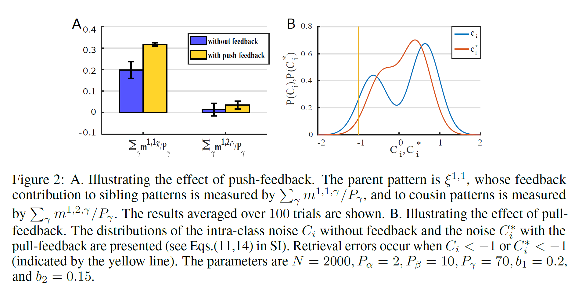
2. Forming connections among neurons
——the push feedback
Notes:
Here is the effect of push feedback. This value means given the parent pattern, the average retrieval accuracy of all sibling patterns.

Slide 11
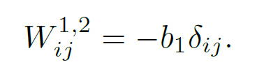
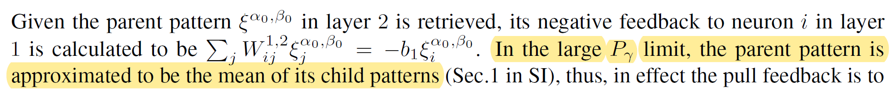
2. Forming connections among neurons
——the pull feedback
……
-
-
-
-
……
The law of large numbers
Notes:
Now we deal with intra-class interference by pull feedback.
Again, to analyze the effect of pull-feedback, we assume perfect retrieval in parent layer.
By the law of large numbers, the mean of the state of neuron i over all child patterns = b1 * the state of its parent neuron
Subtracting the mean of all sibling patterns.

Slide 12
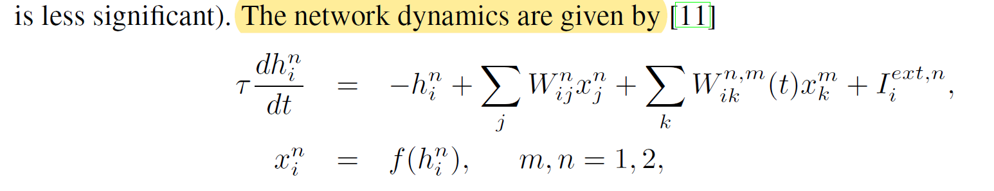
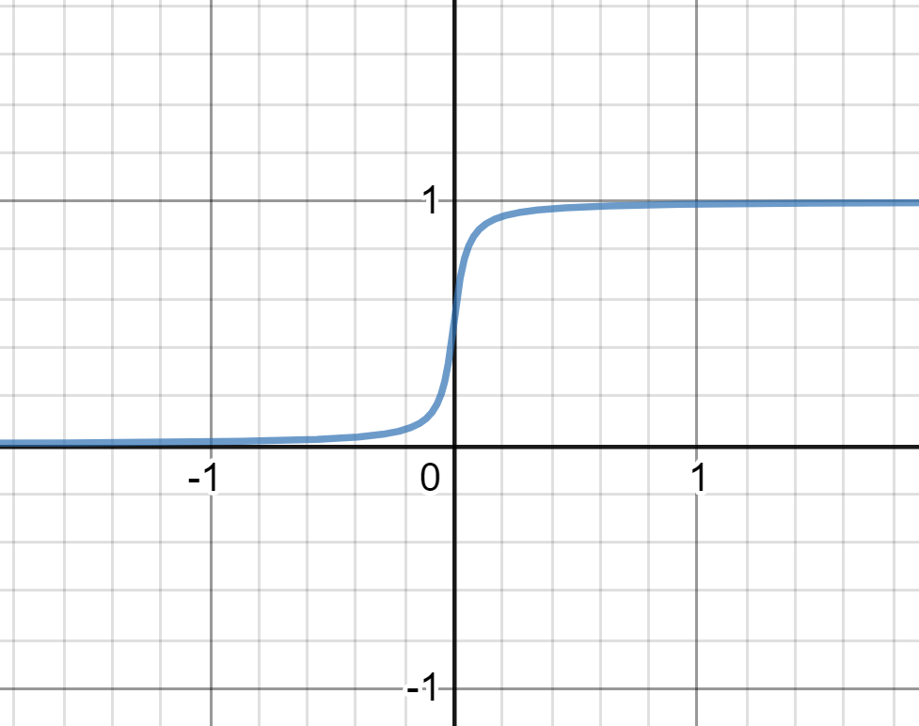
2. Forming connections among neurons
——the continuous version
x
Decaying term
h
Recurrent input
Push/pull alternating
Corrupted input pattern
Notes:
In continuous version, the memory pattern can take up value either 0 or 1.

Slide 13
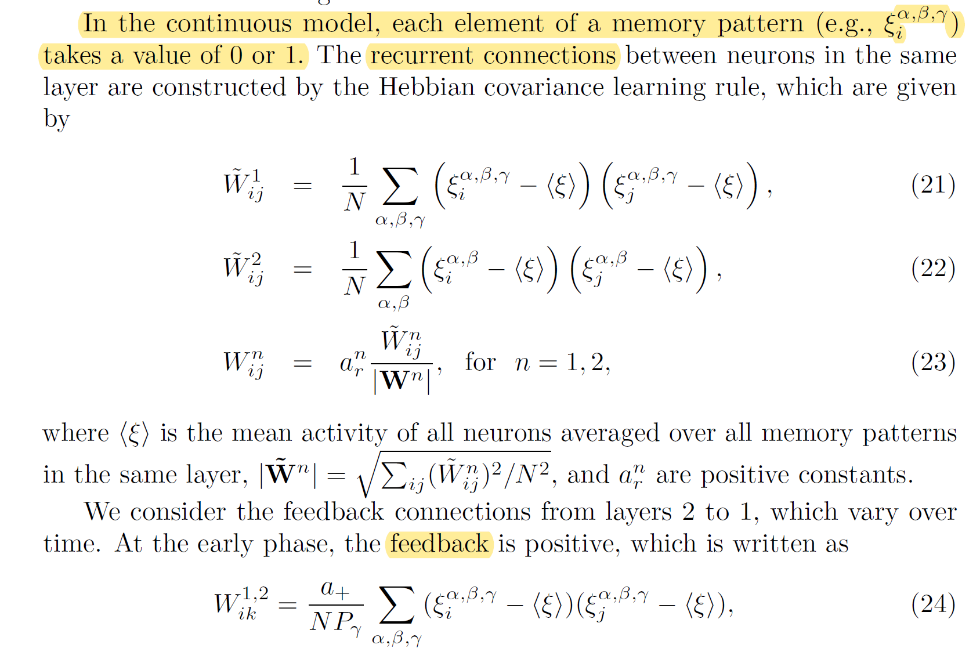
2. Forming connections among neurons
——the continuous version
To make things work, they also have to introduce more parameters…

Slide 14
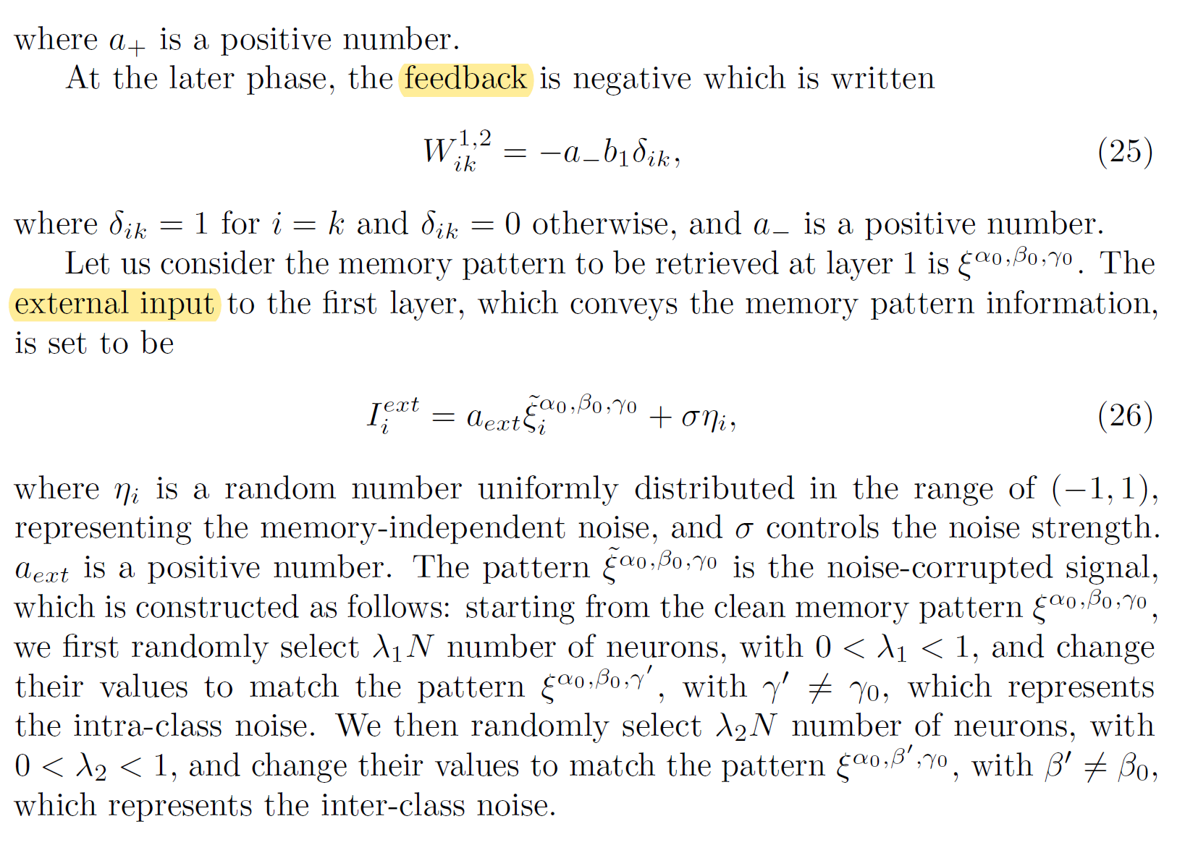
2. Forming connections among neurons
——the continuous version
To make things work, they also have to introduce more parameters…

Slide 15
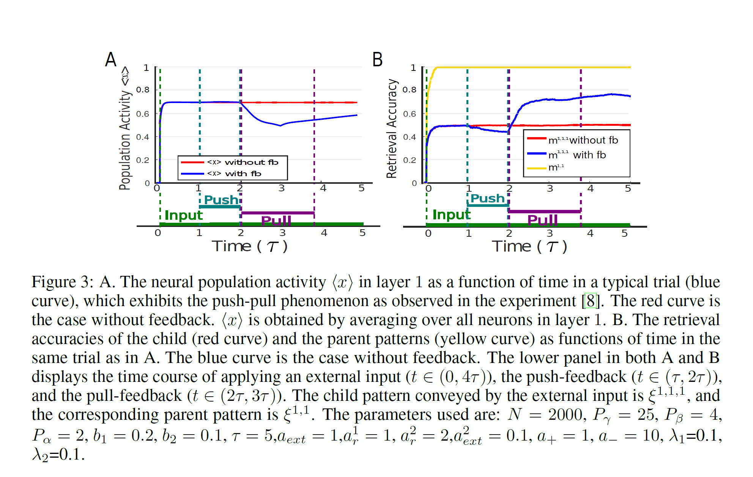
3. Testing retrieval accuracy ——using memory patterns generated in 1
Notes:
The first set of result is based on the memory patterns generated in section 1.
Figure A shows the average population activity of neurons in layer 1.
Figure B shows the retrieval accuracy across time.

Slide 16
3. Testing retrieval accuracy ——using memory patterns generated by VGG
2 layers
Parent layer represent cat/dog (2 patterns), child layer represent subtypes of cat / subtypes of dog (each has 9 patterns)
Each pattern x 100 images = 1800 images
Assumption: VGG can reflect hierarchical information
1 images -> (taking the last layer) responses of 4096 neurons
Notes:
The second set of results is based on memory patterns generated by VGG.

Slide 17
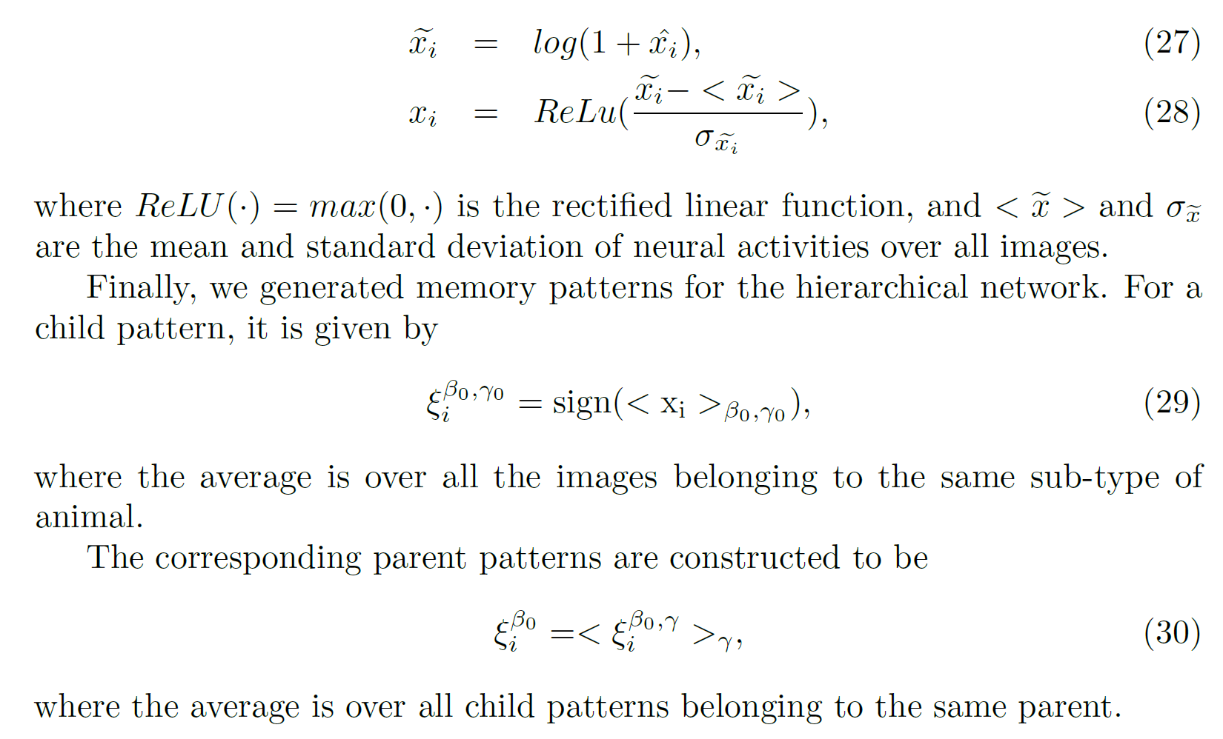
3. Testing retrieval accuracy ——using memory patterns generated by VGG
Decrease individual difference of the response of neurons
Normalization
Average over the 100 images of the same subtype
Average over the 900 images of the same type

Slide 18
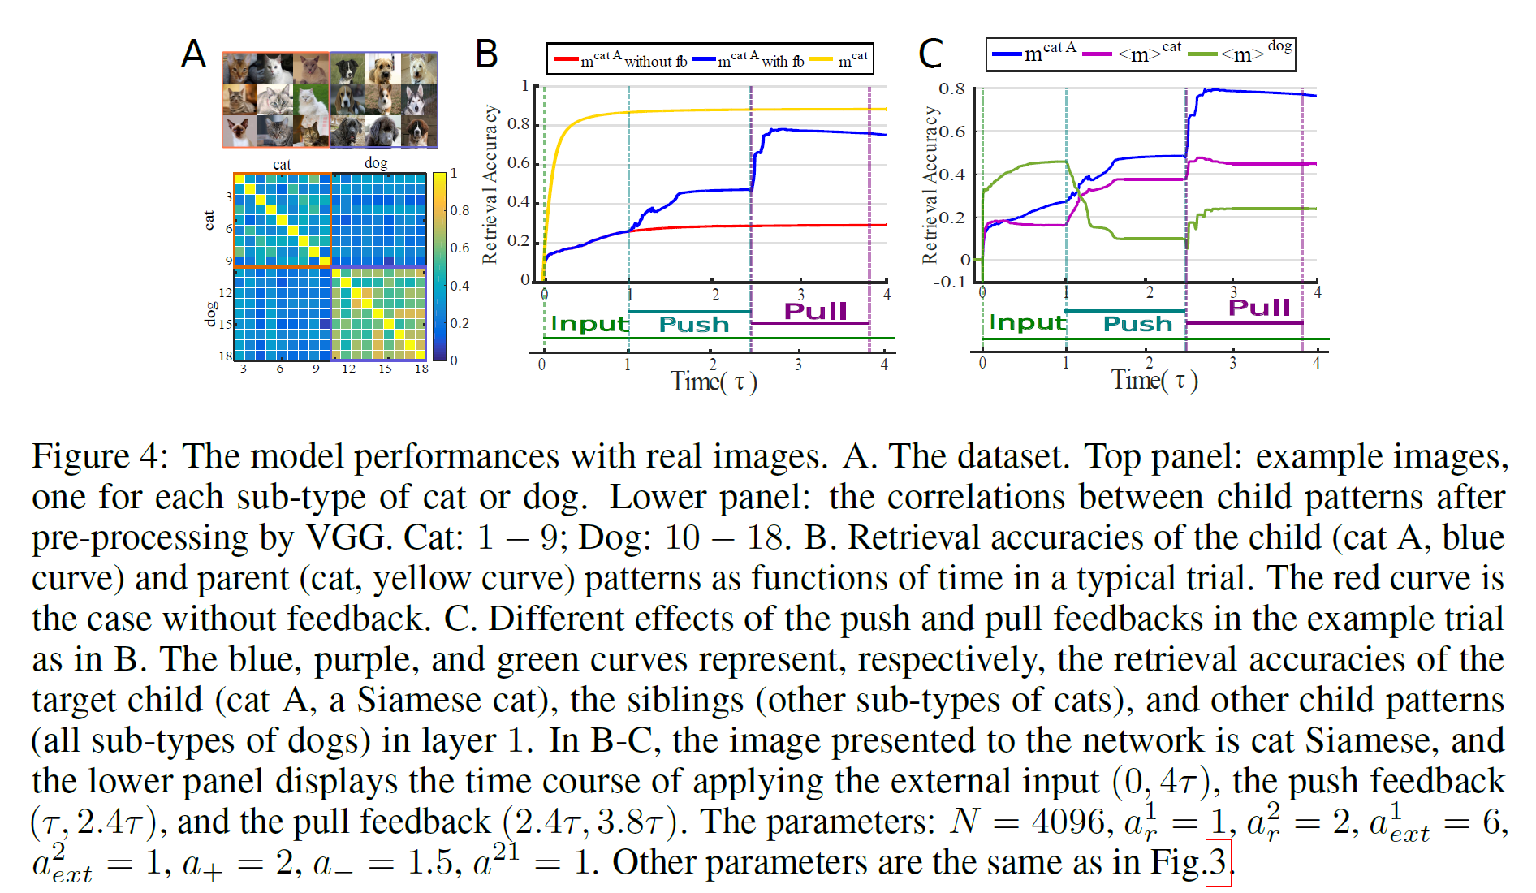
3. Testing retrieval accuracy ——using memory patterns generated by VGG
Notes:
After you subtract some input from the first layer, you always amplify something, and that contributes to the increase of accuracy in the pull state.

