Slide 1
Routing Networks and the Challenges of Modular and Compositional Computation
Clemens Rosenbaum, Ignacio Cases, Matthew Riemer, and Tim Klinger
Presented by Hal Rockwell 7/17/20

Slide 2
Introduction
Modularity: reusing computational modules for different tasks
Composition: stringing those modules based on the specific task
Routing: a solution to the general problem of learning both the structure of the models, and how to compose them, at the same time

Slide 3
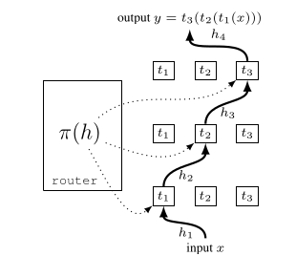
Routing
Introduced in 2017, a kind of zero-shot architecture search
Distinction between “hard” and “soft” routing
Many methods can be expressed as some simplified form of routing networks

Slide 4
Connections to biology
On a basic level, whole brain areas are modular, but their composition is usually very simple
Some theories cited about spiking synchrony used to route signals in a task/stimulus-specific way
Connections to our ideas about specific recurrent subnetworks in early visual areas being activated by stimuli; those could be “modules”

Slide 5
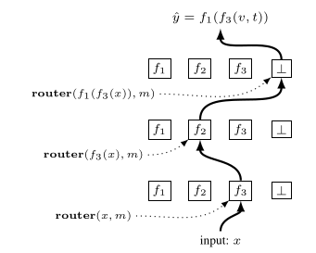
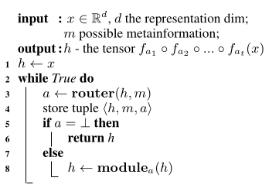
Routing networks (forward pass)

Slide 6
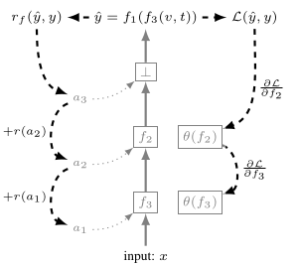
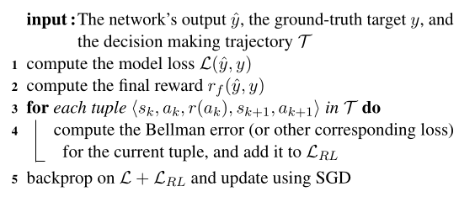
Routing networks (backward pass)

Slide 7
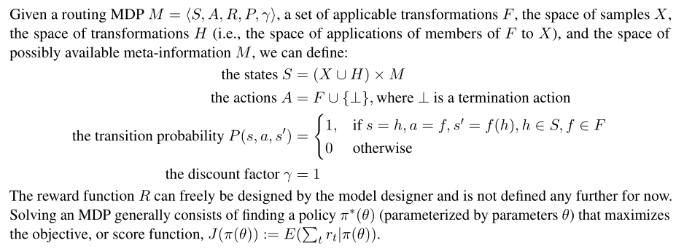
Framing as an MDP (slightly questionable)

Slide 8
Losses
Standard classification loss (sometimes binary right/wrong signals actually work better than more fine-grained accuracy)
Regularization: mostly about how often each module is used, trying to ensure diversity of use and avoid collapse

Slide 9
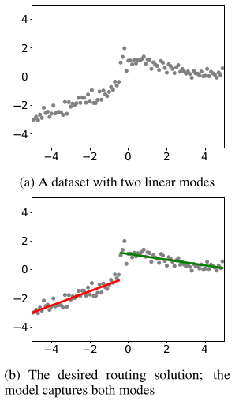
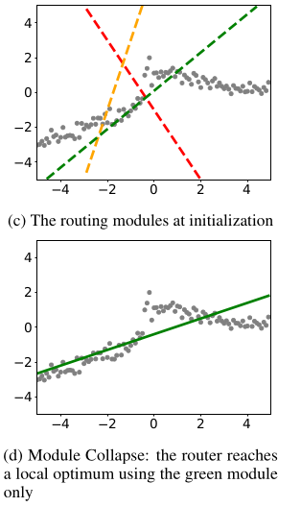
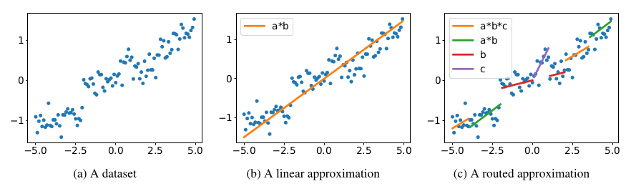
Problems with training
Very easy to overfit or underfit, due to highly flexible architecture and unstable training

Slide 10
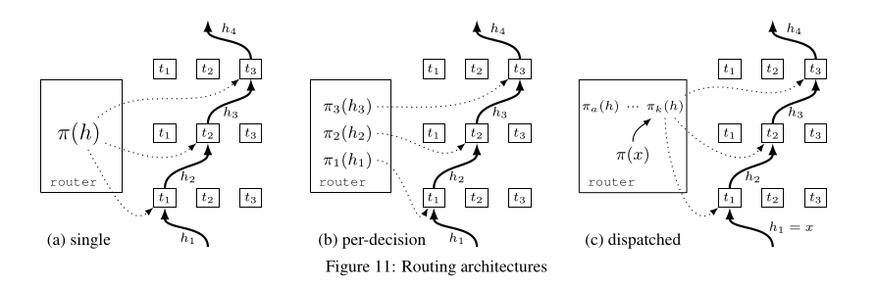
Simplified versions (non-exhaustive)
Adding constraints helps with stability, one of the biggest problems

Slide 11
Technical details (skippable)
They run experiments with a variety of different learning algorithms and losses, on CIFAR-100 (routing the CNN’s fully-connected layers) and an NLP task
Findings: simple SGD is best, value-based (not policy-gradient-based) learning algorithms work best, and meta-information (context) is very useful

Slide 12
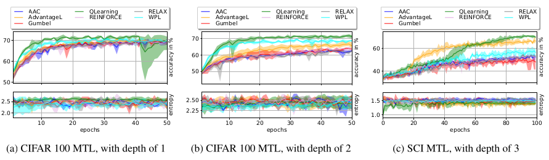
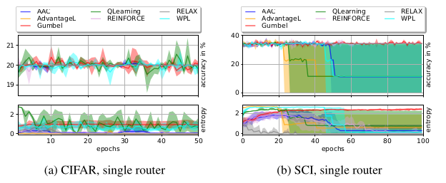
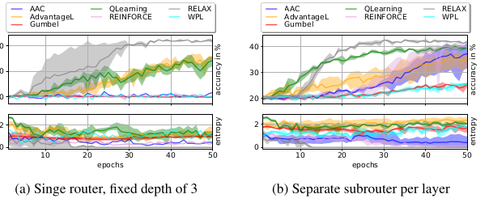
Technical details (skippable)

Slide 13
Conclusions
Biological connections might be kind of tenuous, but I’m not sure about the specifics regarding astrocytes
The method is very flexible, and a lot of the important work might center around finding constraints and simplifications that work

