Slide 1
SOM-VAE: INTERPRETABLE DISCRETE REPRESENTATION
LEARNING ON TIME SERIES
Vincent Fortuin, Matthias Hüser & Francesco Locatello

Slide 2
Background
● Generative modeling : GAN, VAE
● not interpretable
● not discrete -> self-organizing map (SOM)
● no notion of time -> Markov model

Slide 3
Overview
● Goal: learn interpretable discrete representations of High-dimensional time series
● Method:
● gradient-based version of SOM
● Markov model uncovers the temporal transition structure
● Dataset:
● (Fashion-)MNIST
● chaotic Lorenz attractor system
● eICU data
● Result:
● applied to high-dimensional data with salient data features and smoothness
● improves clustering performance

Slide 4
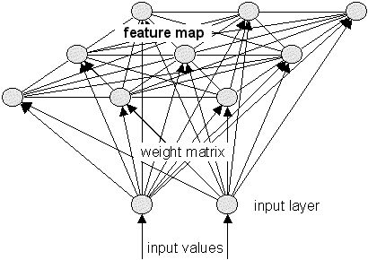
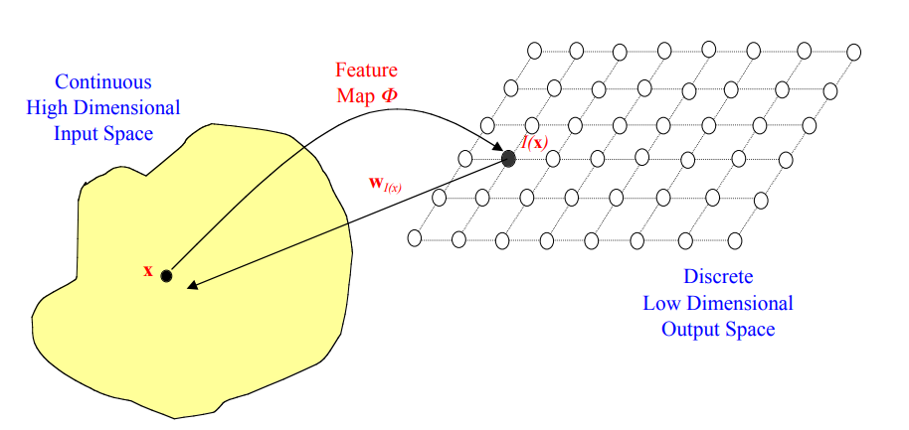
SOM : self-organizing map
Unsupervised neural networks that cluster high-dimensional data
Goal : cause different parts of the network to respond similarly to certain input patterns
Rule : competitive learning, Winner-Take-All
The training Process
1. Initialize neural network weights
2. Randomly select an input
3. Select the winning neuron using Euclidean distance
4. Update neuron weights
5. Go back to 2 until done training
https://www.cs.bham.ac.uk/~jxb/NN/l16.pdf

Slide 5
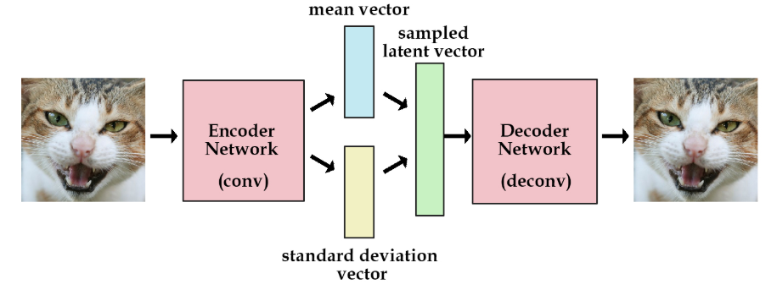
VAE : Variational autoencoders
Autoencoder: a deep learning technique for learning latent representations
VAE allowing easy random sampling and interpolation by outputting two distribution vectors

Slide 6
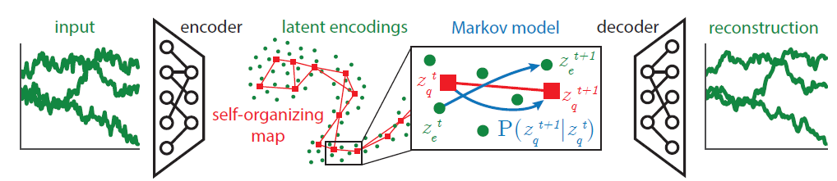
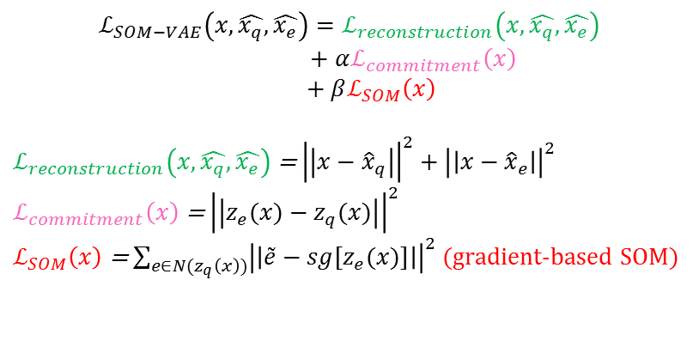
Model Architecture
SOM-VAE loss
Temporal loss
$$ℒ_{SOM−VAE}\left(x, \hat{x_{q}}, \hat{x_{e}}\right)=ℒ_{reconstruction}\left(x, \hat{x_{q}}, \hat{x_{e}}\right)$$
$$+ αℒ_{commitment}\left(x\right)$$
$$+ βℒ_{SOM}\left(x\right)$$
$ℒ_{reconstruction}\left(x, \hat{x_{q}}, \hat{x_{e}}\right)$ = ${\left|\left|x−{\hat{x}}_{q}\right|\right|}^{2}+{\left|\left|x−{\hat{x}}_{e}\right|\right|}^{2}$
$ℒ_{commitment}\left(x\right)$ = ${\left|\left|z_{e}(x)−z_{q}(x)\right|\right|}^{2}$
$ℒ_{SOM}\left(x\right)$ = $\sum_{e∈N(z_{q}\left(x\right))}{{\left|\left|{\tilde{e}−sg[z}_{e}(x)]\right|\right|}^{2}}$ (gradient-based SOM)

Slide 7
Technique
Overcoming the Non-Differentiability
Cannot compute a gradient with respect to a discrete nearest neighbor operation
VQ-VAE: They simply copy the feedback (gradient) from the codebook
SOM-VAE: add a fully differentiable path from the loss to the encoder
Encourage smoothness over time
define a system state as the assigned node in the SOM and then learn a Markov model for the transitions between those states, learned jointly with the SOM-VAE

Slide 8
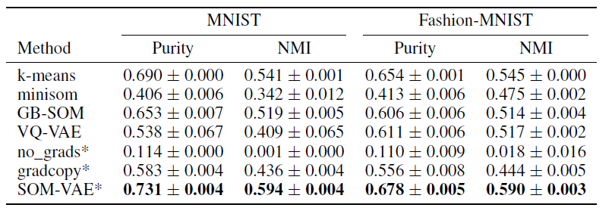
Result
We performed clustering experiments on static MNIST and Fashion-MNIST data to test the SOM-VAE

Slide 9
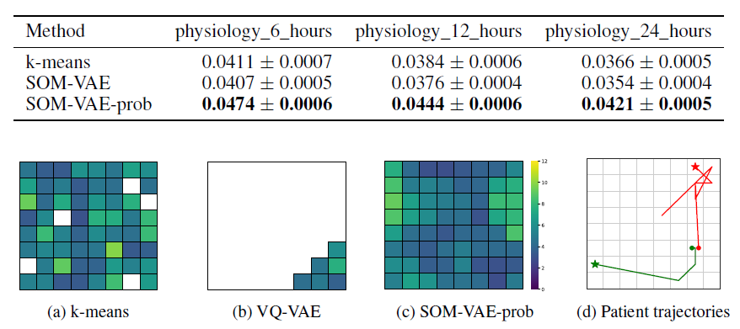
Then we performed experiments on real world eICU data to assess the interpretability and informativeness for downstream tasks (measured in NMI)

Slide 10
Conclusion
● recover topologically interpretable state representations on time series in an unsupervised way
● improve on clustering performance and informativeness for downstream tasks

