Slide 1
Differential contributions of visual concepts to CNN performance in object recognition
Xuyang Fang

Slide 2
What is Visual Concept?
Visual Concepts are introduced In order to see how frequently occurring patterns are represented.
We can study these patterns by using clustering methods to learn dictionaries of them at different levels of the visual hierarchy.
We call each cluster a ‘visual concept’.

Slide 3
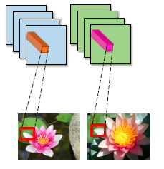
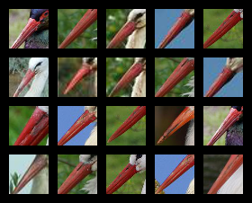
Use K-means to cluster the feature responses at the hidden layer of a CNN, yielding a dictionary of part representations known as Visual Concept.
The visualization of original image patches corresponding to pool3 hidden layer features in the same visual concept

Slide 4


The application of Visual Concept
1) as a regularizer
K-means:
( R Liao , A Schwing , R Zemel ,R Urtasun Learning Deep Parsimonious Representations, NIPS 2016)
Final objective: L+λR

Slide 5
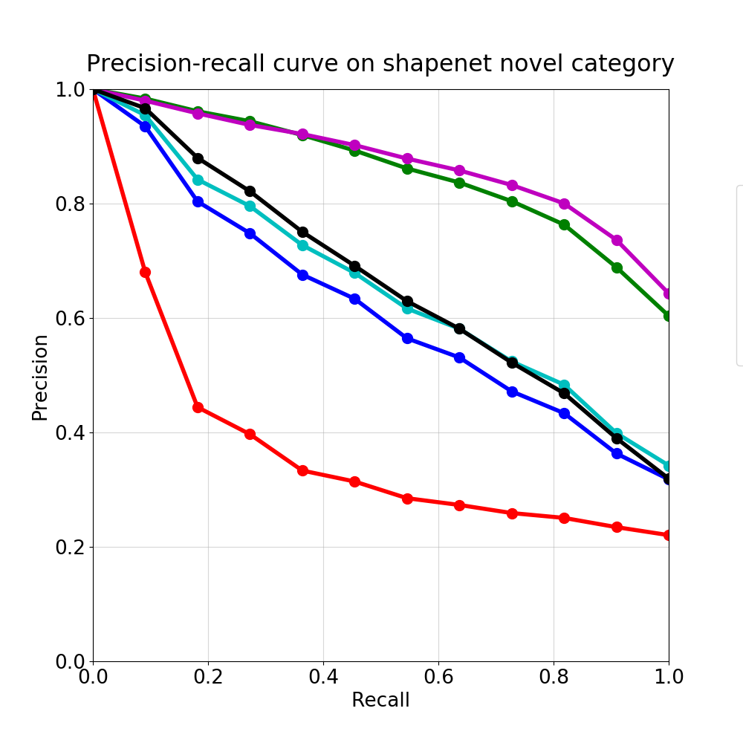
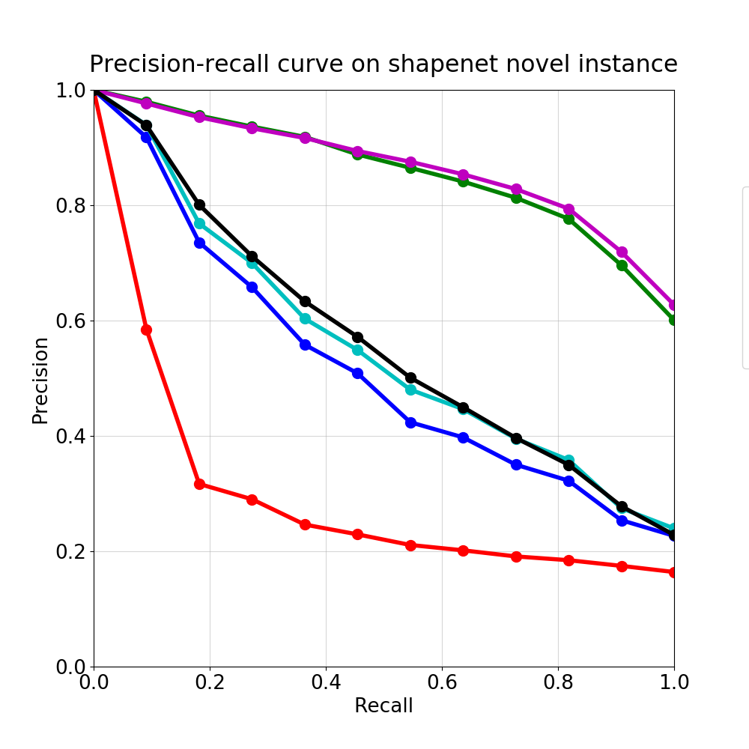
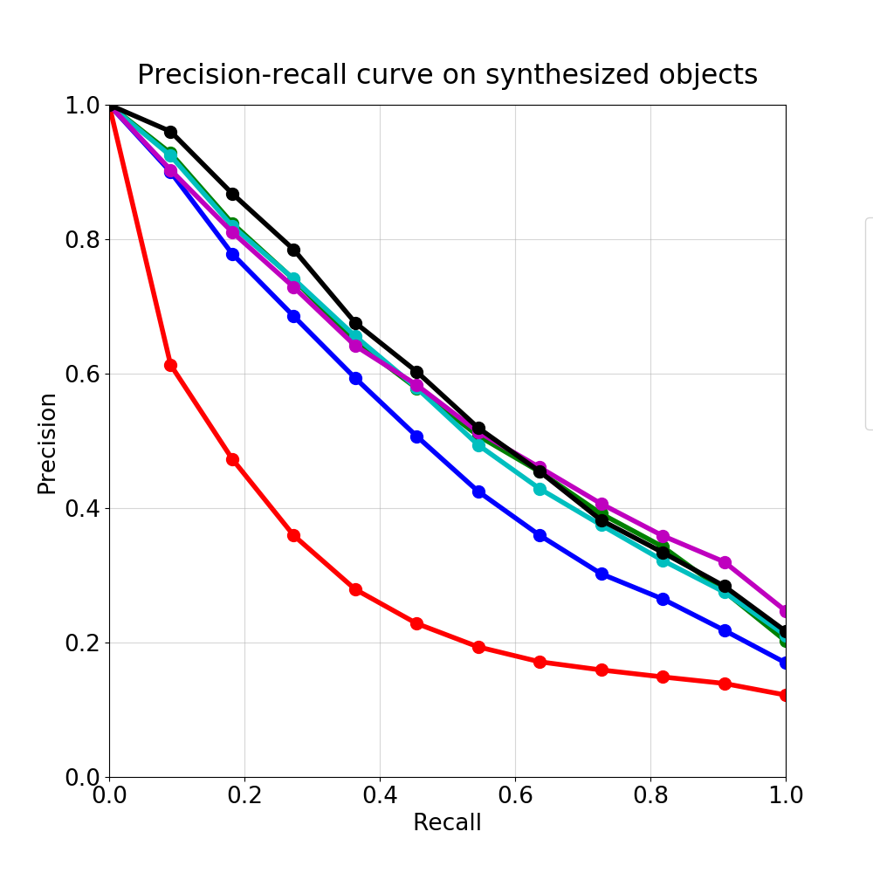
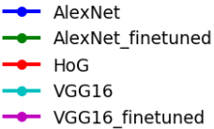
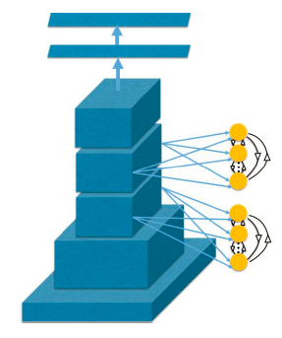
Sparse encoding:
BLACK CURVE:
VGG16_finetuned with sparse encoding
Integrate the visual concepts with deep networks by introducing additional neurons
The additional neurons, which we call vc-neurons, are trained using sparsity in an unsupervised manner. they can be trained jointly with the deep network. As new training data arrives, assigning the feature vector to the closest visual concept and updating the receptive field of that vc-neuron.
The vc-neurons compete with each other to explain the data yielding a soft-max output which ensures sparsity by encouraging only one vc-neuron to fire strongly (in the extreme version of hard-max only one vc-neuron would fire).
Introduce Sparse loss to the loss function

Slide 6
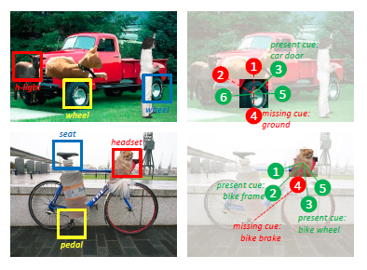
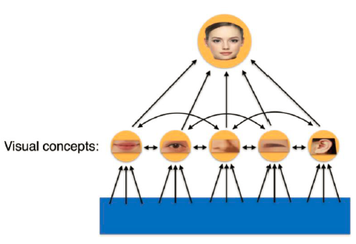
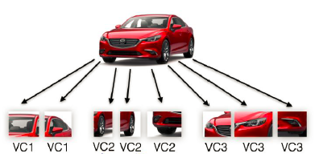
2) used in voting model in some recognition task
Factorized Model
Compositional model
switched off automatically in presence of occlusion
Notes:
Botziman gauss mixture

Slide 7
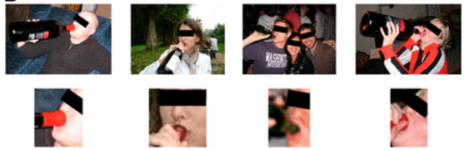
Intuition and motivation
It’s hard for a deep neural network trained by un-occluded images to recognize objects with occlusion.
However, human can easily recognize an object from only part of it. For example, A kid can recognize the panda hidden in the bamboos even if he hasn't seen many of this kind of animals before, and we can recognize our pet cats with only their tails or paws easily. Human can recognize an object from partial information, which enables human to easily recognize occluded objects.
The full images are highly variable. Recognition of the common action can be obtained from local configurations, in which variability is reduced.
human visual system uses features and processes that current models do not. As a result, humans are better at recognizing minimal images, and they exhibit a sharp drop in recognition at the MIRC(Minimal recognizable configurations) level, which is not replicated in models.
(cited : Ullman, S, et al. "Atoms of recognition in human and computer vision." Proceedings of the National Academy of Sciences of the United States of America 113.10(2016):2744.)

Slide 8
Approach
Motivated by all of above, here we propose a new method based on occlusion paradigm to find which parts are necessary and sufficient for object recognition.
Then we can focus on these parts and ignore the redundant ones, which could improve object recognition under occlusion. This method indicates that we can recognize objects from partial images, which enables computer vision to act more like a human
Problem to be solved:
1) How to find the parts of a certain category of objects without semantic part annotations and prior knowledge of that category ?
2) How to determine the usefulness of each individual or set of parts?

Slide 9
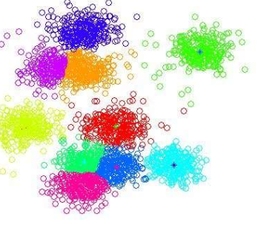
To find the parts of a certain category of objects without semantic part annotations and prior knowledge of that category, we apply an effective unsupervised clustering technique to cluster the feature responses at the hidden layer of a CNN called VGG, yielding a dictionary of part representations known as Visual Concept.
Step1:
Apply K-means to cluster the features at pool3 in pre-trained and fine-tuned VGG(a DCNN model) network, yielding a dictionary of visual concepts.
Tricks:
Evaluate a cluster through its nodes’ distance with each other and the distance between that cluster and other clusters.
If 20% of cluster A’s nodes are in a circle which can include 95% of cluster B’s node, then merge them together.
Use magic number to delete loose cluster
Step2:
Use greedy merging method to prune the visual concepts.

Slide 10
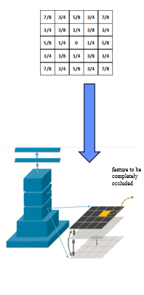
To determine the difference between recognition probability with or without specific visual concepts, we ‘occlude’ the visual concepts by modifying the unit responses corresponding to them in the pool3 feature layer of VGG with a Gaussian window during the inference process.
Step3:
Apply VGG to an image. Attenuate pool3 unit response corresponding to a visual concept within a Gaussian window.
Step4:
Calculate relative drop in probability of the target class with and without the presence of the VC. Large relative drop means the VC is more important.
Repeat with pair, triplet and quadruplet VCs and compare the difference between them

Slide 11
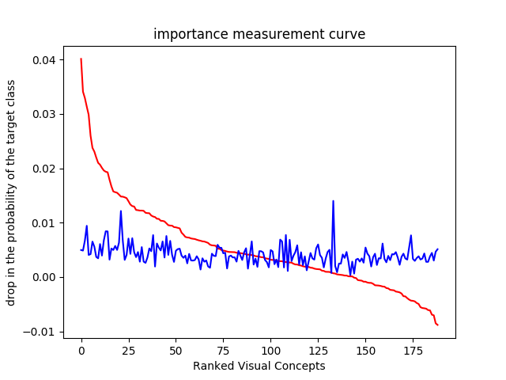
Why not evaluate the VC directly from the recognition probability of it?
Step5:
Apply VGG to an image. Attenuate pool3 unit responses outside Gaussian windows added on a VC, trying to explain the advantage of occlusion paradigm measurement.
Relative recognition drop got from using Occlusion Paradigm Method on single VC
Recognition accuracy got from step5 method on single VC

Slide 12
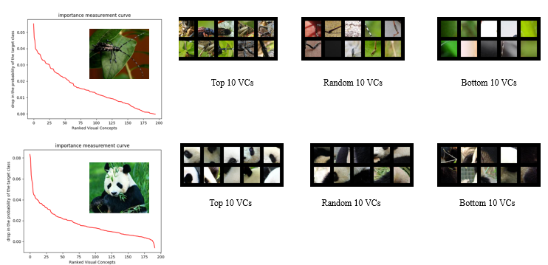
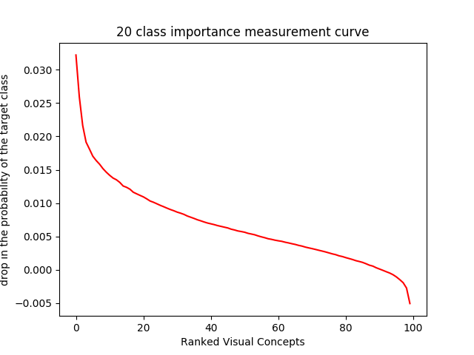
Result and Analysis
Occlude single VC

Slide 13
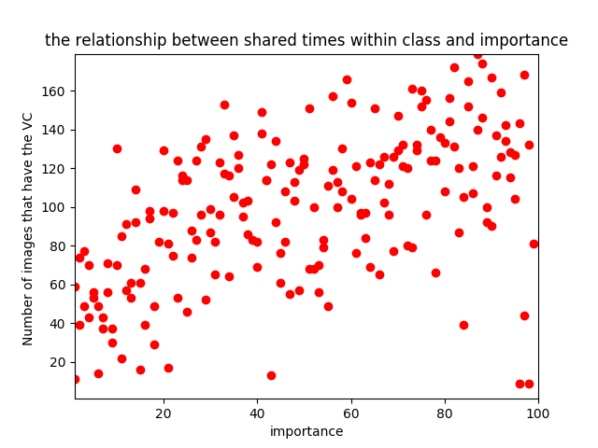
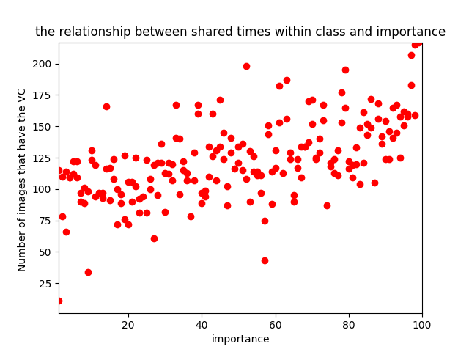
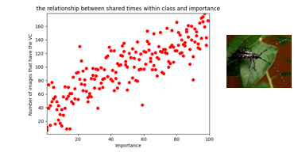
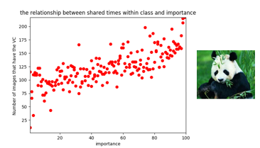
What makes some VCs more important?

Slide 14
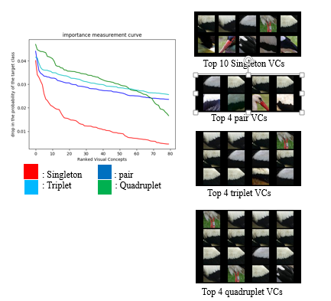
TOp 10 singleton VCs
The visualization of importance of pair VCs
Ranked Singleton VCs

Slide 15
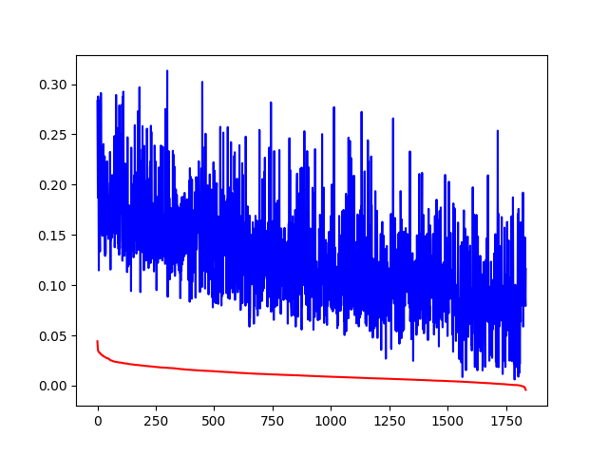


Future Work
Our work shows that different parts of an object have different impact on the recognition result. We obtained a dictionary of Visual Concepts sorted by importance in recognition task.
Our work indicates that it might be possible to recognize objects with partial information. After learning the useful parts, we plan to fine-tune the network by using these useful parts as training data, thus helping the networks focus on the key information for recognition task and ignore the redundant parts, which can potentially improve the performance of recognizing occluded objects.

