Slide 1
Summer project on visual concepts
Xuyang Fang

Slide 2
What is Visual Concept?
Visual Concepts are introduced In order to see how frequently occurring patterns are represented.
We can study these patterns by using clustering methods to learn dictionaries of them at different levels of the visual hierarchy.
We call each cluster a ‘visual concept’.

Slide 3
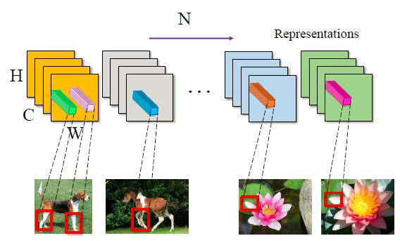



Slide 4
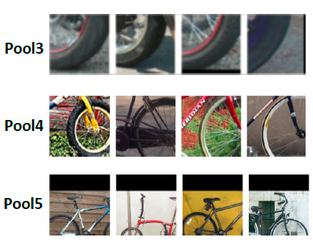
Visualization of Visual Concepts
This figure shows example visual concepts on different object categories from the VehicleSemanticPart dataset, for layers pool3,pool4 and pool5. Each row visualizes three visual concepts with four example patches, which are randomly selected from a pool of well-matched patches. These visual concepts are visually and semantically tight. We can easily identify the semantic meaning and parent object class.
Regularizer
Semantic part detector
Recognition
Faster computation
Notes:
Visual concepts from the fourth layer of a Siamese-Triplet Network with vc-neurons trained by competitive learning

Slide 5


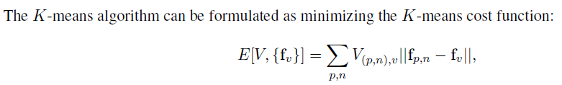
Clustering by using K-MEANS like method
For each input image I (corresponding to a view of the object) we obtain a set of feature vectors where is the deep network lattice at the fourth layer. We have a set of images.
We have a set of images of the objects
K-means algorithm takes as input the set of all fourth layer feature vectors for all the training images
we ignore the spatial positions of the feature vectors

Slide 6
Alan Yuille’s report for MICrONS Challenge
Sparse encoding and online clustering
Compositional model

Slide 7

Sparse Encoding for Visual Concepts
Integrate the visual concepts with deep networks by introducing additional neurons
The additional neurons, which we call vc-neurons, are trained using sparsity in an unsupervised manner. they can be trained jointly with the deep network. As new training data arrives, assigning the feature vector to the closest visual concept and updating the receptive field of that vc-neuron.
The vc-neurons compete with each other to explain the data yielding a soft-max output which ensures sparsity by encouraging only one vc-neuron to fire strongly (in the extreme version of hard-max only one vc-neuron would fire).
the vc-neuron’s respond to a feature vector
the receptive field of the neuron
A feature vector( in L3 or L4)

Slide 8
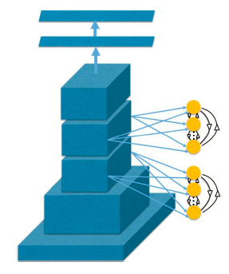
Detail implementation
N*H*W*num of visual concepts
multiply the elements in the last axis one by one. Sum, Mean, reverse to get the sparse loss.
Softmax on the last axis
N*H*W*num of visual concepts
Conv ( fv )
Normed Feature Vectors (N*H*W*C)
Exp: (2, 2) is less sparse than (1, 3)
And softmax(2,2) = exp(2)*2+exp(2)*2 /exp(2)+exp(2)
< softmax(1,3) = exp(1)*1+exp(3)*3 /exp(1)+exp(3)

Slide 9


Why softmax sparse encoding?
The key mathematical result underlying the equivalence between K-means and competitive learning is that normalization implies
The competitive learning can be interpreted as an online variant of the K -means algorithm, provided the feature vectors and the visual concepts are both normalized to unit norm. Experiments show that we get tighter clustering if we use the competitive learning algorithm than the original K-means clustering.
from loss function with regularization terms to loss functions with hidden variables
Sparse loss

Slide 10


Compositional Voting Model
Sparse Encoding of Spatial Patterns: we can encode a pixel p with feature vectors fp by a binary feature vector
T=0.8
Given a set of image patches corresponding to a semantic part we first encode each image into a set of binary valued encoding. This leads to a natural similarity measure between patterns, so that two patterns with similar encodings are treated as being the same underlying pattern
factorized model: SP means semantic part or object

Slide 11
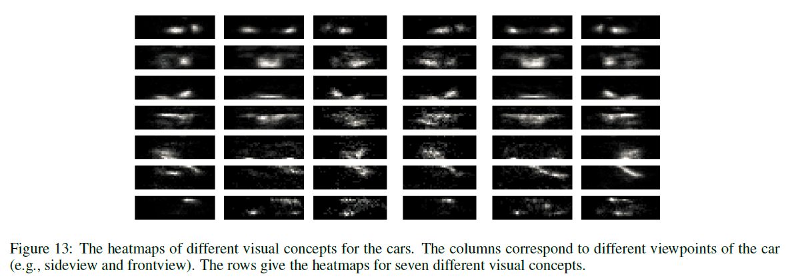
These binary features can also generate a for each visual concept to show how it responds on average to a semantic Part or object

Slide 12
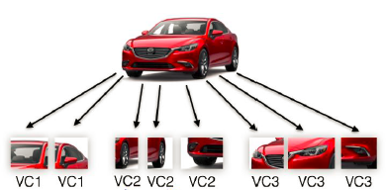
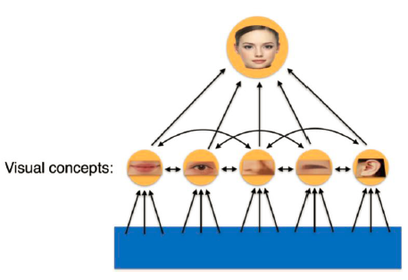
Factorized Model
Compositional model
Notes:
Botziman gauss mixture

Slide 13
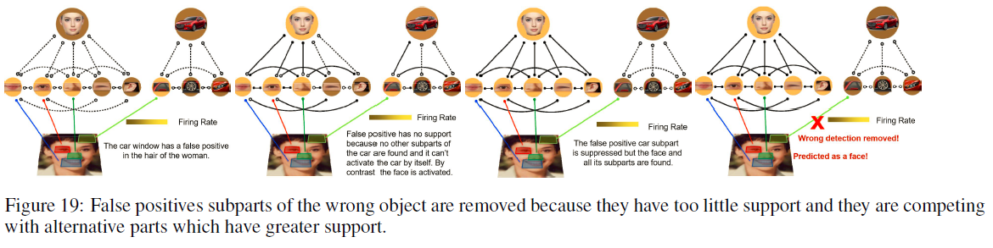

Slide 14
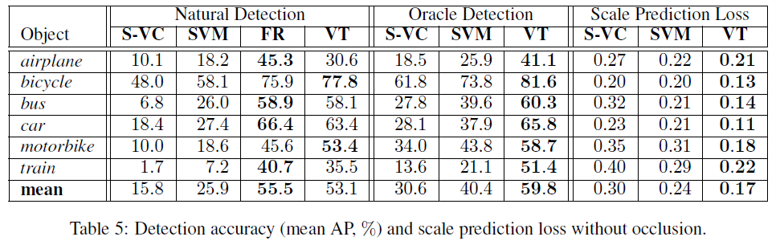
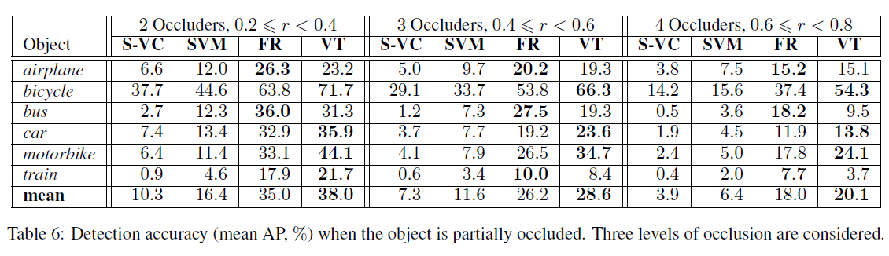

Slide 15
What do I want to do
show the advantage of visual concept by comparing the normal neural network and the network generated from visual concept layer, and experiments on xingyu's net and alan's net.
visualize the lower layer's visual concepts to see if they are common figures shared by different categories.
Does the sparsity of meaningless Visual Concepts do harm to the performance?
using occlusion paradigm to find the useful parts of visual concepts. Alan’s compositional model just find what contributes to the object but doesn’t find what exacly helps most to the recognition.
Normal nn
Visual concept neurons

