Slide 1



KPMG Proposal
April 2019

Slide 2
Agenda
Background and Project Scope
Existing Process
Initial thoughts on Improvement opportunities
Short Term Solution
Long Term Solution

Slide 3
Background, Objective and deliverables
Background
Objective
EXL F&A team is currently doing financial reporting work for KPMG (US) across all 3 verticals of KPMG - Audit, Tax, Advisory
EXL team has 14 members and is tasked with creation of ~575 different reports of different cadence. In total, 5000+ deliverables are produced in a month
KPMG is looking to add value to current reporting process through optimizing the process with short and long term solutions.
Standardize, improve and automate current workflow for following value adds
Visual enhancements
Process improvement
Reduce turnaround time
Reduce manual intervention
Improve accuracy
Deliverables
Estimation of time and effort for process improvement and streamline
Enhancement of reports
Any related documentation
Notes:
Font - simplify

Slide 4
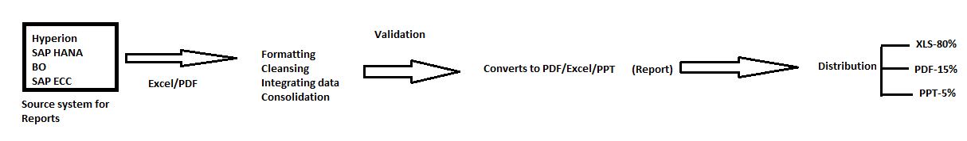
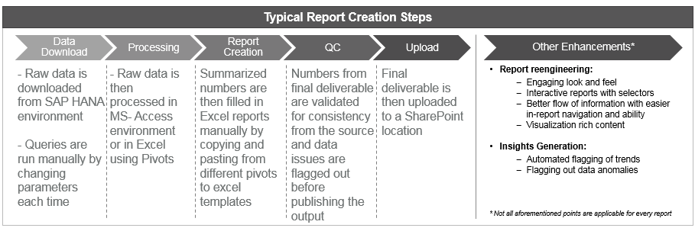
Current Process FLOW
Report are generated for TAX, Audit, Advisory, Suit system.
90% generated reports are straight pull from source and sent to stakeholders , rest 10 % involves some logical changes. Team can view the data model available at source end. Delivers 5000+ reports on monthly basis. Reports are placed in shared path / SharePoint / Inbox for users.
Notes:
Formatting – needs to be cleaned up
-- See slide 6 from Visa Deck
---Add slide 5 content below

Slide 5
Challenges with the current PROCESS
1) 500+ distinct reports are being exported manually from source systems into Excel and manual processing done on these before exporting to xls, pdf and ppt to be sent to users via SharePoint, shared path or inbox.
2) Source systems are reporting tools (Hyperion, BO and ECC) currently having not sufficient configuration to support the reporting needs hence team needs to process it in Excel.

Slide 6
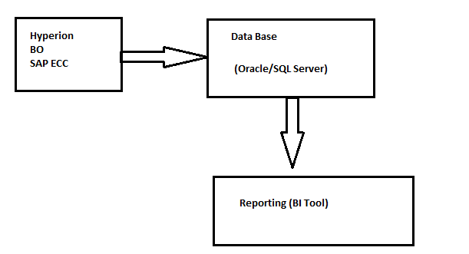
Tactical Solution
Manual process can be reduced by implementing the database structure and automating the queries to build the reports instead of manually generating excel files.
Team confirmed 90% of reports are direct pull from Source system, rest 10 % has some logical changes. We can focus on those 10 % report by migrating the dependent entity into table and build reports out of it.
Notes:
Data basr-Rename Aquistion layer(slide 14 format to be followed)
Add slide 13(Refer VISA ppt)

Slide 7
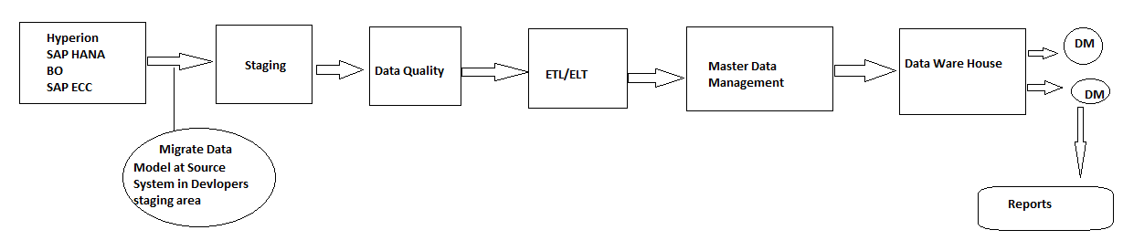
long term Solution
1) Migrate all data model component at source end into report development workspace, perform ETL/ELT and build the DW .Derive reports based on DW and schedule it to user inbox. This will remove all redundant and manual task involved in developing and distributing reports to end user.
2) Access server configuration and do load analysis. Based on this optimize/reconfigure the server to match reports requirement. Build all the reports at the source system itself and schedule it to user inbox. This will remove all redundant and manual task involved in developing and distributing reports to end user.
Notes:
Slide no -17

Slide 8
ASK:
1) How much manual effort is involved on monthly basis? Person-hours on daily /weekly/monthly based on reports and data volume.
2) Categories and define the complexity of reports based on subject area, logic and data volume. Share the stat for same.
3) Let us know the configuration of all the source systems.
4) Share the requirement document for reports developed by team.
5) Share adhoc request stat and content to understand the requirement in depth.
6) Detail document on source system which includes information on universe ,its object, security etc., all DB objects.
7) Share Top 10 critical reports based on logic and usage.

