Slide 1

E2E PROJECT
Title of Project
Reel2MovieName: Multimodal Movie Identification from Short Video Clips
Team Guide: Dr. N. Srihari Sir
Batch No: 04
S.No | Roll Number | Name
1. | 23BQ1A05H3 | P. Sathwik
2. | 23BQ1A05D3 | M. Krishna Revanth
3. | 23BQ1A05F1 | M. Leela Madhavi
4. | 23BQ1A05F2 | N. Yaswanth

Slide 2

PHASE-1:IDEATION AND PLANNING

Slide 3

PROBLEM IDENTIFICATION
Short-video platforms like Instagram Reels and YouTube Shorts widely share movie scenes without mentioning the movie name.
Viewers often struggle to identify the original movie from short, edited, or low-context video clips.
Replacement or removal of original movie audio makes existing audio-based identification tools unreliable.
Users depend on comments or manual searching, which is time-consuming and often inaccurate.
Lack of proper movie identification leads to misinformation and poor content attribution.
The entertainment and media technology industries require better solutions for content discovery and audience engagement.
There is a need for a reliable, cross-platform system that can identify movies using multiple inputs such as video, audio, and text.
Movie?

Slide 4
PROBLEM STATEMENT
There is no widely available cross-platform system that can reliably identify movies from short video clips across both web and Android platforms, especially when audio is modified or missing. Existing solutions fail to combine multiple sources of information such as audio, visuals, and text. Hence, there is a need to develop a multimodal movie identification system that can analyze short video clips and provide accurate movie details through both a web application and an Android application.

Slide 5
MODULE DIVISION
User Interface Module (Web & Android):
Provides user interaction through a web app and Android app
Allows users to upload short video clips or paste reel/video URLs
Validates video size, duration, and format before upload and displays upload status, loading indicators, and results
Video & Audio Processing Module:
Trims the uploaded video to a fixed short duration
Extracts the audio track from the video and key video frames at regular intervals or scene changes
Reduces processing load by avoiding full video analysis
Temporarily stores extracted media and deletes it after processing
Audio Recognition Module:
Analyzes extracted audio using audio fingerprinting
Matches audio with known movie soundtracks or dialogues
Generates movie name with a confidence score and Sends results to the decision module for validation
Visual Analysis Module:
Processes key video frames as images
Analyzes actors, costumes, scenes, and visual patterns
Compares frames with known movie scene representations
Useful when audio is missing or replaced and Outputs visually matched movie candidates with confidence

Slide 6

Text Extraction & NLP Module
Extracts on-screen text using OCR techniques
Analyzes hashtags, captions, or metadata (if available)
Filters and extracts meaningful keywords and provides additional clues for movie identification
Decision & Fusion Module
Combines results from audio, visual, and text modules and selects the most accurate movie match
Assigns priority based on confidence scores
Detects and resolves conflicts between different sources
Movie Information Retrieval Module
Fetches movie details from external movie databases
Retrieves title, release year, cast, genre, and ratings
Ensures structured and up-to-date information
Enhances the final output quality for users.

Slide 7
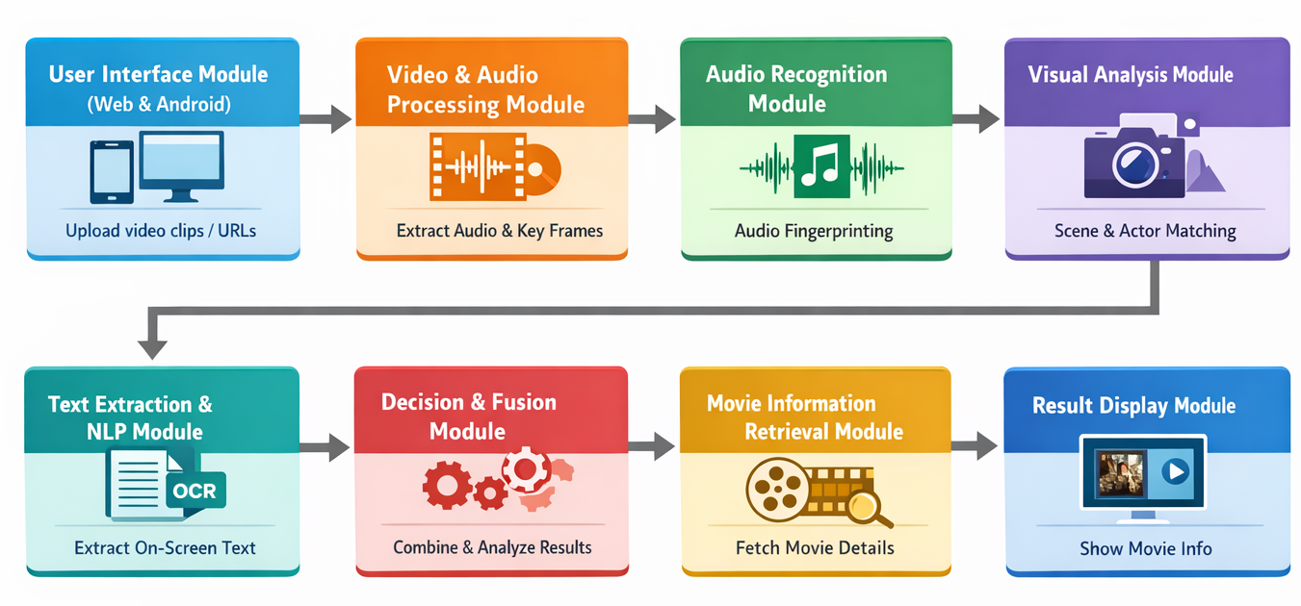
Result Display Module
Displays identified movie details clearly
Shows confidence level and related information
Presents posters, cast lists, and summaries

Slide 8
TECHNICAL STACK
Frontend
Web Application: React.js
Android Application:
Android Studio
WebView (to load the web application)
Backend / AI / Services
FastAPI, Python, Uvicorn
AI & ML: PyTorch, CLIP, NumPy
Text / NLP: spaCy
Audio Recognition: ACRCloud API
Movie Info: TMDB API
Deployment Platforms
Backend: Render
Web App: Vercel
. Database: MongoDB
Android App: Android Studio APK

Slide 9
Github Link : https://github.com/leelamadhavi0211/Reel2MovieProject-Batch04.git

