Slide 1
Billing Analysis & Recommendations
By - Leela manikanta Cheekatla

Slide 2
Data Analysis & Validation Approach
• Implement daily validation of billing data to ensure accuracy.
• Used Excel formulas to check lease charge calculations.
• Cross-check lease start dates and billing initiation to identify misalignments.
• Flag discrepancies and collaborate with relevant teams to resolve issues.

Slide 3
Key Questions for Cross-Team Collaboration
• Are there standard rules for lease charge calculations?
• How frequently is pricing data updated?
• What steps are followed when a billing discrepancy is found?
• How do we ensure lease status (Active, Surplus) is always updated?
• Who should be contacted for resolving incorrect charges?

Slide 4
Key Billing Trends & Insights
• Lease charges vary by vehicle model and cap cost.
• Some units have initial billing dates misaligned with in-service dates.
• Identified a pattern of lease charge discrepancies exceeding $100 threshold.
• Certain models consistently have billing errors due to outdated pricing data.

Slide 5
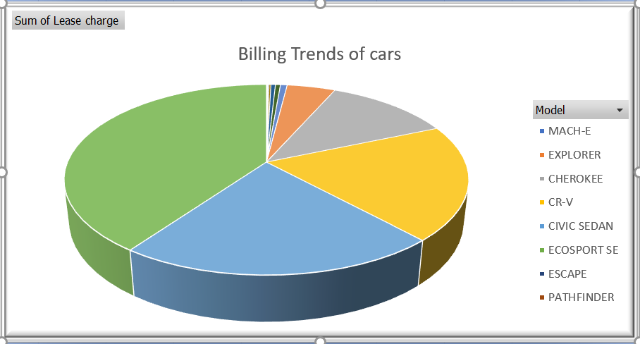
Billing Trends of Cars
This pie chart shows the distribution of lease charges across different vehicle models.
Larger segments indicate higher total lease charges for that model, showing the most frequently leased vehicles.

Slide 6
Lease Charge Summary
This table provides a breakdown of lease charges by vehicle model.
Higher charges for models like Corolla and Patriot indicate their higher
leasing frequency and potential billing risks.

Slide 7
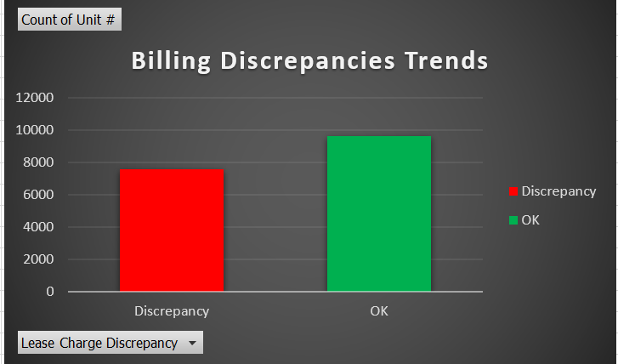
Billing Discrepancies Trends
This bar chart provides an updated view of billing discrepancies.
7,564 units have lease charge discrepancies, whereas 9,622 units are correctly billed.
This indicates a need for better validation processes to reduce errors.

Slide 8
Discrepancy Count Summary
This table summarizes the count of units with discrepancies versus correctly billed units.
Approximately 44% of the units have lease charge discrepancies, highlighting potential process gaps.
Resolving these discrepancies can improve billing accuracy and financial reporting.

Slide 9
Potential Process Breakdowns
• Lack of automated validation for lease billing accuracy.
• Inconsistencies in unit status updates leading to incorrect billing.
• Manual data entry errors impacting lease charge calculations.
• Misalignment in data between inventory and pricing sheets, causing discrepancies.

Slide 10
Recommended Controls for Billing Accuracy
• Implement automated lease charge validation using Excel formulas.
• Use Data Validation in Excel to prevent incorrect data entry.
• Automate discrepancy flagging using Conditional Formatting.
• Establish a regular audit process to ensure accurate billing and lease status updates.
• Improve communication between teams to resolve discrepancies efficiently.

Slide 11
Summary & Next Steps
Billing validation must be a daily process.
Automating checks will reduce errors significantly.
Next Steps:
- Implement automated Excel validations.
- Strengthen team collaboration for issue
resolution.
- Conduct regular audits to refine billing accuracy.

