Slide 1
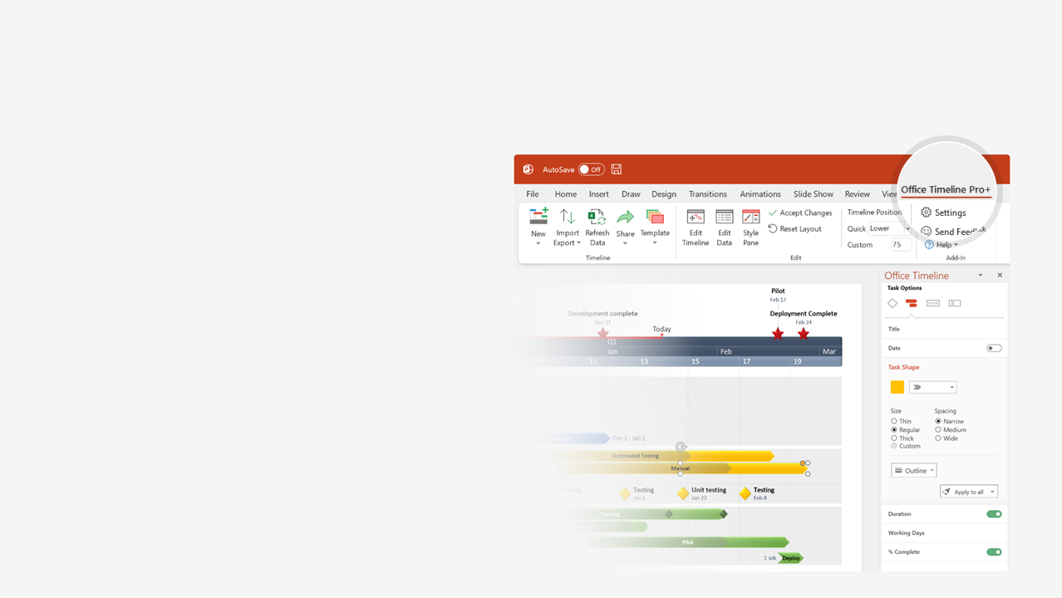

How to update this template in seconds
The Office Timeline add-in for PowerPoint will help you edit it with just a few clicks.
Get your free 14-day trial of Office Timeline here: https://www.officetimeline.com/office-timeline/14-days-trial Re-open this template, and create your impressive PowerPoint visual in 3 easy steps:
1
Click the Edit Data button on the Office Timeline tab.
2
Use the Data and Timeline views to edit swimlanes, milestones and tasks.
3
Click Save to instantly update the template.

Slide 2
2022/Mar
2022/Jul
2022/Sep
2022/Dec
Kickoff Meeting
KPIs Defined
Jan 28 - Mar 31
Jul 13 - Sep 30
Feb 17 - Mar 31
Oct 21 - Dec 25
Jan 2 - Mar 31
Jun 4 - Jul 11
Feb 23 - Apr 7
Apr 2 - Apr 28
Apr 2 - Jun 10
Jul 7 - Sep 14
Aug 3 - Oct 28
Sep 1 - Oct 21
Apr 2 - Jun 2
Feb 2 - Apr 7
Jun 5 - Aug 5
Apr 1 - Sep 1
44.8 days
56.4 days
43.5 days
30.4 days
18.3 days
62.2 days
63.8 days
44.5 days
45.9 days
26 days
46 days
50 days
50 days
7.1 wks
Dec 20
Aug 10
Oct 19
May 19
Oct 18
Dec 21
Jan 16
Mar 31
Mar 31
Jul 28
2022
Apr 1
Jun 7
75%
75%
75%
75%
Today
2022
Swimlane Diagram template
Q1 Review
Q2 Review
Q3 Review
Q4 Review
Q1
Q2
Q3
Q4
Vision
100%
Planning
Objectives
100%
100%
Goals
Strategic Intent
Sales Budget
Beta + Release Plans
Competitor Review
Market Analysis
SWOT
Price List (Hypothesis)
Strategy
Business Model
Price Research
Final Price List
Objectives
Sales Trends Analysis
Service Development
Alpha
Private Beta
Public Beta
Staging
Go Live!
6.1 wks
22 wks
May 20
Jun 30
Aug 10
Nov 15
Dec 20
75%
Product Roadmap
Development
RC
Release to Web
Business Intelligence
Service Metrics
Quality Metrics
Service Dashboard
Real-time Analytics
Sales Dashboard
Conversion Metrics
Real-time Reporting

