Slide 1
Making Mario In Silico

Slide 2
Approach
Create ensemble of weak learners for prediction of cell type. For example,
Labels: Cell types 1:16
AITC
Menthol
Capsaicin
K40
R3J
GFP
IB4
Image

Slide 3
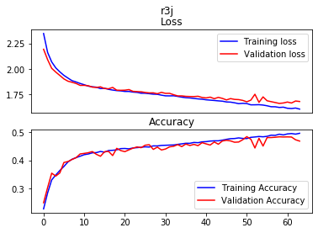
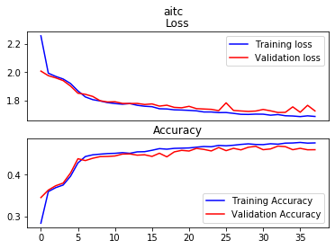
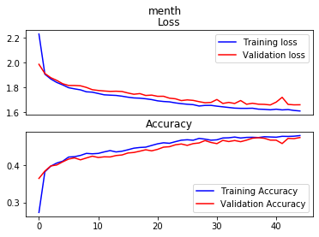
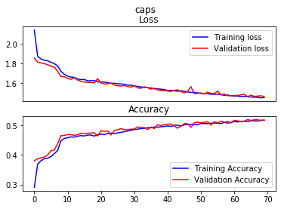
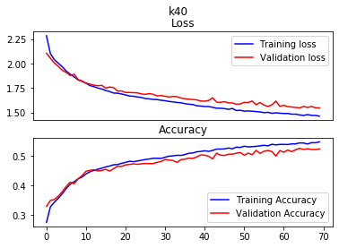

Slide 4
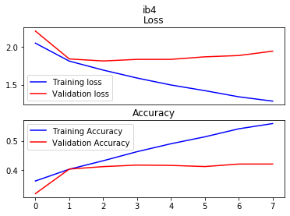
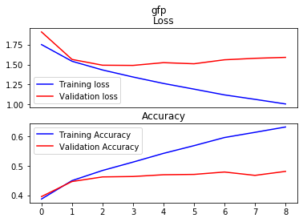
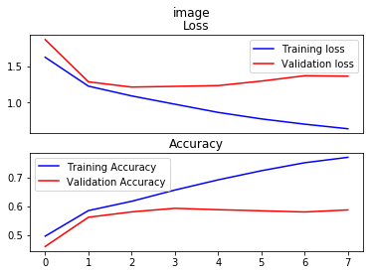

Slide 5
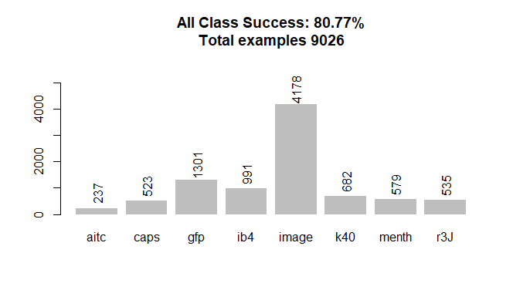

Slide 6
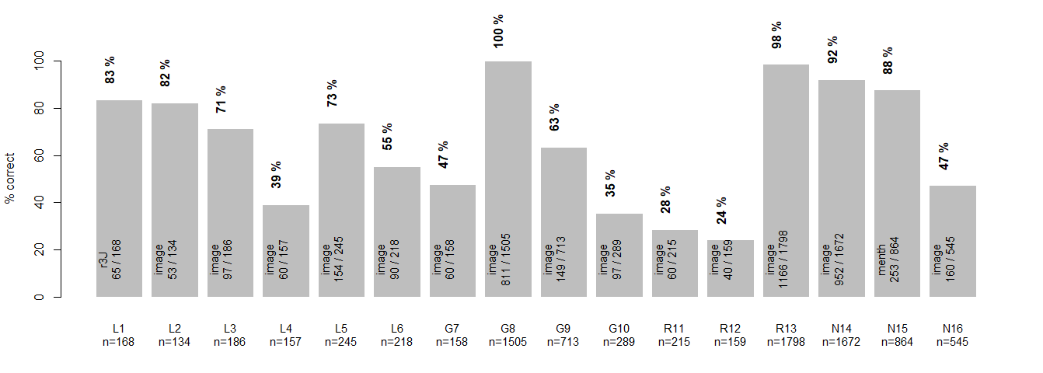

Slide 8
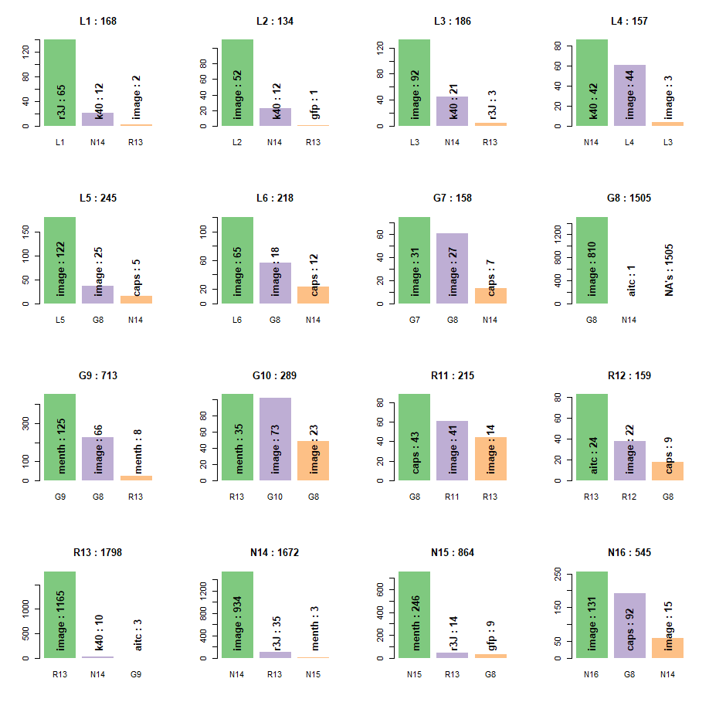

Slide 9
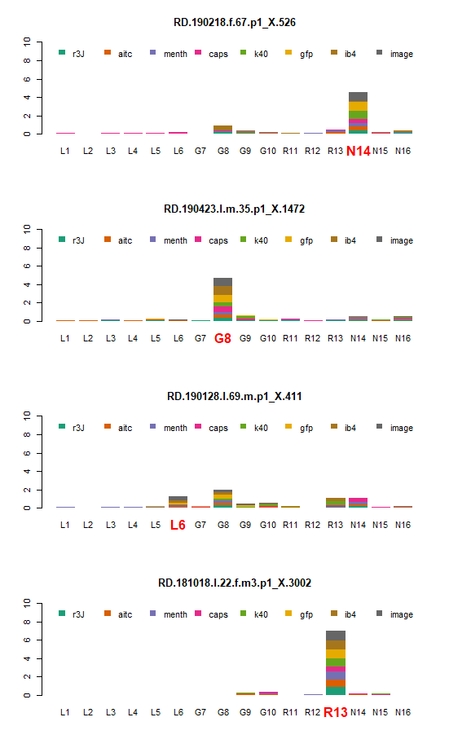
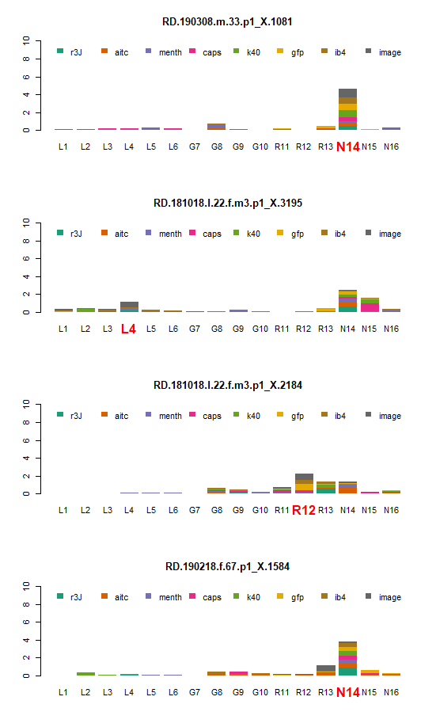
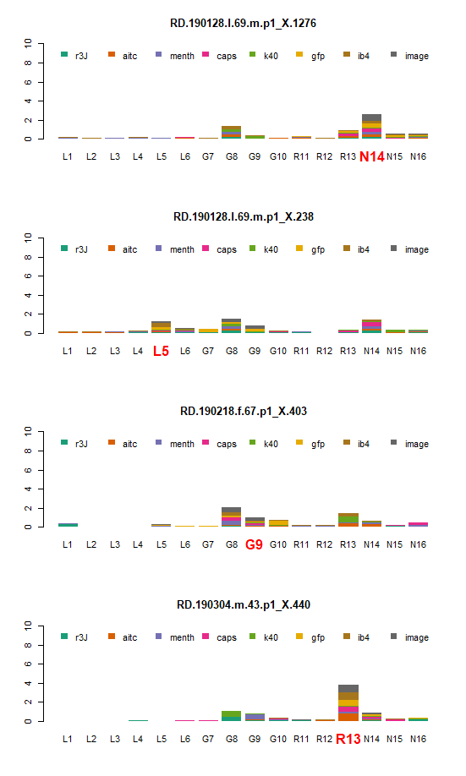

Slide 10
Approach
Create ensemble of weak learners for prediction of cell type. For example,
Labels: Cell types 1:16
AITC
Menthol
Capsaicin
K40
R3J
GFP
IB4
Image

Slide 11
Approach
Create ensemble of weak learners for prediction of cell type. For example,
Labels: Cell types 1:16
AITC
Menthol
Capsaicin
K40
R3J
GFP
IB4
Image

Slide 12
Approach
Create ensemble of weak learners for prediction of cell type. For example,
Labels: Cell types 1:16
AITC
Menthol
Capsaicin
K40
R3J
GFP
IB4
Image

Slide 13
Approach
Create ensemble of weak learners for prediction of cell type. For example,
Labels: Cell types 1:16
AITC
Menthol
Capsaicin
K40
R3J
GFP
IB4
Image

Slide 14
Approach
Create ensemble of weak learners for prediction of cell type. For example,
Labels: Cell types 1:16
AITC
Menthol
Capsaicin
K40
R3J
GFP
IB4
Image

Slide 15
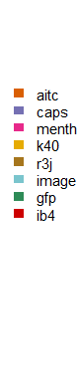
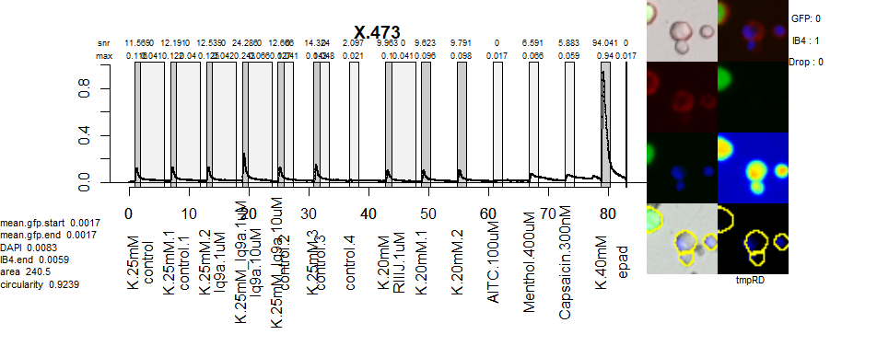

Slide 24
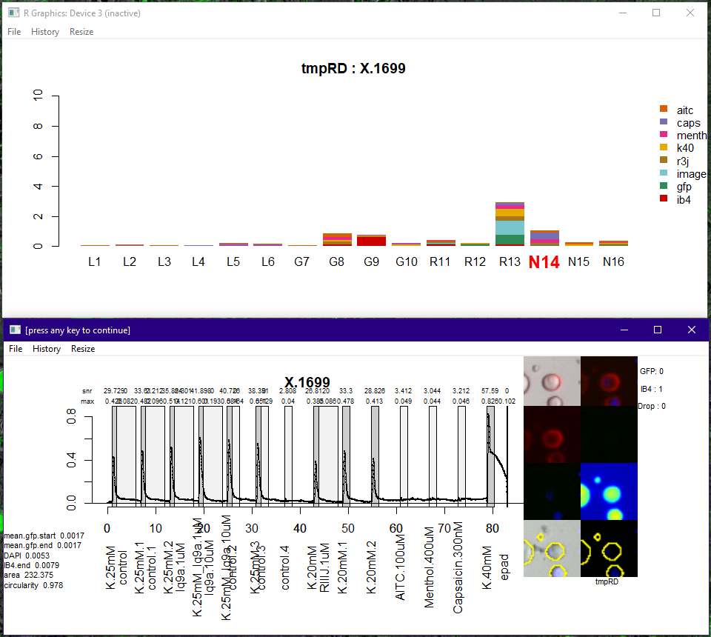

Slide 25
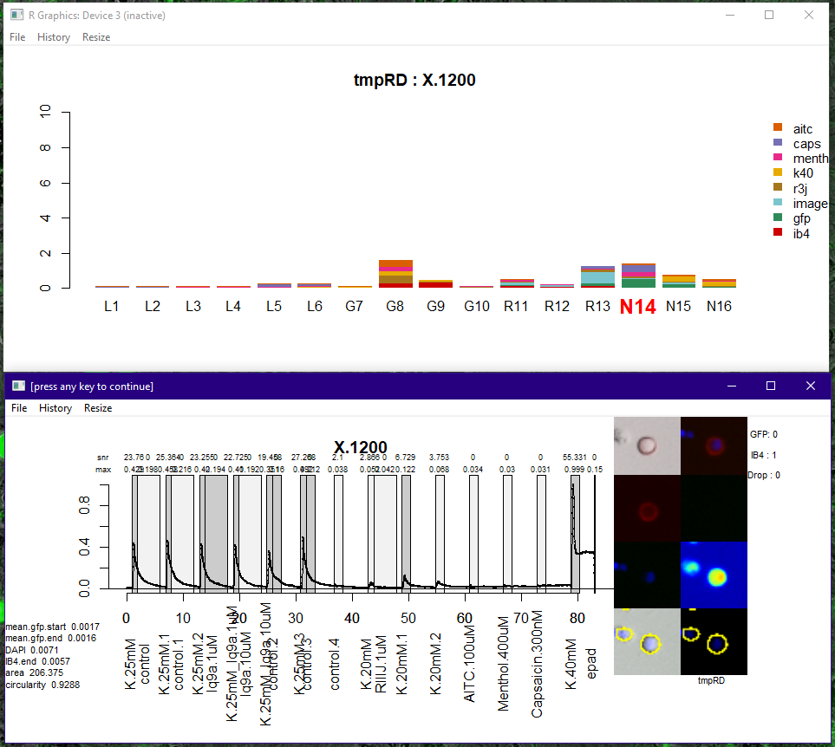

Slide 26
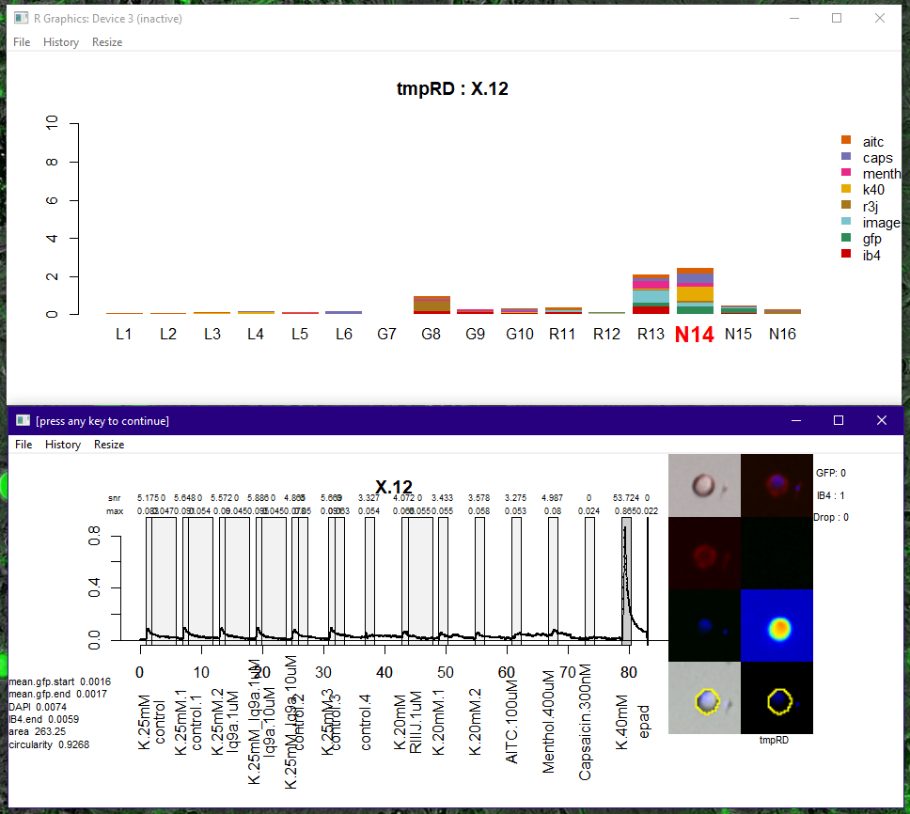

Slide 27
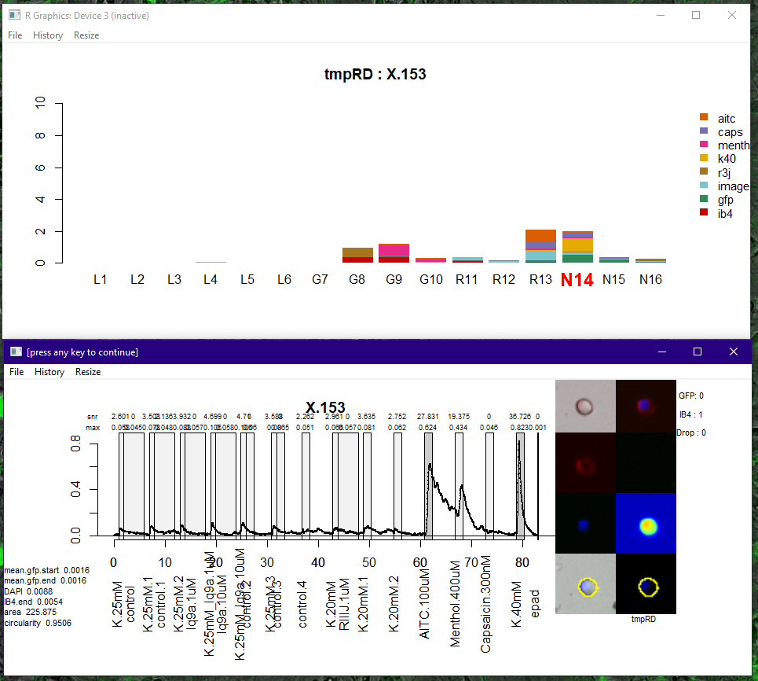

Slide 28
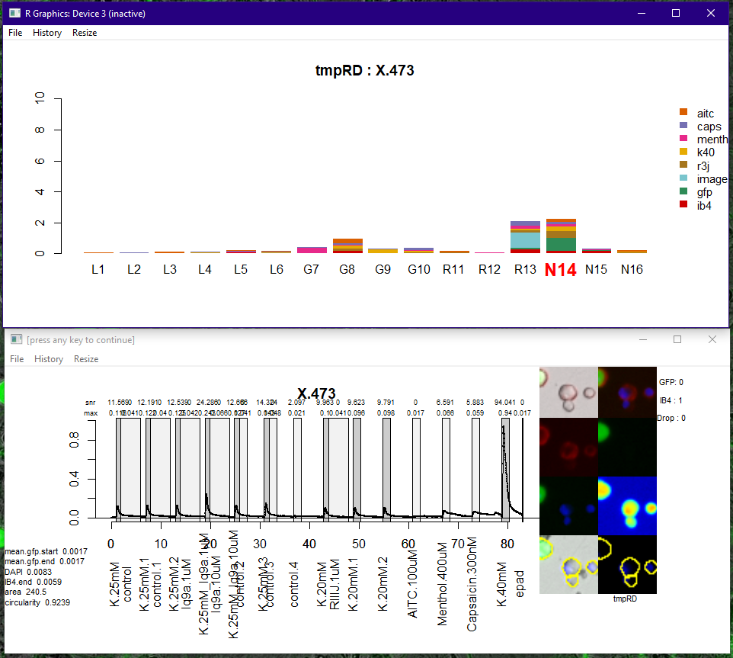

Slide 29
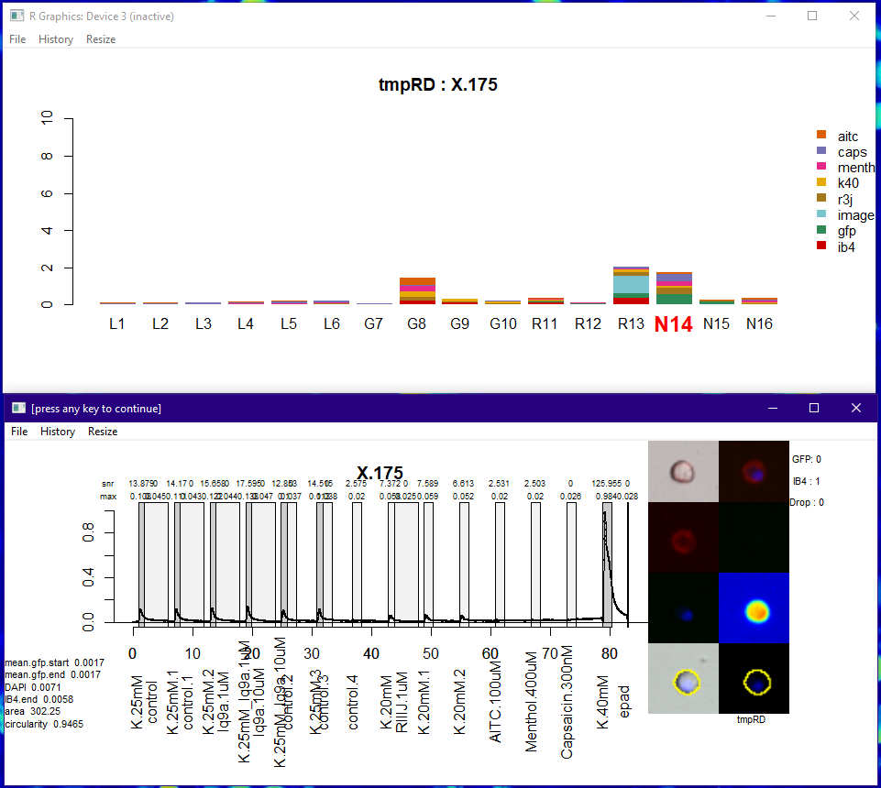

Slide 30
