Slide 1
The Byzantine Generals Problem
Leslie Lamport, Robert Shostak, and Marshall Pease
ACM TOPLAS 1982
Practical Byzantine Fault Tolerance
Miguel Castro and Barbara Liskov
OSDI 1999

Slide 2
Announcements
Dave is at Hotnets
  TA (James Hendricks) gave lecture
Outline requested by 11/30
  Not graded, but less sympathy if you skip. Goals: (1) Ensure you pass, (2) help you cut down on amount of effort spent
  Feel free to give James drafts of writeup at any time

Slide 3
A definition
Byzantine (www.m-w.com):
  1: of, relating to, or characteristic of the ancient city of Byzantium
  …
  4b: intricately involved : labyrinthine <rules of Byzantine complexity>
Lamport’s reason:
  “I have long felt that, because it was posed as a cute problem about philosophers seated around a table, Dijkstra's dining philosopher's problem received much more attention than it deserves.”
  (http://research.microsoft.com/users/lamport/pubs/pubs.html#byz)

Slide 4
Byzantine Generals Problem
Concerned with (binary) atomic broadcast
  All correct nodes receive same value
  If broadcaster correct, correct nodes receive broadcasted value
Can use broadcast to build consensus protocols (aka, agreement)
  Consensus: think Byzantine fault-tolerant (BFT) Paxos

Slide 5
Synchronous, Byzantine world
Synchronous
Asynchronous
Fail-stop
Byzantine

Slide 6
Cool note
Example Byzantine fault-tolerant system:
  Seawolf submarine’s control system
Sims, J. T. 1997. Redundancy Management Software Services for Seawolf Ship Control System. In Proceedings of the 27th international Symposium on Fault-Tolerant Computing (FTCS '97) (June 25 - 27, 1997). FTCS. IEEE Computer Society, Washington, DC, 390.
But it remains to be seen if commodity distributed systems are willing to pay to have so many replicas in a system

Slide 7
First protocol: no crypto
Secure point-to-point links, but no crypto allowed
Protocol OM(m): Recursive, exponential, all-to-all
  [Try to sketch protocol – see page 388]
  May be inefficient, but shows 3f+1 bound is tight
  [Discuss: Understand that this is for synchronous setup without crypto!]
Need at least 3f+1 to tolerate f faulty!
  See figures 1 and 2
  How to fix? Signatures (for example). Or hash commitments, one-time signatures, etc.

Slide 8
Second protocol: With crypto
Protocol SM(m)
  [Page 391, but can skip protocol]
  Given signatures, do m rounds of signing what you think was said. Many messages (don’t need as many in absence of faults).
  Shows possible for any # of faults tolerated
  [Discuss. Understand: Synchronous, lots of messages, but possible.]
[Skip odd topologies. Note that “signature” can be emulated for random (not malicious) faults.]

Slide 9
Practical Byzantine Fault Tolerance:
Asynchronous, Byzantine
Synchronous
Asynchronous
Fail-stop
Byzantine

Slide 10
Practical Byzantine Fault Tolerance
Why async BFT? BFT:
  Malicious attacks, software errors
  Need N-version programming?
  Faulty client can write garbage data, but can’t make system inconsistent (violate operational semantics)
Why async?
  Faulty network can violate timing assumptions
  But can also prevent liveness
[For different liveness properties, see, e.g., Cachin, C., Kursawe, K., and Shoup, V. 2000. Random oracles in constantipole: practical asynchronous Byzantine agreement using cryptography (extended abstract). In Proceedings of the Nineteenth Annual ACM Symposium on Principles of Distributed Computing (Portland, Oregon, United States, July 16 - 19, 2000). PODC '00. ACM, New York, NY, 123-132.]

Slide 11
Distributed systems
Async BFT consensus: Need 3f+1 nodes
  Sketch of proof: Divide 3f nodes into three groups of f, left, middle, right, where middle f are faulty. When left+middle talk, they must reach consensus (right may be crashed). Same for right+middle. Faulty middle can steer partitions to different values!
[See Bracha, G. and Toueg, S. 1985. Asynchronous consensus and broadcast protocols. J. ACM 32, 4 (Oct. 1985), 824-840.]
FLP impossibility: Async consensus may not terminate
  Sketch of proof: System starts in “bivalent” state (may decide 0 or 1). At some point, the system is one message away from deciding on 0 or 1. If that message is delayed, another message may move the system away from deciding.
  Holds even when servers can only crash (not Byzantine)!
  Hence, protocol cannot always be live (but there exist randomized BFT variants that are probably live)
[See Fischer, M. J., Lynch, N. A., and Paterson, M. S. 1985. Impossibility of distributed consensus with one faulty process. J. ACM 32, 2 (Apr. 1985), 374-382.]

Slide 12
Aside: Linearizability
Linearizability (“safety” condition) -- two goals:
  Valid sequential history
  If completion of E1 precedes invocation of E2 in reality, E1 must precede E2 in history
Why it’s nice: Can reason about distributed system using sequential specification
[Can give example on board if time]
[See Herlihy, M. P. and Wing, J. M. 1990. Linearizability: a correctness condition for concurrent objects. ACM Trans. Program. Lang. Syst. 12, 3 (Jul. 1990), 463-492.]

Slide 13
Cryptography
Hash (aka, message digest):
  Pre-image resistant: given hash(x), hard to find x
  Second pre-image resistant: given x, hard to find y such that hash(x) = hash(y)
  Collision resistant: hard to find x,y such that hash(x) = hash(y)
  Random oracle: hash should be a random map (no structure)
  Assembly SHA1 on 3 GHZ Pentium D -- ~250 MB/s
  Brian Gladman, AMD64, SHA1: 9.7, SHA512:13.4 (cycles/byte)
MACs: ~1 microsecond, > 400 MB/s (700 MB/s?)
Signatures: ~150 microseconds – 4 milliseconds
  150 microseconds: ESIGN (Nippon Telegraph and Telephone)
  (Compare to Castro’s 45 millisecond on PPro 200)
Castro&Liskov use 128-bit AdHash for checkpoints. Broken by Wagner in 2002 for keys less than 1600 bits.Moral of the story: Beware new crypto primitives unless they reduce to older, more trusted primitives!

Slide 14
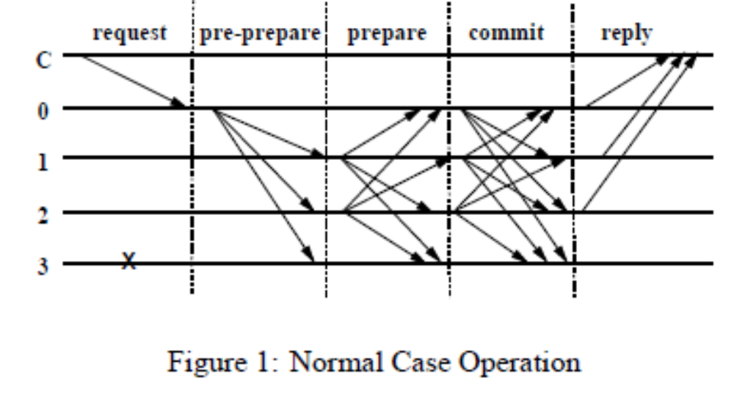
Basic protocol
Plus view change protocol, checkpoint protocol.
Question: When is this not live?
Answer: During successive primary timeouts. (Compare to Q/U)

Slide 15
Recent systems
[Show network patterns]
Q/U: 5f+1, 1 roundtrip (SOSP 2005)
H/Q: 3f+1, 2 roundtrips (OSDI 2006)
Zyzzyva: 3f+1, 3 one-way latencies but need 3f+1 responsive

Slide 16
Evaluation
Only implemented parts of protocol that mattered for evaluation/analysis
  Hint: Not a bad idea for 712 projects!
NFS loopback trick is pretty standard -- good idea for prototyping
Tolerate 1 fault, use multicast.
BFT prototype: no disk writes
  NFS server: disk writes for some operations!
  Explanation: Replication provides redundancy
  Is this a fair comparison? How about BFS vs replicated NFS?

