Slide 1
Blockchain

Slide 2
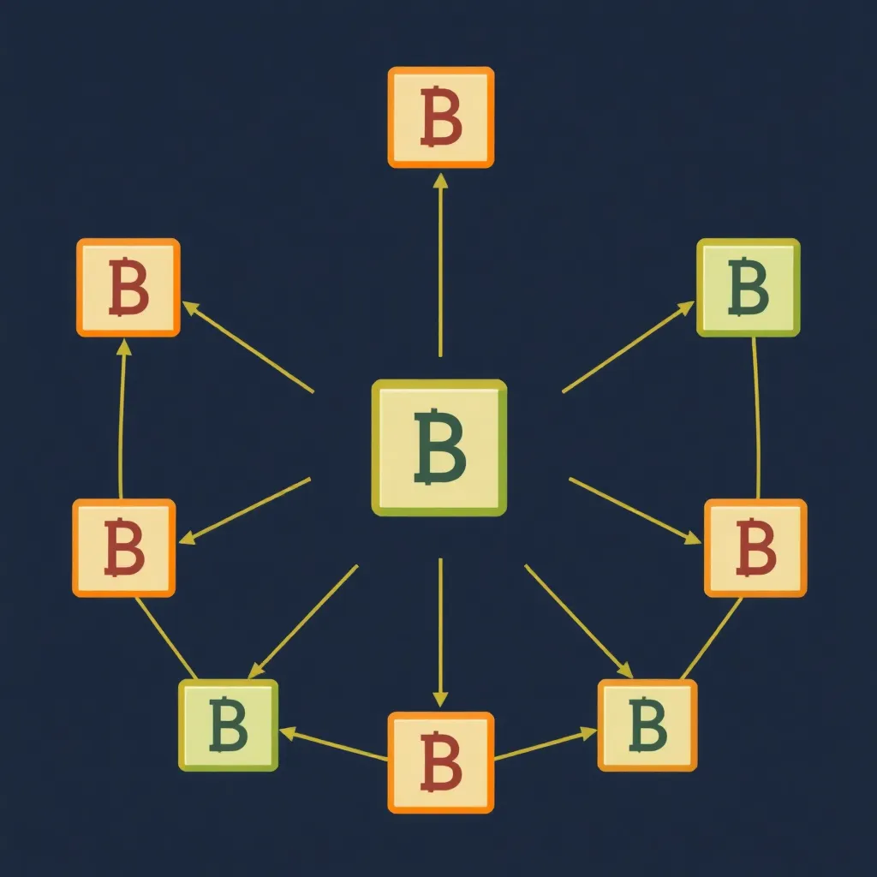
What is Blockchain?
• Distributed ledger technology
• Peer-to-peer network
• Secure, transparent, and immutable

Slide 3
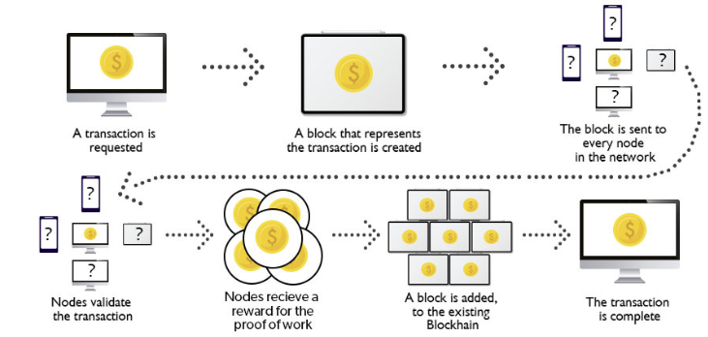
How Does Blockchain Work?
1. Transaction is initiated and packaged into a block
2. Block is broadcast to the network for validation
3. Network validates the transaction using consensus
4. Block is added to the blockchain, making the transaction complete

Slide 4
Key Features of Blockchain
• Decentralization: No single authority controls the blockchain
• Transparency: All transactions are visible to participants
• Security: Advanced cryptographic methods ensure data security
• Immutability: Once added, data cannot be altered

Slide 5

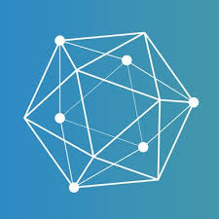
Types of Blockchain
• Public Blockchain: Open to everyone (e.g., Bitcoin)
• Private Blockchain: Restricted access (e.g., Hyperledger)
• Consortium Blockchain: Governed by multiple organizations (e.g., Corda)

Slide 6
Blockchain in Action – Real-World Use Cases
• Cryptocurrency: Used for creating and managing digital currencies (e.g., Bitcoin)
• Supply Chain: Track products from production to delivery
• Finance: Secure and fast cross-border payments
• Healthcare: Secure patient records and data privacy

Slide 7
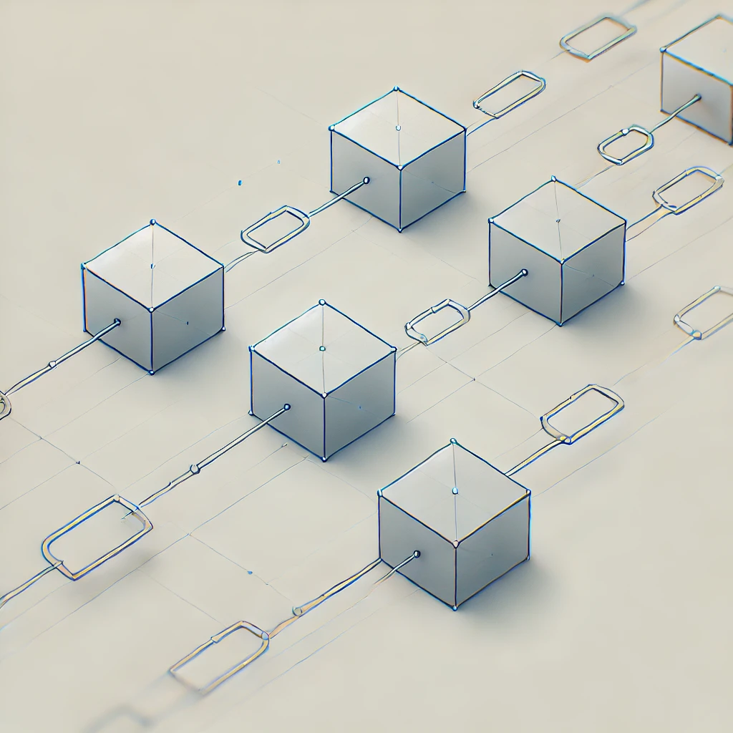
Benefits and Challenges
Benefits:
• Improved security
• Transparency and reduced costs
Challenges:
• Scalability issues
• High energy consumption
• Regulatory challenges

Slide 8
The Future of Blockchain
• Interoperability: Enabling different blockchains to communicate
• Green Blockchain: Solutions addressing energy concerns
• Central Bank Digital Currencies (CBDCs): Blockchain in mainstream finance

Slide 9
Conclusion
Blockchain is a decentralized, secure, and transparent technology
with the potential to revolutionize industries. Although it faces challenges,
the possibilities for its applications are vast and promising.

Slide 10
Thank you

