Slide 1


Issue of Homelessness
Team Details
1. G.ANAGHA SANJANA - 22071A0218 – EEE-A
2. G.THARUN - 22071A6657 – AIML-A
3. G.LEELESAWARA ADITYA - 22071A6718 – CSD-A
Mentor Name : Dr.K.Archana Bhange
Centre for Presencing & Design Thinking
VNRVJIET

Slide 2

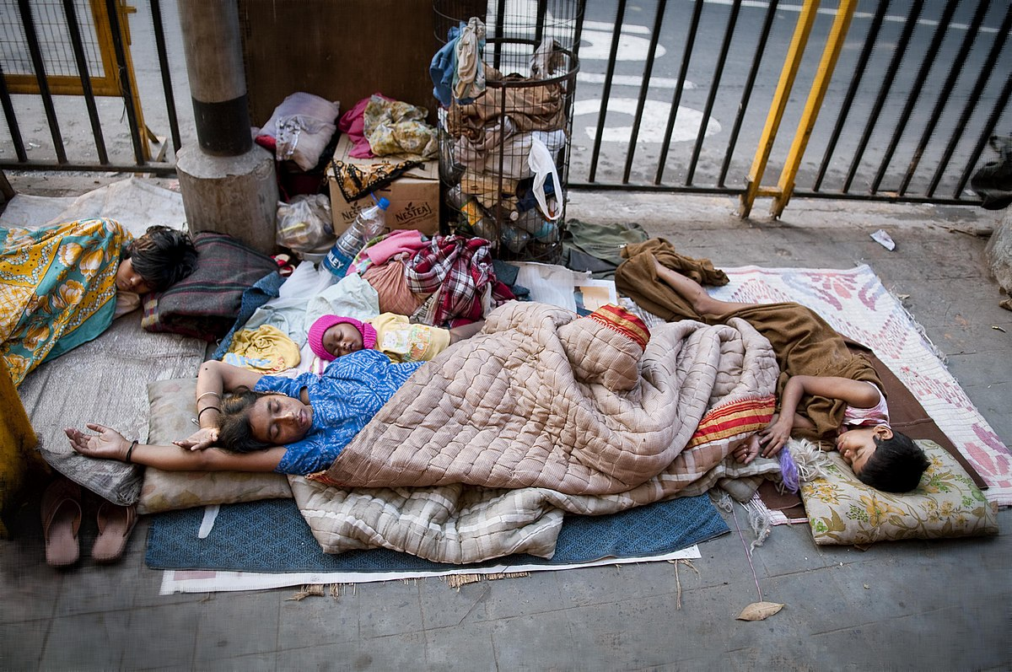
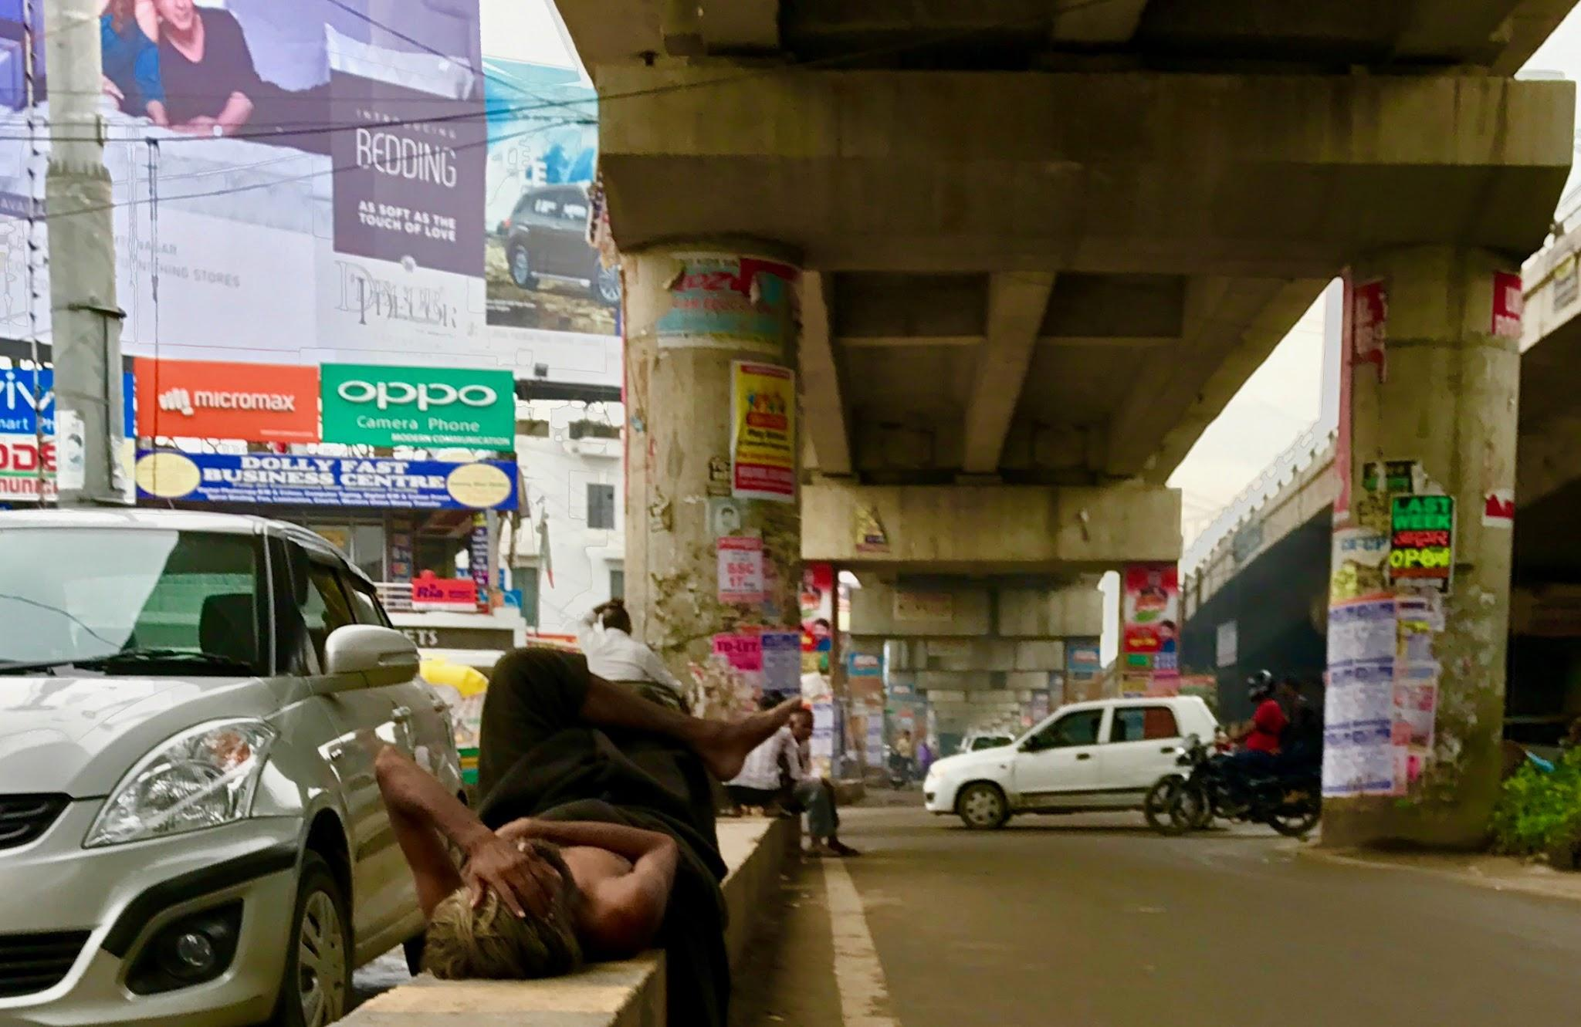
Problem Statement:
Address the issue of homelessness and recommendations for temporary housing solutions with safety.

Slide 3
Value Proposition
Addressing homelessness through temporary housing reflects a commitment to human rights, social justice, and dignity restoration. The strategy recognizes and tackles systemic issues like poverty and housing shortages, promoting social equity and inclusivity. It contributes to public health and safety by mitigating health risks for individuals and communities. Stable housing is considered vital for economic productivity, aiding individuals in regaining employment and stability. The initiative fosters innovation and collaboration, aiming for sustainable social impact and the creation of resilient, inclusive, and compassionate communities.

Slide 4
Selected Users & other Stakeholders
Selected Users
Individuals experiencing homelessness
Vulnerable Populations
Communities experiencing Homelessness
Stakeholders
Government Agencies
Non-profit Organizations
Business and private Sector
Healthcare providers

Slide 5
Empathy Process – User Persona
Demographics:
Age: 32
Gender: Female
Employment: Part-time administrative assistant
Education: College graduate
Marital Status: Single
Ethnicity: Hispanic
Residence: Urban area, currently experiencing homelessness
Behavior:
Sarah is diligent and hardworking but faced job loss due to company downsizing, leading to financial instability and eventual homelessness.
Despite her situation, she actively seeks employment opportunities and engages in local community programs for support.
She values her independence and is determined to overcome her current challenges to regain stability.
SAMPLE
What She Is Looking For:
Immediate Shelter: Sarah is looking for a safe and temporary housing solution where she can find stability while actively seeking employment.
Employment Opportunities: Her primary goal is to secure stable employment to regain financial independence and transition out of homelessness.
Stress Points:
Job Insecurity: The uncertainty of finding stable employment is a significant stress point for Sarah, affecting her confidence and well-being.
Lack of Permanent Housing: The absence of a stable living situation adds stress, making it challenging for Sarah to plan for the future or focus on long-term goals.
Anxiety and Mental Health: Dealing with anxiety related to her homelessness situation and the societal stigma associated with it can be overwhelming at times..

Slide 6
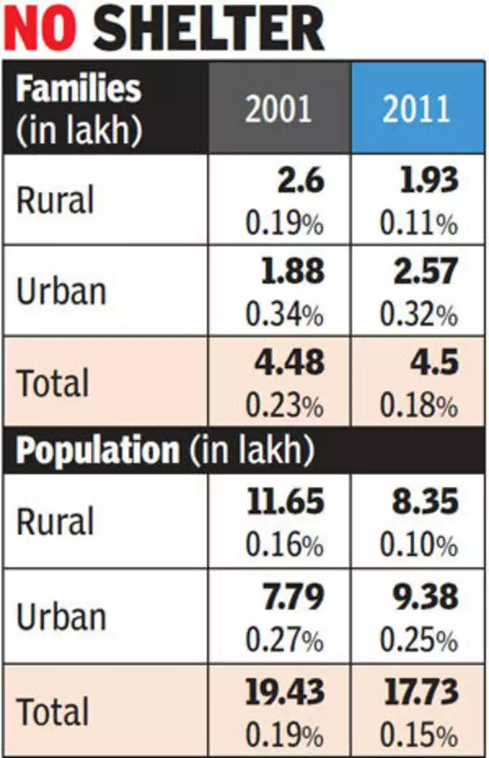
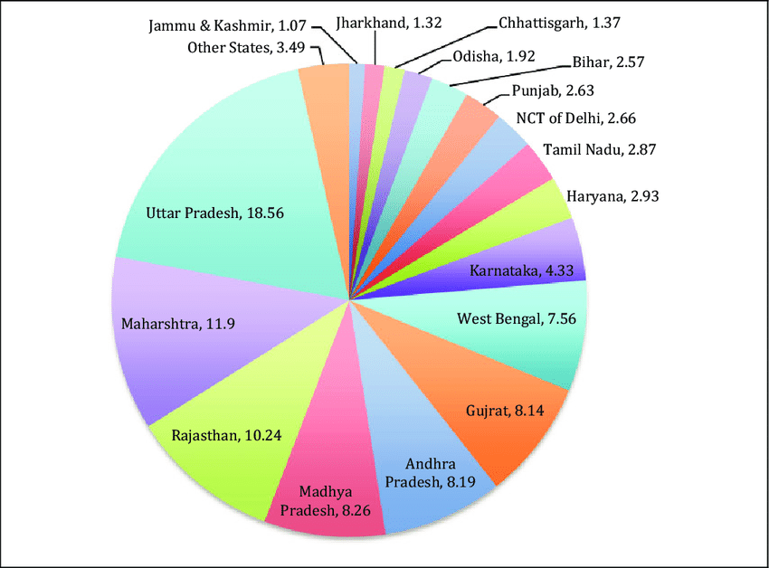
Empathy Process
Primary Sources:Interviews, Focus Group Discussions, Stakeholder Workshops, Site Visits and Observations, Surveys and Questionnaires, Empathy-Building Activities.
Secondary Sources: Literature and Research Papers, Government Reports and Policies, Non-Profit Organization Reports, News Articles and Media Coverage, Legal and Policy Documents

Slide 7
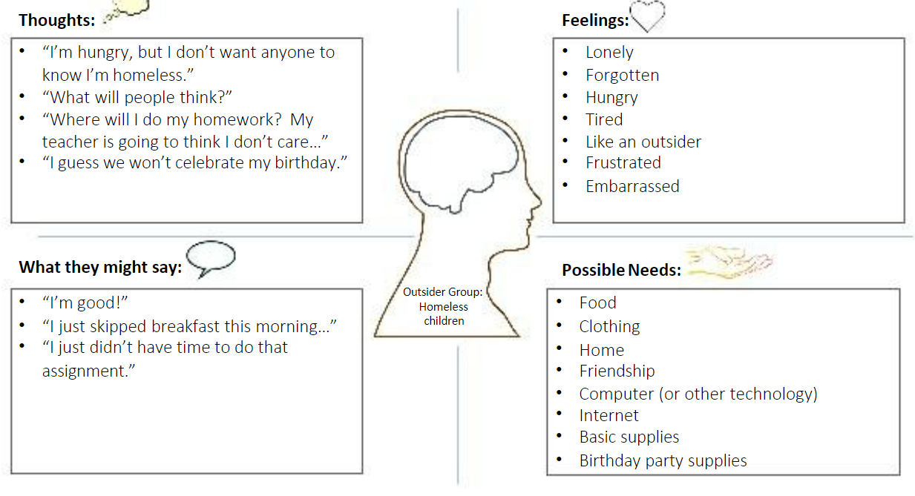
Empathy Tool Used: EMPATHY MAP

Slide 8
Need Analysis
Insights
Primary Needs
Immediate Shelter
Access to Basic Amenities
Support Services
Employment Opportunities
Community Integration
Secondary Needs
Education and Skill Development
Safe and Inclusive Spaces
Affordable Housing Options
Dignity and Respect
Latent Needs
Crisis Intervation
Education and Awareness
Child and Family Support
Transportation Assistance
Hygiene and Personal Care

Slide 9
Customer Journey Map
Precarious Housing Situation
Homelessness Onset
Seeking Support
Seeking Permanent Housing
Transition to Temporary Housing
Daily Challenges
Reintegration into Community
Achieving Stability
Providing Houses

Slide 10
Ideation through Brainstorming
 | Sanjana | Aditya | Tarun
NO. OF IDEAS SHARED | 2 | 2 | 4
IDEAS SHORTLISTED | 1 | 1 | 1
IDEAS RANKED | 3 | 4 | 1
Establishing mobile shelters for immediate relief, creating job training programs tailored to individual skills, and leveraging technology for access to resources. Affordable housing initiatives, coupled with legal support services, aim to provide stability and protect individuals' rights. Community engagement campaigns and educational programs work towards reducing stigma and promoting understanding. Ultimately, a holistic case management system ensures comprehensive, personalized support to guide individuals on their journey out of homelessness.
Selected Solution from all ideas:

Slide 11
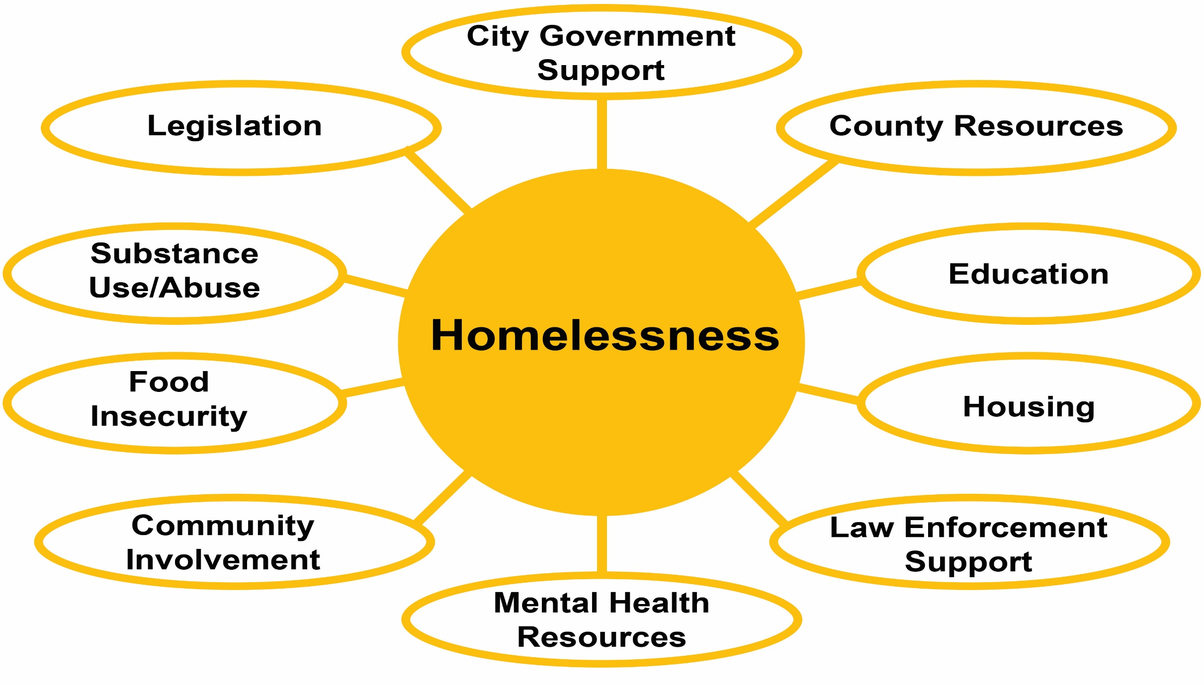
Value of the Solution Idea

Slide 12
Applied Ideation Method: 3-BOX THINKING
Box 1: Managing the Present - Immediate Relief (Short-Term):
Prioritize the establishment of mobile shelters and temporary housing solutions to address the urgent need for safe accommodation.
Implement support services such as healthcare access, food resources, and hygiene facilities to ensure the well-being of individuals in the immediate term.
Develop and deploy mobile applications or platforms to connect individuals with existing services, resources, and job opportunities.
Box 2: Selectively Abandoning the Past - Reimagining Solutions (Mid-Term):
Evaluate and refine existing support systems, abandoning approaches that have proven ineffective or insufficient.
Challenge traditional stereotypes and stigmas associated with homelessness through targeted education and awareness initiatives.
Collaborate with local government and advocacy groups to address policy barriers hindering affordable housing and employment opportunities.
1.

Slide 13
Applied Ideation Method: 3-BOX THINKING
Box 3: Creating the Future - Sustainable Solutions (Long-Term):
Innovate in the creation of sustainable, affordable housing solutions, considering eco-friendly and community-integrated designs.
Develop and implement long-term job training and education programs to enhance the employability and resilience of individuals transitioning out of homelessness.
Foster partnerships between educational institutions, businesses, and support organizations to create a holistic ecosystem for skill development and employment.
1.

Slide 14
Solution Prototype
1. Mobile Shelter Units:
Description: Deployable shelters that provide immediate relief and safety for individuals facing homelessness.
Features:
Portable and easily transportable.
Equipped with basic amenities, including bedding, hygiene facilities, and storage.
2. Community Engagement App:
Description: A mobile application connecting individuals with services, resources, and job opportunities.
Features:
User-friendly interface with a map of available services and shelters.
Job listings, skill-building courses, and support services accessible in one platform.
Emergency alerts and notifications for weather conditions or available resources.

Slide 15
Solution Prototype
3. Affordable Housing Initiatives:
Description: Innovative approaches to providing stable and affordable housing options.
Features:
Micro-housing projects with low-cost, sustainable designs.
Advocacy for policy changes supporting increased affordable housing options.
Partnerships with landlords to create housing opportunities for those transitioning out of homelessness.
4. Legal Support Services:
Description: Accessible legal assistance to protect the rights of individuals experiencing homelessness.
Features:
Mobile legal clinics providing pro bono legal advice.
Educational campaigns informing individuals of their legal rights.
Collaboration with legal aid organizations for ongoing support.

Slide 16
Final Real-Win-Worth
REAL:
Immediate impact on individuals: Provides tangible solutions for basic needs, safety, and support services.
Engages the community: Fosters understanding, reduces stigma, and creates a more inclusive society.
Data-driven approach: Continuously measures impact, iterates, and ensures resources are used effectively.
WIN:
Reduced homelessness: Leads to fewer individuals experiencing homelessness and its associated challenges.
Improved quality of life: Enhances physical, mental, and social well-being for those who have been homeless.
Stronger communities: Builds a more cohesive, supportive, and economically vibrant community.
WORTH:
Cost-effective long-term solution: Reduces societal costs associated with homelessness, such as healthcare and social services.
Potential for systemic change: Inspires innovative approaches to homelessness in other communities.
Promotes social justice and equity: Addresses a critical societal issue and creates a more just and equitable society.

Slide 17
Team Experiences
The journey of this project was filled with ups and downs, fueled by late-night snacks and bursts of creativity. Brainstorming sessions were fun and full of wild ideas, from tech-powered shelters to quirky housing, with laughter even as some ideas didn't work out. Research trips took us from warm shelter kitchens to high-tech conferences, learning about the different aspects of homelessness. Disagreements during intense debates helped us create a stronger, more balanced solution through compromise. Awards and accolades don't compare to the quiet victories – one person finding a home, a child's hopeful drawing inspired by our outreach. As team meetings evolved from project updates to shared stories and lessons, a deep sense of purpose grew. We didn't just build a solution, we built a community, united by the shared dream of ending homelessness.

Slide 18

MB - 08
This Photo by Unknown Author is licensed under CC BY-SA

