Slide 1
Predicting Gene Expression Using Classification Models In TCGA Data
Michael Lee
Jonathan Wolf

Slide 2
Abstract
Gene expression refers to the process by which a functional gene is produced by the information from a gene. This process is ubiquitous in all organisms and understanding it better is all the more pertinent in a cancer data set. In this project we predict gene expression for cancer afflicted patients using classification models.

Slide 3

Data
500 Patients
50 Random Genes
Gene | Classification
ZNF502 | High
NEK5 | Low
KCNE3 | High
PRPSAP2 | Low
Patient ID
Patient Tumor Sample ID | avg_percent_lymphocyte_infiltration
BMI | avg_percent_normal_cells
Avg Percent Lymphocyte Invasion | age_at_initial_pathologic_diagnosis
Cancer Stage – (Stage I, II, III, IV) | number_of_lymphnodes_examined
Nearest Mutation | avg_percent_monocyte_infiltration

Slide 4
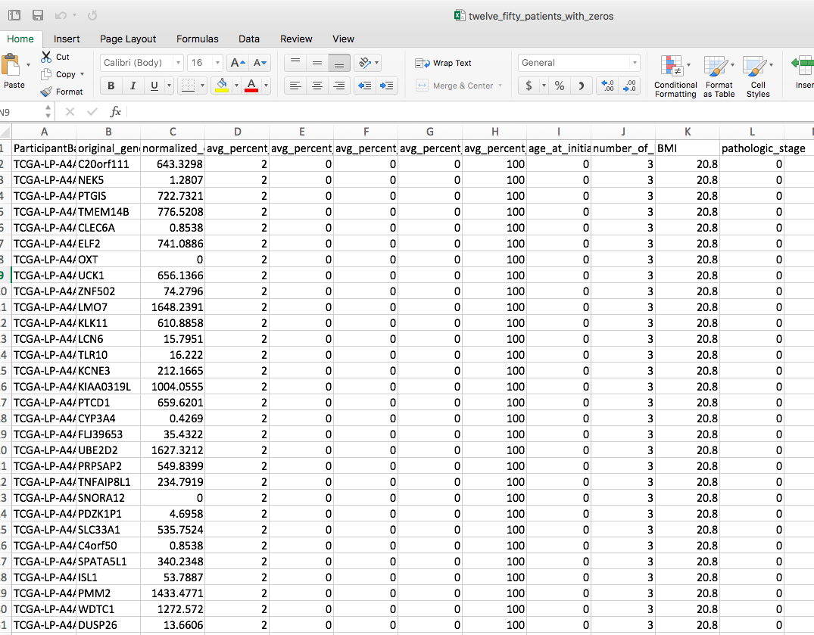
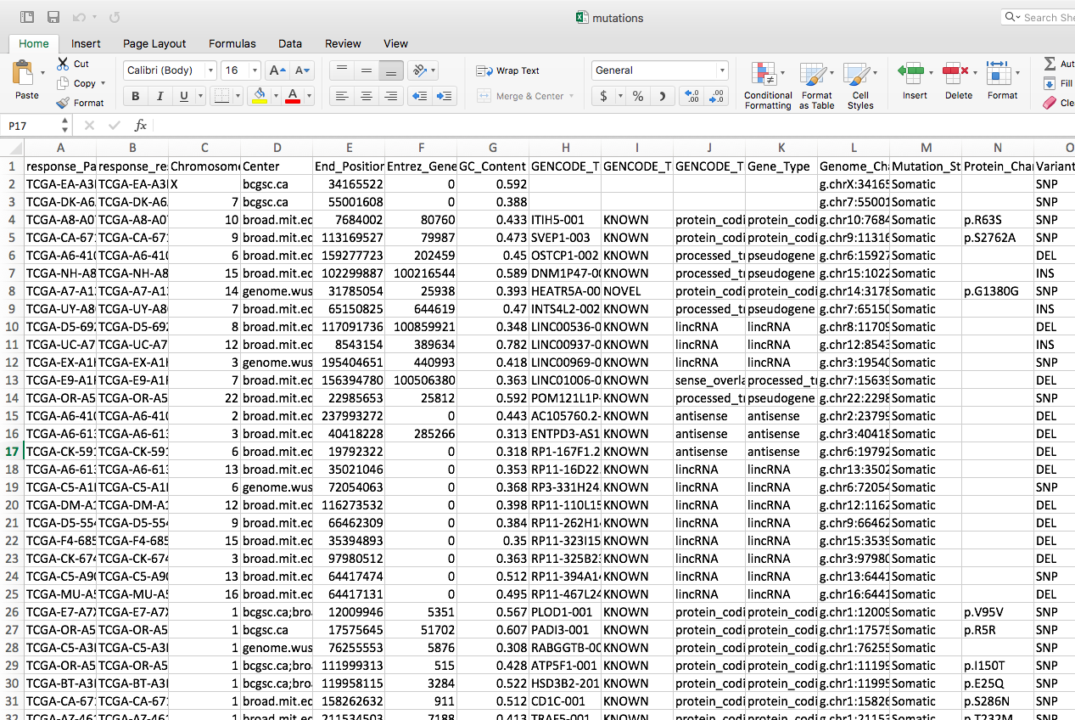

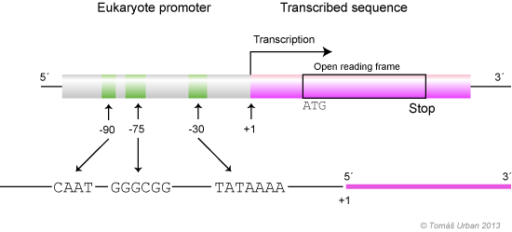
Methods
Data Retrieval
SQL
Annotation
ZNF502
Cytoband To Chromosomal Coordinates
Compute Nearest Mutation
What effects transcription?

Slide 5
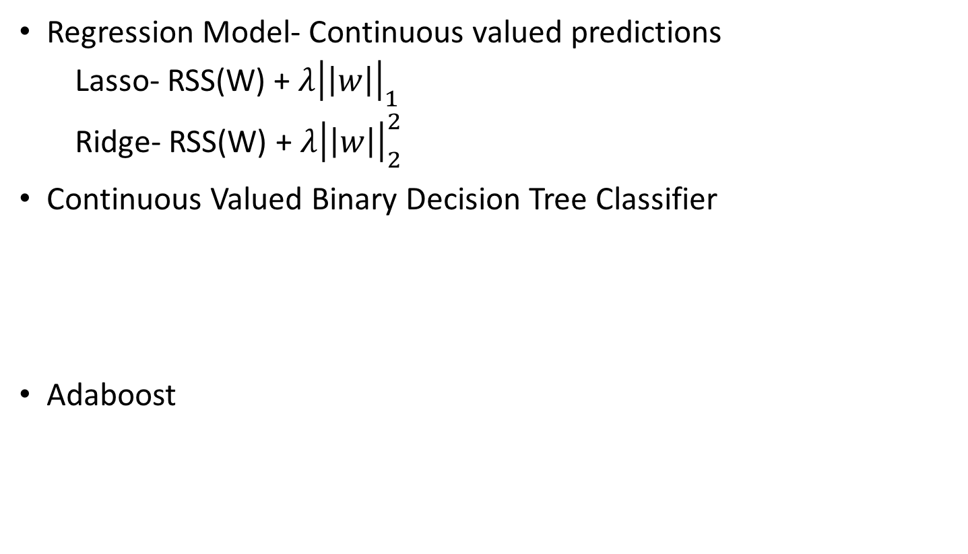
Methods
Regression Model- Continuous valued predictions
Lasso- RSS(W) + $λ{\left|\left|w\right|\right|}_{1}$
Ridge- RSS(W) + $λ{\left|\left|w\right|\right|}_{2}^{2}$
Continuous Valued Binary Decision Tree Classifier
Adaboost
Choose Best Feature To Split On
Repeat
Create Root
Compute Coefficient Of New Decision Stump
Recompute and normalize data weights
Learn decision stump with data weights

Slide 6
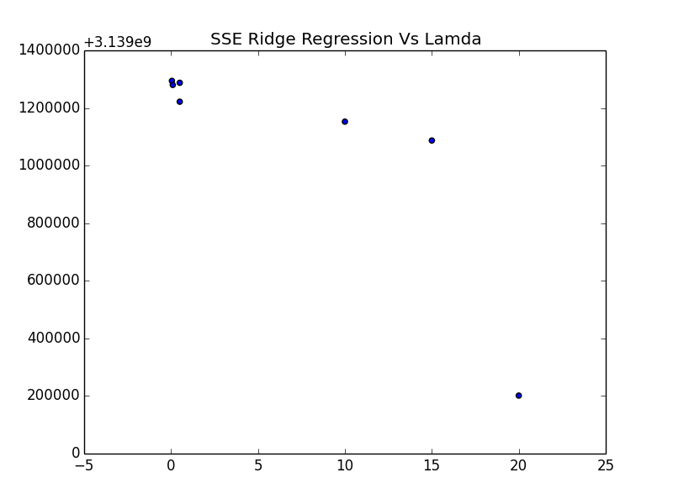
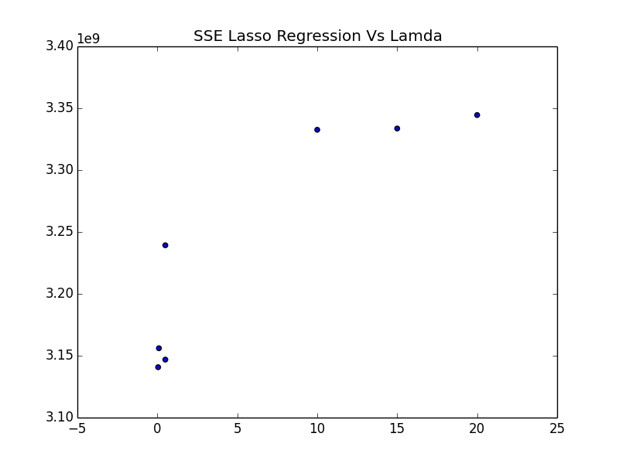
Results
Regression Model
Decision Tree

Slide 7
Results
AdaBoost Framework

Slide 8
Conclusion

Slide 9
References:
[blank person] Retrieved 3/9/2017 from https://img.clipartfest.com/8be7c9a62f86421bba3845f5e357abc7_clipart-person-icon-cliparts-clipart-person-symbol_620-800.png
[DNA Promoter Region] Retrieved 3/9/2017 http://web2.mendelu.cz/af_291_projekty2/vseo/print.php?page=307&typ=html
[Google Big Query Symbol] Retrieved 3/9/2017 from
http://dwhlaureate.blogspot.com/2016/01/google-bigquery-externalized-version-of.html
Acknowledgements:
We would like to thank Sheila Reynolds from the Institute for Systems Biology for giving access to this data and provision google credits to fund our project.
We would also like to thank Bill Noble and Max Libbretch for helpful advice.

