Slide 1
Mitchell Lee Micro-grid vs Solar Home Systems Progress Reports
November 7, 2013

Slide 2
HOMER Models
Modeled current system using ug01 demand (sum of circuits, ignoring metering losses).
Optimally sized SharedSolar system for ug01 demand (sum of circuits, ignoring metering losses) for a range of reliabilities.
Optimally Sized home systems using historical data for:
a “big” consumer
“small” consumer who briefly had elevated levels of energy consumption
“small” consumer

Slide 3
INPUT DATA

Slide 4
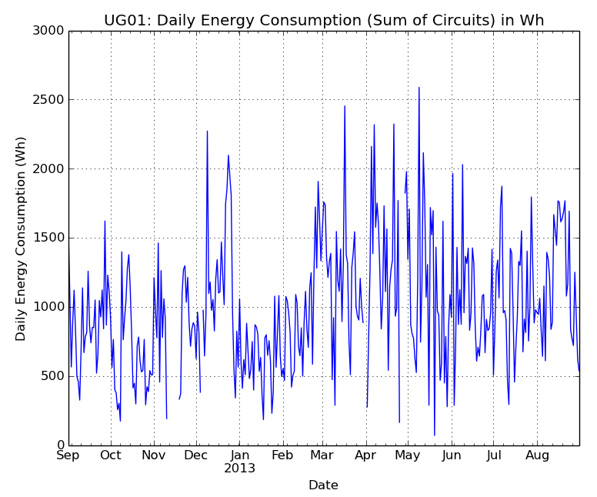
Input Data

Slide 5
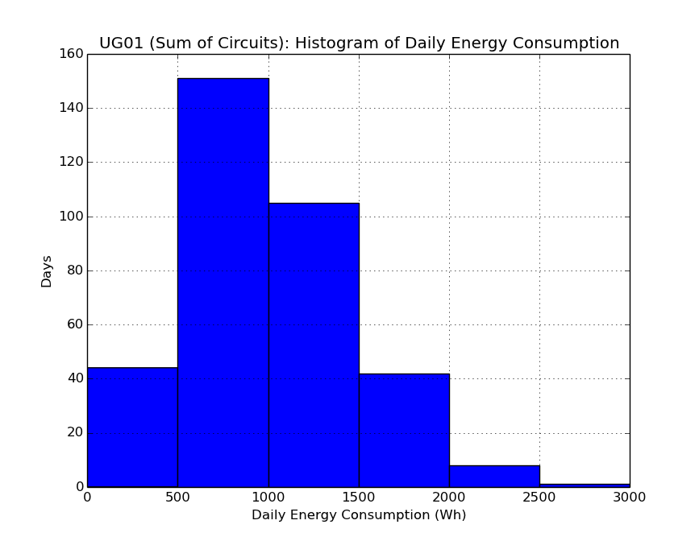

Slide 6
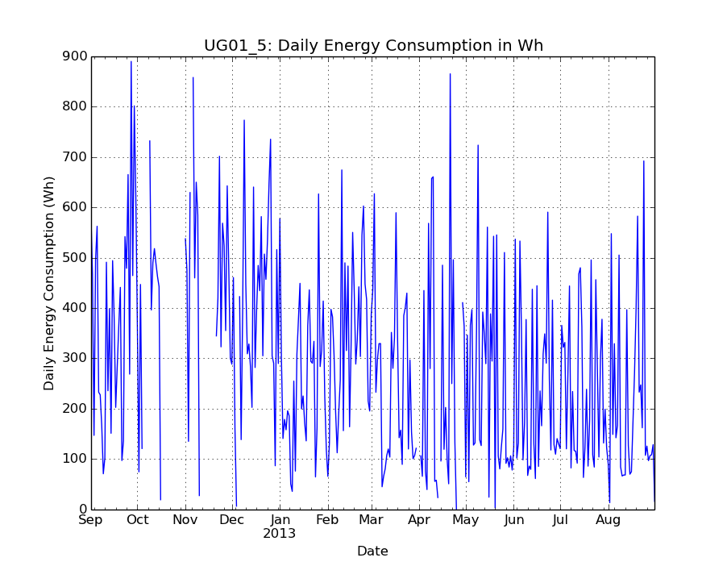
Input Data: Sample “Big” Customer

Slide 7
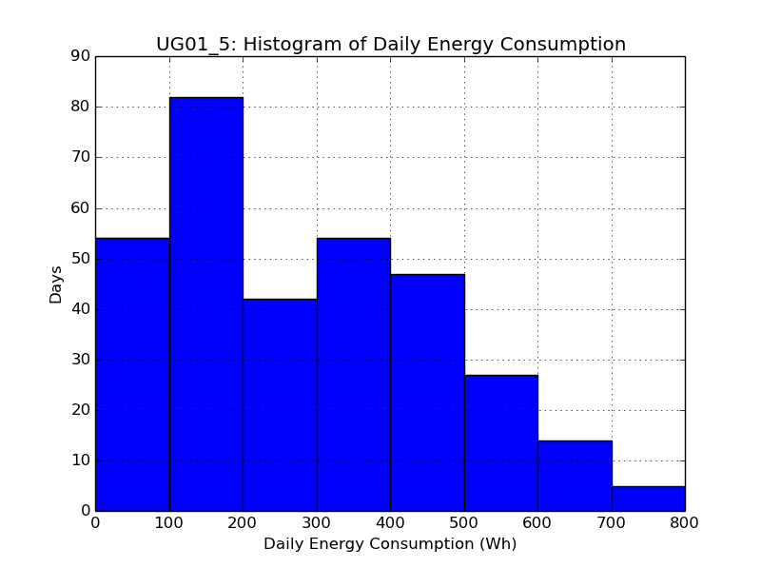

Slide 8
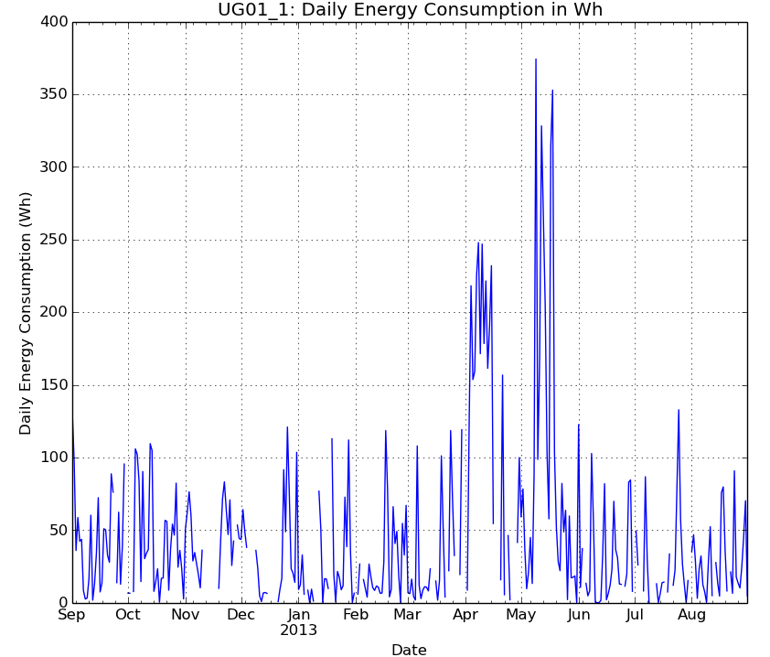
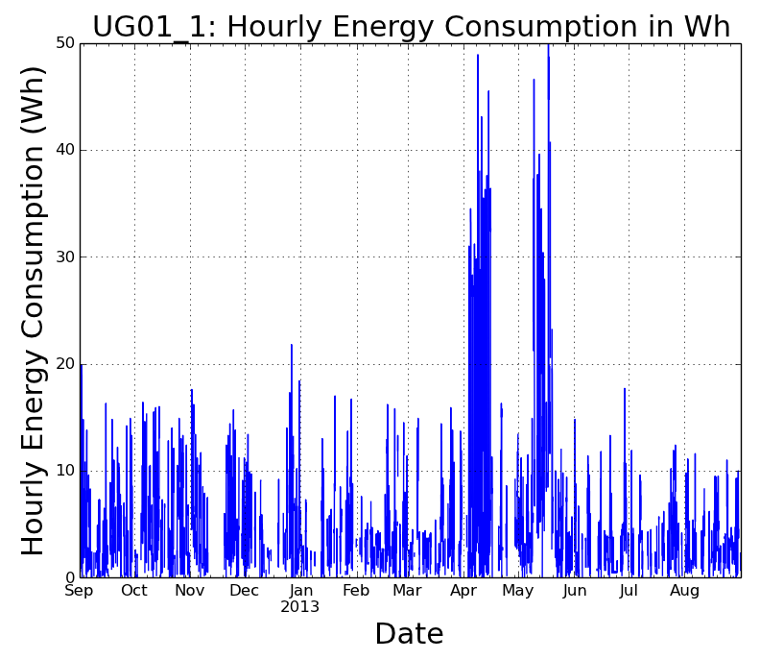
Sample “Small” Customer
Short period with TV

Slide 9
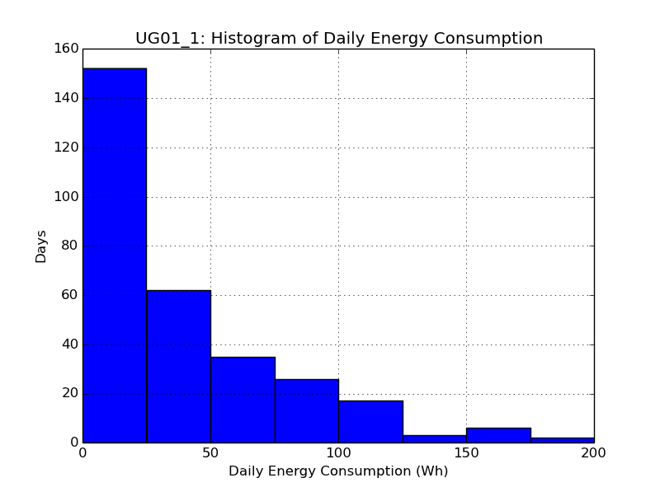

Slide 10
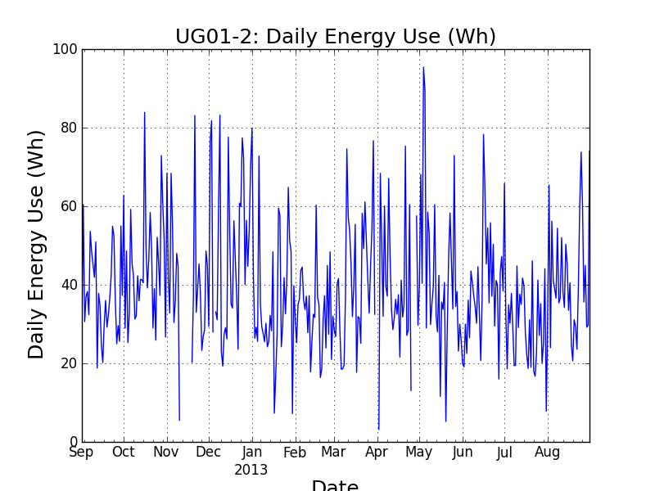

Slide 11
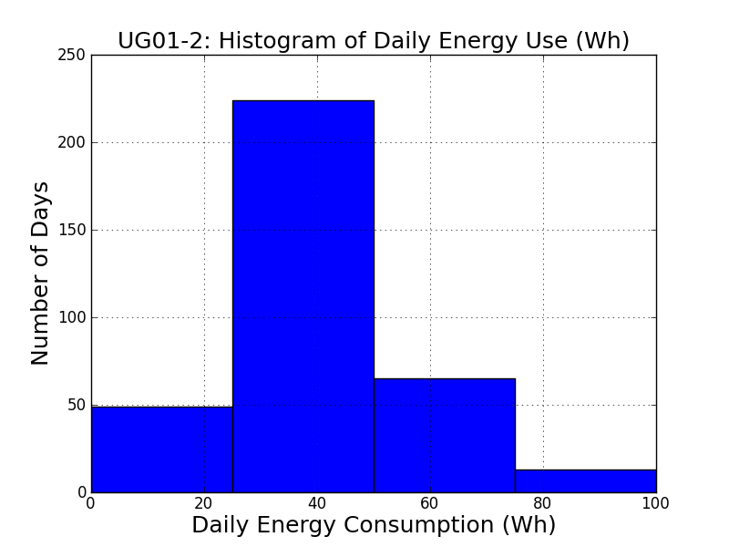

Slide 12
Cost Assumptions
PV – 1 USD/W, design life20 years.
Battery – 0.52 USD/Wh capacity, min SOC = 40 %, battery life depend on use.
Inverter – 0.60 USD/W capacity, 15 year design life
Project life of 25 years

Slide 13
HOMER MODEL RESULTS

Slide 14
Model of Current System
PV (kW) | Battery (kWh) | Converter (kW) | Initial capital | Operating cost ($/yr) | Total NPC | COE ($/kWh) | Capacity shortage
1.4 | 17.28 | 0.75 | $5,090 | 543 | $12,027 | 2.649 | 0
Battery lifespan is 5 years in simulation
This model uses size of currents system, and current consumer demand. Metering losses are not included in consumption making the system seem even more oversized.

Slide 15
Current System Optimally Sized
Max. Cap. Shortage (%) | PV (kW) | # of Batteries CP12240D | Battery (kWh) | Converter (kW) | Initial capital | Operating cost ($/yr) | Total NPC | COE ($/kWh) | Capacity shortage
0 | 0.8 | 16 | 4.608 | 0.8 | $2,144 | 163 | $4,233 | 0.933 | 0
0.5 | 0.8 | 16 | 4.608 | 0.6 | $2,024 | 160 | $4,070 | 0.897 | 0
1 | 0.6 | 16 | 4.608 | 0.6 | $1,824 | 159 | $3,854 | 0.855 | 0.01
1.5 | 0.6 | 16 | 4.608 | 0.6 | $1,824 | 159 | $3,854 | 0.855 | 0.01
2 | 0.6 | 16 | 4.608 | 0.4 | $1,704 | 155 | $3,680 | 0.82 | 0.02
5 | 0.6 | 12 | 3.456 | 0.4 | $1,488 | 161 | $3,552 | 0.802 | 0.03
10 | 0.4 | 12 | 3.456 | 0.4 | $1,288 | 149 | $3,196 | 0.768 | 0.1
Battery lifespan is between 3 and 5 years in simulations

Slide 16
UG01-5: Solar Home System
Max. Cap. Shortage (%) | PV (kW) | CP12240D | Battery Capacity (kWh) | Converter (kW) | Initial capital | Operating cost ($/yr) | Total NPC | COE ($/kWh) | Capacity shortage
0 | 0.28 | 8 | 2.304 | 0.2 | $800 | 70 | $1,693 | 1.381 | 0
0.5 | 0.28 | 6 | 1.728 | 0.2 | $700 | 54 | $1,390 | 1.137 | 0
1 | 0.3 | 5 | 1.44 | 0.2 | $670 | 47 | $1,266 | 1.039 | 0.01
1.5 | 0.26 | 5 | 1.44 | 0.2 | $630 | 46 | $1,220 | 1.007 | 0.01
2 | 0.24 | 5 | 1.44 | 0.2 | $610 | 46 | $1,197 | 0.991 | 0.02
5 | 0.18 | 5 | 1.44 | 0.2 | $550 | 45 | $1,124 | 0.949 | 0.04
10 | 0.16 | 4 | 1.152 | 0.2 | $480 | 45 | $1,053 | 0.925 | 0.08

Slide 17
UG01-1: Solar Home System
Max. Cap. Shortage (%) | PV (kW) | CP12240D | Battery Capacity (kWh) | Converter (kW) | Initial capital | Operating cost ($/yr) | Total NPC | COE ($/kWh) | Capacity shortage
0 | 0.08 | 3 | 0.864 | 0.1 | $290 | 26 | $627 | 3.3 | 0
0.5 | 0.06 | 3 | 0.864 | 0.1 | $270 | 26 | $604 | 3.182 | 0
1 | 0.12 | 2 | 0.576 | 0.1 | $280 | 19 | $520 | 2.765 | 0.01
1.5 | 0.08 | 2 | 0.576 | 0.1 | $240 | 18 | $475 | 2.527 | 0.01
2 | 0.06 | 2 | 0.576 | 0.1 | $220 | 18 | $452 | 2.413 | 0.02
5 | 0.06 | 2 | 0.576 | 0.1 | $220 | 18 | $452 | 2.413 | 0.02
10 | 0.06 | 1 | 0.288 | 0.1 | $170 | 10 | $300 | 1.704 | 0.08

Slide 18
UG01-2: Solar Home System
Max. Cap. Shortage (%) | PV (kW) | CP12240D | Battery Capacity (kWh) | Converter (kW) | Initial capital | Operating cost ($/yr) | Total NPC | COE ($/kWh) | Capacity shortage
0 | 0.04 | 1 | 0.288 | 0.1 | $150 | 10 | $278 | 1.582 | 0
0.5 | 0.02 | 1 | 0.288 | 0.1 | $130 | 10 | $255 | 1.456 | 0
1 | 0.02 | 1 | 0.288 | 0.1 | $130 | 10 | $255 | 1.456 | 0
1.5 | 0.02 | 1 | 0.288 | 0.1 | $130 | 10 | $255 | 1.456 | 0
2 | 0.02 | 1 | 0.288 | 0.1 | $130 | 10 | $255 | 1.456 | 0
5 | 0.02 | 1 | 0.288 | 0.1 | $130 | 10 | $255 | 1.456 | 0
10 | 0.02 | 1 | 0.288 | 0.1 | $130 | 10 | $255 | 1.456 | 0

Slide 19
Cost per Unit Energy Comparison
 | COE ($/kWh)
Max. Cap. Shortage (%) | UG01-All | UG01-5 | UG01-1 | UG01-2
0 | 0.933 | 1.381 | 3.3 | 1.582
0.5 | 0.897 | 1.137 | 3.182 | 1.456
1 | 0.855 | 1.039 | 2.765 | 1.456
1.5 | 0.855 | 1.007 | 2.527 | 1.456
2 | 0.82 | 0.991 | 2.413 | 1.456
5 | 0.802 | 0.949 | 2.413 | 1.456
10 | 0.768 | 0.925 | 1.704 | 1.456
UG01-5: a “big” consumer
UG01-1: “small” consumer who briefly had elevated levels of energy consumption
UG01-2: “small” consumer

