Slide 1
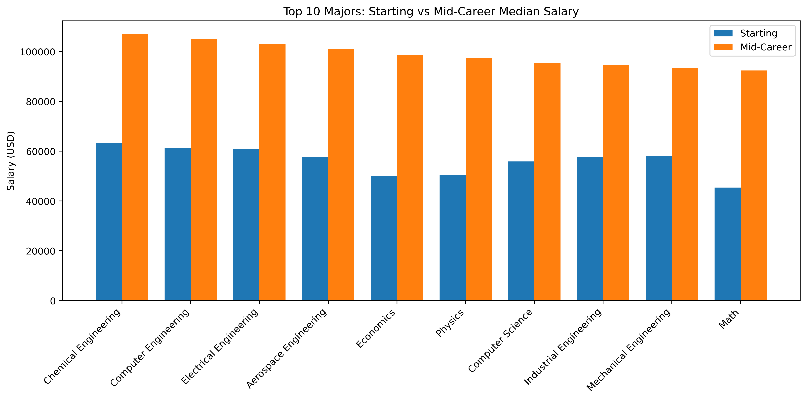
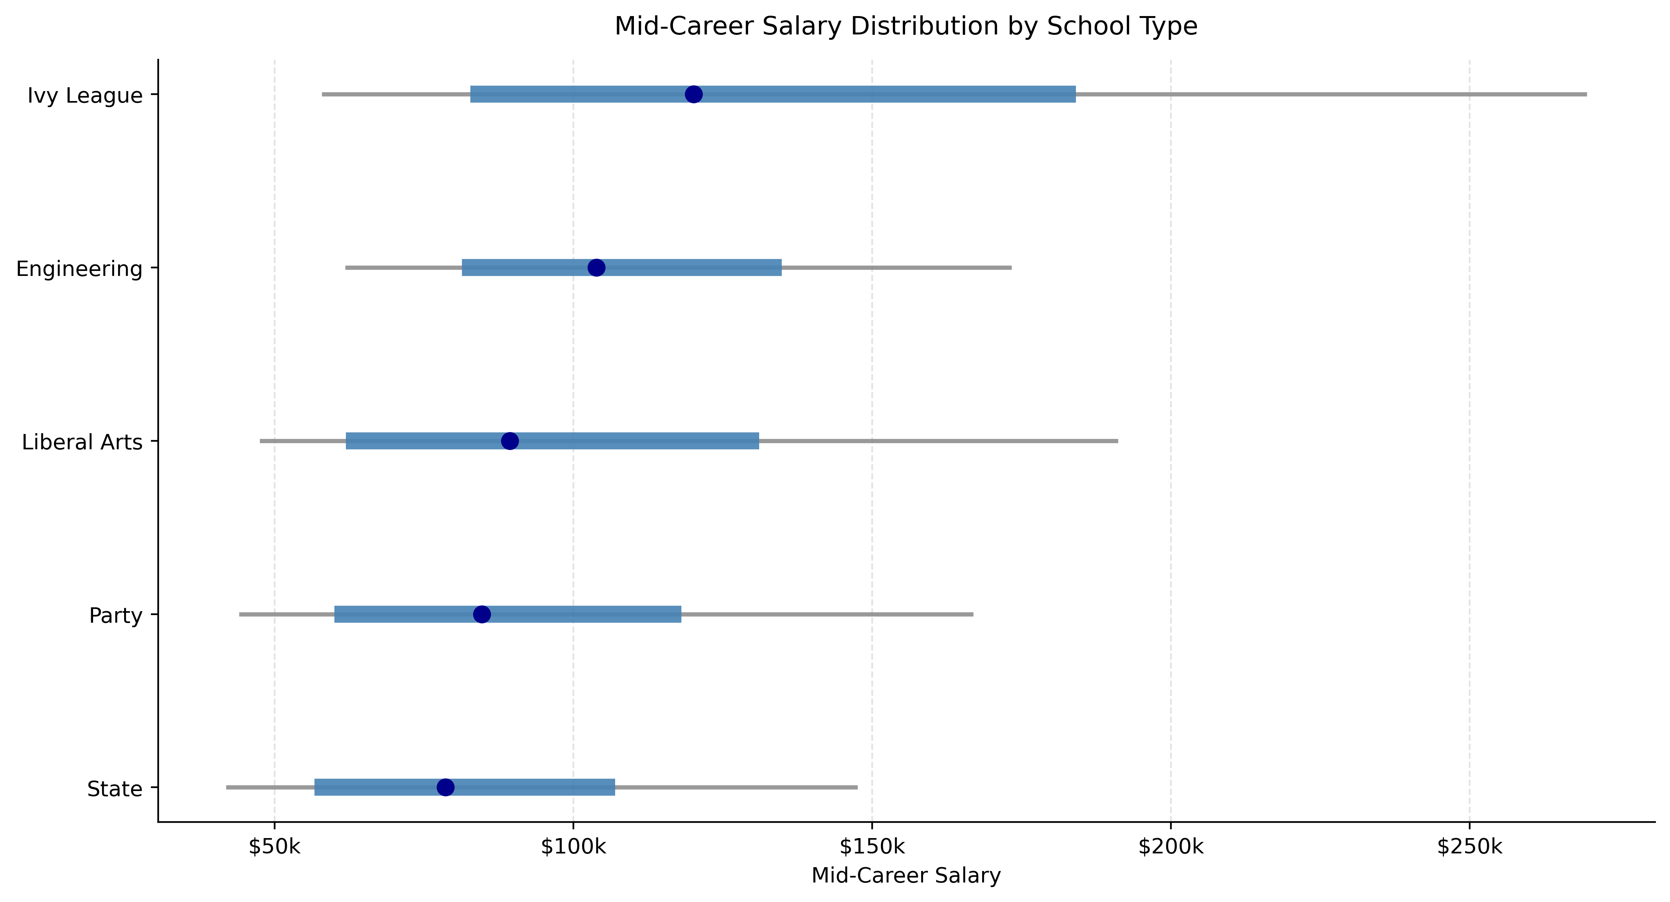
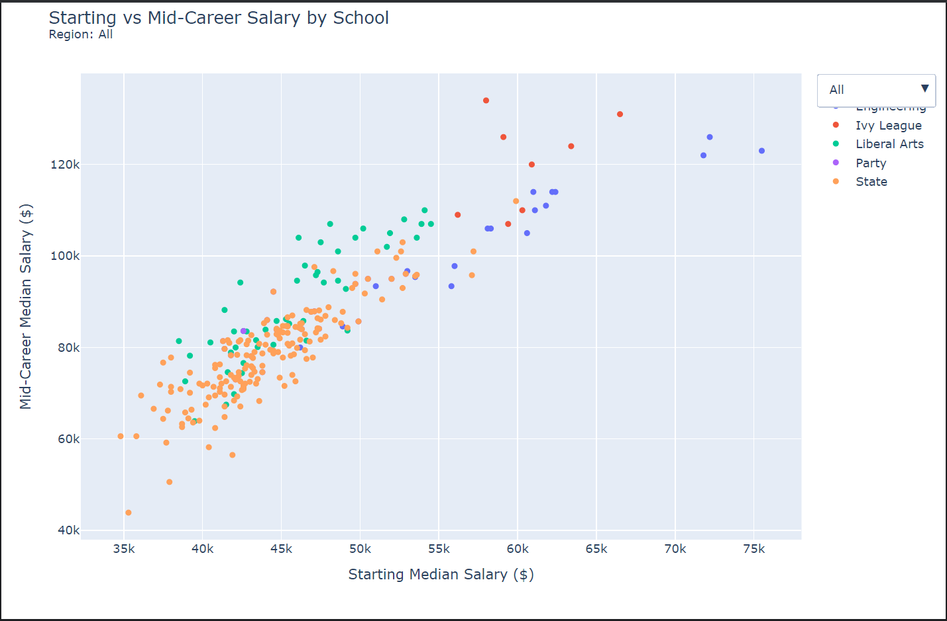
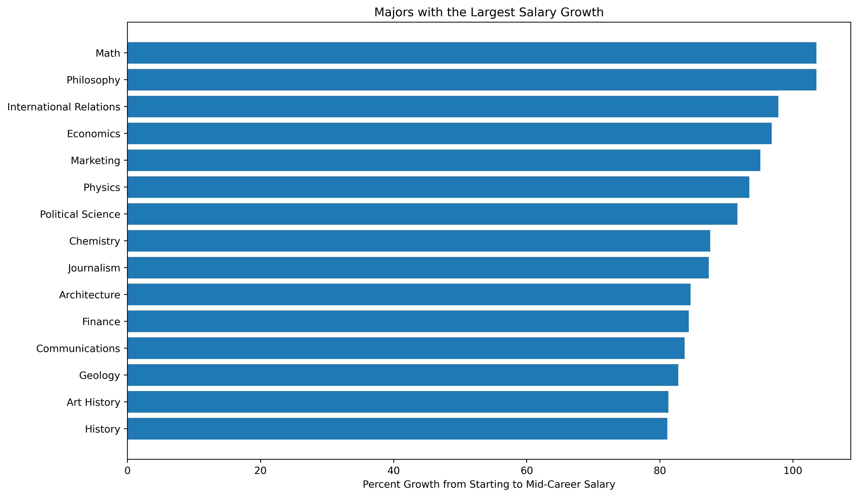
How does your major and school affect career outcomes?
This poster will examine post-grad and mid-career outcomes to attempt to answer the following
How does major choice affect a persons financial outcomes?
Is there always correlation between starting salary and mid career salary?
How much does the type of school you attend change your mid career salary outcomes?
Which majors allow for the biggest salary growth over time?
The below chart shows the top 10 majors based on starting salary compared to the salary of that major at their mid-career point
Choosing the college you want to go to is a hard enough decision on your own during your senior year of high school, not even considering how stressful it can be to keep up grades and get good testing scores. Unfortunately you have to make a major decision which will affect your long term outcomes at a relatively young age. So many people get caught up in the brand of a school, rather than how it can actually help you succeed in the long term.
The above plot demonstrates that there are certain majors that do give you a more likely chance of obtaining a better starting and mid career salary compared to others. A lot of this majors are more specialized and most fall into the STEM space, which is always in high demand.
While these majors are great for those who want to go down one of these career paths, they don’t work for everyone. Luckily, these aren’t the only options that lead towards success.
The above chart shows the distributions of mid-career salary outcomes based on the type of school. As one could expect, the top 10% of students from Ivy League schools do incredibly well financially. What most probably wouldn’t expect is how much the rest of their students outcomes end up overlapping with those from other types of schools.
As can be seen above, there is not that much difference between the outcomes for students at most types of schools, especially for those who fall between the 25th and 75th percentiles within Engineering, Liberal Arts, Party, and State schools.
Also, within these categories not every school is the same. Some may have better outcomes than others, and overall some may just be a better fit for a prospective student than others.
** https://leemcnu.github.io/hostHTML/ **
While this plot does show correlation between starting salary and mid-career salary, it is not direct and doesn’t mean that a bad post-grad start dictates you will have bad mid-career outcomes
Looking specifically at liberal arts schools, they have slightly higher starting median salaries than most state schools but by mid-career the former students outcomes compare with those from engineering schools and even some ivy leagues.
Footnote
Mid career is defined as 10 years post-grad
All included in the survey have bachelors degrees
Data is from about 9 years ago so the numbers have definitely changed, but the same general trends still hold up.
The above chart shows the majors with the highest growth from median starting salary to median mid-career salary. It is based on percentage of their starting salary.
Although some STEM related majors still fall into these growth categories, there are a lot more majors which fall more into business, political, or creative fields. Even though you may have to sacrifice a bit of comfort living at the start of your career, these majors have massive growth opportunities which can allow you to make a comfortable salary very quickly.

