Slide 1
ORION
Regime-Dependent Limits of
Hierarchical Memory Orchestration for AI Inference
Nature Computational Science - Submitted 2026
G. Lim - Samsung Electronics, Data Service Lab.
S = 4.12
0.50
93.4%
3.2x
Sharpness at capacity
boundary theta_C
Capacity threshold
theta_C (analytic)
Classifier accuracy
(5-fold CV)
Efficiency gap across
operating regimes
Notes:
ORION paper — Nature Computational Science. Four key numbers: S=4.12 sharpness at capacity boundary, theta_C=0.50 (analytic), 93.4% classifier accuracy, 3.2x throughput-per-Watt gap.

Slide 2
Motivation: The Hidden Cost of Memory Misalignment
Modern foundation models exceed accelerator memory — inference latency is now governed by data coordination, not arithmetic throughput
Once trained, serving cost dominates the model's lifetime resource footprint
Memory capacity, bandwidth, and interconnect latency are the binding constraints
Misaligned orchestration causes avoidable energy waste:
CO2 per million tokens: 15.8 g (aligned) vs 42.5 g (I/O-limited) — a 2.7x penalty
2.7x
CO2 penalty
I/O-limited vs aligned
15.8 vs 42.5 g
CO2 per 10^6 tokens
(IEA 2024 carbon intensity)
>3x
Throughput-per-Watt gap
between regimes
Notes:
CO2 numbers: IEA 2024 global average 494 gCO2/kWh. Energy penalty of misaligned memory orchestration is substantial and avoidable.

Slide 3
The Core Question
Is hierarchical memory orchestration a continuously optimisable problem — or does it admit intrinsic limits beyond which additional coordination cannot improve, and can worsen, latency?
Continuous Optimisation View
Our Finding: Regime Structure
More coordination always helps (with diminishing returns)
Strategy rankings are stable across configurations
Tuning parameters is the answer
Three intrinsic regimes with abrupt transitions
Strategy rankings INVERT across regime boundaries
Regime identification must precede optimisation
Notes:
Central thesis: NOT continuously optimisable. Strategy rankings invert — not just diminishing returns — across regime boundaries.

Slide 4
Prior Work and the Unresolved Gap
FlexGen
-3.1% (capacity-limited) | -18.4% (coord-dom) | +8.2% (I/O-limited)
CPU/NVMe Offloading
DeepSpeed-Inference
-2.8% (capacity-limited) | -23.6% (coord-dom) | +11.7% (I/O-limited)
CPU/NVMe Offloading
vLLM (PagedAttention)
-1.2% (capacity-limited) | -19.1% (coord-dom) | +3.4% (I/O-limited)
KV-Cache Management
SwapAdvisor
Gains within coordination regime; degrades near I/O boundary
GPU-CPU Swapping
Gap: no unifying framework predicts when and why orchestration fails — regime-awareness is missing
Notes:
All tools deliver gains in some configurations but fail in others — sometimes worsening latency. No framework explains this heterogeneity.

Slide 5
Two Dimensionless Ratios Govern All Regimes
Any hierarchical-memory inference system is fully characterised by two dimensionless ratios:
R_C = C_fast / W
R_B = B_slow * dt / D
Fast-Memory Residency Ratio
Transfer-Pressure Ratio
C_fast = GPU HBM resident memory capacity
W = W_param + W_act + W_kv (active working set)
R_C < 0.50: majority of working set evicted
R_C >= 0.50: sufficient residency for coordination
B_slow = sustained host-to-device bandwidth
D = compulsory data volume per inference step
R_B < 0.40: transfer demand saturates bandwidth
R_B >= 0.40: bandwidth headroom for orchestration
Both ratios computable from hardware datasheets + model cards — before running a single experiment
Notes:
Llama-3 8B example: 80GB HBM, W=41.8GB -> R_C=1.91 (coordination-dominated). Constrain to 20GB HBM -> R_C=0.48 (capacity-limited). Both computed analytically, no experiments.

Slide 6
Three Operational Regimes
Capacity-Limited
Coordination-Dominated
I/O-Limited
R_C < theta_C = 0.50
R_C >= 0.50 AND R_B >= 0.40
R_B < theta_B = 0.40
Fast memory cannot hold the active working set
Frequent eviction: T_mem dominates regardless of strategy
Coordination overhead becomes purely additive
Lever: increase HBM, reduce batch, quantise weights
Coordination gains: <= 5% (negligible)
All four latency terms are of comparable magnitude
Strategy choice reshapes latency composition
Orchestration delivers 18-27% latency gains
Lever: pipelining, KV-cache, compute-transfer overlap
ORION gain: up to -27.1% (Llama-3 8B, A100)
Sustained bandwidth approaches physical limit
T_swap dominates; coordination overhead is additive
FlexGen/DeepSpeed worsen latency 8-12%
Lever: reduce compulsory transfer volume
Swap reduction -10% recovers 14.2% latency
Notes:
Three regimes. The key finding: strategy rankings INVERT across boundaries — not just diminishing returns. FlexGen: -18.4% in coord-dom, +8.2% in I/O-limited.

Slide 7
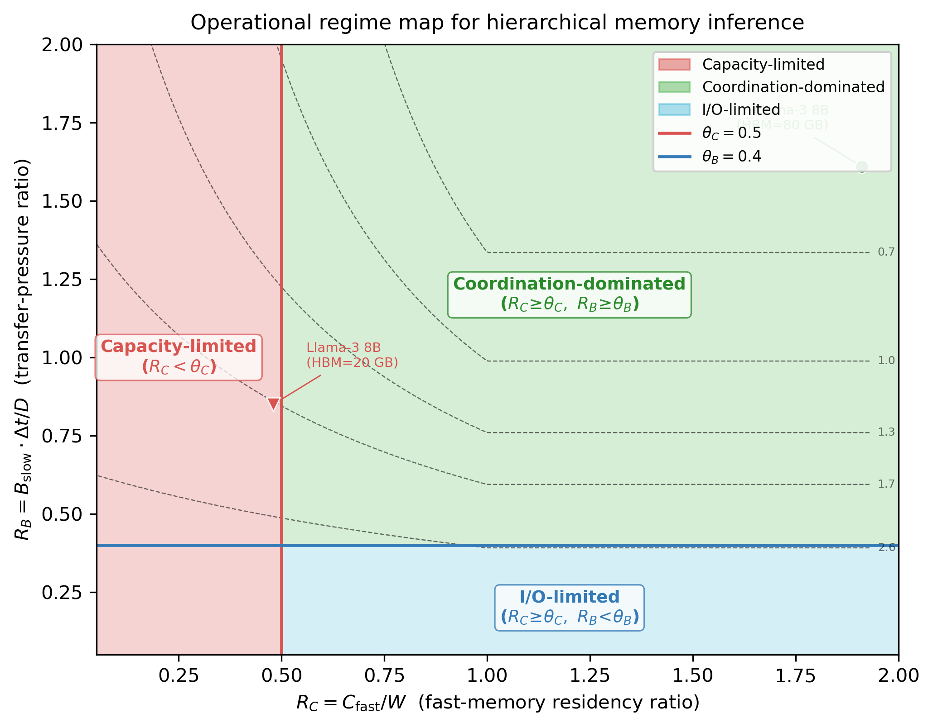
The Regime Map: Two Ratios, Three Zones
theta_C = 0.50
Capacity boundary
(analytically derived)
theta_B = 0.40
Bandwidth boundary
(empirically calibrated)
+/- 0.05
Cross-platform consistency
across all 5 hardware platforms
S = 4.12
Sharpness at theta_C
(> 2x abruptness threshold S*=2.0)
All boundaries from real hardware measurements on 5 platforms (A100, TPU v4, Inferentia2, MI250, Optane-PMem)
Notes:
Regime map shows 2D (R_C, R_B) space. Red shading = empirically observed failure regions. Filled markers = Llama-3 8B operating points from Introduction example.

Slide 8
Analytical Model and Structural Lower Bound
T_total = T_comp + T_mem + T_swap + T_sync
T_comp
T_mem
T_swap
T_sync
Accelerator
compute time
HBM miss-driven
memory access
Cross-tier DMA
transfer time
Synchronisation
collective ops
Structural Lower Bound (independent of orchestration policy):
T_total >= rho * W * max(0, 1 - R_C) + D / B_slow
rho = HBM miss-penalty per byte (1.2-3.1 ns/byte across 5 platforms; measured via CUPTI streaming kernel)
Bound holds regardless of scheduling or compute-transfer overlap strategy
At regime boundaries: bound accounts for 78-84% of observed T_total; remaining 16-22% is T_sync
ORION drives T_total to within 8-14% of this physical lower bound across all five platforms
Notes:
Structural lower bound proves regime transitions are mathematically inevitable. rho measured via CUPTI synthetic streaming kernel. ORION achieves 8-14% gap from bound — near-achievable in practice.

Slide 9
Why theta_C = 0.50: A Platform-Independent Derivation
Step 1
C_miss = W - C_fast = W(1 - R_C)
Cache-miss volume per inference step
Step 2
C_miss > W / 2
Majority-eviction condition: more than 50% of working set misses fast memory
Step 3
W(1 - R_C) > W/2 => R_C < 0.5
Solve for R_C
Result
theta_C = 0.50
Independent of rho, B_slow, or any hardware constant. Consistent +/-0.02 across all 5 platforms
Practitioner shortcut: compute R_C = C_fast / W from a hardware datasheet and a model card — no experiments required
Notes:
theta_C=0.50 is derived analytically from the majority-eviction condition. When >50% of working set misses fast memory, T_mem dominates regardless of coordination strategy. Platform-independent.

Slide 10
Quantifying Transition Abruptness: Sharpness Coefficient S
S = | d ln T_total / d ln R | via symmetric finite differences, Delta_R = 0.05
S = 4.12
S = 3.74
S < 0.4
at theta_C (+/-0.31, n=5)
10% drop in R_C -> 41.2% latency rise
at theta_B (+/-0.27, n=5)
Bandwidth boundary
Interior of coord-dominated
(near-zero sensitivity)
Statistical test: One-sided Wilcoxon signed-rank (H0: S <= S* = 2.0) Near-boundary: p < 0.05 (two boundaries p < 0.01) Interior: p > 0.40 — consistent with H0
Dashed line = abruptness threshold S* = 2.0 (a 10% change in R produces >20% latency change)
Notes:
S=4.12 at theta_C: 10% reduction in R_C produces 41.2% latency increase. S drops to 0.31 well inside coordination-dominated regime. Abruptness threshold S*=2.0 exceeded by more than 2x at both boundaries.

Slide 11
Key Finding: Strategy Rankings Invert Across Regime Boundaries
Llama-3 8B | NVIDIA A100 (80 GB) | batch=8, seq=2048 | mean +/- 95% bootstrap CI (n_eff=150)
Strategy | Capacity-Limited R_C=0.35, R_B=0.55 | Coord.-Dominated R_C=0.70, R_B=0.55 | I/O-Limited R_C=0.70, R_B=0.18
PyTorch (baseline) | 0% | 0% | 0%
FlexGen | -3.1 +/- 0.5% | -18.4 +/- 1.3% | +8.2 +/- 0.9%
DeepSpeed-Inference | -2.8 +/- 0.4% | -23.6 +/- 1.5% | +11.7 +/- 1.1%
vLLM (KV-cache) | -1.2 +/- 0.3% | -19.1 +/- 1.2% | +3.4 +/- 0.6%
Swap reduction -10% | -0.8 +/- 0.3% | -0.3 +/- 0.2% | -14.2 +/- 1.1%
ORION (adaptive) | -5.2 +/- 0.6% | -27.1 +/- 1.6% | -16.8 +/- 1.2%
Bold red = latency INCREASE (worse than baseline) | Ranking reversal, not diminishing returns, is the hallmark of genuine regime structure
Notes:
Critical: FlexGen -18.4% in coord-dominated but +8.2% in I/O-limited. DeepSpeed -23.6% vs +11.7%. This is ranking inversion, not just diminishing returns.

Slide 12
ORION: Three-Subsystem Measurement Framework
Used as a measurement instrument for controlled traversal of the regime space — not a production serving engine
1 GPU Process Allocator
2 Task Memory Manager
3 GPU Booster (Swap)
Reserves context IDs, memory pools, kernel queues up-front
Separates memory segments across models (limits cache pollution)
Co-schedules I/O-intensive + compute-intensive models
Enables direct observation of T_comp per kernel batch
NUMA-aware: mbind() + numa_alloc_onnode() per tensor
jemalloc heap: small objects separated from large tensors
T_access = T_local + gamma * T_remote (gamma = NUMA penalty)
Lightweight pressure predictor triggers mitigation early
Graph-walk identifies inactive tensors (KV caches, checkpoints)
Async PCIe DMA overlapped with computation
4 MB aligned swap units; priority-aware reload by reuse frequency
Served models up to 17B params on <80 GB VRAM
Validation: 4-term sum matches wall-clock within 3% (mean residual 1.8%, s.d. 0.6%)
Notes:
ORION is a measurement instrument. Three subsystems make T_comp, T_mem, T_swap, T_sync individually observable at runtime. Key validation: four-term sum matches wall-clock within 3%.

Slide 13
Regime Classifier: Adaptive Strategy Switching at <0.1 ms
Depth-3 CART Decision Tree
93.4%
Input features (3): swap/compute ratio, cache hit rate, DMA utilisation
Training data: 2,400 probing measurements
5 platforms x 3 regimes, balanced sampling
Evaluation: stratified 5-fold cross-validation
Classification cost: <0.1 ms per inference step
Adaptive loop: classifies every 100 ms, switches strategy on regime change
Classifier contribution to ORION total gain: 21-69% (largest in coord-dom regime)
Mean accuracy (s.d. 1.2%)
5-fold cross-validation
<0.1 ms
Classification cost per step
(negligible vs request latency)
21-69%
Classifier contribution
to total ORION gain
Caveat: 93.4% accuracy is in-distribution (same 5 platforms). Generalisation to unseen hardware has not been validated.
Notes:
Classifier enables adaptive switching. 21-69% of ORION's total gain is from the classifier vs hardware subsystems alone. Largest contribution in coordination-dominated regime where strategy choice has most leverage.

Slide 14
Multi-Platform Validation: Regime Structure is Universal
NVIDIA A100 (x2)
Google TPU v4
AWS Inferentia2
80 GB HBM | PyTorch 2.4, CUDA 12.2
Primary experimental platform
JAX 0.4.26, SPMD-style collectives
Delta_theta_B = +0.03 (elevated T_sync)
NeuronSDK 2.18
Constrained host-device bandwidth; earlier I/O boundary
AMD MI250
Intel Optane-PMem
ROCm 6.0
Full regime structure confirmed
Xeon + Persistent Memory servers
PMem serves as intermediate DRAM tier
Regime boundaries within +/-0.05 across 5 platforms | All results from real hardware — no simulation or emulation
Notes:
All five platforms executed identical probing sweep. Platform-specific shifts (e.g. TPU +0.03 on theta_B from SPMD collectives) affect precise threshold location but not existence of regime structure.

Slide 15
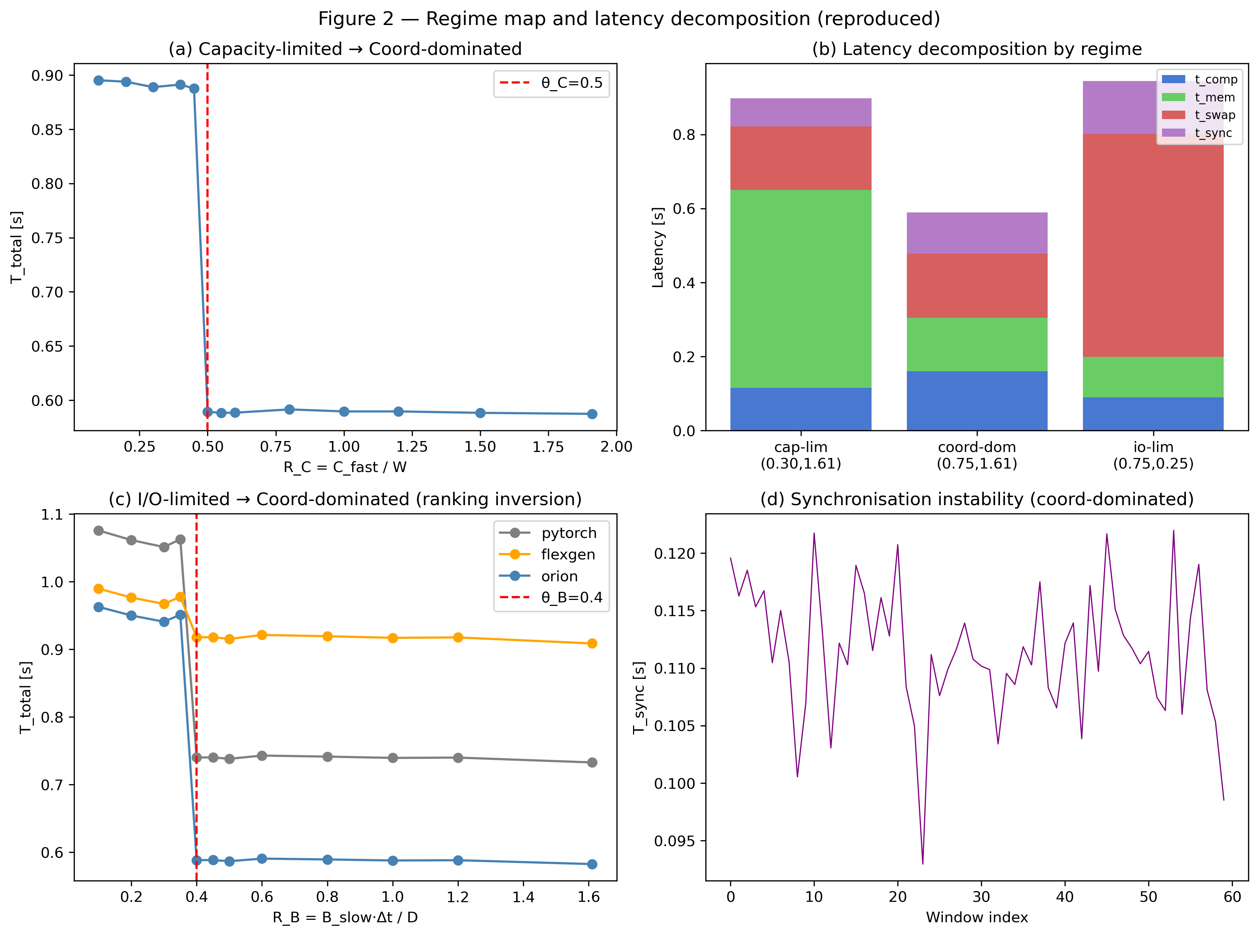
Experimental Results: Regime-Oriented Probes
(a) Load Time
Capacity-limited sensitivity: high W causes large load-time variance
(b) Memory Efficiency
Capacity-limited: working-set pressure vs memory efficiency
(c) Inference Latency
Spans all 3 regimes — ranking inversion visible at I/O boundary
(d) Stability
Coordination-dominated: T_sync spikes under aggressive pipelining
A100 (80GB) x2 | Llama-3 8B | batch=8, seq=2048 | error bars: bootstrap 95% CI (n_eff=150)
Notes:
Figure 2 from the paper. Ranking inversion most visible in panel (c). Panel (d) shows stability collapse in coordination-dominated regime under aggressive pipelining.

Slide 16
Generality: Regime Structure Beyond LLMs
The regime framework governs any workload whose active working set can exceed fast-memory capacity
BLIP2 Visual QA
RAG (FAISS)
YOLOv8 Edge
Regime: Coord-dom -> I/O-limited (mid-inference)
Regime: Cap-limited -> Coord-dom (mid-inference)
Regime: I/O-limited (steady-state)
R_C = 0.53 -> 0.51
R_B = 0.43 -> 0.31
R_C = 0.46 -> 0.58
R_B = 0.42
R_C = 0.49
R_B = 0.22
ORION: -11.2 +/- 1.4%
ORION: -17.4 +/- 1.8%
ORION: -9.5 +/- 1.2%
+1.8% (FlexGen worsens — saturated path)
-5.1% (misses adaptive coordination margin)
+7.8% (FlexGen worsens latency)
In all three cases: observed regime matches (R_C, R_B) classifier prediction — two-ratio framework generalises across modality
Notes:
Regime structure is not LLM-specific. YOLOv8: frame-drop rate cut from 12% to 2.5% with ORION. BLIP2 and RAG show mid-inference regime transitions that fixed-strategy approaches cannot handle.

Slide 17
Energy Efficiency: Regime Misalignment as Root Cause
3.2x
15.8 g
42.5 g
Throughput-per-Watt gap
coord-dom vs I/O-limited
CO2 per 10^6 tokens
(R_B >= 0.40, aligned)
CO2 per 10^6 tokens
(R_B < 0.20, I/O-limited)
Throughput-per-Watt (normalised to PyTorch = 100) | Coordination-dominated regime | NVML 100ms power sampling
Method | Avg. Power (W) | Throughput (tok/s) | Tput/Watt (norm.)
PyTorch (default) | 310 +/- 4 | 6,200 +/- 80 | 100.0
FlexGen | 315 +/- 5 | 6,800 +/- 90 | 108.0 +/- 2.1
SwapAdvisor | 320 +/- 5 | 7,040 +/- 95 | 110.0 +/- 2.2
vLLM | 318 +/- 5 | 7,120 +/- 90 | 112.0 +/- 2.1
ORION (adaptive) | 322 +/- 5 | 7,620 +/- 100 | 118.5 +/- 2.4
CO2 figures: IEA 2024 global average 494 gCO2/kWh | Grid-mix variability dominates CO2 uncertainty (+/-30%)
Notes:
3.2x throughput-per-Watt gap between coordination-aligned and I/O-limited operation. Regime misalignment is a root cause of energy inefficiency, not just hardware limitations.

Slide 18
Discussion: Crossover vs True Phase Transition
Thermodynamic Phase Transition
Finite-Size Crossover (our case)
System size L -> infinity
Order parameter changes discontinuously
Susceptibility (analogous to S) diverges at critical point
S -> infinity at the transition
Cannot happen in finite systems
L = number of transformer layers (fixed, finite)
S bounded; carries O(1/L) corrections from continuum limit
S = 4.12 at theta_C — operationally indistinguishable from a true transition at any practical model scale
Sharpness scales with L: larger models -> sharper transitions
Resolves the 'phase-like' qualifier used throughout the paper
Practical implication: ORION addresses real operational crossovers — actionable at any model scale
Notes:
Important nuance: finite-size crossovers, not true thermodynamic phase transitions. But S=4.12 >> S*=2.0 means operationally indistinguishable at practical scales. S scales with L — larger models show sharper transitions.

Slide 19
Limitations and Future Work
Classifier Generalisation
93.4% accuracy is in-distribution (same 5 platforms). Validation on unseen hardware, CXL-pooled memory, or novel bandwidth profiles is an open direction.
Multi-Node Scaling
4-node A100 experiments show Delta_theta_B = +0.05 from inter-node coordination. Full characterisation of regime fragmentation at cluster scale remains open.
Hysteresis / Regime Memory
Latency hysteresis when workloads traverse boundaries in both directions suggests nonlinear cache-reuse effects. Exploiting this in adaptive scheduling is a concrete open problem.
MoE and Speculative Decoding
MoE: W_eff = W_param x (k/N_exp) + W_act + W_kv shifts R_C upward. Speculative decoding: draft and target models may occupy different regimes — requiring per-model (R_C, R_B) classification.
RL or Bayesian optimisation combined with boundary theory is a promising direction for within-regime optimal orchestration.
Notes:
Four key limitations. Classifier generalisation is most important. MoE and speculative decoding extensions are natural next steps.

Slide 20
Conclusion
Hierarchical memory orchestration for AI inference
is not a continuous optimisation problem — it is a regime-aware design problem.
1 Regime-Dependent Principle
2 Minimal Analytical Model
Three intrinsic regimes with abrupt transitions; strategy rankings invert across boundaries — not just diminishing returns
Structural lower bound proving transitions are inevitable; theta_C=0.50 derived analytically; theta_B from 3 measurements in 10 min
3 Multi-Platform Validation
4 Workload Generality
Boundaries within +/-0.05 across A100, TPU v4, Inferentia2, MI250, Optane-PMem — all real hardware, no simulation
LLM, BLIP2, RAG, YOLOv8 all exhibit the same three-regime structure — framework is architecture-agnostic
R_C and R_B are computable from hardware datasheets and model cards — no experiments required.
Notes:
Take-away: two ratios computable before deployment. Regime-aware design, not continuous tuning, is the right framing. Paper submitted to Nature Computational Science.

