Slide 1
LOAIUUTIEN
MaLoaiUT
TenLoaiUT
BIENNHAN
MaLePhi
MaDoiBong
SoTien
NgayBatDau
NgayHetHan
NgayThanhToan
TinhTrang
SANTHIDAU
MaSan
TenSan
DiaChiSan
SucChua
TieuChuan
UT_XEPHANG
MaMuaGiai
MaLoaiUT
MucDoUT
BANGXEPHANG
MaMuaGiai
MaVongDau
MaDoiBong
SoTran
SoTranThang
SoTranThua
SoBanThang
SoBanThua
HieuSo
Diem
DOIBONG
MaDoiBong
TenDoiBong
CoQuanChuQuan
ThanhPhoTrucThuoc
MaSan
HLV
ThongTin
Logo
MUAGIAI
MaMuaGiai
TenMuaGiai
NgayBatDau
NgayKetThuc
VONGDAU
MaVongDau
MaMuaGiai
LuotDau
SoThuTu
NgayBatDau
NgayKetThuc
THAMSO
TenThamSo
GiaTri
MG_DB_CT
MaMuaGiai
MaDoiBong
MaCauThu
BANTHANG
MaBanThang
MaTranDau
MaDoiBong
MaCauThu
MaLoaiBanThang
ThoiDiem
TRANDAU
MaTranDau
MaVongDau
MaDoiBongNha
MaDoiBongKhach
NgayThiDau
GioThiDau
MaSan
BanThangDoiNha
BanThangDoiKhach
THEPHAT
MaThePhat
MaTranDau
MaCauThu
MaLoaiThePhat
ThoiGian
LyDo
CAUTHU
MaCauThu
TenCauThu
NgaySinh
QuocTich
LoaiCauThu
ViTri
ChieuCao
CanNang
SoAo
TieuSu
AnhCauThu
DSTHEPHAT
MaCauThu
MaVongDau
MaMuaGiai
SoThePhat
TinhTrangThiDau
VUAPHALUOI
MaCauThu
MaMuaGiai
SoTran
SoBanThang
LOAIBANTHANG
MaLoaiBanThang
TenLoaiBanThang
MoTa
LOAITHEPHAT
MaLoaiThePhat
TenTheLoaiPhat
MoTa

Slide 2
VONGDAU
MaVongDau
MaMuaGiai
LuotDau
SoThuTu
NgayBatDau
NgayKetThuc
LOAIUUTIEN
MaLoaiUT
TenLoaiUT
BANGXEPHANG
MaMuaGiai
MaVongDau
MaDoiBong
SoTran
SoTranThang
SoTranThua
SoBanThang
SoBanThua
HieuSo
Diem
UT_XEPHANG
MaMuaGiai
MaLoaiUT
MucDoUT
MUAGIAI
MaMuaGiai
TenMuaGiai
NgayBatDau
NgayKetThuc
DOIBONG
MaDoiBong
TenDoiBong
CoQuanChuQuan
ThanhPhoTrucThuoc
MaSan
HLV
ThongTin
Logo

Slide 3
LOAIUUTIEN
MaLoaiUT
TenLoaiUT
THAMSO
TenThamSo
GiaTri
TenThamSo | GiaTri
DiemThang | 3
DiemHoa | 1
DiemThua | 0
UT_XEPHANG
MaMuaGiai
MaLoaiUT
MucDoUT

Slide 4
VONGDAU
MaVongDau
MaMuaGiai
LuotDau
SoThuTu
NgayBatDau
NgayKetThuc
MUAGIAI
MaMuaGiai
TenMuaGiai
NgayBatDau
NgayKetThuc
DSTHEPHAT
MaCauThu
MaVongDau
MaMuaGiai
SoThePhat
TinhTrangThiDau
TRANDAU
MaTranDau
MaVongDau
MaDoiBongNha
MaDoiBongKhach
NgayThiDau
GioThiDau
MaSan
BanThangDoiNha
BanThangDoiKhach
CAUTHU
MaCauThu
TenCauThu
NgaySinh
QuocTich
LoaiCauThu
ViTri
ChieuCao
CanNang
SoAo
TieuSu
AnhCauThu
THEPHAT
MaThePhat
MaTranDau
MaCauThu
MaLoaiThePhat
ThoiGian
LyDo
LOAITHEPHAT
MaLoaiThePhat
TenTheLoaiPhat
MoTa

Slide 5
TRANDAU
MaTranDau
MaVongDau
MaDoiBongNha
MaDoiBongKhach
NgayThiDau
GioThiDau
MaSan
BanThangDoiNha
BanThangDoiKhach
DOIBONG
MaDoiBong
TenDoiBong
CoQuanChuQuan
ThanhPhoTrucThuoc
MaSan
HLV
ThongTin
Logo
CAUTHU
MaCauThu
TenCauThu
NgaySinh
QuocTich
LoaiCauThu
ViTri
ChieuCao
CanNang
SoAo
TieuSu
AnhCauThu
BANTHANG
MaBanThang
MaTranDau
MaDoiBong
MaCauThu
MaLoaiBanThang
ThoiDiem
MUAGIAI
MaMuaGiai
TenMuaGiai
NgayBatDau
NgayKetThuc
VUAPHALUOI
MaCauThu
MaMuaGiai
SoTran
SoBanThang
LOAIBANTHANG
MaLoaiBanThang
TenLoaiBanThang
MoTa

Slide 6
BANTHANG
MaBanThang
MaTranDau
MaDoiBong
MaCauThu
MaLoaiBanThang
ThoiDiem
THAMSO
TenThamSo
GiaTri
TenThamSo | GiaTri
ThoiDiemGhiBanToida | 90

Slide 7
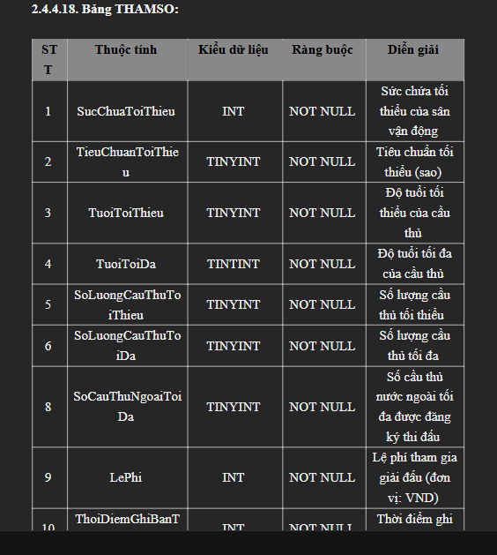
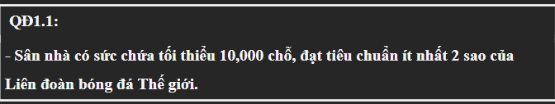
SANTHIDAU
MaSan
TenSan
DiaChiSan
SucChua
TieuChuan
DOIBONG
MaDoiBong
TenDoiBong
CoQuanChuQuan
ThanhPhoTrucThuoc
MaSan
HLV
ThongTin
Logo
THAMSO
TenThamSo
GiaTri
TenThamSo | GiaTri
SucChuaToiThieu | 10,000
TieuChuanToiThieu | 2

Slide 8
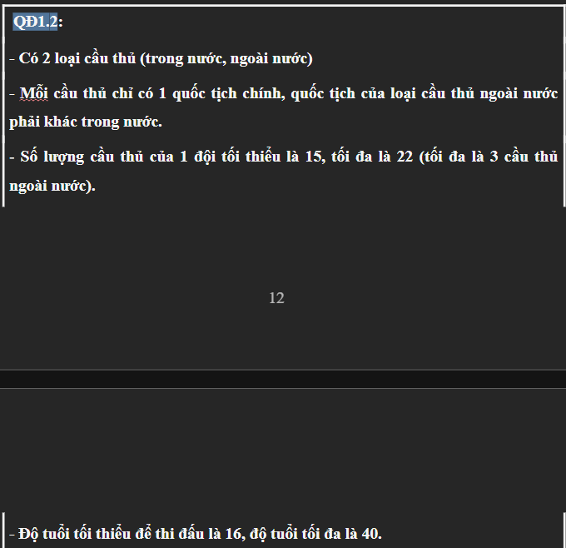
SANTHIDAU
MaSan
TenSan
DiaChiSan
SucChua
TieuChuan
DOIBONG
MaDoiBong
TenDoiBong
CoQuanChuQuan
ThanhPhoTrucThuoc
MaSan
HLV
ThongTin
Logo
CAUTHU
MaCauThu
TenCauThu
NgaySinh
QuocTich
LoaiCauThu
ViTri
ChieuCao
CanNang
SoAo
TieuSu
AnhCauThu
THAMSO
TenThamSo
GiaTri
TenThamSo | GiaTri
SoLuongCauThuToiThieu | 15
SoLuongCauThuToiDa | 22
SoLuongCauThuNgoaiNuocToiDa | 3
MG_DB_CT
MaMuaGiai
MaDoiBong
MaCauThu

Slide 9
SANTHIDAU
MaSan
TenSan
DiaChiSan
SucChua
TieuChuan
DOIBONG
MaDoiBong
TenDoiBong
CoQuanChuQuan
ThanhPhoTrucThuoc
MaSan
HLV
ThongTin
Logo
CAUTHU
MaCauThu
TenCauThu
NgaySinh
QuocTich
LoaiCauThu
ViTri
ChieuCao
CanNang
SoAo
TieuSu
AnhCauThu
MUAGIAI
MaMuaGiai
TenMuaGiai
NgayBatDau
NgayKetThuc
MaGiaiDau
MG_DB_CT
MaMuaGiai
MaDoiBong
MaCauThu

Slide 10
SANTHIDAU
MaSan
TenSan
DiaChiSan
SucChua
TieuChuan
DOIBONG
MaDoiBong
TenDoiBong
CoQuanChuQuan
ThanhPhoTrucThuoc
MaSan
HLV
ThongTin
Logo
CAUTHU
MaCauThu
TenCauThu
NgaySinh
QuocTich
LoaiCauThu
ViTri
ChieuCao
CanNang
SoAo
TieuSu
AnhCauThu
MUAGIAI
MaMuaGiai
TenMuaGiai
NgayBatDau
NgayKetThuc
MaGiaiDau
MG_DB_CT
MaMuaGiai
MaDoiBong
MaCauThu
THAMSO
TenThamSo
GiaTri
TenThamSo | GiaTri
TuoiToiThieu | 16
TuoiToiDa | 40
SoCauThuNgoaiToiDa | 3
SoLuongCauThuToiThieu | 15
SoLuongCauThuToiDa | 22

Slide 11
SANTHIDAU
MaSan
TenSan
DiaChiSan
SucChua
TieuChuan
DOIBONG
MaDoiBong
TenDoiBong
CoQuanChuQuan
ThanhPhoTrucThuoc
MaSan
HLV
ThongTin
Logo
THAMSO
TenThamSo
GiaTri
TenThamSo | GiaTri
SucChuaToiThieu | 10,000
TieuChuanToiThieu | 2

Slide 12
THAMSO
TenThamSo
GiaTri
DOIBONG
MaDoiBong
TenDoiBong
CoQuanChuQuan
ThanhPhoTrucThuoc
MaSan
HLV
ThongTin
Logo
BIENNHAN
MaLePhi
MaDoiBong
SoTien
NgayBatDau
NgayHetHan
NgayThanhToan
TinhTrang
TenThamSo | GiaTri
LePhi | 1,000,000,000

Slide 13
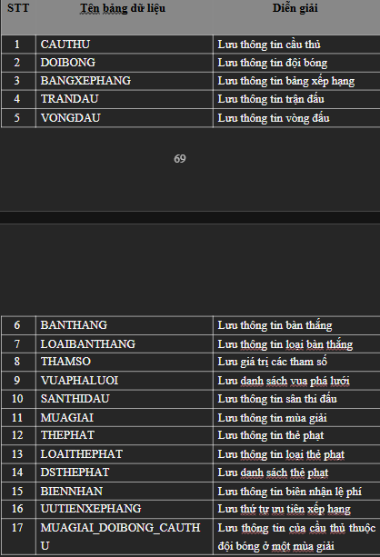
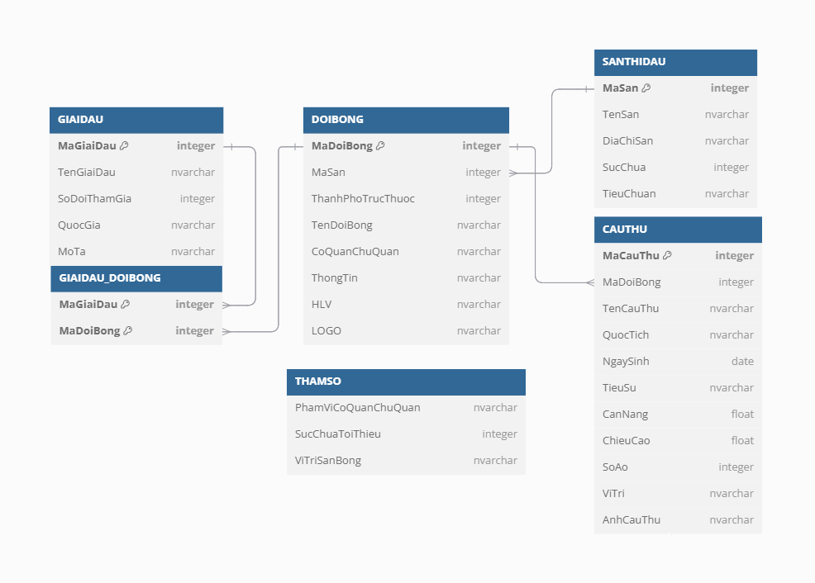


















SANTHIDAU
MaSan
TenSan
DiaChiSan
SucChua
TieuChuan
DOIBONG
MaDoiBong
TenDoiBong
CoQuanChuQuan
ThanhPhoTrucThuoc
MaSan
HLV
ThongTin
Logo
CAUTHU
MaCauThu
TenCauThu
NgaySinh
QuocTich
LoaiCauThu
ViTri
ChieuCao
CanNang
SoAo
TieuSu
AnhCauThu
MUAGIAI
MaMuaGiai
TenMuaGiai
NgayBatDau
NgayKetThuc
MaGiaiDau
MG_DB_CT
MaMuaGiai
MaDoiBong
MaCauThu
THEPHAT
MaThePhat
MaTranDau
MaCauThu
MaLoaiThePhat
ThoiGian
LyDo
LOAITHEPHAT
MaLoaiThePhat
TenTheLoaiPhat
MoTa
DSTHEPHAT
MaCauThu
MaVongDau
MaMuaGiai
SoThePhat
TinhTrangThiDau
VONGDAU
MaVongDau
MaMuaGiai
LuotDau
SoThuTu
NgayBatDau
NgayKetThuc
BANGXEPHANG
MaMuaGiai
MaVongDau
MaDoiBong
SoTran
SoTranThang
SoTranThua
SoBanThang
SoBanThua
HieuSo
Diem
BIENNHAN
MaLePhi
MaDoiBong
SoTien
NgayBatDau
NgayHetHan
NgayThanhToan
TinhTrang
TRANDAU
MaTranDau
MaVongDau
MaDoiBongNha
MaDoiBongKhach
NgayThiDau
GioThiDau
MaSan
BanThangDoiNha
BanThangDoiKhach
VUAPHALUOI
MaCauThu
MaMuaGiai
SoTran
SoBanThang
BANTHANG
MaBanThang
MaTranDau
MaDoiBong
MaCauThu
MaLoaiBanThang
ThoiDiem
UUTIEN_XEPHANG
MaUT
HieuSo
DoiDau
SoThePhat
SoBanThang
TenDoiBong
LOAIBANTHANG
MaLoaiBanThang
TenLoaiBanThang
MoTa

