Slide 1














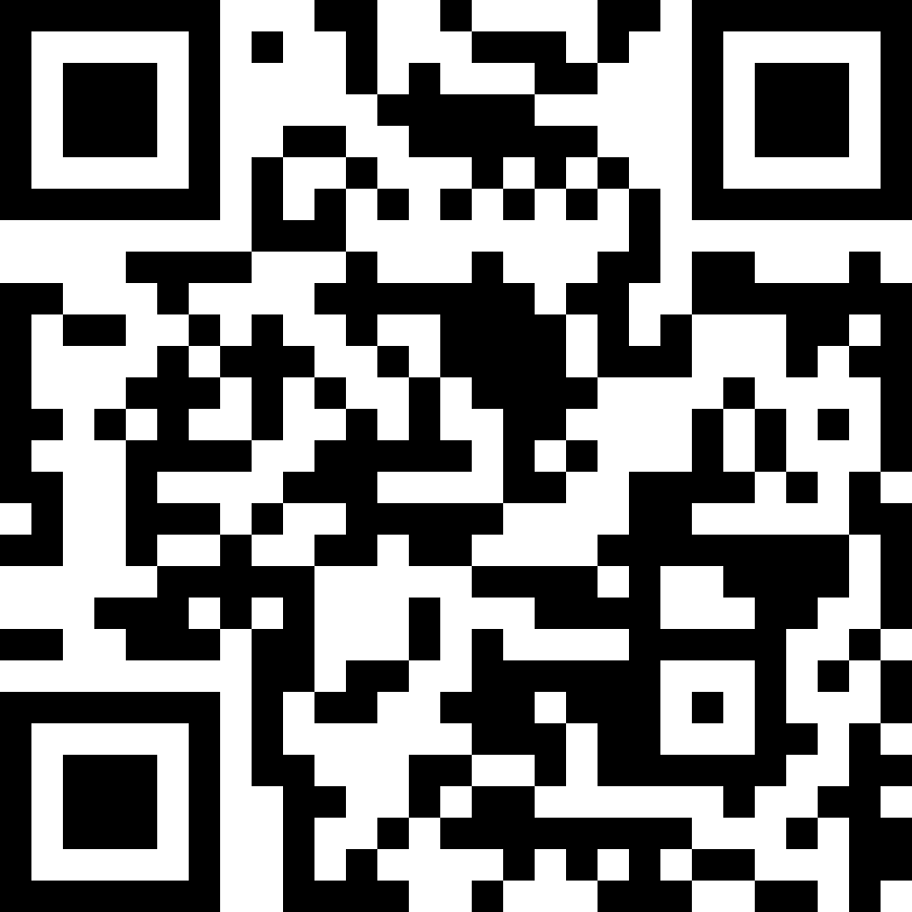



Linux Users’ Group
@ NC State
Learn about Linux and free software!
Meet likeminded tech enthusiasts!
Operating since 1994!
Visit our website!
Meetings every Friday at 7:00 PM!
Or go to lug.ncsu.edu
Other OS users also welcome!

