Slide 1

Introduction to Machine Learning
Rohit Kate
Assignment 1

Slide 2
Scikit Learn
Scikit learn or sklearn is a popular machine learning library:
https://scikit-learn.org/stable/
Includes several machine learning methods
Freely available and open source

Slide 3
Background: Python
If you do not know the Python programming language then you should familiarize yourself with it
It is easy to learn and very straightforward
Following is the official resource:
https://docs.python.org/3/tutorial/index.html
Another good resource to learn Python:
https://www.w3schools.com/python/default.asp

Slide 4
Background: NumPy Library
Besides basic Python, it will be a good idea to also familiarize yourself with Python’s NumPy library because sklearn uses it extensively for data
This is a good resource: https://www.w3schools.com/python/numpy_intro.asp
For this course, familiarity with the multi-dimensional array data structure will suffice

Slide 5
Background: Pandas Library
Besides NumPy, sklearn also uses Python’s Pandas library to work with data
This is a good resource:
https://www.w3schools.com/python/pandas/default.asp
For this course, basic familiarity with Series and DataFrames will suffice

Slide 6
Background: Matplotlib Library
Useful for plotting graphs
A good resource:
https://www.w3schools.com/python/matplotlib_intro.asp
For this course, knowing how to plot on x-y axes graphs will suffice

Slide 7
Installation
Please install Python on your computer: https://www.python.org/downloads/
Play with it from the IDLE prompt (see IDLE.pptx slides)
Next install sklearn library as follows:
From the command prompt of the computer (e.g. “Windows Powershell” after right-click from Start button and choose “Terminal”; not from Python’s prompt) you need to do:
pip install –U scikit-learn
See: https://scikit-learn.org/stable/install.html

Slide 8
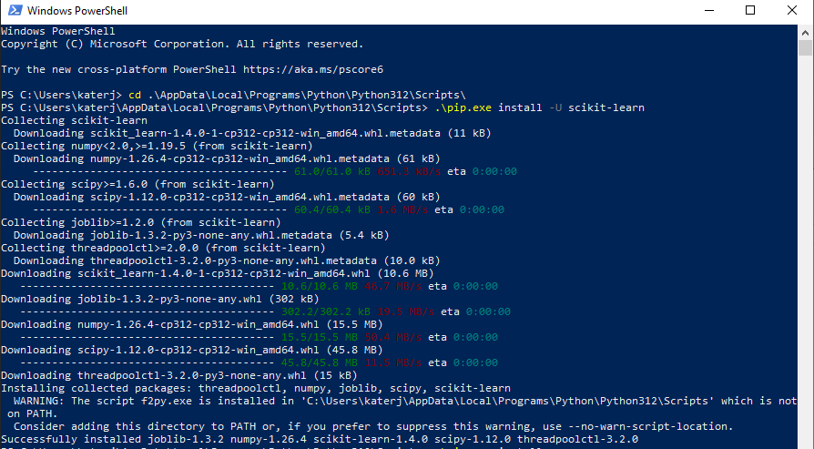
Install scikit-learn
Note: In case your computer does not recognize pip, you may need to go to Python’s installation folder/Scripts and use ./pip as shown below.
Do “cd AppData\Local\Programs\Python\Python312\Scripts\” to be in the folder first.

Slide 9
Install Other Libraries
Similarly, also install pandas and matplotlib (numpy gets installed with scikit-learn)
pip install pandas
pip install matplotlib

Slide 10
Loading Dataset
sklearn can load datasets in some standard formats and from some standard sources
https://scikit-learn.org/stable/api/sklearn.datasets.html
In this assignment, you will use a dataset from OpenML (a free platform for datasets) (https://www.openml.org/search?type=data)
A dataset from OpenML can be loaded in sklearn using fetch_openml()
See the next slides

Slide 11
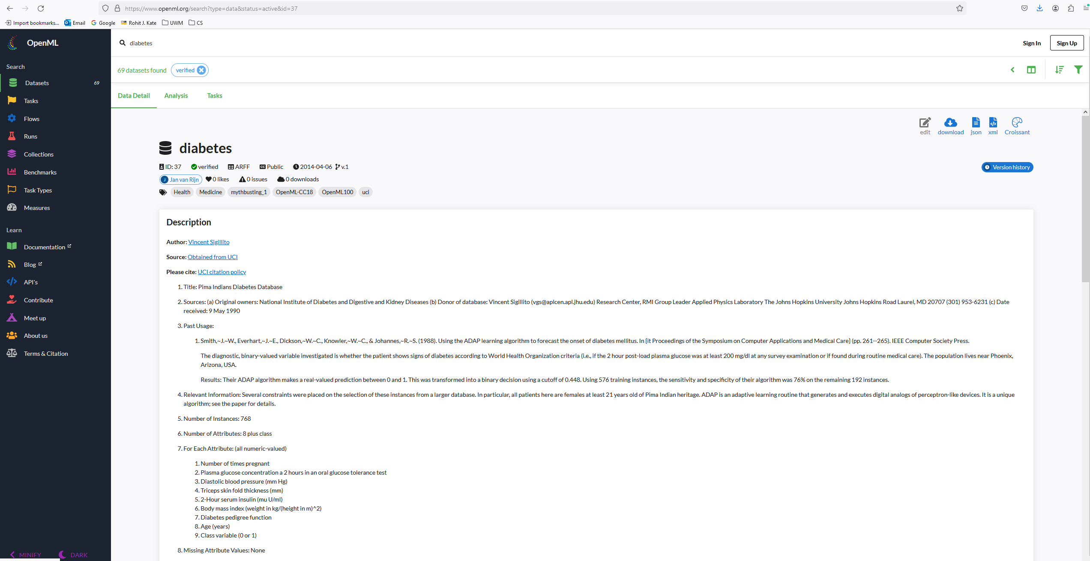
Fetching Dataset from OpenML
Suppose you want to load “diabetes” dataset from openml.org
Note its id from the URL
For filtering the type of datasets
For
searching
Id=37

Slide 12
Fetching Dataset from OpenML
Then you would do:
>>> from sklearn import datasets
>>> dia = datasets.fetch_openml(data_id=37)
Note:
scikit-learn library is imported as sklearn
datasets is a sublibrary of sklearn
Internet should be working for fetching the dataset for the first time
The dataset is now loaded in variable dia
>>> dia.feature_names
['preg', 'plas', 'pres', 'skin', 'insu', 'mass', 'pedi', 'age’]

Slide 13
Loaded Dataset
>>> dia.data
preg plas pres skin insu mass pedi age
0 6.0 148.0 72.0 35.0 0.0 33.6 0.627 50.0
1 1.0 85.0 66.0 29.0 0.0 26.6 0.351 31.0
2 8.0 183.0 64.0 0.0 0.0 23.3 0.672 32.0
3 1.0 89.0 66.0 23.0 94.0 28.1 0.167 21.0
4 0.0 137.0 40.0 35.0 168.0 43.1 2.288 33.0
.. ... ... ... ... ... ... ... ...
763 10.0 101.0 76.0 48.0 180.0 32.9 0.171 63.0
764 2.0 122.0 70.0 27.0 0.0 36.8 0.340 27.0
765 5.0 121.0 72.0 23.0 112.0 26.2 0.245 30.0
766 1.0 126.0 60.0 0.0 0.0 30.1 0.349 47.0
767 1.0 93.0 70.0 31.0 0.0 30.4 0.315 23.0
[768 rows x 8 columns]

Slide 14
Loaded Dataset
>>> dia.target
0 tested_positive
1 tested_negative
2 tested_positive
3 tested_negative
4 tested_positive
...
763 tested_negative
764 tested_negative
765 tested_negative
766 tested_positive
767 tested_negative
Name: class, Length: 768, dtype: category
Categories (2, object): [tested_negative, tested_positive]

Slide 15
Loaded Dataset
The type of dia.feature_names is a list, type of dia.data is a pandas DataFrame, and type of dia.target is pandas Series and
>>> type(dia.feature_names)
<class 'list'>
>>> type(dia.data)
<class 'pandas.core.frame.DataFrame'>
>>> type(dia.target)
<class 'pandas.core.series.Series'>

Slide 16
Documentation for sklearn
User guide: https://scikit-learn.org/stable/user_guide.html
Application programming interface (API): https://scikit-learn.org/stable/modules/classes.html

Slide 17
Decision Trees
sklearn.tree module has decision tree learners (classifiers and regressors)
https://scikit-learn.org/stable/api/sklearn.tree.html
Decision tree classifiers:
https://scikit-learn.org/stable/modules/generated/sklearn.tree.DecisionTreeClassifier.html

Slide 18
Decision Trees
Let us create a decision tree object named mytree:
>>> from sklearn.tree import DecisionTreeClassifier
>>> mytree = DecisionTreeClassifier(criterion="entropy")
Use criterion="entropy” for a decision tree based on information gain, by default (without the parameter) it creates decision tree based on Gini index
mytree is now an object of DecisionTreeClassifier class
Not trained yet

Slide 19
Decision Tree Parameters
DecisionTreeClassifier has several parameters
Type the following and wait for a few seconds, it shows the options
>>> tree.DecisionTreeClassifier(
Alternatively, you can type the following and click on the “Squeezed text (793 lines)”
>>> help(tree.DecisionTreeClassifier)
min_samples_leaf is the parameter that controls minimum number of examples required to be at a leaf

Slide 20
Training
There is a consistency in sklearn for using all the machine learning methods
All machine learning methods (i.e. their objects) are trained using the “fit” method with features and targets as parameters
See it in documentation of Decision Tree Classifier
Fit the tree to the features and target:
>>> mytree.fit(dia.data,dia.target)
Now mytree has been trained.

Slide 21
Learned Tree
The learned tree can be displayed in text:
>>> from sklearn import tree
>>> print(tree.export_text(mytree))
|--- feature_1 <= 127.50
| |--- feature_7 <= 28.50
| | |--- feature_5 <= 30.95
| | | |--- feature_0 <= 7.50
| | | | |--- feature_6 <= 0.67
| | | | | |--- class: tested_negative
| | | | |--- feature_6 > 0.67
| | | | | |--- feature_6 <= 0.69
| | | | | | |--- class: tested_positive
| | | | | |--- feature_6 > 0.69
| | | | | | |--- class: tested_negative
| | | |--- feature_0 > 7.50
| | | | |--- class: tested_positive
| | |--- feature_5 > 30.95
…
…
…

Slide 22
Making Predictions
In sklearn, all machine learning methods (i.e. their objects) make predictions using the “predict” method with the features as parameter
Must have been trained (“fit”) before
>>> predictions = mytree.predict(dia.data)
Note: This was testing on the training data
>>> type(predictions)
<class 'numpy.ndarray'>
>>> predictions
array(['tested_positive', 'tested_negative', 'tested_positive',
'tested_negative', 'tested_positive', 'tested_negative’,
…
…

Slide 23
Evaluating
There are many evaluation metrics in sklearn
https://scikit-learn.org/stable/modules/model_evaluation.html
>>> from sklearn import metrics
>>> metrics.accuracy_score(dia.target, predictions)
1.0
For the following, you need to specify the class name for which to compute the metric
>>> metrics.f1_score(dia.target, predictions, pos_label="tested_positive")
1.0
>>> metrics.precision_score(dia.target, predictions, pos_label="tested_positive")
1.0
>>> metrics.recall_score(dia.target, predictions, pos_label="tested_positive")
1.0

Slide 24
Evaluating
You cannot use roc_auc_score unless the predictions were numerical (e.g. probabilities)
Use “predict_proba” method
>>> pp = mytree.predict_proba(dia.data)
It gives probability for each class, see the order of class names using classes_
>>> mytree.classes_
array(['tested_negative', 'tested_positive'], dtype=object)
>>> metrics.roc_auc_score(dia.target, pp[:,1])
1.0

Slide 25
Cross-Validation
In the previous slides we were testing on the training data
You could yourself separate training and test data or use sklearn’s train_test_split function
https://scikit-learn.org/stable/modules/generated/sklearn.model_selection.train_test_split.html#sklearn.model_selection.train_test_split
Or even better, you can do cross-validation
sklearn has multiple cross-validation functions ()
https://scikit-learn.org/stable/api/sklearn.model_selection.html
See under Model Validation

Slide 26
Cross-Validation
We want to plot ROC curve, so we want prediction probabilities, hence we will use cross_val_predict
>>> from sklearn import model_selection
>>> dtc = DecisionTreeClassifier(criterion="entropy", min_samples_leaf=3)
>>> y_scores = model_selection.cross_val_predict(dtc, dia.data, dia.target, method="predict_proba", cv=10)
ML method
object
Parameter
Number of folds
We want prediction probabilities

Slide 27
Cross-Validation
The returned object stores probabilities of both the classes for each example (across all the folds)
>>> y_scores.shape
(768, 2)
>>> y_scores
array([[0. , 1. ],
[1. , 0. ],
[0. , 1. ],
...,
[1. , 0. ],
[0.66666667, 0.33333333],
[1. , 0. ]])

Slide 28
AUC
>>> from sklearn.metrics import roc_auc_score
>>> roc_auc_score(dia.target, y_scores[:,1])
0.7489813432835821

Slide 29
Plotting ROC Curve
>>> from sklearn.metrics import roc_curve
>>> fpr, tpr, th = roc_curve(dia.target, y_scores[:,1],pos_label="tested_positive")
>>> fpr
array([0. , 0.166, 0.174, 0.184, 0.216, 0.232, 0.238, 0.258, 0.296,
0.318, 0.326, 1. ])
>>> tpr
array([0. , 0.46641791, 0.47014925, 0.48507463, 0.52985075,
0.56343284, 0.56716418, 0.5858209 , 0.63432836, 0.66044776,
0.68283582, 1. ])
Column of probabilities for
the positive class
(order as shown in dia.target)
Need to tell w.r.t. which class

Slide 30
Plotting ROC Curve
from matplotlib import pyplot as plt
plt.xlabel("1 - Specificity")
plt.ylabel("Sensitivity")
plt.xlim(0,1)
plt.ylim(0,1)
plt.plot(fpr,tpr,label="Decision Tree")
plt.legend()
plt.show()

Slide 31
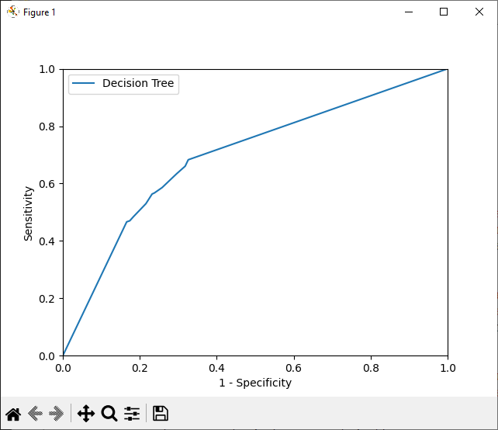
Plotting ROC Curve

Slide 32
Overfitting and Underfitting
The default value for min_samples_leaf is 1 which makes the model prone for overfitting
Recall definition of overfitting
A higher value of that parameter is likely to achieve better performance on test data (even though worse on training data)
A very high value of the parameter will lead to underfitting
on training data
on test data
accuracy
h’
h
hypothesis complexity (tree size)

