Slide 1

Introduction to Machine Learning
Rohit Kate
Assignment 4:
Image Classification Using CNNs

Slide 2
CNNs in Keras
It is fairly easy to implement CNNs in Keras
In this assignment, you will build CNN models for an image classification task
Your own architecture
Fine-tune a pre-trained architecture

Slide 3
Dataset
We will use the “6 Human Emotions for image classification” dataset from Kaggle:
https://www.kaggle.com/datasets/yousefmohamed20/sentiment-images-classifier/data
Download it (122.5 Mb zip file)
Requires signing-in from an email
After unzipping the file (you may need to install 7-zip https://www.7-zip.org/):
Keep the inner “6 Emotions for image classification” folder directly under the Python folder

Slide 4
Dataset
The dataset has 6 folders, one for each emotion
Folder names are the class names
This is a general structure for many classification datasets
Program would easily work with any other such dataset

Slide 5
Remove Corrupt Image Files
Corrupted images are not uncommon (even when they display correctly)
All the images in this dataset are in JPEG format (.jpeg or .jpg extension)
A corrupt JPEG file can be identified as not having “JFIF” (byte literal) in its header (first 10 bytes)
We will remove these files (not doing so will give error in Keras):
import os, glob
files = glob.glob("6 Emotions for image classification/*/*")
for file in files :
f = open(file, "rb") # open to read binary file
if not b"JFIF" in f.peek(10) :
f.close()
os.remove(file)
else :
f.close()

Slide 6
Loading Image Dataset
Keras provides a handy preprocessing function to load an image dataset from the folder structure: image_dataset_from_directory
https://keras.io/api/preprocessing/image/
from tensorflow.keras.preprocessing import image_dataset_from_directory
training_set = image_dataset_from_directory("6 Emotions for image classification", validation_split=0.2, subset="training", label_mode="categorical", seed=0, image_size=(100,100))

Slide 7
Loading Image Dataset
image_dataset_from_directory arguments:
First: name of the folder
label_mode="categorical": give labels corresponding to categorical labels
Will automatically do one-hot encoding
image_size=(100,100): resize all images to 100x100
validation_split=0.2: use 80% part for training set (randomly selected)
subset="training": create the training set
seed=0: seed for random number (use the same seed to generate the other 20% part and for other experiments to compare models)

Slide 8
Loading Image Dataset
Function image_dataset_from_directory returns a tensorflow Dataset object
It includes labels, and can be directly fed to Keras fit or evaluate functions
If you iterate through the Dataset, you will see it consists of tuples of numpy arrays corresponding to the images (100x100x3) and their labels (one-hot encoded), in batches (default 32)
for e in training_set :
print(e)
a = input() # to pause
Indexing or slicing does not work on it

Slide 9
Loading Image Dataset
You can look at some of the loaded images and their labels:
training_set.class_names
One-hot encoding labels will be in the above order of classes.
import matplotlib.pyplot as plt
for e in training_set :
print(e[1][0])
plt.imshow(e[0][0]/255)
plt.show()
Close an image to see the next; <control>-c to exit
Label
Image (numpy array)
plt.imshow accepts
RGB between 0-1.

Slide 10
Loading Image Dataset
We create a test set with the rest of the data (important: use the same seed)
test_set = image_dataset_from_directory("6 Emotions for image classification", validation_split=0.2, subset="validation", label_mode="categorical", seed=0, image_size=(100,100))

Slide 11
Building CNN
Now we are ready to build a CNN
from tensorflow.keras.models import Sequential
from tensorflow.keras.layers import Input, Rescaling, Conv2D, Dense, Flatten, MaxPooling2D, Dropout
We will need all the above types of layers (details later)
m = Sequential()
m is the variable name of our model

Slide 12
Building CNN
We first add Input layer giving it the tuple of the shape of each example
m.add(Input((100,100,3)))
Why 3?
We add a rescaling layer so that the input numbers are between 0 and 1 (currently the colors are between 0 and 255):
m.add(Rescaling(1/255))
https://keras.io/api/layers/preprocessing_layers/image_preprocessing/rescaling/

Slide 13
Building CNN
We add the first convolutional layer:
m.add(Conv2D(32, kernel_size=(3, 3),
activation="relu"))
Filter size 3x3
Number of filters
ReLU activation
function
https://keras.io/api/layers/convolution_layers/convolution2d/
Defaults: stride=(1,1) and padding=valid

Slide 14
Building CNN
We add a pooling layer using max function :
m.add(MaxPooling2D(pool_size=(2, 2)))
See other types of pooling layers: https://keras.io/layers/pooling/
Pooling using max
Pooling window size 2x2

Slide 15
Building CNN
We add the next convolutional layer and a pooling layer:
m.add(Conv2D(64, (3, 3), activation="relu"))
m.add(MaxPooling2D(pool_size=(2, 2)))
Convolutional layers and their documentation: https://keras.io/layers/convolutional/

Slide 16
Building CNN
Before we get to the final dense layers, we need to combine the outputs (of the last layer) and then flatten the structure

Slide 17
Building CNN
From here we will build a regular full-connected (dense) neural network that will lead to output, to do that first we need to change the nodes of a 2D layer to 1D layer:
m.add(Flatten())
Example:
[[[2,3], [4,5]], [[6,7], [8,9]]] # two examples
[[2, 3, 4, 5],
[6, 7, 8, 9]]
See other reshaping layers:
https://keras.io/api/layers/reshaping_layers/flatten/
See all other layers:
https://keras.io/api/layers/
Flatten

Slide 18
Building CNN
We add a traditional neural network Dense layer:
m.add(Dense(128, activation="relu"))
A dense hidden layer with 128 units and ReLU activation function.

Slide 19
Building CNN
We add a “dropout” layer: It randomly sets the specified fraction of inputs to 0 to avoid overfitting
Adding this layer and deciding the fraction is a design decision
m.add(Dropout(0.2))
See other regularization layers:
https://keras.io/api/layers/regularization_layers/

Slide 20
Building CNN
Finally we add the output layer with 6 nodes and softmax activation (because it is classification task)
m.add(Dense(6, activation="softmax"))
Size of output
Because it is classification

Slide 21
Setting CNN
We are done building the CNN, now we need to “compile” it to specify its settings
m.compile(loss="categorical_crossentropy",
metrics=["accuracy"])
You can see the summary of the model:
m.summary()
Other losses: https://keras.io/api/losses/
Other optimizers: https://keras.io/api/optimizers/
Other metrics: https://keras.io/api/metrics/
For classification
Evaluation metric

Slide 22
Training CNN
We train the CNN using the fit function
history = m.fit(training_set, epochs=20, verbose=2)
Have enough number of epochs so that the training accuracy plateaus.
You can run fit again, it continues to train.

Slide 23
Testing CNN
We can test the model’s accuracy on the test data
score = m.evaluate(test_set, verbose=2)
print("Test accuracy:", round(score[1],3))
Test accuracy: 0.335
(You may not get the exact same value due to randomness.)
Note: This is better than random prediction which will give accuracy of 1/6 = 0.167
One could design and evaluate different CNN architectures

Slide 24
Saving and Loading Models
It is possible to save models in Keras so that one does not need to train every time
One can train them once and load them any time for testing
One can also load it and continue training using fit
Uses .keras extension
m.save("my_cnn1.keras")
It will be saved in Python’s installation folder by default.
And load it later:
from keras.models import load_model
old_model = load_model("my_cnn1.keras")
See: https://keras.io/guides/serialization_and_saving/
See Models API: https://keras.io/api/models/
See FAQ: https://keras.io/getting_started/faq/

Slide 25
Fine-Tuning a Pre-Trained Model
There are several CNN architectures available which are already trained on many images (typically on ImageNet dataset: https://image-net.org/challenges/LSVRC/)
https://keras.io/api/applications/
Scroll down to see example codes
These can be fine-tuned to your task
from tensorflow.keras.applications import EfficientNetV2B3
base_model = EfficientNetV2B3 (include_top=False)
Do not include the top layer

Slide 26
Fine-Tuning a Pre-Trained Model
For the previous step, the first time your computer will download the model
Doing it on IDLE sometimes becomes very slow
Do it on the simple Python prompt instead
After that you can use it on IDLE

Slide 27
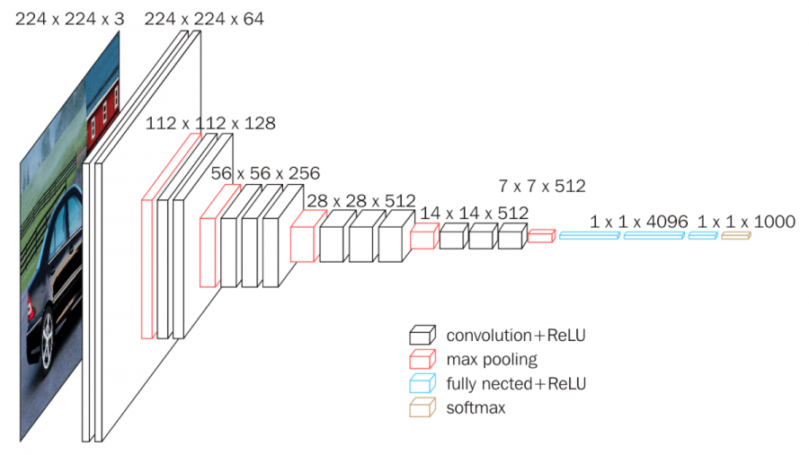
Recall: Fine-Tuning a Pre-Trained Model
VGG-16 Model
Pre-trained on 1000000s of images for a general classification task
Fine-tuned on 100s of images for
human emotion classification
X
X
1024
Softmax (6)
Dense layer weights
to adapt to our data
Freeze weights

Slide 28
Fine-Tuning a Pre-Trained Model
x = base_model.output
# output layer of the base model
from tensorflow.keras.layers import GlobalAveragePooling2D
x = GlobalAveragePooling2D()(x)
https://keras.io/api/layers/pooling_layers/global_average_pooling2d/
Reduces dimensions
by averaging.
Example:
[[[[ 0, 1], [ 2, 3]], [[ 4, 5], [ 6, 7]]],
[[[ 8, 9], [10, 11]],[[12, 13], [14, 15]]]] # two examples of shape (2,2,2)
[[ 3, 4],
[11, 12]]
GlobalAveragePooling2D
Average of 0, 2, 4 & 6
Note: This is not Sequential model, this is the Functional API that gives more
control to connect layers. “Call” one layer on another layer object.

Slide 29
Fine-Tuning a Pre-Trained Model
x = Dense(1024, activation='relu')(x)
# a fully-connected layer
output_layer = Dense(6, activation="softmax")(x)

Slide 30
Fine-Tuning a Pre-Trained Model
from keras.models import Model
# this is the model we will train
m = Model(inputs=base_model.input, outputs=output_layer)

Slide 31
Fine-Tuning a Pre-Trained Model
We do not want the model to re-learn the weights of the base_model
for layer in base_model.layers:
layer.trainable = False
After this compile, train and evaluate like any other model.

Slide 32
Predicting Using CNN
Note: In case the following gives error, install the Python imaging library pillow (pip install pillow) and then restart the Python shell (save the trained model in a file first, if needed).
One can also make predictions on individual images:
image_file = "test.jpg"
from tensorflow.keras.preprocessing.image import load_img, img_to_array
img = load_img(image_file,target_size=(100,100))
The above loads the image in an internal format, we need to change it to numpy array:
img_arr = img_to_array(img)
img_arr.shape
(100, 100, 3)
See the image:
plt.imshow(img_arr.astype("uint8"))
(or plt.imshow(img_arr/255))
plt.show()

Slide 33
Predicting Using CNN
The predict function takes a bunch of examples to test, we have only one example, hence we need to increase its dimension
img_cl = img_arr.reshape(1,100,100,3)
score = m.predict(img_cl)
print(score.round(3))
[[1. 0. 0. 0. 0. 0. 0. 0. 0. 0.]]
100% confident that it is Class 0
Class order is according to training_set.class_names
One can do np.argmax(score) to get the index

