Slide 1
Evaluation 2 Minor Skilled
Nils Meijer 466301 – 20-04-2023

Slide 2
TABLE OF CONTENTS
01
Refresher
Planning of this term
Week 5 & 6
02
03
04
Learning goals & problem solving
05
06
07
08
Week 7, 8 & 9
Planning of next term
Quality assurance
Reflection

Slide 3
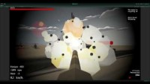
Refresher
01
Showing the gameplay demo from the last progress pitch, as comparison to my current progress.

Slide 4
Learning goals & problem solving
02
Getting better at structuring systems/codebases
Improved by implementing FSM for several parts of the project
Improving editor tool creation
Improved by visualizing the camera controllers through gizmos as much as possible in a logical manner
AI behaviour: N/A (next term)
When stuck with a certain bug or problem, solve by:
Do level design for a while
Try to visualize the problem & solution, either on paper or in the editor (gizmos)
Take a walk

Slide 5
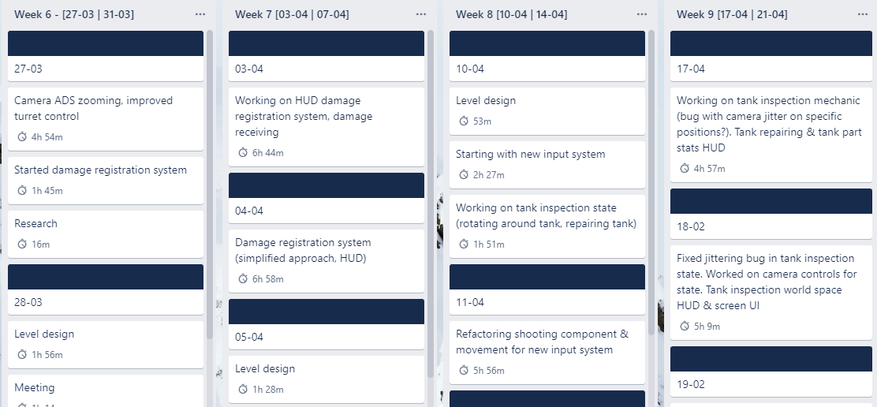
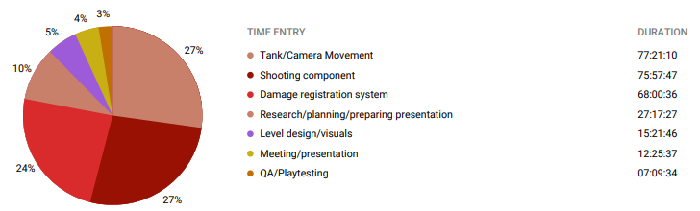
Planning of this term
Time spent
Logbook
03
Total hours:
283:33:57
Trello
Hours since last evaluation:
154:18:05

Slide 6
Planning of this term
Tank shooting
Damage registration & repair
Level design
03
Hours estimation
Hours spent
Priority/importance
80
75.5
2
Week 5 & 6
80
68
3
Week 7, 8 & 9
30
15
4
I only work on level design if the bucket of programming creativity is empty

Slide 7

Week 5 & 6
Week 5 | 20-03/24-03
Week 6 | 27-03/31-03
04
Level design
Range finding (mildots – scrapped)
Improved turret & barrel rotation
Shell dropoff physics formula
Enemy UI indicators
Level design
Converting tank functionality & camera controllers into Finite State machine

Slide 8
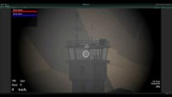
Week 7, 8 & 9
Week 7 | 03-04/07-04
Week 8 | 10-04/14-04
05
Processing collision data: Armor, health, VFX systems. Highly damaged = more VFX
Tank inspection (player & hostile)
HUD & camera tweening
Level design
Improving Finite State Machine
Conversion to new input system
Tank inspection (player & hostile). Rotation around tank
Editor tool to control camera movement limitations
Conversion old HUDManager -> new FSM States
Week 9(.5) | 17-03/19-04
Finish damage registration system
Preparing presentation
QA

Slide 9
Planning of next term
Week 9
Week 11 & 12
Week 10
06
Holiday
Week 13
Damage registration: finish system
Probably some work as well
Continue with AI behaviour
Enemy AI: finish system Main Menu Tank customization: UI design Next evaluation?
Research behaviour trees Start designing/ implementing actions & conditions Movement through the level (navmesh) Strategy

Slide 10
Quality assurance
Point 1
Point 2
Point 3
07
Not available due to circumstances
Mercury is the closest planet to the Sun
Venus is the second planet from the Sun
Despite being red, Mars is actually a cold place

Slide 11
Reflection
Take care of QA earlier on
Prepare concepts better
Get rid of distractions
08
This prevents unexpected events like mentioned.
But also not too early, as the feedback cover only part of the total progress that term.
The vision of what I wanted wasn’t always clear during development of mainly the damage registration component.
This term, I tended to get distracted by my phone, Discord, etc.
Put phone in another room, close Discord.
Allows for deep focus on work.

Slide 12
THANK YOU
Any questions?
Please keep this slide for attribution

