Slide 1
Evaluation 3 Minor Skilled
Nils Meijer 466301 – 30-05-2023

Slide 2
TABLE OF CONTENTS
01
Refresher
Planning of this term
Planning of this term
02
03
04
Learning goals & problem solving
05
06
07
08
09
Activities of this term
Activities of this term
Planning of next term
Quality Assurance
Self Reflection

Slide 3

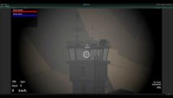
Refresher
01
Showing the gameplay demos from the last progress pitch, as comparison to my current progress.

Slide 4
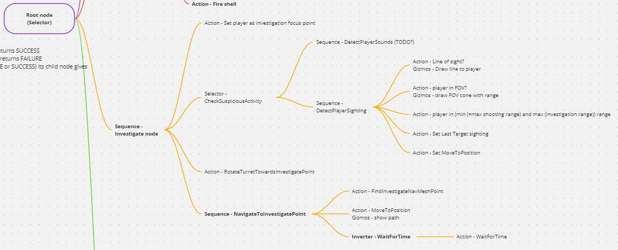
Learning goals & problem solving
02
AI behaviour - Learned how to design & implement behaviour tree systems from scratch
System design - Improved skills for designer-friendly editor tools - Gizmo visualization for nodes - Usability of Scriptable Object behaviour tree composition - Miro board

Slide 5
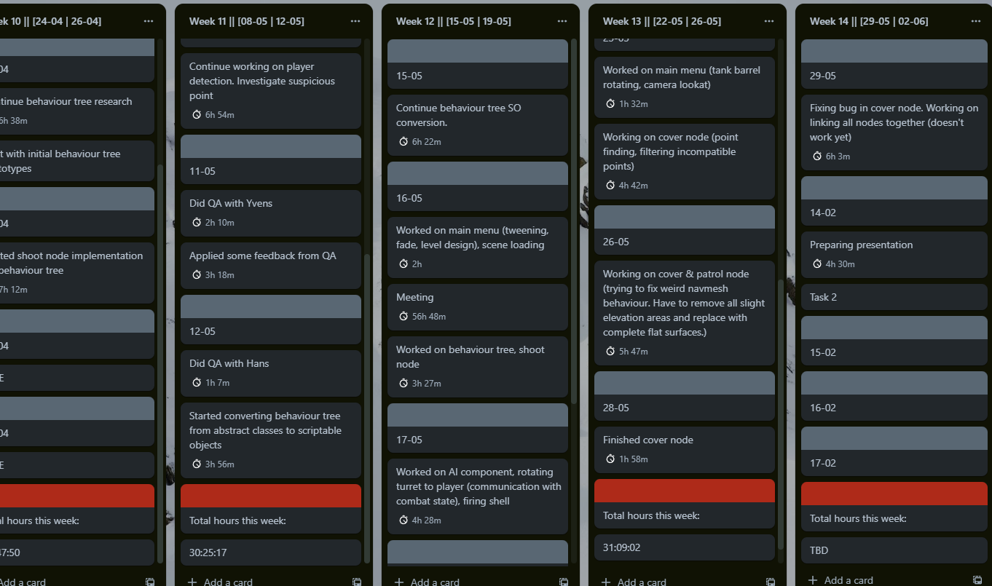
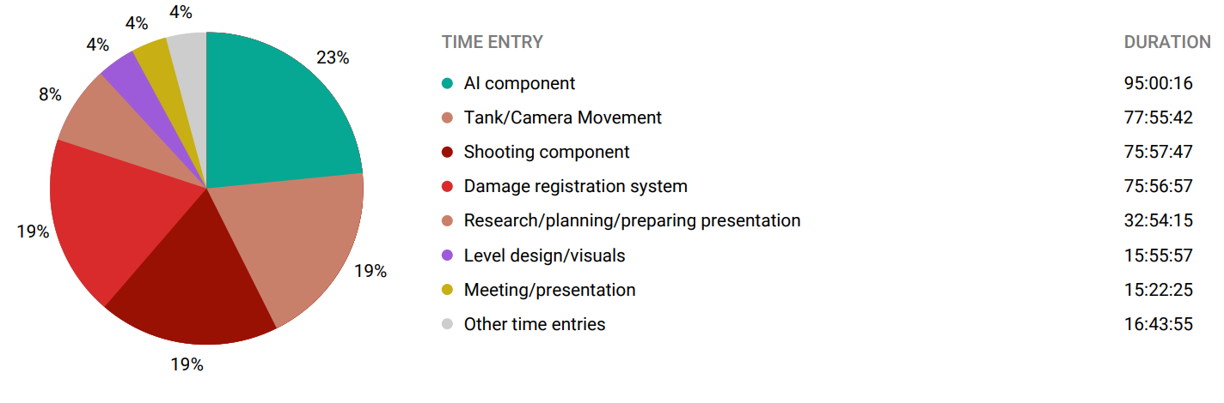
Planning of this term
Time spent
Logbook
03
Total hours:
405:47:14
Trello
Hours since last evaluation:
116:20:54

Slide 6
Planning of this term
AI behaviour tree
04
Hours estimation
Hours spent (“+” = compared to last term
Priority/importance
Damage registration system
80
76 (+8)
3
Week 10
80
95 (+95)
5
Week 10, 11, 12, 13 & 14(1/5)
Main menu
20
6.25 (+6.25)
6
Week 10, 11, 12 & 13

Slide 7
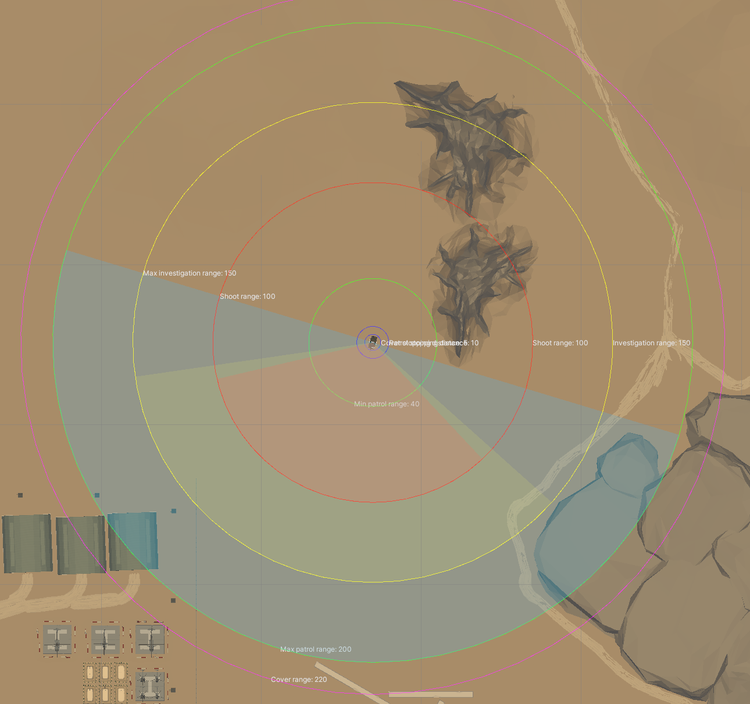
Activities this term
Week 10 | 24-04/26/04
Week 11 | 08-05/12-05
05
Behaviour tree research
Initial prototypes
QA
Yvens Serpa (as catch up QA from last term)
Hans Wichman (QA for this term)
Expanded on behaviour trees (abstract class implementation)
Implement feedback from Yvens

Slide 8
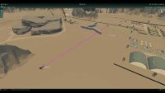
Activities this term
Week 12 | 15-05/17-05
06
Week 14 | 29-05/02/06
Conversion behaviour trees from abstract class to Scriptable Objects
Implement feedback from Yvens (continue) & Hans
Worked on shoot & investigation nodes
Finishing behaviour tree
Presentation preparing
Week 13 | 22-05/26-05
Worked on patrol & cover nodes

Slide 9
Planning of next term
Week 14
Week 17
Week 15
07
Week 16
Week 18/19/20
Finish AI behaviour trees Continue main menu
Start working on report Tank customization?
Finish tank customization? Continue report Improve NavMesh (better AI navigation) Finish main menu
Polishing (game feel, juice) Work on report Testing, fix bugs in the overall project Final presentation..?
Finish main menu Tank customization?

Slide 10
Quality assurance
Point 1
Point 2
Point 3
08
Hans wichman
Reconsider behaviour tree approach (abstract classes or Scriptable Objects?)
Think about how to present the FSM & behaviour tree nodes
Blackboard variable getters/setters (exception throwing in setters. Not possible if I want to be able to change it in the inspector.)
Scene hierarchy organization
Scene render optimization
Profiling
Project folder structure (mainly organize external assets)
Mercury is the closest planet to the Sun
Venus is the second planet from the Sun
Despite being red, Mars is actually a cold place

Slide 11
Self Reflection
Don’t automatically implement all feedback from QA
Lower the bar
09
If I lowered the bar for the overall minor, it might have been easier at times to keep up motivation (?).
I would implement some feedback too hastily, without considering if I actually should (= advice from Hans)

Slide 12
THANK YOU
Any questions?
Please keep this slide for attribution

