Slide 1


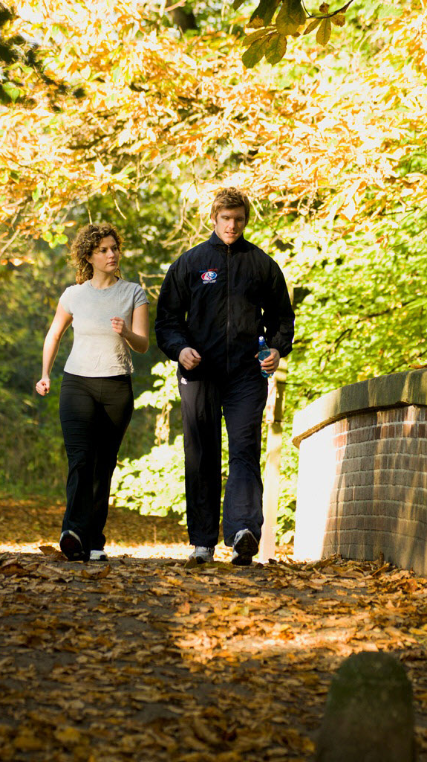

Pedestrian Safety Matters
Keeping That New Year’s Resolution To Be More Active
z

Slide 2
Take a Walk
Everyone can benefit from walking
Safety is important for all ages
Pick a good place to walk
Pay attention as you walk in public places
Obey laws and regulations for pedestrians
Guard against careless or aggressive drivers

Slide 3
Respect Your Surroundings
Choose where you walk for safety
Walk on sidewalks or paths
Walk facing traffic as far to the left as possible
Be aware of traffic moving around you
Cross streets safely—look right and left
Cross streets at a corner
Use traffic signals and crosswalks

Slide 4
Wear the Right Outfits
Make sure you can be seen
Wear reflective material with clothing
Consider fun, neon colors
Remember sun screen

Slide 5
Increase Your Visibility
Lights are a bright idea!
Regardless of the time of day, bring a light
Most will clip to your shirt or waistband
Remember that visibility is reduced on cloudy, rainy days

Slide 6
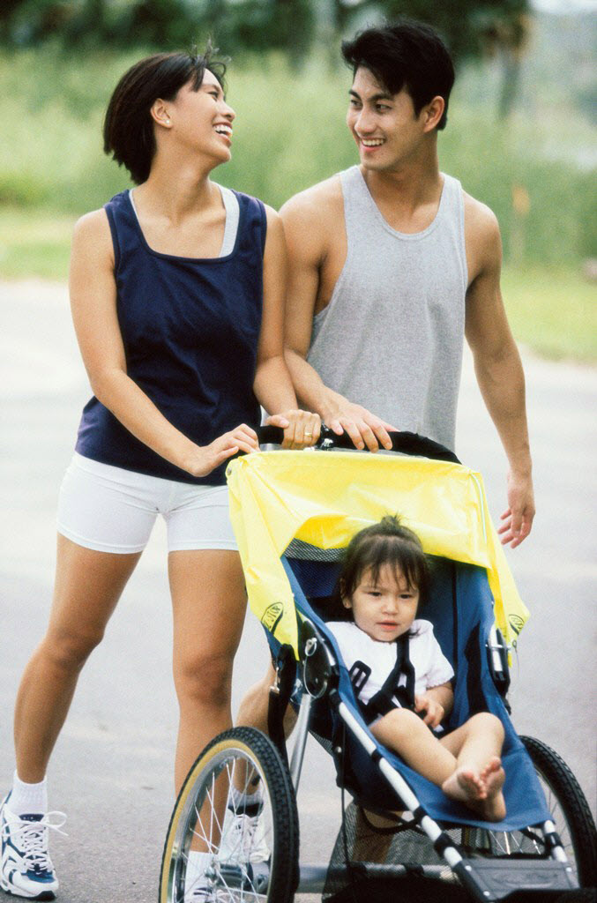
Use Caution
Be aware of traffic conditions
Stay away from trees or plants that block your view
Avoid parked cars

