Slide 1
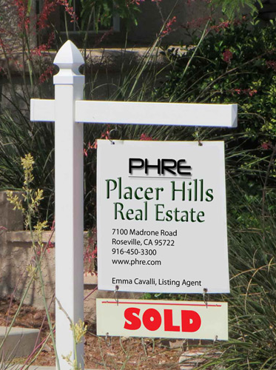
Prepare to Buy Your First Home
Placer Hills Real Estate

Slide 2
Learn About Mortgages
Fixed rate mortgage
The same interest rate for the life of the loan
Adjustable rate mortgage (ARMs)
Very low introductory rate for 5-7 years
Much higher rate after 5-7 years
For short-term buyers or those planning to “flip”
Can be dangerous

Slide 3
Mortgage Points
Fees paid to the lender
One point equals 1% of mortgage value
Required if buyer has less than 20% down payment
Can be used to buy down mortgage rate

Slide 4
Fixed Mortgage Rate Averages
Information based on Freddie Mac survey data
http://www.freddiemac.com/pmms/pmms30.html

Slide 5

Sample Fixed Rate Payments
https://www.zillow.com/mortgage-calculator
Home Price $250,000—Down Payment $50,000 (20%)
Loan $200,000 | Rate | Number of Payments | Monthly Payments Principle + Interest | Total Paid
15 Year Fixed | 3.64 | 180 | $1,444 | $259,920
30 Year Fixed | 4.31 | 360 | $991 | $356,760
Loan cost only—add taxes and insurance costs.
Lender rates are influenced by credit scores.
Plan for a 20% down payment to avoid cost of points.

Slide 6
Buying Is a Huge Decision
Be patient
Be sure you are ready
Determine how much house you can afford
Get your credit in shape
Save for your down payment
Get mortgage pre-approval

