Slide 1
This work is licensed under CC BY 4.0
Model-based Segmentation:
Part I
Medical Image Analysis
Koen Van Leemput

Slide 2
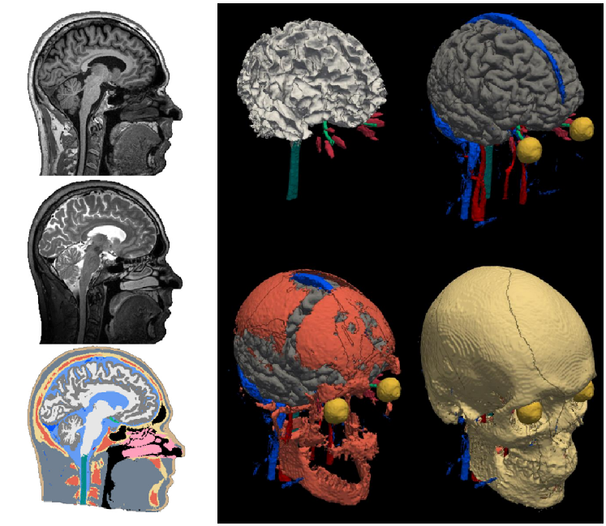
Segmentation
images
segmentation
- individual patients (diagnosis, treatment planning, follow-up)
- group studies (drug trials, elucidating disease mechanisms)

Slide 3
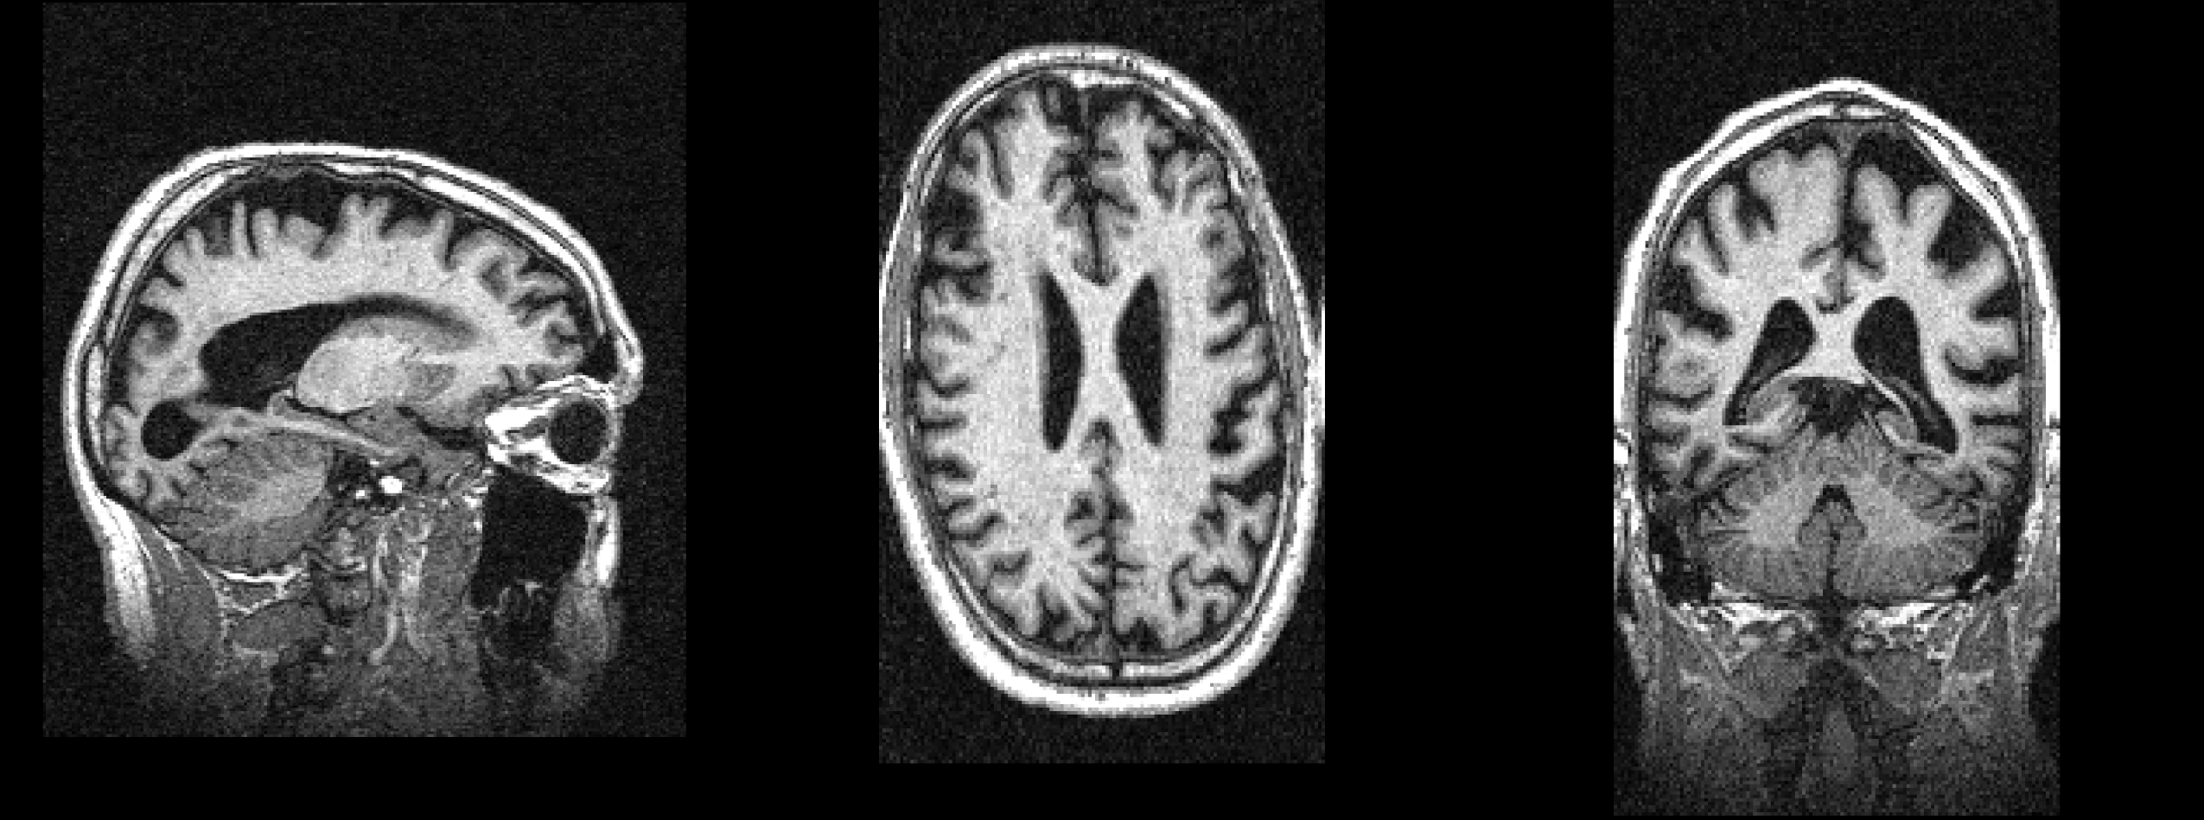
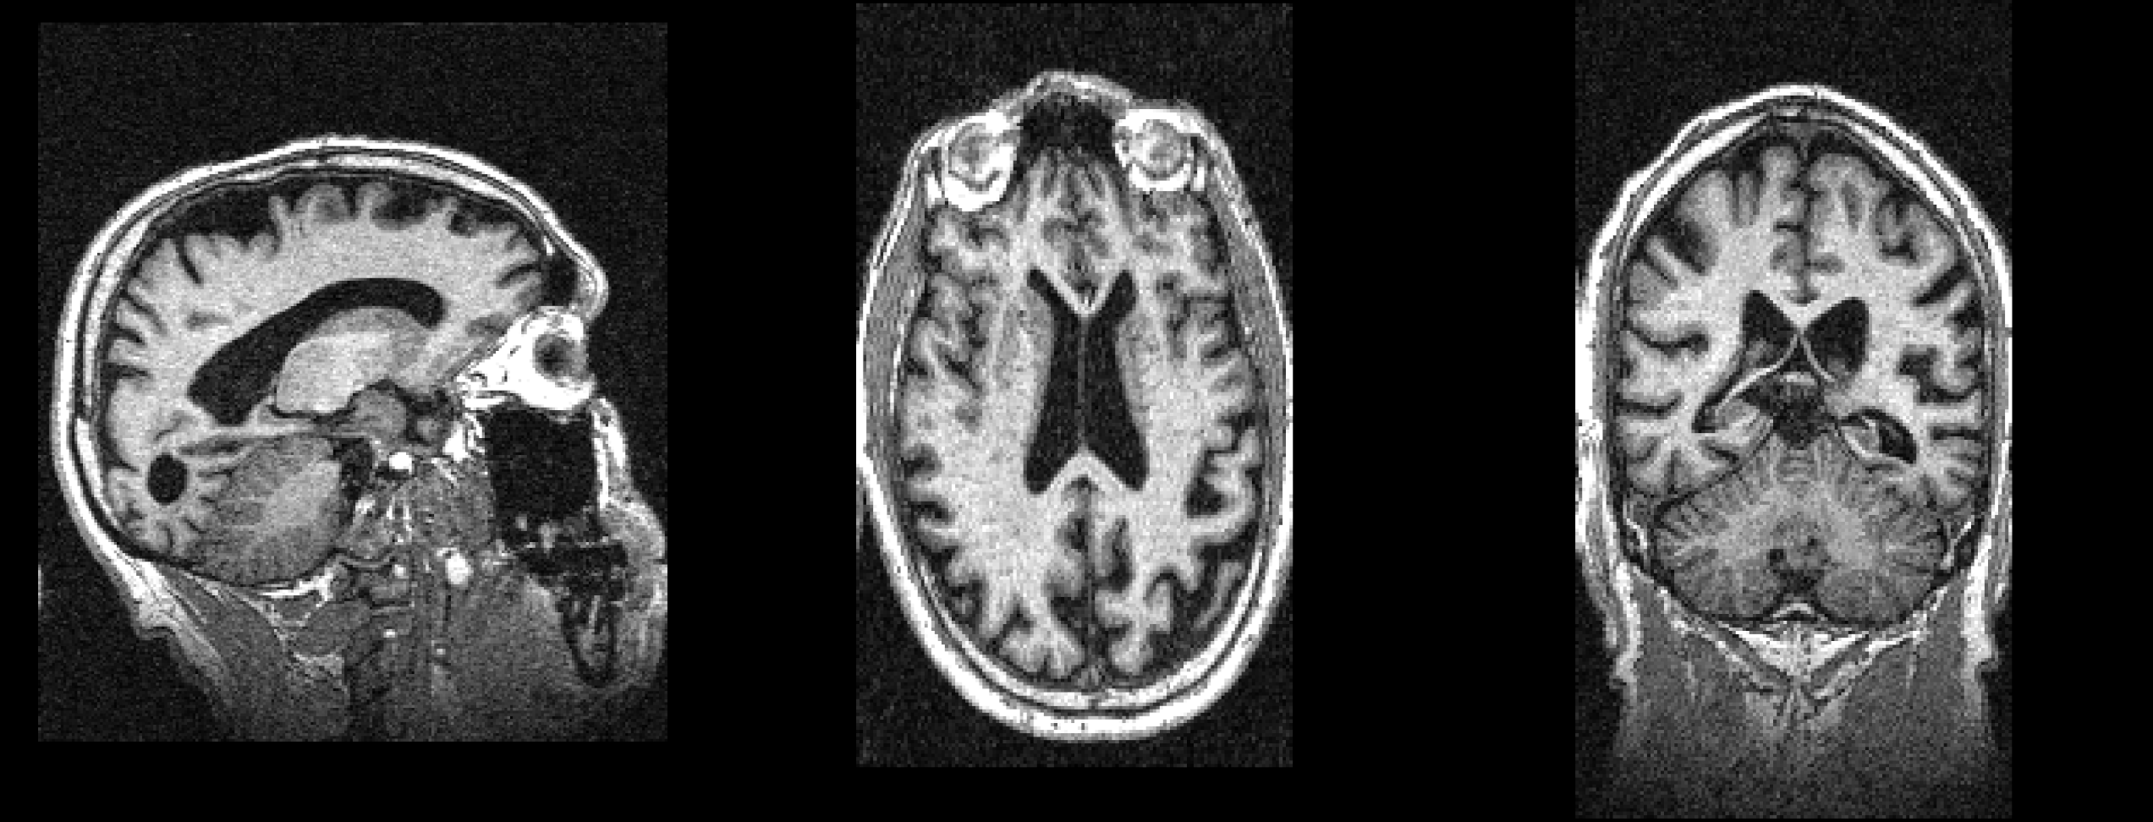
Exposing the “unseeable”
today
8 months ago

Slide 4
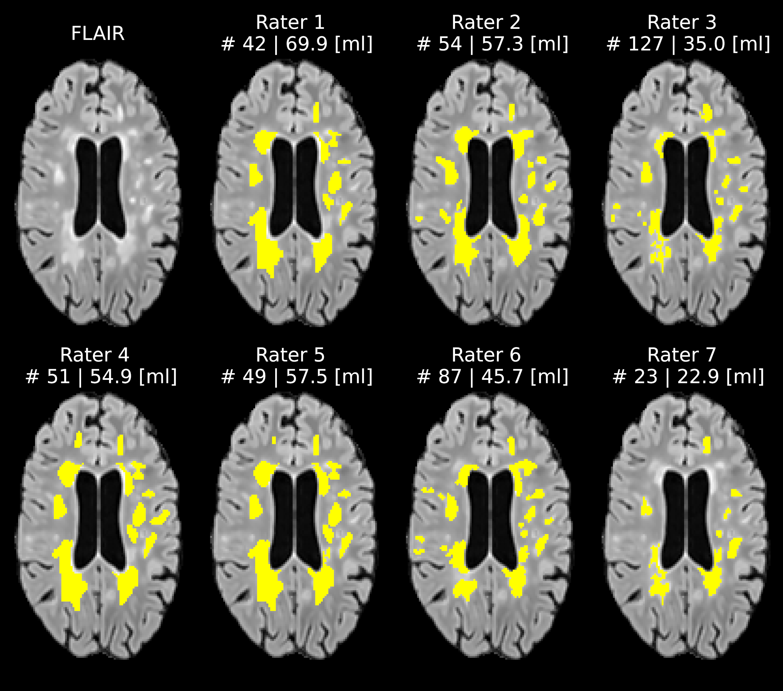
Measuring more consistently
Quantifying lesions in multiple sclerosis (MS):
- number (#)
- volume (ml)

Slide 5
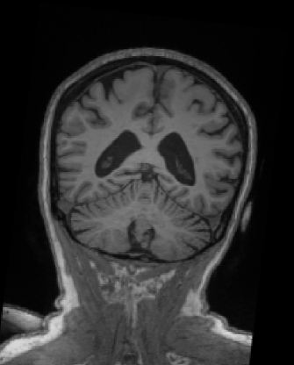
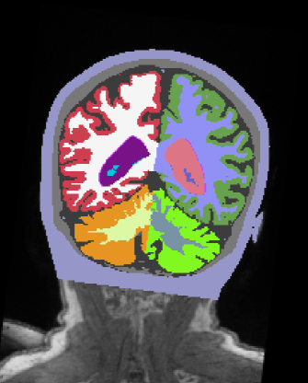
Analyzing images faster
MRI
segmentation

Slide 6
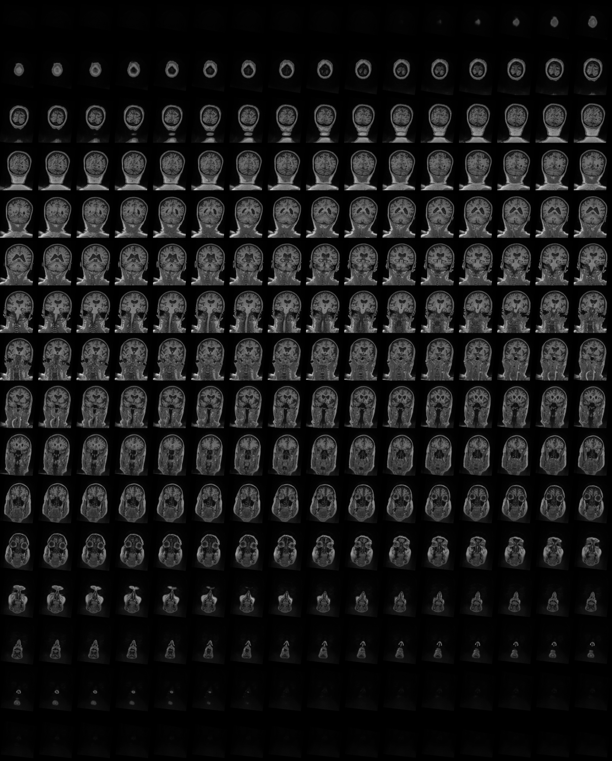
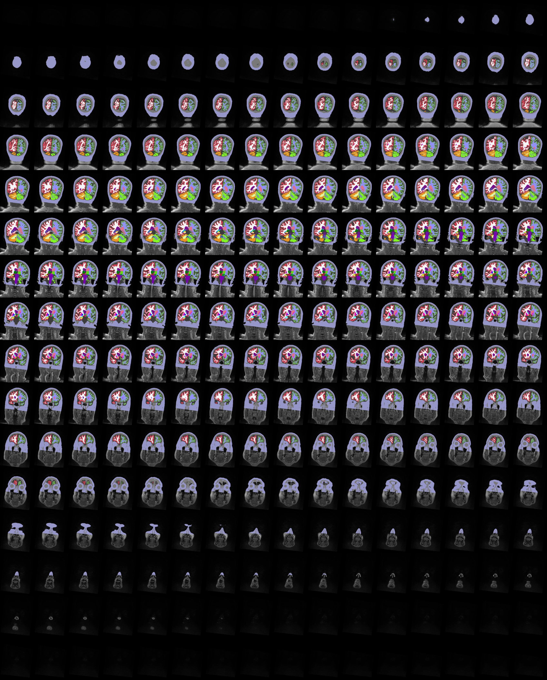
MRI
segmentation

Slide 7
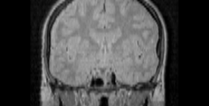
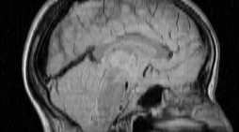
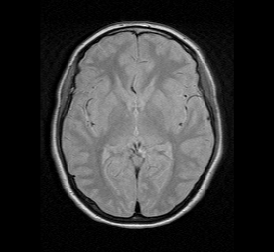
Voxel-based segmentation
“voxel”
Determine which anatomical structure each voxel belongs to:
  - think “LEGO bricks”
  - outer surfaces can easily be extracted if needed

Slide 8
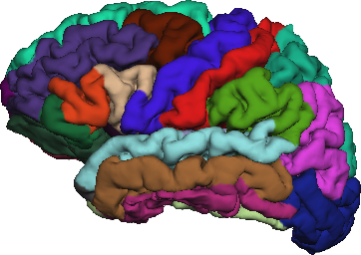
This and next lecture
Automated computational methods

Slide 9
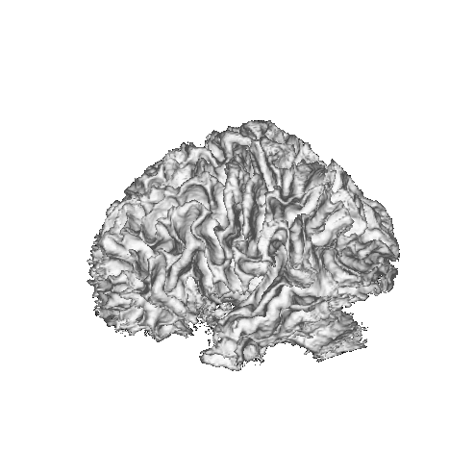
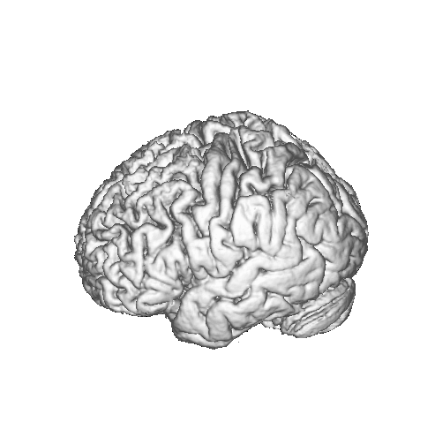
This and next lecture
Automated computational methods

Slide 10
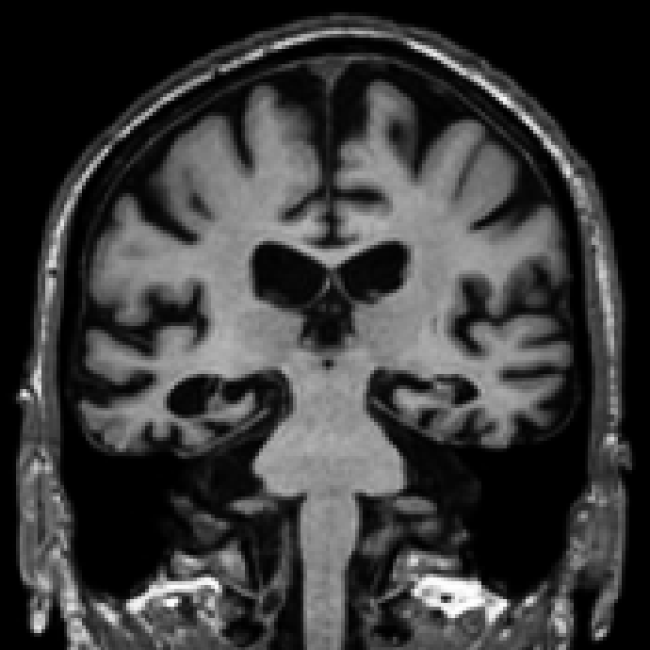
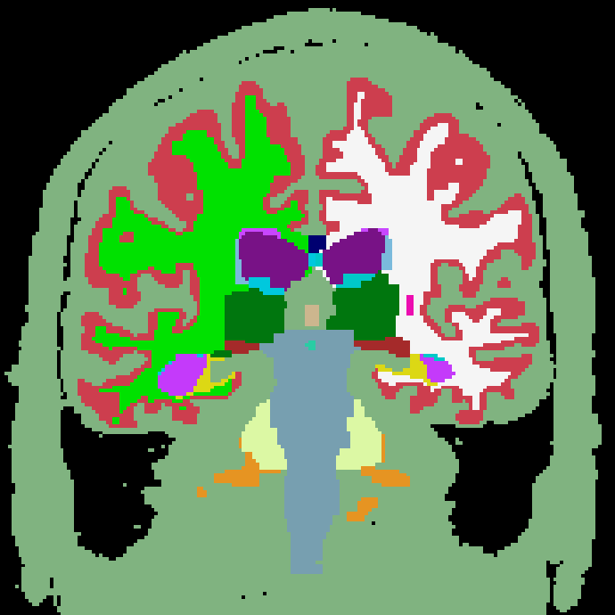










The problem to be solved
MRI image
Label image
voxels
: intensity in voxel
: number of classes

Slide 11



One solution: generative modeling
  Formulate a statistical model of how a medical image is formed
  The model depends on some parameters
  Appropriate values are assumed to be known for now...
“labeling model”
“imaging model”
Label image
MRI image

Slide 12

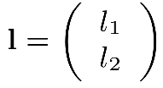



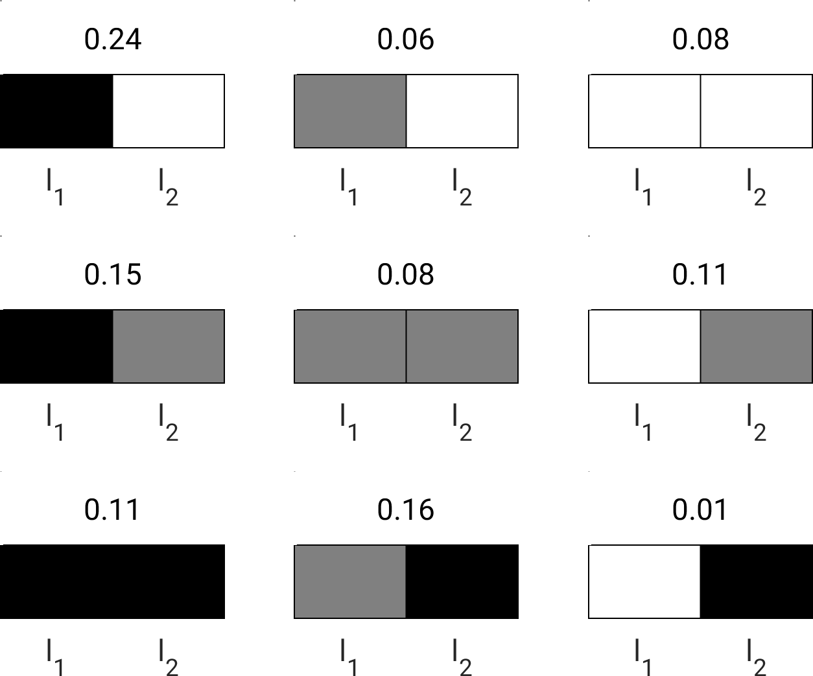
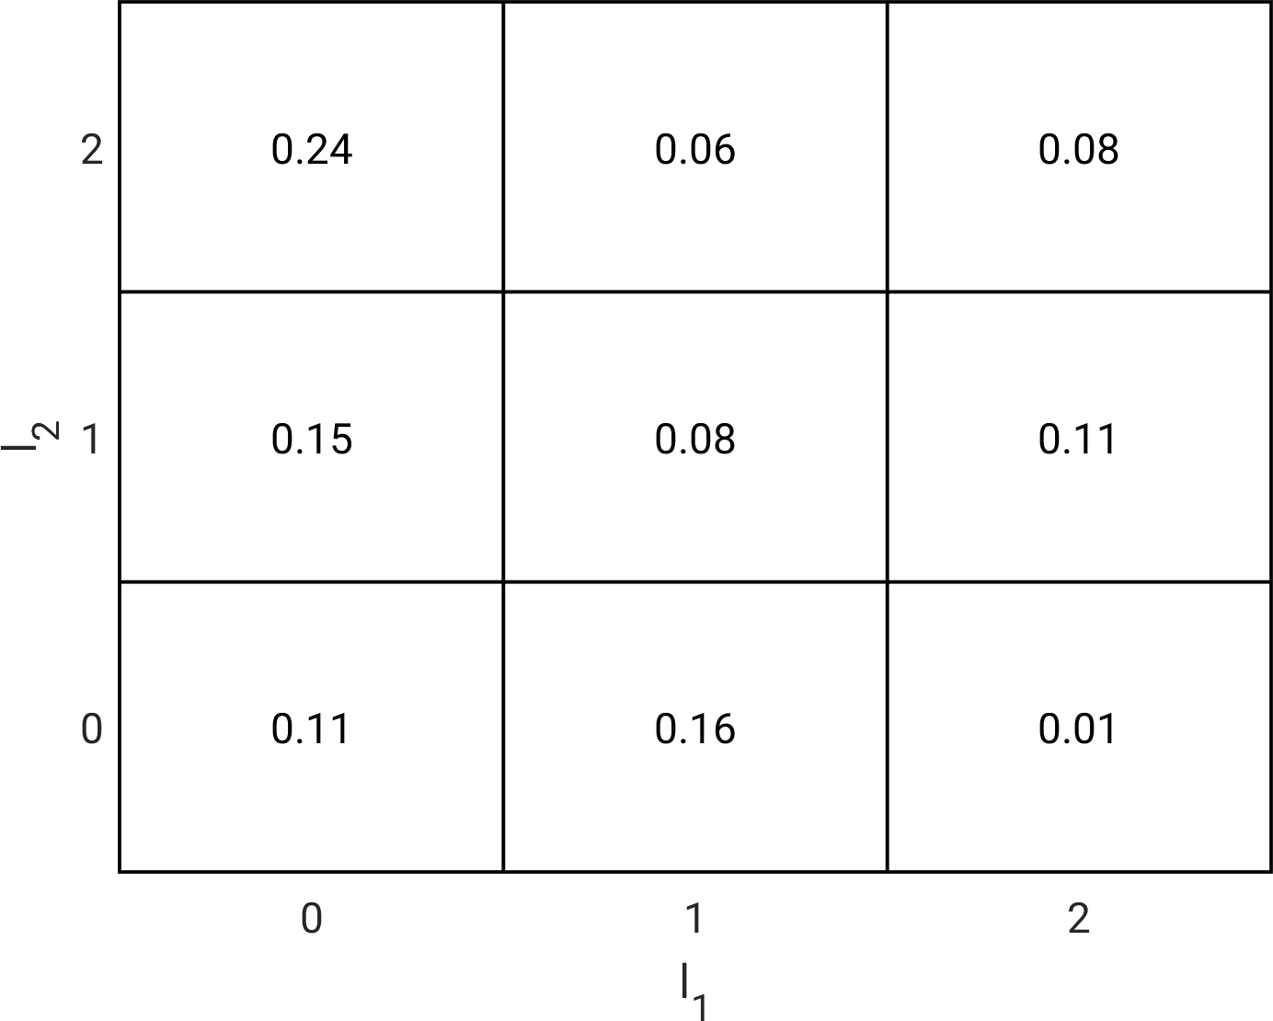
Toy example
voxels
classes
labeling model

Slide 13
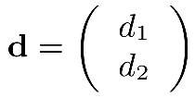


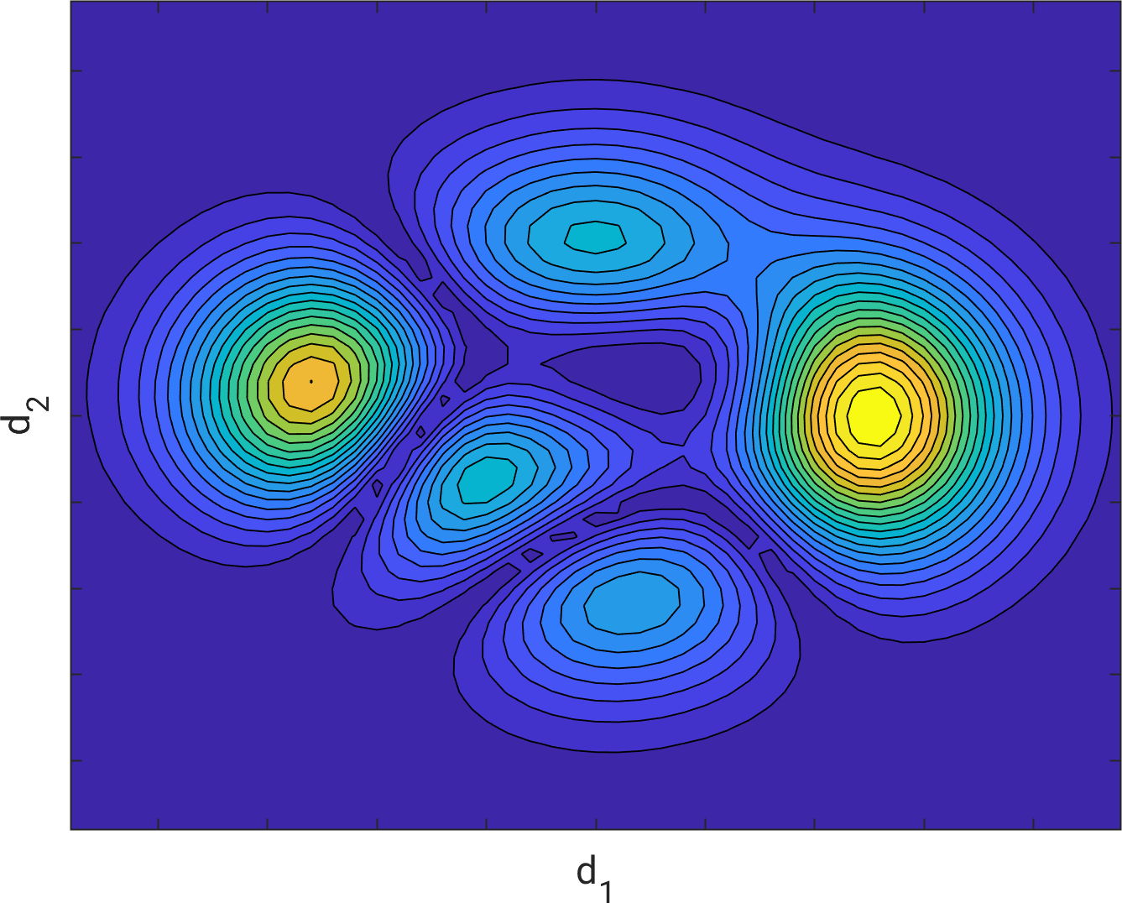
Toy example
voxels
classes
imaging model

Slide 14
Segmentation = inverse problem
MRI image
Label image

Slide 15




Segmentation = inverse problem
MRI image
Label image
The posterior distribution is given by Bayes rule:

Slide 16
Segmentation = inverse problem
MRI image
Label image
The posterior distribution is given by Bayes rule:
labeling model

Slide 17
Segmentation = inverse problem
MRI image
Label image
The posterior distribution is given by Bayes rule:
imaging model

Slide 18

Segmentation = inverse problem
MRI image
Label image
The posterior distribution is given by Bayes rule:
(but not needed)

Slide 19




Gaussian mixture model
“labeling model”
“imaging model”
Label image
MRI image
  Assign a label to each voxel independently
  Probability of assigning label is

Slide 20

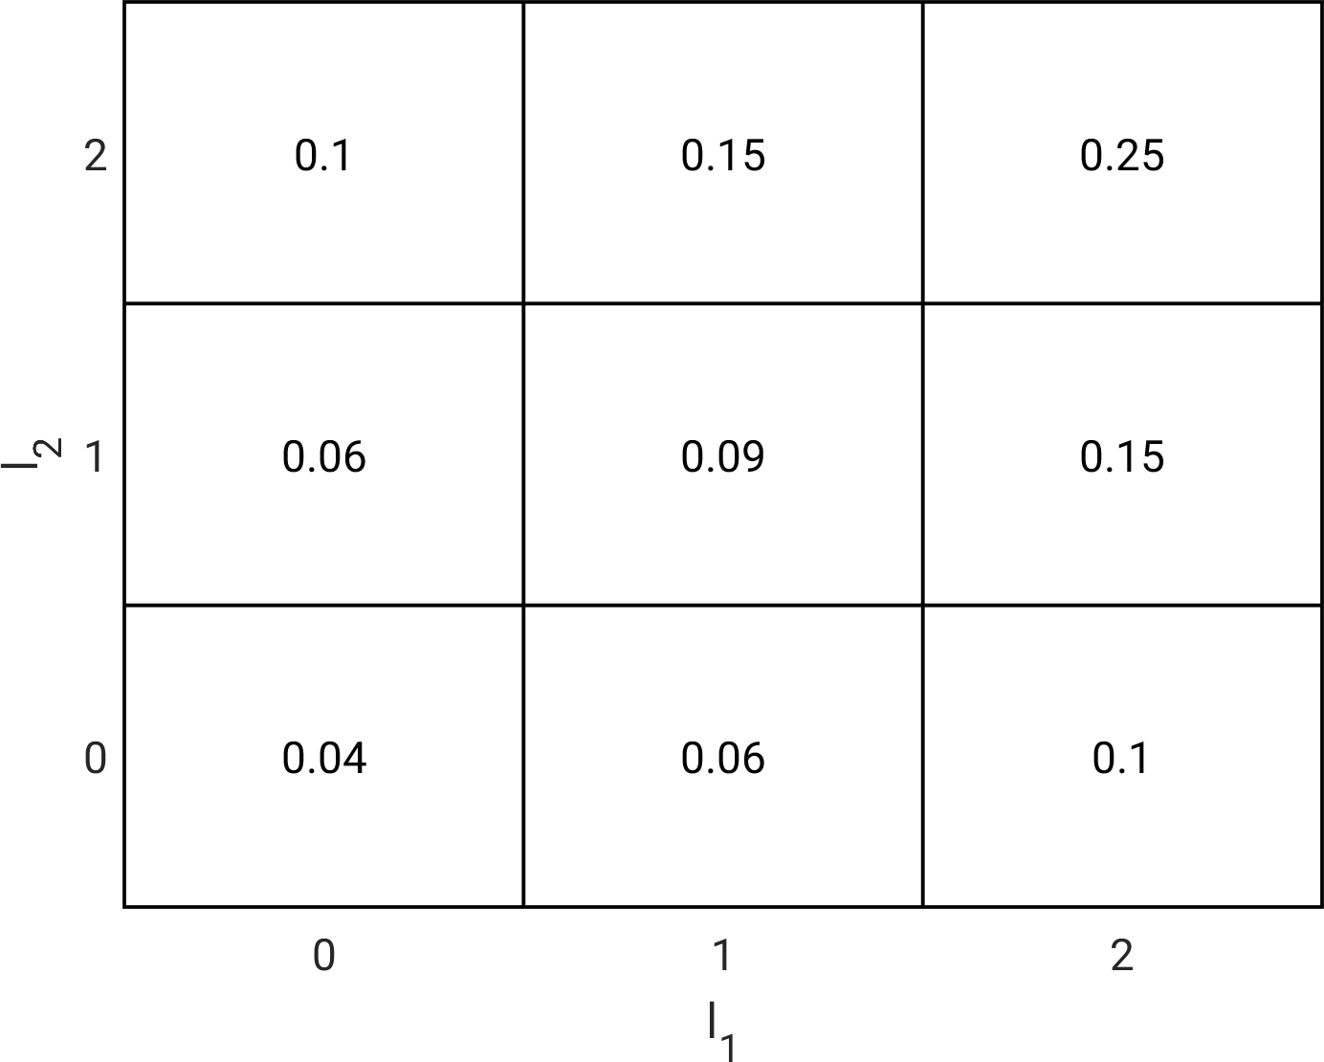
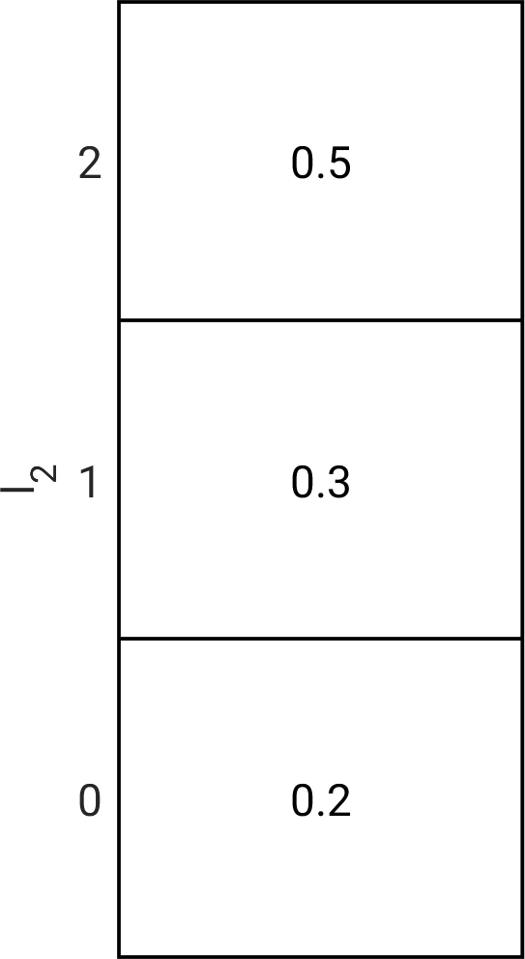
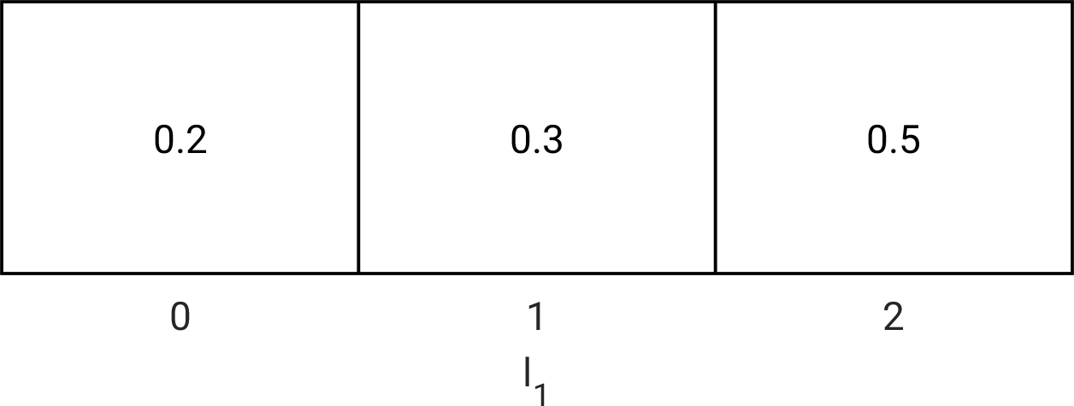
Gaussian mixture model
voxels
classes
independence between voxels
=
.

Slide 21





Gaussian mixture model
“labeling model”
“imaging model”
Label image
MRI image
  Draw the intensity in each voxel with label from a Gaussian distribution with mean and variance

Slide 22

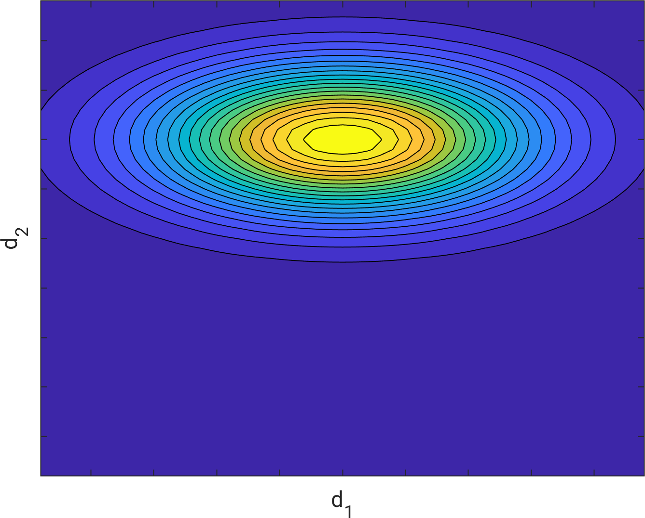
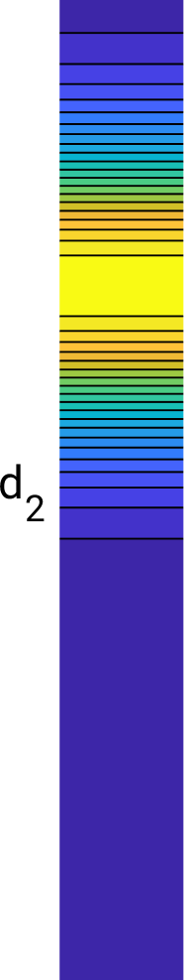
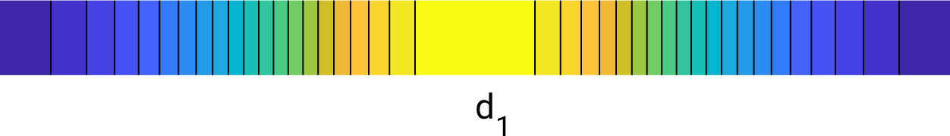
Toy example
voxels
classes
=
.

Slide 23
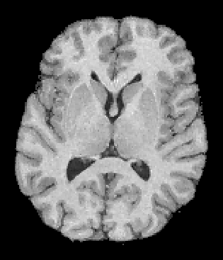
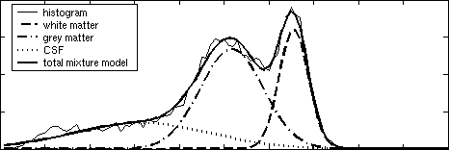

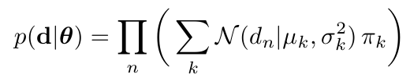
Gaussian mixture model
labels

Slide 24
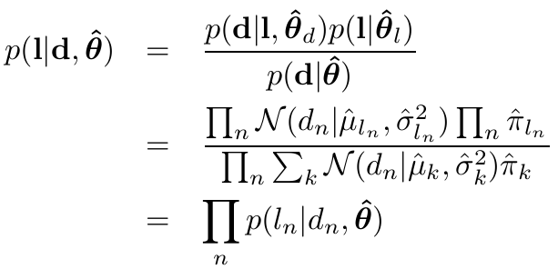
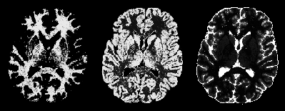
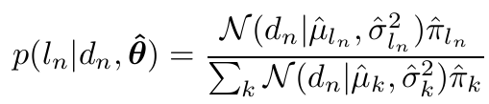
Posterior probability distribution

Slide 25

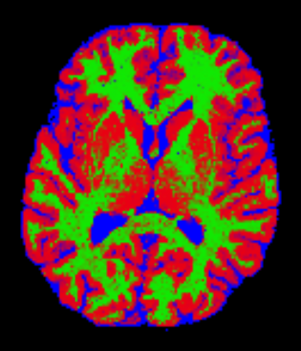
Maximum a posteriori segmentation
white matter
CSF
gray matter

Slide 26
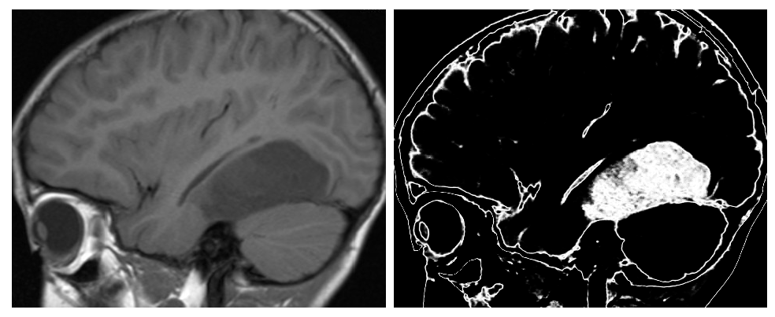
Problem solved?
Two-component Gaussian mixture model:
tumor vs. “other”
MR scan
Posterior probability for tumor

Slide 27
Gaussian mixture model
“labeling model”
“imaging model”
Label image
MRI image
which part of the model needs fixing?

Slide 28
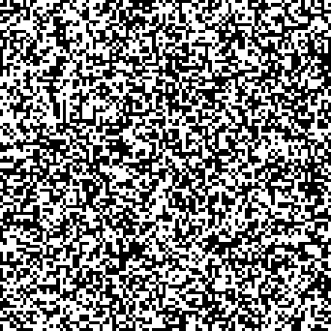
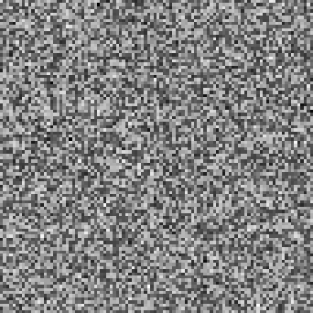
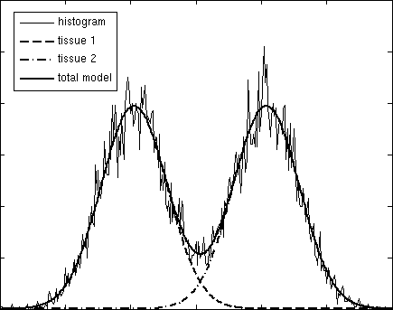
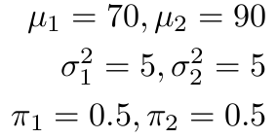
Gaussian mixture model
“labeling model”
“imaging model”
Label image
MRI image

Slide 29
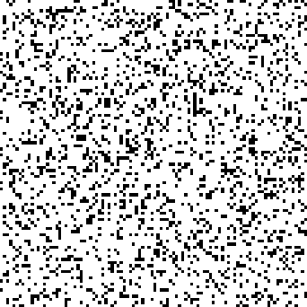
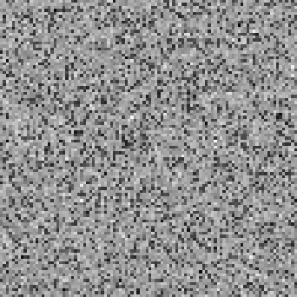
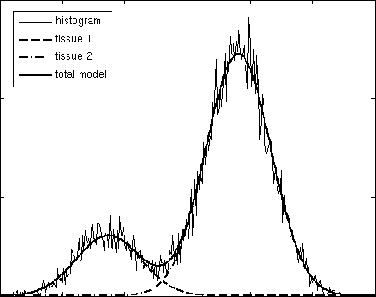
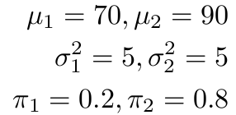
Gaussian mixture model
“labeling model”
“imaging model”
Label image
MRI image

Slide 30
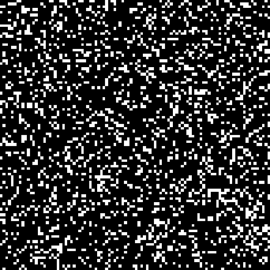
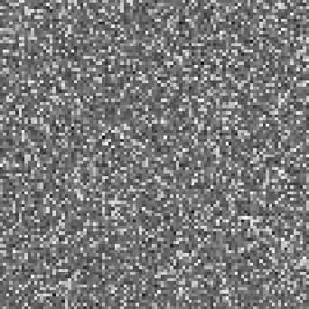
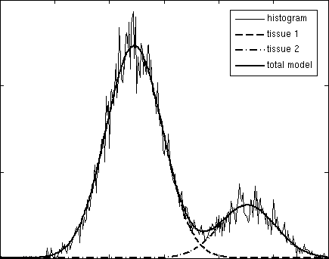
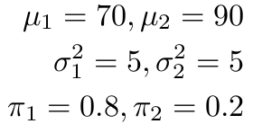
Gaussian mixture model
“labeling model”
“imaging model”
Label image
MRI image

Slide 31

Markov random field model
“labeling model”
“imaging model”
Label image
MRI image

Slide 32



Markov random field model
  Prior that prefers voxels with the same label to be spatially clustered
strength of penalty
zero if labels are the same, one otherwise
sum over all neighboring voxels
  is a normalizing constant (not needed in practice)

Slide 33



Markov random field model
  Slightly more general:
  are the model parameters
  Reduces to Gaussian mixture model prior for !

Slide 34




Toy example
voxels
classes

Slide 35
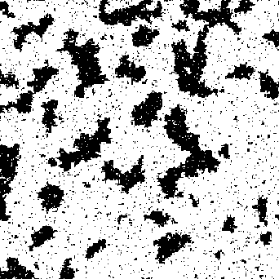
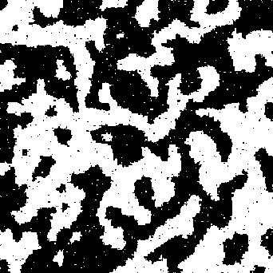
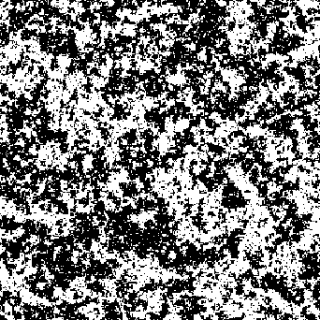
Samples
  Different values for model parameters

Slide 36


Why exactly this model?
  Long-range statistical dependencies between voxels
  Local computations (efficient!):
all labels except
the one of voxel i
neighbors of voxel i

Slide 37


Mean field approximation
  In the Gaussian mixture model, the posterior was of the form
  With the Markov random field model, the posterior no longer “factorizes” that way
  For a 2-label model in a standard 256x256x128 MR scan, there are over 10¹⁰⁰⁰⁰⁰⁰ unique label images with each its own posterior probability!
  Solution: approximate

Slide 38




Mean field approximation
  Approximate with something of the form
  Find the voxel-wise distributions that minimize the
  difference between and
  Quantify the difference between the two distributions using the “Kullback-Leibler divergence”

Slide 39






Toy example
voxels
classes
.

Slide 40


Mean field approximation
  Solution for one voxel :
  where

Slide 41
Mean field approximation
  Solution for one voxel :
  where
Influenced by the result
in neighboring voxels:
spatial context!!!!

Slide 42
Mean field approximation
  Solution for one voxel :
  where
Influenced by the result
in neighboring voxels:
spatial context!!!!
  Need to iterate across all voxels

Slide 43




Example
Two-component Gaussian mixture model:
tumor vs. “other”
MR scan
for tumor class

Slide 44


Example
Two-component Gaussian mixture model:
tumor vs. “other”
MR scan
for tumor class

Slide 45


Example
Two-component Gaussian mixture model:
tumor vs. “other”
MR scan
for tumor class

