Slide 1
This work is licensed under CC BY 4.0
Smoothing
and
Interpolation​
Medical Image Analysis
Koen Van Leemput
Fall 2024

Slide 2
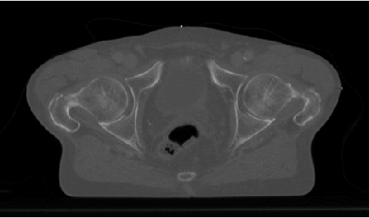
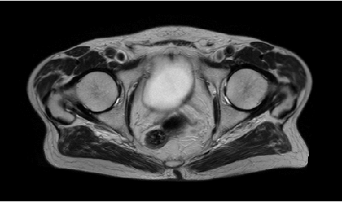
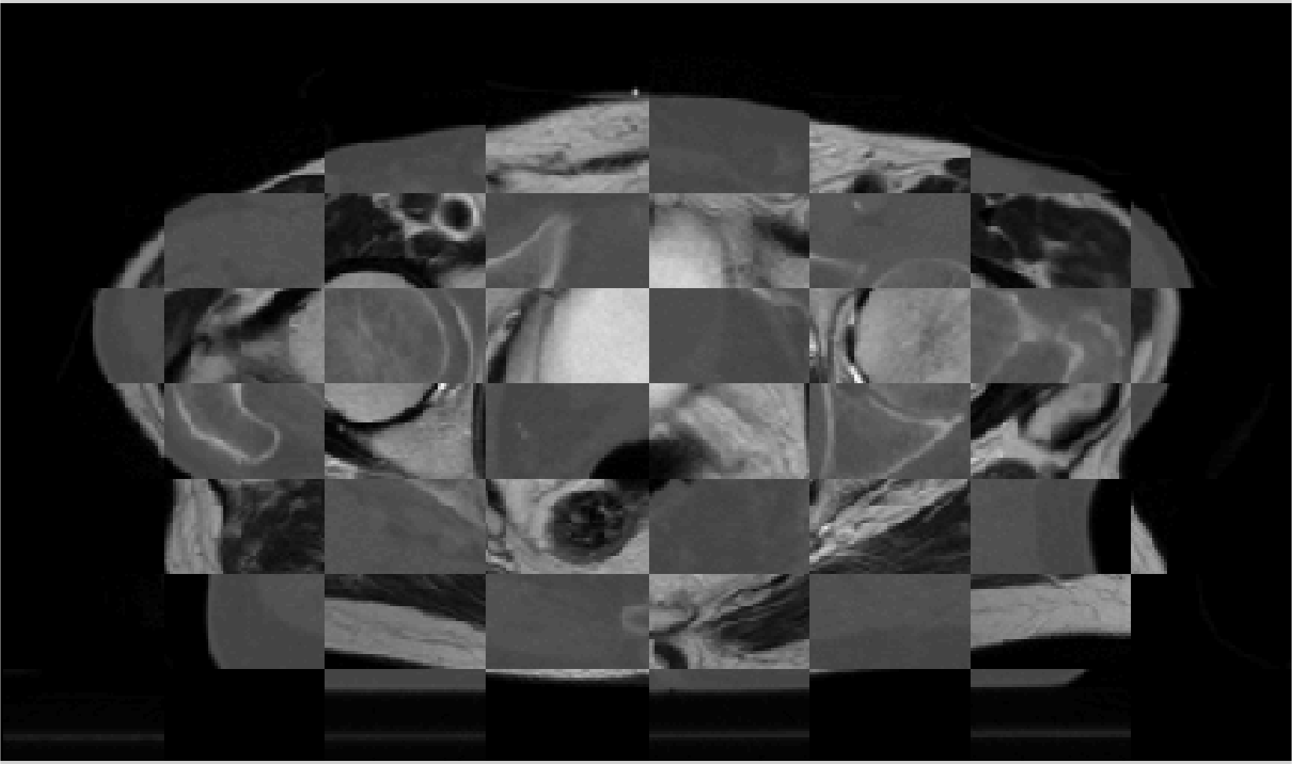

Why care about smoothness?
Example: image registration
CT
MRI
mosaic CT/MRI

Slide 3
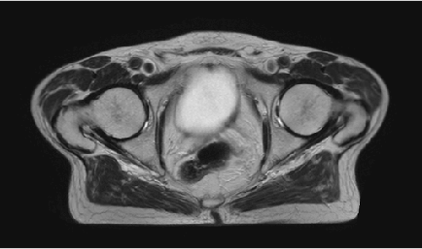
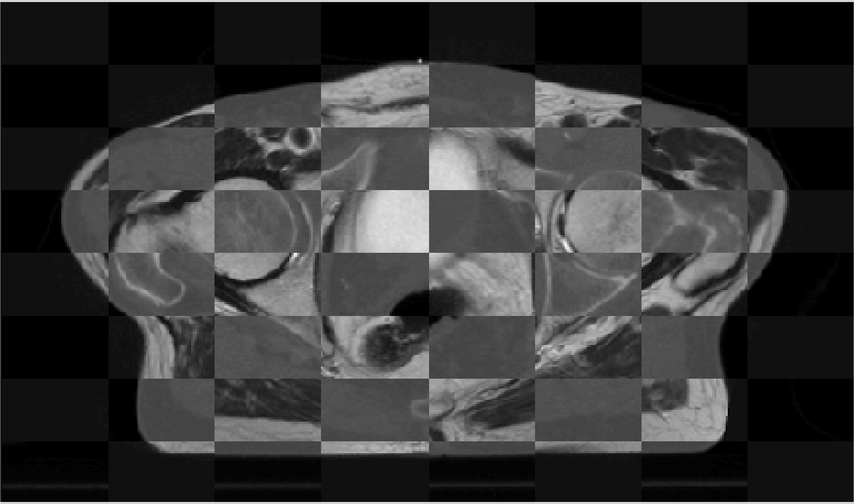
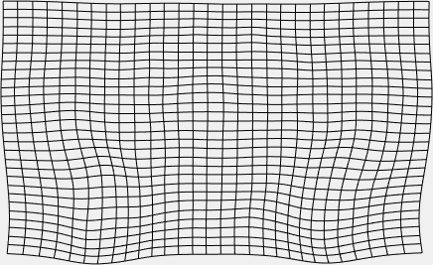
Why care about smoothness?
Example: image registration
CT
MRI
mosaic CT/MRI

Slide 4
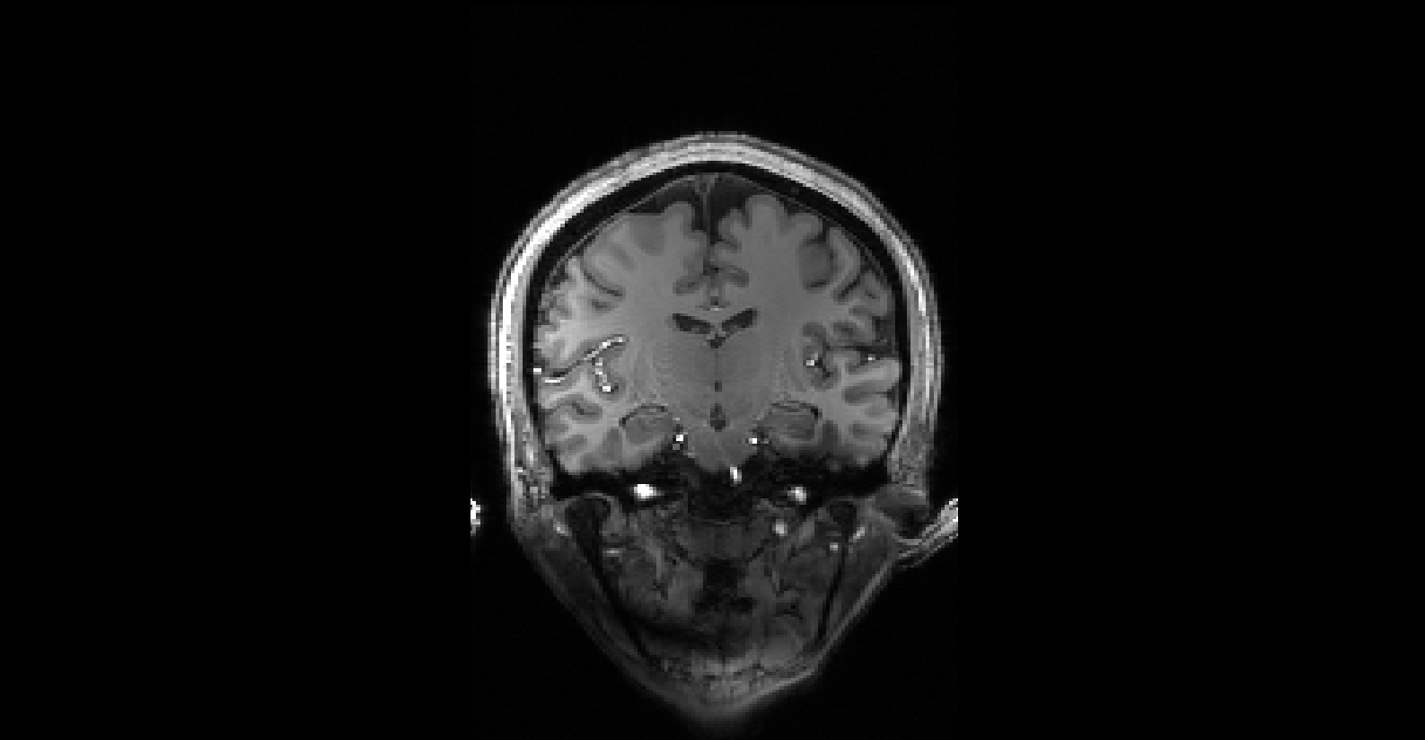

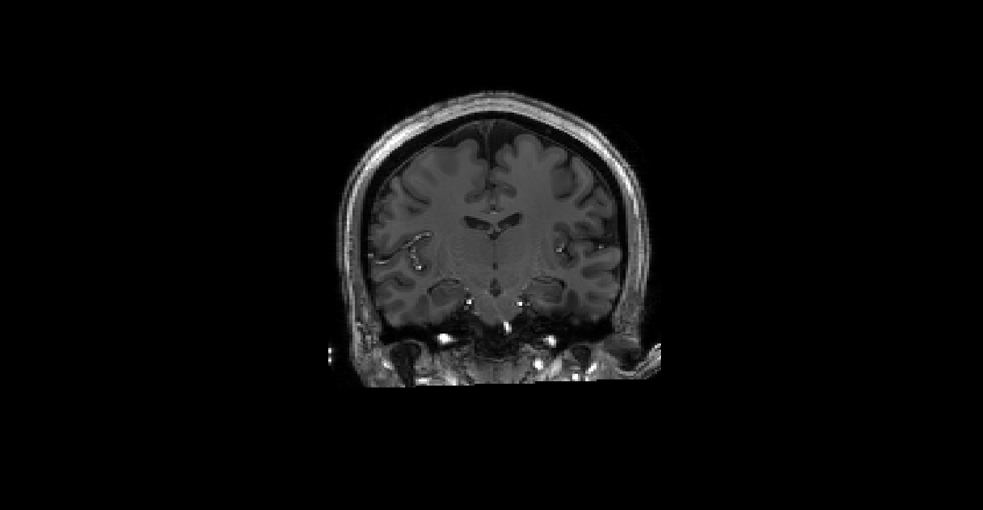
Why care about smoothness?
Example: image segmentation
MR scan (7 Tesla)
estimated “bias field”
bias field corrected

Slide 5
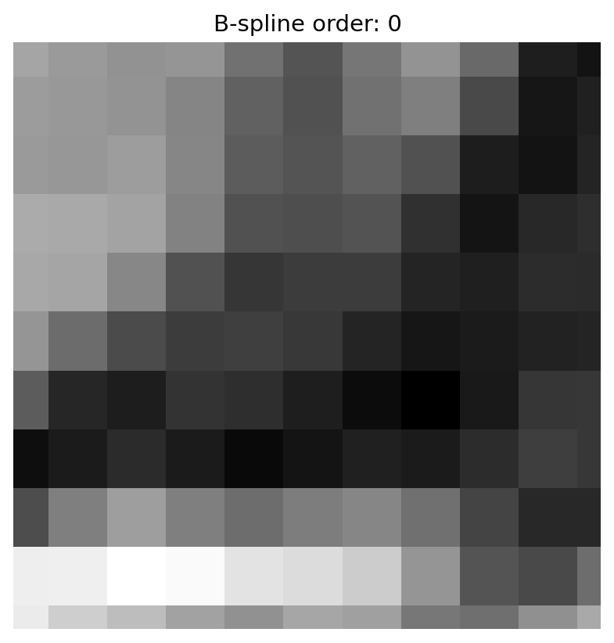

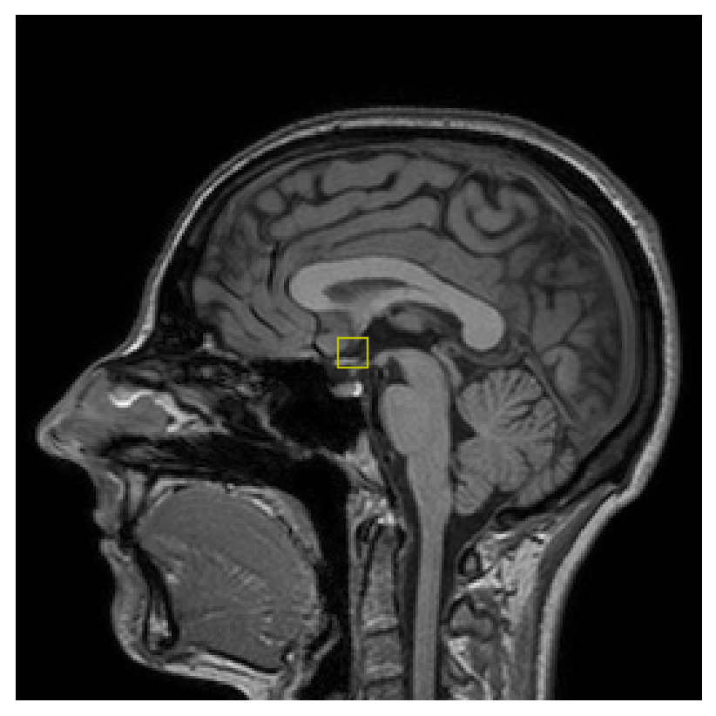
Why care about smoothness?
Example: image interpolation

Slide 6






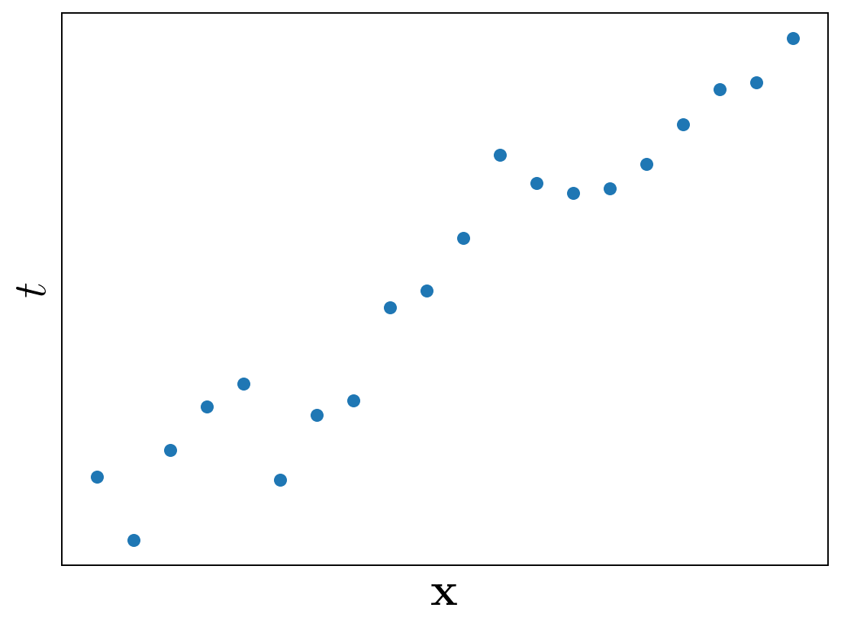
Linear regression
Let denote a spatial position in a -dimensional space
Given measurements at locations , what is at a new location ?

Slide 7
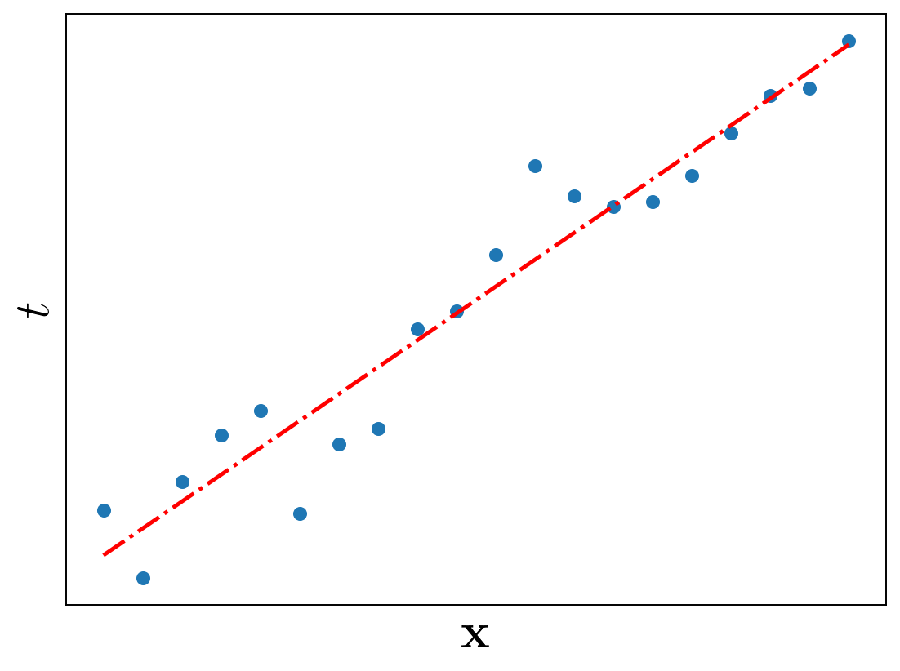

Linear regression
Let denote a spatial position in a -dimensional space
Given measurements at locations , what is at a new location ?
tunable weights

Slide 8
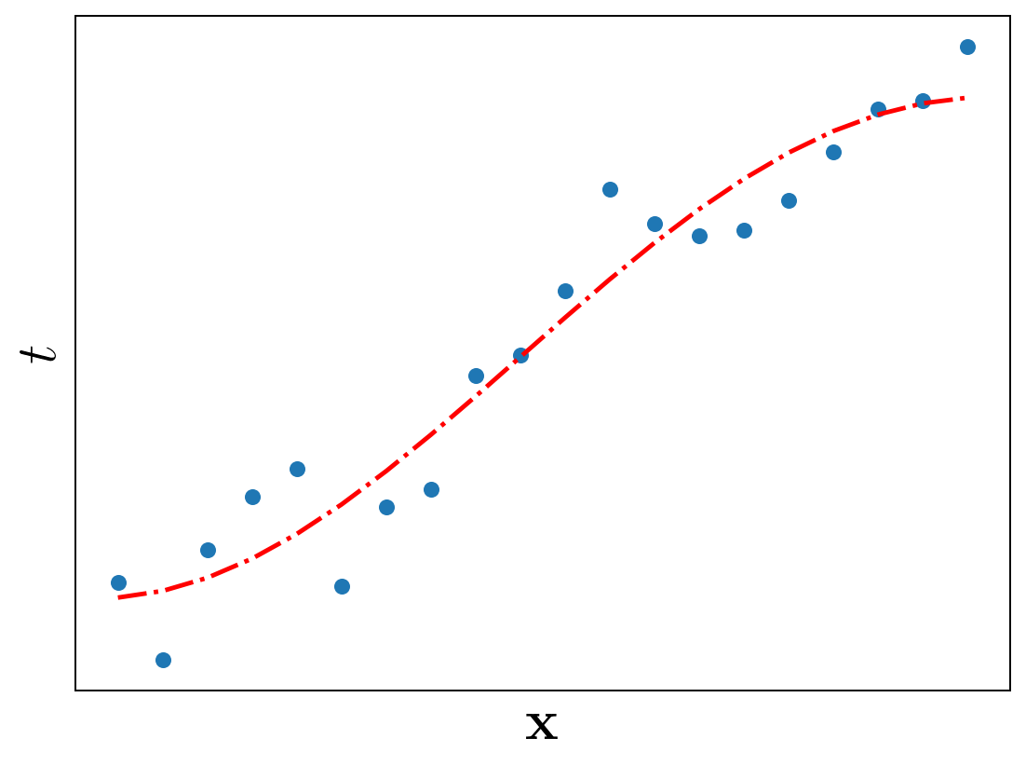
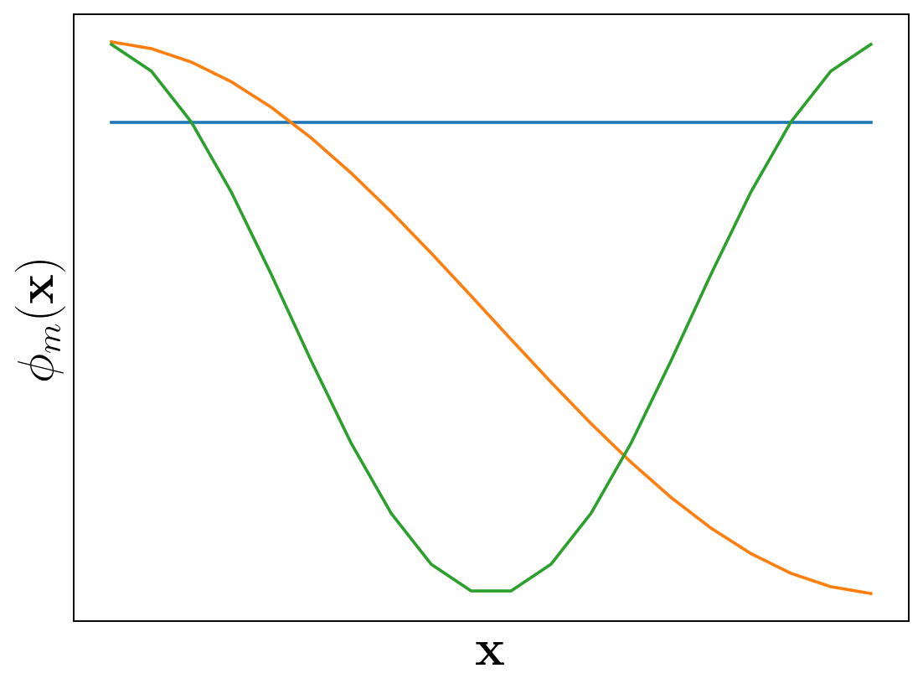
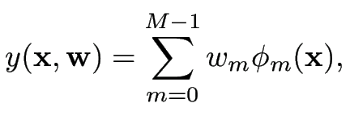
Linear regression
Let denote a spatial position in a -dimensional space
Given measurements at locations , what is at a new location ?
nonlinear basis functions
tunable weights

Slide 9

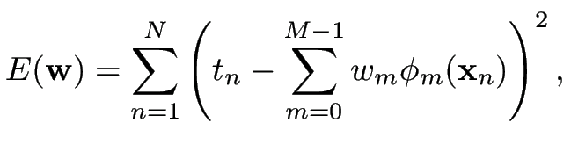
Linear regression
What are “suitable” values for the weights ?
Minimize the energy

Slide 10

Linear regression
What are “suitable” values for the weights ?
Minimize the energy
Task: find that minimizes

Slide 11
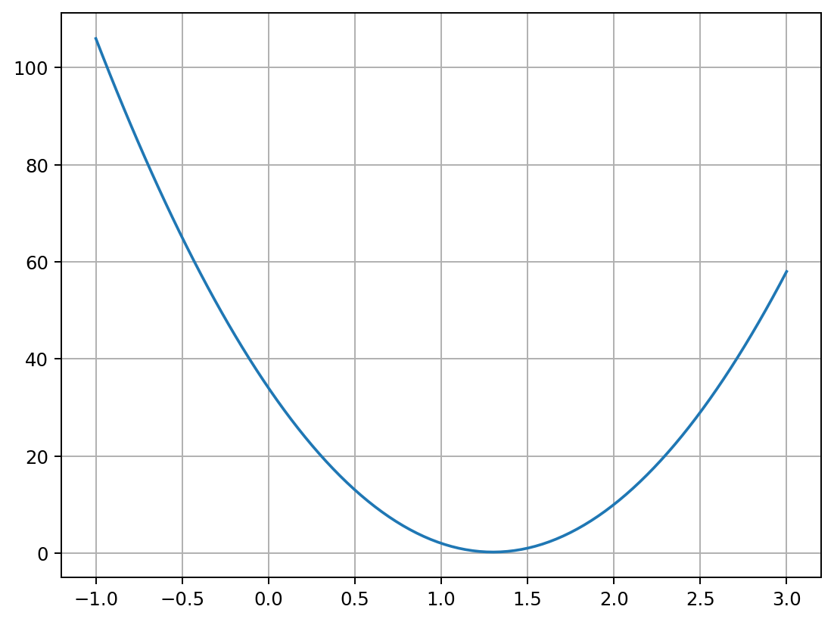
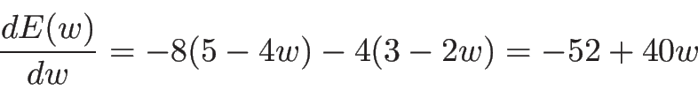
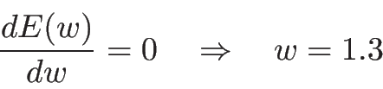
Linear regression
What are “suitable” values for the weights ?
Minimize the energy
Task: find that minimizes

Slide 12
Linear regression
What are “suitable” values for the weights ?
Minimize the energy

Slide 13
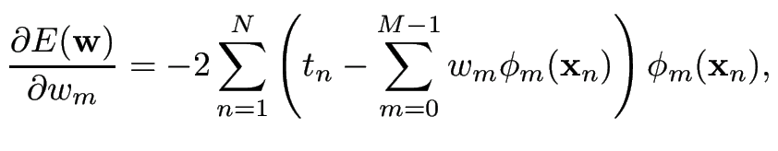
Linear regression
What are “suitable” values for the weights ?
Minimize the energy

Slide 14
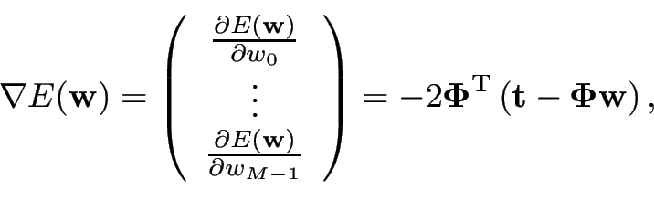
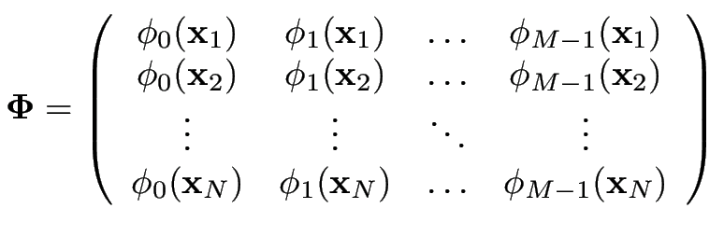

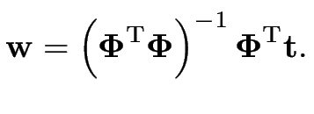
Linear regression
What are “suitable” values for the weights ?
Minimize the energy

Slide 15
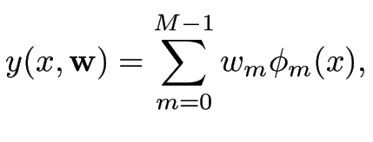


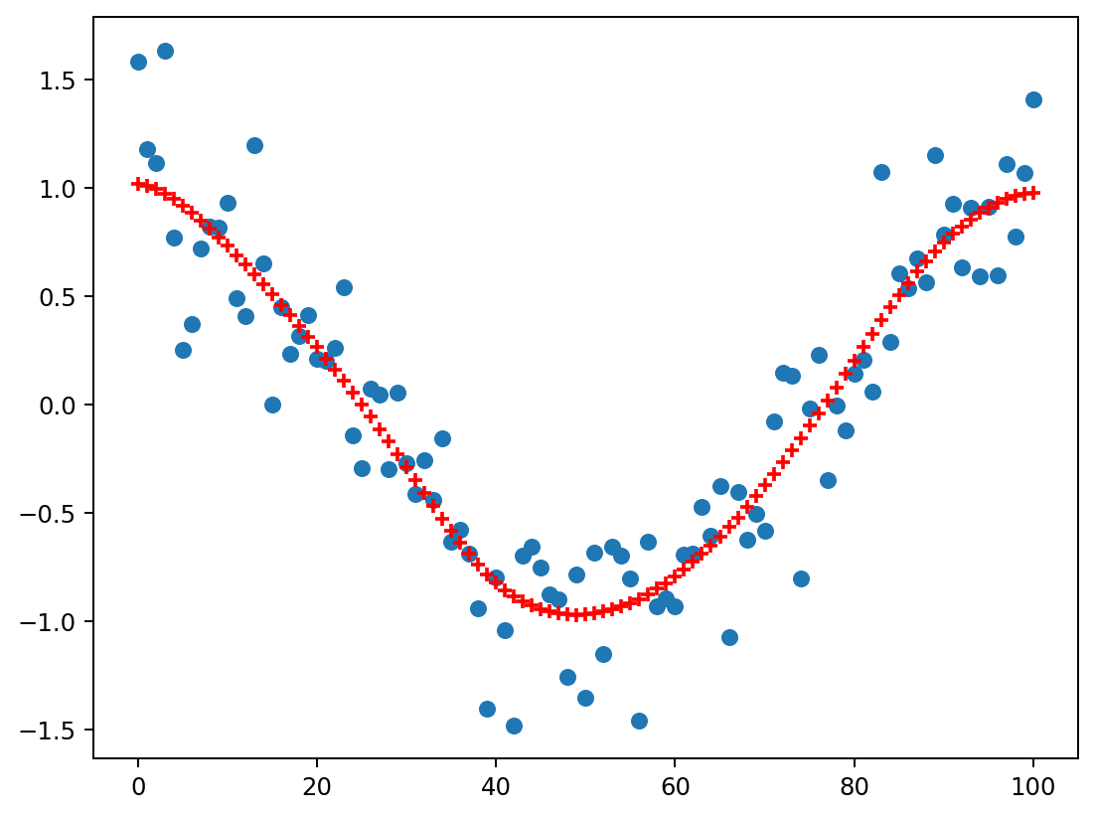



Smoothing
Let’s concentrate on one-dimensional (1D) “images”:
Functions of the form where the location is a scalar
Measurement points are defined on a regular grid:
“Denoising”:
The measurements are noisy observations
Recover the underlying signal at the locations

Slide 16



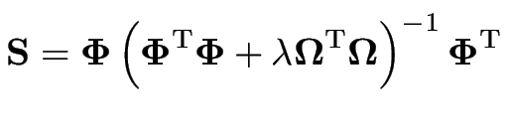
Smoothing
We aim to recover from
Since and :
with

Slide 17
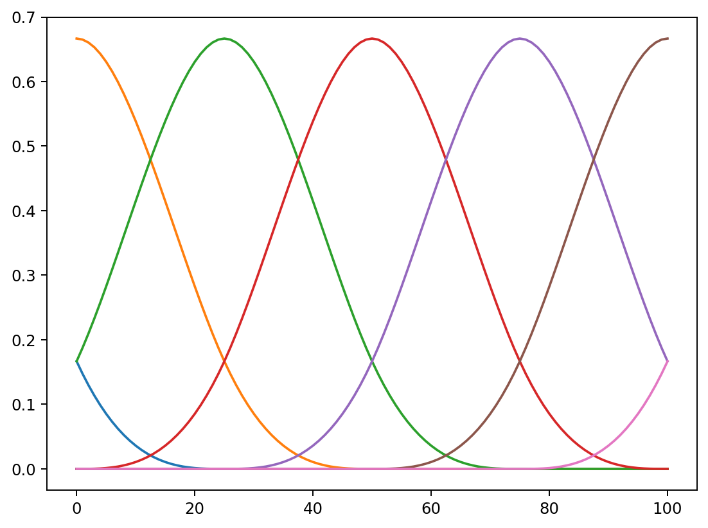
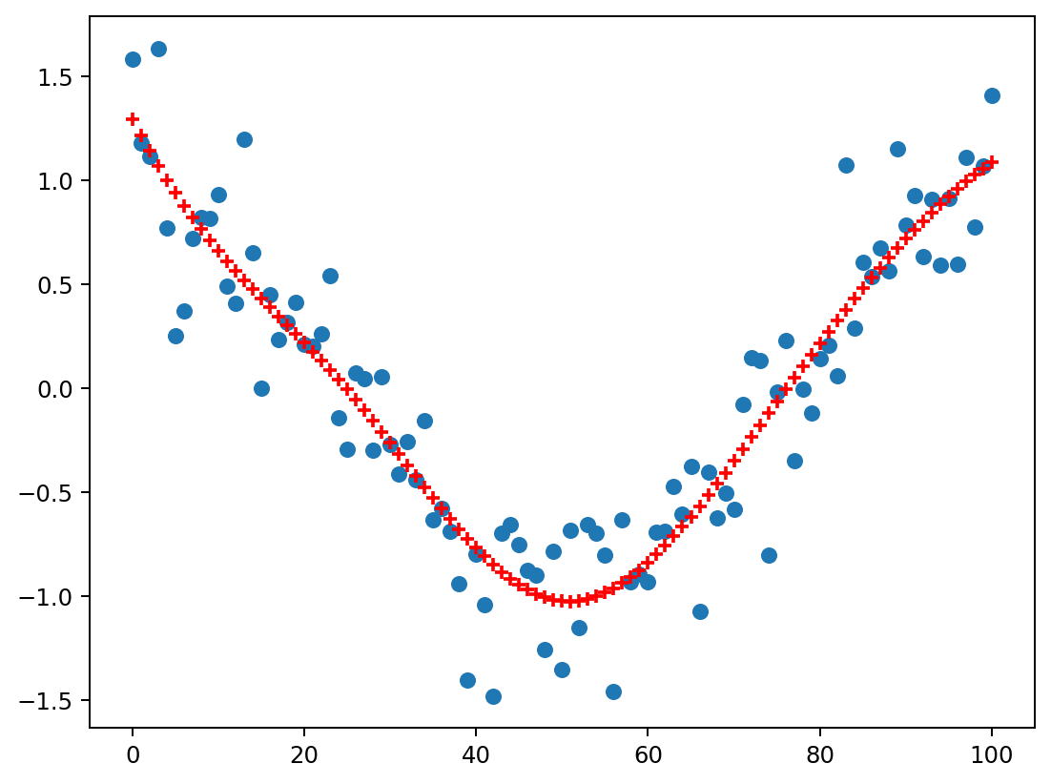
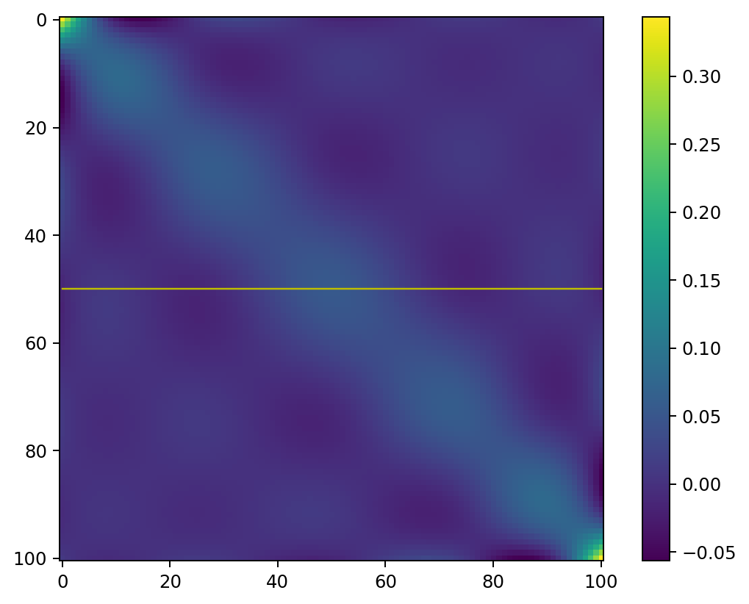
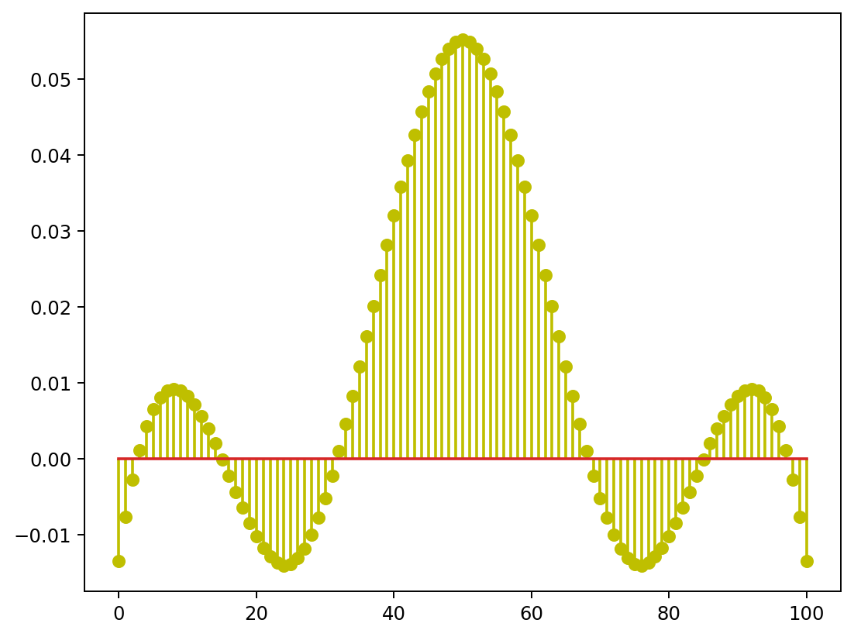

Example
M=7 basis functions

Slide 18
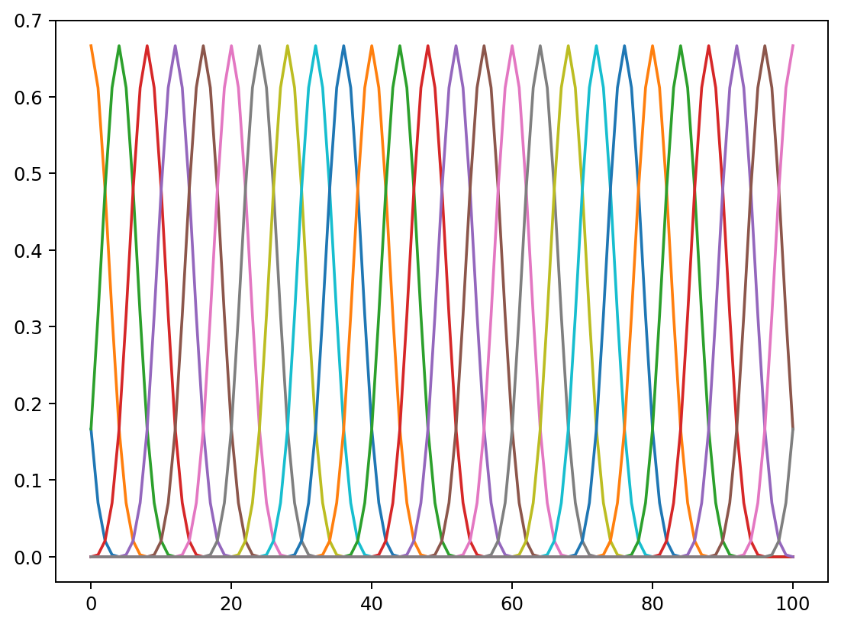
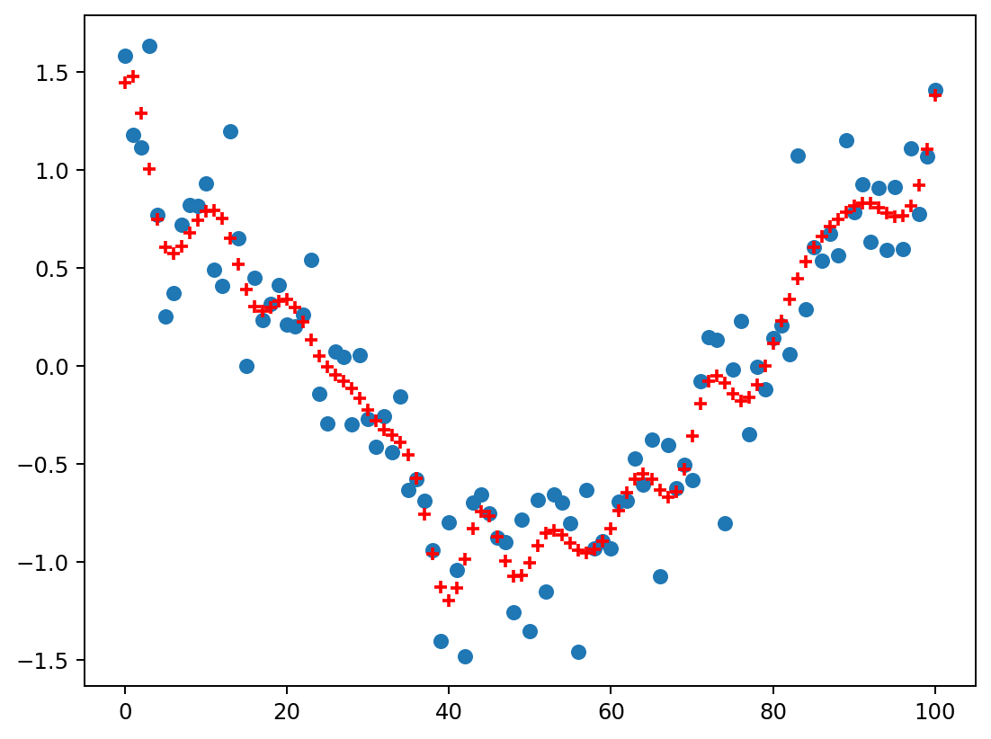
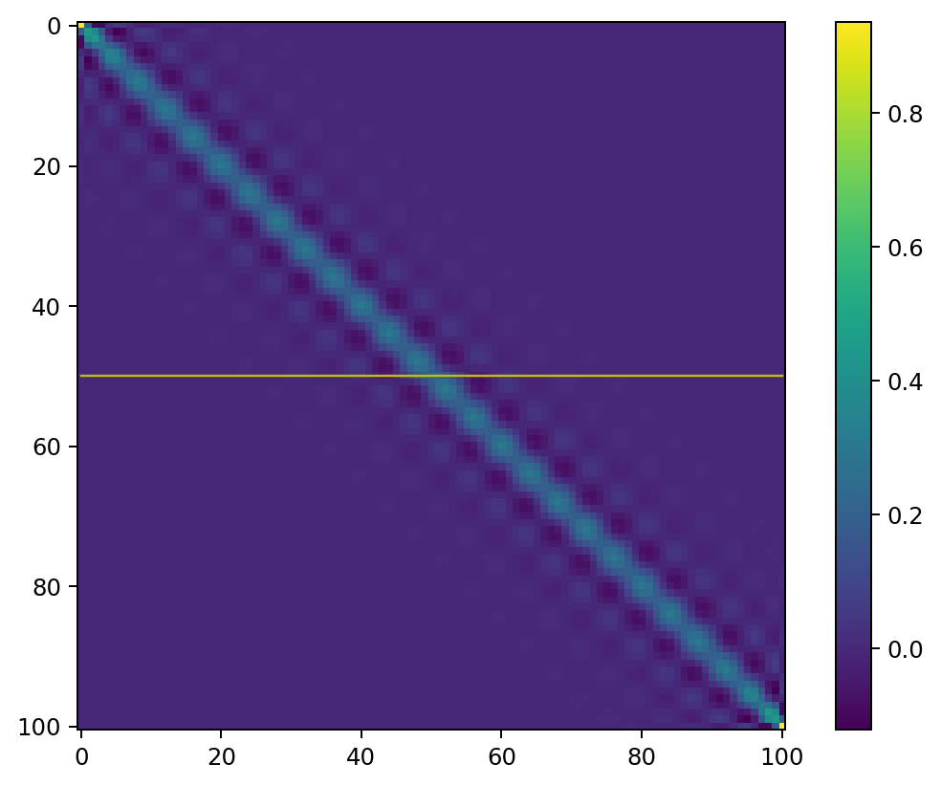
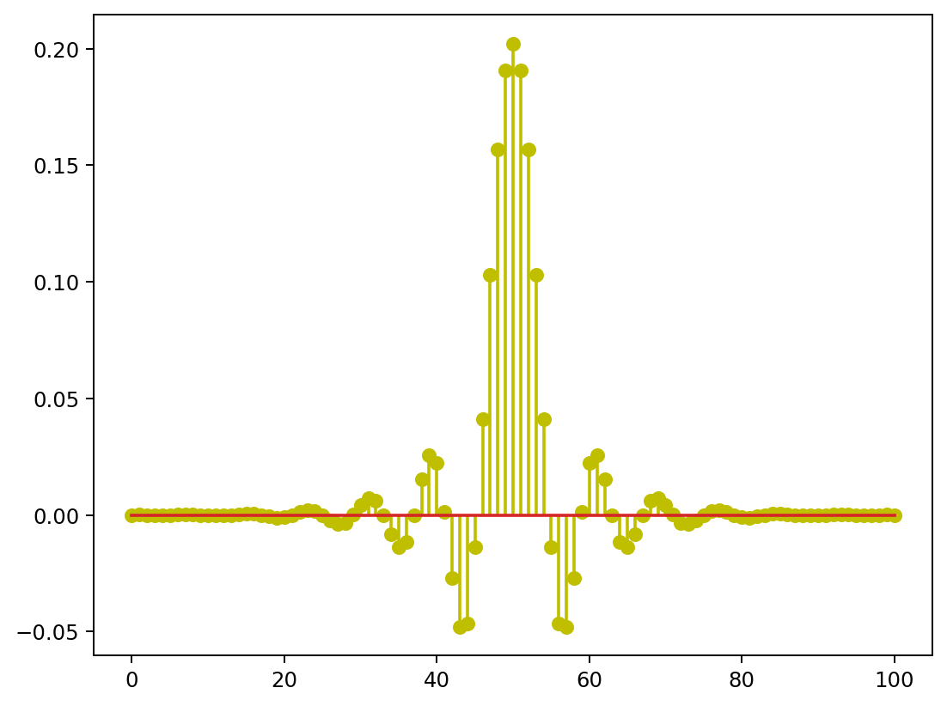
Example
M=28 basis functions

Slide 19
Example
What happens when M=N?
M=28 basis functions

Slide 20


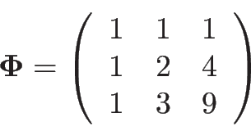
Discuss with your neighbor
Consider the case and
Task 1: what is ?
Task 2: what are and ?
Can you explain (e.g., draw) what’s happening?
Task 3: same as task 2 but when

Slide 21
Discuss with your neighbor
Consider the case and
Task 1: what is ?
Task 2: what are and ?
Can you explain (e.g., draw) what’s happening?
Task 3: same as task 2 but when

Slide 22

Discuss with your neighbor
Consider the case and
Task 1: what is ?
Task 2: what are and ?
Can you explain (e.g., draw) what’s happening?
Task 3: same as task 2 but when

Slide 23
Discuss with your neighbor
Consider the case and
Task 1: what is ?
Task 2: what are and ?
Can you explain (e.g., draw) what’s happening?
Task 3: same as task 2 but when

Slide 24
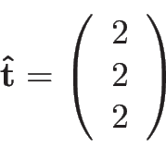
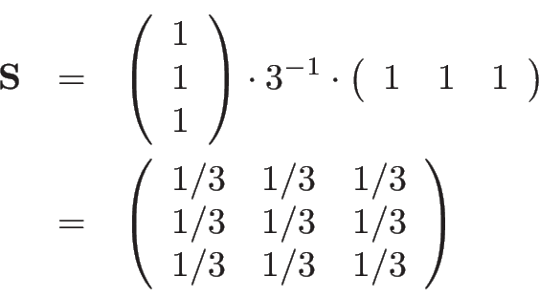
Discuss with your neighbor
Consider the case and
Task 1: what is ?
Task 2: what are and ?
Can you explain (e.g., draw) what’s happening?
Task 3: same as task 2 but when

Slide 25
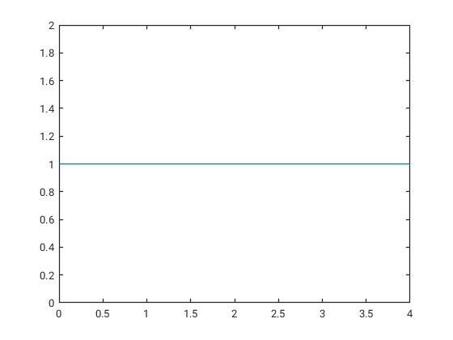
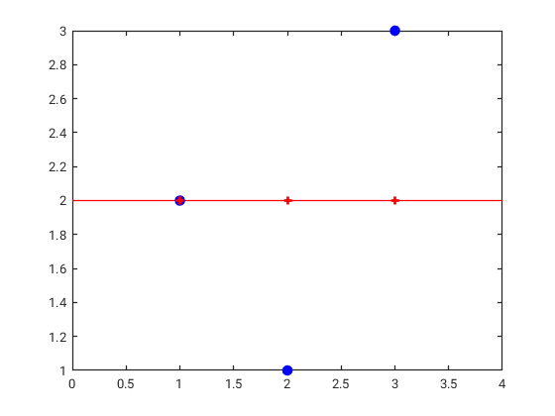
Discuss with your neighbor
Consider the case and
Task 1: what is ?
Task 2: what are and ?
Can you explain (e.g., draw) what’s happening?
Task 3: same as task 2 but when

Slide 26
Discuss with your neighbor
Consider the case and
Task 1: what is ?
Task 2: what are and ?
Can you explain (e.g., draw) what’s happening?
Task 3: same as task 2 but when

Slide 27
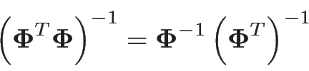
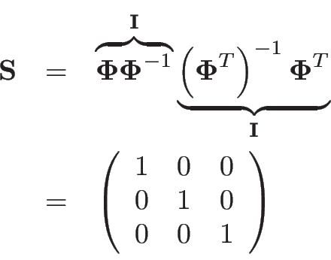
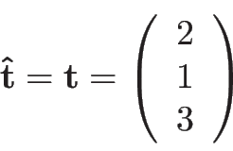
Discuss with your neighbor
Consider the case and
Task 1: what is ?
Task 2: what are and ?
Can you explain (e.g., draw) what’s happening?
Task 3: same as task 2 but when

Slide 28
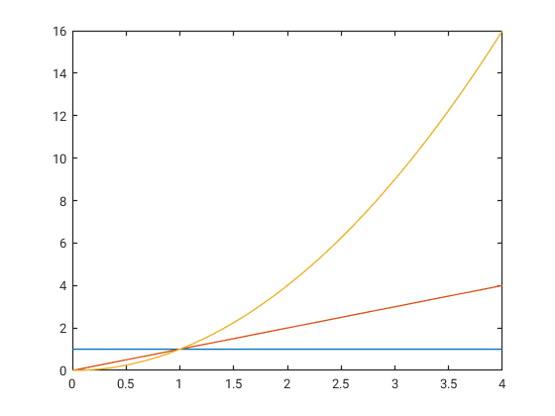
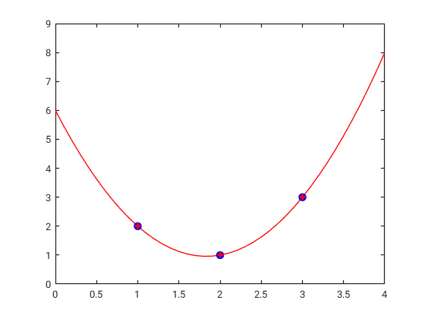
Discuss with your neighbor
Consider the case and
Task 1: what is ?
Task 2: what are and ?
Can you explain (e.g., draw) what’s happening?
Task 3: same as task 2 but when
When M=N,
no smoothing is applied!

Slide 29
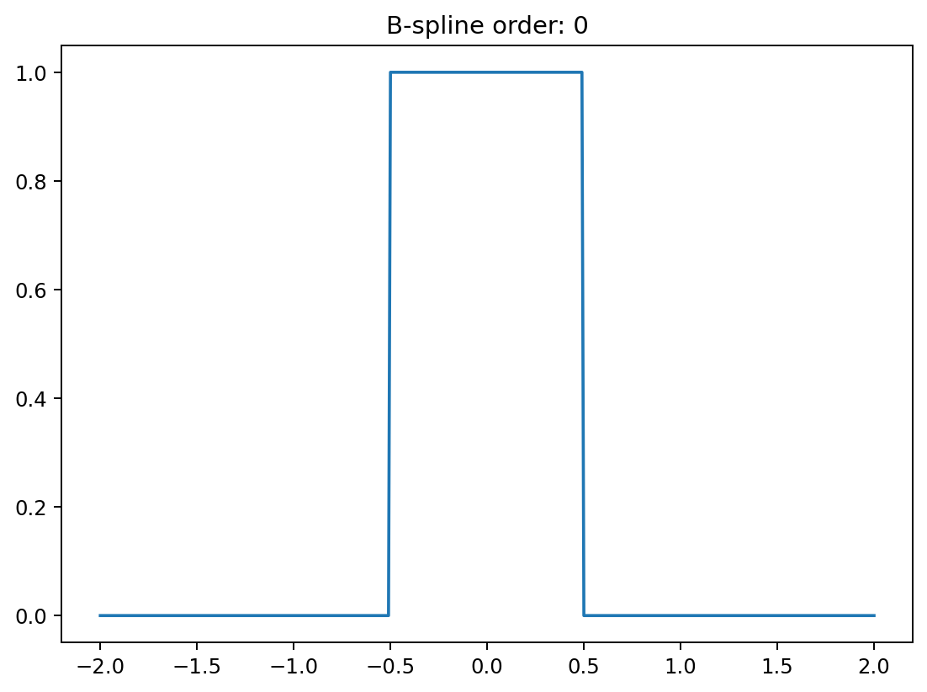
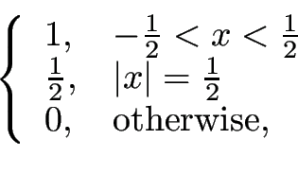


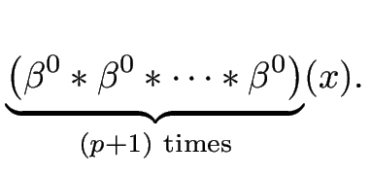
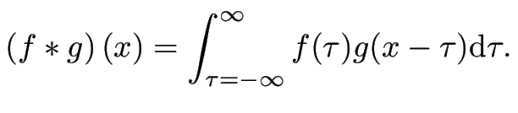

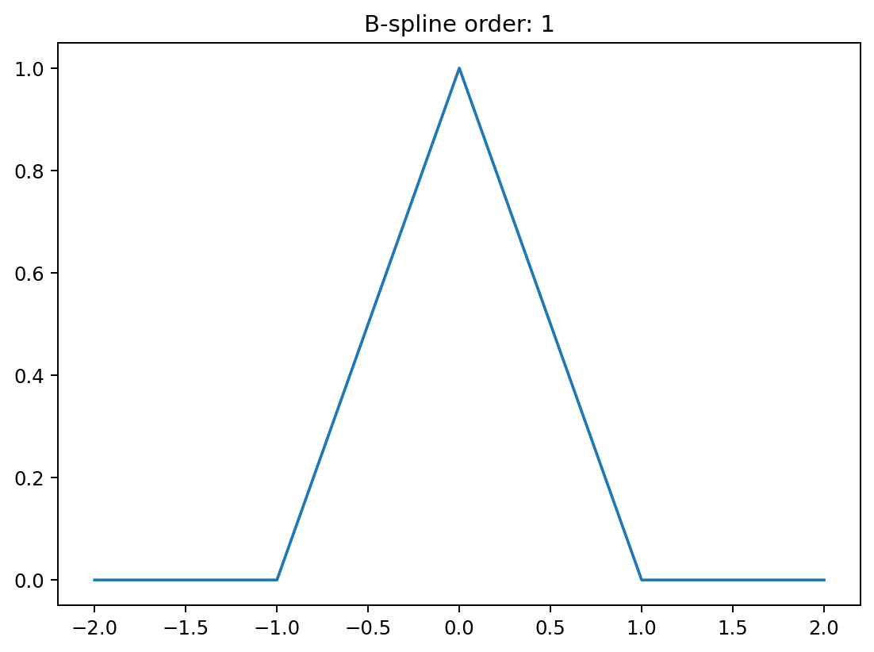
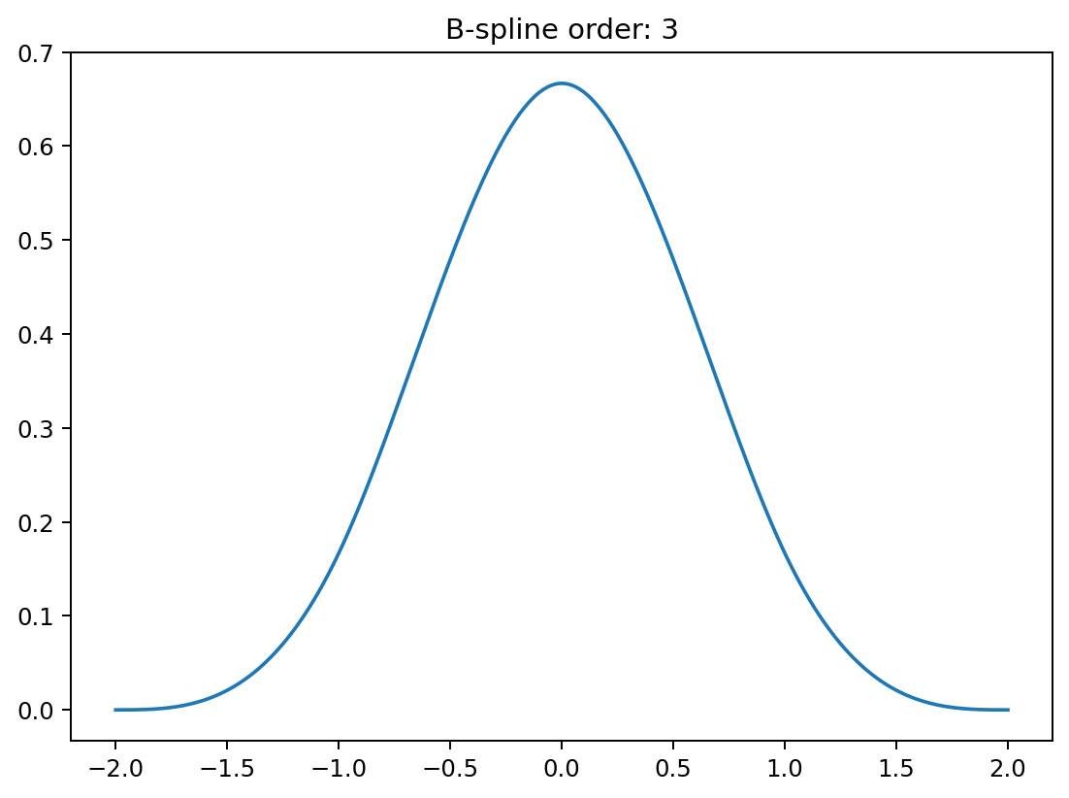
Interpolation
Meet the B-spline family:
where
“order”

Slide 30





Interpolation
Use basis functions:
will pass exactly through at the integer locations
Order 0: “nearest neighbor” interpolation
(almost)

Slide 31

Interpolation
Use basis functions:
will pass exactly through at the integer locations
Order 1: “linear” interpolation

Slide 32

Interpolation
Use basis functions:
will pass exactly through at the integer locations
Order 3: “cubic” interpolation

Slide 33




Going to higher dimensions
Re-arrange pixels in 2D images of size into 1D signals of length
Vectorize the image to be smoothed or interpolated
Also vectorize each of the 2D basis functions
Solve the resulting 1D problem as before

Slide 34





Separable basis functions
Create 2D basis functions from two sets of 1D basis functions
Kronecker product: , where
Column in contains a vectorized version of

Slide 35




Separable basis functions
x
=

Slide 36





Exploiting separability
When , we can compute faster as follows:
where
As a result, we can also compute as:
where

Slide 37
Exploiting separability
When , we can compute faster as follows:
where
As a result, we can also compute as:
where
Example: naively interpolating a 256x256 image (M = 256*256 = 65,536 basis functions in 2D!)
Storing takes 32 GB, vs. 1MB to store both and
Inverting is almost 10 million times slower than inverting both and

Slide 38






Smoothing in 2D
smoothing in the
column-direction
smoothing in the row-direction

Slide 39

Interpolation in 2D
“nearest neighbor”
“linear”
“cubic”

