Slide 1
This work is licensed under CC BY 4.0
Medical Image Analysis ​
NBE-E4010
Koen Van Leemput
Fall 2026

Slide 2
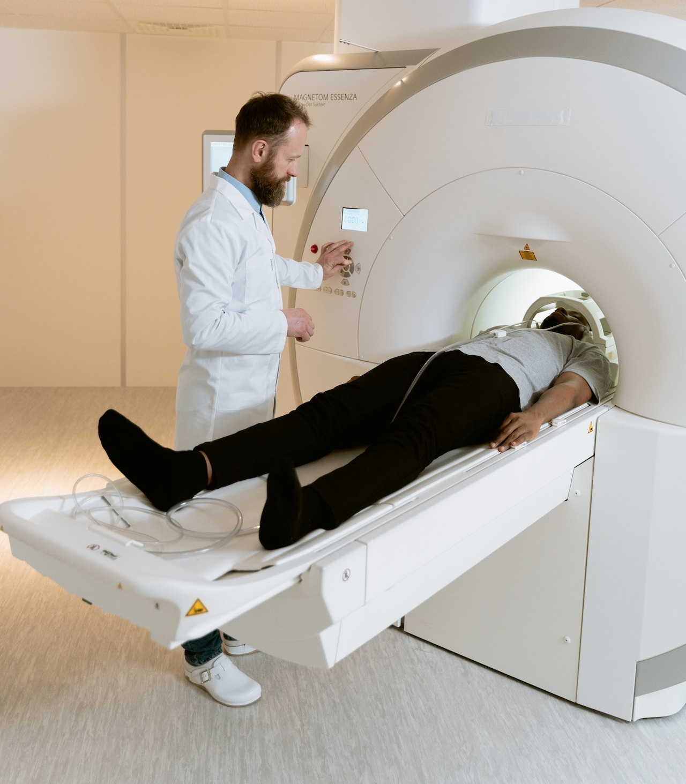
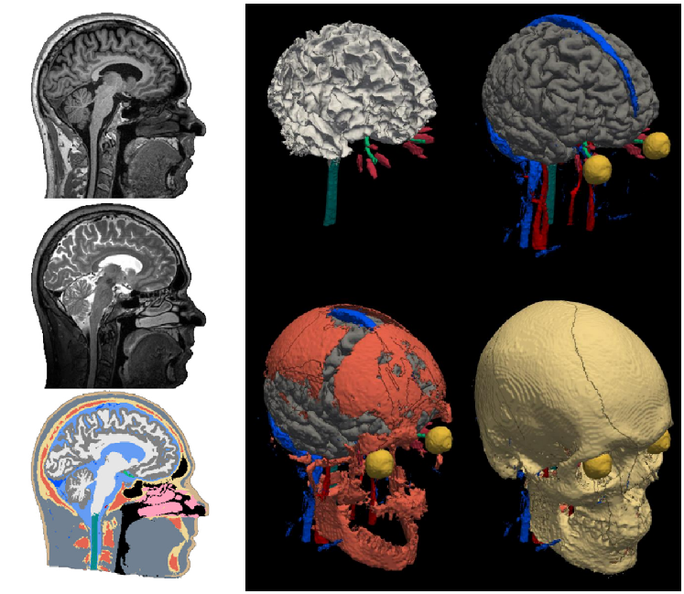
AI in medical imaging
images
scanner
- acquire images faster
- visualize more details

Slide 3
AI in medical imaging
images
scanner
- expose the “unseeable”
- measure more consistently
- analyze images faster
information

Slide 4
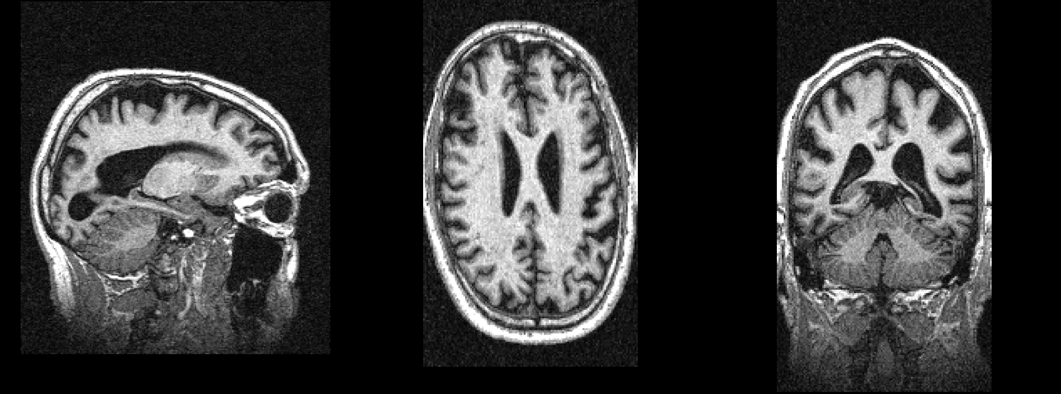
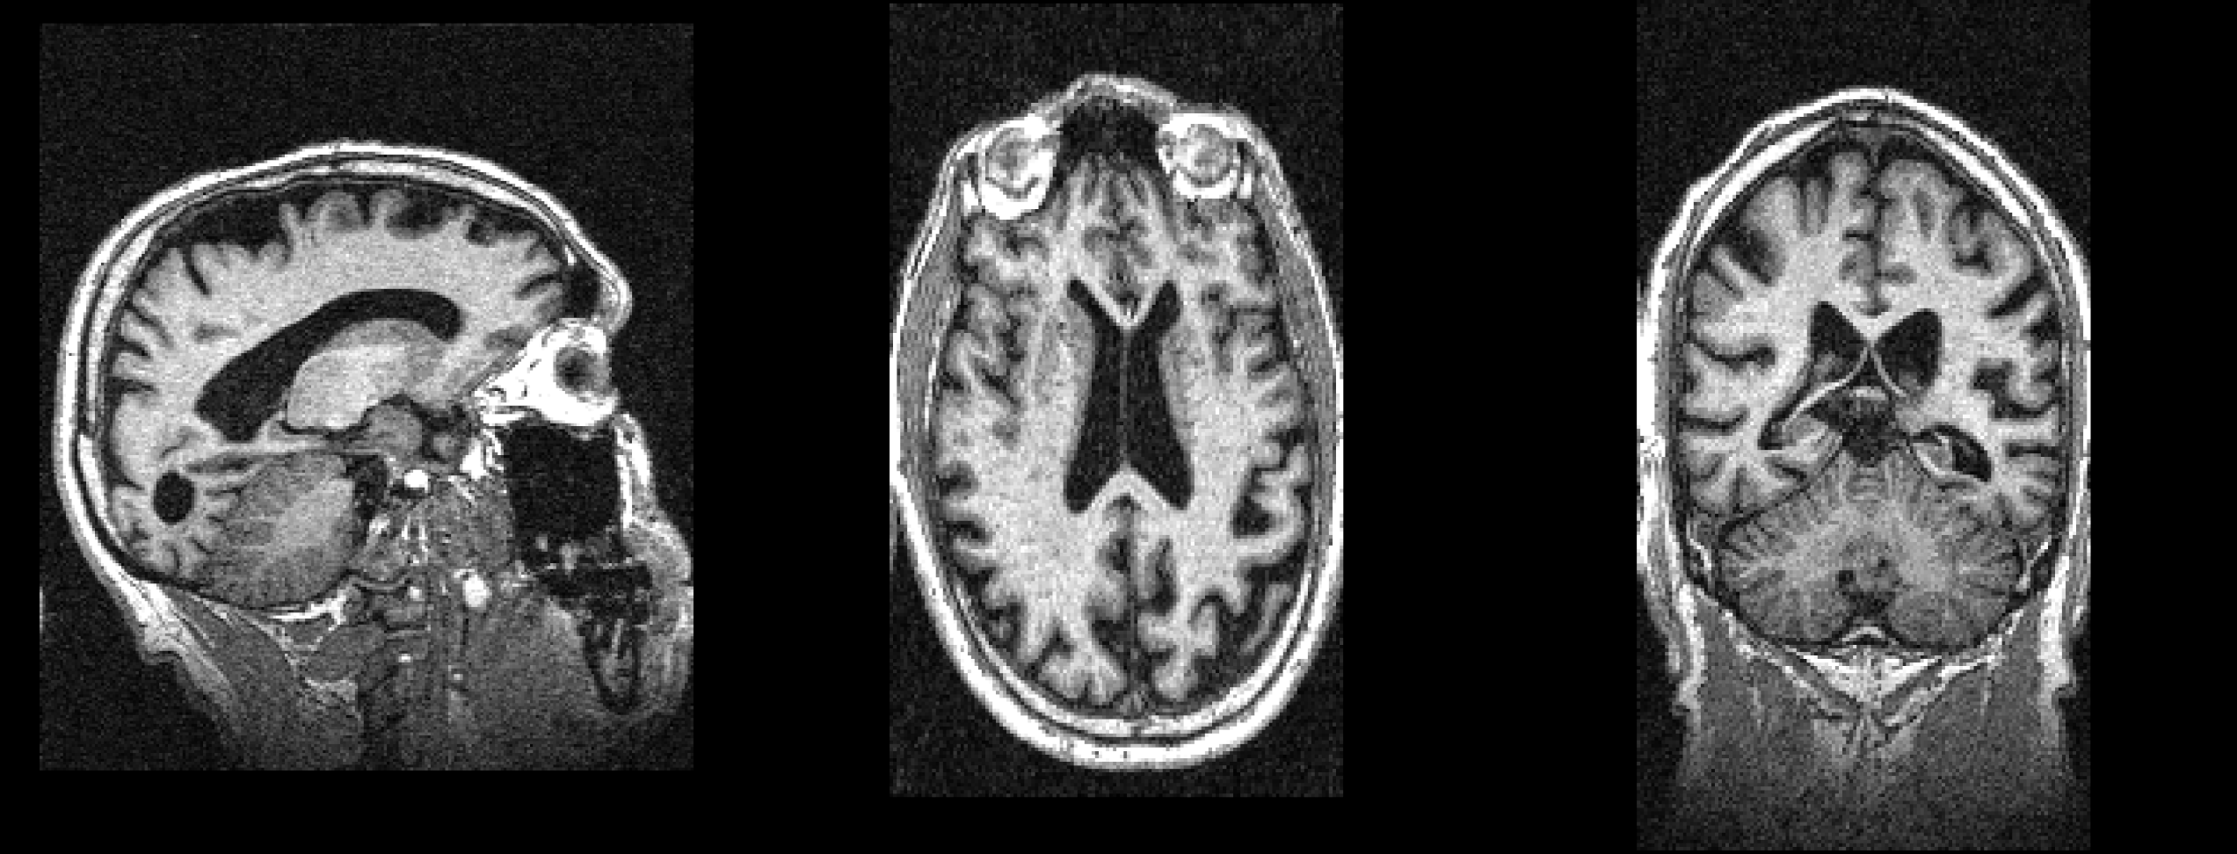
Exposing the “unseeable”
today
8 months ago

Slide 5
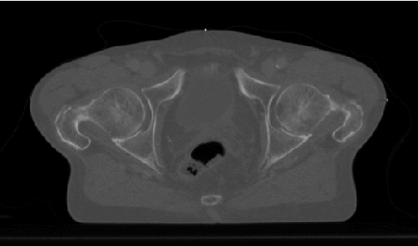
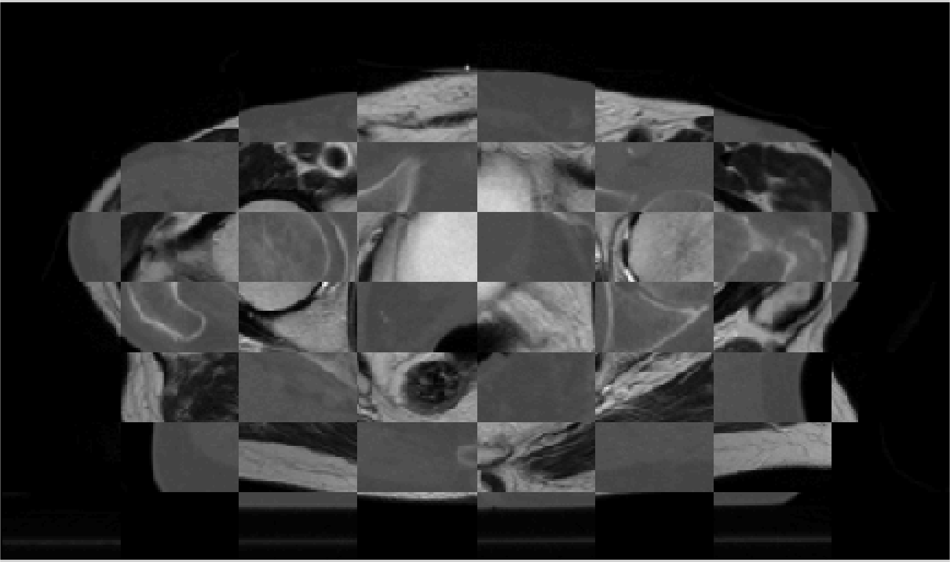
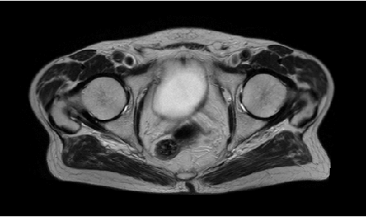
Exposing the “unseeable”
CT
today
mosaic CT/MRI
MRI
8 months ago

Slide 6
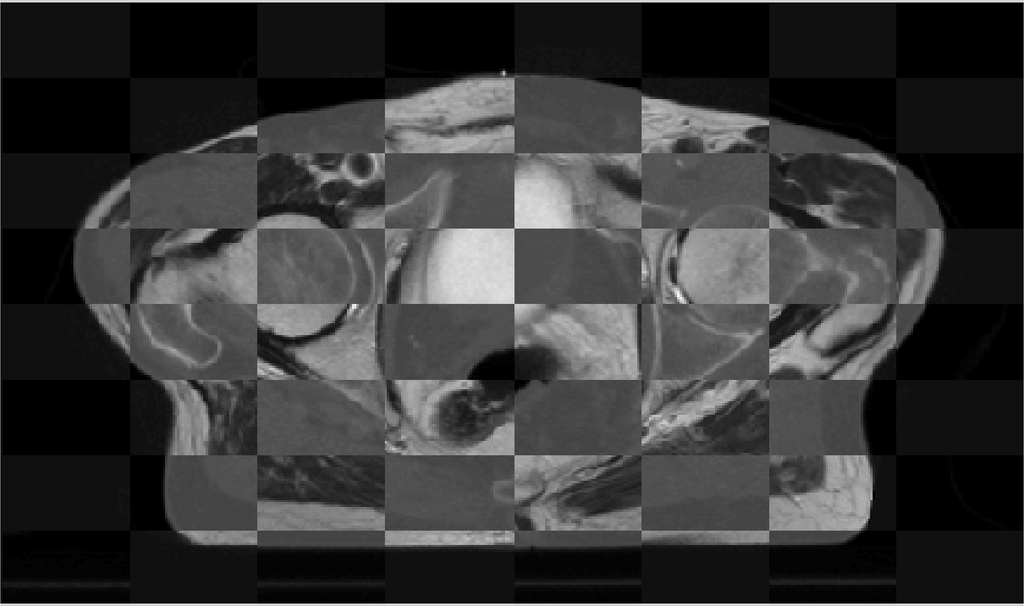
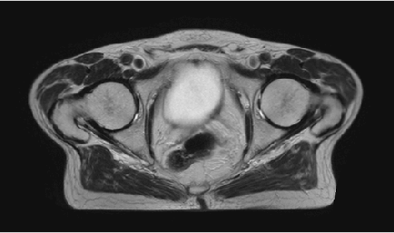
Exposing the “unseeable”
CT
today
mosaic CT/MRI
MRI
8 months ago

Slide 7
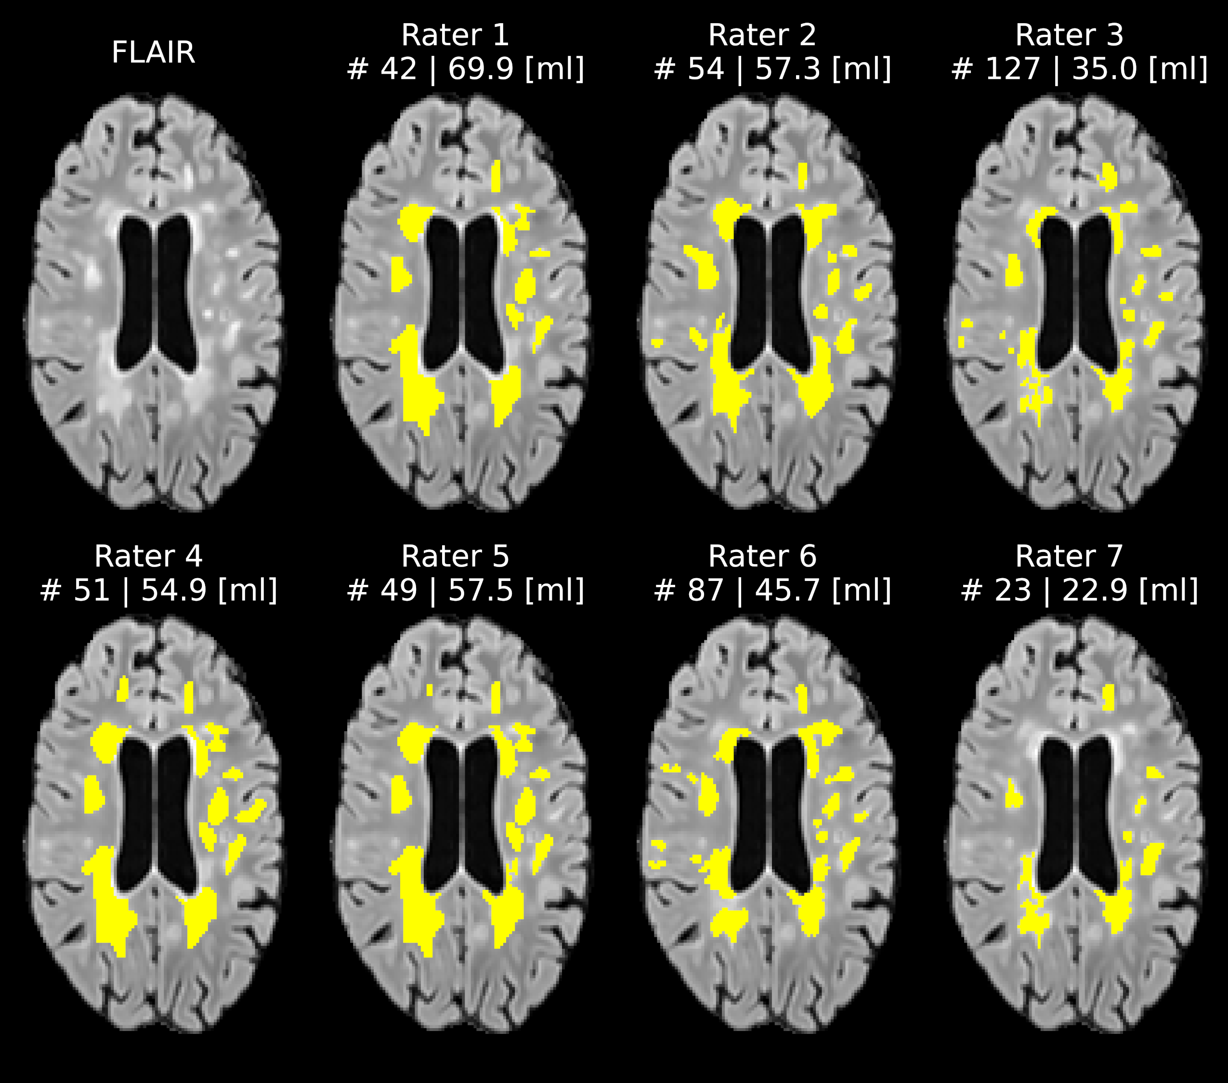
Measuring more consistently
Quantifying lesions in multiple sclerosis (MS):
- number (#)
- volume (ml)

Slide 8
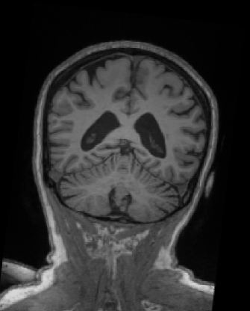
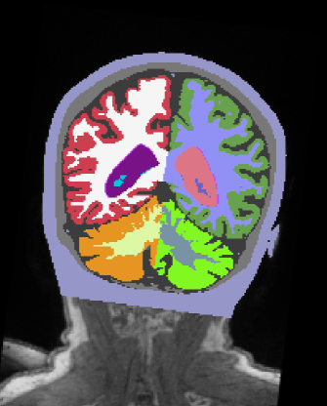
Analyzing images faster
MRI
segmentation

Slide 9
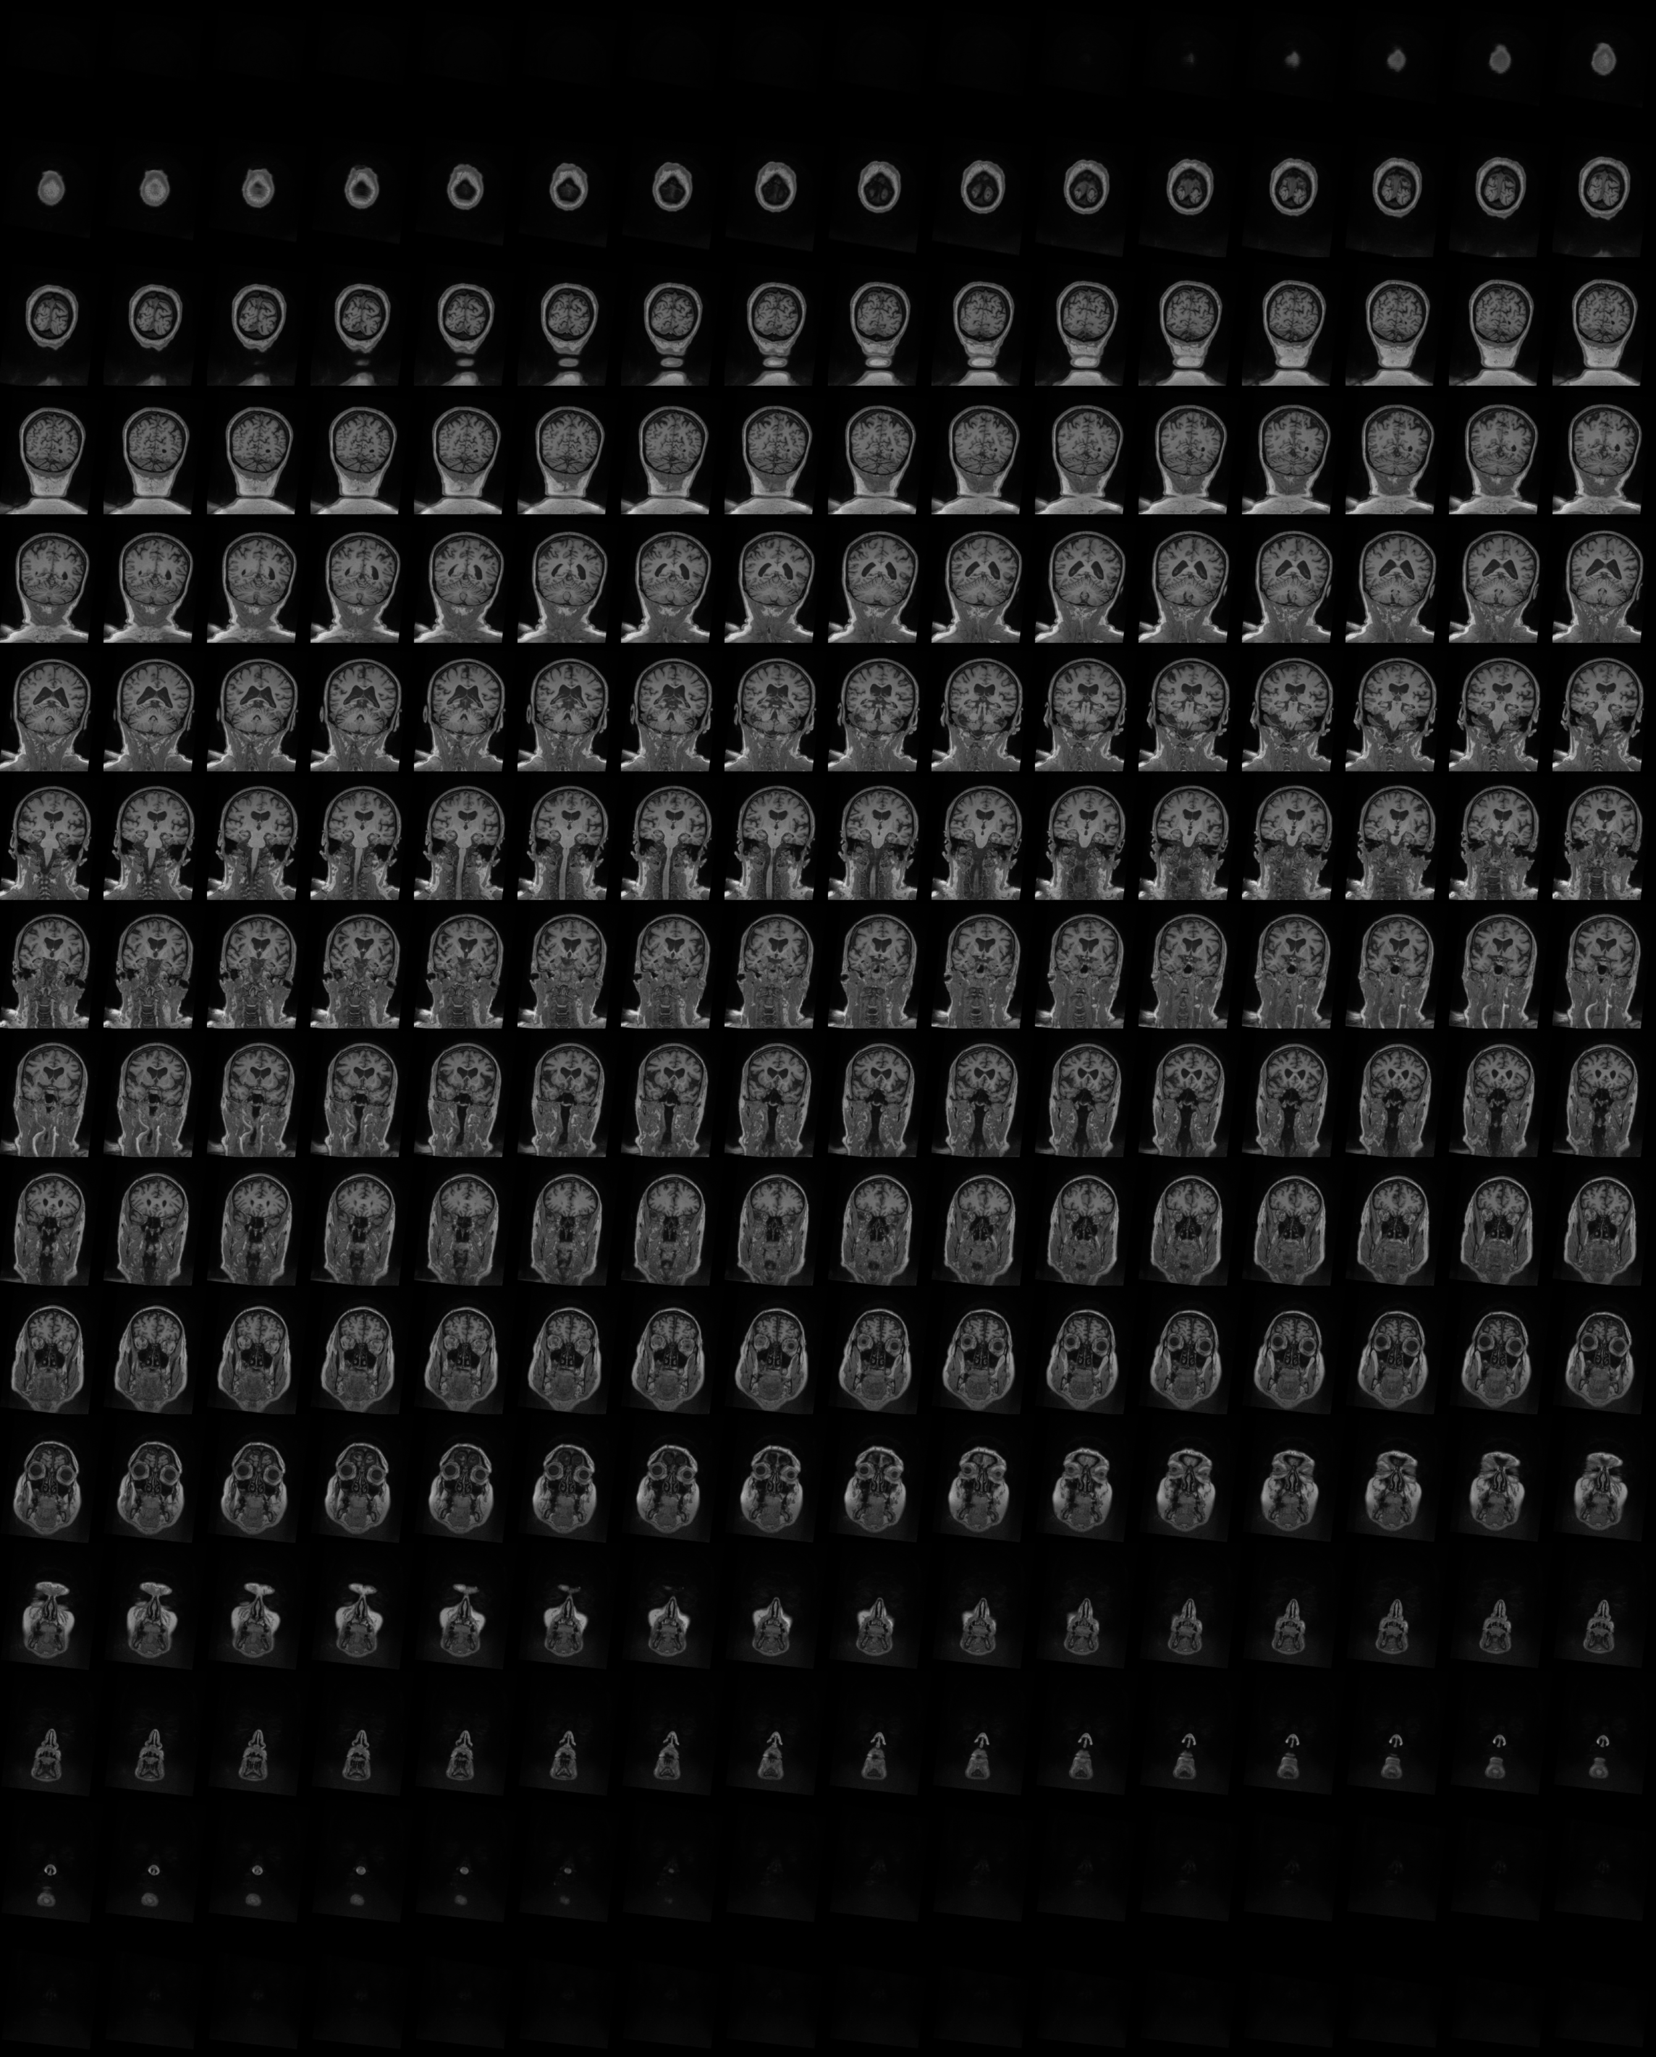
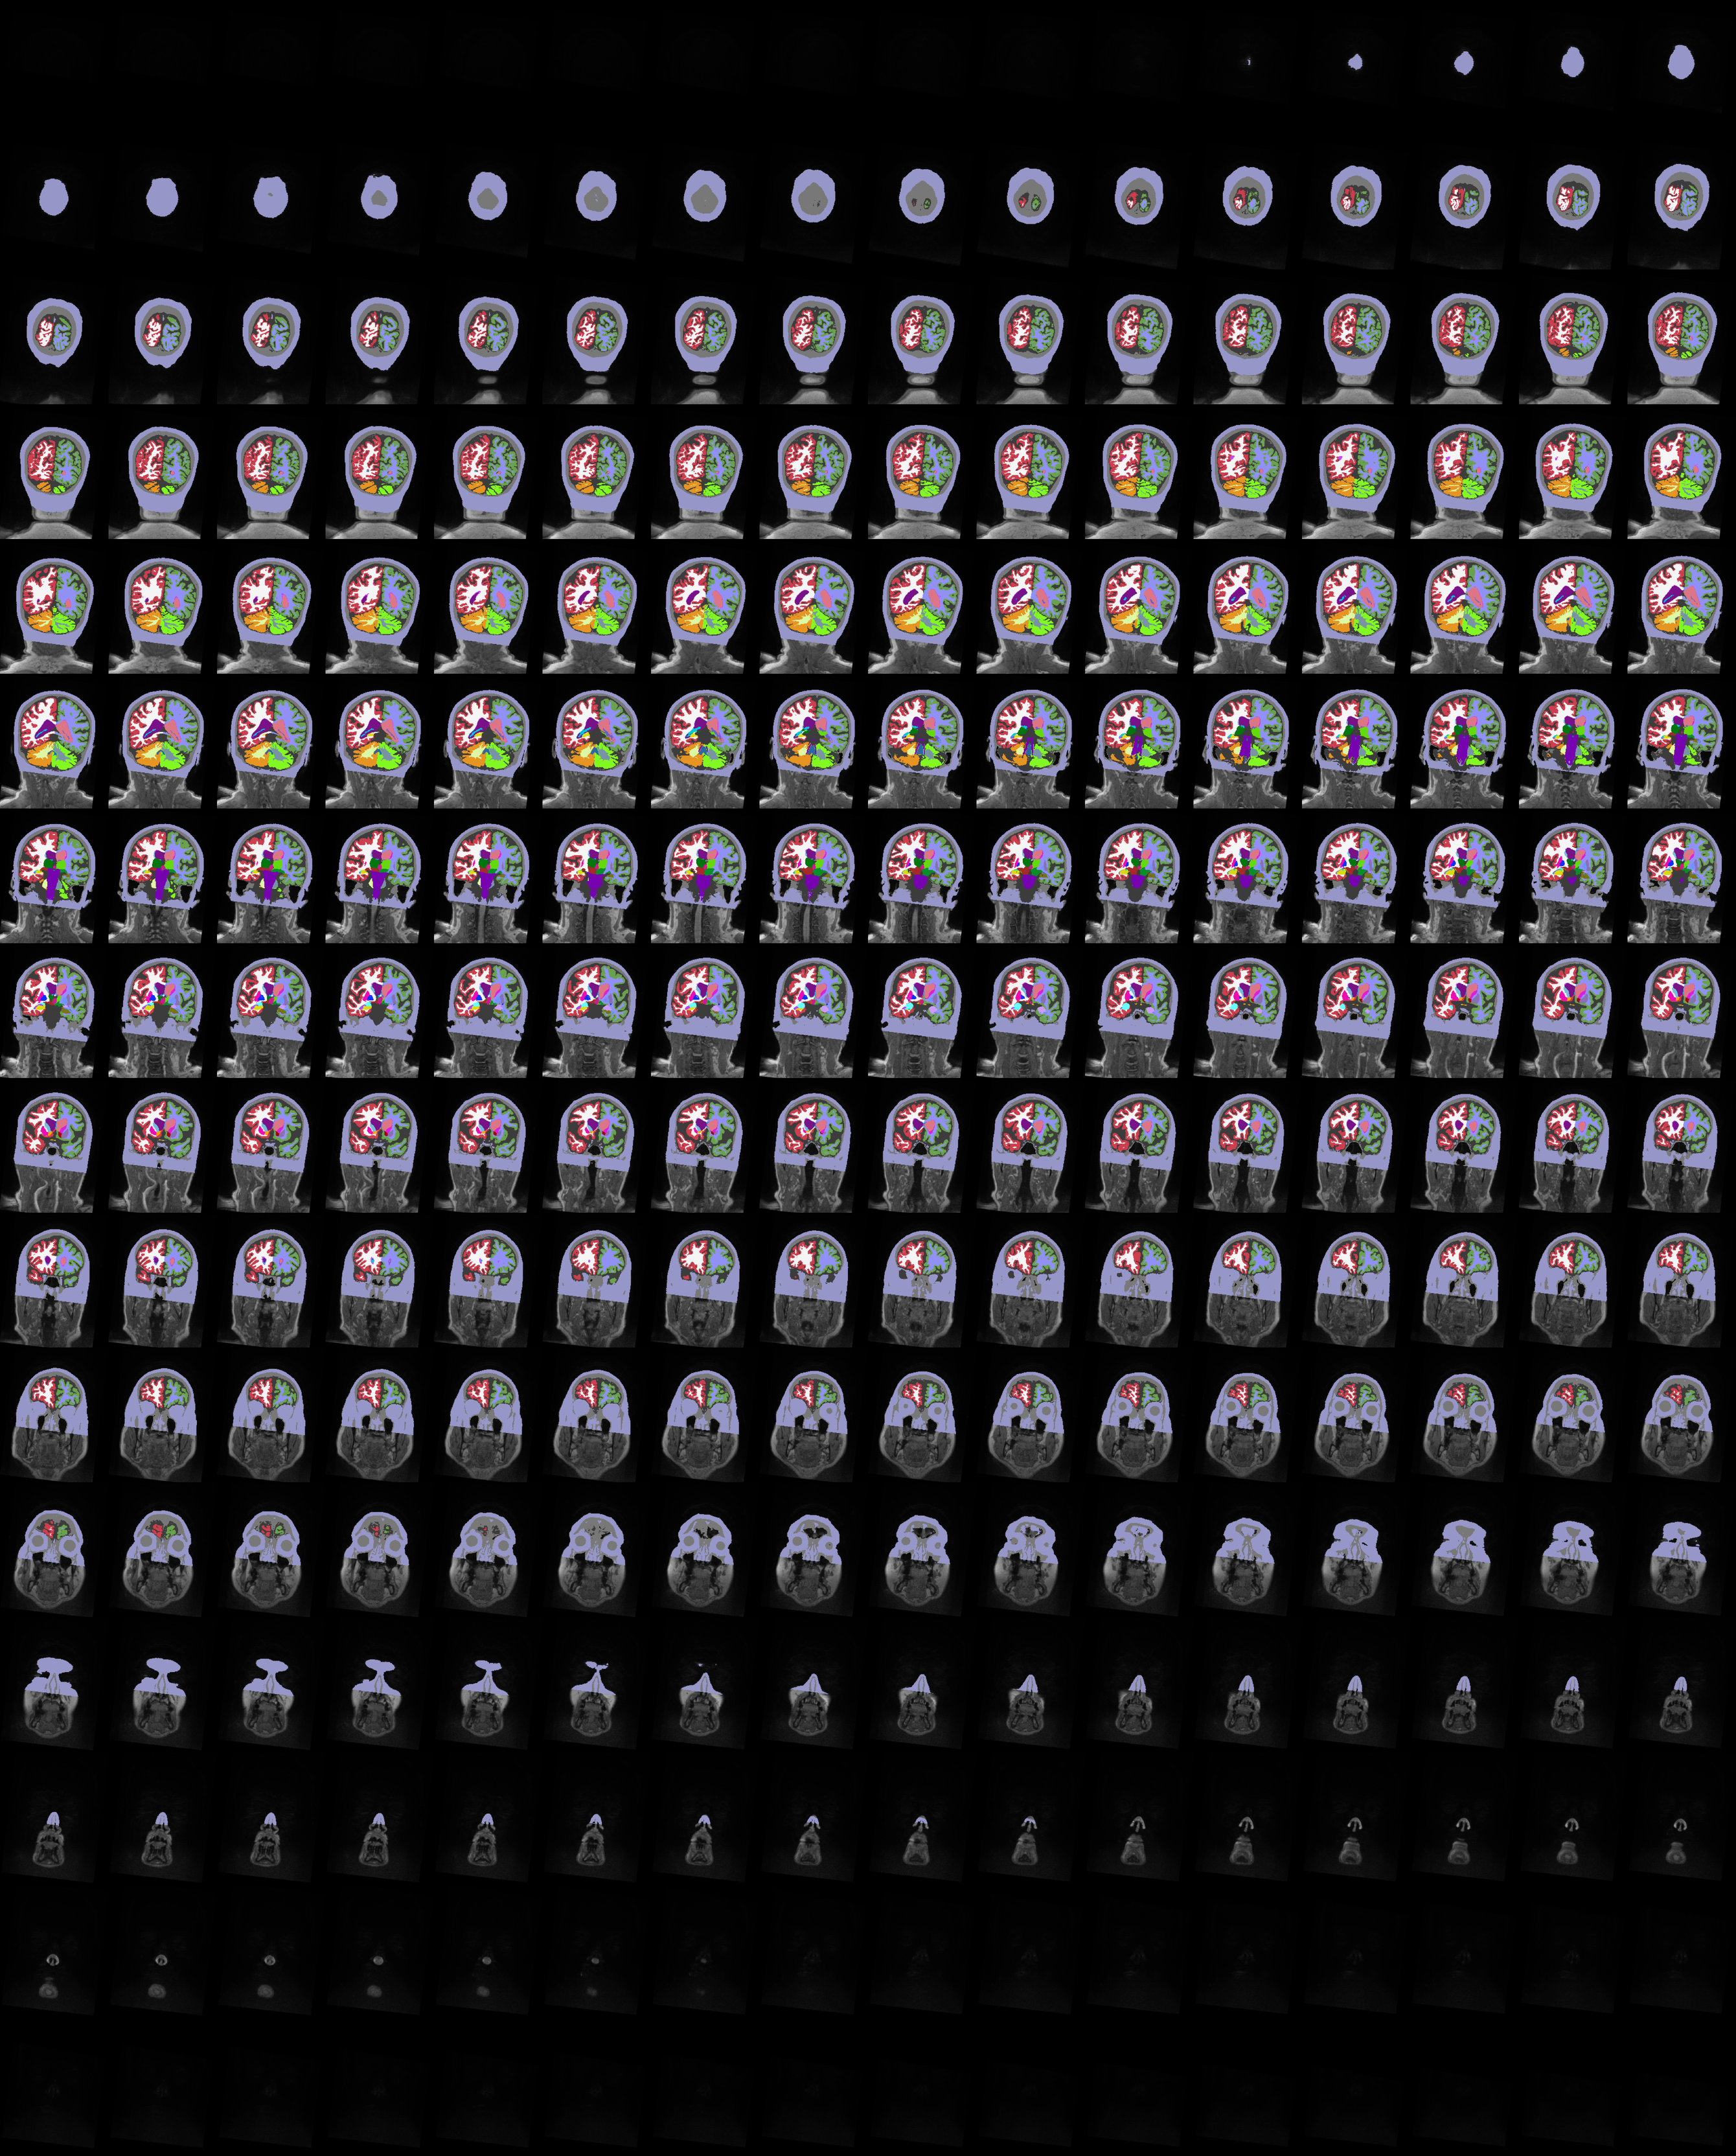
MRI
segmentation

Slide 10
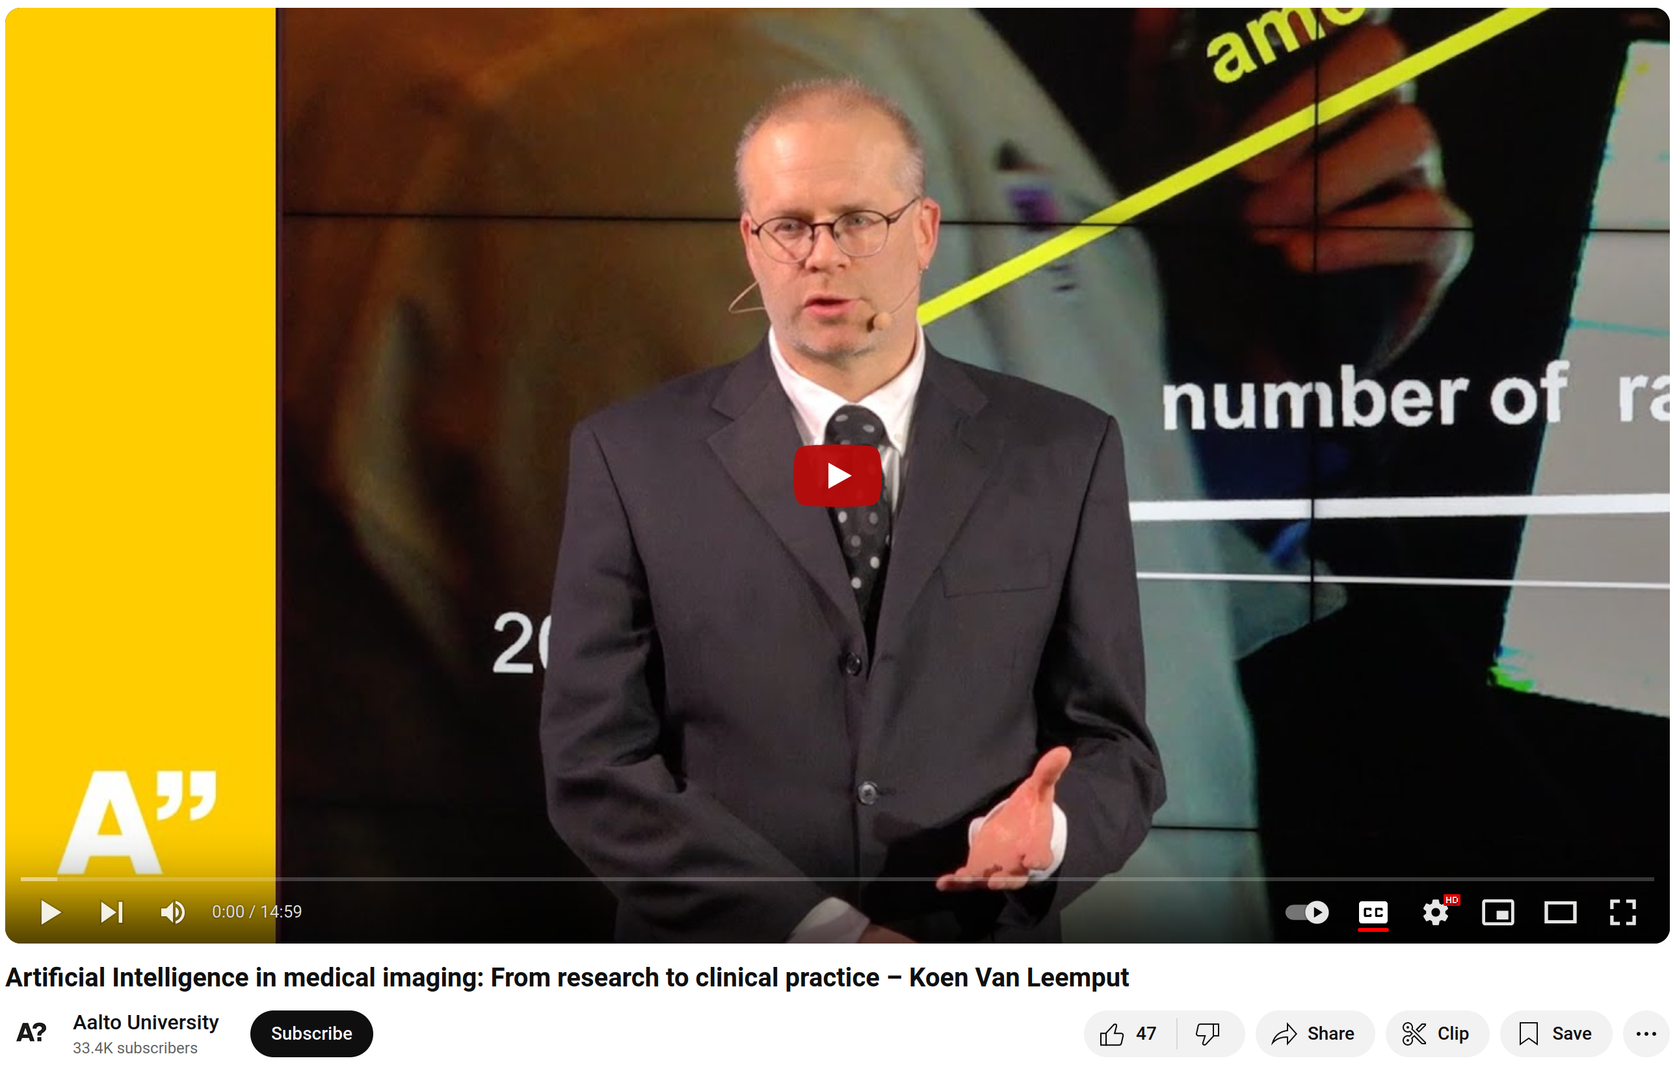
Want to know more?
https://youtu.be/iiw4j-Frljo

Slide 11
Learning objectives
After this course you should be able to:
Implement image smoothing and interpolation techniques
Use spatial coordinate systems in medical images
Perform landmark-based and intensity-based image registration
Solve segmentation problems using generative models
Perform image segmentation using discriminative methods (neural nets)
A “do” course

Slide 12
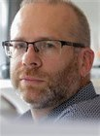
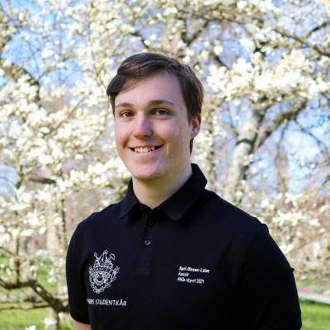
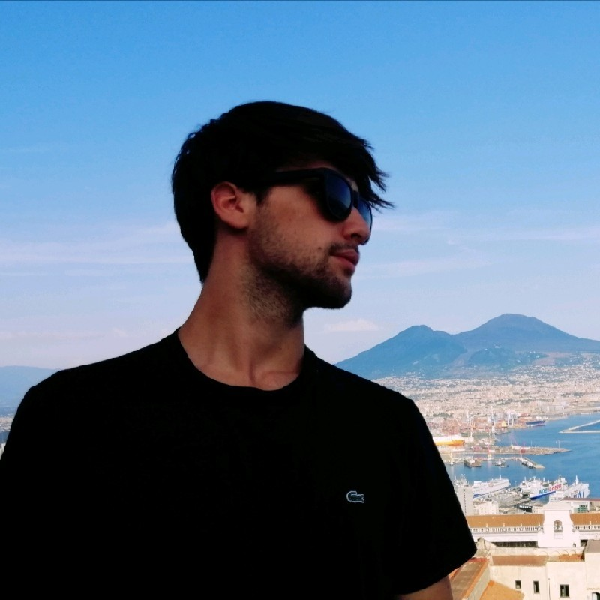
Who are we?
Koen Van Leemput, teacher (Professor, Neuroscience and Biomedical Engineering)
Karl Olsson-Lalor, TA (Doctoral Researcher, Neuroscience and Biomedical Engineering)
Alessandro De Florio, TA (Doctoral Researcher, Neuroscience and Biomedical Engineering)

Slide 13
Who are you?
Master's Programme in Life Science Technologies 29
Exchange studies (SCI + ELEC): 11
Master's Programme in Computer, Communication and Information Sciences 6
Bachelor's Programme in Electrical Engineering 5
Bachelor's Programme in Science and Technology 3
Aalto Bachelor's Programme in Science and Technology 3
Bachelor's Programme in Chemical Engineering 2
JOO Studies (Engineering, manufacturing and construction), SCI 2
Master's Programme in ICT Innovation 2
Master's Programme in Engineering Physics 2
Master's Programme in Health Technology Engineering 1
Aalto Doctoral Programme in Science 1

Slide 14
Teaching form
Lectures:
Mondays 12.15-14.00 (U141 U3, Otakaari 1)
Two guest lectures (one from industry, one from university hospital)
The “correct” exercise solutions will be discussed in class
Exercises
Tuesdays 10.15-12.00 (A123 A1, Otakaari 1)
Python/NumPy + Jupyter notebooks
Group-work (2-3 students per group)
Six exercises in total, submission deadline after < 2 weeks (Friday evening)
Peer grading + light review by TAs (informal feedback)
Exam:
Individual oral exam, determines your grade
Blindly pick one of your own exercise reports and discuss
Active course participation (peer grading, quality of exercise reports) is taken into account for grading
- try to find group members today
- go to MyCourses and select a group
- no 1-student “groups” please
- get more detailed feedback by attending lectures
and exercise sessions
- numerical scores don’t directly affect your grade
- during weeks 30 Nov - 4 Dec or 7-11 Dec
- pick a suitable time slot in MyCourses
(coming up)

Slide 15
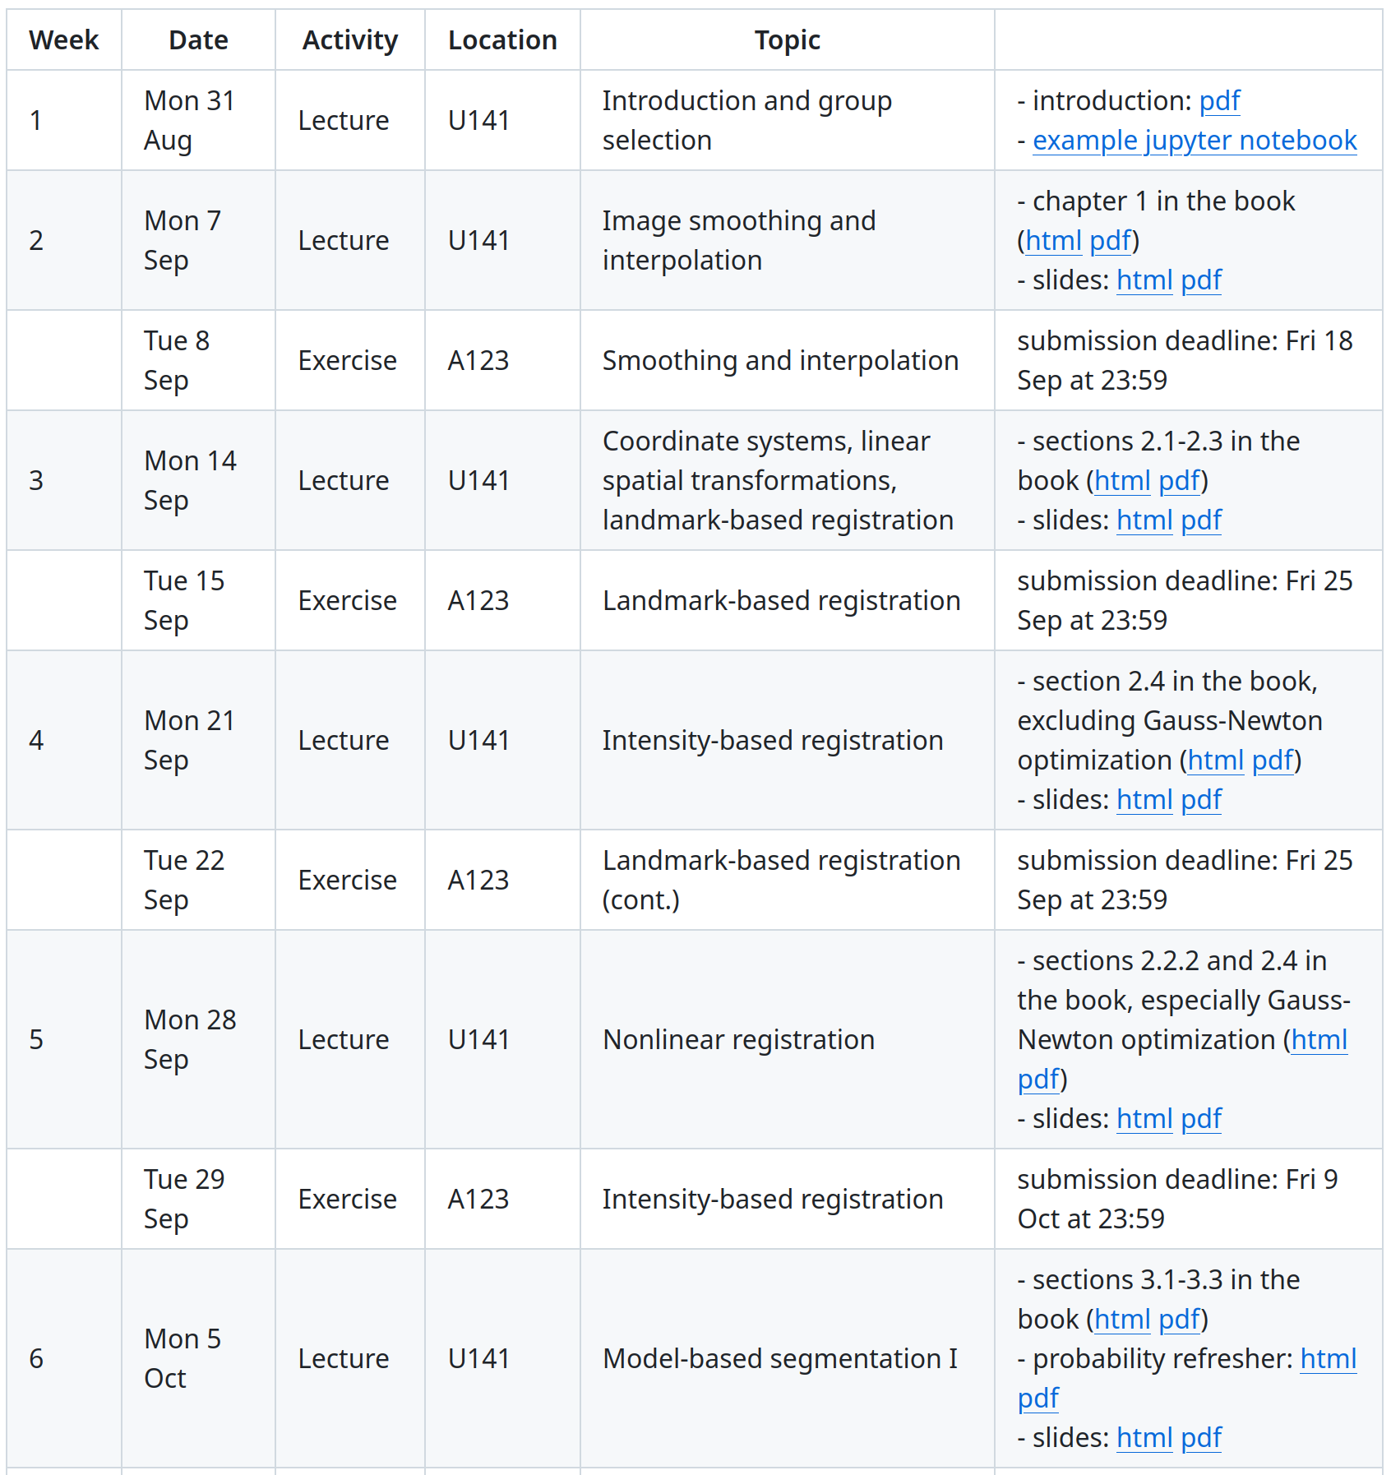
Logistics
https://leempko.github.io/mia/
Course material (book, slides)
Schedule
https://mycourses.aalto.fi/
Group selections
Exercises (input data, report submissions, peer grading)
Important announcements
Discussion fora (secondary place to ask questions)

Slide 16
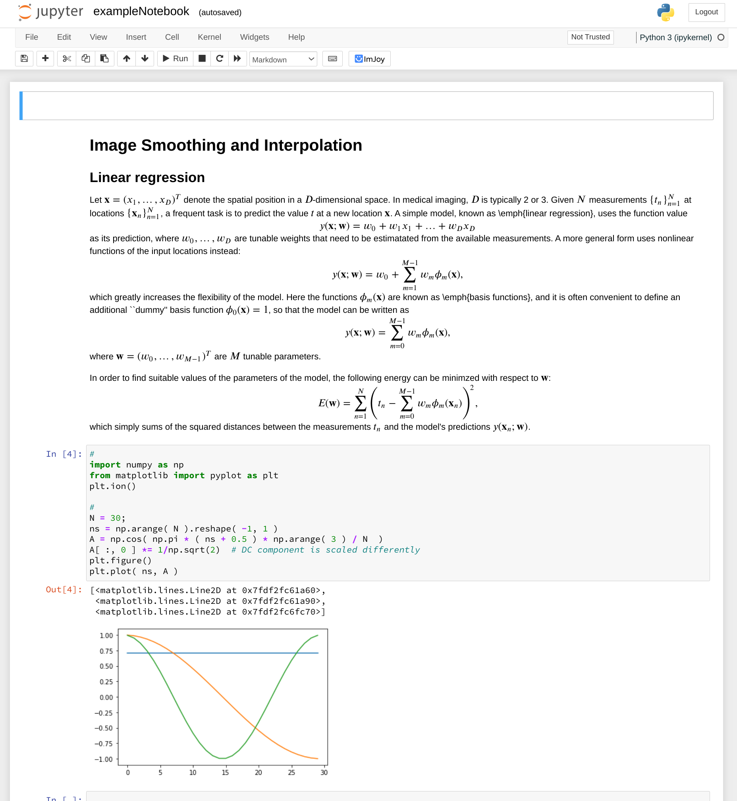
Python/NumPy,
Jupyter Notebooks
Python: https://lectures.scientific-python.org/
Jupyiter Notebooks:
- https://www.dataquest.io/blog/jupyter-notebook-tutorial/
- https://jupyter.cs.aalto.fi/
https://leempko.github.io/mia/

Slide 17
To conclude...
Physical attendance
Is expected in the lectures and the exercise sessions
Your primary way to ask questions and get feedback
(It’s technically possible to follow online, but strongly discouraged)
Questions?
Solve exercises in groups (2-3 students per group)
Try to find group members today
Go to MyCourses and select a group
No 1-student “groups” please

Slide 18
Copyrights
"Accurate and robust whole-head segmentation from magnetic resonance images for individualized head modeling“ by Puonti et al. NeuroImage (2020), licensed under CC-BY-NC-ND

