Slide 1
This work is licensed under CC BY 4.0
Medical Image Analysis ​
NBE-E4010
Koen Van Leemput
Fall 2024

Slide 2
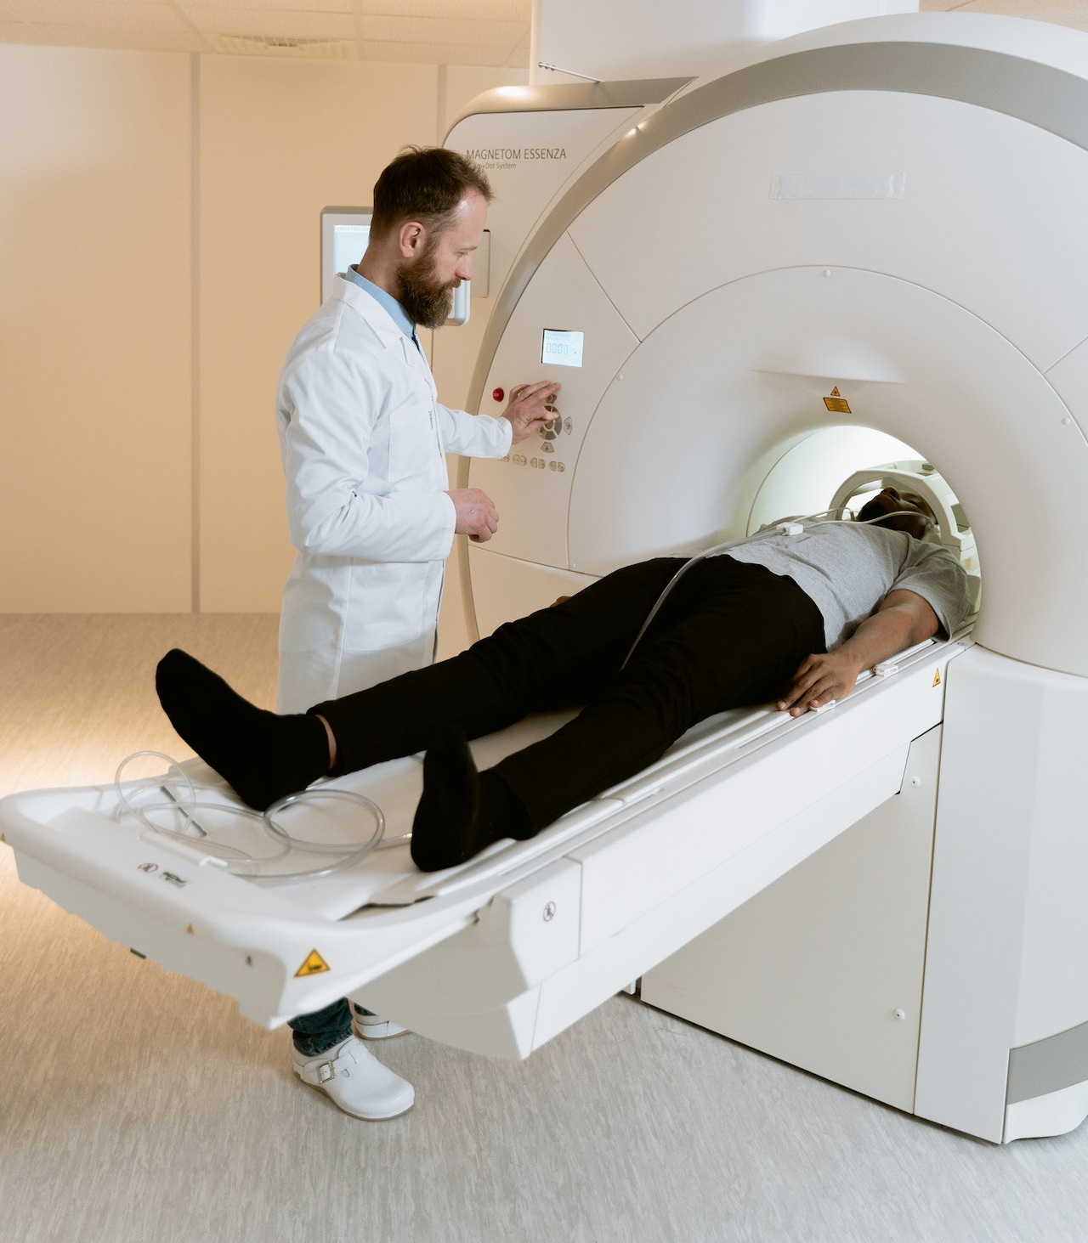
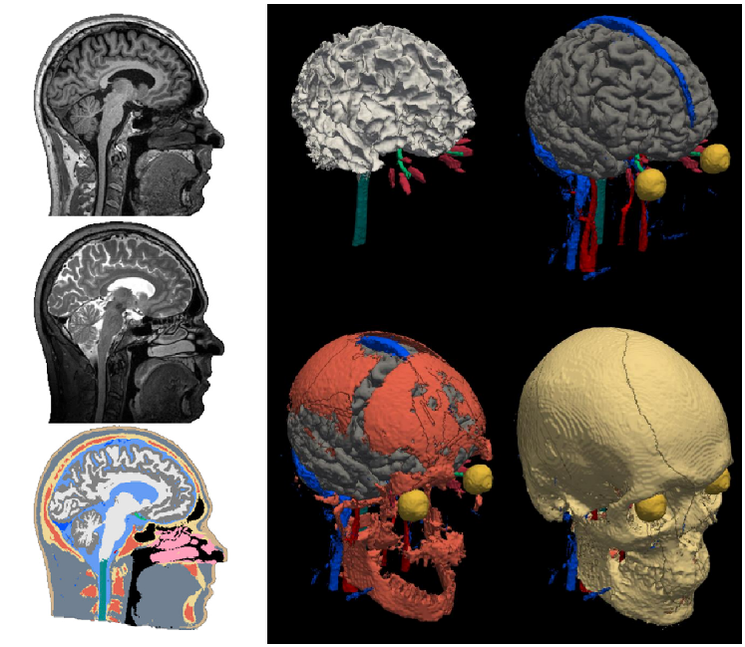
AI in medical imaging
images
scanner
- acquire images faster
- visualize more details

Slide 3
AI in medical imaging
images
scanner
- expose the “unseeable”
- measure more consistently
- analyze images faster
information

Slide 4
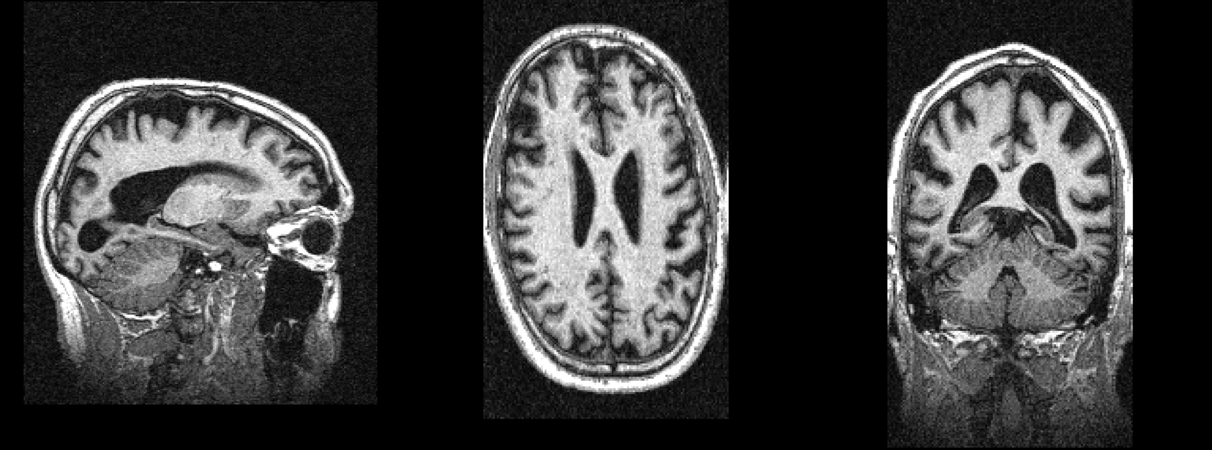
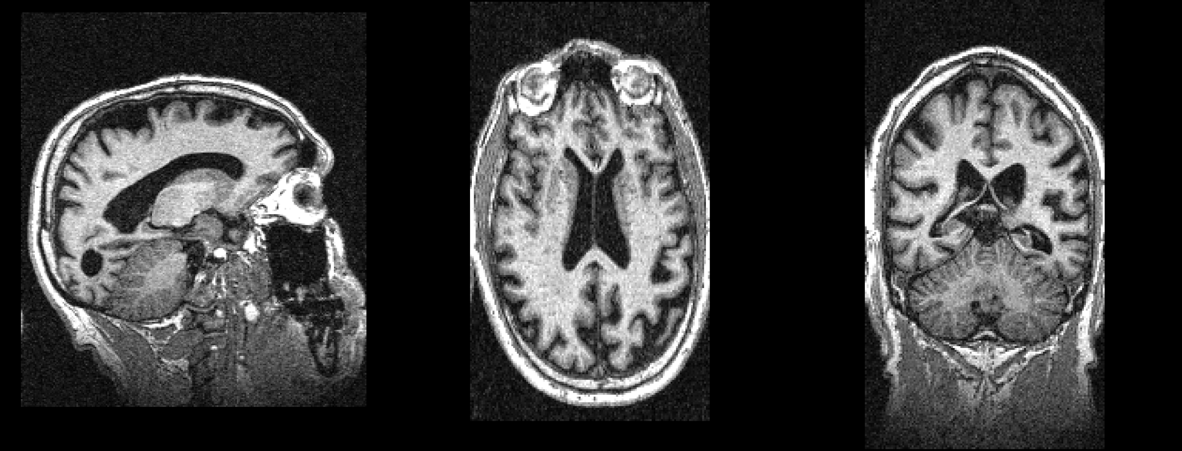
Exposing the “unseeable”
today
8 months ago

Slide 5
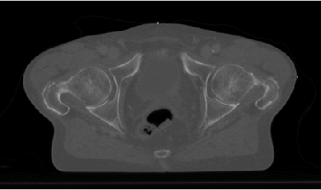
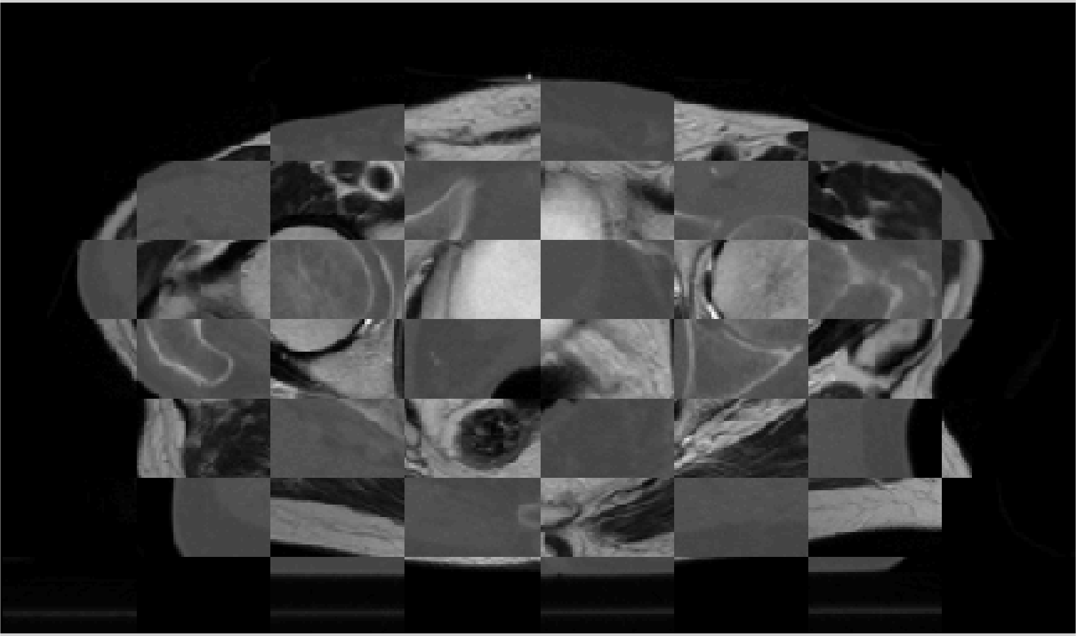
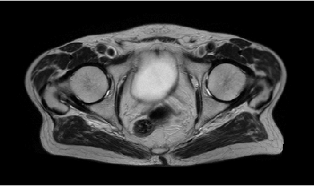
Exposing the “unseeable”
CT
today
mosaic CT/MRI
MRI
8 months ago

Slide 6
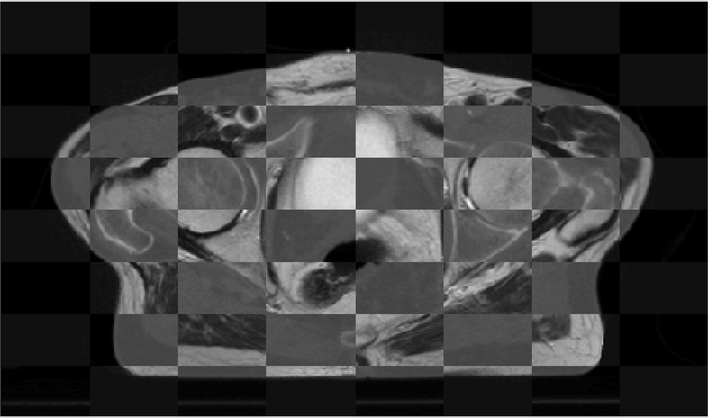
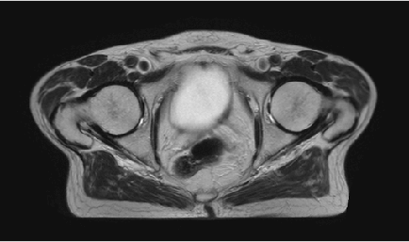
Exposing the “unseeable”
CT
today
mosaic CT/MRI
MRI
8 months ago

Slide 7
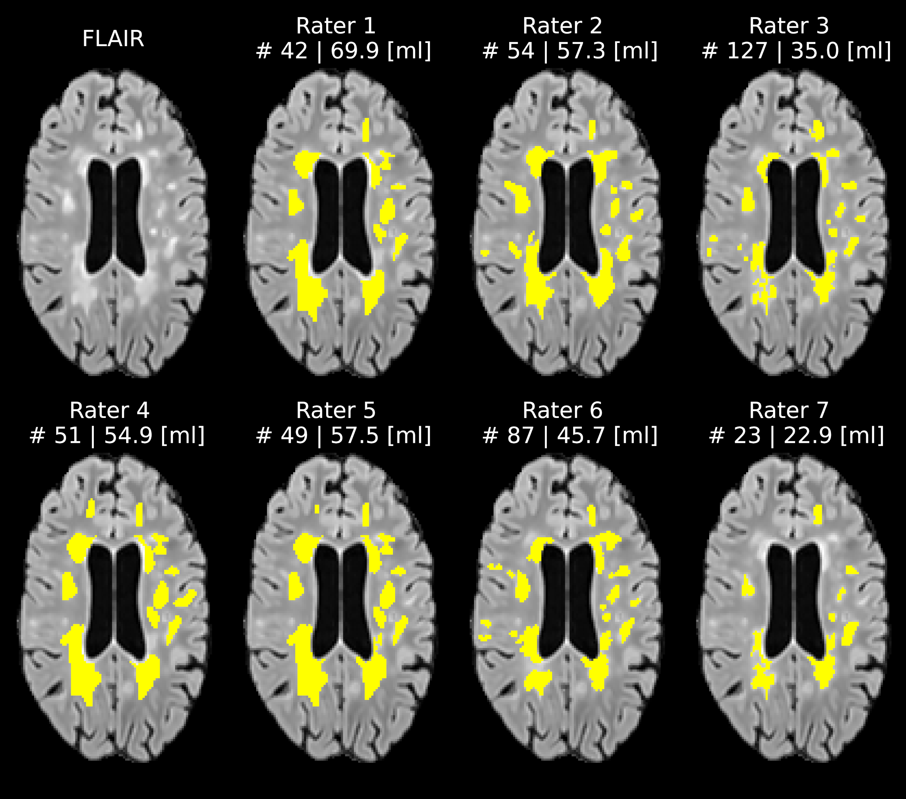
Measuring more consistently
Quantifying lesions in multiple sclerosis (MS):
- number (#)
- volume (ml)

Slide 8
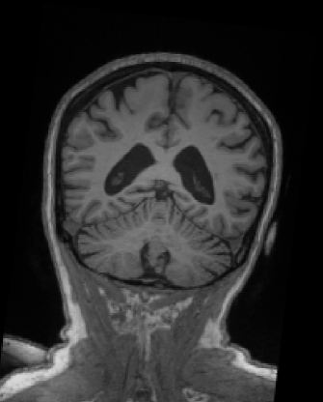
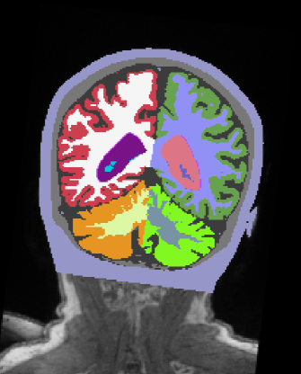
Analyzing images faster
MRI
segmentation

Slide 9
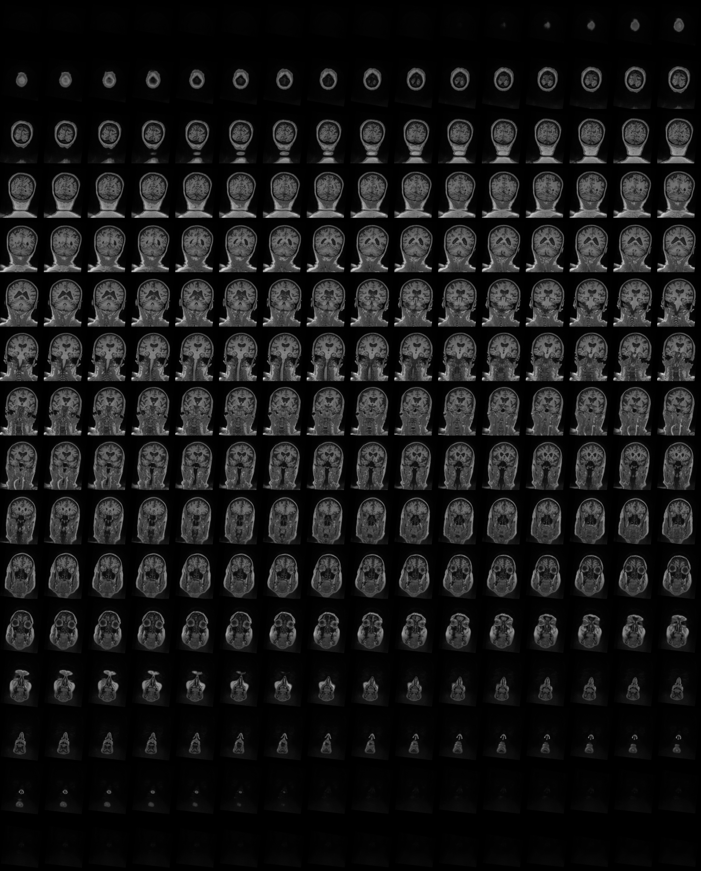
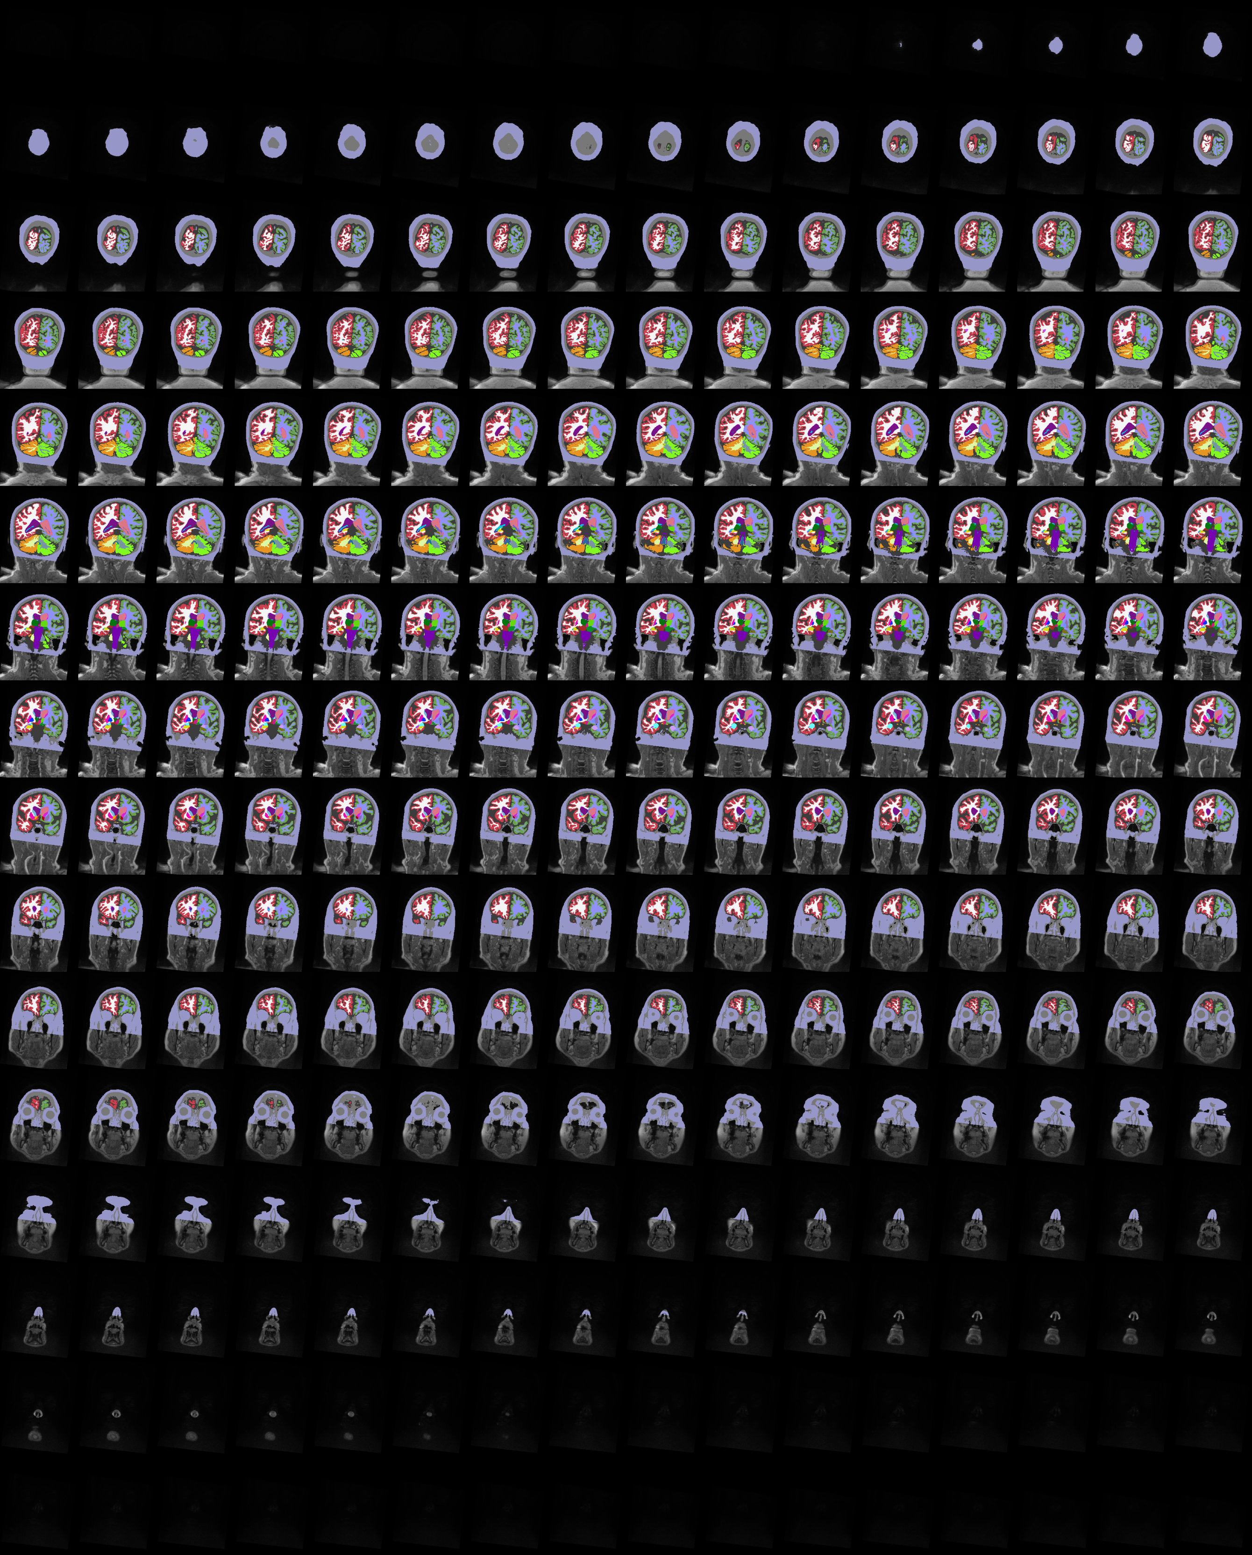
MRI
segmentation

Slide 10
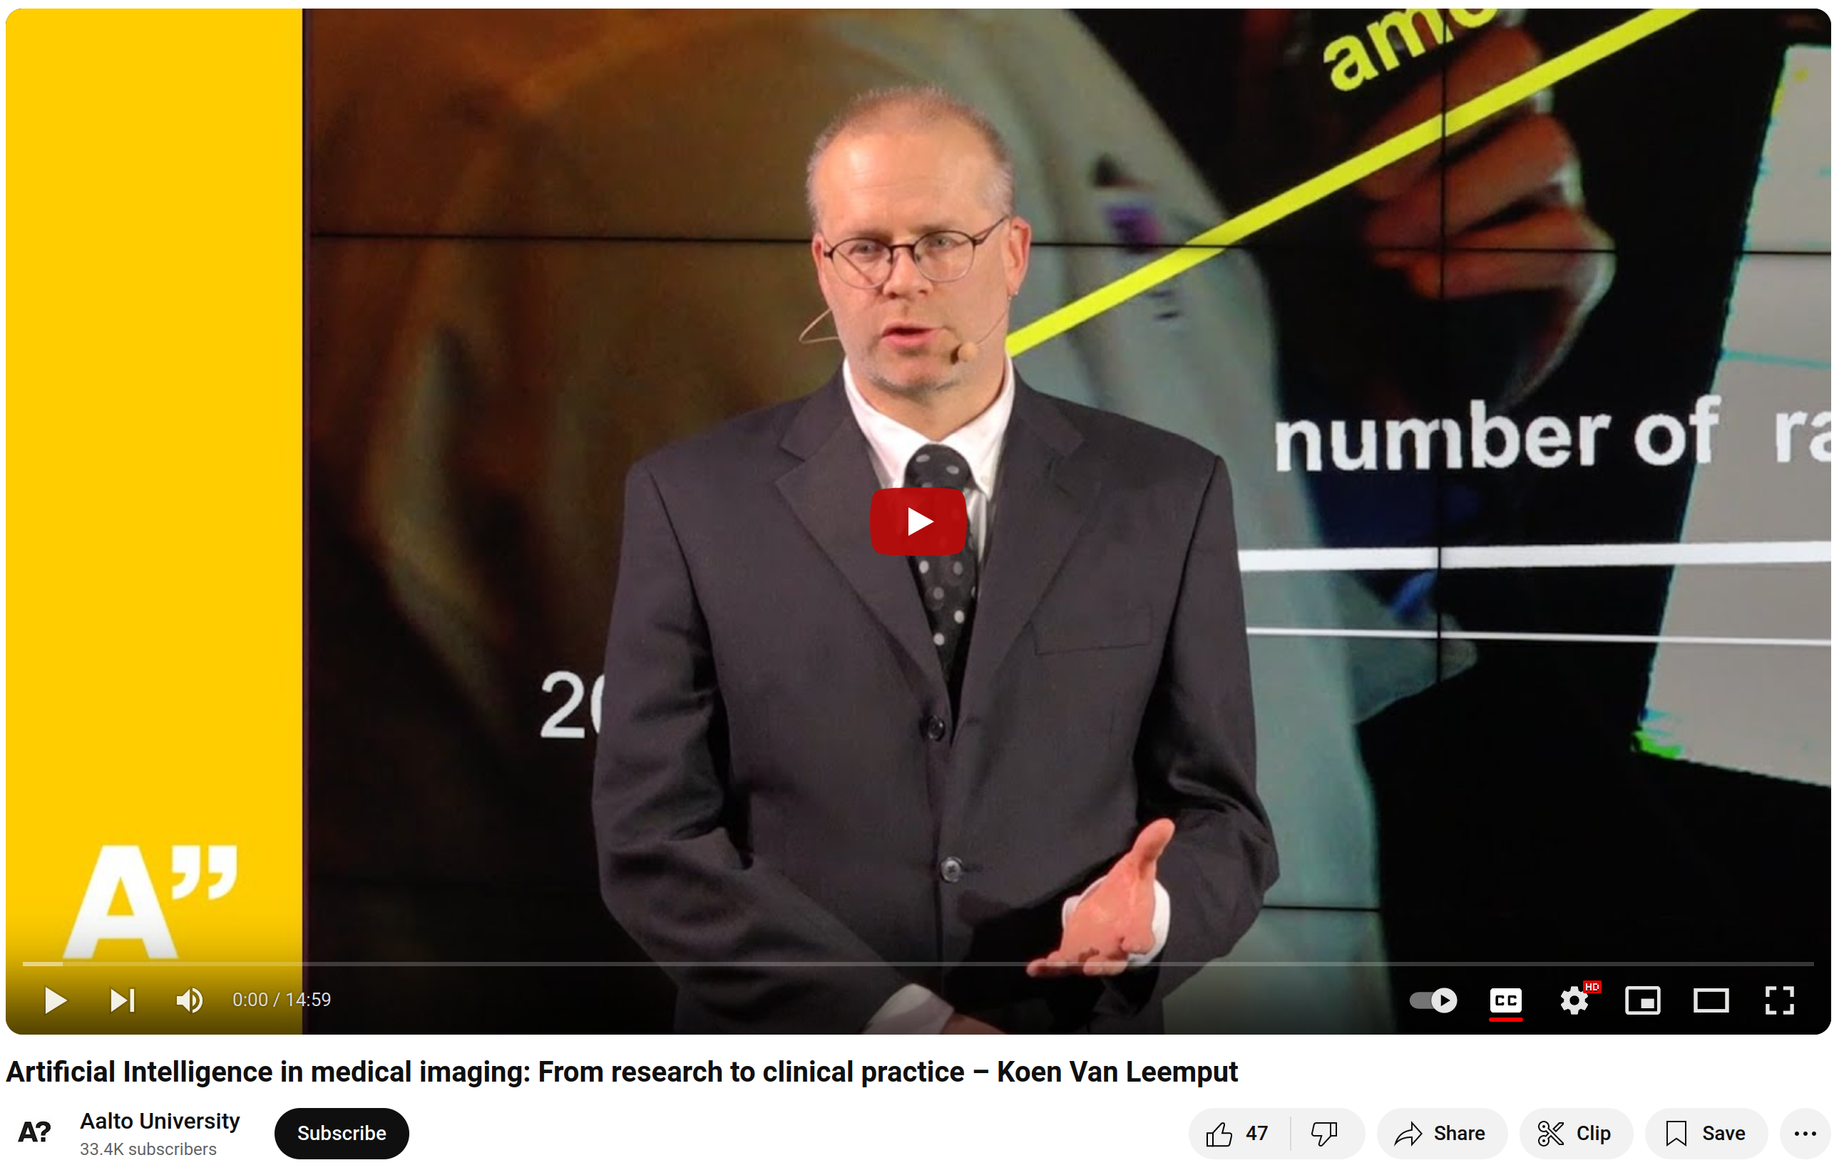
Want to know more?
https://youtu.be/iiw4j-Frljo

Slide 11
Learning objectives
After this course you should be able to:
Implement image smoothing and interpolation techniques
Use spatial coordinate systems in medical images
Perform landmark-based and intensity-based image registration
Select the most appropriate similarity measure for specific image registration problems
Implement rigid, affine and nonlinear spatial transformation models
Solve segmentation problems using generative models
Perform image segmentation using discriminative methods (neural nets)
Weigh the advantages and limitations of generative vs. discriminative techniques in medical image analysis
A “do” course

Slide 12

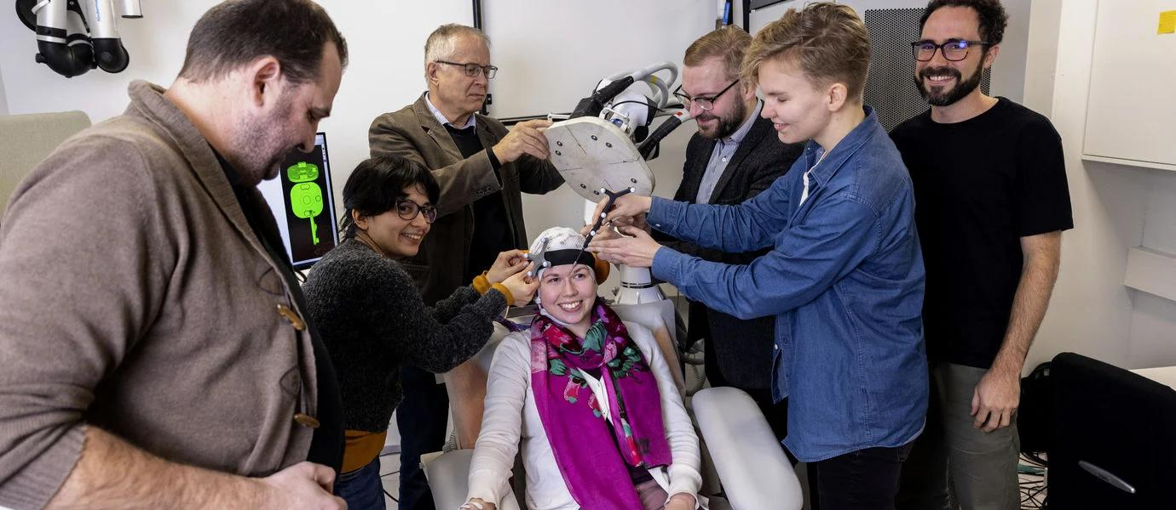
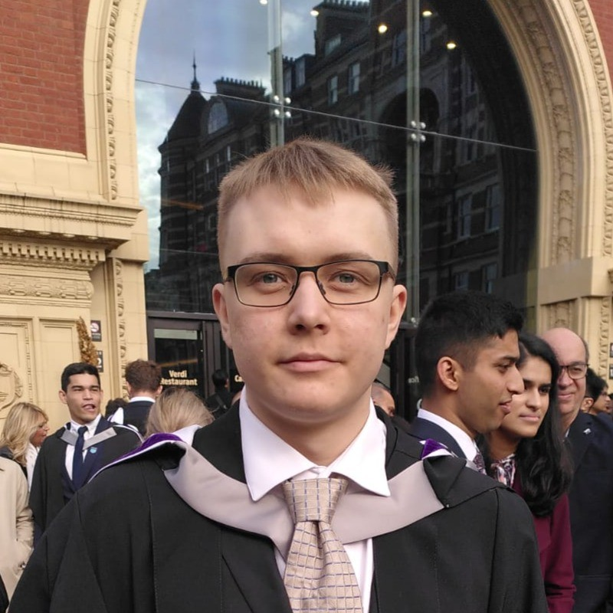
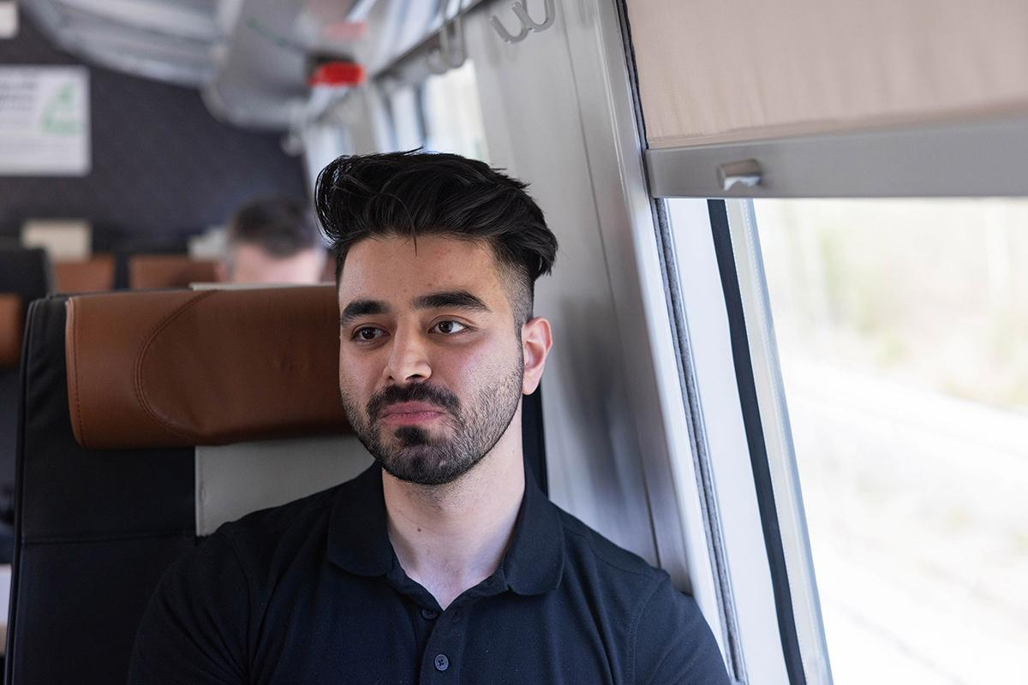
Who are we?
Koen Van Leemput, teacher (Professor, Neuroscience and Biomedical Engineering)
Ida Granö, TA (Doctoral Researcher, Neuroscience and Biomedical Engineering)
Matias Vuokko, TA (Doctoral Researcher, Neuroscience and Biomedical Engineering)
Amir Hassankhani, TA (Doctoral Researcher, Neuroscience and Biomedical Engineering)

Slide 13
Who are you?
Life Science Technologies: 21
Exchange studies: 10
Electrical Engineering: 6
Aalto Doctoral Programme in Science: 4
Science and Technology: 2
Chemical Engineering: 1
Engineering: 1
Computer, Communication and Information Sciences: 1
Chemical Technology: 1
Non-degree Studies (Arts and Culture): 1
Physical attendance:
- not “required” in lectures or exercise sessions
- but but...

Slide 14
Teaching form
Lectures:
Mondays 12.15-14.00
Lecture recordings will be made available
Two guest lectures: Aino Nieminen (Disior) and Eero Salli (HUS Radiology)
Exercises:
Thursdays 12.15-14.00
Python + Jupyter notebooks
Group-work (max. 3 students per group)
2 weeks to submit a group report (6 reports in total)
Peer grading using FeedbackFruits
Student presentations:
Students present their fellow students’ exercise reports
Instead of the lectures on 21 Oct and 25 Nov

Slide 15
Teaching form
Lectures:
Mondays 12.15-14.00
Lecture recordings will be made available
Two guest lectures: Aino Nieminen (Disior) and Eero Salli (HUS Radiology)
Exercises:
Thursdays 12.15-14.00
Python + Jupyter notebooks
Group-work (max. 3 students per group)
2 weeks to submit a group report (6 reports in total)
Peer grading using FeedbackFruits
Student presentations:
Students present their fellow students’ exercise reports
Instead of the lectures on 21 Oct and 25 Nov
Course grading:
- peer grading quality (10%)
- teachers’ final score on reports (80%)
- student presentation (10%)

Slide 16
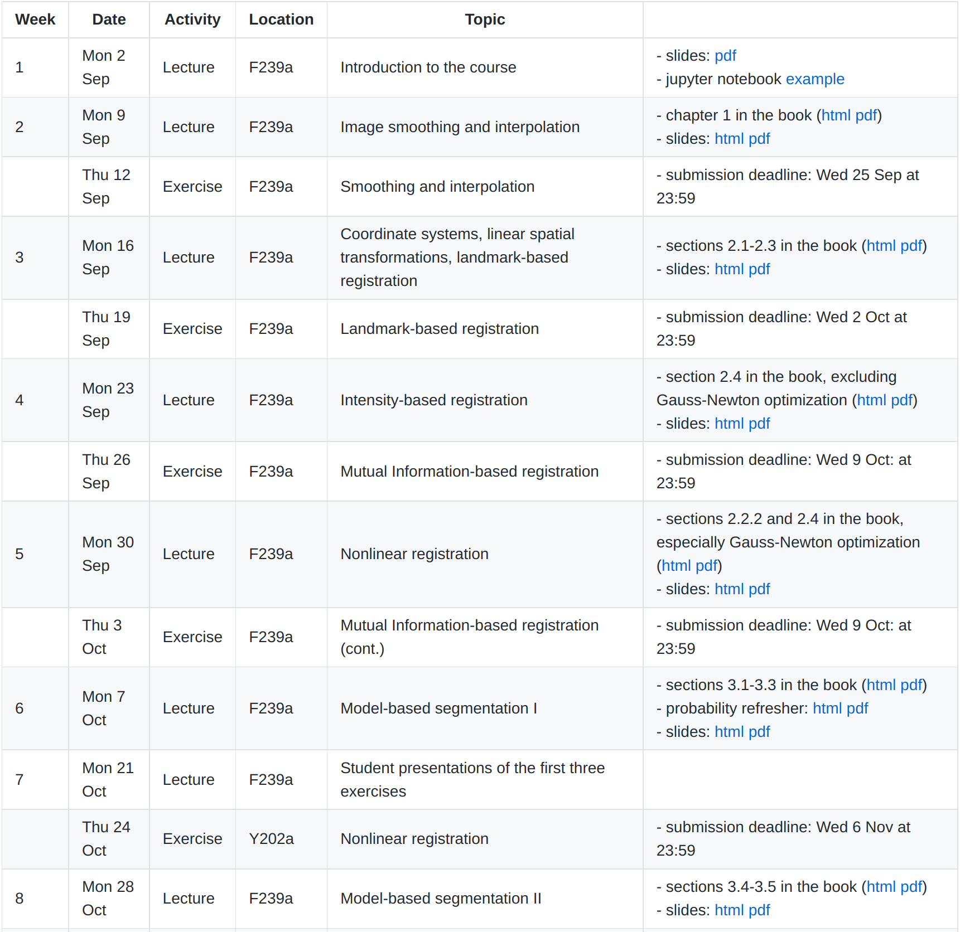
Logistics
https://leempko.github.io/mia/
Course material (book, slides)
Schedule
https://mycourses.aalto.fi/
Announcements
Discussion fora
Exercises (input data, report submissions, peer grading)

Slide 17
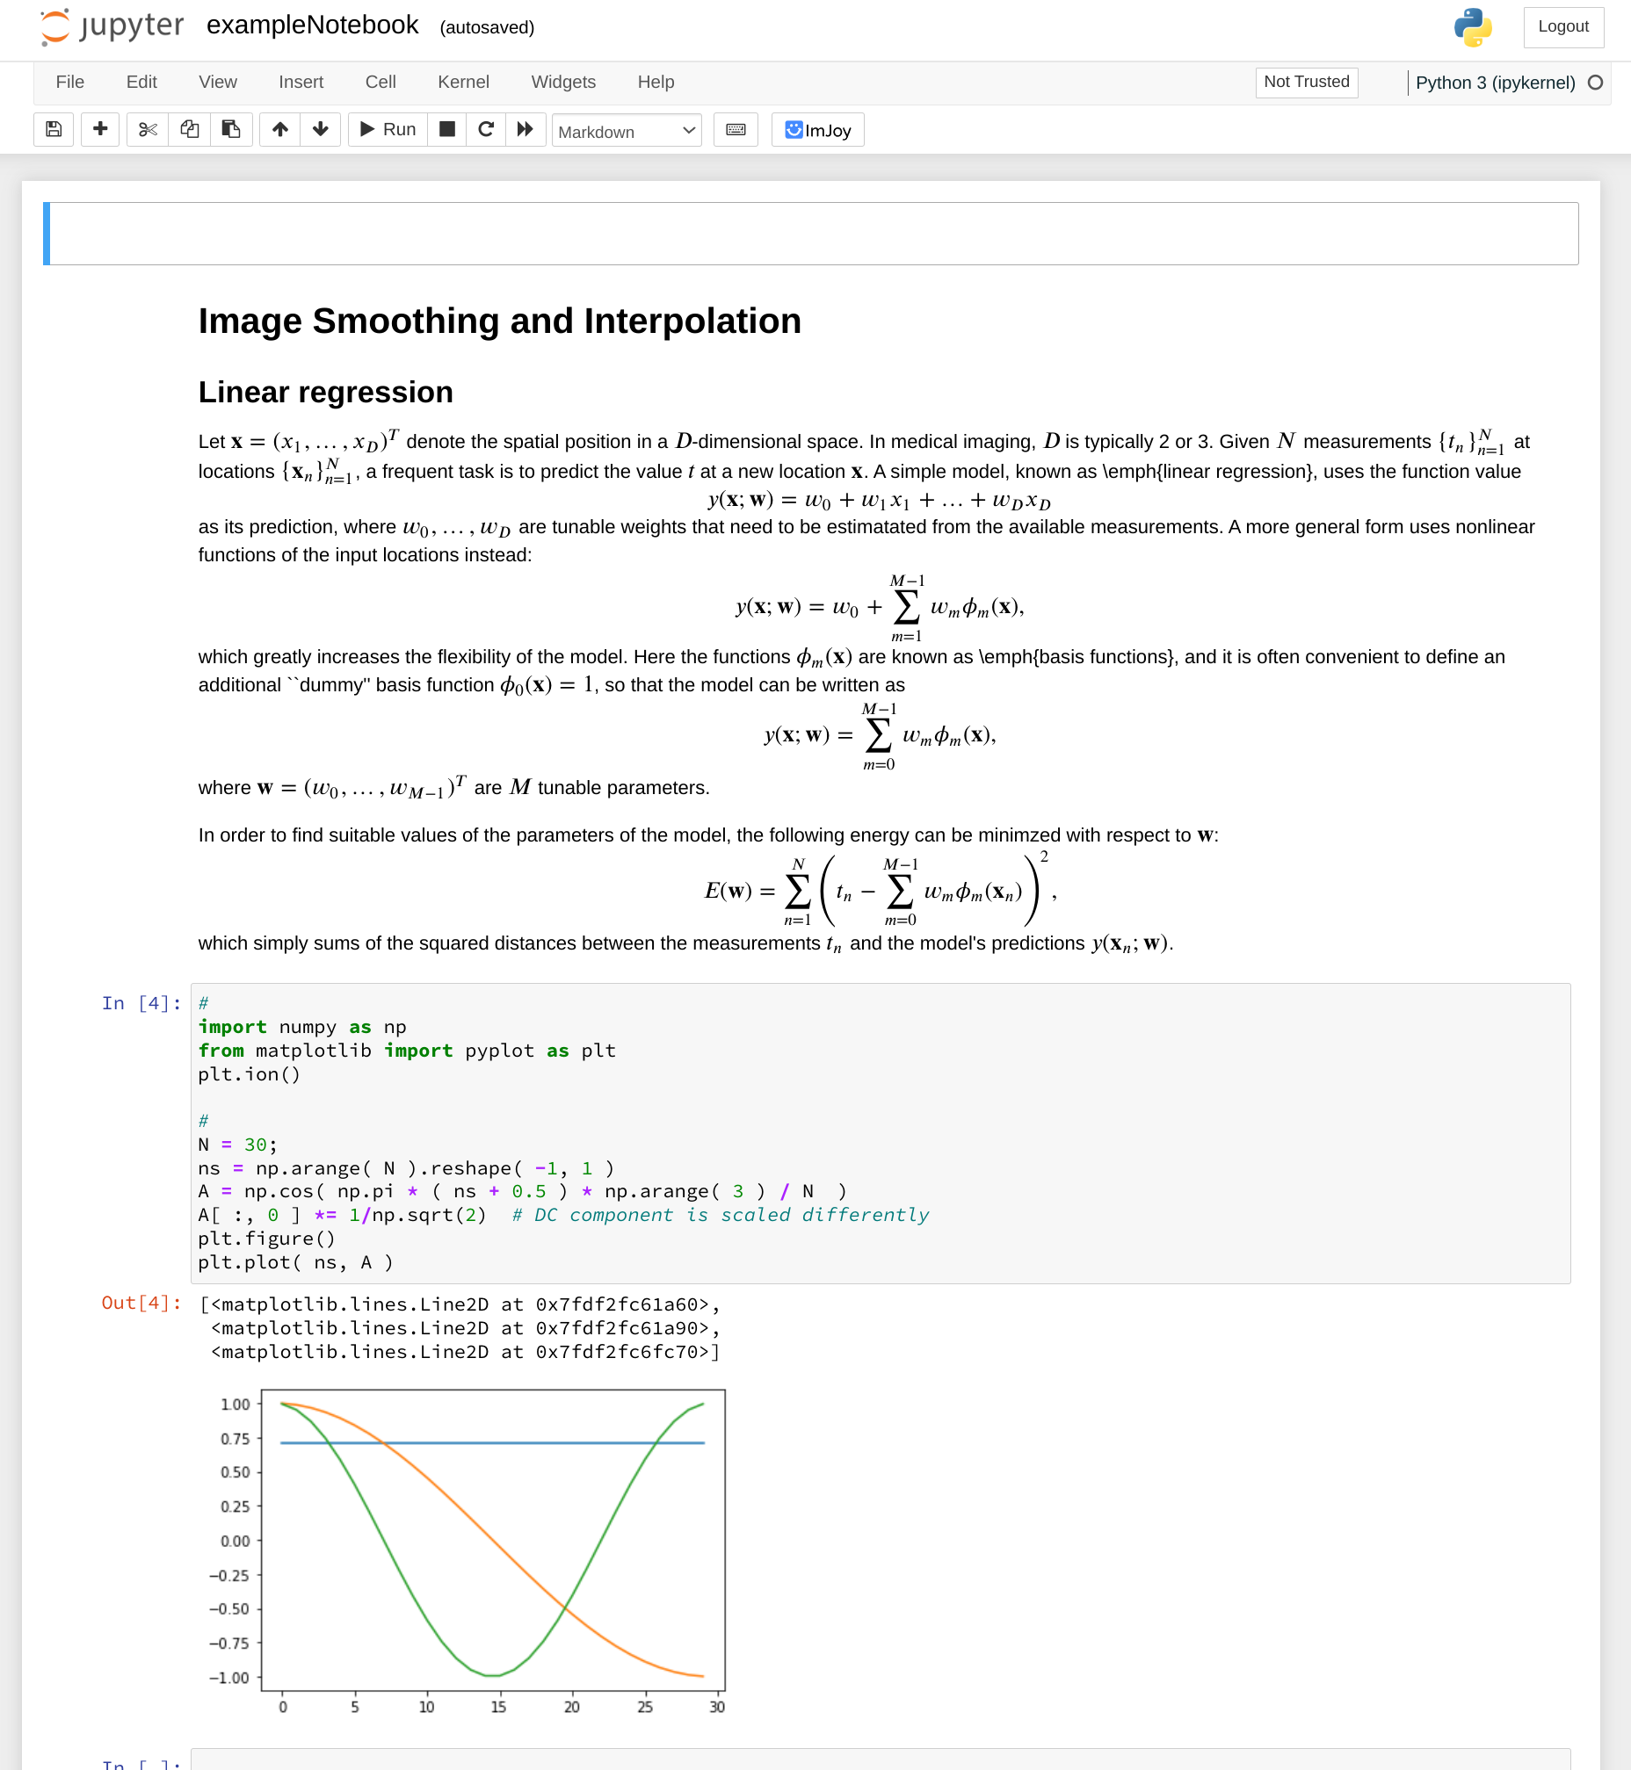
Python and
Jupyter Notebooks
Python: https://lectures.scientific-python.org/
Jupyiter Notebooks:
https://www.dataquest.io/blog/jupyter-notebook-tutorial/

Slide 18
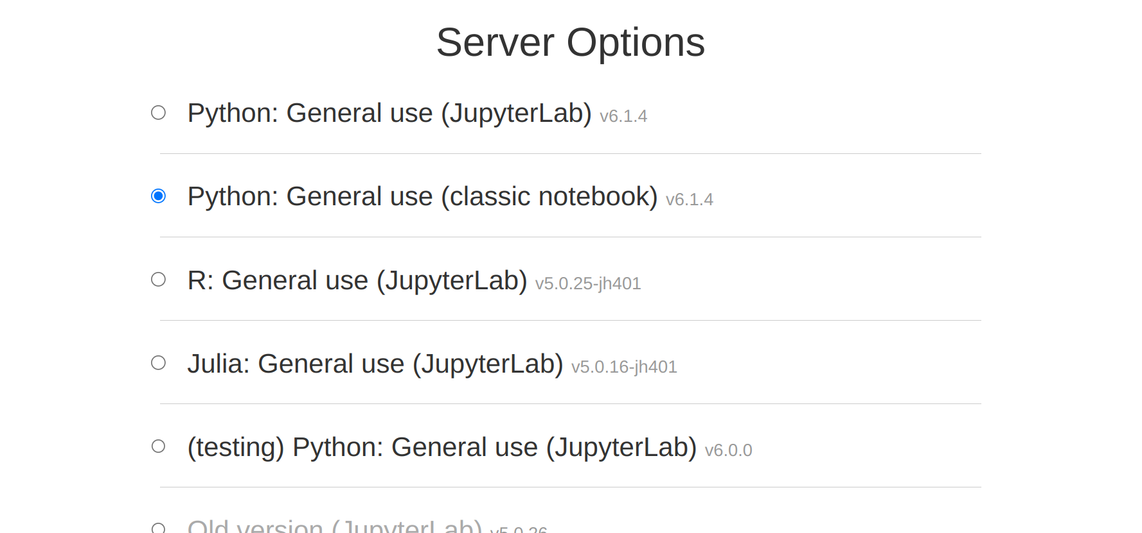
Jupyter notebooks at Aalto
https://jupyter.cs.aalto.fi/

Slide 19
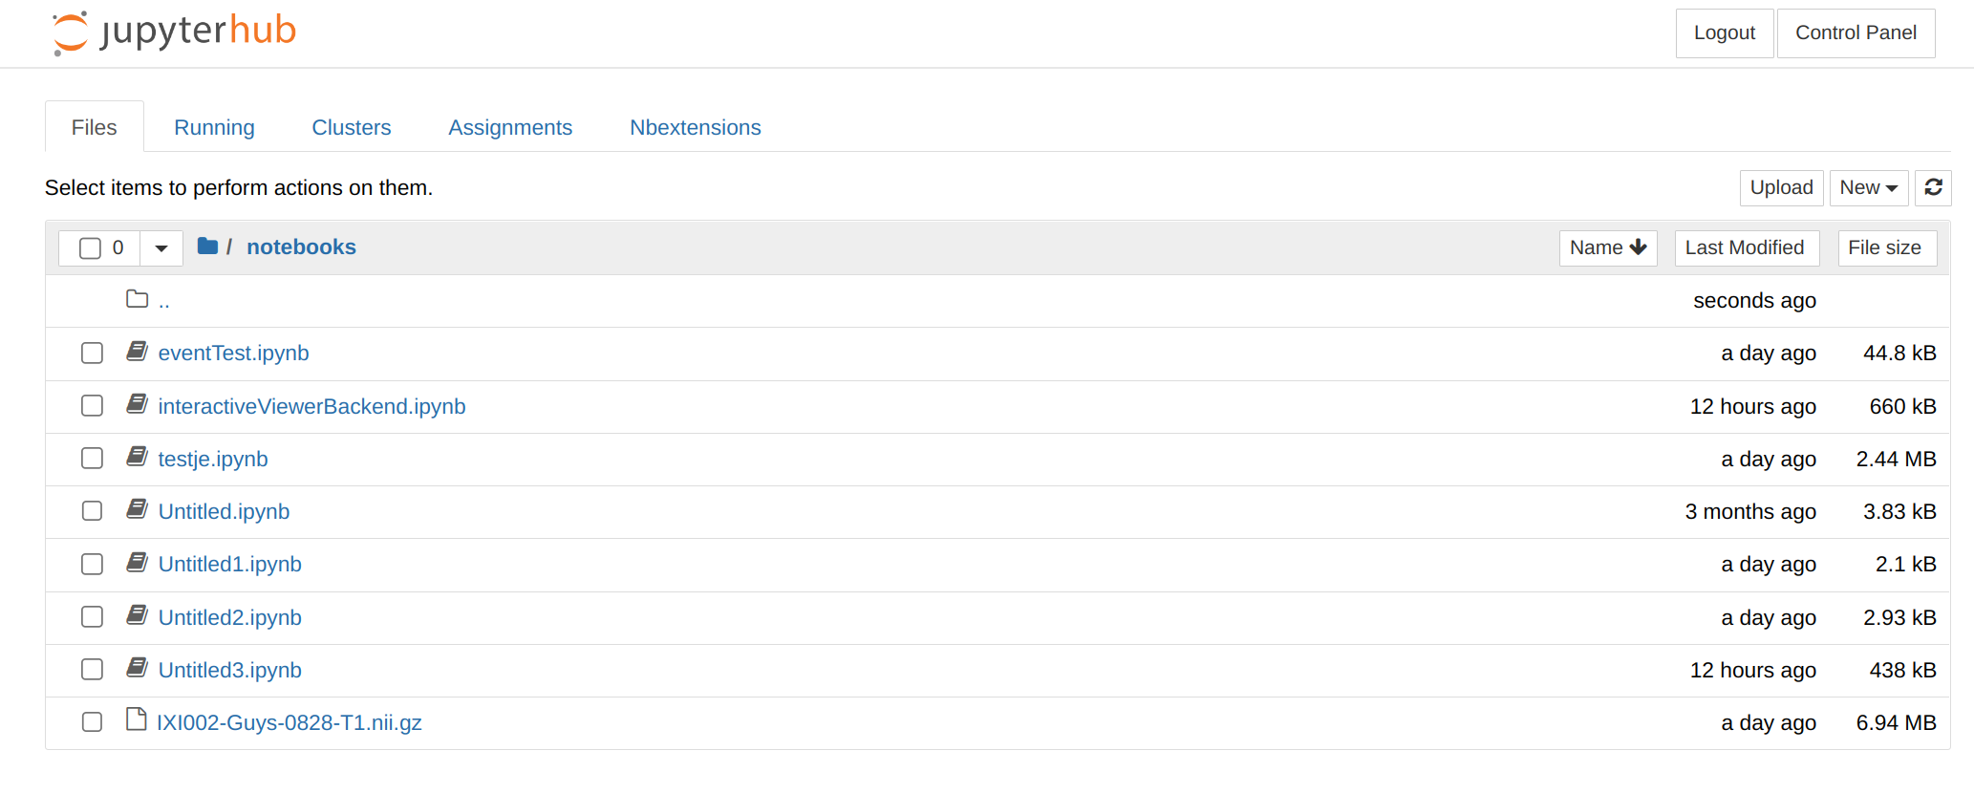
Jupyter notebooks at Aalto
https://jupyter.cs.aalto.fi/

Slide 20
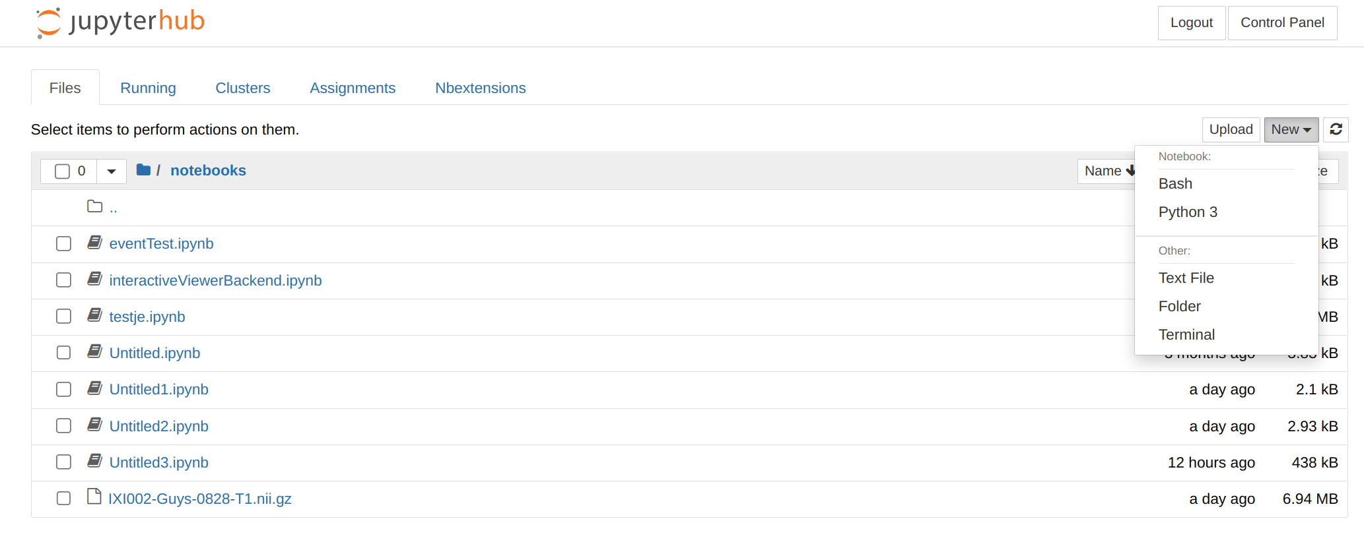
Jupyter notebooks at Aalto
https://jupyter.cs.aalto.fi/
Text

Slide 21
Copyrights
"Accurate and robust whole-head segmentation from magnetic resonance images for individualized head modeling“ by Puonti et al. NeuroImage (2020), licensed under CC-BY-NC-ND

