Slide 1
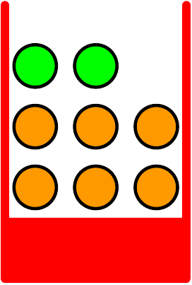
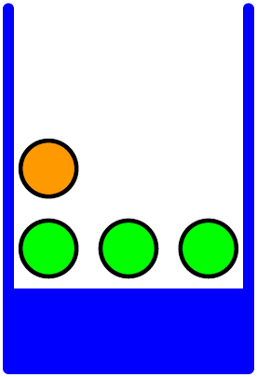


Apples and oranges
  Randomly choose one box, and then randomly pick a piece of fruit from that box

Slide 2
Apples and oranges
  Randomly choose one box, and then randomly pick a piece of fruit from that box
probability we
choose red Box

Slide 3
Apples and oranges
  Randomly choose one box, and then randomly pick a piece of fruit from that box
probability we
choose blue Box

Slide 4
Apples and oranges
  Randomly choose one box, and then randomly pick a piece of fruit from that box
“apples”

Slide 5
Apples and oranges
  Randomly choose one box, and then randomly pick a piece of fruit from that box
“oranges”

Slide 6
Apples and oranges
  Randomly choose one box, and then randomly pick a piece of fruit from that box
  (1) What is the probability we get an apple?
  (2) If the fruit we end up with is an orange, what is the probability we had chosen the red box?

Slide 7






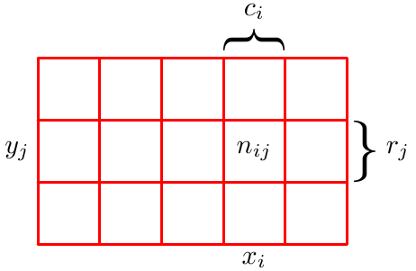
The two rules of probability
  Two random variables:
    takes values where
    takes values where
  Observe outcomes of samples, with

Slide 8


The two rules of probability
  Two random variables:
    takes values where
    takes values where
  Observe outcomes of samples, with
number of samples
in which
and

Slide 9
The two rules of probability
  Two random variables:
    takes values where
    takes values where
  Observe outcomes of samples, with
number of samples
in which

Slide 10
The two rules of probability
  Two random variables:
    takes values where
    takes values where
  Observe outcomes of samples, with
number of samples
in which

Slide 11

The two rules of probability
  Two random variables:
    takes values where
    takes values where
  Observe outcomes of samples, with
“joint probability”

Slide 12

The two rules of probability
  Two random variables:
    takes values where
    takes values where
  Observe outcomes of samples, with
“marginal probability”

Slide 13


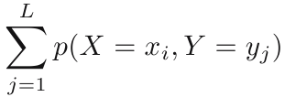
The two rules of probability
  Two random variables:
    takes values where
    takes values where
  Observe outcomes of samples, with
“marginal probability”

Slide 14
The two rules of probability
  Two random variables:
    takes values where
    takes values where
  Observe outcomes of samples, with
“marginal probability”
“sum rule”

Slide 15

The two rules of probability
  Two random variables:
    takes values where
    takes values where
  Observe outcomes of samples, with
“conditional probability”

Slide 16
The two rules of probability
  Two random variables:
    takes values where
    takes values where
  Observe outcomes of samples, with
“joint probability”

Slide 17

The two rules of probability
  Two random variables:
    takes values where
    takes values where
  Observe outcomes of samples, with
“joint probability”

Slide 18
The two rules of probability
  Two random variables:
    takes values where
    takes values where
  Observe outcomes of samples, with
“joint probability”
“product
rule”

Slide 19
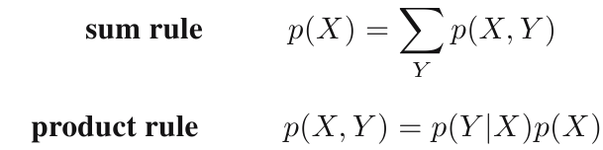

The two rules of probability
  Direct result of product rule: “Bayes' rule”

Slide 20
Apples and oranges
  (1) What is the probability we get an apple?

Slide 21

Apples and oranges
  (1) What is the probability we get an apple?

Slide 22
Apples and oranges
  (2) If the fruit we end up with is an orange, what is the probability we had chosen the red box?

Slide 23


Apples and oranges
  (2) If the fruit we end up with is an orange, what is the probability we had chosen the red box?

Slide 24




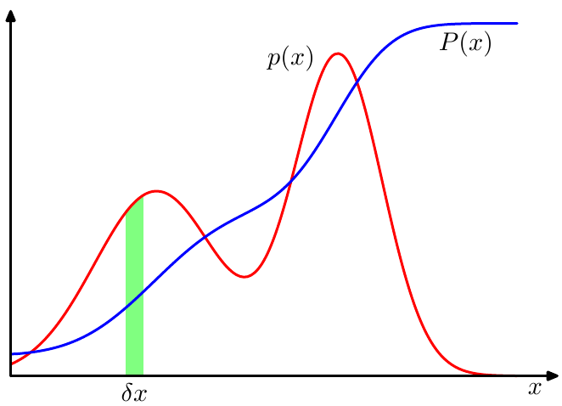
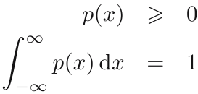
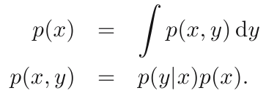
Continuous variables
  is called the probability density over
  if the probability that falls in the interval
  is given by for
sum rule:
product rule:

Slide 25

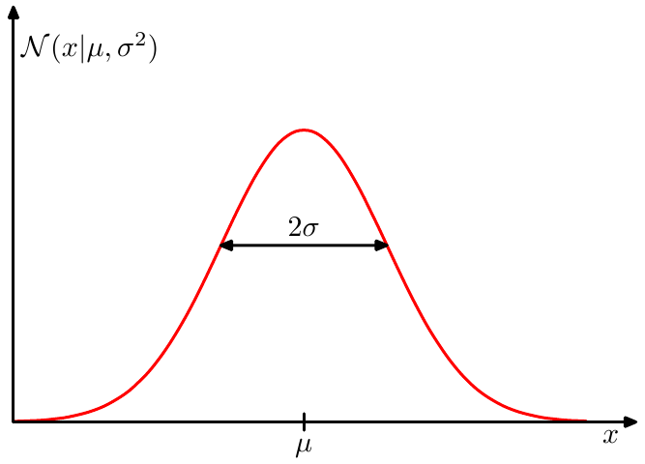

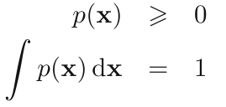
Continuous variables
  Example: Gaussian distribution
  Multivariate probability density:

