Slide 1
Generative models for segmentation II
Course 22525
Koen Van Leemput
DTU HealthTech
Technical University of Denmark

Slide 2
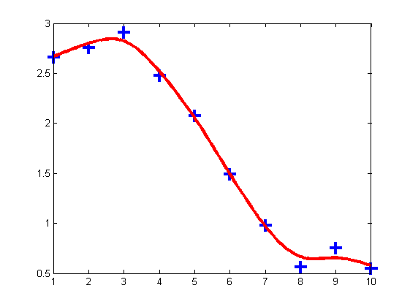
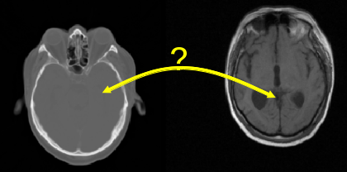
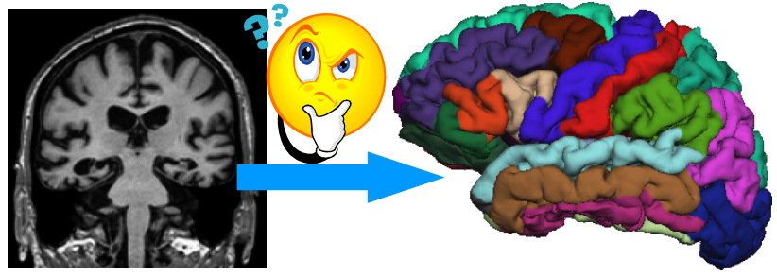
Course structure
Fitting functions
Registration
Segmentation

Slide 3
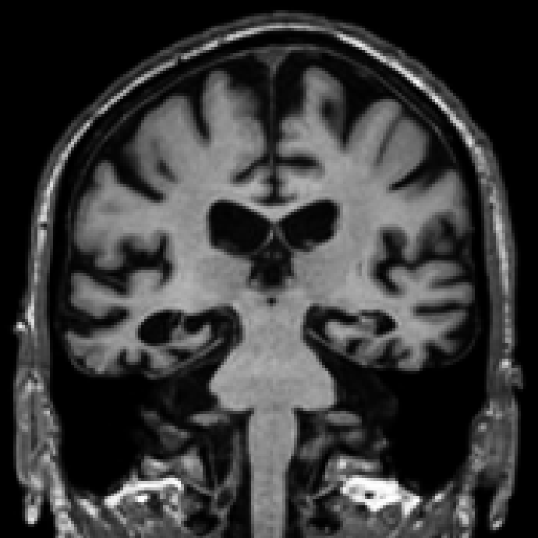











The problem to be solved
MRI image
Label image
voxels
: intensity in voxel
: number of classes

Slide 4



One solution: generative modeling
  Formulate a statistical model of image formation
“labeling model”
“imaging model”
Label image
MRI image
  The model depends on some parameters

Slide 5
Segmentation = inverse problem
MRI image
Label image

Slide 6


Segmentation = inverse problem
MRI image
Label image
Bayesian inference
  Play with the mathematical rules of probability

Slide 7




Gaussian mixture model
“labeling model”
“imaging model”
Label image
MRI image
  Assign a label to each voxel independently
  Probability of assigning label is

Slide 8





Gaussian mixture model
“labeling model”
“imaging model”
Label image
MRI image
  Drawn the intensity in each voxel with label from a Gaussian distribution with mean and variance

Slide 9
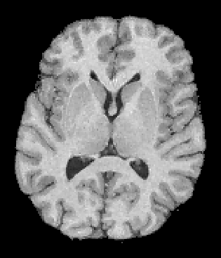
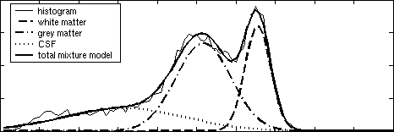

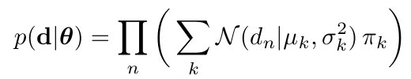
Gaussian mixture model
labels

Slide 10
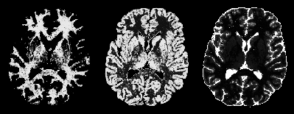


Gaussian mixture model
  Apply Bayes’ rule:

Slide 11
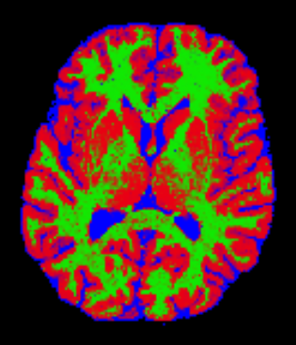

Gaussian mixture model
white matter
CSF
gray matter

Slide 12
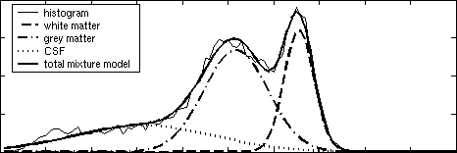
Today's lecture
How to obtain ?

Slide 13
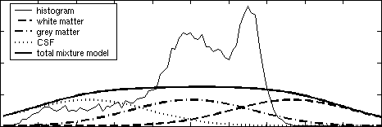
Today's lecture
How to obtain ?

Slide 14

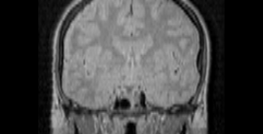
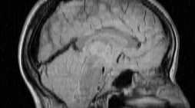
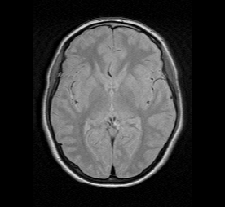
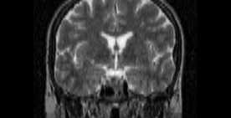
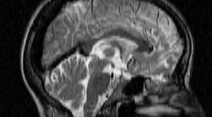
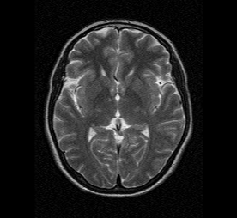
How to obtain model parameters?
  Click manually on some representative points for each label
  “Train once, apply forever”
  Doesn't work well in MRI:
    different imaging protocols
    different scanner platforms (make, version)
    software/hardware upgrades
    ….

Slide 15
How to obtain model parameters?
  Click manually on some representative points for each label
  “Train once, apply forever”
  Doesn't work well in MRI:
    different imaging protocols
    different scanner platforms (make, version)
    software/hardware upgrades
    ….
Estimate the model parameters automatically from each individual scan

Slide 16





Parameter optimization
  Estimate the maximum likelihood parameters:

Slide 17
Parameter optimization
  Estimate the maximum likelihood parameters:
1. Is this valid - e.g., could I use sine() instead of log()?
2.Benefit? Hint: compute (0.01)^1000 in Matlab/Python

Slide 18
Parameter optimization
  Expectation Maximization (EM) algorithm:
  Repeatedly maximize a lower bound to the objective function

Slide 19

Parameter optimization
  Expectation Maximization (EM) algorithm:
  Repeatedly maximize a lower bound to the objective function
(current estimate)

Slide 20
Parameter optimization
  Expectation Maximization (EM) algorithm:
  Repeatedly maximize a lower bound to the objective function
(current estimate)

Slide 21
Parameter optimization
  Expectation Maximization (EM) algorithm:
  Repeatedly maximize a lower bound to the objective function
(current estimate)

Slide 22
Parameter optimization
  Expectation Maximization (EM) algorithm:
  Repeatedly maximize a lower bound to the objective function
(current estimate)

Slide 23
Parameter optimization
  Expectation Maximization (EM) algorithm:
  Repeatedly maximize a lower bound to the objective function
(current estimate)

Slide 24
Parameter optimization
  Expectation Maximization (EM) algorithm:
  Repeatedly maximize a lower bound to the objective function
(current estimate)

Slide 25
Parameter optimization
  Expectation Maximization (EM) algorithm:
  Repeatedly maximize a lower bound to the objective function
(current estimate)

Slide 26
Parameter optimization
  Expectation Maximization (EM) algorithm:
  Repeatedly maximize a lower bound to the objective function
  Guaranteed to never move in a wrong direction!
(current estimate)

Slide 27
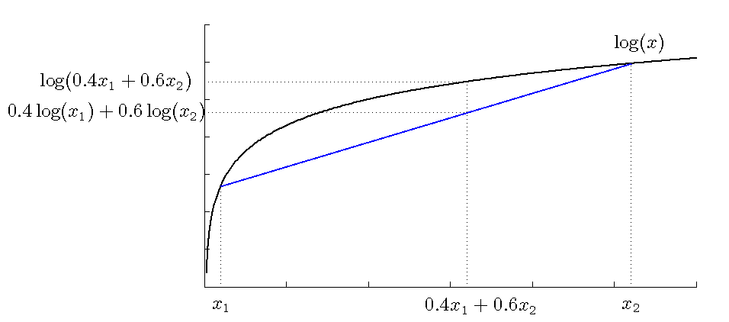


Constructing the lower bound
  Extends easily to more than two variables (Jensen’s inequality):

Slide 28
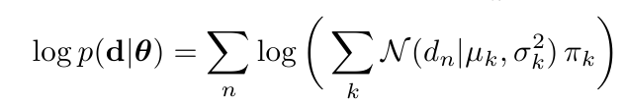
Constructing the lower bound
current estimate

Slide 29
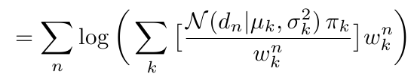
Constructing the lower bound
current estimate

Slide 30


Constructing the lower bound
current estimate

Slide 31
Constructing the lower bound
current estimate

Slide 32
Constructing the lower bound
current estimate

Slide 33

Constructing the lower bound
  The lower bound touches the objective function at the current parameter estimate if
current estimate

Slide 34
Constructing the lower bound
  The lower bound touches the objective function at the current parameter estimate if
current estimate

Slide 35
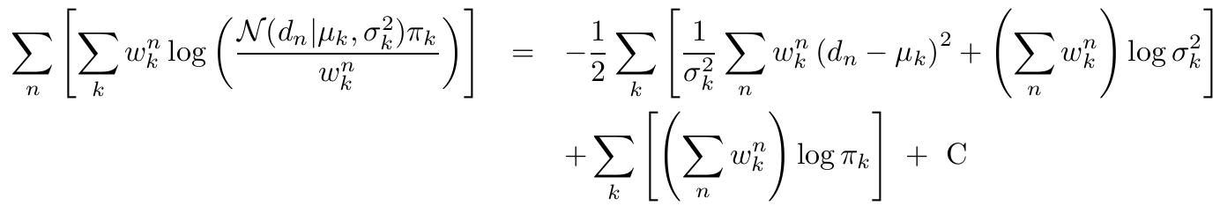
Maximizing the lower bound
  Lower bound:
new estimate
?

Slide 36



Maximizing the lower bound
  Lower bound:
1. What is ?
2. What is ?
3. What is ?
new estimate
?

Slide 37

Maximizing the lower bound
  Lower bound:
new estimate
?

Slide 38

Maximizing the lower bound
  Lower bound:
new estimate
?

Slide 39
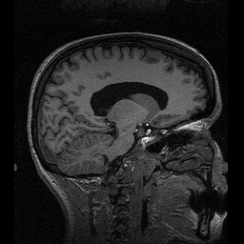
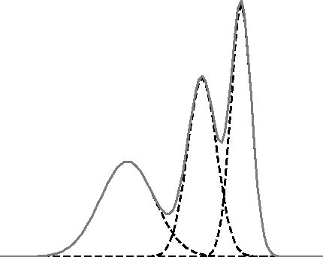
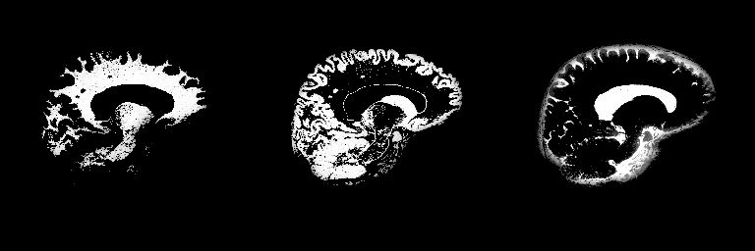
Parameter optimizer summarized
MRI data
Classify the image voxels according to the current parameter estimate
(“E-step”)
classification

Slide 40
Parameter optimizer summarized
Update the parameter estimate based on the current classification
(“M-step”)

Slide 41
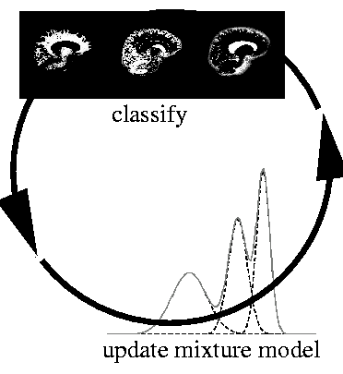
Parameter optimizer summarized
  Repeatedly apply closed-form parameter updates
  Each iteration improves the log likelihood

Slide 42
Example
initialization
initialization

Slide 43
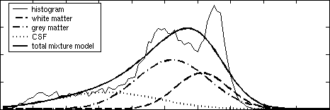
Example
after one iteration

Slide 44
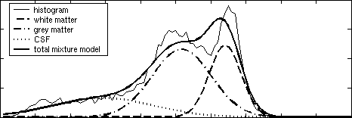
Example
after 10 iterations

Slide 45
Example
after 30 iterations

Slide 46
Example
white matter
CSF
gray matter

Slide 47
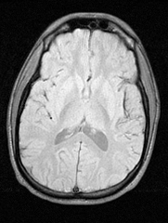
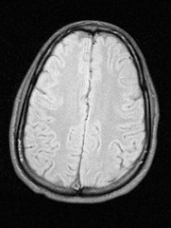
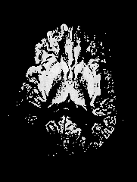
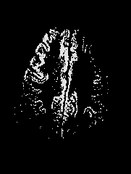
MRI “bias field” artifact
  Imaging artifact in MRI
  Smooth intensity variations across the image area
MRI data
after intensity windowing…

Slide 48
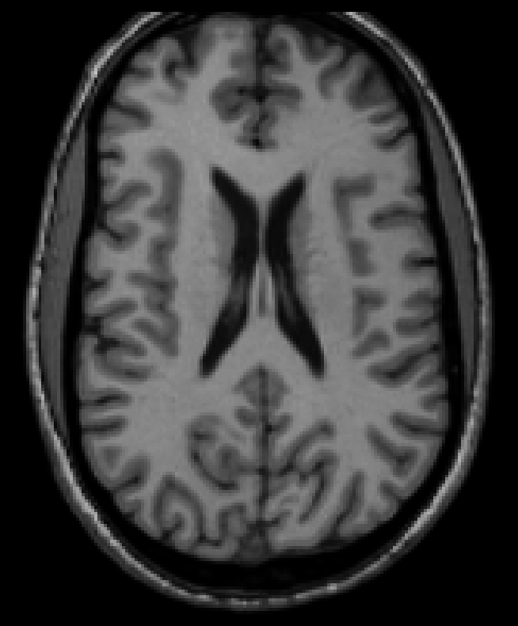
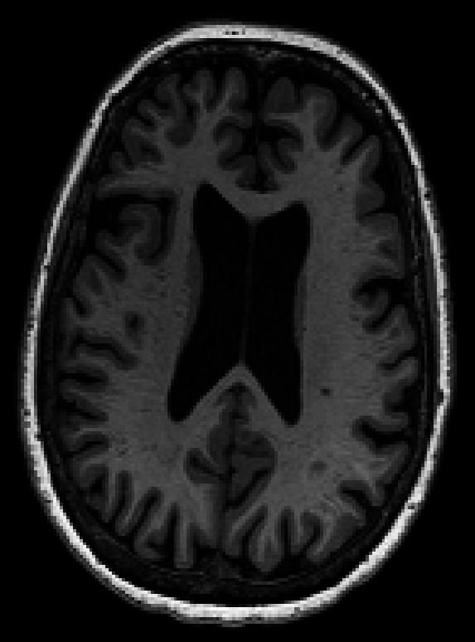
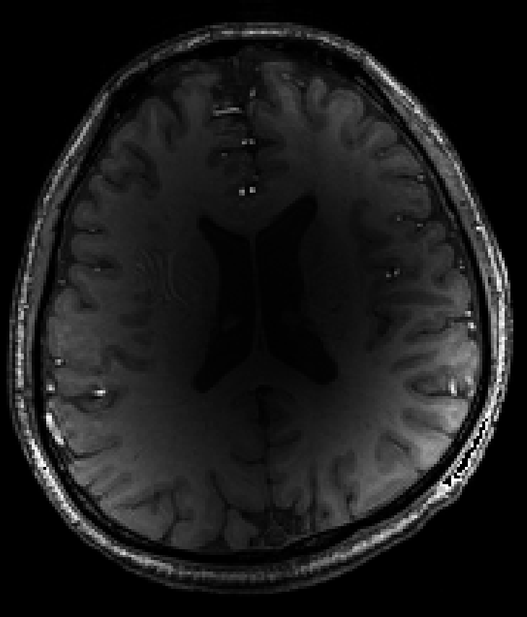
MRI “bias field” artifact
  Depends on the object being scanned
  Is much worse on the newest generation scanners
1.5 Tesla scanner
3 Tesla scanner
7 Tesla scanner

Slide 49
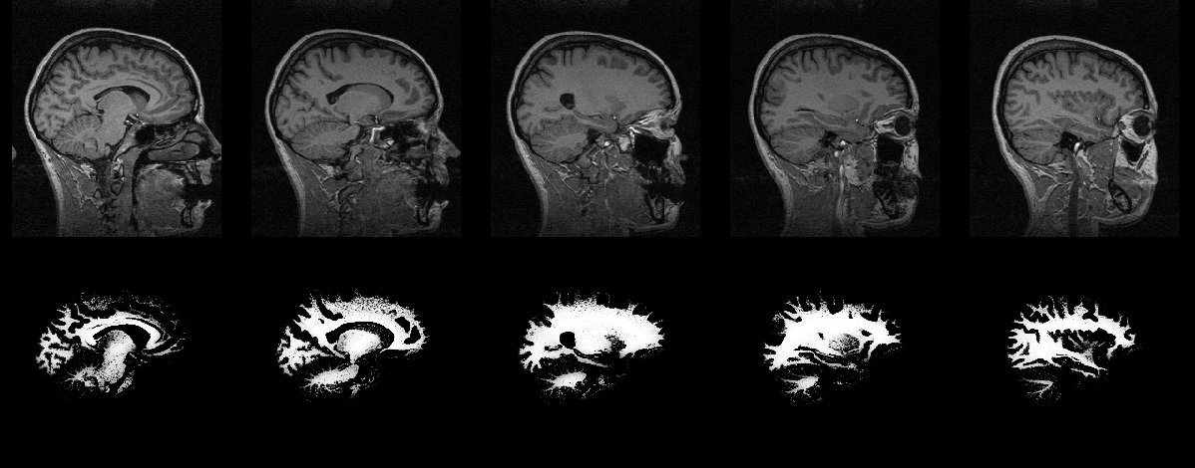
MRI “bias field” artifact
Causes segmentation errors with our segmentation procedure so far…

Slide 50
MRI “bias field” artifact
Causes segmentation errors with our segmentation procedure so far…

Slide 51
Generative model
“labeling model”
“labeling model”
“imaging model”
“imaging model”
Label image
Label image
MRI image
MRI image

Slide 52
Improved imaging model
“labeling model”
“labeling model”
“imaging model”
“imaging model”
Label image
Label image
MRI image
MRI image

Slide 53
Improved imaging model
“labeling model”
“labeling model”
“imaging model”
“imaging model”
Label image
Label image
MRI image
MRI image
old model

Slide 54

Improved imaging model
“labeling model”
“imaging model”
Label image
MRI image
+
parametric bias field model
old model

Slide 55

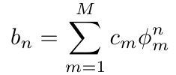



Bias field model
  Linear combination of smooth basis functions
: value of the mth basis function in voxel
: parameters of the bias field model

Slide 56
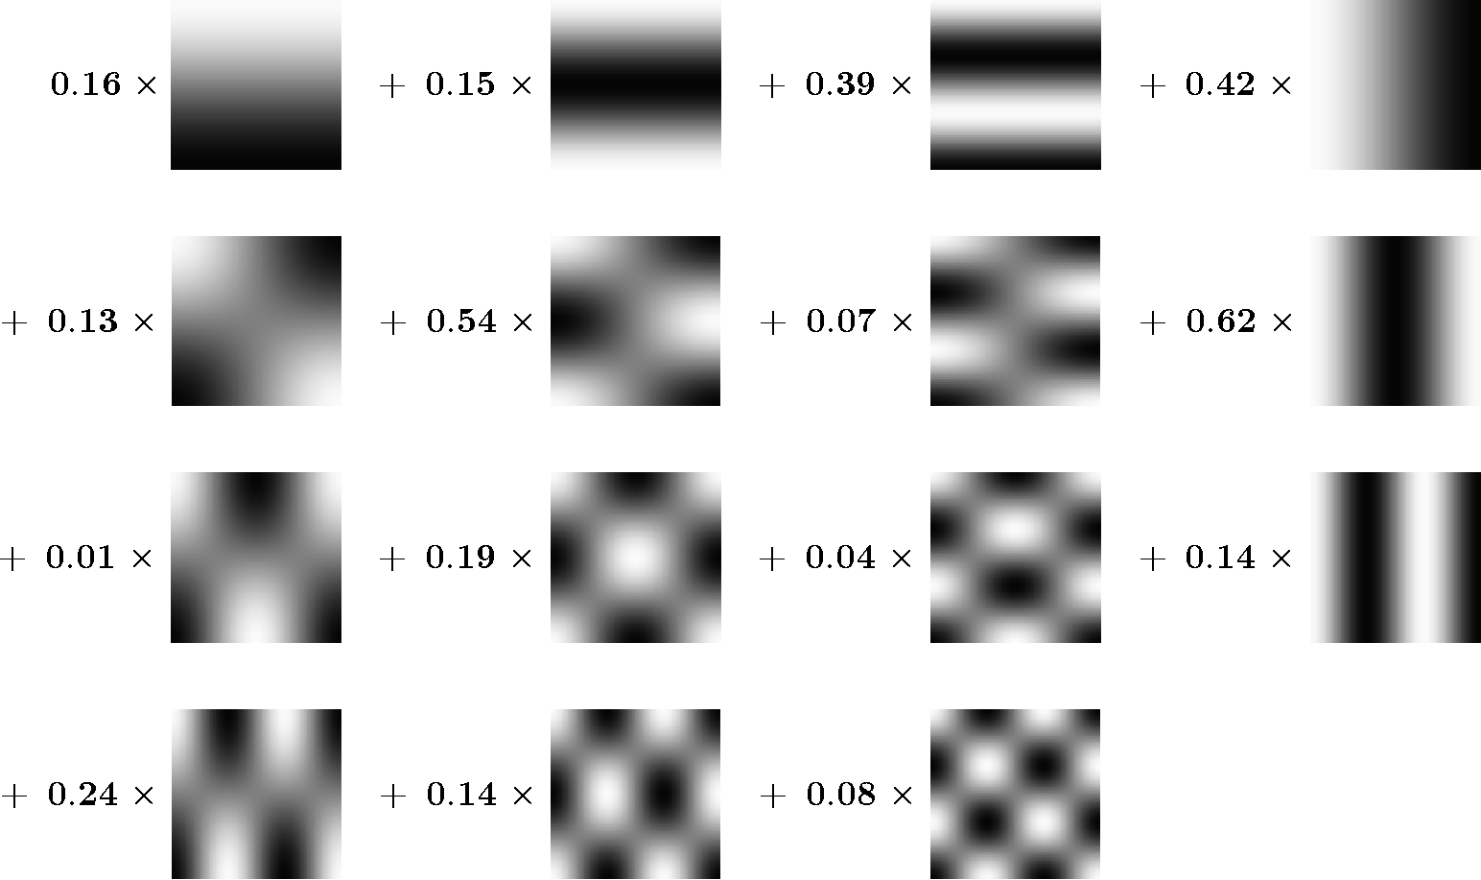

Bias field model
=

Slide 57
Parameter optimization
  Bias field parameters are part of the model parameters
  Parameter optimization with a Generalized Expectation Maximization (GEM) algorithm
  Repeatedly improve a lower bound to the log likelihood function
  Still guaranteed to never move in a wrong direction!
(current estimate)

Slide 58

Constructing the lower bound
  Same derivations as before
  The lower bound touches the objective function at current parameter estimate if
current estimate

Slide 59


Improving the lower bound

Slide 60
Improving the lower bound

Slide 61

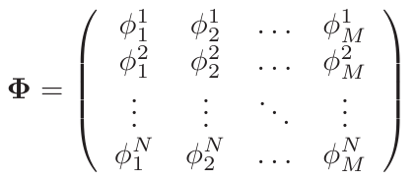
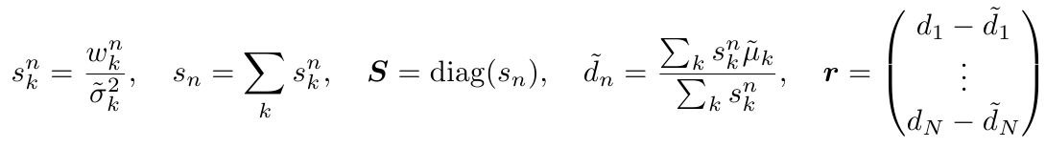
Improving the lower bound (cont.)
cf. linear basis function regression
smoothing operation

Slide 62
Improving the lower bound (cont.)
cf. linear basis function regression
smoothing operation

Slide 63
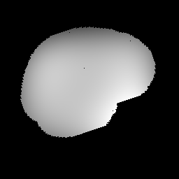
E-step
MRI data
bias field
classification

Slide 64
M-step part 1: distribution estimation
classification
MRI data
bias field

Slide 65
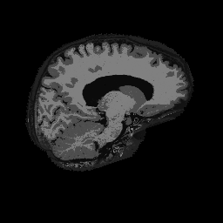
M-step part 2: bias field estimation
classification
predicted

Slide 66
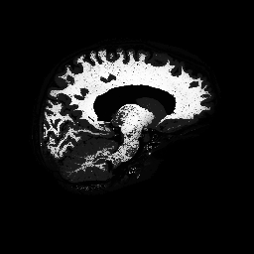
M-step part 2: bias field estimation
classification
predicted
weights

Slide 67
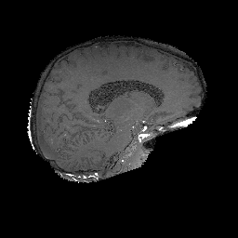
M-step part 2: bias field estimation
-
=
MRI data
predicted
residue
weighted smoothing
weights
bias field

Slide 68
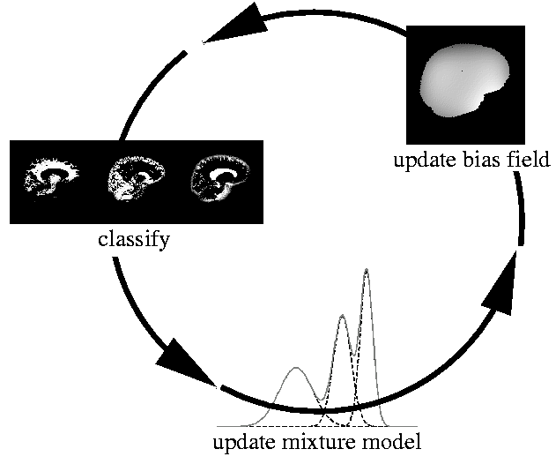
Parameter optimizer summarized
  Repeatedly apply closed-form parameter updates
  Each iteration improves the likelihood

Slide 69
Example
MRI data
Estimated bias field
Bias-corrected MRI data

Slide 70
Example
MRI data
White matter without bias field model
White matter with bias field model
Estimated bias field

Slide 71
Example
MRI data
White matter without bias field model
White matter with bias field model
Estimated bias field

