Slide 1
This work is licensed under CC BY 4.0
Nonlinear
Registration
Medical Image Analysis
Koen Van Leemput

Slide 2
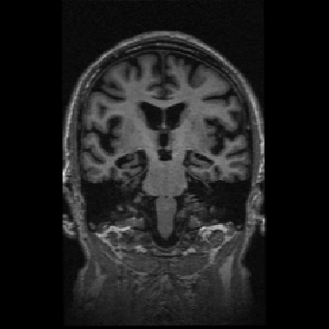
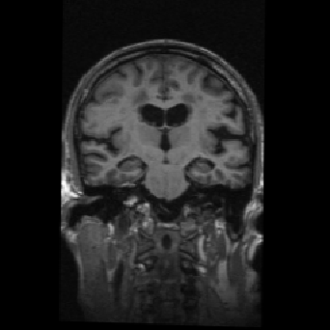


Spatial transformations
“fixed” image
“moving” image

Slide 3
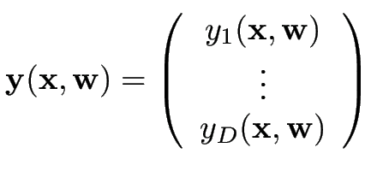
Spatial transformations
“fixed” image
“moving” image

Slide 4




Spatial transformations
“fixed” image
“moving” image
controls how points in the fixed image
move along the -th direction in the moving image
as the parameters are varied

Slide 5
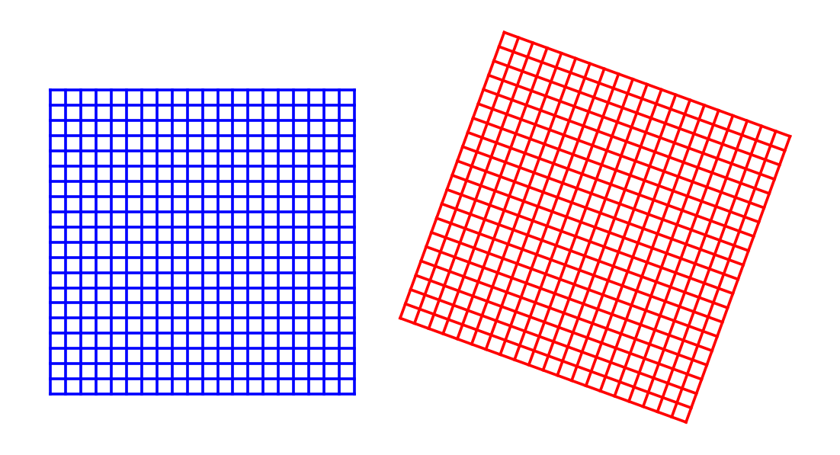
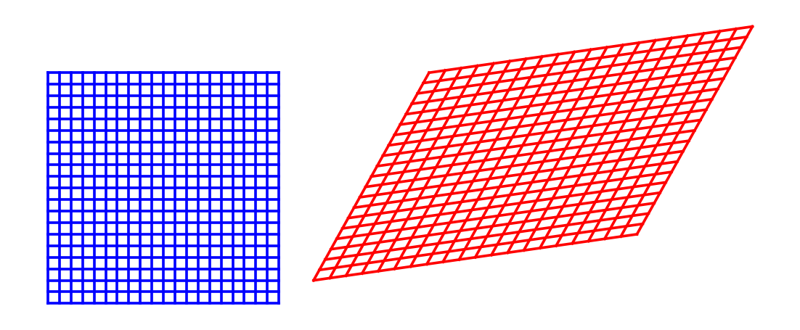
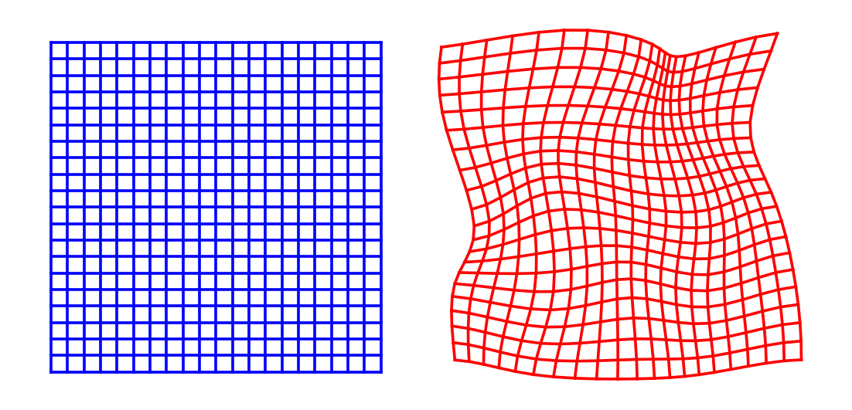
Spatial transformations
rigid
affine
nonlinear

Slide 6
Spatial transformations
Examples of usage?
rigid
affine
nonlinear

Slide 7

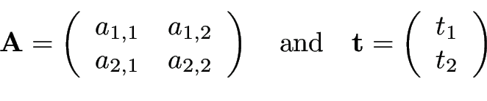
Affine transformation

Slide 8



Affine transformation
controls how points in the fixed image
move along the -th direction in the moving image
as the parameters are varied

Slide 9
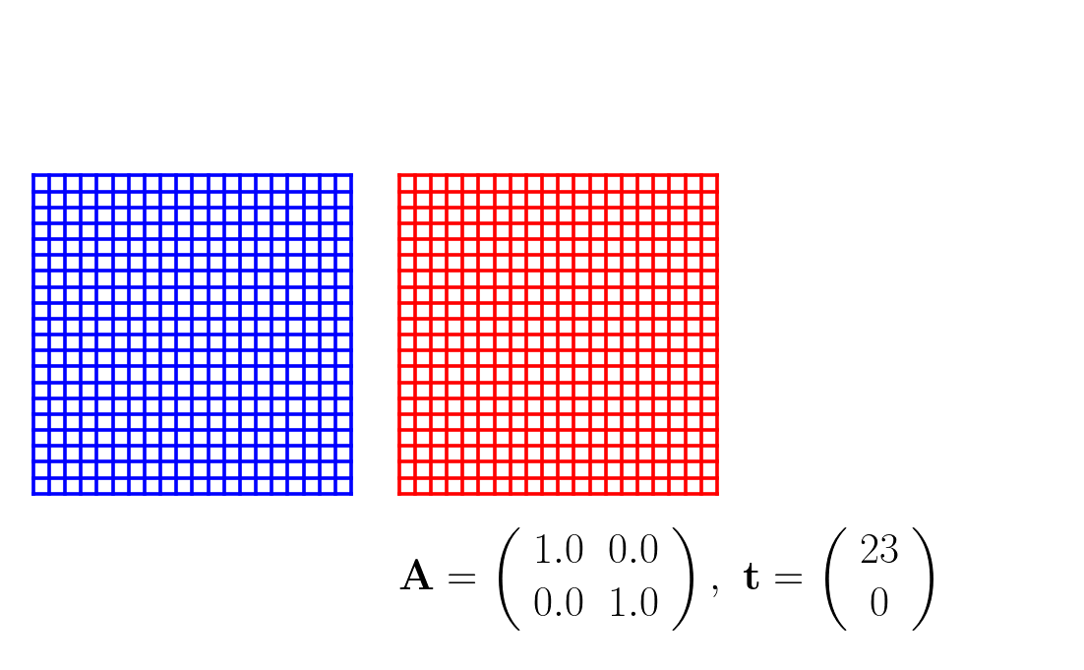
Affine transformation

Slide 10
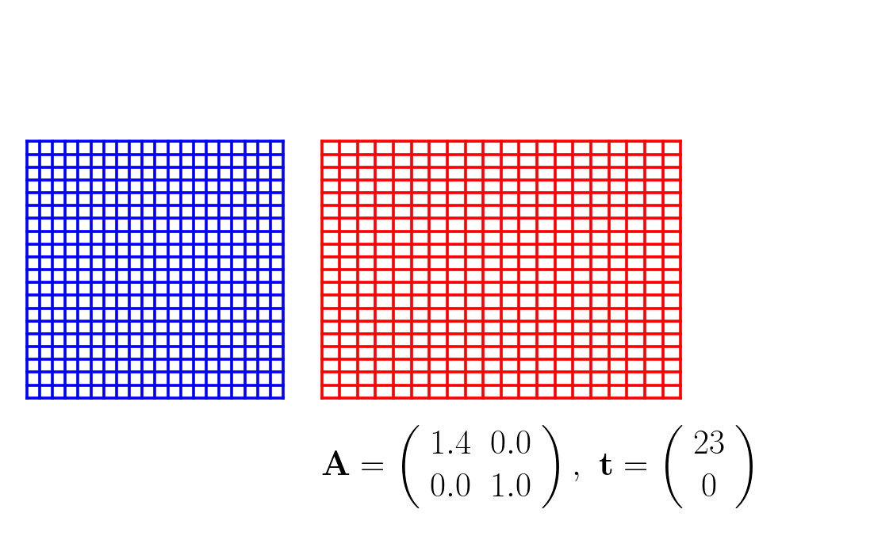
Affine transformation

Slide 11
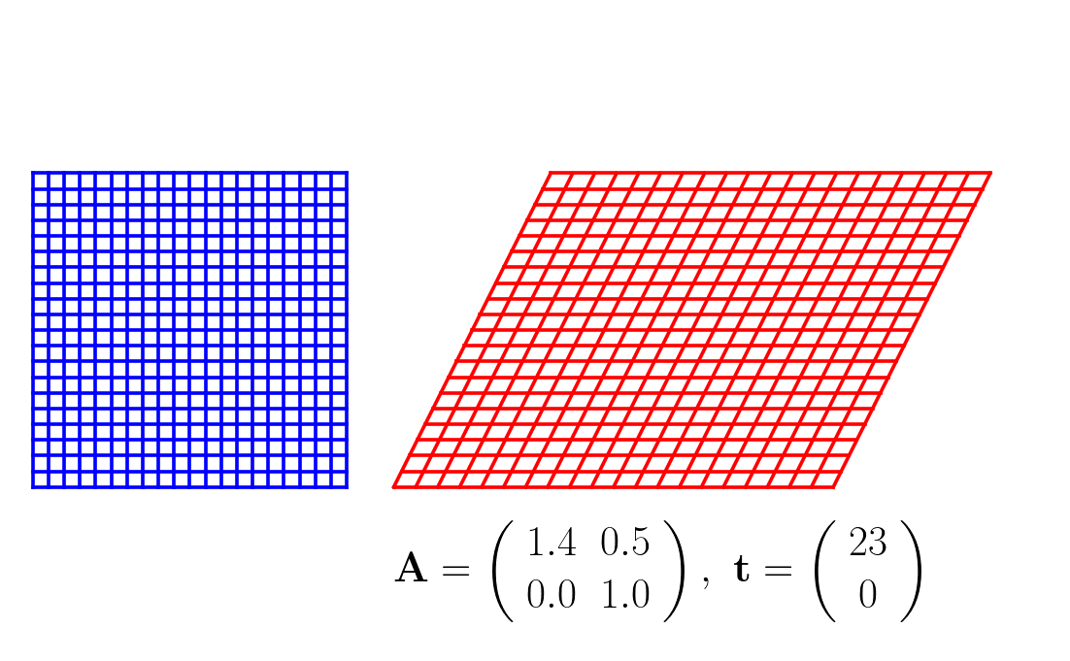
Affine transformation

Slide 12
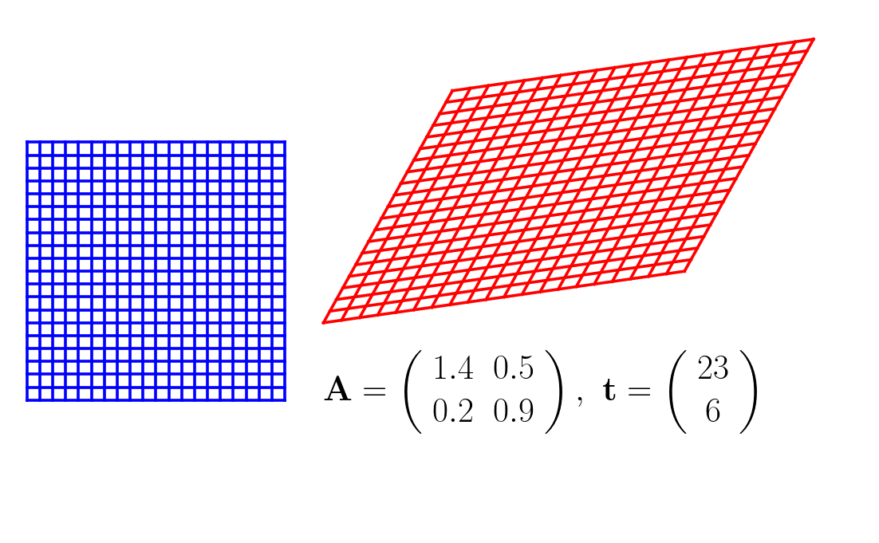
Affine transformation

Slide 13
Affine (linear) transformation...

Slide 14

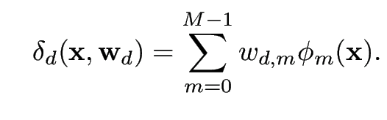


...vs. nonlinear transformation
with

Slide 15
...vs. nonlinear transformation
“residual deformation”
with
nonlinear basis functions

Slide 16




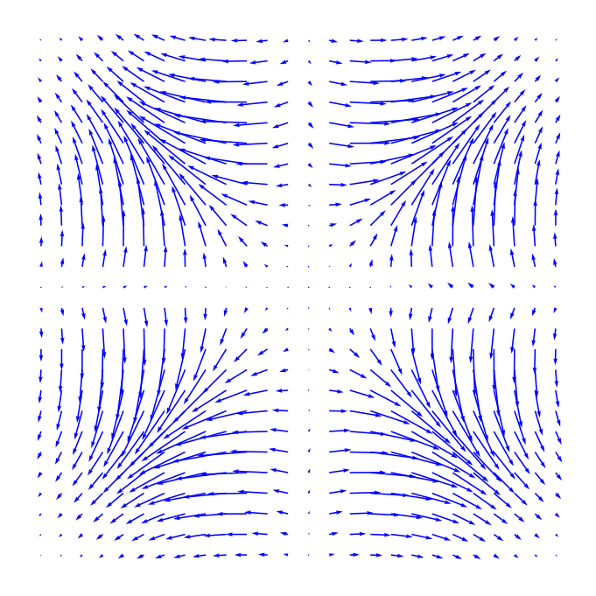
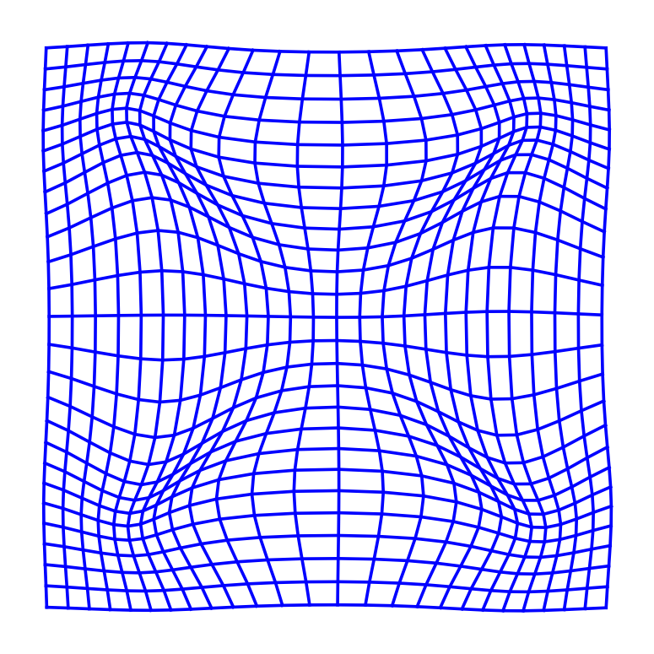


fixed image
moving image
deformation
interpolated moving image

Slide 17
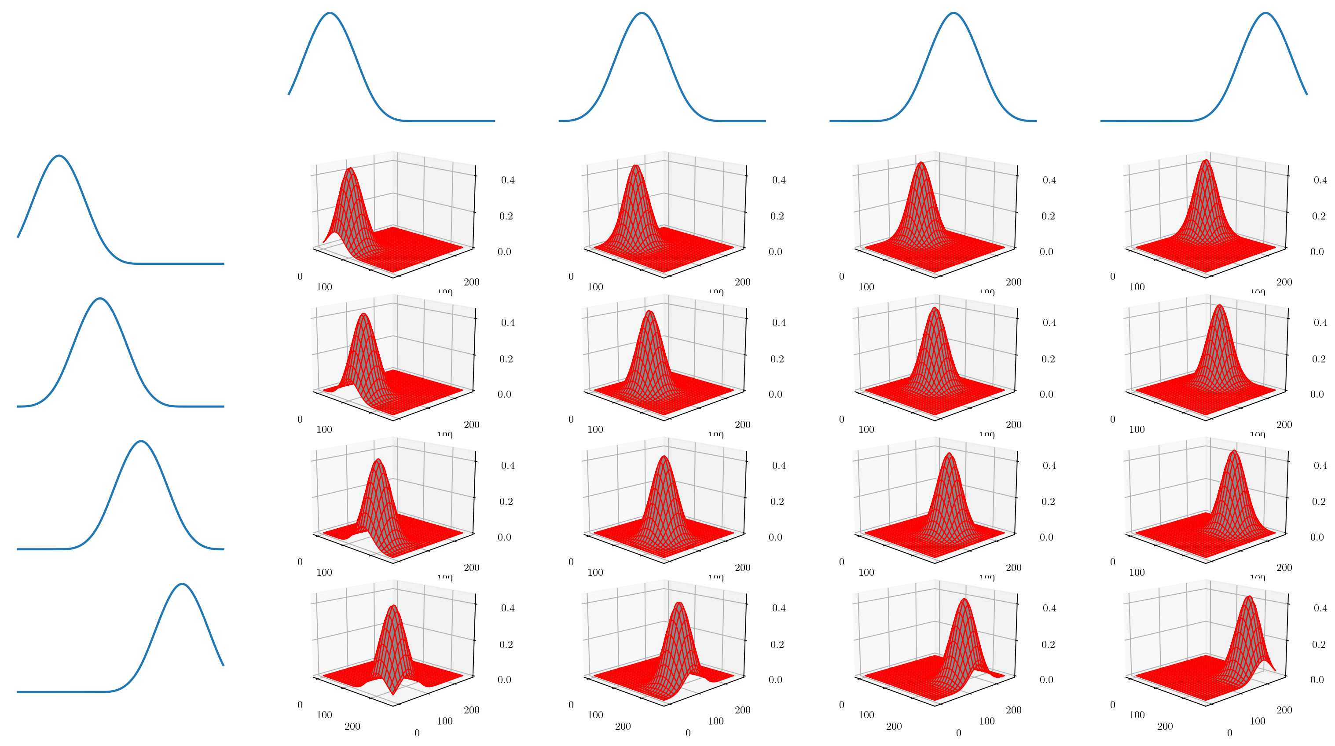
16 nonlinear basis functions

Slide 18

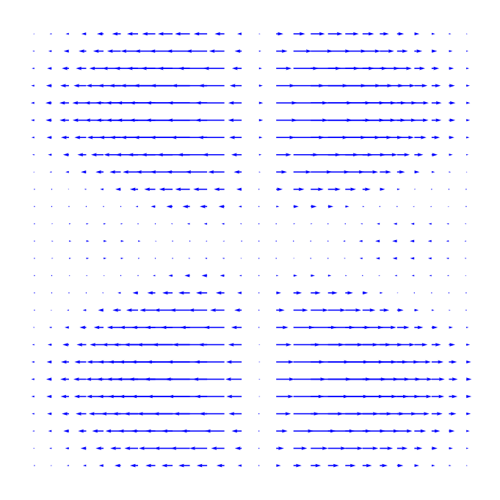


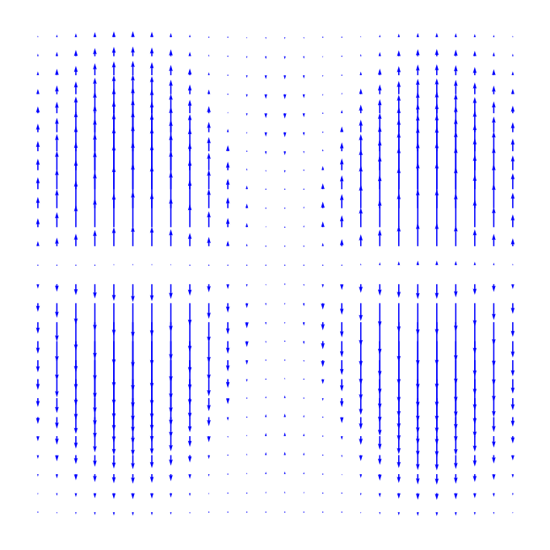

direction 1
direction 2
deformation

Slide 19
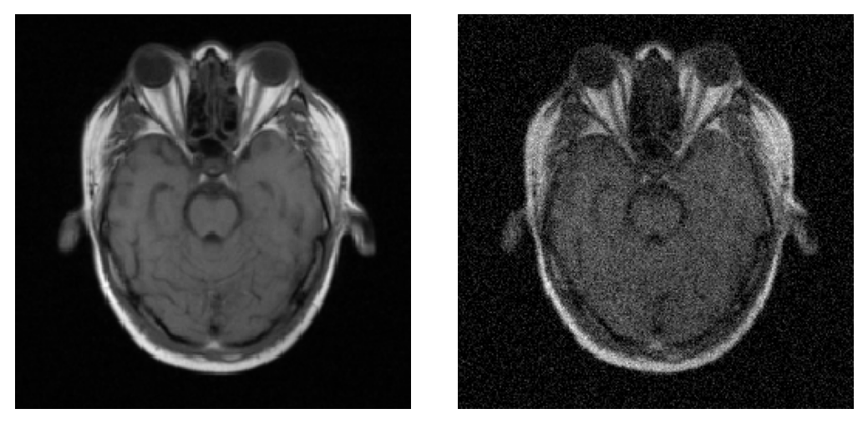
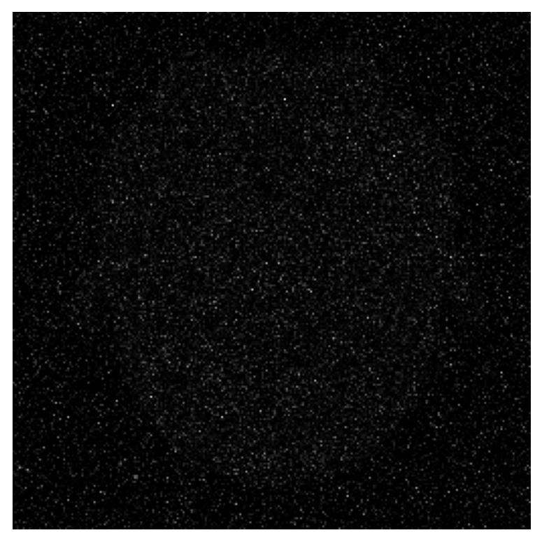

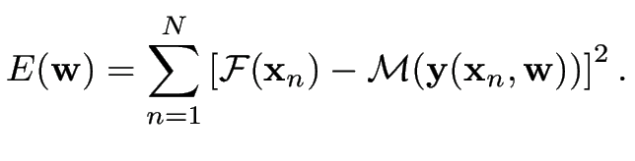
Focus on intra-modal registration
Images have similar intensity characteristics
sum over all voxels

Slide 20
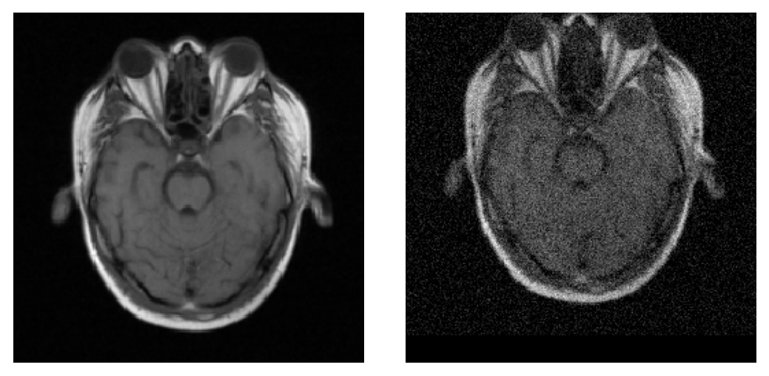
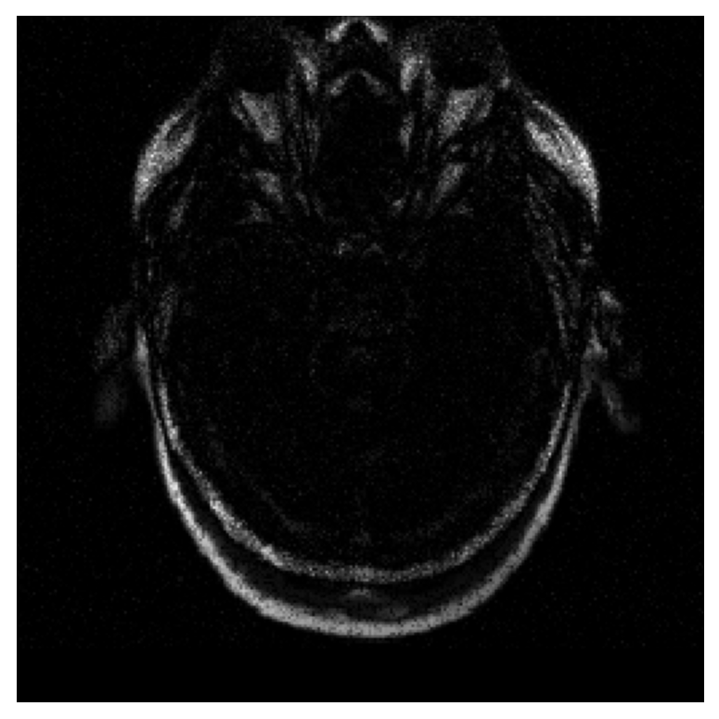
Focus on intra-modal registration
Images have similar intensity characteristics
sum over all voxels

Slide 21
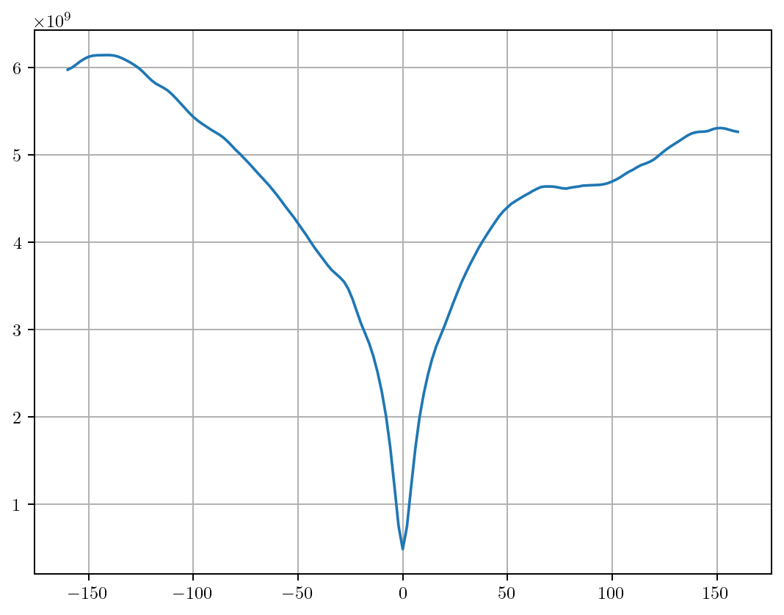

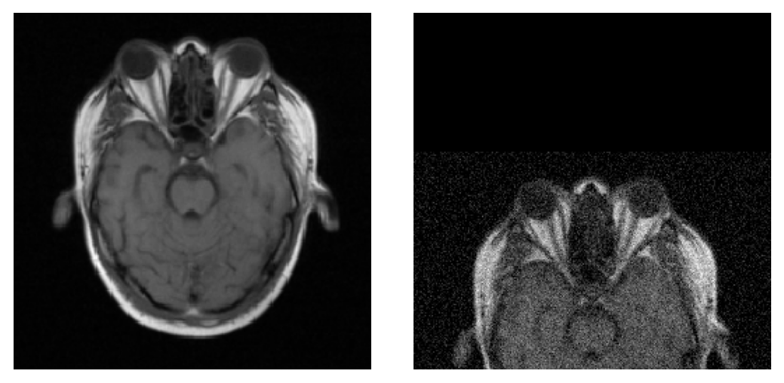
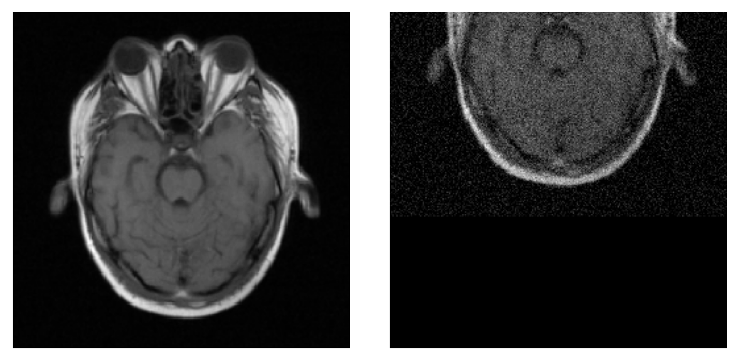

Slide 22
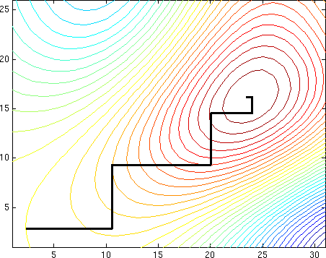
Numerical optimization
Find transformation parameters that minimize

Slide 23

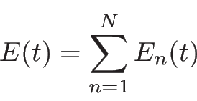

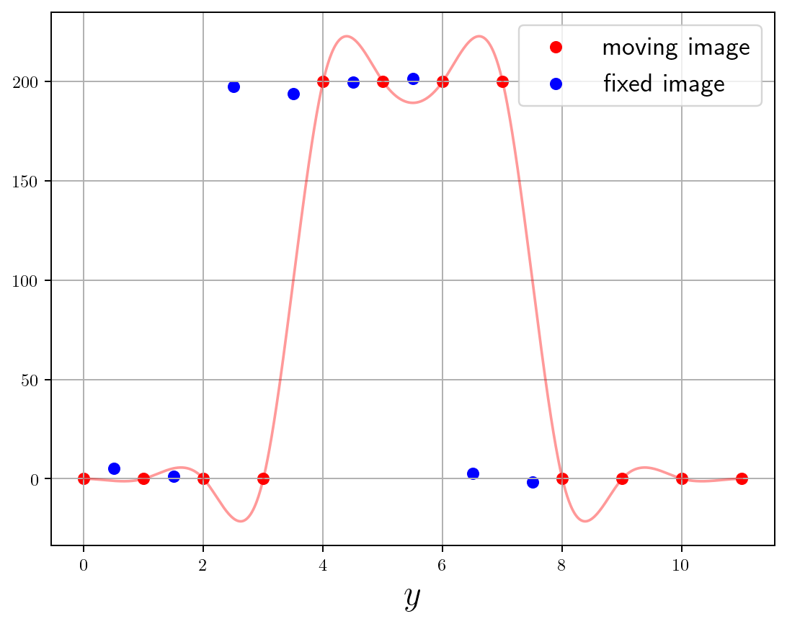
Gauss-Newton optimization
Toy example: 1D and translation only
transformation model:
energy: with
parameter to be optimized
before optimization

Slide 24
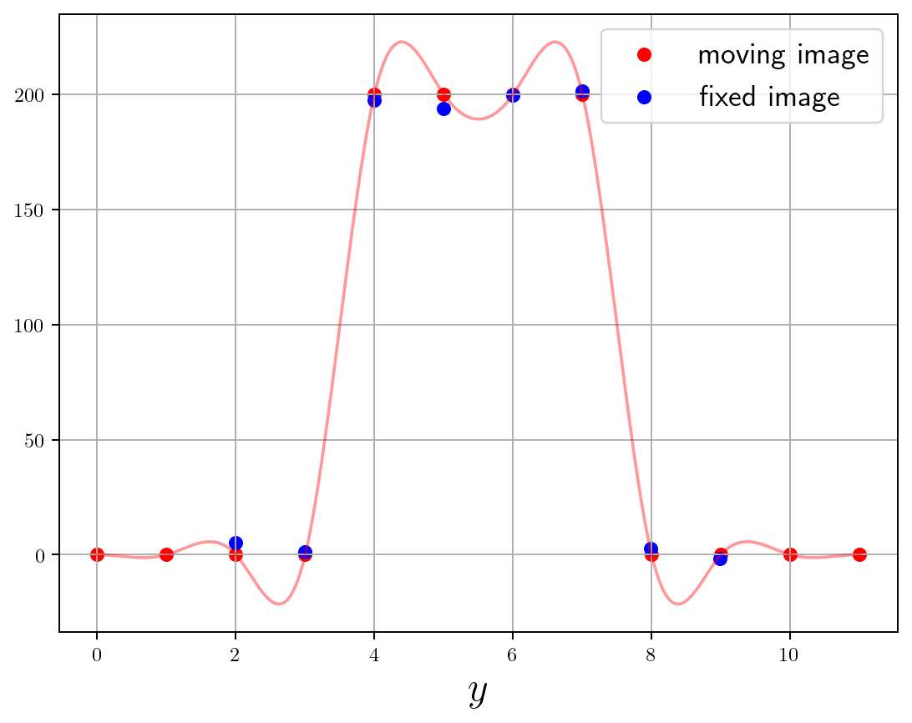
Gauss-Newton optimization
Toy example: 1D and translation only
transformation model:
energy: with
parameter to be optimized
after optimization

Slide 25
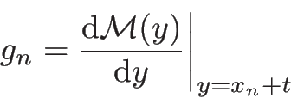

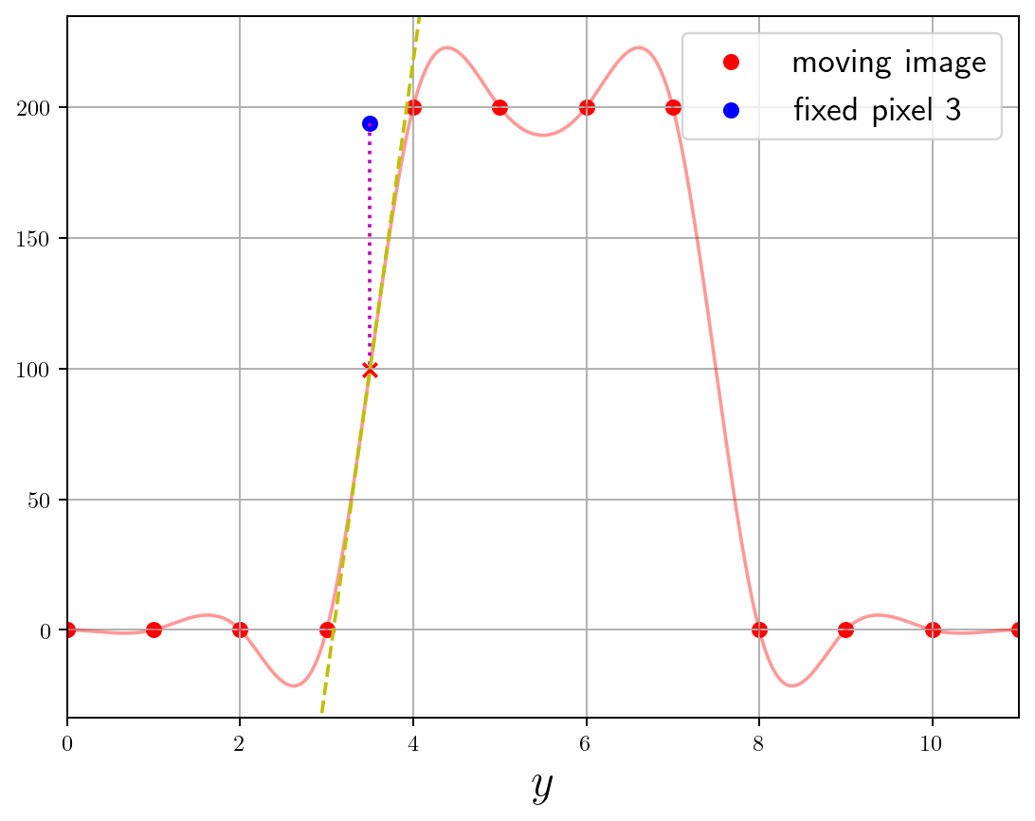
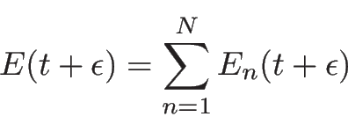


Gauss-Newton optimization
Idea: for a small deviation around current estimate of :
Energy: with
Task: what is minimizing ?

Slide 26


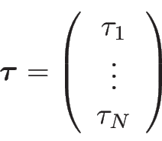

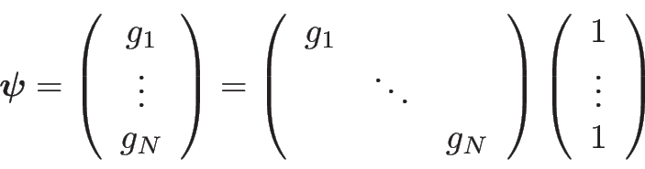
Gauss-Newton optimization
Solution: standard linear regression!
Now update :
where
with
and
one basis function

Slide 27
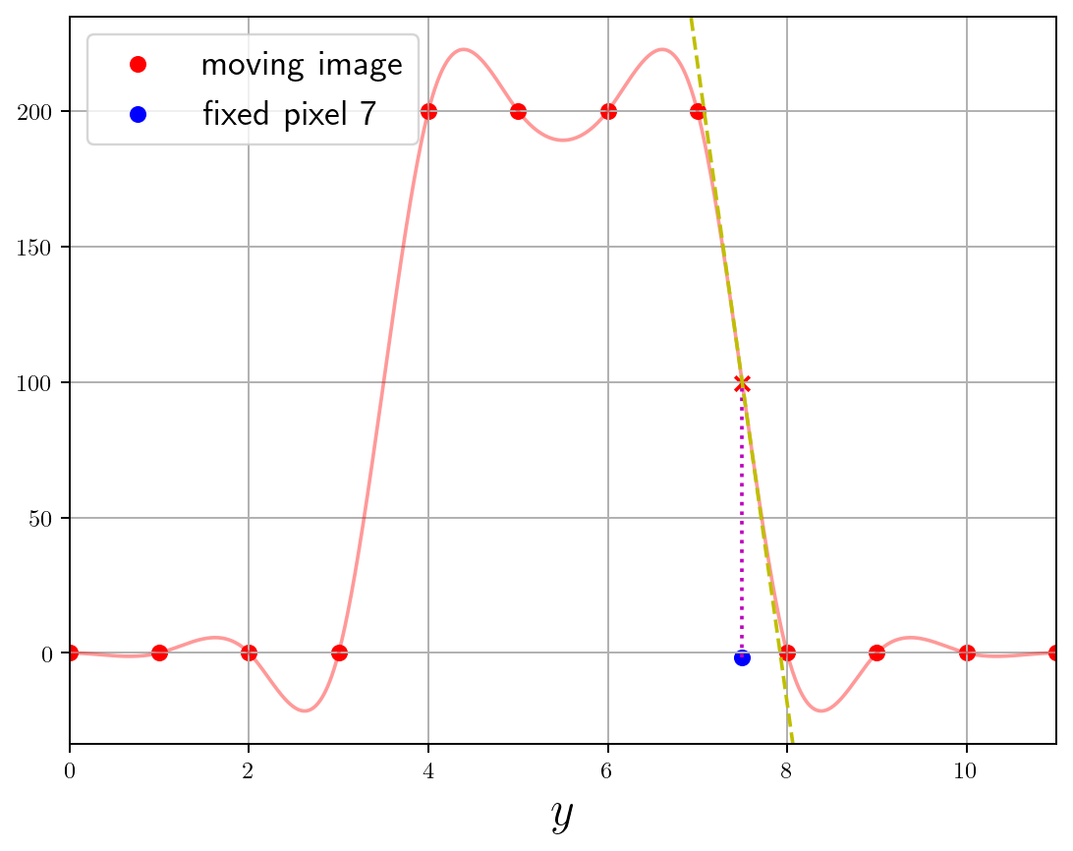
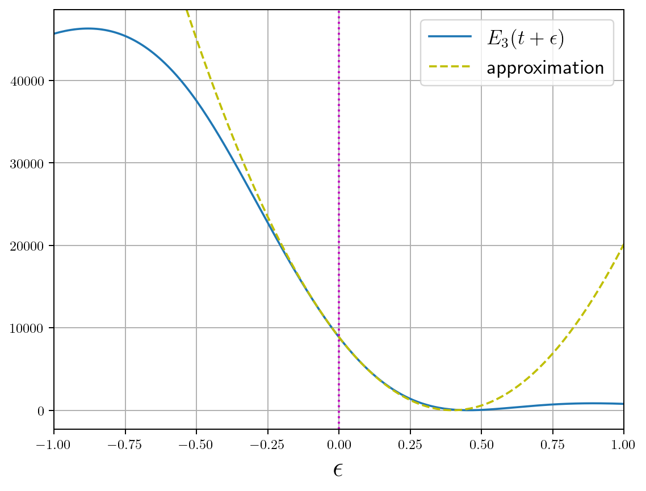
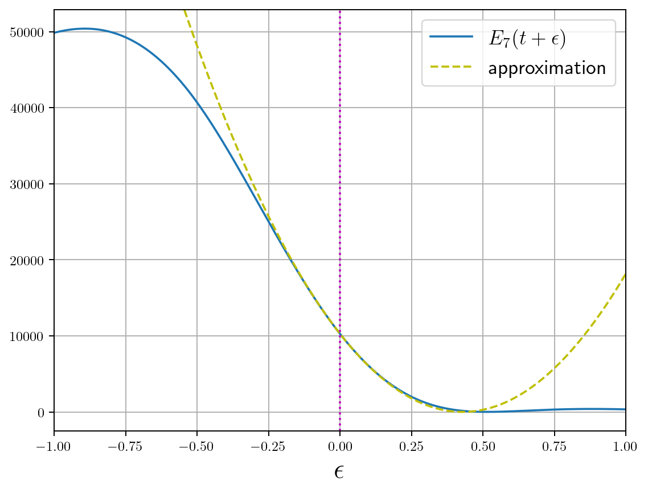
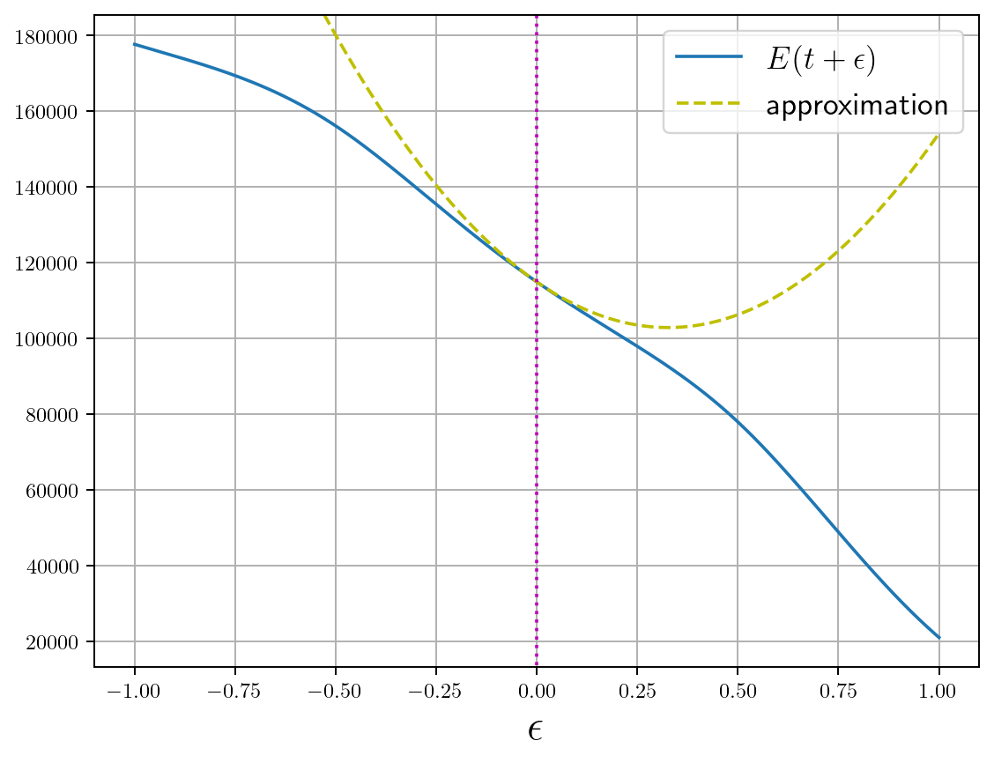
initialization
pixel 3
pixel 7
all pixels
… +
… + ...
+ … =
Energy: with

Slide 28
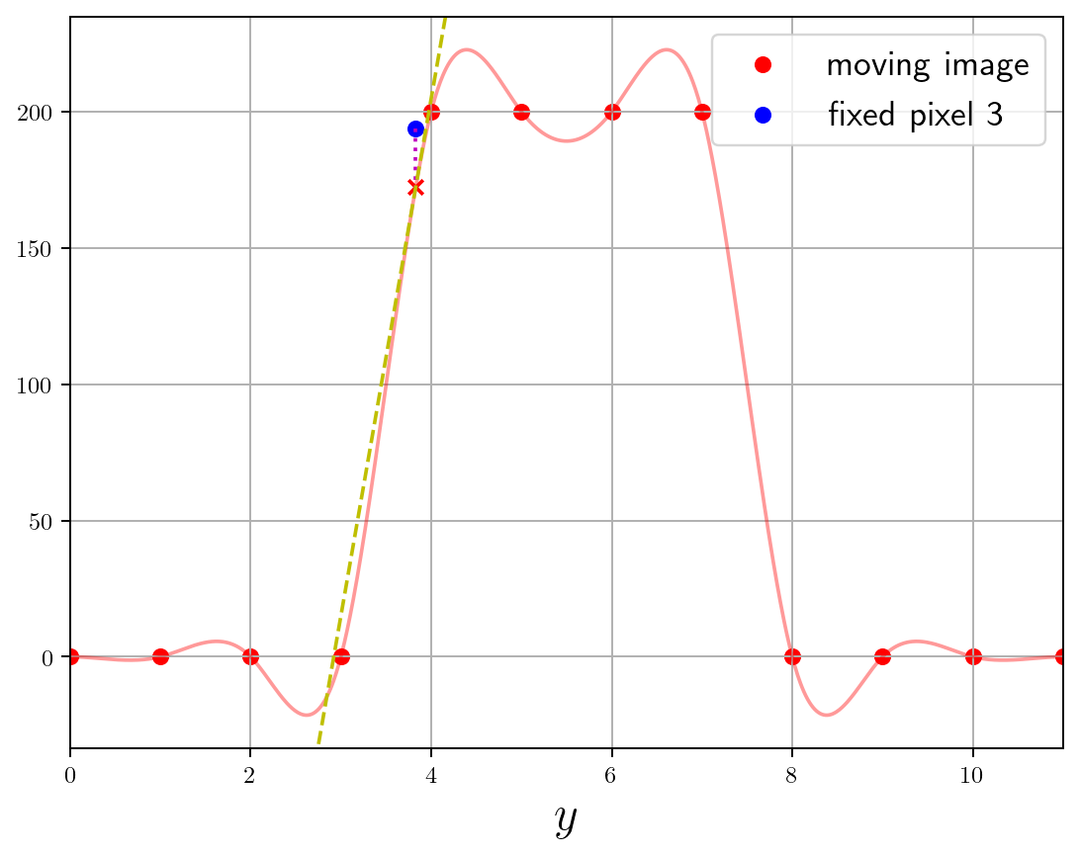
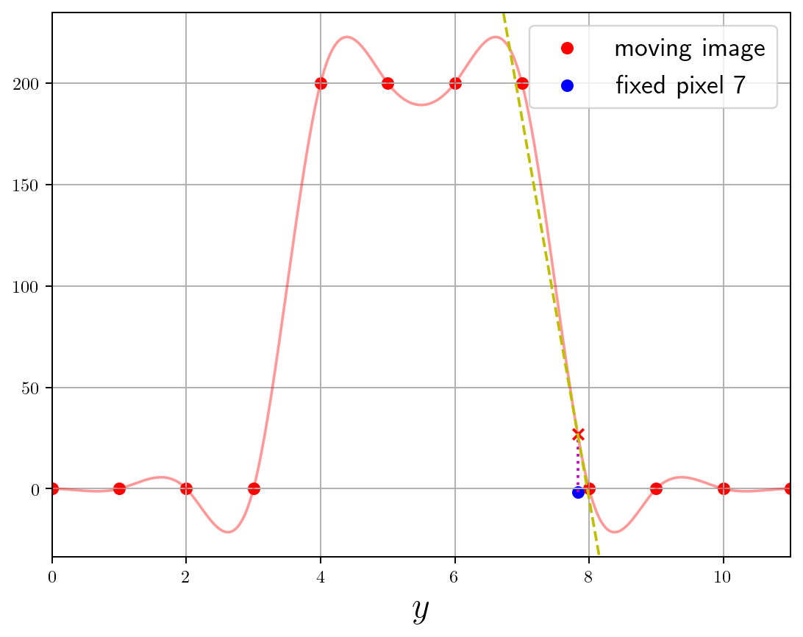
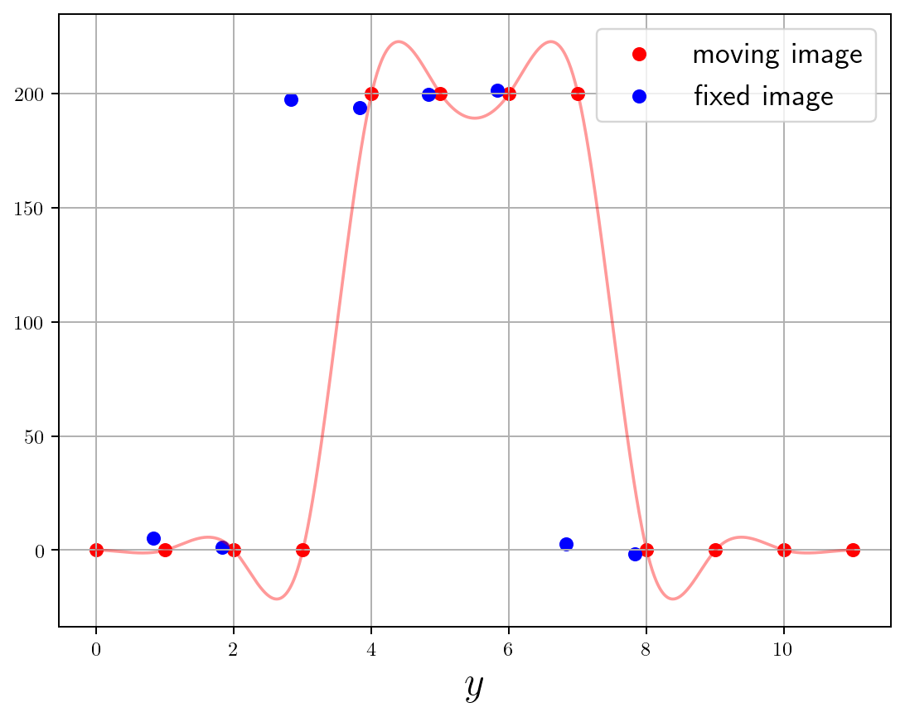
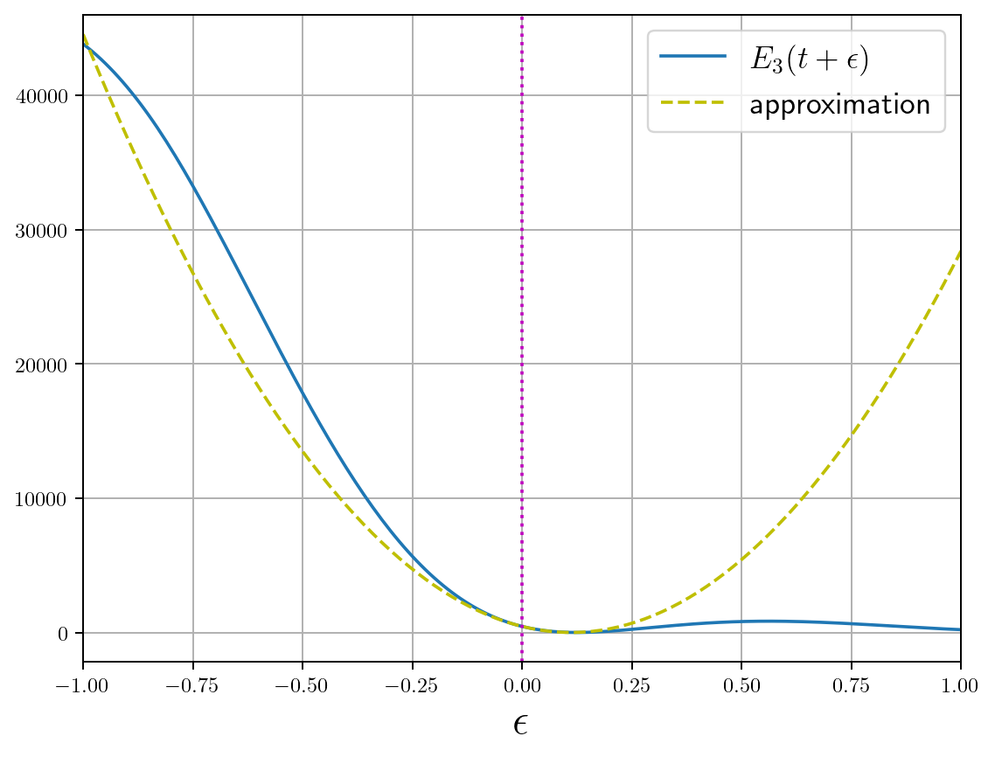
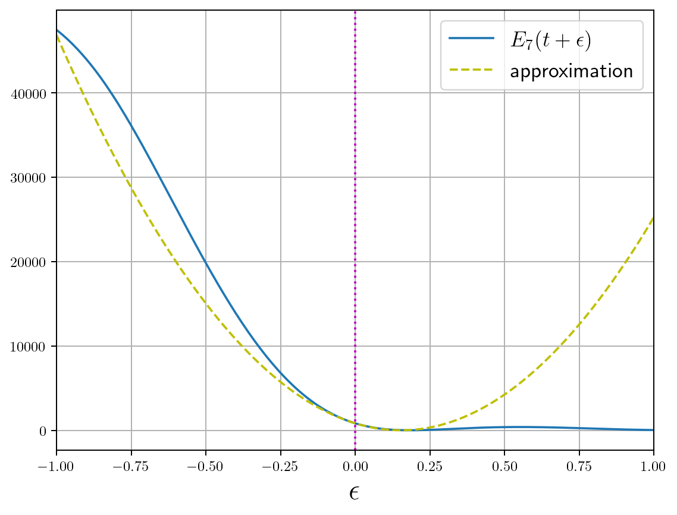
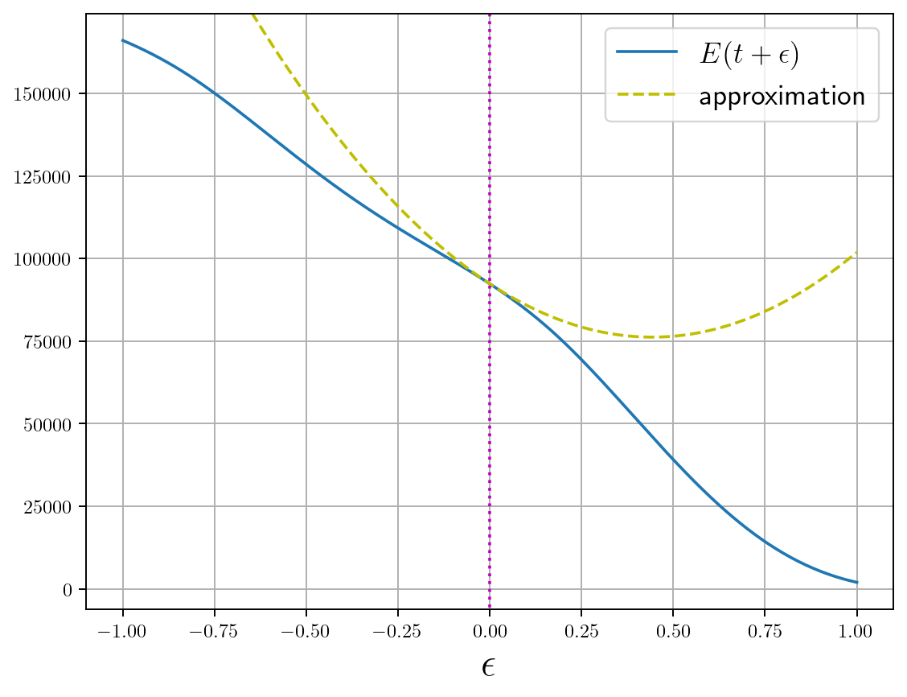
after 1 iteration
pixel 3
pixel 7
all pixels
… +
… + ...
+ … =
Energy: with

Slide 29
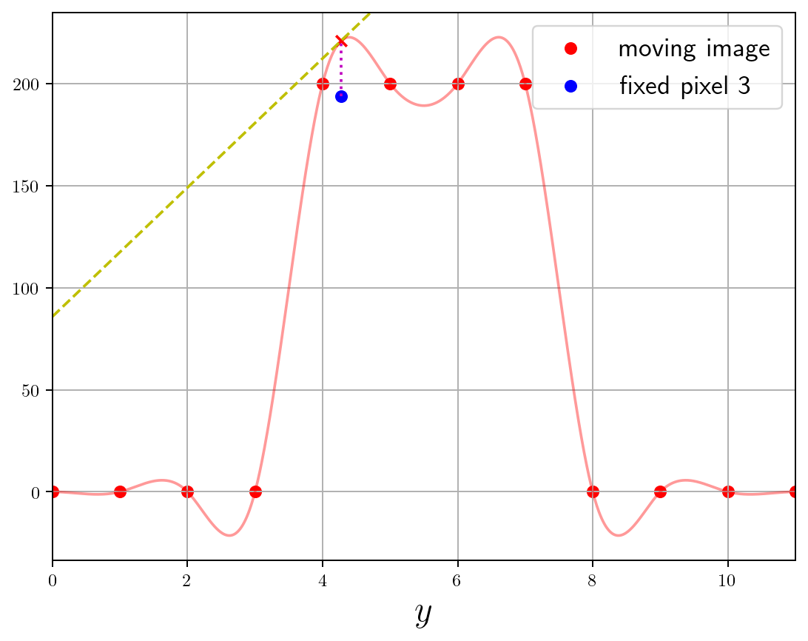
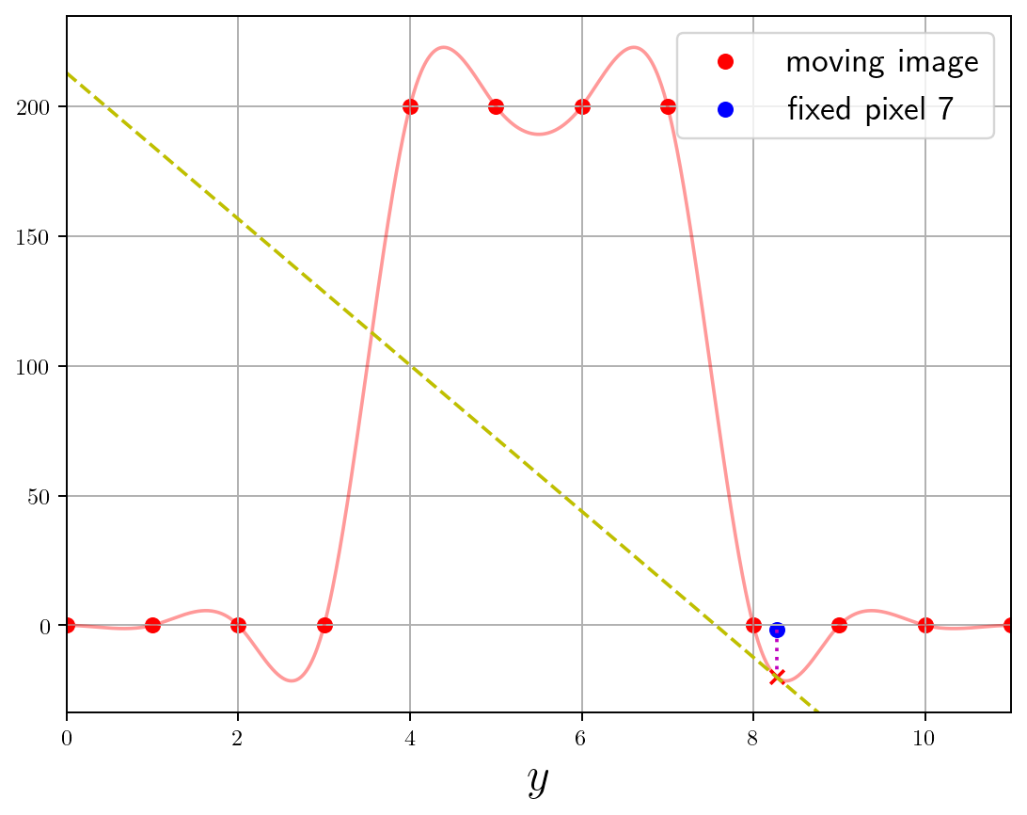
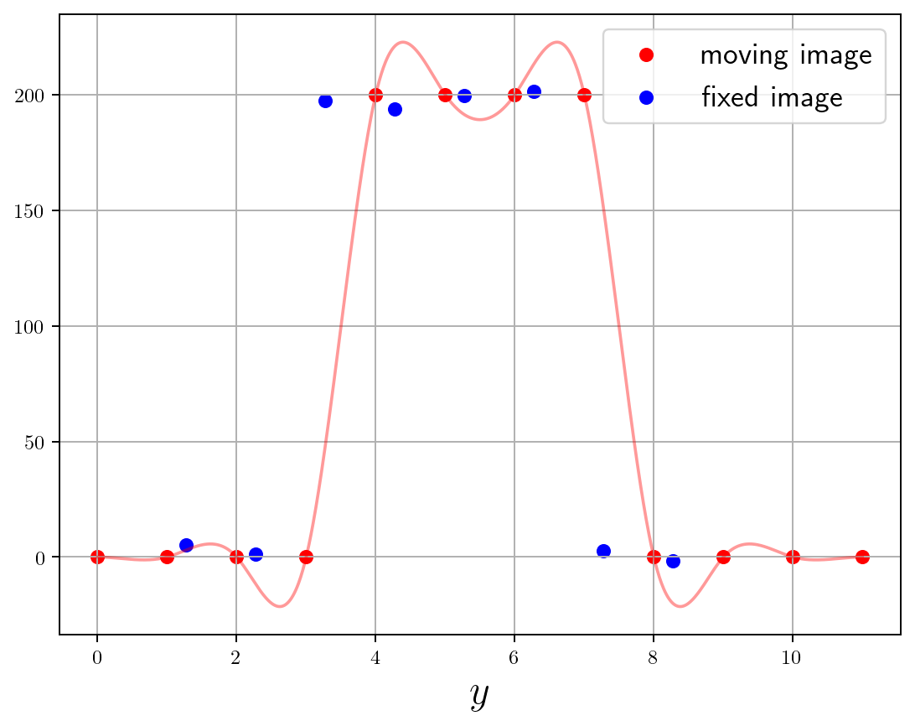
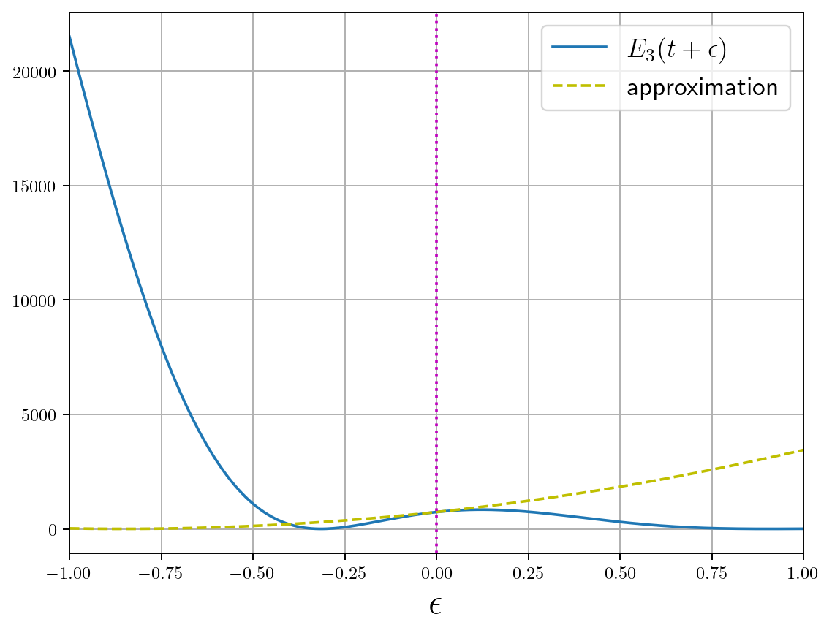
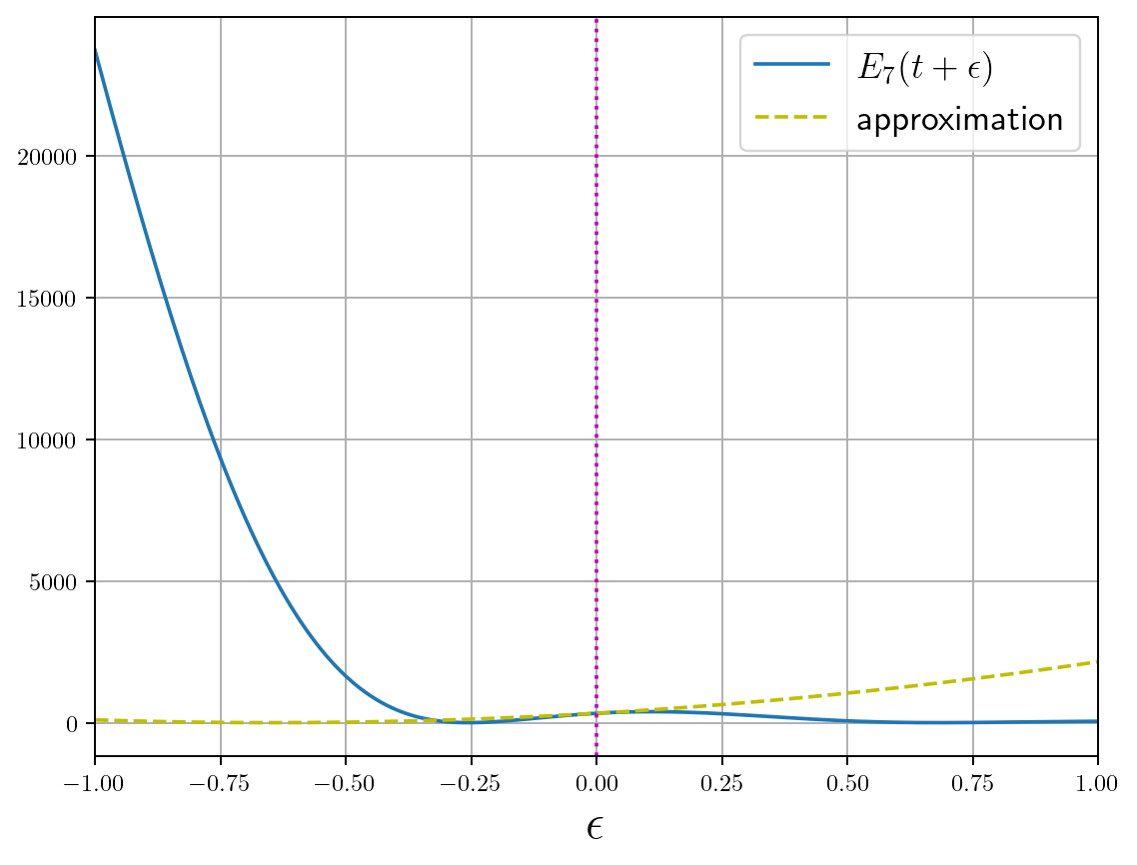
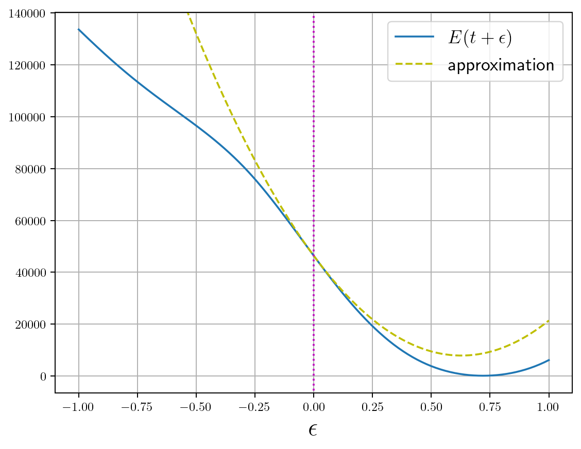
after 2 iterations
pixel 3
pixel 7
all pixels
… +
… + ...
+ … =
Energy: with

Slide 30






after 3 iterations
pixel 3
pixel 7
all pixels
… +
… + ...
+ … =
Energy: with

Slide 31





after 4 iterations
pixel 3
pixel 7
all pixels
… +
… + ...
+ … =
Energy: with

Slide 32
Gauss-Newton optimization
Solution: standard linear regression!
Now update :
where
with
and
one basis function

Slide 33

Gauss-Newton optimization
Solution: standard linear regression!
Now update :
where
with
and
one basis function

Slide 34







Gauss-Newton optimization
In real situations, exactly the same idea but:
spatial dimensions
basis functions
Solution: where
and

Slide 35



initialization
fixed image
interpolated moving image
deformation

Slide 36


after 10 iterations
fixed image
interpolated moving image
deformation

Slide 37


after 30 iterations
fixed image
interpolated moving image
deformation

Slide 38


after convergence
fixed image
interpolated moving image
deformation

Slide 39

What could possibly go wrong?
after convergence
fixed image
interpolated moving image
deformation

Slide 40



Safety rails...
We have assumed that is small
What if it isn’t? Energy could go up instead of down!
Solution: Levenberg–Marquardt
tunable

